Slide 1
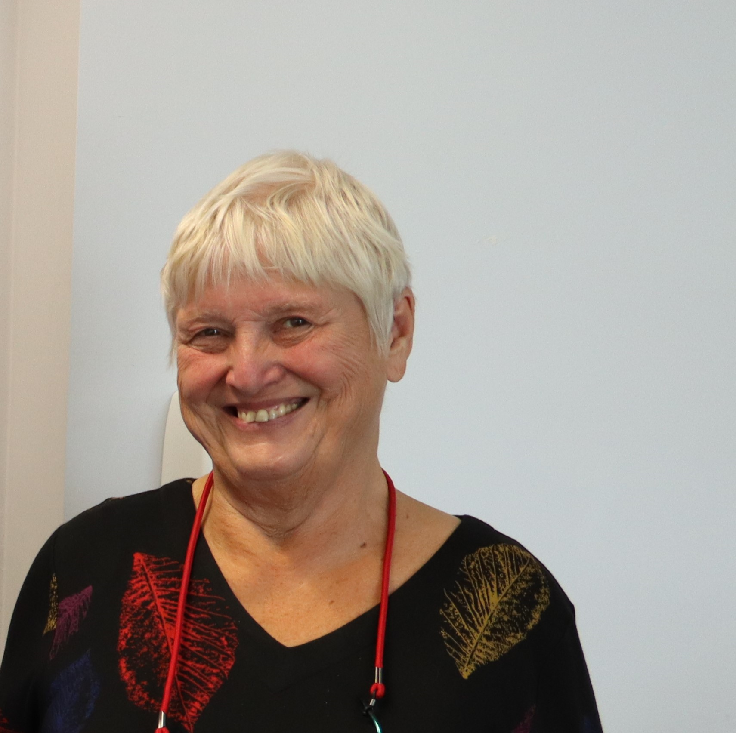
Some guidance on how to quarry from your dissertation to write a publishable output
Prof Sally Brown
sally-brown.net

Slide 2
6. Using your dissertation as a basis for publication
 | Do: | Do not:
1 | Review your thesis looking for publication potential as fast as possible after the assessment so the ideas remain current and you don’t have extra work to do updating references and so on. | Give up hope if you’ve done nothing for years: it’s possible to revive elements of an old thesis and still find things worth saying.
2 | Look for discrete / freestanding elements of your thesis that might well be readily turned into a quick publication, for example, re-versioning the literature review as an article for a journal that says in its guidelines that it publishes literature reviews. | Post off your whole thesis to a publisher with a note saying ‘my supervisor / examiner said this is publishable as a book, so please will you publish it?’
3 | Look for the really original ideas within your work, and see if you can write an opinion piece for a journal conveying your key thoughts. | Expect the text to simply be capable of being ‘boiler-plated’ into a journal article; you are likely to need to revise style, tone and register to make it fit the author guidelines for a journal.

Slide 3
From dissertation to publication
 | Do: | Do not:
4 | Try to get several articles out of your thesis (particularly doctoral ones). | So thinly ‘salami slice’ your data that you are sending off a number of rather thin articles; one or two chunky one are likely to be better received.
5 | Ask your supervisor for her/his thoughts on what elements of the thesis are the ones that are likely to most lend themselves to publication. | Don’t over-rely on other’s opinions, you’ve worked on this topic for ages so trust your own judgments.
6 | Think through the range of publication options: a book, journal articles, articles for less formal publications like trade journals, newspaper / magazine articles. Think through what your key aims are in relation to publication and work out a plan of what is likely to give you most value in terms of output. | Be afraid to look at ways of using your thesis data set in diverse ways for different audiences ranging from formal to informal: you can say the same thing more than once to different people. Look for different kinds of journal to publish your ideas.

Slide 4
From dissertation to publication
 | Do: | Do not:
7 | Consider the different kinds of articles you could write: overviews, opinion pieces, literature reviews, scientific accounts etc., and select the approaches that fir your work best. | Ignore the author guidelines given by the journal: make sure your articles don’t get rejected straight off because they don’t fit the requirements of the journal. Many fall at the first fence for this reason!
8 | Consider using your thesis as a basis for co-authoring, perhaps even with one of your examiners or peers. | Allow yourself to be exploited by someone familiar with your thesis who wants to use if for a publication with themselves as lead author. Watch out for people who want to exploit your ideas!
9 | Build on the hard work you have put into the literature review and consider updating your literature review regularly so you can use it as a source for future publications. | Stop reading around the topic as soon as you’ve handed in the thesis as you will need to keep up with current ideas.

Slide 5
From dissertation to publication
 | Do: | Do not:
10 | Have a look at the elements you wrote and then later cut out of your thesis: there may be good work there that didn’t fit the thesis but can contribute to a publication. | Ever throw any writing away: keep all rejected text for potential later use.
11 | Re-read your thesis after the examination and think through what your current ideas are now, and how you’ve moved on from your thinking at the time of submission, and use these further insights as a basis for future publication. | Feel that you have to re-state identically in your publication what you said in your thesis: you are likely to have moved on in some areas after you wrote up and you can smooth over some areas that you now no longer like from your original thesis. It’s worth celebrating the fact that ideas have moved on since you first examined the topic.

Slide 6
From dissertation to publication
 | Do: | Do not:
12 | If there were good ideas discussed in your viva, use these to frame your thinking for future publications, and even maybe contact your examiner after the event to follow up on questions or suggestions made. | Cast a veil of darkness over your examination and push it from your mind, since the occasion may well have made you pause for thought about your own work.
13 | Consider submitting to publications in different parts of the world: what may be rather old hat in your country could be a very novel idea elsewhere (and vice versa). | Forget to make sure that your writing is culturally relevant to the nation in which you plan to publish: look out specially for ideas, bodies and organisations mentioned in your thesis that are specific to your nation and unknown elsewhere.

Slide 7
From dissertation to publication
 | Do: | Do not:
14 | Show drafts of your publications to readers other than your supervisor and examiner: it can be helpful to get different opinions from those without any kind of vested interest in your work. | Spend so long getting opinions from others that you don’t actually get round to sending your work off for review by the journals themselves.
15 | Try to retain your own interest in the work: if you are bored of it, others are likely to be too! (But remember new readers are likely to be really interested by what you have to say). | Overwork your original text: if you find you are having to revise significant elements of your original writing it may be more economical of your time simply to start anew altogether.

