Slide 1
What’s going on with HE assessment and feedback right now? Solstice workshop 1 July 2022 10.30-11.30
Sally Brown @ProfSallyBrown
sally@sally-brown.net
Picture credit Julie Sanders PVC Newcastle University

Slide 2
In the past two years universities have faced major changes in assessment practice, with both positive and negative components
In Spring 2020, just about every university globally was faced with a requirement to move from a substantial diet of unseen, time-constrained, invigilated exams in person to methodologies that could be undertaken remotely.
The challenges for academics and students were substantial;
But now is our chance to really shake up higher education assessment, because going back to the old ways is just unthinkable and we may be able to make workloads more manageable but make assessment more fit for purpose in future;

Slide 3
So, what seem to be the big upcoming themes in HE assessment?
What do you think?

Slide 4
Here's what I’m seeing (aided by some thinking from last week’s very successful assessment in HE conference at Manchester) ‘AheConference @aheconference2022 Why not come next year?
The ongoing rise in authentic assessment replacing conventional assessment approaches and methodologies like unseen, time-constrained, on-campus exams and essays. We need to find better ways (and kay Sambell and I have lots to say about this https://sally-brown.net/kay-sambell-and-sally-brown-covid-19-assessment-collection/
Seeking resilient solutions that can cope with not just campus closures but also systems losses due to cyber attacks. This is likely to require a partnership between HEIs, PSRBs and other regulatory bodies to prevent daft restrictions;
Moving towards more diverse formats of assessment which foster learning and engage students productively;
Promoting assessment for social justice as argued for by Jan McArthur, making it more inclusive in all dimensions to avoid further disadvantaging the already disadvantaged;

Slide 5
And some more issues
5. Feedback seen as being dialogic and agentic: involving students in meaningful rather than tokenistic ways;
6. Finding ways to promote good academic conduct: not just using severe policing systems like remote proctoring to prevent cheating, but building a culture of professionalism, as well as designing assignments that don’t lend themselves readily to cheating and plagiarism.
7. The importance of keeping our promises (as argued for by Juuso Nieminen): we need to ensure that the assessment ‘does what it says on the tin’ by constructively aligning. And we also need to keep our promises in terms of how and when feedback is shared!
8. Managing change to assessment practice: Sally Everett at Kings argues for the importance of senior management buy in to effect realistic and lasting change in assessment practices. We need to ensure that the benefits accrued during pandemic changes are not lost when some colleagues want to revert to former approaches.

Slide 6
And the continuing importance of :
9. Programme level assessment as a means of helping students gain an overall picture of their academic goals as well as enabling us to map and balance the student assessment journey through a course. There are also benefits where synoptic assessment is used in terms of potentially reducing over-assessment ;
10. Self and peer review and assessment as a means of helping students develop evaluative judgment which can last career- and life-wide;
11. Involving students as partners in assessment and feedback, so they are not just passive recipients of a process conducted by others;
12. Not just doing it right, but doing the right things in the right way for the right reasons.

Slide 7
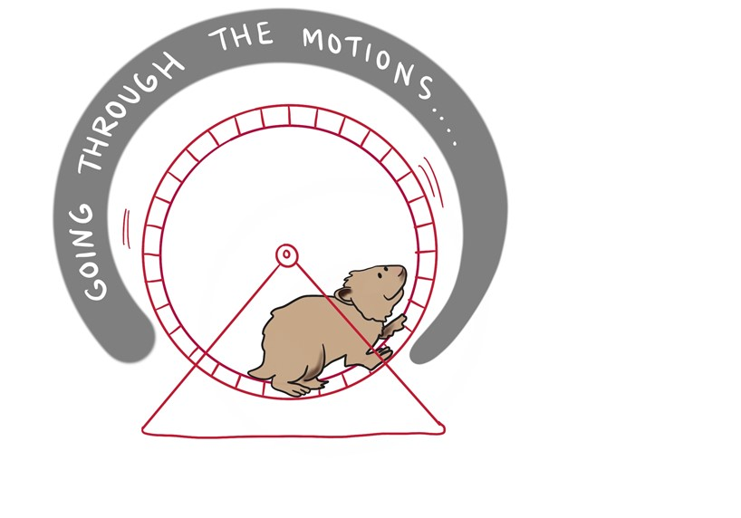
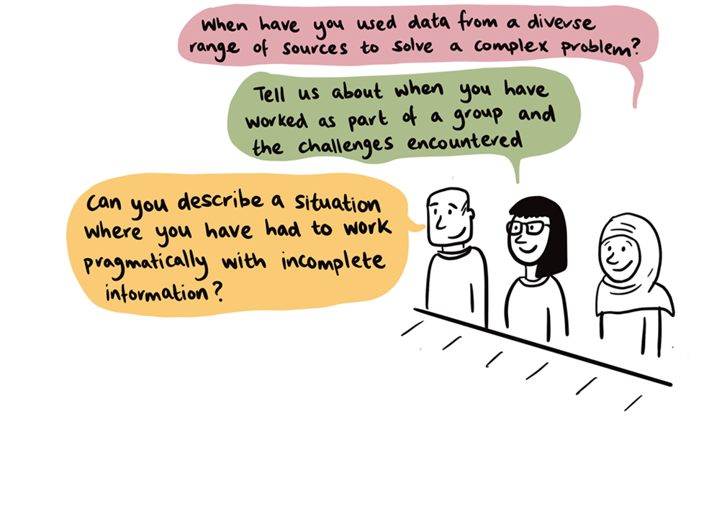
1. Why might we want more about authentic assessment?
Using types of assessment that are more like the ‘real things’ that academics or professionals do in the field generally engage students more meaningfully than tasks which rely on triggering a set response

Slide 8
Do our assessment designs promote the kinds of learning that are desired for the longer term?
Authenticity
DEEP APPROACHES?
Encourage students to genuinely understand the subject as opposed to juggling formulae or performing tasks in an isolated, formulaic or unconnected way?
SENSE OF BECOMING?
How far do the tasks help students feel they are starting to act as a participant in the disciplinary community?
PERSONAL INTEREST & OWNERSHIP?
E.g. issues they have identified, element of choice of topic or method?
INHERENTLY MEANINGFUL
and WORTHWHILE?
Sense of audience, meaningful outputs, plausible contexts?
Involve learning to plan and monitor progress prior to completion, & involvement in feedback processes?

Slide 9
Broadening conceptions of ‘authentic assessment’
Authentic assessment is a concept promoted by Wiggins (1989) and others…traditionally taken to mean that
Students are engaged in “using and applying skills and knowledge to address ‘real world’ problems” (Lund 1997)
Lydia Arnold (2019)
“Authentic assessment is
characterised by realism, cognitive challenge and evaluative judgment
with relevance to self, discipline community or professional community”

Slide 10
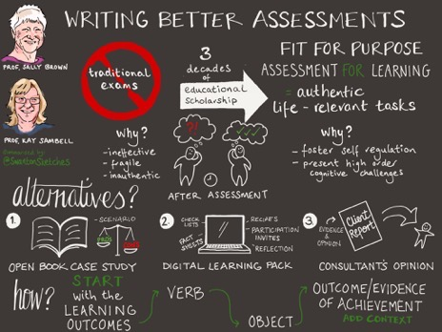
How can you write better assessment tasks? Our Task Generator
Kay and I came up with an approach in our 17th August paper (summarised here by @SwantonSketches) which argues that by starting with the learning outcomes, looking for the powerful verbs contained therein, supplying the object for the verb, together with an indication of what outcome/ evidence of achievement is needed and wrapping this up within a context and supplying some ‘range statements’ it’s possible to design practical authentic assessments in a way that is manageable and contributes to learning by building self –efficacy.

Slide 11
Six steps to designing authentic assignments
Whenever writing assignments, it’s a good idea to start with the learning outcomes,
Identify powerful, driving verbs at their centre to direct student effort, such as ‘interpret’, ‘research and review’, ‘set up and calibrate’, ‘evaluate’ and ‘compile’.
Consider the object of the verb i.e. what students do which provides a focus for action e.g. produce a digital learning pack, or provide a professional opinion in the form of a letter with appendices;
Next indicate what outcomes/evidence of achievement you require so you could be confident the outcome has been achieved;
Wrap round with detail around the subject or professional context/plausible scenario relevant to the subject area/ discipline/ course to bring the assignment to life;
Complete it with modifiers/developments/ range statements to guide the students about the scale and scope of what is required of them.

Slide 12
Verb/ educational outcome | What? i.e. object | Outcome/ evidence of achievement | Modifiers/ developments/ range statements
Interpret | complex and sometimes incomplete or conflicting data | compile a summary meaningful for experts and laypersons | leading to a viable action plan for a team to implement.
Review | data from a variety of sources | produce an executive summary | for a specific audience of employers
Set up | specialised equipment appropriately | draw up a ‘quick guide’ for peers | to enable them to use it safely and appropriately
Evaluate | three proposed solutions to a problem | propose a further two of your own | with suggestions about what might work best
Compile | contingency plans for a professional environment | produce disaster recovery in case of a serious emergency | leading to mitigations and remediation

Slide 13
THE COVID COLLECTION (https://bit.ly/3mMAEFP)
Kay Sambell’s and my resources around assessment during times of coronavirus give more detail of our approaches:
Sambell, K. and Brown, S. (23 March 2020) ‘Contingency-planning: exploring rapid alternatives to face-to-face assessment’.
Sambell, K. and Brown, S. (2 April 2020) ‘Fifty tips for replacements for time-constrained, invigilated on-site exams’
Sambell, K. and Brown, S. (1 June 2020) ‘The changing landscape of assessment: some possible replacements for unseen time-constrained face-to-face invigilated exams’
Brown, S. and Sambell, K. (17th August 2020) Writing Better Assignments in the post-Covid Era: approaches to good task design
Brown, S. and Sambell, K. (21st August 2020) Changing assessment for good: a major opportunity for educational developers
Brown, S. and Sambell, K. (19th March, 9th June, 13th Aug, 17th Nov 2021) 4 compendia of examples of authentic assessment in practice from diverse disciplines
https://sally-brown.net/kay-sambell-and-sally-brown-covid-19-assessment-collection/

Slide 14
Illustrative examples of more authentic tasks can be found in our Compendia https://sally-brown.net/kay-sambell-and-sally-brown-covid-19-assessment-collection/
19 Mar. and 3 May 2021
Compendia of examples of authentic assessment in practice from diverse disciplines
9 June 2021
Mechanics tales: Motivating Mathematics learning through assessment. (Dr Giuseppe Zurlo)
Nov. 2021
13th August, 17th Nov 2021Two more Compendia of examples of authentic assessment in practice

Slide 15
3. Thinking about more diverse exam formats…..
Open book exams
Take home exams
Sambell & Brown, (2020) 50 Tips for replacements for ion-site, time-constrained invigilated exams
Wood, G (2020) Preparing students for open book and take-home exams
Villaroel et al (2020) Using principles of authentic assessment to redesign written examinations and tests

Slide 16
Examples of alternative, more inclusive and authentic assessment formats
In-tray activities
Electronic or hard copy portfolio
Viva voce or individual oral test,
Patchwork assessments,
Blogs
Articles or other types of publications,
Video/audio recordings/ podcasts, Reflective journals,
Rough guides, leaflets and other public outputs, Annotated publications,
Creative artefacts,
Presentations
See Sambell and Brown 2020 https://sally-brown.net/kay-sambell-and-sally-brown-covid-19-assessment-collection/ June 2020 ‘The changing landscape of assessment: some possible replacements for unseen time-constrained face-to-face invigilated exams’ for pros and cons of these

Slide 17
4. A better way to assess
Promoting assessment for social justice as argued for by Jan McArthur, making it more inclusive in al

Slide 18
5. Involving students meaningfully: Dialogic feedback
A definition: ‘interactive exchanges in which interpretations are shared, meanings negotiated and expectations clarified.’ (p90)
‘Dialogic feedback is facilitated when teachers and students enter into trusting relationships in which there are ample opportunities for interaction about learning and around notions of quality.” (p90)
Carless, D., 2013. Trust and its role in facilitating dialogic feedback. Feedback in higher and professional education: Understanding it and doing it well, pp.90-103.
Trusting relationships
Interaction
Notes:
So from this pov fb designs become dialogic- INTERACTIVE XCHANGES in which interpretations are shared,meanings negotatited and expectations clarified – and so a key emphasis is on the social, and interactive, and dialgic fdback is facilitated on foudnations of TRUST- as outlined in my favourite chapter by D carless – and not confined to 1to1 meetings but skilfully manged in groups- and this social, trusting dynamic lies beneath the tip of the fb artefact, but is genramce to eff fb processes, because, as Sadler says: sadly sts don’t l as much as we’d hope by simply being told- no matter how carefully or kindly we craft the message- so we mustn’t ONLY look at the mechanics – and the documented fb info given by ts to sts , BUT ALSO TO ASK OURSELVES– how do the sts USE this? And what ELSEdo We do as educators/teaching teams to make sure that sts are active participants in the process? - and a major role of dialogue is to narrow differing staff and student expectations and perceptions of what counts as quality
Designs could include: formative activities like- if resource permits- feedback on drafts from teachers or peers – but- given a Major role of dialogue is to narrow differing staff and student expectations and perceptions of fb via negotiation and communication- can also include approaches which emphasise students generating and acting upon feedback inputs of different forms via things like well implemented peer feedback processes; Staged sequences in which students self assessment is emphasised; And nested assessment tasks where there are ample opportunities for students to generate, process and act upon inputs of different forms.
The key is that ts consider how they can involve sts more significantly in the fb process, within the curriculum- supporting them to understand, apply and generate fb.
And once you Ie. Once you see the Learner = primary agent of learning process – you realise THEY need opps for interacting, uptaking, making sense of, and acting upon performance-relevant info
And those active words USE’ SEEK’, APPLY etc. -which are so germane to new perspectives on fb - all require we place greater emphasis on fb as a social and participatory process involving dialogue and interchange
As we can see in carless’ formulation on my slide- Dialogic fb: = ‘interactive exchanges in which interpretations are shared, meanings negotiated and expectations clarified.’
and acc to this brilliant chapter by Carless –TRUST is vital- dial fb is facilitated when teachers and students enter into trusting relationships in which there are ample opportunities for interaction about learning and around notions of quality.”
So this casts educator as a designer of learning environments rather than just a producer/giver of comments
– BUT DON’T FORGET- THESE new paradigms EMPHASISE informal as well as formal opps- things like asst briefings and discussion which you might see as PREPARATION: opportunities to share, discuss appreciate standards and help sts get heads round expectations, criteria and standards
often in whole-class contexts, which are interactive, dialogic (in the sense of sense-making and negotiating /clarifying sharing meanings-)

Slide 19
Student has first attempt in learning and produces work on a given topic
Class discussions (e.g. teacher-led plenary discussions) deepen insights into the strengths and weaknesses of different approaches
Students evaluate their first attempt in learning in light of new knowledge/insights and note changes to their approach or learning strategies
In class, student compares their first attempt with 3 carefully chosen exemplars
Dialogic use of exemplars in a whole-group setting
(Sambell and Graham, 2020)

Slide 20
Transformed roles for students in the feedback process
“I used rather informal language, and I saw I have to change that.”
“When we discussed this task in class I realised that what I had written didn’t focus on the question, and I had looked more at socialisation rather than social construction. It was this that made me read around the subject more.”
“Having to comment on someone else’s presentation makes you think a lot more, made you more aware…by looking at other people’s work you were seeing what you’re good at and what you need to improve on….”

Slide 21
Activate inner feedback via comparison-making
“Internal feedback is the new knowledge that students generate when they compare their current knowledge/competence against some reference information” (Nicol, 2021: p757)
Produce
Compare
Reflect and expound

Slide 22
9. Programmatic planning of assessment enables teams to:
Look systematically at all modules over the duration of the whole programme;
Explore the extent to which assignments are constructively aligned with what is taught;
Review the assessment and feedback patterns for students and markers to avoid bunching and overload;
Consider diversity of assessment methods (Goldilocks);
Consider whether there is a good enough balance of formative and summative assessment;
Review how far knowledge and skills are assessed;
Consider whether the assessment strategy is viable, manageable and in the interests of students.
Hartley, P. and Whitfield, R., 2011. The case for programme-focused assessment. Educational Developments, 12(4), pp.8-12

Slide 23
10. Some thoughts about Self and Peer assessment
“Involving students in peer- and self- assessment can let them into the assessment culture they must survive” (Race 2020)
He quotes Sadler (2013 p54) “ For students to become self-sustaining producers of high quality intellectual and professional goods, they must be equipped to take control of their own learning and performance. How can students become better at monitoring the emerging quality of their work during accrual production? Opening up the assessment agenda and liberating the making of judgments fro the strictures of pre-set criteria provides better prospects for developing mature independence in learning”

Slide 24
12. Not just doing it right but doing the right things in the right way for the right reasons.
What ideas do you have for continually improving assessment?

Slide 25
References 1
Arnold, L (2019) Unlocking the power of authentic assessment , Edinburgh Napier University ARISE lecture
Ashford-Rowe, K., Herrington, J. and Brown, C. (2014) ‘Establishing the critical elements that determine authentic assessment’, Assessment and Evaluation in Higher Education, 39(2), pp. 205–222. doi: 10.1080/02602938.2013.819566
Boud D and Dawson P (2021) What feedback literate teachers do: an empirically-derived competency framework, Assessment & Evaluation in Higher Education, DOI: 10.1080/02602938.2021.1910928
Burton, K., 2011. A framework for determining the authenticity of assessment tasks: applied to an example in law. Journal of Learning Design, 4(2), pp.20-28.
Brown, S. (2014) Learning, teaching and assessment in higher education: global perspectives. Palgrave Macmillan.
Brown, S. and Race, P. ‘Using effective assessment and feedback to promote learning’ in Hunt, L. and Chalmers, D., 2020 (at press). University teaching in focus: A learning-centred approach. Routledge.
Brown, S. (2019) ‘Using assessment and feedback to empower students and enhance their learning’, in Bryan, C. and Clegg, K. (eds) Innovative Assessment in Higher Education. 2nd edn. Oxford: Routledge, pp. 50–63.
Brown, S., and Sambell, K. The Covid Assessment Collection, Kay Sambell and Sally Brown: Covid-19 Assessment Collection - Sally Brown Sally Brown (sally-brown.net)
Buckley, A. (2020) Heriot Watt University Adapting your assessments: supporting student online learning toolkit https://lta.hw.ac.uk/sslo-assessment/ (accessed May 2020).
Davison, G.,2011. Investigating the Relationships Between Authentic Assessment and the Development of Learner Autonomy. Doctoral thesis, Northumbria University.
D’Arcy Norma dot net (blog), March 31, 2020. ‘Online Exam Proctoring’; https://darcynorman.net/2020/03/31/online-exam-proctoring/ (accessed May 2020)
https://www.pebblepad.co.uk/
Everett, S. and Oswald, G., 2018. Engaging and training students in the development of inclusive learning materials for their peers. Teaching in Higher Education, 23(7), pp.802-817.
Gordon, D. (2020) Don’t Panic: the Hitchhiker’s Guide to alternative online assessment. http://www.damiantgordon.com/Guide.pdf

Slide 26
References 2
Hartley, P. and Whitfield, R., 2011. The case for programme-focused assessment. Educational Developments, 12(4), pp.8-12.
HEA (2012) A Marked Improvement: transforming assessment in higher education, York: Higher Education Academy. (http://www.heacademy.ac.uk/assets/documents/assessment/A_Marked_Improvement.pdf
Hendry, G. (2020) Practical assessment strategies to prevent students from plagiarising https://www.sydney.edu.au/education-portfolio/ei/news/pdfs/Practical%20assessment%20strategies%20to%20prevent%20students%20from%20plagiarising3.pdf
Henderson, H.,. M. Phillips, T. Ryan, D. Boud, P. Dawson, E. Molloy, and P. Mahoney. 2019b. “Conditions That Enable Effective Feedback.” Higher Education Research & Development 38 (7):1401–1416. doi:1 0.1080/07294360.2019.1657807.
Hounsell, D. 2007. “Towards More Sustainable Feedback to Students.” In Rethinking Assessment in Higher Education: Learning for the Longer Term edited by D. Boud & N. Falchikov 101–113. London: Routledge
JISC (2015) https://www.jisc.ac.uk/guides/transforming-assessment-and-feedback/assessment-design
Lawrence, Jenny. (2020) Designing out plagiarism for online assessment. https://thesedablog.wordpress.com/2020/04/02/online-assessment/ (accessed May 2020).
McArthur, J., 2016. Assessment for social justice: The role of assessment in achieving social justice. Assessment & Evaluation in Higher Education, 41(7), pp.967-981.
Newton, P. M. and Lang, C. (2016) Custom Essay Writers, Freelancers, and Other Paid Third Parties. In: Bretag, T. (eds) Handbook of Academic Integrity. 249-271.
Nicol, D., 2021. The power of internal feedback: exploiting natural comparison processes. Assessment & Evaluation in Higher Education 46 (5) 756-778.
RSA(2020) www.thersa.org
Nieminen, J.H., Tai, J., Boud, D. and Henderson, M., 2022. Student agency in feedback: beyond the individual. Assessment & Evaluation in Higher Education, 47(1), pp.95-108.
Reimann, N., Sadler, I. and Sambell, K., 2019. What’s in a word? Practices associated with ‘feedforward’in higher education. Assessment & Evaluation in Higher Education.
Reimann, N., Sambell, K., Sadler, I. and Kreber, C., 2021. Addressing the challenges of assessment and feedback in business schools: developing assessment practices which support learning. In Handbook of Teaching and Learning at Business Schools. Edward Elgar Publishing.
Sadler, D.R., 2013. Opening up feedback. Reconceptualising feedback in higher education: Developing dialogue with students, 1, pp.54-63.
Sambell, K. Brown, S and Race, P (2021) Combating contract cheating and other Quick Guides (various assessment and feedback topics, including ‘Thinking Programmatically about your assessment processes’ all free to download and adapt from Heriot Watt University Learning and Teaching Academy Assessment and Feedback - Learning and Teaching Academy (hw.ac.uk)
Sambell, K., Brown, S. and Race, P., 2019. Assessment as a locus for engagement: priorities and practicalities. Italian Journal of Educational Research, pp.45-62.

Slide 27
References 3
Sambell, K. and Graham, L., 2020. “We need to change what we’re doing.” Using pedagogic action research to improve teacher management of exemplars. Practitioner Research in Higher Education, 13(1), pp.3-17.
Sambell, K, McDowell, L and Montgomery, C. (2013) Assessment for Learning in Higher Education. Routledge.
Sokhanvar, Z., Salehi, K. and Sokhanvar, F., 2021. Advantages of authentic assessment for improving the learning experience and employability skills of higher education students: A systematic literature review. Studies in Educational Evaluation, 70, p.101030.
Sotiriadou, P., Logan, D., Daly, A. and Guest, R., 2019. The role of authentic assessment to preserve academic integrity and promote skill development and employability. Studies in Higher Education, pp.1-17.
Tai, J., Ajjawi, R., Boud, D., Dawson, P. and Panadero, E., 2018. Developing evaluative judgement: enabling students to make decisions about the quality of work. Higher Education, 76(3), pp.467-481.
ce agendas on the enactment of feedback processes. Assessment in Education: Principles, Policy & Practice, 28(3), pp.261-278.
Villarroel, V., Bloxham, S., Bruna, D., Bruna, C. and Herrera-Seda, C., 2018. Authentic assessment: Creating a blueprint for course design. Assessment & Evaluation in Higher Education, 43(5), pp.840-854.
Villaroel, V., Boud, D., Bloxham, S., Bruna, D. and Bruna, C., 2020. Using principles of authentic assessment to redesign written examinations and tests. Innovations in Education and Teaching International, 57(1), pp.38-49.
Wallace, M. J. and Newton, P. M. (2014) Turnaround time and market capacity in contract cheating. Educational Studies, 40(2), 233-236.
Webster, H. and Crow, C. (2020) Newcastle University Writing Centre https://eur02.safelinks.protection.outlook.com/?url=https%3A%2F%2Fblogs.ncl.ac.uk%2Facademicskills%2Ffiles%2F2020%2F05%2FWriting-coursework-under-time-constraints-v2.pdf&amp;data=02%7C01%7CS.Brown%40leedsbeckett.ac.uk%7C0094394477944eb4031108d7f991e631%7Cd79a81124fbe417aa112cd0fb490d85c%7C0%7C0%7C637252277459343117&amp;sdata=Er1Fgo8Prq0CTivK2aZbdZI7cZgLvNqlE011j40sOwI%3D&amp;reserved=0
Webster. H. (2020) Writing Development Centre Newcastle University ‘WDC explains it all in one slide Higher Order Thinking: Critical Analysis’ https://www.youtube.com/watch?v=dqyJVotAOdo (accessed May 2020).
Winstone, N. E., and D. Carless. 2019. Designing Effective Feedback Processes in Higher Education: A Learning-Focused Approach. London: Routledge
Winstone, N. and Carless, D., 2019. Designing effective feedback processes in higher education: A learning-focused approach. Routledge.
Winstone, N.E. and Carless, D., 2021. Who is feedback for? The influence of accountability and quality assuranWood, G.C. & Gibbs, B. (2020). COVID-19 Crisis: Transitioning from traditional invigilated exams to ‘take-home’ exam papers. Sheffield: University of Sheffield.
Wood, G. (11 May 2020) Preparing students for take-home and Open Book exams https://www.garycwood.uk/ and 19th May 2020 7 Tips for students on the day of the exam itself: https://www.garycwood.uk/2020/05/sitting-your-take-home-and-open-book-exams.html, University of Sheffield | Department of Mechanical Engineering.

