Slide 1
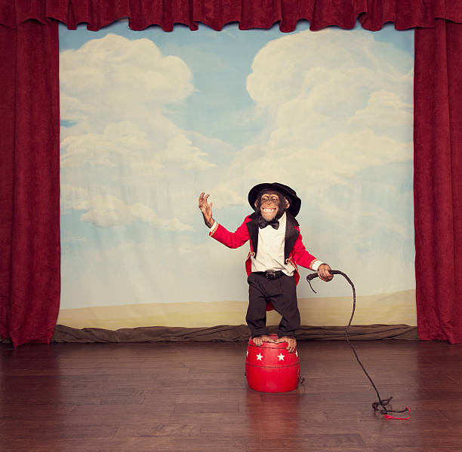
Twelve questions we need to address post-pandemic: a crowd sourced keynote convened by Sally Brown Monday 13th September 2021
Please use Padlet to interact to the session the session

Slide 2
1. How can we ensure that the benefit that accrued to some disadvantaged students during lockdown can continue?
Reported benefits for some students include:
Easier to manage childcare;
Cheaper not having to commute;
Ability to participate in less exposing ways than asking questions publicly;
Ability to save Teams chats for review later;
Opportunities for asynchronous learning….
BUT

Slide 3
2. What are lectures for? What purposes do they serve? What problems do they solve? How can lectures best be presented?
Traditional lectures can provide opportunities to:
bring whole cohorts together and build group identity;
be inspired by a great teacher;
benefit from learning at scale;
Interact productively with peers…..
BUT
(see the @UoB_HEFi Active Learning Cookbook of techniques.)

Slide 4
3. Where face-to-face has been replaced with virtual teaching, how have we ensured that engagement is maximised, and how can this best be carried forward? By:
Providing a rich multi-layered, multi-faceted, multi-channel learning environment.
Flipped learning, Webinars with guest speakers, discussion boards, explainer videos, drop-in sessions, Interactive quizzes, games, polls, shared activities, Q&A, virtual office hours, enhanced assignment briefings…..
These can be used alongside f-2-f and virtual sessions

Slide 5
4. How can we capitalise on the learning that has accrued in the pandemic about the relationship between pedagogy and technology? What have we learned that we need to continue?
We must
Be open to new ways of doing things;
Foreground the humanity/ compassion/commitment of the lecturer in relation to students;
Maintain a commitment to digital upskilling for ourselves as well as our students;
Recognise and value the communities/teams that work together to build rich learning environments;

Slide 6
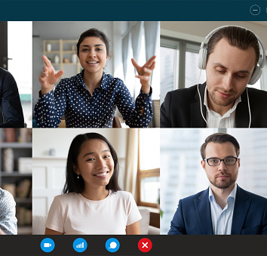
5. Engagement in activities in class and virtually has often been different: how can we make the best of both worlds to get as many students (and indeed staff) as possible to keep fully engaging?
We have learned that
The specific platform or technology is less important than the confidence of staff & students in using it and the clear rationale for its implementation;
Implementation of new systems needs to be staged and very well supported;
If something has worked well in the pandemic, let’s keep on using it whatever the format!

Slide 7
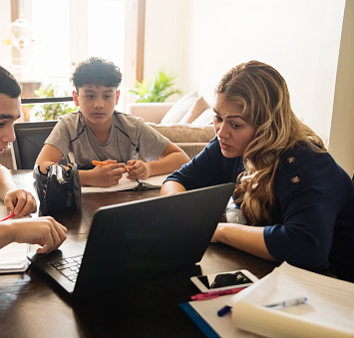
6. Partnership with students has long been important and has been made more so during the pandemic. How can we build on any gains we can perceive?
It’s important to:
Keep the dialogue going through all sorts of routes including the chat functions in teaching sessions;
Work closely with Student Unions and student reps (and maybe help them achieve AFHEA);
Ensure that there is genuine dialogue and not just tokenism;
Recognise that partnership across institutions needs to be pre-planned and integral, not an afterthought.

Slide 8
7. Relationships between Quality Assurance & Enhancement staff and academics have shifted in many cases for the better during the pandemic. How can we keep this positivity going?
We need to:
Dispel myths (and always discuss before making assumptions);
Value flexibility and adaptability;
Recognise that QA and QE staff are here to keep us and our students’ degree standards safe;
If the rules are stupid and stop us doing good things, change the rules rather than finding elaborate workarounds.

Slide 9
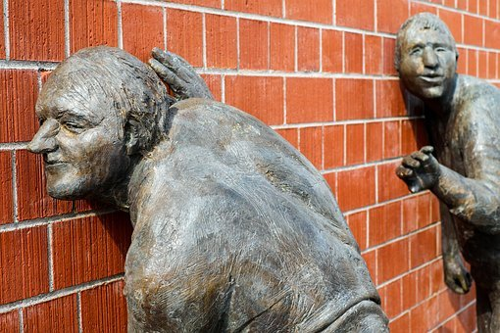
8. Senior managers had to listen to educational developers, quality assurers, educational technologists, learning support staff, information specialists and others, and learn the better from them during the pandemic. How can we make sure they keep listening?
We must
keep making visible to managers how our work underpins new ways of working;
capitalize on the goodwill that has accrued during the crisis towards the lower echelons;
recognise and integrate what matters most to all stakeholders when making changes to the ways things work in universities.

Slide 10
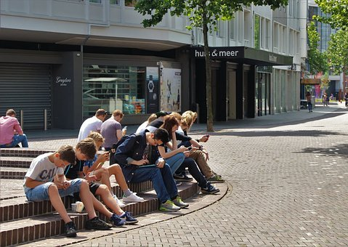
9. Do we need to rationalise the functions of the buildings on the university campus as we balance keeping people safe, and encouraging a sense of community?
Yes! We need to:
Recognise that learning is fluid so our approaches must also be flexible;
Value non-timetabled opportunities for learning to be articulated;
Make opportunities for self directed insights to be shared and deconstructed.

Slide 11
10. The pandemic has raised major issues about both staff and student wellbeing. How can we ensure that the right kinds of support are in place to avoid a further pandemic of mental health problems?
Be kind!
Avoid tokenism at all costs (Don’t offer me yoga sessions, give me some practical help!)!
Signpost resources and services available for both students and staff;
Offer genuine training, have open discussions on MH, don’t assume all staff are experts, refer on to specialists
Recognise that assessment times are often the breaking point for both staff and students;
Offer rewards for staff which can include sabbaticals, clear links to career progression for teaching and supporting student learning, valuing enhancement activities that improve the student experience.

Slide 12
11. Is there still a place for time-constrained exams post-pandemic? Can we ensure they are only used when they add real value?
Largely NO!
But… Maybe…
OSCEs, open-book, or open-note (or, like OU extensive handbook) tests, MCQs for specific purposes…

Slide 13
12. Kay Sambell and I have argued for more authentic assessment approaches over the pandemic. See https://sally-brown.net/kay-sambell-and-sally-brown-covid-19-assessment-collection/ What are the best strategies for ensuring this is taken forward?
Focus on practical engaging tasks which build on realistic scenarios or plausible contexts to bring learning to life;
Authentic assessment is not always about employability but also can be about developing assured personhood (including confidence, self-efficacy and empathy) as part of citizenship.

Slide 14
Very many thanks to:
Mark Glynn, Theo Gilbert, Mick Healey, Ruth Healey, Becky Sellars, Ale Armellini, Kay Sambell, Nick Freestone, Suzanne Fergus, Peter Hartley, Mark Childs, Sue Beckingham, Daniellle Hinton, Matt East, Lydia Arnold, Phil Race, Paul Kleiman, Claire Timmins, Jonathan Wilson, Mary Jacob, Iain McLaren, Linda Kaye, Sarah Floyd, Samantha Pugh, Laura West-Burnham, Katrina Swanton, Ruth Ni Bheolain, Richard Pennington, @Breflex Bernard, Chloe Agg, Nelson Chong, Abbi @thisaeshaw, Cath brown, Martin Compton and more!

