Slide 1
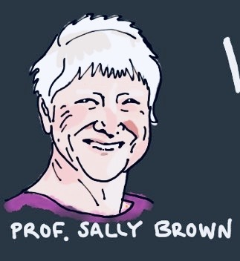
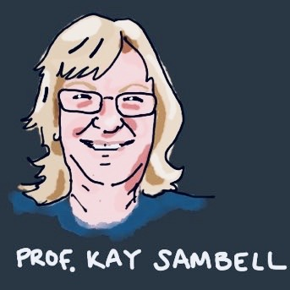
Making assessment future fit: ensuring authentic assessment approaches in the light of Coronavirus changes to HE practice
IEECOnline
Wednesday September 9th Sally Brown @ProfSallyBrown
sally@sally-brown.net
and Kay Sambell, Edinburgh Napier University
k.sambell@napier.ac.uk @kay_sambell

Slide 2
The world changed in Spring 2020 and so did university assessment!
In Spring 2020, just about every university globally was faced with a requirement to move from a substantial diet of unseen, time-constrained, invigilated exams in person to methodologies that could be undertaken remotely.
For decades, many have argued for a radical restructuring of assessment in Higher Education to integrate assessment more fully into the learning process as Assessment for Learning thereby ensuring it is more fit-for-purpose and helpful to students.
In this keynote we argue that we’ve never had a better chance to really shake up higher education assessment, because going back to the old ways is just unthinkable!

Slide 3
Everyone has been affected and we’ve all had to change orientation rapidly
Students have had to battle with working from home, often with sub-optimal kit, poor broadband access, caring responsibilities and nowhere peaceful to work, against a background of high anxiety. They’ve been flexible but won’t always be so forgiving;
University staff have faced often exactly the same conditions and everyone (academics, learning support staff, librarians, quality assurers, educational developers and others) had to move quickly to do the best by their students without any loss to quality and standards. With some exceptions, we’ve pulled it off, but we don’t ever want to be put in the same position again;
Senior managers were under huge pressure to manage the process under conditions that changed rapidly and unpredictably. Unless they had strong pedagogic backgrounds themselves, they had to rely on advice from internal and external colleagues (including us!) to make matters workable.

Slide 4
Our resources around assessment during times of coronavirus give more detail of our approaches:
Sambell, K. and Brown, S. (23 March 2020) ‘Contingency-planning: exploring rapid alternatives to face-to-face assessment’.
Sambell, K. and Brown, S. (2 April 2020) ‘Fifty tips for replacements for time-constrained, invigilated on-site exams’
Sambell, K. and Brown, S. (1 June 2020) ‘The changing landscape of assessment: some possible replacements for unseen time-constrained face-to-face invigilated exams’
Brown, S. and Sambell, K. (17th August 2020) Writing Better Assignments in the post-Covid Era: approaches to good task design
Brown, S. and Sambell, K. (21st August 2020) Changing assessment for good: a major opportunity for educational developers
Find them all collected here and look out for the next one!
https://sally-brown.net/kay-sambell-and-sally-brown-covid-19-assessment-collection/

Slide 5
We started thinking about changing assessment due to Covid and began reviewing the role of traditional assessment
Unseen, time-constrained exams have been known to have their limitations for some time and this seems like a wonderful opportunity, not just to make changes in crisis conditions, but also to improve university assessment forever!
It’s the best opportunity Enterprise educators have ever had to make assessment more relevant and authentic.

Slide 6
Learning for longer term
Personal meaning
Employability
Development of professionalism, skills, identity, sense of agency
Academic integrity
Relevance
Deep approaches
Engagement
Authentic assessment
Authentic feedback processes, feedforward and inner feedback
Development of evaluative judgement
Application of knowledge to local communities/
connected to real world
Creativity, problem formulation, divergent
Cognitive challenge
Ways of thinking and practising
Universal Design
For Learning
Notes:
See below- from HK and paper 3- but the paper 4 updates include
(Arnold- def of authenctictcity = Authentic – real and true
Authentic to employability (real, like work)
Authentic to discipline (growing in discipline)
Authentic to self (as I wish to become)
Real world relevance- mirros the profession or problems, or mirrors how knowledge is created in the dssicpliane/cofp
And authenticity for davison = ? (personal issues they’d identified for selves/choice, involvement , not isolated- in comms, with social interactions.
Arnold- cheating not impossible, but Less likely when: Viva, in-class tasks, personalised and unique tasks, and reflections. Cheating tends to be associated with pressure, competing demands, pressure, over asst.
In the main body of the paper we review some of the options and adjustments we have seen used locally and globally to adjust on-site exams for remote working. We draw extensively on scholarship in the area, to integrate assessment more fully into the learning experiences of students. Some of the methods we discuss are already widely used in many HEIs around the world and some are newly minted as a result of the Coronavirus crisis. We set out below some descriptions of the methodology, together with advantages and disadvantages of each and some key points to note if you plan to adjust or replace unseen time-constrained invigilated exams and other site-constrained methodologies with these approaches. We particularly focus, where possible, on alternatives which promote assessment’s authenticity. Building on Arnold (2019) and Sambell, McDowell and Montgomery (2013), we take authenticity to include ‘employability’, academic integrity and the development of professional skills (Sotiradou et al, 2019), but also to embrace other forms of realism, such as application of subject-knowledge to the local community, or learners developing the disciplinary ways of thinking and practicing of our research communities. Authenticity also implies, for us, an appropriate level of cognitive challenge, and the development of evaluative judgment which is the lynchpin of lifelong learning (Villaroel et al, 2020). Ideally, going forward, it also will find better ways to embrace authentic feedback processes (Dawson, Carless and Lee, 2020). We also draw attention, where appropriate, to the longer-term possibilities for universal design and tactics which address issues of inclusivity.
[See the Irish Forum guidance note on 10 ways to ensure your online assessment is accessible and inclusive at https://www.teachingandlearning.ie/resource/10-ways-to-ensure-online-assessment-is-accessible-and-inclusive/]

Slide 7
Authentic assessment is more than employability
“Authenticity has been identified as a key characteristic of assessment design which promotes learning. Authentic assessment aims to replicate the tasks and performance standards typically found in the world of work and has been found to have a positive impact on student learning, solve problems skills, autonomy, motivation, self-regulation and metacognition; abilities highly related with employability.” Villarroel et al (2019)
But for us, authenticity implies much more than this. We needs students to become agents for change in their own lives and beyond. It involves cognitive challenge, development of metacognitive capabilities, shaping of identity, building of confidence and a growth towards active citizenship. Hence, we are keen to develop and value assessment practices which are transformative, and which stimulate student engagement, both now and in the longer term
“This entails redesigning assessment practices to foster individual engagement in learning activities and subject matter, but also involves the development of assessment practices whereby students learn via participation and the development of identity (Sambell, Brown and Race 2019)

Slide 8
Think for a moment or two about what kinds of authentic assessment you would prefer to see used

Slide 9
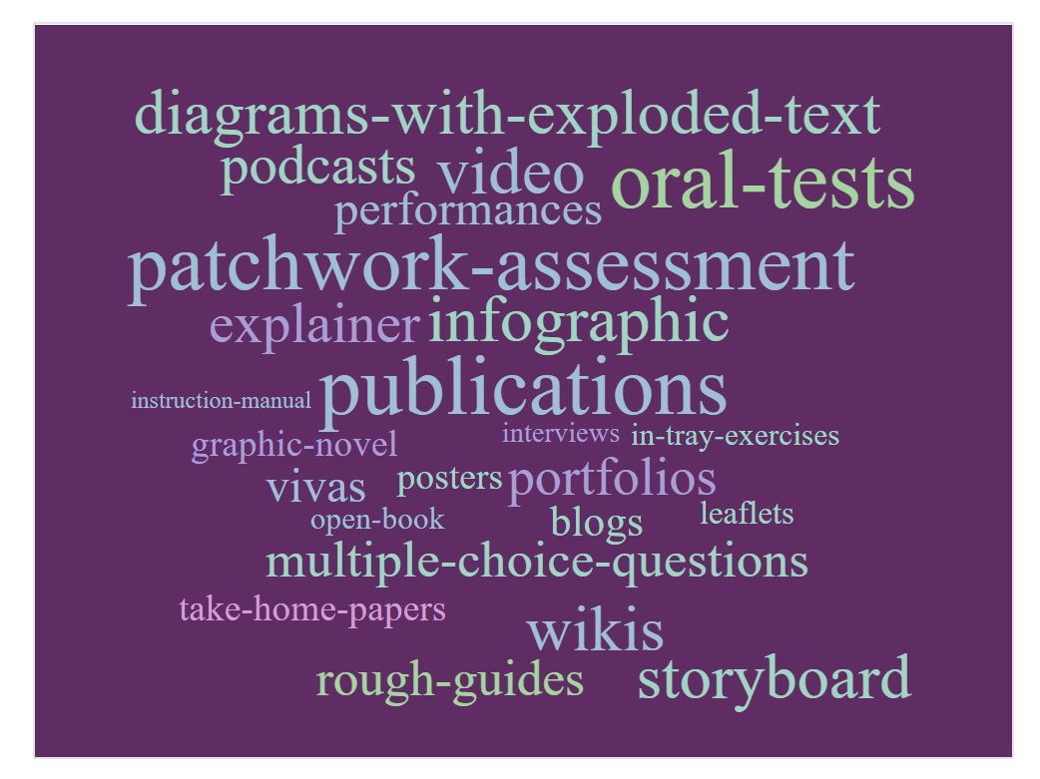
What are some alternatives you use/know of which boost authenticity?
[Add from paper 3 eg a wordcloud]
Take-home-papers
Open-book
Multiple-choice-questions
Portfolios
Oral-tests
vivas
Interviews
Objective-structured-clinical-exams
Patchwork-assessment
Blogs
Wikis
Publications
Rough-guides
Leaflets
Infographic
Graphic-novel
Storyboard
Video
Explainer
Diagrams-with-exploded-text
Workshop-guide
Instruction-manual
Podcasts
Audio-recordings
Evaluative-comparisons
Reflective-Journals
Annotated-bibliographies
Posters
In-tray-exercises
Creative-artefacts
Performances

Slide 10
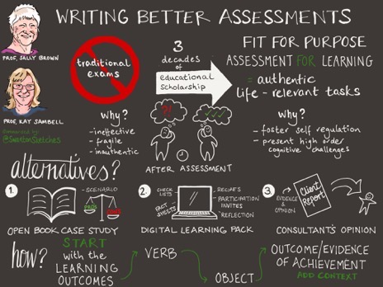
How can you write better assessment tasks
Paper summarised by @SwantonSketches

Slide 11
Working in partnership with students to improve assessment
Many of these innovative approaches can offer greater possibilities for students to contribute to the assessment design, development and quality assurance processes, which Healey et al (2016) for example consider offers significant benefit to both staff and students. Students, we suggest, can in redesigning assessment post-Covid19, potentially:
Help us design briefings that are clear, meaningful and recognizably authentic, thereby helping to avoid excessive numbers of queries from students who don’t understand what is required.
Advise us about special difficulties students might have complying with requirements, that might not be obvious to the assessment designers.
Provide feedback on formats and approaches that require technologies and applications that students may not have at home (good broadband, exclusive use of laptops, the correct software, quiet places to work etc.).
Advise on the extent that feedback could be helpful on replacement assessments.

Slide 12
Conclusions
Things can never be the same as formerly is unquestionable so it is more important than ever, to design assessments that minimise stress for students, boost their sense of authenticity and reduce the temptation for poor academic conduct.
Now is a chance like never before to be radical, innovative and powerful in making changes borne of these difficult times that can ultimately improve assessments in universities for all stakeholders in particular in relation to enterprise education.
We've advocated for many years the importance of making assessment truly for learning, and in making the most of the current situation to reengineer assessment for the future, we need to maintain and further advance this principle.

Slide 13
References and other useful reading
Arnold, L (2019) Unlocking the power of authentic assessment, DLTE ARISE lecture, Edinburgh Napier University Nov 27th. Slides and recording available (ENU staff only) https://staff.napier.ac.uk/services/dlte/Pages/DLTE-Past-Events-201920.aspx, or slides from https://lydiaarnold.wordpress.com/
Arnold, L., Williams, T. and Thompson, K., (2009(. Advancing the Patchwork Text: The Development of Patchwork Media Approaches. International Journal of Learning, 16(5).
Bjerrum Nielsen, S. (2020a) (blog) ’Preventing Academic Misconduct in digital exams using third-party programs’ https://uniwise.co.uk/blog/preventing-academic-misconduct-in-digital-exams-using-third-party-programs (accessed May 2020).
Bjerrum Nielsen, S. et. al. (2020b) (blog) ‘WISEcon 2019: Beyond the standard written exam’ https://uniwise.co.uk/blog/wisecon-2019-beyond-standard-written-exam (accessed May 2020).
Brown, S. and Race, P. ‘Using effective assessment and feedback to promote learning’ in Hunt, L. and Chalmers, D., 2020 (at press). University teaching in focus: A learning-centred approach. Routledge.
Brown, S. and Sambell, K (2020a) ‘Contingency planning: exploring rapid alternatives to face to face assessment’ Downloadable from https://sally-brown.net/2020/03/13/assessment-alternatives-at-a-time-of-university-closures/ (accessed May 2020).
Brown, S. and Sambell, K (2020b) Fifty tips for replacements for time-constrained, invigilated on-site exams Downloadable from https://sally-brown.net/2020/04/02/kay-sambell-sally-brown-coronavirus-contingency-suggestions-for-replacing-on-site-exams/ (accessed May 2020).
Buckley, A. (2020) Heriot Watt University Adapting your assessments: supporting student online learning toolkit https://lta.hw.ac.uk/sslo-assessment/ (accessed May 2020).

Slide 14
References 2
Clarke, J.L. and Boud, D., 2018. Refocusing portfolio assessment: Curating for feedback and portrayal. Innovations in education and teaching international, 55(4), pp.479-486.
D’Arcy Norma dot net (blog), March 31, 2020. ‘Online Exam Proctoring’; https://darcynorman.net/2020/03/31/online-exam-proctoring/ (accessed May 2020)
https://www.pebblepad.co.uk/
Ghandi, S (2016) Lessons from the coalface: supporting inclusivity. Lessons of an accidental inclusivist. Advance HE Equality and Diversity in L and T: . https://s3.eu-west-2.amazonaws.com/assets.creode.advancehe-document-manager/documents/ecu/ED-in-LT-Section-B_1573211644.pdf
Godfrey, J., (2020). The Student Phrase Book: Vocabulary for Writing at University. Macmillan International Higher Education.
Gordon, D. (2020) Don’t Panic: the Hitchhiker’s Guide to alternative online assessment. http://www.damiantgordon.com/Guide.pdf
HEA (2012) A Marked Improvement: transforming assessment in higher education, York: Higher Education Academy. (http://www.heacademy.ac.uk/assets/documents/assessment/A_Marked_Improvement.pdf
Healey, M., Flint, A. and Harrington, K., 2016. Students as partners: Reflections on a conceptual model. Teaching & Learning Inquiry, 4(2), pp.1-13.
Hendry, G. (2020) Practical assessment strategies to prevent students from plagiarising https://www.sydney.edu.au/education-portfolio/ei/news/pdfs/Practical%20assessment%20strategies%20to%20prevent%20students%20from%20plagiarising3.pdf
Hughes, J. and Purnell, E., 2008. Blogging for beginners? Using blogs and eportfolios in Teacher Education.

Slide 15
References 3
Joughin, G. (2010) A short guide to oral assessment http://eprints.leedsbeckett.ac.uk/2804/1/100317_36668_ShortGuideOralAssess1_WEB.pdf
JISC (2015) https://www.jisc.ac.uk/guides/transforming-assessment-and-feedback/assessment-design
Lawrence, Jenny. (2020) Designing out plagiarism for online assessment. https://thesedablog.wordpress.com/2020/04/02/online-assessment/ (accessed May 2020).
Logan, D., Sotiriadou, P., Daly, A. and Guest, R., 2017, October. Interactive oral assessments: Pedagogical and policy considerations. In E-Learn: World Conference on E-Learning in Corporate, Government, Healthcare, and Higher Education (pp. 403-409). Association for the Advancement of Computing in Education (AACE).
Orr. S. (2020) private correspondence.
Radclyfe Thomas, N. (2012) ‘Blogging is additive’ in Increasing Student Engagement and Retention using Online Learning Activities: Wikis, Blogs and Webquests Cutting-edge Technologies in Higher Education, Volume 6A, 75107 by Emerald Group Publishing Limited.
RSA(2020) www.thersa.org
Sambell, K. Brown, S and Race, P (2019) Combatting Contract Cheating. DLTE Edinburgh Napier Quick Guide (#14) https://staff.napier.ac.uk/services/dlte/Pages/QuickGuides.aspx
Sambell, K. and Brown, S. (2020) The changing landscape of assessment: some possible replacements for unseen, time-constrained, face-to-face invigilated exams. Sambell, K., Brown, S. and Race, P., 2019. Assessment as a locus for engagement: priorities and practicalities. Italian Journal of Educational Research, pp.45-62.
Sotiriadou, P., Logan, D., Daly, A. and Guest, R., 2019. The role of authentic assessment to preserve academic integrity and promote skill development and employability. Studies in Higher Education, pp.1-17.
Villaroel, V., Boud, D., Bloxham, S., Bruna, D. and Bruna, C., 2020. Using principles of authentic assessment to redesign written examinations and tests. Innovations in Education and Teaching International, 57(1), pp.38-49.

Slide 16
References 4
Webster, H. and Crow, C. (2020) Newcastle University Writing Centre https://eur02.safelinks.protection.outlook.com/?url=https%3A%2F%2Fblogs.ncl.ac.uk%2Facademicskills%2Ffiles%2F2020%2F05%2FWriting-coursework-under-time-constraints-v2.pdf&amp;data=02%7C01%7CS.Brown%40leedsbeckett.ac.uk%7C0094394477944eb4031108d7f991e631%7Cd79a81124fbe417aa112cd0fb490d85c%7C0%7C0%7C637252277459343117&amp;sdata=Er1Fgo8Prq0CTivK2aZbdZI7cZgLvNqlE011j40sOwI%3D&amp;reserved=0
Webster. H. (2020) Writing Development Centre Newcastle University ‘WDC explains it all in one slide Higher Order Thinking: Critical Analysis’ https://www.youtube.com/watch?v=dqyJVotAOdo (accessed May 2020).
Wood, G. (11 May 2020) Preparing students for take-home and Open Book exams https://www.garycwood.uk/ and 19th May 2020 7 Tips for students on the day of the exam itself: https://www.garycwood.uk/2020/05/sitting-your-take-home-and-open-book-exams.html, University of Sheffield | Department of Mechanical Engineering.

