Slide 1
Changing assessment for good: improving post-Covid19 assessment long term A keynote and discussion for the Centre for Learning, Teaching and Technology (LTTC) at The Education University of Hong Kong (EdUHK)
Professor Sally Brown
Emerita Professor Leeds Beckett, Independent consultant
Visiting Professor at Edge Hill University and formerly at the Universities of Plymouth, Robert Gordon, South Wales and Liverpool John Moores and at Australian universities: James Cook, Central Queensland and the Sunshine Coast.
Honorary Doctorates awarded by the Universities of Plymouth, Kingston, Bournemouth, Edinburgh Napier and Lincoln.
NTF, PFHEA, SFSEDA PhD, MA, BA, PGCert, ADBEd
https://sally-brown.net/
@ProfSallyBrown

Slide 2
An opportunity for long-term change
Universities globally have had to work hard and move fast this year to implement assessment practices to replace unseen, time-constrained, on-site exams due to the Covid-19 pandemic. For many these, heroic efforts signal a unique opportunity to radically review how higher education assessment works currently, and to rethink our practices in the future.
Kay Sambell and I have spent recent months helping HEIs globally put in place immediate contingency plans to cope with the current fast-moving situation, and now we are working together to present some of our suggestions on future-focused enhancements to assessment methods, systems and strategies that align more fully with four decades of pedagogic research on HE assessment, arguing for a fit-for-purpose, authentic approach that genuinely foregrounds student learning.
In this keynote I will explore with you how we can introduce new formats, approaches and tasks within our assessment diets, designed to ensure business continuity in our institutions while mitigating risks in an unknown future and contributing positively to student engagement and achievement.

Slide 3
Everyone has been affected, and we’ve all had to change orientation rapidly
Students have had to battle with working from home, often with sub-optimal kit, poor broadband access, caring responsibilities and nowhere peaceful to work, against a background of high anxiety. They’ve been flexible, but won’t always be so forgiving;
University staff have faced often exactly the same conditions and everyone (academics, learning support staff, librarians, quality assurers, educational developers and others) had to move quickly to do the best by their students without any loss to quality and standards. With some exceptions, we’ve pulled it off, but we don’t ever want to be put in the same position again;
Senior managers were under huge pressure to manage the process under conditions that changed rapidly and unpredictably. Unless they had strong pedagogic backgrounds themselves, they had to rely on advice from internal and external colleagues (including us!) to make matters workable.

Slide 4

Our resources around assessment during times of coronavirus give more detail of our approaches:
Sambell, K. and Brown, S. (23 March 2020) ‘Contingency-planning: exploring rapid alternatives to face-to-face assessment’.
Sambell, K. and Brown, S. (2 April 2020) ‘Fifty tips for replacements for time-constrained, invigilated on-site exams’
Sambell, K. and Brown, S. (1 June 2020) ‘The changing landscape of assessment: some possible replacements for unseen time-constrained face-to-face invigilated exams’
Find them all collected here and look out for the next one!
https://sally-brown.net/kay-sambell-and-sally-brown-covid-19-assessment-collection/

Slide 5
The RSA argue that there are transformational opportunities that can lead to lasting change for the good, coming out of the current crisis:
“As we think of ‘bridges to the future’, we are thinking too of the variety of measures and activities that have been put in place during the crisis response, from those which may be most promising signs of new ways of doing things to those we see as only ever temporary.” (RSA,2020). They suggest four potential post-crisis response measures:
End: We’ve done these things to respond to immediate demands, but they are specific to the crisis;
Restart: We’ve had to stop these things to focus on the crisis, but they need to be picked up in some form;
Let go: We’ve been unable to stop doing things that were already or are now unfit for purpose;
Amplify: We’ve been able to try these new things and they show some signs of promise for the future.

Slide 6
Broadly there have been four phases to our work which align with these responses:
Emergency planning when exams can’t be run, to put into place arrangements to conduct this academic year’s assessment where we need to replace all unseen, time-constrained invigilated on-site exams with something university systems and students can manage, involving emergency protocols and crisis management processes.
Working out how we can switch to other formats immediately, by exploring what could replace face-to-face exams (for example, open-book exams).
Exploring workable alternative forms of assignments to exams (using a handy pros and cons table!) which are likely also to have benefits for learners when there is a slightly longer lead-in for change in the new academic year when campus access is still likely to be patchy.
Thinking over the summer of 2020, how we can make changes for good, to ensure that systems, methods and processes are ultimately improved long term. Assessment can thereby be redesigned to become more future-focused administratively and, more importantly, philosophically in design, rather than returning to business-as-usual conservatism.

Slide 7
So then we started thinking that we don’t want to go back to how we did things before, do we?
Unseen, time-constrained exams have been known to have their limitations for some time, and this seems like a wonderful opportunity, not just to make changes in crisis conditions, but also to improve university assessment forever! It’s the best opportunity educators have ever had to make assessment more relevant and authentic.

Slide 8
So what’s wrong with a traditional exams?
The time/place/duration constraints carry high risks issues, preventing the traditional exam being taken, and thereby risk business continuity interruption, which would require on-the-hoof mitigations.
Traditional exams lack relevance to students’ future lives in employment, entrepreneurship and civil society, since they are not in any meaningful way a valid representation of what work or life challenges actually require.
The range of activities that students can be asked to do in a traditional written exam are very limited, writing with a pen individually in silence, with no reference to wider resources. In employment and wider contexts, most will have internet access and a keyboard to work on, as well as the expectation that they will work as team members, often in interdisciplinary settings.
Because (in the UK at least), traditional unseen exams rarely have a feedback function, the process of sitting an exam adds little or nothing to students’ learning – no scope for formative development or active student participation in the feedback process.

Slide 9
Authentic assessment is more than employability
“Authenticity has been identified as a key characteristic of assessment design which promotes learning. Authentic assessment aims to replicate the tasks and performance standards typically found in the world of work and has been found to have a positive impact on student learning, solve problems skills, autonomy, motivation, self-regulation and metacognition; abilities highly related with employability.” Villarroel et al (2019).
But for us, authenticity implies much more than this. We needs students to become agents for change in their own lives and beyond. It involves cognitive challenge, development of metacognitive capabilities, shaping of identity, building of confidence and a growth towards active citizenship. Hence, we are keen to develop and value assessment practices which are transformative, and which stimulate student engagement, both now and in the longer term.
“This entails redesigning assessment practices to foster individual engagement in learning activities and subject matter, but also involves the development of assessment practices whereby students learn via participation and the development of identity” (Sambell, Brown and Race, 2019).

Slide 10
So what should future assessment be like, building on current work?
Old-style traditional exams should be used more rarely, recognising that they have limited value as authentic assessment methodologies. A case will need to be made as to why these are used, rather than relying on them as the default methodology.
As part of techniques to risk-assess, and design for future crisis planning, where these types of exams are used, questions will need to be designed in future that can be used in different scenarios, face-to-face on site, remotely managed or virtually.
The language of assessment questions should be radically reviewed to focus less on recollection and memorisation of information, and more on its usage within specific contexts: we need to consider the ‘learning outcomes’ required by each exam question to promote more explaining, reasoning, applying and arguing, and less describing and listing (Hendry 2020).
Feedback, especially generic collective guidance should become an integral part of new assessment processes.

Slide 11
Further changes
There should be a greater reliance on reflection on practice in examinations to ensure that students’ alignment with the work being produced is authenticated.
Greater use should be made of asynchronous assessments, since these are less susceptible to crisis contexts, and can cope better with students accessing exams in different time zones.
Exam-based assessment should not result in ‘sudden death’ of students’ progress and life chances, with less reliance on performance on a single occasion.
Replacements to exams must be inclusive and allow for reasonable adjustments for students with special or additional needs, as indeed do current exams.

Slide 12
Working in partnership with students to improve assessment
Many of these innovative approaches can offer greater possibilities for students to contribute to the assessment design, development and quality assurance processes, which Healey et al (2016) for example consider offers significant benefit to both staff and students. Students, we suggest, can in redesigning assessment post-Covid19, potentially:
Help us design briefings that are clear, meaningful and recognizably authentic, thereby helping to avoid excessive numbers of queries from students who don’t understand what is required.
Advise us about special difficulties students might have complying with requirements, that might not be obvious to the assessment designers.
Provide feedback on formats and approaches that require technologies and applications that students may not have at home (good broadband, exclusive use of laptops, the correct software, quiet places to work etc.).
Advise on the extent that feedback could be helpful on replacement assessments.

Slide 13
Assessment for the future must offer:
Authentic, life-relevant tasks that foster self-regulation rather than tutor over-direction;
Assignments that place as much emphasis on process as on outcome ;
Tasks that require students to source and evaluate reference material, which they would need to list and formulate appropriately for the context.
Flexibility to be undertaken whatever the circumstances to avoid the problems we have experienced this year.
The next slide shows an approach to redesigning assessment tasks: see appendix for more examples.

Slide 14
Verb/educational outcome | What? | Then what? | Modifiers/ developments
Interpret | complex and sometimes incomplete or conflicting data | compile a summary meaningful for experts and laypersons | leading to a viable action plan.
Review | data from a variety of sources | produce an executive summary | for a specific audience
Set up | specialised equipment appropriately | draw up a ‘quick guide’ for peers | to enable them to use it safely and appropriately
Evaluate | three proposed solutions to a problem | propose a further two of your own | with suggestions about what might work best
Compile | contingency plans for a professional environment | produce disaster recovery in case of a serious emergency | leading to mitigations and remediation

Slide 15
Thinking about what you are asking students to produce, instead of an exam script you could seek for example:
*An electronic or hard copy portfolio, *A viva voce or individual oral test, *A virtual Objective Structured Clinical Examination (OSCE), *Patchwork assessments, *Blogs, *Articles or other types of publications, *Video/audio recordings/ podcasts, *Reflective journals, *Rough guides, leaflets and other public documents/outputs, *Annotated publications, *Evaluative comparisons and judgments, *In tray exercises, *Creative artefacts, *Presentations, or *Performances (see Sambell and brown, (2020c) for descriptions and pros and cons of each of these). What follows next are three worked examples:
A case study task
A learning pack
A consultant’s opinion.

Slide 16
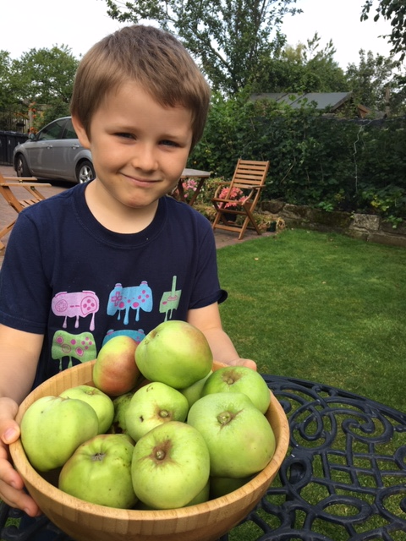
Worked example 1: Early years teaching
Exam question:
“What approaches to struggling young readers are available to teachers, and what are the benefits and disadvantages of each?”

Slide 17
Worked example 1: Early years teaching Alternative: case study task
In your class you have a boy, Kai, from a disadvantaged background who is really struggling to get beyond sounding words out. From your experience and from your reading around the topic (which you should reference), draw up a table to help you consider the potential advantages and disbenefits of each of the following interventions to support Kai, and say how each might help him to make progress. Please also suggest one more course of action derived from your wider reading. Provide a conclusion in which you show your plan of action for the next twelve weeks and justify your choices of approach.
Sending home a letter to Kai’s parents asking hem to read with him every day for the next 12 weeks.
Asking your classroom volunteer (Granny Sally) to come in for extra sessions every week for the next twelve to work intensively with Kai.
Make time yourself to work several times a week with Kai using flash cards to help him become very familiar with a number of targeted high-frequency words.
Work with the whole class over 12 weeks to learn ‘the word of the day’ thereby helping Kai and all the others gain confidence and familiarity with 60 new words.

Slide 18
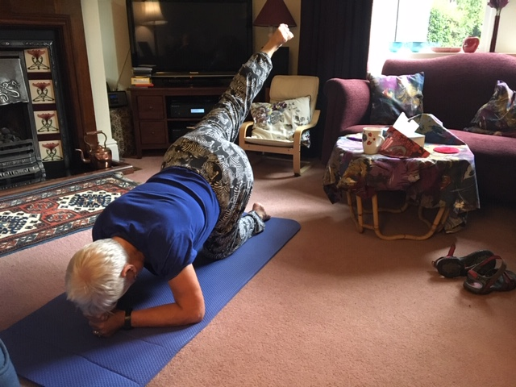
Example 2: Sports, physical education and well-being
Exam question:
“Outline the health risks associated with an inactive lifestyle and poor diet for Type2 diabetic older females and describe what remedies could improve their health and well-being”.

Slide 19
Example 2: Sports, physical education and well-being
Alternative: Learning pack
As a community sports facilitator, you have been asked to support a group of older women with Type 2 diabetes who take little exercise and whose diet is less than optimum. Produce a digital learning pack targeted to help this group that might contain, for example, self-produced and collated visually attractive and clearly written fact sheets, check lists, recipes and invitations to participate in group activities. Your pack should contain at least five items and no more than eight. Provide a reflective commentary outlining your rationale for choices about what to include (max 200 words), a reference list to your scientific sources (both text and community-based)(max 300 words), a short note on how you accessed, identified and prioritised your information sources (100 words) and a statement of the extent to which your own perceptions and beliefs have altered during the course of undertaking this assignment (max 200 words).

Slide 20
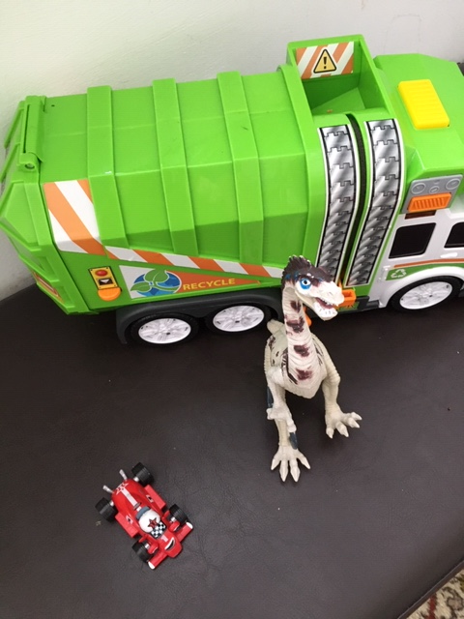
Example 3: Business and Law
Exam question:
“Outline the legal and professional responsibilities of a company importing children’s toys and games into Hong Kong and the UK in terms of health and safety”.

Slide 21
Example 3: Business and Law
Alternative: Consultant’s opinion
This scenario assumes you are working in a consultancy advising clients on importing and exporting goods into Hong Kong and the UK. You have been approached by a client who has discovered that one of her suppliers of children’s toys and games has been found to have been using unsafe lead-based paint on some items for at least five years. Draw up a brief immediate response for your client, advising her with due caveats of the range of implications this is likely to have for her business in Hong Kong and the UK, and indicating what actions she needs to take as a matter of urgency. Provide with your short opinion an appendix that lists relevant legislation, reference material and other information to back up your advice.

Slide 22
Rethinking assessment with a future-focus (1)
Every assessment activity we ask students to undertake in a post-pandemic context should clearly contribute to the student learning journey, by enabling them to develop as well as demonstrate skills and capabilities, as well as knowledge. We know students take assignments more seriously, and undertake them more thoroughly if they can see them to be meaningful and potentially useful, so we should design them to:
We need to engage students and stretch their capabilities so they find the work challenging but satisfying, with outcomes that require them to contribute from their inner resources and individual thinking, rather than just using what they’ve learned in class;
Our assignments should be demonstrably relevant to 21st century contexts, making use of technologies, data bases, information sources and other evidence that enable them to make research-based decisions relevant to the personal, professional, work or civic society environment;
We must foster integration of learning from different elements of their programmes of study so that theory and practice mutually inform one another leading to holistic approaches;

Slide 23
Rethinking assessment with a future-focus (2)
We want our students to reflect on their learning within and beyond their university studies, fostering life-long learning which builds on asking not just ‘how?’ and ‘what?’, but also ‘why?’ ‘so what?’ and ‘then what?’, so they consider rationales, implications and next steps;
We must provide secure contexts, where students can trust the judgments of assessors to be fair, valid and reliable, with different assessors working to the same standards;
We should avoid over-assessment, and provide clear notional workloads and word counts (e.g. if 24 hours are allowed in total, a guidance note could indicate that students are expected to spend no more than three on the task) thereby avoiding unrealistic and unhealthy student self-expectations and making assessment manageable for students and staff.
This means we must rethink feedback processes radically to empower students to learn to self regulate and thereby foster lifelong learning.

Slide 24
We must foreground the needs of students rather than those of the institution by:
Moving away from always requiring pen and paper examinations, rather than allowing usage of laptops, due to fears around security, since many IT solutions exist nowadays, to ‘lock down’ kit only, ‘whitelisting’ access to particular software packages or data bases;
Providing choice for students to undertake their summative assignments when they feel ready, rather than on single set dates, allowing students to work through programmes at their own pace;
Fostering a sense of belonging among students, which encourages cooperative rather than competitive behaviours, and builds a community of learners that in some ways mirrors the ways in which they will be working and learning after graduation;
Encouraging students’ own professional responsibility and integrity, rather than continuously monitoring performance which assumes all students are keen to cheat and plagiarise; and, above all …
Developing assessment and feedback approaches that are transformative, that is, leading to changes in behaviour and attitudes of students as they move from student to graduate status and grow in status towards professionalism.

Slide 25
Conclusions
Things can never be the same as formerly is unquestionable, so it is more important than ever to design assessments that minimise stress for students, boost their sense of authenticity and reduce the temptation for poor academic conduct.
Now is a chance like never before to be radical, innovative and powerful in making changes borne of these difficult times, that can ultimately improve assessments in universities for all students.
We've advocated for many years the importance of making assessment truly for learning, and in making the most of the current situation to reengineer assessment for the future, we need to maintain and further advance this principle.
We need to make assessments manageable for staff and students, while maintaining the assurance of standards, avoiding over-assessment wherever possible.
More than anything, we must ensure our assignments are authentic and work in the service of student learning.

Slide 26
Appendix: examples of tasks to replace exams
Interpret complex and sometimes incomplete or conflicting data, compiling a summary that is meaningful both for experts and laypersons, leading to a viable action plan.
Review data from a variety of self-sought published materials, informal media and other sources, and produce an executive summary for a specific audience.
Set up specialised equipment appropriately and draw up a ‘quick guide’ for peers that would enable them to use it safely and appropriately.
Articulate the central aspects of a problem, perhaps presented in a case study, and offer a variety of reasoned solutions.
Argue for a particular solution based on a range of complex contextual factors, together with a reasoned rationale for this choice.
Evaluate three proposed solutions to a problem and propose a further two of your own, with suggestions about what might work best.
Compile contingency plans for a professional environment for disaster recovery in case of a serious emergency, leading to mitigations and remediation.
Prioritise action to be taken in a busy work context where all tasks appear equally urgent.
In a given context, draw up an action plan with milestones of achievement and measurable indicators of success.
Research and reference an area of innovation, and draw conclusions from your sources of information for the success or failure of the initiative.
Offer synopses of multiple and diverse sources including text, image and data which can explain a particular phenomenon discussed within a programme.
Critique three perspectives on or readings of a text, choosing one that is most convincing to you and giving your reasons for this choice.
Provide a rationale for a course of action taken in a professional setting, illustrating this with appropriate, relevant and current publications.

Slide 27
References and other useful reading
Arnold, L (2019) Unlocking the power of authentic assessment, DLTE ARISE lecture, Edinburgh Napier University Nov 27th. Slides and recording available (ENU staff only) https://staff.napier.ac.uk/services/dlte/Pages/DLTE-Past-Events-201920.aspx , or slides from https://lydiaarnold.wordpress.com/
Arnold, L., Williams, T. and Thompson, K. (2009). Advancing the Patchwork Text: The Development of Patchwork Media Approaches. International Journal of Learning, 16(5).
Bjerrum Nielsen, S. (2020a) (blog) ’Preventing Academic Misconduct in digital exams using third-party programs’ https://uniwise.co.uk/blog/preventing-academic-misconduct-in-digital-exams-using-third-party-programs (accessed May 2020).
Bjerrum Nielsen, S. et. al. (2020b) (blog) ‘WISEcon 2019: Beyond the standard written exam’ https://uniwise.co.uk/blog/wisecon-2019-beyond-standard-written-exam (accessed May 2020).
Brown, S. and Race, P. ‘Using effective assessment and feedback to promote learning’ in Hunt, L. and Chalmers, D., 2020 (at press). University teaching in focus: A learning-centred approach. Routledge.
Brown, S. and Sambell, K (2020a) ‘Contingency planning: exploring rapid alternatives to face to face assessment’ Downloadable from https://sally-brown.net/2020/03/13/assessment-alternatives-at-a-time-of-university-closures/ (accessed May 2020).
Brown, S. and Sambell, K (2020b) Fifty tips for replacements for time-constrained, invigilated on-site exams Downloadable from https://sally-brown.net/2020/04/02/kay-sambell-sally-brown-coronavirus-contingency-suggestions-for-replacing-on-site-exams/ (accessed May 2020).
Buckley, A. (2020) Heriot Watt University Adapting your assessments: supporting student online learning toolkit https://lta.hw.ac.uk/sslo-assessment/ (accessed May 2020).

Slide 28
References 2
Clarke, J.L. and Boud, D., 2018. Refocusing portfolio assessment: Curating for feedback and portrayal. Innovations in education and teaching international, 55(4), pp.479-486.
D’Arcy Norma dot net (blog), March 31, 2020. ‘Online Exam Proctoring’; https://darcynorman.net/2020/03/31/online-exam-proctoring/ (accessed May 2020)
https://www.pebblepad.co.uk/
Ghandi, S (2016) Lessons from the coalface: supporting inclusivity. Lessons of an accidental inclusivist. Advance HE Equality and Diversity in L and T: . https://s3.eu-west-2.amazonaws.com/assets.creode.advancehe-document-manager/documents/ecu/ED-in-LT-Section-B_1573211644.pdf
Godfrey, J., (2020). The Student Phrase Book: Vocabulary for Writing at University. Macmillan International Higher Education.
Gordon, D. (2020) Don’t Panic: the Hitchhiker’s Guide to alternative online assessment. http://www.damiantgordon.com/Guide.pdf
HEA (2012) A Marked Improvement: transforming assessment in higher education, York: Higher Education Academy. (http://www.heacademy.ac.uk/assets/documents/assessment/A_Marked_Improvement.pdf
Healey, M., Flint, A. and Harrington, K., 2016. Students as partners: Reflections on a conceptual model. Teaching & Learning Inquiry, 4(2), pp.1-13.
Hendry, G. (2020) Practical assessment strategies to prevent students from plagiarising https://www.sydney.edu.au/education-portfolio/ei/news/pdfs/Practical%20assessment%20strategies%20to%20prevent%20students%20from%20plagiarising3.pdf
Hughes, J. and Purnell, E., 2008. Blogging for beginners? Using blogs and eportfolios in Teacher Education.

Slide 29
References 3
Joughin, G. (2010) A short guide to oral assessment http://eprints.leedsbeckett.ac.uk/2804/1/100317_36668_ShortGuideOralAssess1_WEB.pdf
JISC (2015) https://www.jisc.ac.uk/guides/transforming-assessment-and-feedback/assessment-design
Lawrence, Jenny. (2020) Designing out plagiarism for online assessment. https://thesedablog.wordpress.com/2020/04/02/online-assessment/ (accessed May 2020).
Logan, D., Sotiriadou, P., Daly, A. and Guest, R., 2017, October. Interactive oral assessments: Pedagogical and policy considerations. In E-Learn: World Conference on E-Learning in Corporate, Government, Healthcare, and Higher Education (pp. 403-409). Association for the Advancement of Computing in Education (AACE).
Orr. S. (2020) private correspondence.
Radclyfe Thomas, N. (2012) ‘Blogging is additive’ in Increasing Student Engagement and Retention using Online Learning Activities: Wikis, Blogs and Webquests Cutting-edge Technologies in Higher Education, Volume 6A, 75107 by Emerald Group Publishing Limited.
RSA(2020) www.thersa.org
Sambell, K. Brown, S and Race, P (2019) Combatting Contract Cheating. DLTE Edinburgh Napier Quick Guide (#14) https://staff.napier.ac.uk/services/dlte/Pages/QuickGuides.aspx
Sambell, K. and Brown, S. (2020) The changing landscape of assessment: some possible replacements for unseen, time-constrained, face-to-face invigilated exams. (Link to be added when posted)
Sambell, K., Brown, S. and Race, P., 2019. Assessment as a locus for engagement: priorities and practicalities. Italian Journal of Educational Research, pp.45-62.
Sotiriadou, P., Logan, D., Daly, A. and Guest, R., 2019. The role of authentic assessment to preserve academic integrity and promote skill development and employability. Studies in Higher Education, pp.1-17.
Villaroel, V., Boud, D., Bloxham, S., Bruna, D. and Bruna, C. (2020) Using principles of authentic assessment to redesign written examinations and tests. Innovations in Education and Teaching International, 57(1), pp.38-49.

Slide 30
References 4
Webster, H. and Crow, C. (2020) Newcastle University Writing Centre https://eur02.safelinks.protection.outlook.com/?url=https%3A%2F%2Fblogs.ncl.ac.uk%2Facademicskills%2Ffiles%2F2020%2F05%2FWriting-coursework-under-time-constraints-v2.pdf&amp;data=02%7C01%7CS.Brown%40leedsbeckett.ac.uk%7C0094394477944eb4031108d7f991e631%7Cd79a81124fbe417aa112cd0fb490d85c%7C0%7C0%7C637252277459343117&amp;sdata=Er1Fgo8Prq0CTivK2aZbdZI7cZgLvNqlE011j40sOwI%3D&amp;reserved=0
Webster. H. (2020) Writing Development Centre Newcastle University ‘WDC explains it all in one slide Higher Order Thinking: Critical Analysis’ https://www.youtube.com/watch?v=dqyJVotAOdo (accessed May 2020).
Wood, G. (11 May 2020) Preparing students for take-home and Open Book exams https://www.garycwood.uk/ and 19th May 2020 7 Tips for students on the day of the exam itself: https://www.garycwood.uk/2020/05/sitting-your-take-home-and-open-book-exams.html, University of Sheffield | Department of Mechanical Engineering.

