Slide 1
Edinburgh Napier University School of Health and Social Care Bachelor of Nursing & Midwifery scrutiny Enhancement workshop
6th February 2020
Sally Brown NTF, PFHEA, SFSEDA
@ProfSallyBrown http://sally-brown.net
Kay Sambell, NTF, PFHEA
k.sambell@napier.ac.uk

Slide 2
Provisional programme
9.30 Enhancing learning outcomes. Thinking through the language to ensure these are fit-for-purpose and usable by all stakeholders
10.45 Providing formative feedback: some manageable ways of doing this both pre-emptively and subsequently.
11.30 break
11.45 Building a community of practice to ensure consistency of feedback across multiple markers
12.30 lunch
1.15 Ensuring fairness in assessed group activities and presentations
2.15 Demonstrating progression over 3yrs of assessed tasks, e.g. presentations
3.15 ask us anything about teaching and learning particularly assessment and feedback
4.30 close

Slide 3
1. Are your learning outcomes SMART or VASCULAR? The usual ‘requirements’ are that they be:
Specific;
Measurable;
Achievable;
Realistic;
Time constrained.
Instead let’s make them VASCULAR
https://www.youtube.com/watch?v=3fWvtbojDfA&feature=youtu.be

Slide 4
VASCULAR learning outcomes
Verifiable: Can we tell when they’ve been achieved? And can students?
Action orientated: Do they lead to real and useful activity?
Singular: i.e. not portmanteau outcomes combining two or more into one, making it difficult to assess if differently achieved, but readily matchable to student work produced?
Constructively aligned? (Biggs and Tang, 2011) so that there is clear alignment between aims (What do students need to be able to know and do?), what is taught/ learned, how these are assessed and evaluated);
Understandable i.e. using language codes that are meaningful to all stakeholders?
Level-appropriate? Suitable and differentiable between1st year, 2nd year, 3rd year, Masters, other PG?
Affective-inclusive i.e. not just covering actions but capabilities in the affective domain?
Regularly reviewed? Not just stuck in history and always fit-for-purpose.

Slide 5
Enhancing your learning outcomes following scrutiny event
Do you have too many?
Are your verbs active and meaningful? Can you verify when they have been achieved? Are they written in language that is understandable by all stakeholders including students, colleagues out in practice settings, employers and quality assurers in Napier and within NMB and SCQF?
Can we see them reflected in the assessed tasks?
Can you see progression from year to year with your learning outcomes being more challenging as students grow in knowledge and capability?
Moving from learning outcomes to module content, does the language become more student-facing?
Notes:
Scottish Credit and Qualifications Framework Level Descriptors at https://scqf.org.uk/media/1123/scqf-level-descriptors-web-aug-2015.pdf

Slide 6
Formative and summative assessment
Formative assessment is primarily concerned with feedback aimed at prompting improvement, is often continuous and usually involves words.
Summative assessment is concerned with making evaluative judgments, is often end point and involves numbers.

Slide 7
2. Providing formative feedback
Is what you have written in the free-text box (15b) about Formative Assessment student-facing in its language and tone?
Does it tell students how they will be supported to know how they are doing and what is expected of them before finalising their summative work, and to do (even) better on future assignments (feed-forward)?
Is it part of an assessment-for learning-approach?
https://t.co/LIrQvA1JZd
Video from Sue Beckingham of Feedback Acrostic

Slide 8
Providing formative feedback
This part of the workshop is designed to foster further thinking about how you can make formative assessment fit-for-purpose and manageable;
We will discuss not just how we complete the proforma using student-facing language, but also how we can manage the formative feedback process in ways that really contribute to their learning.

Slide 9
What kinds of things could you say in the formative feedback box? Elements could include:
Formative feedback designed to help you enhance current and future work will be given throughout the module in a variety of ways, including oral and written comments, delivered face-to-face and virtually in a variety of contexts;
You will be required to bring extracts of your partially completed assignment (for example, a draft bibliography, blogposts or an outline plan) to feedback tutorials for peer discussion and tutor commentary;
Formative feedback will be provided by the tutor on draft extracts of your assignment submitted to the tutor online (or to peers via the VLE);
Formative advice and feedback will be given orally in your practice sessions: you will be advised to make notes or record the comments for subsequent reference.
Regular online quizzes will be available to help you review your own progress.

Slide 10
Underpinning premises for AfL
Assessment can be a powerful means of focusing student effort and enhancing achievement if it is well designed and constructively aligned (Biggs and Tang, 2011);
We need to deploy a diverse range of tactics to our assessment and feedback to ensure that they work to enhance and extend student learning;
Students need to achieve assessment literacy to ensure they understand and can benefit from our assessment systems;
Assessment needs to be manageable for staff and students if it is going to engage students in learning activities.

Slide 11
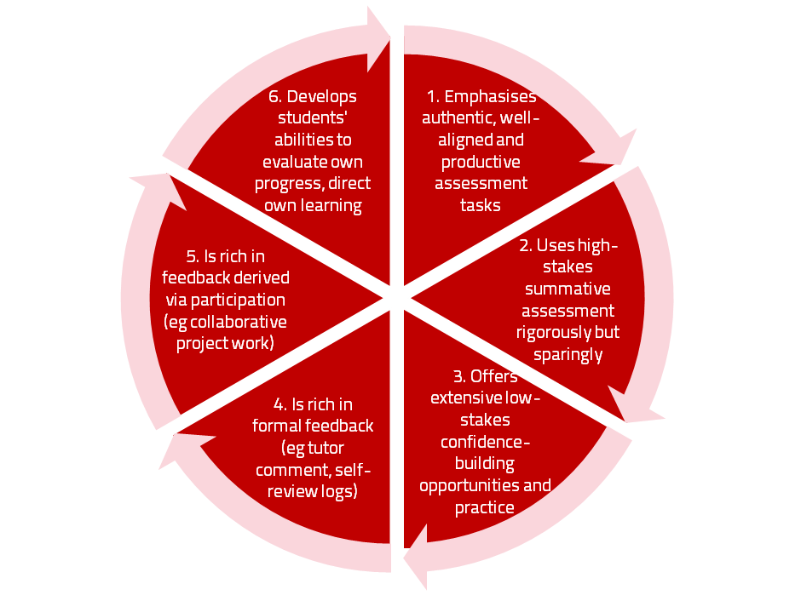
AfL the Northumbria model

Slide 12
Using assessment for learning (Sambell et al, 2013)
Assessment that is meaningful to students can provide them with a framework for activity;
“Students can escape bad teaching but they can’t escape bad assessment” (Boud, 1995);
Where assessment is fully part of the learning process and integrated within it, the act of being assessed can help students to make sense of their learning;
Assessment should be formative, informative, developmental and remediable.

Slide 13
Assessment for learning: some useful thoughts
1. Tasks should be challenging, demanding higher order learning and integration of knowledge learned in both the university and other contexts;
2. Learning and assessment should be integrated, assessment should not come at the end of learning but should be part of the learning process;
3. Students are involved in self assessment and reflection on their learning, they are involved in judging performance;
4. Assessment should encourage metacognition, promoting thinking about the learning process not just the learning outcomes;
5. Assessment should have a formative function, providing ‘feedforward’ for future learning which can be acted upon. There is opportunity and a safe context for students to expose problems with their study and get help; there should be an opportunity for dialogue about students’ work;

Slide 14
Assessment for learning
6. Assessment expectations should be made visible to students as far as possible;
7. Tasks should involve the active engagement of students developing the capacity to find things out for themselves and learn independently;
8. Tasks should be authentic; worthwhile, relevant and offering students some level of control over their work;
9. Tasks are fit for purpose and align with important learning outcomes;
10. Assessment should be used to evaluate teaching as well as student learning.
(Bloxham and Boyd)

Slide 15
For any assessment activity, we need to be clear about:
Aims: is this an early stage assignment, that is principally about building confidence and helping students see what is required of them, or is it a key element of their summative assessment, designment to gauge fitness to progress, or fitness-to-practice?
Scope: is this testing low level outcomes, like demonstrating recollection of key terms, or is it cognitively more demanding requiring synthesis of multiple elements, critical analysis, evaluation and reflection?
Scale: is this a small scale or a substantial task carrying a heavy weighting? Do students know how much effort and energy is needed to achieve at least a satisfactory level?
Orientation: Is the key aim to demonstrate the achievement of skills and competences, and/or to produce a definite product or is it primarily about demonstrating mastery of appropriate processes?
Constructive alignment: To what extent does the assessment closely link to the learning outcomes (and specifically the verbs used in them)?

Slide 16
The importance of dialogic feedback (Sadler, 2010)
Students need to be exposed to, and gain experience in making judgements about, a variety of works of different quality... They need planned rather than random exposure to exemplars, and experience in making judgements about quality. They need to create verbalised rationales and accounts of how various works could have been done better. Finally, they need to engage in evaluative conversations with teachers and other students.

Slide 17
Helping students better understand what is needed of them through anticipatory feedback
This can be achieved in a variety of ways, including:
Using games (like the Biscuit game) can help make students think hard about criteria and required outcomes;
Ensuring that briefings (in the form of documentation, and more importantly, live/ face-to-face briefings, where students can actively interrogate criteria) are useful;
Getting students to self-assess to start a feedback dialogue;
Using exemplars to show students what high quality work in this domain comprises, and what features and aspects are crucial for success.

Slide 18
Briefings for students: setting the context
Early-stage students are likely to need more reassurance in your briefings in which the tone of your language may be crucial;
We should aim for as much transparency as possible: no student should be having to guess what you are looking for at any stage of their academic careers;
Whenever we use what may be to them an unfamiliar format, briefings should be linked to trial-runs, risk-free rehearsals and Q&A opportunities to clarify any areas of misconceptions;
This is not ‘spoonfeeding’ but instead giving them the knives and forks to feed themselves!

Slide 19
Essential components of an effective assignment brief I would suggest include:
Housekeeping arrangements: when does it have to be completed? How must it be submitted? Are you setting limitations around format and layout (e.g. font size, margins, use of figures, tables etc)?
Clarifying the scope of the task: how big is the task? How many words? Approximately how much time would you intend an average student to spend on this work? How many and what kinds of references should they use?
Support: Where can students go for help? How much and what kind of support can they get? (e.g. checking drafts, proofreading);
Good academic conduct: what do they need to know about the appropriate levels of peer support? How might plagiarism regulations impact on them?
Choosing the right medium: is an oral or video briefing best? What kinds of documentary detail do they need? Is the briefing a dialogue or monologue?

Slide 20
What are exemplars, and how can we use them productively?
Exemplars are not model answers. They are carefully selected examples of authentic student work from previous cohorts (anonymised and with permission) or teacher-constructed examples (based on your extensive experience of the kinds of responses and common mistakes students make). They are chosen to typify and illustrate designated levels of quality or competence.
The concrete nature of exemplars means that they are able to convey messages in a way that nothing else can (Sadler, 2002). Carefully selected examples can not only help students to ‘see’ what the teacher expects with regard to the task in hand (Scoles et al, 2013), but also guide their action.

Slide 21
Exemplars can enable students to:
gain a feel for what the final product looks like in terms of layout, structure and language;
develop their insights into the nature of academic writing;
raise awareness of the diverse ways a task might fruitfully (or erroneously) be tackled;
hone students’ evaluative skills.
Act as powerful learning tools (Sadler, 2010), helping students gain insight into the nature of quality and standards, ideally through close analysis and discussion (Hendry et al, 2016). Students typically find exemplars to be more useful than standalone lists of criteria, grids and rubrics (Hawe et al, 2017).

Slide 22
What can we do when using exemplars?
Choose examples which will help students firmly grasp task requirements;
Help students practice applying criteria to samples of work;
Enable students to reflect deeply on, and discuss, what high quality work looks like;
Choose examples to promote self-efficacy;
Carefully orchestrate discussion activities to promote understanding of fruitful learning strategies and approaches;
Use exemplars-based activities to develop students’ skills to monitor their own work while they are producing it;
Help them rate their work by comparison with their peers.

Slide 23
3. Building a community of practice to ensure consistency of feedback across multiple markers
“Staff and students need to develop their own understandings of what is required from, and entailed in the assessment and feedback process. They are not passive recipients in the process, but will actively engage with it over time, building their knowledge and experience. A common understanding of the meanings of standards - both academic and professional- requires mutual trust and dialogue between staff and students”
A Marked Improvement (HEA) p 21

Slide 24
Constructing standards in the programme community (after O'Donovan, B., Price, M. and Rust, C., 2008.)
Where do you provide opportunities for staff to engage in dialogues about standards among staff?
How can you involve students in these dialogues?
How do you induct new staff members into your community of assessors?
How do you brief all staff assessing an assignment to ensure they are all assessing using the same standards?
How do you calibrate an individual’s standards with the group as a whole?
How do you identify assessors who deviate significantly from agreed standards and what do you do about them?
How can your external examiners help?

Slide 25
Firstly, are your students aware of all the processes and procedures we use to ensure fair assessment?
Do they know how we require assessors to match grades to achievement of assessment criteria?
Are they familiar with the steps we take to ensure inter-assessor reliability?
Do they understand that moderation processes are in place, for example through exam boards, to ensure that justice is done to each individual?
Do they get to hear about the work of external examiners (or even get to meet them?)?

Slide 26
Activity
You are asked to mark two simulated examples of student work;
A task involving assessment critical thinking was chosen as it is an area which both students and assessors often find challenging. (Brookfield (1987) and Bryan (2015) are both illuminating in this area);
You are asked in the first instance to read the criteria and mark the work individually, after which a discussion will follow;
Please provide brief feedback to each student, Aru and Tena.

Slide 27
Learning points from this activity?
The examples have been designed so that neither is either completely disastrous or stupendously good. Both have their flaws and it is in discussing the flaws that the facilitator can help assessors recognise that assessment is a complex, nuanced and demanding process, requiring the exercise of judgment by the assessors with outcomes that are rarely clear-cut.
In discussing what marks have been given, it is likely that these will vary significantly across the whole group, which can give rise to conversations about how best to ensure inter-assessor reliability and how to ensure everyone is marking to the same standard.

Slide 28
Advice on achieving consistency of marking when multiple markers are involved
Every assignment requires a ‘captain’ who is in charge of drafting the assignment, getting peer feedback on its feasibility and practicality, drafting the briefing for students in collaboration with peers and putting together the mark scheme and criteria, together with assessor guidance. This could comprise a rubric or notes on what assessors should be specially looking for. (It’s really helpful if this briefing can be in person, live or virtual)
The ‘captain’ should not always be the module leader especially if more than one assignment is used in a module;
The ‘captain’ is responsible for some level of scrutiny of the marking process, looking for anomalies and preparing a brief debrief for fellow assessors.

Slide 29
Ensuring consistency of feedback
It’s helpful if the assignment captain can provide guidance on the amount of feedback to be given by each assessor (word count or box size), the nature of the feedback and suggestions about resources that could be helpful for other assessors to mention (e.g. additional numeracy tasks to help students gain practice);
School agreement on tone of feedback and dos and don’ts is also very helpful (i.e. a focus on making feedback forward-looking (termed feed-forward by some), encouraging and avoiding final language which gives students nowhere to go.

Slide 30
Sample assignment return proforma
Criterion no | Criterion | Mark (0-5 marks) | Tutor comments and suggestions for further work | Student response
1 | Demonstrates ability to present information clearly logically, accurately and fluently | 3 | This work is written reasonably fluently but there are some typos that would not slip in if spell checker used properly. Also note you don’t use the definite and indefinite articles (‘a’ and ‘the’ appropriately: please refer to the language guidance 17.3 on the VLE | This is something I’ve had problems with over the years but am still working on it
2 | Demonstrates ability to choose and use appropriate software | 5 | Made excellent choices and used it well to suit the context of the problem being addressed | Thank you
3 | Demonstrates ability to use a range of reference materials and cite them appropriately | 1 | Cited only one reference and did so inaccurately Please refer to the referencing guide on the VLE and ensure that you provide all the information required | I've checked it out and see where I was going wrong

Slide 31
4. Ensuring fairness in assessed group activities and presentations
Unfairness in assessment is one of the most complained-about areas in student feedback, especially NSS, and often results from some students perceiving others to be not ‘pulling their weight’;
Fellow students are more understanding of poor contributors if they know there is a good reason for it;
It is a key responsibility for assessors and assessment captains to set up assessed group activities in ways that mitigate against poor group behaviour, and establishing shared ground rules is a crucial part of this.

Slide 32
Implicit values in group work
Respect for the opinions and viewpoints of others, listening and responding appropriately:
An agreement to take turns rather than excessive domination by individuals;
Respect for valid reasoning. The ability to detect poor argument and to engage in respectful dialogue;
A commitment to regular attendance and to cooperation with others in independent group work involving debate and dialogue;
Consensus that a fairly-agreed course of action will be stood by under the principle of collective responsibility;
A commitment to shared reflection on course processes.
(adapted from Foreman-Peck and Winch, 2010)

Slide 33
Why get students working in small groups?
Teaching in small groups requires a range of skills different from those used in lecturing, particularly in terms of managing student inputs and activities. Group size and means of formation can influence student behaviors, hence the importance of tutor choices.
Effective tutoring can engender positive student behaviours and study habits, to ensure that all students are well prepared as learners.
Most employers expect graduates to be able to perform well in team situations, and so effective in-course support for skills development is key.

Slide 34
Group work to encourage learning
Working in small groups can be a highly effective means of engendering learning particularly when purposeful and systematic approaches are used;
Students frequently quite like being involved in group tasks, but often don’t like being assessed as a member of a group as they often see it as unfair;
When you ask students years after they have finished university what they found their most memorable experiences, group work often features in both positive and negative comments.

Slide 35
Ten steps for effective assessed group work
In the initial briefings, emphasise not just what is to be achieved and how it is to be assessed, but also the rationale for both doing group work and assessing it;
Provide references to research literature on the value placed on group work by employers and graduates;
Ensure that the criteria for assessment are transparent, logical, constructively aligned and reward good group behaviour;
Ensure the tasks you give them are authentic and meaningful;

Slide 36
Ten stages of effective assessed group work (continued)
Provide risk-free rehearsal opportunities so that students can make mistakes in a safe environment;
Offer dialogic opportunities for students to ask questions and clarify potential misunderstandings;
Make it clear that sorting out group dysfunction is part of the task;
Offer the services of an ‘ombudsperson’ to provide arbitration as necessary;
Debrief at the end of the task and the assessment process so students recognise how the marks have been achieved.
Clarify what are the values that underpin your group assessment process.

Slide 37
How are you going to set up group work: 7 strategies for assessing students in groups
If the task is small and early and the weighting of marks in relation to the overall module mark is minor, give the students a group mark with no differentiation (but then talk to them about the implications of this);
Break up the group task into separate equivalent elements and assess students individually on these tasks;
Give an overall mark to the group assignment, but give each student an additional individual task (for example, a reflection) to differentiate effort;
Give an overall mark to the group assignment outcome, and then viva the students individually on their learning from the task;

Slide 38
Strategies for assessing students in groups
Give an overall mark to the group assignment outcome, and then set an exam question at the end of the module to enable students individually to demonstrate their learning from the group task.
Give an overall mark to the group assignment outcome and then get students to additionally peer assess each other’s contribution to the group task using agreed criteria like active engagement in the task, the ability to facilitate the participation of others, commitment to group success etc.
Give an overall mark to the group assignment outcome, divide that mark by the number of students in the group and then ask the students to decide whether each student in the group merits the average mark, the average +1 or +2 or the average -1 or -2.
(Brown, Rust and Gibbs, (1994) Strategies for Diversifying Assessment)

Slide 39
Involving students in assessing peers in groups: Why?
Available research indicates that involving students in their own assessment makes them better learners (deep not surface learning);
If students feel they can get away with a free ride, then engagement may be harder to promote;
Assessing group participation really needs the involvement of peers to be meaningful;
Students can get inside the criteria and start to work out what they really mean in practice.

Slide 40
However:
Criteria need to be explicit and clear to all concerned from the outset;
Assessment must use evidence matched against the criteria;
Students and staff need training and rehearsal before it is implemented ‘for real’;
Rehearsal implies having the opportunity to practice giving marks and feedback in a non-threatening and supportive environment where issues can be raised and discussed freely and productively.

Slide 41
5. Demonstrating progression across the three years of assessed tasks (n.b. this is not easy!)
Many UK universities learned from the experiences at Alverno College (Mentowski, 2006), which proposes that in skills and capabilities, just as in knowledge, our assignments should demonstrate progression of achievement over the length of a programme;
This suggests that our criteria for assessment outputs like presentations and posters should require more from students in the final year than from novices;
These should be reflected in the learning outcomes at different levels as well as in the assessment criteria and guidance (‘range statements’) for each assignment;
Can the SQF verbs/phrases be useful (handout)? Or can Bloom’s verbs be helpful? (Knowledge, application, comprehension, analysis, synthesis and evaluation).
Notes:
Scottish Qualifications Framework suggested verb/phrases on p59 ENU Assessment Handbook

Slide 42
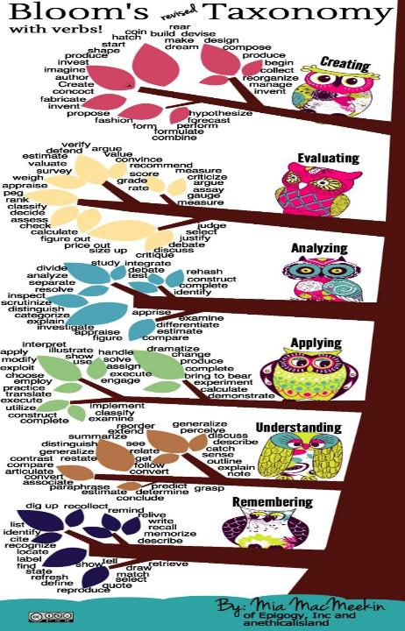

Slide 49
Task 1: typical criteria for a group presentation might include:
Clarity of ideas expressed;
Evidence of team work and group contributions;
Accuracy of content matter;
Appropriate use of audio-visual aids;
Succinct expression of theory underpinning the content;
Effective information management and appropriate referencing;
Effective presentation techniques (clear speaking, confidence, interaction with audience, ability to respond appropriately to questions etc).
In small groups, discuss what differences you would expect to see at each of the three levels of the programme. Draft short guidance notes for students and fellow assessors.

Slide 50
Task 2: typical criteria for a group poster might include:
Visual impact (e.g. use of images, colour, etc)
Appropriate balance of graphics and text;
Clarity of ideas expressed;
Evidence of team work and group contributions;
Accuracy of content matter;
Succinct expression of theory underpinning the content;
Effective information management and appropriate referencing.
In small groups, discuss what differences you would expect to see at each of the three levels of the programme. Draft short guidance notes for students and fellow assessors.

Slide 51
Some thoughts on levels of expectations for presentations and posters
Think through in advance inclusive practice requirements (e.g., for a student with notified special needs requiring reasonable adjustments, can students contribute a video rather than a live contribution?);
Note that there are cultural implications for presentations e.g. in many cultures, making direct eye confidence with strangers or superiors is unacceptable;
Aim to seek reasonable evidence for each level (e.g. “ability to answer questions that go beyond the scope of the presentation with confidence and authority” is probably a PhD level requirement rather than a final year undergraduate one!);
Try to avoid simple comparators (“adequate”, “good” “excellent”).

Slide 52
Ask us anything
In this section, we are happy to take any questions about the processes and practicalities of assessment and feedback.

Slide 53
Use link below to download the materials on feedback and assessment produced in 2017-18 by Kay Sambell, Sally Brown and Phil Race for Edinburgh Napier University
https://staff.napier.ac.uk/services/dlte/Pages/QuickGuides.aspx

Slide 54
Useful references: 1
Assessment Reform Group (1999) Assessment for Learning: Beyond the black box, Cambridge UK, University of Cambridge School of Education.
Bain, K. (2004) What the best College Teachers do, Cambridge: Harvard University Press.
Biggs, J. and Tang, C. (2011) Teaching for Quality Learning at University, Maidenhead: Open University Press.
Bloxham, S. and Boyd, P. (2007) Developing effective assessment in higher education: a practical guide, Maidenhead, Open University Press.
Bloom, B.S., 1956. Taxonomy of educational objectives. Vol. 1: Cognitive domain. New York: McKay, pp.20-24.
Boud, D. (1995) Enhancing learning through self-assessment, London: Routledge.
Boud, D. and Associates (2010) Assessment 2020: seven propositions for assessment reform in higher education Sydney: Australian Learning and Teaching Council.

Slide 55
Useful references: 2
Brown, S. (2012) Assimilate compendium, Leeds, Leeds Met Press
Brown, S. (2012) ‘What are the perceived differences between assessing at Masters level and undergraduate level assessment? Some findings from an NTFS–funded project’ Innovations in Education and Teaching International, forthcoming
Brown, S., Deignan, T. Race, P. and Priestley, J. (2012) ‘Assessing students at Masters Level: learning points for Educational Developers’ Educational Developments, SEDA, Birmingham.
Brown, S (2012) ‘Diverse and innovative assessment at Masters Level: alternatives to conventional written assignments’ in AISHE-J: The All Ireland Journal of Teaching and Learning in Higher Education Vol 4, No 2.
Brown, S. (2014) Learning, teaching and assessment in higher education: global perspectives. London: Palgrave Macmillan.

Slide 56
Useful references: 3
Brown, S. and Glasner, A. (eds.) (1999) Assessment Matters in Higher Education, Choosing and Using Diverse Approaches, Maidenhead: Open University Press.
Brown, S. and Knight, P. (1994) Assessing Learners in Higher Education, London: Kogan Page.
Brown, S. and Race, P. (2012) Using effective assessment to promote learning in Hunt, L. and Chambers, D. (2012) University Teaching in Focus, Victoria, Australia, Acer Press. P74-91
Brown, S. Rust, C. & Gibbs, G. (1994) Strategies for Diversifying Assessment, Oxford: Oxford Centre for Staff Development.

Slide 57
Useful references: 4
Carless, D., Joughin, G., Ngar-Fun Liu et al (2006) How Assessment supports learning: Learning orientated assessment in action Hong Kong: Hong Kong University Press.
David Carless & David Boud (2018): The development of student feedback literacy: enabling uptake of feedback, Assessment & Evaluation in Higher Education, DOI:10.1080/02602938.2018.1463354
Carroll, J. and Ryan, J. (2005) Teaching International students: improving learning for all. London: Routledge SEDA series.
Crooks, T. (1988) Assessing student performance, HERDSA Green Guide No 8 HERDSA (reprinted 1994).
Crosling, G., Thomas, L. and Heagney, M. (2008) Improving student retention in Higher Education, London and New York: Routledge.
O'Donovan, B., Price, M. and Rust, C., 2008. Developing student understanding of assessment standards: A nested hierarchy of approaches. Teaching in Higher Education, 13(2), pp.205-217.

Slide 58
Useful references: 5
Foreman-Peck, L. and Winch, C. (2010) Using Educational Research to Inform Practice: A Practical Guide to practitioner research in universities and colleges. London: Routledge
Gibbs, G. (1999) Using assessment strategically to change the way students learn, in Brown S. & Glasner, A. (eds.), Assessment Matters in Higher Education: Choosing and Using Diverse Approaches, Maidenhead: SRHE/Open University Press.
Higher Education Academy (2012) A marked improvement; transforming assessment in higher education, York: HEA.
Hounsell, D. (2008). The trouble with feedback: New challenges, emerging strategies, Interchange, Spring, Accessed at www.tla.ed.ac.uk/interchange.
Knight, P. and Yorke, M. (2003) Assessment, learning and employability Maidenhead, UK: SRHE/Open University Press.

Slide 59
Useful references: 6
McDowell, L. and Brown, S. (1998) Assessing students: cheating and plagiarism, Newcastle: Red Guide 10/11 University of Northumbria.
Mentkowski, M. and associates (2000) p.82 Learning that lasts: integrating learning development and performance in college and beyond, San Francisco: Jossey-Bass.
Meyer, J.H.F. and Land, R. (2003) ‘Threshold Concepts and Troublesome Knowledge 1 – Linkages to Ways of Thinking and Practising within the Disciplines’ in C. Rust (ed.) Improving Student Learning – Ten years on. Oxford: OCSLD.
Morgan, C., Dunn, L., Parry, S. and O'Reilly, M. (2004) The student assessment handbook: New directions in traditional and online assessment, London, Routledge.

Slide 60
Useful references: 7
Mentowski, M,. (2006) Accessible and adaptable elements of Alverno assessment-as-learning: Strategies and Challenges for peer Review in Innovative Assessment in Higher Education: ed. Cordelia Bryan and Karen Clegg: London: Routledge, pp48-63)
Newstead, S. E., Franklyn-Stokes, A., & Armstead, P. (1996) Individual differences in student cheating, Journal of Educational Psychology, 88(2), 229-241
Nicol, D. J. and Macfarlane-Dick, D. (2006) Formative assessment and self-regulated learning: A model and seven principles of good feedback practice, Studies in Higher Education Vol 31(2), 199-218.
PASS project Bradford http://www.pass.brad.ac.uk/ Accessed November 2013.
Peelo, M. T., & Wareham, T. (Eds.). (2002). Failing students in higher education. Society for Research into Higher Education.
Pickford, R. and Brown, S. (2006) Assessing skills and practice, London: Routledge.

Slide 61
Useful references: 8
Race P. (2020) The lecturer’s toolkit (5th edition), London: Routledge.
Race, P. (2001) A Briefing on Self, Peer & Group Assessment, in LTSN Generic Centre Assessment Series No 9, LTSN York.
Race, P. (2014) Making learning happen: 3rd edition, London: Sage.
Rotheram, B. (2009) Sounds Good, JISC project http://www.jisc.ac.uk/whatwedo/programmes/usersandinnovation/soundsgood.aspx
Rust, C., Price, M. and O’Donovan, B. (2003) Improving students’ learning by developing their understanding of assessment criteria and processes, Assessment and Evaluation in Higher Education. 28 (2), 147-164.

Slide 62
Useful references: 9
Ryan, J. (2000) A Guide to Teaching International Students, Oxford Centre for Staff and Learning Development.
Sadler, D. R. (2010) Beyond feedback: Developing student capability in complex appraisal. Assessment & Evaluation in Higher Education, 35(5), 535-550.
Sambell, K., McDowell, L & Montgomery, C. (2013) Assessment for Learning in Higher Education. Routledge.
Seymour, D. (2005) Learning Outcomes and Assessment: developing assessment criteria for Masters-level dissertations. Brookes eJournal of Learning and Teaching 1(2).
Winstone, N. and Carless, D. (2020) ‘Designing effective feedback processes in Higher Education: a learning-focussed approach’ Routledge London and New York
Yorke, M. (1999) Leaving Early: Undergraduate Non-completion in Higher Education, London: Routledge.

