Slide 1
Assessment and feedback
Solent University
28th November 2019
Sally Brown NTF, PFHEA, SFSEDA
@ProfSallyBrown http://sally-brown.net
Phil Race, NTF, PFHEA
phil@phil-race.co.uk http://phil-race.co.uk

Slide 2
Central to student satisfaction, retention and positive regard for our programmes are excellent curriculum design delivery and assessment.
This needs to be developed strategically using contemporary evidence-based approaches and research-informed principles, involving a constructively aligned programme level cycle comprising:
Determining and reviewing subject material: reviewing currency, relevance, level;
Designing and refining learning outcomes, which are the lifeblood of learning;
Considering delivery modes including face-to-face, online, PBL, and blended approaches;
Thinking through student support to maximise engagement;
Designing fit-for-purpose assessment methods and approaches;
Assuring quality, matching HEI, national and PRSB requirements;
Evaluating programmes, exploring strengths and areas for improvement;
Enhancing quality, seeking continuous improvement.

Slide 3
Designing assessment as a central part of curriculum design
Assessment is a complex, nuanced and highly important process​ and if we want students to engage fully, we must make it really meaningful to them and convince them that there is merit in the activities we ask them to undertake. To focus students’ effort and improve their engagement with learning, we need to take a fresh look at our current practice to make sure assessment is for rather than just of learning, with students learning while they are being assessed rather than it being merely a summative end process. We also need to ensure that we make assessment practices and the giving of feedback manageable for staff and valuable for students.

Slide 4
Determining and reviewing subject material: currency, relevance, level
Enhancing quality, seeking continuous improvement
Designing and refining learning outcomes
Evaluating programmes, strengths and areas for improvement
Curriculum
Design
Essentials
Considering delivery modes: face-to-face, online, PBL, blended…
Assuring quality, matching HEI, national and PRSB requirements
Thinking through student support
Designing fit for purpose assessment methods and approaches

Slide 6
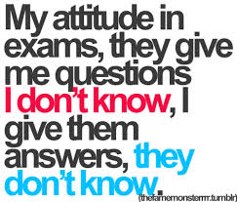
Attitude
is important

Slide 7
Are your learning outcomes SMART or VASCULAR? The usual ‘requirements’ are that they be:
Specific;
Measurable;
Achievable;
Realistic;
Time constrained.
Instead let’s make them VASCULAR
https://www.youtube.com/watch?v=3fWvtbojDfA&feature=youtu.be

Slide 8
Peter Hartley’s NTFS Bradford-led project on Programme Level Assessment
It set out to focus on redressing problems including:
not assessing learning outcomes holistically at a programme level;
the atomisation of assessment, often resulting in too much summative and not enough formative feedback and over-standardisation in regulations.
This results in students and staff failing to see the links between disparate elements of the programme, over-assessment and multiple assignments using repetitive formats.
Modules were often too short for complex learning and this tended to lead to surface learning and ‘tick-box’ mentality.

Slide 9
What do we mean by Programme Focused Assessment?
“The first and most critical point is that the assessment is specifically designed to address major programme outcomes rather than very specific or isolated components of the course. It follows then that such assessment is integrative in nature, trying to bring together understanding and skills in ways which represent key programme aims. As a result, the assessment is likely to be more authentic and meaningful to students, staff and external stakeholders.”
Chris Rust. See also PASS project at http://www.pass.brad.ac.uk/position-paper.pdf

Slide 10
Programme Focused Assessment: potential benefits include:
Integrated learning and assessment at the meta-level, ensuring assessment of programme outcomes.
Students taking a deep approach to their learning.
Increased self and peer-assessment, developing assessment literacy.
Greater responsibility of the student for their learning and assessment, developing self-regulated learners.
The possibility of slow learning.

Slide 11
Mapping progression
Is there a coherent model of progression across the student life-cycle from induction to ‘outduction’?
Do you manage transitions from year one to year two and year two to year three to ensure students remain committed and engaged?
Is there some continuity in the sources of student support throughout the course (e.g. personal tutors)?
Are students offered support and guidance in relation to personal development and employability?

Slide 12
The concept of universal design
“Instead of retrofitting curriculum for students via accommodations and modifications, the principles of UDL prompt teachers to design curriculum that is flexible and adaptable to multiple forms of learning and engagement to facilitate the learning of all students.” (Lancaster, 2008)
“The ‘universal’ in UDL does not mean there is a single optimal solution for everyone. Instead, it underscores the need for flexible approaches to teaching and learning that meet the needs of different kinds of learners. ” (Rose and Meyer, 2006)

Slide 13
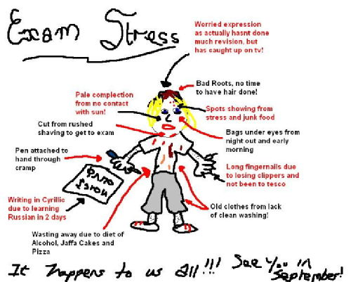
Exam stress affects different people in different ways

Slide 14
VASCULAR learning outcomes
Verifiable: Can we tell when they’ve been achieved? And can students?
Action orientated: Do they lead to real and useful activity?
Singular: i.e. not portmanteau outcomes combining two or more into one, making it difficult to assess if differently achieved, but readily matchable to student work produced?
Constructively aligned? (Biggs and Tang, 2011) so that there is clear alignment between aims (What do students need to be able to know and do?), what is taught/ learned, how these are assessed and evaluated);
Understandable i.e. using language codes that are meaningful to all stakeholders?
Level-appropriate? Suitable and differentiable between1st year, 2nd year, 3rd year, Masters, other PG?
Affective-inclusive i.e. not just covering actions but capabilities in the affective domain?
Regularly reviewed? Not just stuck in history and always fit-for-purpose.

Slide 15
Phil Race is concerned we need to go beyond learning outcomes and include:
Learning incomes: all the things learners are bringing to the learning situation:
Emergent learning outcomes: those we didn’t (and maybe couldn’t) predict, which may surprise and astound us!:
Intended learning outgoings: helping them link the intended learning outcomes to the wider world of future learning and employment;
See http://phil-race.co.uk/2018/05/beyond-learning-outcomes/

Slide 16
Enhancing Assessment and Feedback
Effective assessment is crucial for student satisfaction and achievement. This session will explore how we can review and revise our assessment approaches so that students have the best possible chance of success, particularly by:
building students' assessment literacy and thereby enabling them better to understand how criteria and assessment practices work;
ensuring that assessment is for not just of learning;
fostering approaches to feedback that mean students take good note of and use the comments and advice provided by their assessors.
By the end of the session, participants will have had opportunities to come to grips with typical problematic aspects of assessment and feedback, and to devise strategies to ensure their own practices and approaches are fit-for-purpose and manageable by students and themselves.

Slide 17
Underpinning premises for A4L
Assessment can be a powerful means of focusing student effort and enhancing achievement if it is well designed and constructively aligned (Biggs and Tang, 2011);
We need to deploy a diverse range of tactics to our assessment and feedback to ensure that they work to enhance and extend student learning;
Students need to achieve assessment literacy to ensure they understand and can benefit from our assessment systems;
Assessment needs to be manageable for staff and students if it is going to engage students in learning activities.

Slide 18
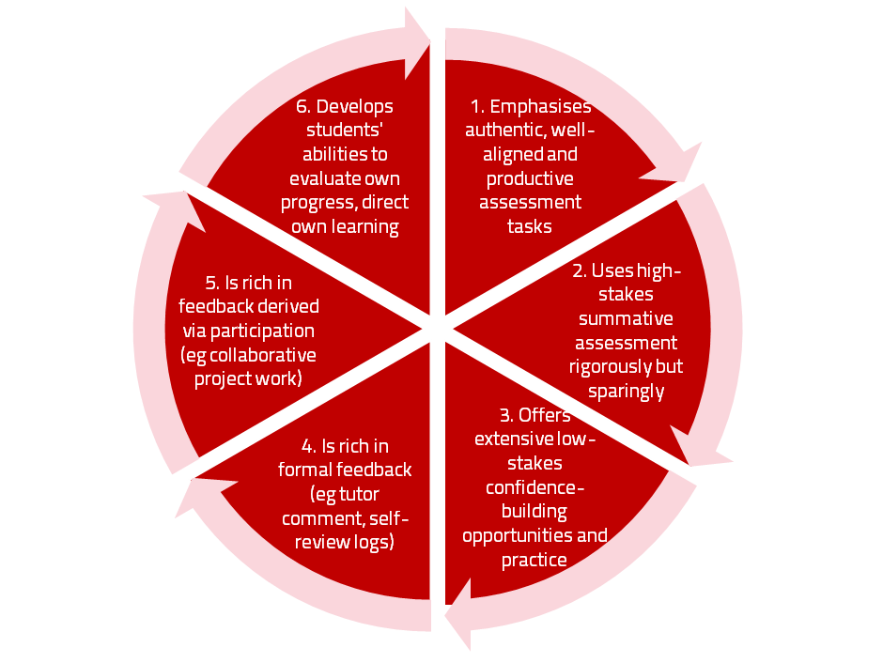
A4L the Northumbria model

Slide 19
Using assessment for learning (Sambell et al, 2012)
Assessment that is meaningful to students can provide them with a framework for activity;
“Students can escape bad teaching but they can’t escape bad assessment” (Boud, 1995);
Where assessment is fully part of the learning process and integrated within it, the act of being assessed can help students to make sense of their learning;
Assessment should be formative, informative, developmental and remediable.

Slide 20
Assessment for learning: some useful thoughts
1. Tasks should be challenging, demanding higher order learning and integration of knowledge learned in both the university and other contexts;
2. Learning and assessment should be integrated, assessment should not come at the end of learning but should be part of the learning process;
3. Students are involved in self assessment and reflection on their learning, they are involved in judging performance;
4. Assessment should encourage metacognition, promoting thinking about the learning process not just the learning outcomes;
5. Assessment should have a formative function, providing ‘feedforward’ for future learning which can be acted upon. There is opportunity and a safe context for students to expose problems with their study and get help; there should be an opportunity for dialogue about students’ work;

Slide 21
Assessment for learning
6. Assessment expectations should be made visible to students as far as possible;
7. Tasks should involve the active engagement of students developing the capacity to find things out for themselves and learn independently;
8. Tasks should be authentic; worthwhile, relevant and offering students some level of control over their work;
9. Tasks are fit for purpose and align with important learning outcomes;
10. Assessment should be used to evaluate teaching as well as student learning.
(Bloxham and Boyd)

Slide 22
My fit-for-purpose model of assessment: the key questions
Why are we assessing?
What is it we are actually assessing?
How are we assessing?
Who is best placed to assess?
When should we assess?
Notes:
22

Slide 23
For any assessment activity, we need to be clear about:
Aims: is this an early stage assignment, that is principally about building confidence and helping students see what is required of them, or is it a key element of their summative assessment, designment to gauge fitness to progress, or fitness-to-practice?
Scope: is this testing low level outcomes, like demonstrating recollection of key terms, or is it cognitively more demanding requiring synthesis of multiple elements, critical analysis, evaluation and reflection?
Scale: is this a small scale or a substantial task carrying a heavy weighting? Do students know how much effort and energy is needed to achieve at least a satisfactory level?
Orientation: Is the key aim to demonstrate the achievement of skills and competences, and/or to produce a definite product or is it primarily about demonstrating mastery of appropriate processes?
Constructive alignment: To what extent does the assessment closely link to the learning outcomes (and specifically the verbs used in them)?

Slide 24
In the exam room you’re on your own

Slide 25
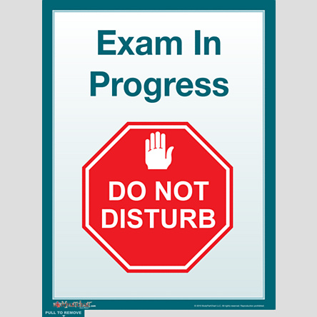
Peace and quiet at last!

Slide 26
So to help us focus on assessment criteria and developing students’ assessment literacy, a game!
This game is designed to help you think about how we can explain the importance of taking assessment criteria seriously in assessment to help students really understand what they need to do to succeed;
Biscuits are a metaphor!

Slide 28
Thinking through the issues raised in the biscuit game
It is often useful to start from individual perspectives at the outset of an assignment and clarify preconceptions;
Assessment is a complex nuanced task with grey areas, and just as agreed definitions of biscuits are not always readily achievable, so also assignments benefit from dialogue to clarify expectations;
Category definitions can sometimes be complicated when setting assignments. It’s helpful in advance of an assessment to agree definitions of what is, for example, a portfolio;
It’s helpful to face the fact that although criteria may be considered to be explicit, the way people grade using criteria can differ substantially;
Assigning grades is an imprecise and inexact activity, and we need to recognise that absolute certainty about grades is not always achievable;
Generic discussion about assessment, and how we grade can help develop assessment literacy.

Slide 29
Formative and summative assessment
Formative assessment is primarily concerned with feedback aimed at prompting improvement, is often continuous and usually involves words.
Summative assessment is concerned with making evaluative judgments, is often end point and involves numbers.

Slide 30
The importance of dialogic feedback (Sadler)
Students need to be exposed to, and gain experience in making judgements about, a variety of works of different quality... They need planned rather than random exposure to exemplars, and experience in making judgements about quality. They need to create verbalised rationales and accounts of how various works could have been done better. Finally, they need to engage in evaluative conversations with teachers and other students.

Slide 31
Assessment literacy: students do better if they can:
Make sense of key terms such as criteria, weightings, and level;
Encounter a variety of assessment methods (e.g. presentations, portfolios, posters, assessed web participation, practicals, vivas etc) and get practice in using them;
Be strategic in their behaviours, putting more work into aspects of an assignment with high weightings, interrogating criteria to find out what is really required and so on;
Gain clarity on how the assessment regulations work in their HEI, including issues concerning submission, resubmission, pass marks, condonement etc.

Slide 32
Students tend to be more convinced about the fairness of the assessment process if
Requirements and procedures are transparent and made readily available to them;
They believe that the tasks they are asked to do are worthwhile and are closely linked to what course documentation indicates they should be able to know and do at the end of the programme i.e. authentic assessment;
They fully understand the ‘rules of the game’.

Slide 33
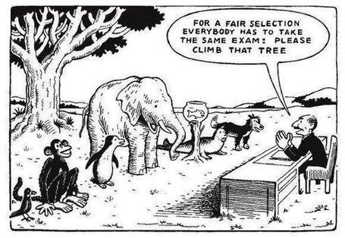

Slide 34
Do your international students understand UK assessment approaches?
Have you clarified the ground rules on issues like pass marks, criterion-referenced assessment and grading systems?
Have you explained how extensions, condonements, and university assessment regulations work?
Are the assignments built around a curriculum international in scope and content? Are tasks and case studies globally orientated?

Slide 35
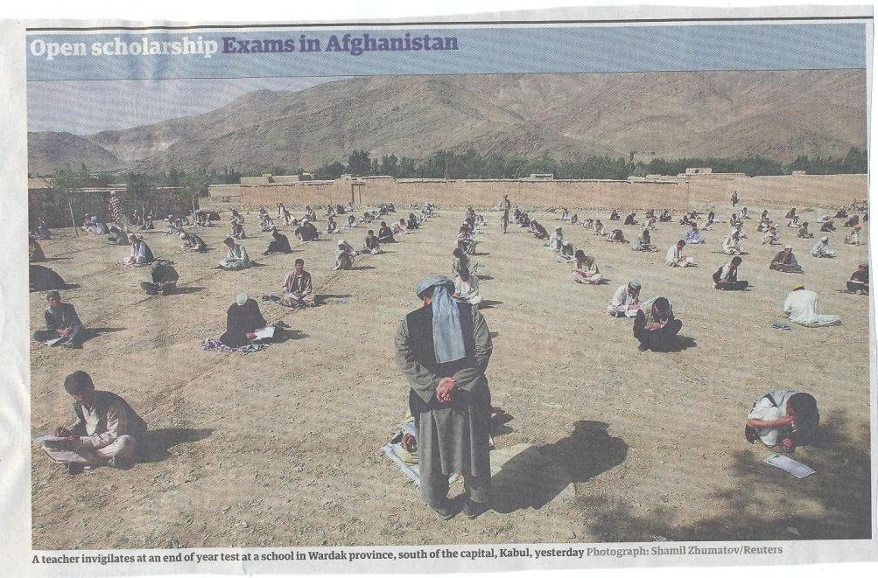

Slide 36
What do we mean by ‘traditional assessment formats”?
At least 80% of UK higher education assessment uses three main forms;
Unseen time constrained exams of some sort;
Essays where students respond to a stimulus question or title;
Reports of some kind.
These are not necessarily authentic or useful means of assessing students knowledge, capabilities and understanding.

Slide 37
Authentic assessment: what are the principal benefits for stakeholders?
Students undertaking authentic assessments tend to be more fully engaged in learning and hence tend to achieve more highly because they see the sense of what they are doing (Sadler, 2005).
University teachers adopting authentic approaches can use realistic and live contexts within which to frame assessment tasks, which help to make theoretical elements of the course come to life.
Employers value students who can quickly engage in real-life tasks immediately on employment, having practiced and developed relevant skills and competences through their assignments.

Slide 38
Wiggins (1990) says assessment can be regarded as authentic if we can draw valid inferences about quality from the work students produce
He proposes that we should aim to offer students assignments that present the student with the full array of tasks that mirror the priorities and challenges found in the best [teaching] activities and that attend to whether the student can craft polished, thorough and justifiable answers, performances or products.
He says they must involve students being able to cope with potentially ill-structured challenges and roles, with incomplete information, that help them rehearse for the complex ambiguities of adult and professional life.

Slide 39
We often assess what is easy to assess, or proxies of what’s been learned, rather than the learning itself
A valid assessment is one that has close relevance to the criteria, which are in turn constructively aligned to the stated learning outcomes of a programme.
Effective assessment is highly relevant to ensuring that graduates can demonstrate the knowledge, behaviours, qualities and attributes that were described in the course outline or programme specification.
Assignments that require students to write about something, rather than be or do something, may not always be fit-for-purpose.

Slide 40
How can authentic assessment engage students?
Using types of assessment that are much more like the ‘real things’ that academics or professionals do in their chosen fields can engage students in much more meaningful ways.
A useful way to help you ascertain how authentic your assessment is could be to ask yourself where in the programme you help students answer questions in job interviews (Sambell, Brown and Graham, 2017)

Slide 41
Questions employers might ask at interview that might help us frame some of our assignments
Can you tell us about an occasion when:
you worked together with colleagues in a group to produce a collective outcome;
you had to work autonomously with incomplete information and self-derived data sources;
you developed strategies to solve real life problems and tested them out;
you had a leadership role in a team, and could you tell us your strategies to influence and persuade your colleagues to achieve a collective task;
you had to communicate outcomes from your project work orally, in writing, through social media and/or through a visual medium?"

Slide 42
Diverse format assignments for authenticity could include:
Simulations (paper-based or computer-based) .
Multiple choice questions , with subsequent questions seeking out rationales for answers.
Scripts for Business/Elevator pitches.
Case studies for interrogation.
The requirement to write executive summaries of complex documents.
Reports of Project outputs.
Action plans based on project activity undertaken.
In-tray exercises where students are required to prioritise and use a variety of documents, graphs, tables etc in real time.
Short-answer questions which can be marked electronically.
Reflective commentaries of practical experience. Critical incident accounts, where students are asked, for example following a placement or project, to write say 200 words on Context, Action taken, Rationale for action, Literature review guiding choice of action, Report of outturn, Indication of what has been learned and what would be done differently next time.

Slide 43
Feed-forward
Language of feedback
Some feedback
issues
National Student Survey
Timing:
24-hours!
Written, printed,
on-screen
Efficiency
Face to face
oral

Slide 44
Standing on the shoulders of giants
The paradigms addressed are reflected in the ongoing work of David Carless, Naomi Winstone and David Nicol on feedback literacy and dialogues, the work of Phil Newton and Philip Dawson on addressing contract cheating and plagiarism in the digital age, and the ‘VASCULAR’ approach of breathing new life into the use of learning outcomes by Sally Brown.

Slide 45
5 References to feedback resouces
Brown, S. (2019) Invigorating the curriculum with VASCLULAR learning outcomes SEDA blog, accessible via https://sally-brown.net/2019/03/08/invigorating-the-curriculum-with-vascular-learning-outcomes/ (accessed November 2019)
Carless, D and Boud, D. (2018) The development of student feedback literacy: enabling uptake of feedback, Assessment & Evaluation in Higher Education, https://doi.org/10.1080/02602938.2018.1463354 (Accessed November 2019)
Nicol, D. (2010) From monologue to dialogue: improving written feedback processes in mass higher education. Assessment & Evaluation in Higher Education, 35(5), 501-517.
Race, P. (2020) The Lecturer’s Toolkit: 5th edition, London: Routledge.
Winstone and Carless (2019) Designing effective feedback processes in higher education, - a learning focused approach, London: Routledge.

Slide 46
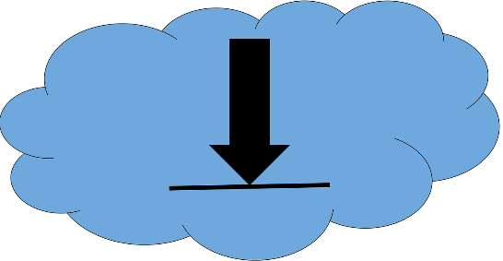
You can download free much of my published work
http://phil-race.co.uk/2016/04/updated-powerpoint-ripples-model/ (Chapter 1 from ‘The Lecturer’s Toolkit 2015)
https://phil-race.co.uk/2016/10/lthe-tweetchat-lthechat-wed-oct-19-8-00-9-00-pm/ (feedback stuff from my most recent two books)
https://phil-race.co.uk/2018/02/feedback-feedforward-just-tips-including-students/ (just the feedback tips!)
http://phil-race.co.uk/2015/01/assessment-bits-new-editions/ (extracts on assessment)
http://phil-race.co.uk/2017/05/lectures-and-learning/ (extracts on lecturing)

Slide 47
The three questions always in each student’s mind…
What will I be expected to show for this?
What does a good one look like and a bad one?
Where does this fit into the big picture?

Slide 48
Addressing the 2020s: Eight concurrent, related paradigm shifts
Online information and the internet now just normal, ‘digital’ has now ‘grown up’, and is no longer something different.
More attention to learning, rather than teaching.
Less focus on classes as ‘transmission’ occasions.
Learning-centred approach to assessment of student outcomes.

Slide 49
Addressing the 2020s: Eight concurrent, related paradigm shifts
Greater focus on feedback dialogues, and development of feedback literacy by students.
Increased recognition of the skills, attitudes and behaviours graduates need to be work-ready.
Responsibility of institutions to prepare students for active citizenship in their own communities, nations and globally.
Increased recognition of the need for teaching staff to be trained, qualified and accredited as teachers.

Slide 50
Teaching, learning and enthusiasm
Knowledge isn’t infectious (unfortunately) but enthusiasm is, and we need to help our students to catch enthusiasm.
We certainly don’t want teaching, assessment or feedback to damage that enthusiasm.

Slide 52
How students really learn
http://phil-race.co.uk/2016/04/updated-powerpoint-ripples-model/ (including Chapter 1 from ‘The Lecturer’s Toolkit 2015 – not much changed in new edition).

Slide 53
Ripples on a pond….
Enhance our students’ want to learn?
Help students to develop ownership of the need to learn?
Keep students learning by doing, practice, trial-and-error, repetition?
Ensure students really use feedback – from us and from each other?
Help students to make sense of what they learn?
Get students deepening their learning by verbalising, explaining things to each other, and to us?
Allow students to deepen their learning by assessing their own learning, and assessing others’ learning – making informed judgements?
What else can we do to use
teaching, assessment and feedback to:
Verbalising
Assessing
making informed judgements
Wanting/
Needing
Doing
Doing
Making sense
Feedback

Slide 54
Thanks, Dr Paul Kleiman

Slide 55
What will I be expected to show for this?
What does a good one look like, and a bad one?
Where does this fit into the big picture?
When explaining assessment criteria to students, and when linking these to evidence of achievement of the intended learning outcomes, we need to make the most of face-to-face whole group contexts and...
Tone of voice
Body language
Facial expression
Eye contact
The chance to repeat things
The chance to respond to puzzled looks
Some things don’t work nearly so well just on paper or on screens.
Some of the
tools we can
use in
face-to-face
contexts

Slide 56
Feedback
Formative, helping to shape and improve future performances, that is Feed-forward;
Energising: helping students to feel motivated and inclined to work towards Enhancement;
Efficient: enabling you to maximise your helpful commentary while minimising your Effort;
Dialogic, involving interaction with and between students, plus Developmental comments;
Benevolent: students should Believe you have their Best interests at heart;
Action-orientated: that is leading students to Actually Advancing their Achievement;
Constructive rather than destructive, taking note of the affective impact of our Comments;
Kindly: when putting across tough messages, we need to remember the affective impact. (Sally Brown, 2019)

Slide 57
Link to videos made by Sue Beckingham of SHU
https://www.youtube.com/watch?v=3fWvtbojDfA&feature=youtu.be
Video of Vascular Acrostic
https://t.co/LIrQvA1JZd
Video of Feedback Acrostic

Slide 58
My favourite new book…
Naomi Winstone and David Carless
Designing effective feedback processes in higher education
Routledge 2019

Slide 59
Use link below to download the materials on feedback and assessment produced in 2017-18 by Kay Sambell, Sally Brown and Phil Race for Edinburgh Napier University
https://staff.napier.ac.uk/services/dlte/Pages/QuickGuides.aspx

Slide 60
Employers need ‘deep skills’?
I very much like the words of @JedKolko: 12/04/2019:
“Not ‘soft skills’. Instead, deep skills. Communication, social intelligence, and emotional intelligence are deep skills that are increasingly valuable, under-appreciated, and often strongest among those traditionally disadvantaged in the labour market. Plus, robots can't do them”. (Jed Kolko, 2019)

Slide 61
Experience of Royce Sadler on standards, assessment and feedback
Well worth looking at this clip from Coursera from Royce Sadler, who’s work informs much of the modern thinking on assessment and feedback…

Slide 62
WIIFM
What’s in it for me?
Consciously address the ‘so what’ in students’ minds;
Warm up their ‘want’ to learn.
Clarify their ‘need’ to learn.
Address their questions:
What will I be expected to show for this?
What does a good one look like and a bad one?
Where does this fit into the big picture?

Slide 63
Feedback and emotions
Probably feedback is for many people the most emotionally charged experience linked to assessment?
How best can we help bring ‘compassion’ into feedback?
It is well worth giving 20 minutes to watch this: (Theo Gilbert and others) https://www.youtube.com/watch?v=3jFVTCuSCOg …​ particularly on how we can help students to learn how to get more from feedback from each other as well as us.

Slide 64
David Carless (on Twitter):
Feedback as telling is seriously overrated!

Slide 65
Developing students’ feedback literacy
The danger with traditional methods of assessment and feedback is that assessment tends to be done on student’s work by staff, and feedback tends to be one-directional from staff to students.
Carless and Boud (2018) stress that we want students to gain skills in making ‘evaluative judgements’ themselves on their work, rather than staff doing this.
David Carless & David Boud (2018): The development of student feedback literacy: enabling uptake of feedback, Assessment & Evaluation in Higher Education, https://doi.org/10.1080/02602938.2018.1463354

Slide 66
Task: think about ghastly feedback
Think back to some occasions, academic or otherwise, historic or recent when you received feedback that you would rather not have received;
How did it make you feel?
Thinking of a single example of ghastly feedback that you are prepared to share with another person, briefly outline the context and say why it was such a negative experience.

Slide 67
Feedback needs to have a future focus
Hounsell et al argue that we need to:
‘increase the value of feedback to the students by focusing comments not only on the past and present … but also on the future – what the student might aim to do, or do differently in the next assignment or assessment if they are to continue to do well or to do better’
(Hounsell, McCune, Hounsell and Litjens 2008, p.5).

Slide 68
Quality feedback: 3 functions
“There is wide consensus within the education literature that ‘quality’ feedback should serve three overlapping functions:
an ‘orientational’ purpose that clarifies the student’s performance and achievement;
a ‘transformational’ purpose that enables the student to reflect, improve their performance, and become more autonomous (often termed ‘feed-forward); and
an ‘affective/interpersonal’ dimension that gives the student confidence and motivation, and builds a strong teacher-student relationship”
(Dunworth & Sanchez, 2016, quoted by Winstone and Nash, 2016).

Slide 69
Ripples on a pond….
Motivates students – helps them to want to learn;
Helps students to identify what they need to do next;
Helps students to take action to improve their learning;
Helps students to make sense of what they are learning;
Helps them to further make sense of their learning by engaging in real dialogue with tutors and peers;
Helps them to make informed judgements on their own work, and each others’ work:
Helps them to reflect on their past work in ways they can use to improve their future work.
Feedback (including feed forward) works well when it:
Coaching,
explaining, teaching
Assessing
making informed judgements
Wanting/
Needing
Doing
Doing
Making sense
Feedback

Slide 70
Feedback works badly when it…
Is just a monologue from tutors to students;
Saps students’ confidence;
Directs students’ activities in inappropriate directions;
Fails to articulate with learning outcomes;
Fails to relate clearly to evidence of achievement of the assessment criteria;
Relates only to what is easy to assess rather than what is at the heart of learning;
Focuses on failings rather than achievements.

Slide 71
What’s wrong with feedback?
Students get it too late.
And too often, it’s just words on paper.
It doesn’t help them enough.
They often don’t take enough notice of it.

Slide 72
But what’s really wrong with feedback?
Too often it’s one-way – monologic.
What students want is dialogue.
They want to talk to us about their work.
But they’re scared to talk to us, for various reasons:
In case it leads to lower marks;
In case they’re ‘found out’;
In case they feel stupid.

Slide 73
To give feedback more effectively & efficiently, we can:
Feedback orally to groups of students;
Write an assignment report;
Use model answers;
Use assignment return sheets;
Use statement banks;
Use technologies for delivering and managing assessment.

Slide 74
Sample assignment return proforma
Criterion no | Criterion | Mark (0-5 marks) | Tutor comments and suggestions for further work | Student response
1 | Demonstrates ability to present information clearly logically, accurately and fluently | 3 | This work is written reasonably fluently but there are some typos that would not slip in if spell checker used properly. Also note you don’t use the definite and indefinite articles (‘a’ and ‘the’ appropriately: please refer to the language guidance 17.3 on the VLE | This is something I’ve had problems with over the years but am still working on it
2 | Demonstrates ability to choose and use appropriate software | 5 | Made excellent choices and used it well to suit the context of the problem being addressed | Thank you
3 | Demonstrates ability to use a range of reference materials and cite them appropriately | 1 | Cited only one reference and did so inaccurately Please refer to the ifs referencing guide on the VLE and ensure that you provide all the information required | I've checked it out and see where I was going wrong

Slide 75
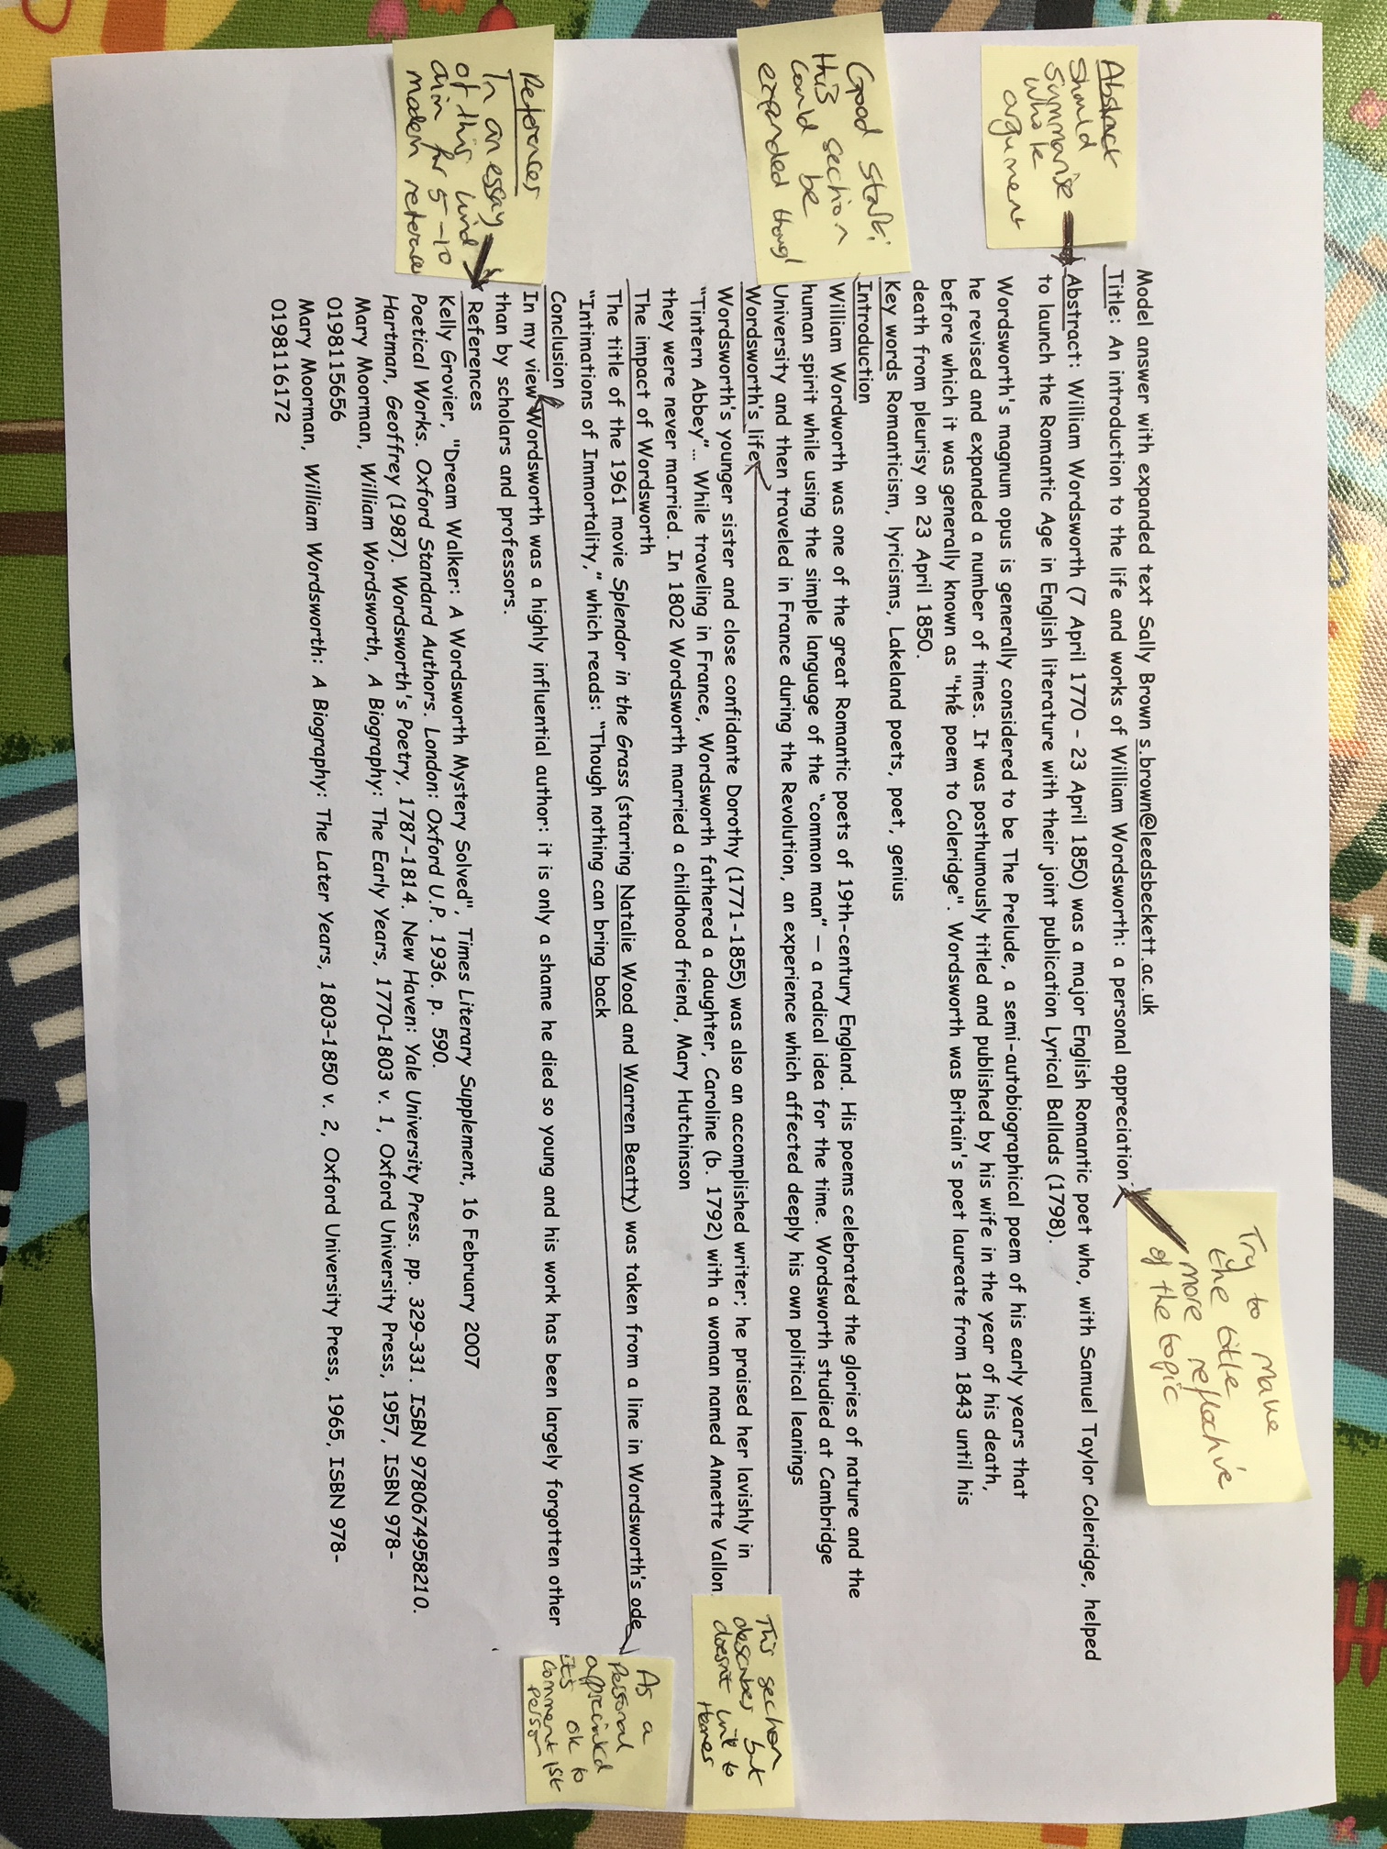

Slide 76
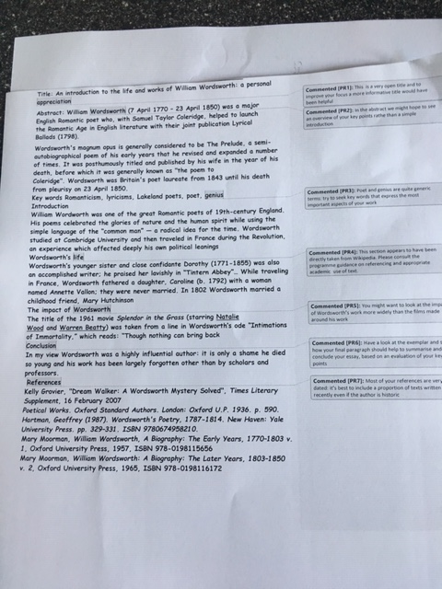

Slide 77
Helping students better understand what is needed of them through anticipatory feedback
This can be achieved in a variety of ways, including:
Using games (like the Biscuit game) can help make students think hard about criteria and required outcomes;
Ensuring that briefings (in the form of documentation, and more importantly, live/ face-to-face briefings, where students can actively interrogate criteria) are useful;
Getting students to self-assess to start a feedback dialogue;
Using exemplars to show students what high quality work in this domain comprises, and what features and aspects are crucial for success.

Slide 78
Briefings for students: setting the context
Early-stage students are likely to need more reassurance in your briefings in which the tone of your language may be crucial;
We should aim for as much transparency as possible: no student should be having to guess what you are looking for at any stage of their academic careers;
Whenever we use what may be to them an unfamiliar format, briefings should be linked to trial-runs, risk-free rehearsals and Q&A opportunities to clarify any areas of misconceptions;
This is not ‘spoonfeeding’ but instead giving them the knives and forks to feed themselves!

Slide 79
Essential components of an effective assignment brief I would suggest include:
Housekeeping arrangements: when does it have to be completed? How must it be submitted? Are you setting limitations around format and layout (e.g. font size, margins, use of figures, tables etc)?
Clarifying the scope of the task: how big is the task? How many words? Approximately how much time would you intend an average student to spend on this work? How many and what kinds of references should they use?
Support: Where can students go for help? How much and what kind of support can they get? (e.g. checking drafts, proofreading);
Good academic conduct: what do they need to know about the appropriate levels of peer support? How might plagiarism regulations impact on them?
Choosing the right medium: is an oral or video briefing best? What kinds of documentary detail do they need? Is the briefing a dialogue or monologue?

Slide 80
What are exemplars, and how can we use them productively?
Exemplars are not model answers. They are carefully selected examples of authentic student work from previous cohorts (anonymised and with permission) or teacher-constructed examples (based on your extensive experience of the kinds of responses and common mistakes students make). They are chosen to typify and illustrate designated levels of quality or competence.
The concrete nature of exemplars means that they are able to convey messages in a way that nothing else can (Sadler, 2002). Carefully selected examples can not only help students to ‘see’ what the teacher expects with regard to the task in hand (Scoles et al, 2013), but also guide their action.

Slide 81
Exemplars can enable students to:
gain a feel for what the final product looks like in terms of layout, structure and language;
develop their insights into the nature of academic writing;
raise awareness of the diverse ways a task might fruitfully (or erroneously) be tackled;
hone students’ evaluative skills.
Act as powerful learning tools (Sadler, 2010), helping students gain insight into the nature of quality and standards, ideally through close analysis and discussion (Hendry et al, 2016). Students typically find exemplars to be more useful than standalone lists of criteria, grids and rubrics (Hawe et al, 2017).

Slide 82
What can we do when using exemplars?
Choose examples which will help students firmly grasp task requirements;
Help students practice applying criteria to samples of work;
Enable students to reflect deeply on, and discuss, what high quality work looks like;
Choose examples to promote self-efficacy;
Carefully orchestrate discussion activities to promote understanding of fruitful learning strategies and approaches;
Use exemplars-based activities to develop students’ skills to monitor their own work while they are producing it;
Help them rate their work by comparison with their peers.

Slide 83
Making assessment work well
Intra-tutor and Inter-tutor reliability need to be assured;
Practices and processes need to be transparently fair to all students;
Cheats and plagiarisers need to be deterred/punished;
Assessment needs to be manageable for both staff and students;
Assignments should assess what has been taught/learned, not what it is easy to assess.

Slide 84
Are your students aware of all the processes and procedures we use to ensure fair assessment?
Do they know how we require assessors to match grades to achievement of assessment criteria?
Are they familiar with the steps we take to ensure inter-assessor reliability?
Do they understand that moderation processes are in place, for example through exam boards, to ensure that justice is done to each individual?
Do they get to hear about the work of external examiners (or even get to meet them?)?

Slide 85
Conclusions The choices are stark: We can either:
Help students to achieve their best by carefully designing assessment systems that work to their advantage or we can confuse and disadvantage them by not using assesment as an integral part of elarning;
Develop their assessment literacy by clarifying what is needed, giving them practice and rehearsal opportunities and opening dialogues or we can leave them to sink or swim;
Offer developmental and productive feedback that helps to transform their practice or we can demotivate and discourage them by using final language, or worse still giving them cursory feedback or none at all!

Slide 86
Useful references: 1
Assessment Reform Group (1999) Assessment for Learning: Beyond the black box, Cambridge UK, University of Cambridge School of Education.
Bain, K. (2004) What the best College Teachers do, Cambridge: Harvard University Press.
Biggs, J. and Tang, C. (2011) Teaching for Quality Learning at University, Maidenhead: Open University Press.
Bloxham, S. and Boyd, P. (2007) Developing effective assessment in higher education: a practical guide, Maidenhead, Open University Press.
Boud, D. (1995) Enhancing learning through self-assessment, London: Routledge.
Boud, D. and Associates (2010) Assessment 2020: seven propositions for assessment reform in higher education Sydney: Australian Learning and Teaching Council.

Slide 87
Useful references: 2
Brown, S. (2012) Assimilate compendium, Leeds, Leeds Met Press
Brown, S. (2012) ‘What are the perceived differences between assessing at Masters level and undergraduate level assessment? Some findings from an NTFS–funded project’ Innovations in Education and Teaching International, forthcoming
Brown, S., Deignan, T. Race, P. and Priestley, J. (2012) ‘Assessing students at Masters Level: learning points for Educational Developers’ Educational Developments, SEDA, Birmingham.
Brown, S (2012) ‘Diverse and innovative assessment at Masters Level: alternatives to conventional written assignments’ in AISHE-J: The All Ireland Journal of Teaching and Learning in Higher Education Vol 4, No 2.
Brown, S. (2014) Learning, teaching and assessment in higher education: global perspectives. London: Palgrave Macmillan.

Slide 88
Useful references: 3
Brown, S. and Glasner, A. (eds.) (1999) Assessment Matters in Higher Education, Choosing and Using Diverse Approaches, Maidenhead: Open University Press.
Brown, S. and Knight, P. (1994) Assessing Learners in Higher Education, London: Kogan Page.
Brown, S. and Race, P. (2012) Using effective assessment to promote learning in Hunt, L. and Chambers, D. (2012) University Teaching in Focus, Victoria, Australia, Acer Press. P74-91
Brown, S. Rust, C. & Gibbs, G. (1994) Strategies for Diversifying Assessment, Oxford: Oxford Centre for Staff Development.

Slide 89
Useful references: 4
Carless, D., Joughin, G., Ngar-Fun Liu et al (2006) How Assessment supports learning: Learning orientated assessment in action Hong Kong: Hong Kong University Press.
David Carless & David Boud (2018): The development of student feedback literacy: enabling uptake of feedback, Assessment & Evaluation in Higher Education, DOI:10.1080/02602938.2018.1463354
Carroll, J. and Ryan, J. (2005) Teaching International students: improving learning for all. London: Routledge SEDA series.
Crooks, T. (1988) Assessing student performance, HERDSA Green Guide No 8 HERDSA (reprinted 1994).
Crosling, G., Thomas, L. and Heagney, M. (2008) Improving student retention in Higher Education, London and New York: Routledge.
Falchikov, N. (2004) Improving Assessment through Student Involvement: Practical Solutions for Aiding Learning in Higher and Further Education, London: Routledge.

Slide 90
Useful references: 5
Gibbs, G. (1999) Using assessment strategically to change the way students learn, in Brown S. & Glasner, A. (eds.), Assessment Matters in Higher Education: Choosing and Using Diverse Approaches, Maidenhead: SRHE/Open University Press.
Higher Education Academy (2012) A marked improvement; transforming assessment in higher education, York: HEA.
Hounsell, D. (2008). The trouble with feedback: New challenges, emerging strategies, Interchange, Spring, Accessed at www.tla.ed.ac.uk/interchange.
Knight, P. and Yorke, M. (2003) Assessment, learning and employability Maidenhead, UK: SRHE/Open University Press.

Slide 91
Useful references: 6
McDowell, L. and Brown, S. (1998) Assessing students: cheating and plagiarism, Newcastle: Red Guide 10/11 University of Northumbria.
Mentkowski, M. and associates (2000) p.82 Learning that lasts: integrating learning development and performance in college and beyond, San Francisco: Jossey-Bass.
Meyer, J.H.F. and Land, R. (2003) ‘Threshold Concepts and Troublesome Knowledge 1 – Linkages to Ways of Thinking and Practising within the Disciplines’ in C. Rust (ed.) Improving Student Learning – Ten years on. Oxford: OCSLD.
Morgan, C., Dunn, L., Parry, S. and O'Reilly, M. (2004) The student assessment handbook: New directions in traditional and online assessment, London, Routledge.

Slide 92
Useful references: 7
Newstead, S. E., Franklyn-Stokes, A., & Armstead, P. (1996) Individual differences in student cheating, Journal of Educational Psychology, 88(2), 229-241
Nicol, D. J. and Macfarlane-Dick, D. (2006) Formative assessment and self-regulated learning: A model and seven principles of good feedback practice, Studies in Higher Education Vol 31(2), 199-218.
PASS project Bradford http://www.pass.brad.ac.uk/ Accessed November 2013.
Peelo, M. T., & Wareham, T. (Eds.). (2002). Failing students in higher education. Society for Research into Higher Education.
Pickford, R. and Brown, S. (2006) Assessing skills and practice, London: Routledge.

Slide 93
Useful references: 8
Race P. (2020) The lecturer’s toolkit (5th edition), London: Routledge.
Race, P. (2001) A Briefing on Self, Peer & Group Assessment, in LTSN Generic Centre Assessment Series No 9, LTSN York.
Race, P. (2014) Making learning happen: 3rd edition, London: Sage.
Rotheram, B. (2009) Sounds Good, JISC project http://www.jisc.ac.uk/whatwedo/programmes/usersandinnovation/soundsgood.aspx
Rust, C., Price, M. and O’Donovan, B. (2003) Improving students’ learning by developing their understanding of assessment criteria and processes, Assessment and Evaluation in Higher Education. 28 (2), 147-164.

Slide 94
Useful references: 9
Ryan, J. (2000) A Guide to Teaching International Students, Oxford Centre for Staff and Learning Development.
Sadler, D. R. (2010) Beyond feedback: Developing student capability in complex appraisal. Assessment & Evaluation in Higher Education, 35(5), 535-550.
Seymour, D. (2005) Learning Outcomes and Assessment: developing assessment criteria for Masters-level dissertations. Brookes eJournal of Learning and Teaching 1(2).
Winstone, N. and Carless, D. (2020) ‘Designing effective feedback processes in Higher Education: a learning-focussed approach’ Routledge London and New York
Yorke, M. (1999) Leaving Early: Undergraduate Non-completion in Higher Education, London: Routledge.

