Slide 1
Doing it for ourselves: collegially developed professional educational development as a means of self care
Sally Brown, Independent Consultant,
Kay Sambell, Edinburgh Napier University
Linda Graham, University of Sunderland

Slide 2
What’s the context?
Higher Education is in a period of rapid change and all-too-often viewed as being in crisis with ebbing funding, soaring fees and mounting expectations about what we will ‘deliver’;
Formerly there were big budgets for Learning, Teaching and Assessment in HEIs, but now there’s not a lot of money around for CPD for us or the people we support;
This session is about how we can use low-cost or (ideally) cost-free opportunities for producing outputs in the domain of learning, teaching and assessment?

Slide 3
What is our key message today?
When targeted funding for learning and teaching development activities and projects is in short-supply, we often have to do it ourselves or miss out;
Without wishing to abnegate any Higher Education Institutions (HEI)’s responsibility to provide proper support for investigating pedagogic innovations and sharing good practice, and works best when supported, we can, in extremis emulate philanthropic models from other sectors and look to how experienced colleagues and others can gift each other opportunities and experiences in kind, without it involving cash transactions or a formal commitment to repay the favour.

Slide 4
We are aiming for models relying on ‘academic altruism’ to share practical wisdom: ‘phronesis’
‘A world in which the process values of dialogue, conversation, phronesis, practical discourse, and judgement are linked to the universal values of solidarity, participation, unity, and mutual recognition’ (Maxcy, 1991, p.20).
We are keen to foster mutually productive dialogues where collegiality and collaboration lead to social hope and kindness in times when the context may seem to foster the context may seem to foster only competition and selfishness (Caddell & Wilder, 2018).

Slide 5
Introduction Activity
Divide into 2 teams.
Team 1 are the Academic Altruists (Glass half full)
Team 2 are the Naysaying Numpties (Glass half empty)
Prepare and deliver a short manifesto on how you will be running CPD in your university and respond to each other’s refuting theirs.

Slide 6
Task 1
Eat biscuits and brainstorm what activities you can do with little or no cash?

Slide 7
So what can we do?
Establish Learning Communities;
Run mutually supported ‘pomodoro’ groups;
Convene self supported mutual encouragement activities to produce articles, conference presentations and even books;
Find alternative ways to attend and run conferences;
Engage in informal activities that can lead to formal publications ;
Run your own events and activities without cash;
Work with mentors.

Slide 8
Self-directed learning communities
North American models rely on these being funded and supported but our version works on self direction (see MacKenzie et al,2010) for example;
Working in a LC offers the opportunity to work collectively meet for discussion and peer support and feedback on work in progress and to work collaboratively to address a particular issue.
Reported benefits include the opportunity to work with like-minded individuals, to try out new ideas, to learn more about possible T&L approaches and to feel valued and empowered to produce collective outputs that will gain more recognition than an individual working alone.

Slide 9
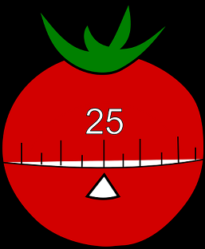
Mutually supported ‘Pomodoro’ writing sessions
This is dedicated time to produce written outcomes focussed on learning and teaching.
The technique uses a kitchen timer to break down work into intervals (it’s named after the tomato shaped timer by its Italian inventor).
Short 10 minutes concentrated activity, without distraction either physical or mental, can be extremely productive.

Slide 10
This technique is based upon three basic assumptions:
‘A different way of seeing time [no longer focused on the concept of becoming productive] alleviates anxiety and in doing so leads to enhanced personal effectiveness.’
‘Better use of the mind enables us to achieve greater clarity of thought, higher consciousness, and sharper focus, all the while facilitating learning.’
‘Employing easy-to-use, unobtrusive tools reduces the complexity of applying the Technique while favouring continuity and allows you to concentrate your efforts on the activities you want to accomplish’ (Cirillo, 2006).

Slide 11
Task 3
Try a tiny cherry pomodoro (10 mins).
Write the first two paragraphs on any article on learning and teaching that set the current scene in higher education.

Slide 12
Convene self-supported mutual encouragement activities
If your institution doesn’t formally offer support for writing about pedagogic practice, it’s possible you might need to self-generate it;
Our version comprises ‘when our jobs took us in different directions and to different HEIs, we decided we would still like to continue working together but had no funds for paid writing retreats etc.
A child’s easel replaces a flip chart, with lining paper for scribing on, and our principal resource (other than home-made food) is each other’s energy, support and senses of humour.
So far we have co-produced a book (Sambell et al, 2017), a suite of open educational development resources that have been used in three HEIs, several conference presentations as well as five journal articles, in the UK and internationally.

Slide 13
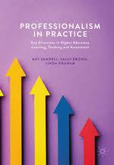
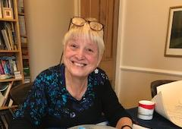
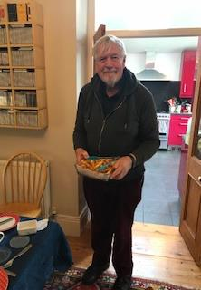
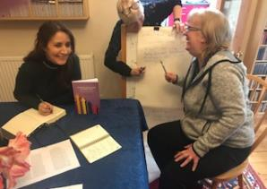
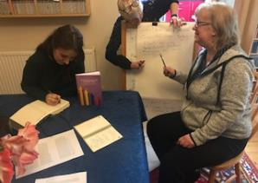
Conservatory Days: Self-led cost-free mutual self-development
Notes:
a. Conservatory days: Kay to talk about the concept of self-led cost-free mutual self-development and illustrate it with a photo of our book as an output. It’s possible to do all this for free and without permission

Slide 14
Why do conservatory days work?
We believe it’s because they offer cost-free opportunities for which we need to ask no permission and create a positive locus for interaction and creativity
The work gets done because we are committed to not letting each other down.
The approach can be emulated by others: we recommend working off-site, rather than within an academic setting because this offers flexibility, having clear ideas about overall goals and outputs, while allowing unfixed views about the precise outcome and ensuring that we genuinely set aside dedicated time for this work just as much as if we were undertaking paid-for CPD.
The days are characterised mutual trust which supports risk-taking and adventurous thinking, as well as peer support

Slide 15
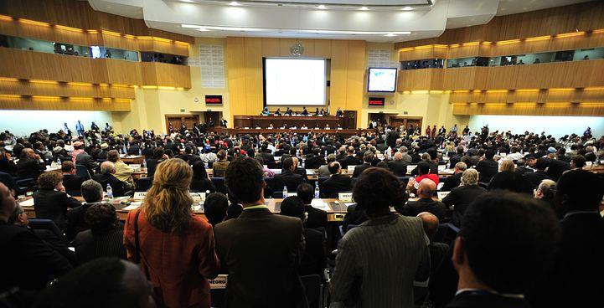
Find alternative ways to attend and run conferences
“Can you find me a job to do at your conference could you consider not charging me a delegate fee?”
“If I forego my fee, can I bring my co-presenter with me and will you pay her travelling expenses too?”
If I join your committee and work really hard beforehand collating the programme, reviewing papers, helping publicise the event, can I come to the conference without charge?”
“Is it possible for non-attendees to access the conference proceedings?”

Slide 16
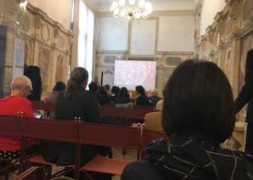
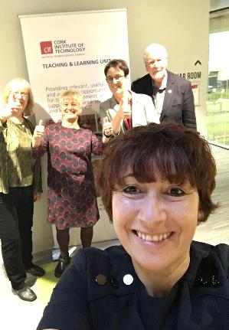
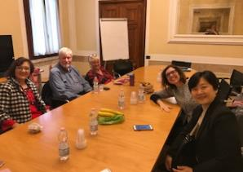
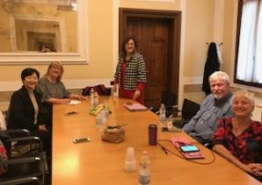
Can we help you?
Notes:
Four go mad in Padua/Cork/ the world: Sally talk about collectively contributing to things here no one pays us, just covers expenses or we pay out of our own money and there’s lots in it for everyone. Talk about outputs including the Padua journals

Slide 17
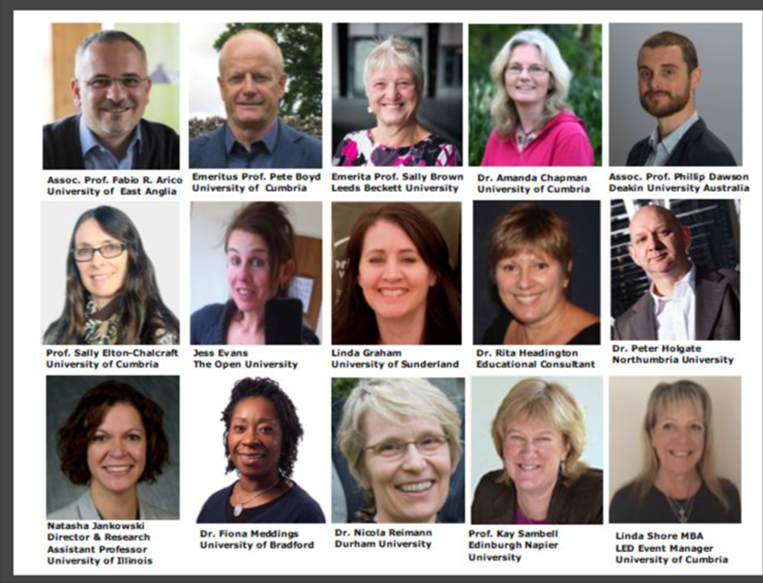
Our next Assessment in Higher Education one day event is on 2nd July 2020 at Manchester

Slide 18
Engage in informal activities that can lead to formal publications
Post blogs, either on curated and widely-read blogs like SEDA’s or on Wonkhe.com, or have your own (I rate rattusscholasticus.word for example);
Work commissioned or accepted by these sites can provide immediate outlet’s for authors newest ideas prior to more formal publications, and can both raise your profile and have impact on current practice;
Improve your writing by publishing with internal HEI ejournals and getting feedback on it.

Slide 19
Engaging with conferences and events without physically going there
Follow the twitter hashtag and contribute by joining in conversations and downloading free presentations;:
#lthechat Wednesdays at 8pm GMT throughout the year: the best free international CPD!
Webinars, e.g. the Australian-originated but global in focus http://transformingassessment.com exploring assessment in higher education, particularly focused on e-assessment;

Slide 20
Running your own events and activities without cash
These events run on white collar piracy: no one is paying anything and everyone gives their services free, they often work best within an institution;
Provide no catering: tell everyone to bring or buy their own (but a few donated biscuits never go amiss);
Go to another campus within your university: often you can book rooms without fees;
But don’t exploit unpaid student labour on the grounds that “it will be good for your CV”.

Slide 21
Work with mentors
A good mentoring relationship is likely to be one of the richest of one’s professional life and a great privilege which can help to set the course of one’s career: we’ve all had at least one and benefited from the occasional well-made suggestion or pressure to complete a task;
A mentor is the person to whom to turn on those days where challenges seem just too challenging, from whom to seek validation and with whom to celebrate when things have gone really well.
We think mentoring works best when it is altruistic, rather than a part of one’s professional duties: for us, the role when undertaken for love rather than money is one that has high value without an enormous personal cost: sometimes it’s great just to be helpful to others just for the fun of it!

Slide 22
Good advice in Phil Race (2019) suggests that:
“How you work with your mentor will be a matter for mutual negotiation, but it is as well to do this from the outset, so you are both clear what you are trying to achieve. Some, with lots of experience will jump straight into advice on things you can do, and others will work hard at drawing from your personal approaches that can help you reach your own decisions. “(pp 279-80)

Slide 23
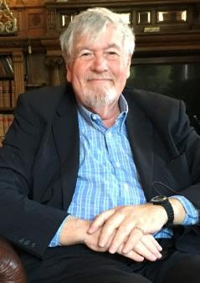
More of Sally’s wise words from Phil’s book
Finding an altruistic mentor is largely a matter of networking, making requests with humility, thinking through how the relationship might benefit both parties, and a certain amount of luck.
Mentoring arrangement can be seen to have worked if both parties feel they have gained from working together: mentors may find the process of mentoring someone younger in career than themselves helps to keep them refreshed and current, and mentees can benefit by enhanced confidence, greater skills proficiency , career advancement and eventually believing in their own agency to help others.
Some mentoring relationships taper off when they have served their purposes, other continue as lifelong relationships, progressively becoming more mutually supportive and ultimately resulting in many cases in deep friendships.
You can never repay the generosity of a good volunteer mentor other than, when you are in an advanced career position later, paying the favour forward by mentoring new-comers to the profession yourself, when you can help to make the next generations’ lives less stressful.

Slide 24
Task 4
What would you like to do with colleagues and friends using any of these suggestions?
Produce a poster

Slide 25
Task 5
Poster display show and tell and competition prize

Slide 26
References
Caddell, M., & Wilder, K. (2018) Seeking Compassion in the Measured University: Generosity, Collegiality and Competition in Academic Practice.
Cirillo, F. (2006) The pomodoro technique (the pomodoro). Agile Processes in Software Engineering, 54(2).
MacKenzie, J. and Bell, S. and Bohan, J. and Brown, A. and Burke, J. and Cogdell, B. and Jamieson, S. and McAdam, J. and McKerlie, R. and Morrow, L. and Paschke, B. and Rea, P. and Tierney, A. (2010) From anxiety to empowerment: a learning community of university teachers. Teaching in Higher Education, 15 (3). pp. 273-284. ISSN 1356-2517
Maxcy, S.J. (1991) Educational Leadership: A Critical Pragmatic Perspective. Critical Studies in Education and Culture Series. Greenwood Publishing Group, Inc., 88 Post Road West, PO Box 5007, Westport, CT 06881-9990 (ISBN-0-89789-259-3, paperback: $16.95; ISBN-89789-258-5, hardback)
Race, P. (2019) The Lecturer’s Toolkit, London and New York, Routledge.

