Slide 1
Improving assessment (and particularly) feedback
Southampton Solent University
School of Business, Law and Comms
Course Leaders’ Forum
23 October 2019 1pm-2pm
Sally Brown NTF, PFHEA, SFSEDA
@ProfSallyBrown http://sally-brown.net

Slide 2
What is the ambition of the Business School in relation to assessment and feedback?
Reinforcing the importance of a consistent approach to marking, giving feedback and moderation;
Ensuring that everyone giving feedback aligns comments to the marks awarded, and that these are consistent with the guidance provided by rubrics;
Ensuring that marking is manageable for assessors (so long pacing is appropriate).
This is not just about enhancing or maintaining good NSS scores, but also about ensuring that students have positive experiences of assessment.

Slide 3
Next steps with NSS (according to OfS, October 2019)
They note that in England 2019, 83% students were satisfied with their courses, with overall satisfaction ranging from 73-91%. As NSS enters its 15th year of operation, OfS are undertaking an in-depth exploration of its impact and a major overhaul. They are:
Considering using with all levels of undergraduates, not just final year students;
Reconsidering its timing, use of a 5-point Likert scale,
Making changes as appropriate;
Exploring new survey questions about mental-health provision and well-being;
A consultation process opens in March 2020.
https://www.officeforstudents.org.uk/news-blog-and-events/our-news-and-blog/next-steps-for-the-national-student-survey/

Slide 4
Determining and reviewing subject material: currency, relevance, level
Enhancing quality, seeking continuous improvement
Designing and refining learning outcomes
Evaluating programmes, strengths and areas for improvement
Curriculum
Design
Essentials
Considering delivery modes: face-to-face, online, PBL, blended…
Assuring quality, matching HEI, national and PRSB requirements
Thinking through student support
Designing fit for purpose assessment methods and approaches

Slide 6
VASCULAR learning outcomes
Verifiable: Can we tell when they’ve been achieved? And can students?
Action orientated: Do they lead to real and useful activity?
Singular: i.e. not portmanteau outcomes combining two or more into one, making it difficult to assess if differently achieved, but readily matchable to student work produced?
Constructively aligned? (Biggs and Tang, 2011) so that there is clear alignment between aims (What do students need to be able to know and do?), what is taught/ learned, how these are assessed and evaluated);
Understandable i.e. using language codes that are meaningful to all stakeholders?
Level-appropriate? Suitable and differentiable between1st year, 2nd year, 3rd year, Masters, other PG?
Affective-inclusive i.e. not just covering actions but capabilities in the affective domain?
Regularly reviewed? Not just stuck in history and always fit-for-purpose.

Slide 7
Designing assessment as a central part of curriculum design
Assessment is a complex, nuanced and highly important process​ and if we want students to engage fully, we must make it really meaningful to them and convince them that there is merit in the activities we ask them to undertake. To focus students’ effort and improve their engagement with learning, we need to take a fresh look at our current practice to make sure assessment is for rather than just of learning, with students learning while they are being assessed rather than it being merely a summative end process. We also need to ensure that we make assessment practices and the giving of feedback manageable for staff and valuable for students.

Slide 9
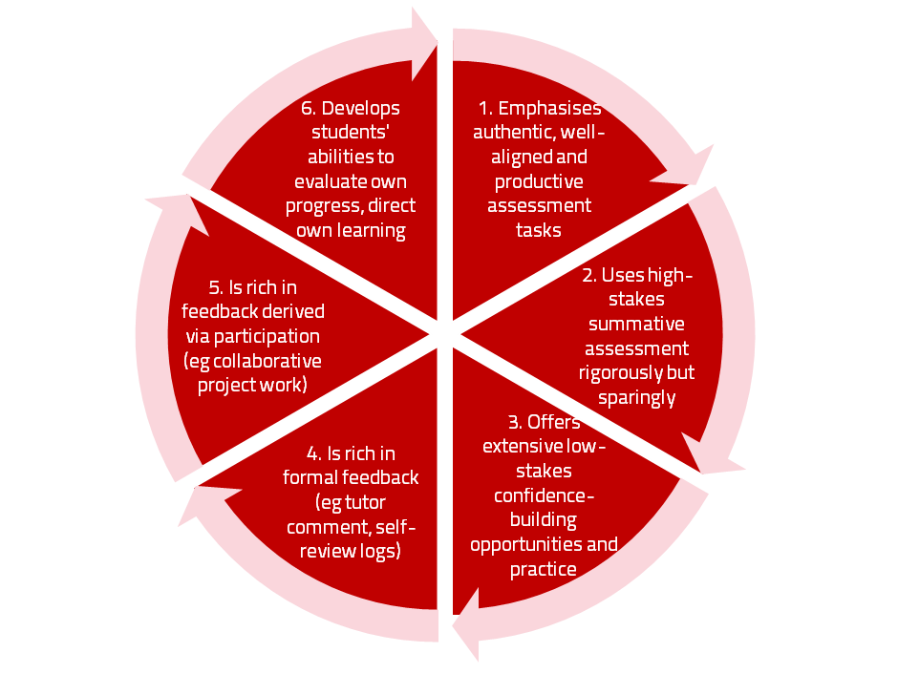
A4L the Northumbria model

Slide 10
For any assessment activity, we need to be clear about:
Aims: is this an early stage assignment, that is principally about building confidence and helping students see what is required of them, or is it a key element of their summative assessment, designment to gauge fitness to progress, or fitness-to-practice?
Scope: is this testing low level outcomes, like demonstrating recollection of key terms, or is it cognitively more demanding requiring synthesis of multiple elements, critical analysis, evaluation and reflection?
Scale: is this a small scale or a substantial task carrying a heavy weighting? Do students know how much effort and energy is needed to achieve at least a satisfactory level?
Orientation: Is the key aim to demonstrate the achievement of skills and competences, and/or to produce a definite product or is it primarily about demonstrating mastery of appropriate processes?
Constructive alignment: To what extent does the assessment closely link to the learning outcomes (and specifically the verbs used in them)?

Slide 11
Formative and summative assessment
Formative assessment is primarily concerned with feedback aimed at prompting improvement, is often continuous and usually involves words.
Summative assessment is concerned with making evaluative judgments, is often end point and involves numbers.

Slide 12
The importance of dialogic feedback (Sadler)
Students need to be exposed to, and gain experience in making judgements about, a variety of works of different quality... They need planned rather than random exposure to exemplars, and experience in making judgements about quality. They need to create verbalised rationales and accounts of how various works could have been done better. Finally, they need to engage in evaluative conversations with teachers and other students.

Slide 13
Do your international students understand UK assessment approaches?
Have you clarified the ground rules on issues like pass marks, criterion-referenced assessment and grading systems?
Have you explained how extensions, condonements, and university assessment regulations work?
Are the assignments built around a curriculum international in scope and content? Are tasks and case studies globally orientated?

Slide 14
Fostering student engagement with feedback
Students tend to regard marks like money, and so will put more energy into things that ‘count’ than those they see as options;
Formative feedback, that is developmental and supportive, and given at the right stage so that it guides future performance can be exceptionally powerful in improving achievement and retention;
Feedback and ‘feed-forward’ must be integral to student learning programmes, rather than something that students opt into, so needs to be within live or virtual face-to-face interaction.

Slide 15
Encouraging better use of feedback
Emphasise early on the importance to students of formative feedback;
Consider how best to provide them with feedback (orally, in writing, face-to-face, virtually);
Provide them with training on why and how feedback is provided;
Get students to practise drafting and delivering feedback;
Get students to focus on comments rather than marks;
Help students to believe they have the agency to improve their work;
Encourage students to think of feedback as a trigger to them taking action;
Give them some examples of helpful feedback as a prompt to discussion.

Slide 16
Good feedback: (after Brown, S. (2015), Assessment, learning and teaching in higher education: global perspectives, London: Palgrave-MacMillan)
Is dialogic, rather than mono-directional, giving students chances to respond to comments from their markers and seek clarification where necessary.
Helps clarify what good work looks like, so students are really clear about goals, criteria and expected standards, and provides opportunities to close the gap between current and desired performance.

Slide 17
Good feedback:
Actively facilitates students reviewing their own work and reflecting on it, so that they become good judges of the quality of their own work.
Doesn’t just correct errors and indicate problems, potentially leaving students discouraged and demotivated, but also highlights good work and encourages them to believe they can improve and succeed.

Slide 18
Good feedback:
Delivers high-quality information to students about their achievements to date and how they can improve their future work. Where there are errors, students should be able to see what needs to be done to remediate them, and where they are undershooting in terms of achievement, they should be able to perceive how to make their work even better.

Slide 19
Good feedback:
Offers ‘feed-forward’ aiming to ‘increase the value of feedback to the students by focusing comments not only on the past and present … but also on the future – what the student might aim to do, or do differently in the next assignment or assessment if they are to continue to do well or to do better’ (Hounsell, 2008, p.5).
Ensures that the mark isn’t the only thing that students take note of when work is returned, but that they are encouraged to read and use the advice given in feedback and apply it to future assignments.

Slide 20
What is feedback literacy? Slides based on Carless and Boud 2018
One of the main barriers to effective feedback is generally low levels of student feedback literacy. Students’ feedback literacy involves
an understanding of what feedback is and how it can be managed effectively;
capacities and dispositions to make productive use of feedback;
appreciation of the roles of teachers and themselves in these processes.

Slide 21
What is feedback? Carless and Boud 2018
Building on previous definitions (Boud and Molloy 2013; Carless 2015), feedback is defined as a process through which learners make sense of information from various sources and use it to enhance their work or learning strategies.
This definition goes beyond notions that feedback is principally about teachers informing students about strengths, weaknesses and how to improve, and highlights the centrality of the student role in sense-making and using comments to improve subsequent work. Information may come from different sources e.g. peers, teachers, friends, family members or automated computer-based systems to support student self-evaluation of progress.

Slide 22
Present dissatisfaction with feedback Slides based on Carless and Boud 2018
There is also a wide range of evidence from the National Student Survey in England and Wales (Higher Education Funding Council for England 2016) and the Student Experience Survey in Australia (Quality Indicators for Learning and Teaching 2017) that students are not particularly satisfied with feedback and the broader assessment regimes within which feedback is commonly organised.
For feedback processes to be enhanced, students need both appreciation of how feedback can operate effectively and opportunities to use feedback within the curriculum.

Slide 23
Student appreciation of feedback processes Slides based on Carless and Boud 2018
Appreciating feedback refers to both students recognising the value of feedback and understanding their active role in its processes. Students have various conceptions of feedback and these are often not particularly sophisticated, mainly focusing on feedback as telling (McLean, Bond, and Nicholson 2015).
Students sometimes fail to recognise or appreciate forms of feedback other than written comments on submitted work (Price, Handley, and Millar 2011). Based on their secondary school experience, students may have limited absolutist beliefs about knowledge and prefer to receive unequivocal corrective feedback (O’Donovan 2017).

Slide 24
Why ‘feedback as telling’ is not enough Slides based on Carless and Boud 2018
Approaches that emphasise feedback as telling are insufficient because students are often not equipped to decode or act on statements satisfactorily, so key messages remain invisible (Sadler 2010).
Feedback literacy demands that learners acquire the academic language necessary for understanding, interpreting and thinking with complex ideas (Sutton 2012).

Slide 25
Managing the ‘affect’ of feedback Slides based on Carless and Boud 2018
Affect refers to feelings, emotions and attitudes. Students often exhibit defensive responses to feedback, particularly when comments are critical or grades are low (Robinson, Pope, and Holyoak 2013).Under these circumstances, feedback often provokes negative affective reactions and threats to identity, so how students manage their emotional equilibrium impacts on their engagement with critical commentary (To 2016). Affective responses to feedback are mediated by students’ relationships with their teacher and with other participants as they construct meanings together (Esterhazy and Damsa 2017).

Slide 26
Affect, and tone of feedback Slides based on Carless and Boud 2018
An aim of feedback is to challenge students to adopt new perspectives, but students often do not welcome this challenge (Forsythe and Johnson 2017). Critical feedback can have positive or negative impacts depending on a range of factors, including student self-efficacy, motivation and ability to handle emotions constructively (Pitt and Norton 2017).
The tone in which feedback is shared is one of the most critical aspects of how students react to feedback (Lipnevich, Berg, and Smith 2016). When teachers signify in writing and speech that they care about their learners, then student engagement with feedback is enhanced (Sutton 2012).

Slide 27
Affect: developing confidence Slides based on Carless and Boud 2018
If a trusting atmosphere is established, learners are more likely to develop the confidence and faith to reveal what they do not fully understand (Carless 2013).
Student dispositions to engage with feedback are often not optimal. Students seem to recognise that feedback can facilitate progress but underplay their own responsibility to actualise this improvement (Winstone et al. 2017a).
Capable students are often pro-active in seeking out feedback and striving to understand what teachers look for in assignments; i.e. cue-conscious or cue-seeking behaviours identified in the literature (Miller and Parlett 1974; Yang and Carless 2013).

Slide 28
Motivating students to take action Slides based on Carless and Boud 2018
Feedback literacy requires learners to act upon comments that they have received (Sutton 2012).
Students need to engage actively in making sense of information and use it to inform their later work, thereby closing a feedback loop (Boud and Molloy 2013).
This imperative for students to take action is a critical aspect of feedback processes which is sometimes underplayed. Students need motivation, opportunities and means to act on feedback (Shute 2008).

Slide 29
Feedback literate students:
Appreciating feedback
understand and appreciate the role of feedback in improving work and the active learner role in these processes;
recognise that feedback information comes in different forms and from different sources;
use technology to access, store and revisit feedback.
Making judgements
develop capacities to make sound academic judgments about their own work and the work of others;
participate productively in peer feedback processes;
refine self-evaluative capacities over time in order to make more robust judgments.
Managing affect
maintain emotional equilibrium and avoid defensiveness when receiving critical feedback;
are proactive in eliciting suggestions from peers or teachers and continuing dialogue with them as needed;
develop habits of striving for continuous improvement on the basis of internal and external feedback.
Taking action
are aware of the imperative to take action in response to feedback information;
draw inferences from a range of feedback experiences for the purpose of continuous improvement;
develop a repertoire of strategies for acting on feedback.
Carless and Boud: 2018

Slide 30
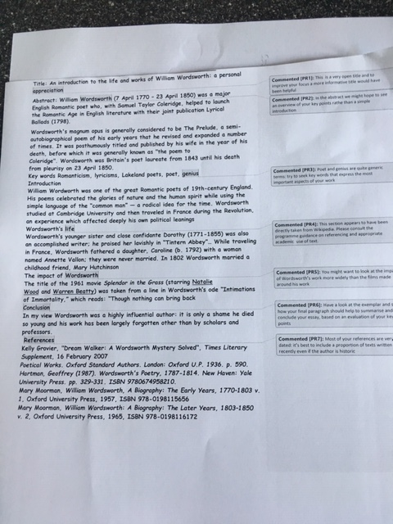

Slide 31
Helping students better understand what is needed of them through anticipatory feedback
This can be achieved in a variety of ways, including:
Using games (like the Biscuit game) can help make students think hard about criteria and required outcomes;
Ensuring that briefings (in the form of documentation, and more importantly, live/ face-to-face briefings, where students can actively interrogate criteria) are useful;
Getting students to self-assess to start a feedback dialogue;
Using exemplars to show students what high quality work in this domain comprises, and what features and aspects are crucial for success.

Slide 32
Briefings for students: setting the context
Early-stage students are likely to need more reassurance in your briefings in which the tone of your language may be crucial;
We should aim for as much transparency as possible: no student should be having to guess what you are looking for at any stage of their academic careers;
Whenever we use what may be to them an unfamiliar format, briefings should be linked to trial-runs, risk-free rehearsals and Q&A opportunities to clarify any areas of misconceptions;
This is not ‘spoonfeeding’ but instead giving them the knives and forks to feed themselves!

Slide 33
Essential components of an effective assignment brief I would suggest include:
Housekeeping arrangements: when does it have to be completed? How must it be submitted? Are you setting limitations around format and layout (e.g. font size, margins, use of figures, tables etc)?
Clarifying the scope of the task: how big is the task? How many words? Approximately how much time would you intend an average student to spend on this work? How many and what kinds of references should they use?
Support: Where can students go for help? How much and what kind of support can they get? (e.g. checking drafts, proofreading);
Good academic conduct: what do they need to know about the appropriate levels of peer support? How might plagiarism regulations impact on them?
Choosing the right medium: is an oral or video briefing best? What kinds of documentary detail do they need? Is the briefing a dialogue or monologue?

Slide 34
What are exemplars, and how can we use them productively?
Exemplars are not model answers. They are carefully selected examples of authentic student work from previous cohorts (anonymised and with permission) or teacher-constructed examples (based on your extensive experience of the kinds of responses and common mistakes students make). They are chosen to typify and illustrate designated levels of quality or competence.
The concrete nature of exemplars means that they are able to convey messages in a way that nothing else can (Sadler, 2002). Carefully selected examples can not only help students to ‘see’ what the teacher expects with regard to the task in hand (Scoles et al, 2013), but also guide their action.

Slide 35
Exemplars can enable students to:
gain a feel for what the final product looks like in terms of layout, structure and language;
develop their insights into the nature of academic writing;
raise awareness of the diverse ways a task might fruitfully (or erroneously) be tackled;
hone students’ evaluative skills.
Act as powerful learning tools (Sadler, 2010), helping students gain insight into the nature of quality and standards, ideally through close analysis and discussion (Hendry et al, 2016). Students typically find exemplars to be more useful than standalone lists of criteria, grids and rubrics (Hawe et al, 2017).

Slide 36
What can we do when using exemplars?
Choose examples which will help students firmly grasp task requirements;
Help students practice applying criteria to samples of work;
Enable students to reflect deeply on, and discuss, what high quality work looks like;
Choose examples to promote self-efficacy;
Carefully orchestrate discussion activities to promote understanding of fruitful learning strategies and approaches;
Use exemplars-based activities to develop students’ skills to monitor their own work while they are producing it;
Help them rate their work by comparison with their peers.

Slide 37
Five things students really hate about poor feedback
Poorly written comments that are nigh on impossible to decode, especially when impenetrable acronyms or abbreviations are used, or where handwriting is in an unfamiliar alphabet and is illegible.
Cursory and derogatory remarks that leave them feeling demoralised ‘Weak argument’, ‘Shoddy work’, ‘Hopeless’, ‘Under-developed’, and so on.
Value judgements on them as people rather than on the work in hand.

Slide 38
Five things students really hate about poor feedback
Vague comments which give few hints on how to improve or remediate errors: ‘OK as far as it goes’, ‘Needs greater depth of argument’, ‘Inappropriate methodology used’, ‘Not written at the right level’.
Feedback that arrives so late that there are no opportunities to put into practice any guidance suggested in time for the submission of the next assignment.

Slide 39
Encouraging students to recognise and use the feedback we provide for them
Delivery of feedback should not be left to chance, so its best to avoid asking students to pick up marked hard copy assignments from departmental offices;
Electronic submission of assignments has benefits and disadvantages but on balance the former outweigh the latter;
Perhaps require students to guestimate expected marks having read your feedback early in their programmes;
‘Assignment handler’ can deliver feedback electronically and only release marks once students have responded;
Audio files of audio feedback can be highly successful in enabling students to capture ‘live’ oral feedback, and can replace written feedback (e.g. JISC project ‘Sounds good’).

Slide 40
Are your students aware of all the processes and procedures we use to ensure fair assessment?
Do they know how we require assessors to match grades to achievement of assessment criteria?
Are they familiar with the steps we take to ensure inter-assessor reliability?
Do they understand that moderation processes are in place, for example through exam boards, to ensure that justice is done to each individual?
Do they get to hear about the work of external examiners (or even get to meet them?)?

Slide 41
Planning to implement enhancements in assessment & feedback in your module/programme
As an individual, are there changes you would like to make to your assessment practices?
Thinking about the teams you work with, are there ways in which you could use ideas from today’s session to help make your assessment more authentic?
How could your influence impact more widely on colleagues across the university?

Slide 42
Useful references: 1
Assessment Reform Group (1999) Assessment for Learning: Beyond the black box, Cambridge UK, University of Cambridge School of Education.
Bain, K. (2004) What the best College Teachers do, Cambridge: Harvard University Press.
Biggs, J. and Tang, C. (2011) Teaching for Quality Learning at University, Maidenhead: Open University Press.
Bloxham, S. and Boyd, P. (2007) Developing effective assessment in higher education: a practical guide, Maidenhead, Open University Press.
Boud, D. (1995) Enhancing learning through self-assessment, London: Routledge.
Boud, D. and Associates (2010) Assessment 2020: seven propositions for assessment reform in higher education Sydney: Australian Learning and Teaching Council.

Slide 43
Useful references: 2
Brown, S. (2012) Assimilate compendium, Leeds, Leeds Met Press
Brown, S. (2012) ‘What are the perceived differences between assessing at Masters level and undergraduate level assessment? Some findings from an NTFS–funded project’ Innovations in Education and Teaching International, forthcoming
Brown, S., Deignan, T. Race, P. and Priestley, J. (2012) ‘Assessing students at Masters Level: learning points for Educational Developers’ Educational Developments, SEDA, Birmingham.
Brown, S (2012) ‘Diverse and innovative assessment at Masters Level: alternatives to conventional written assignments’ in AISHE-J: The All Ireland Journal of Teaching and Learning in Higher Education Vol 4, No 2.
Brown, S. (2014) Learning, teaching and assessment in higher education: global perspectives. London: Palgrave Macmillan.

Slide 44
Useful references: 3
Brown, S. and Glasner, A. (eds.) (1999) Assessment Matters in Higher Education, Choosing and Using Diverse Approaches, Maidenhead: Open University Press.
Brown, S. and Knight, P. (1994) Assessing Learners in Higher Education, London: Kogan Page.
Brown, S. and Race, P. (2012) Using effective assessment to promote learning in Hunt, L. and Chambers, D. (2012) University Teaching in Focus, Victoria, Australia, Acer Press. P74-91
Brown, S. Rust, C. & Gibbs, G. (1994) Strategies for Diversifying Assessment, Oxford: Oxford Centre for Staff Development.

Slide 45
Useful references: 4
Carless, D., Joughin, G., Ngar-Fun Liu et al (2006) How Assessment supports learning: Learning orientated assessment in action Hong Kong: Hong Kong University Press.
David Carless & David Boud (2018): The development of student feedback literacy: enabling uptake of feedback, Assessment & Evaluation in Higher Education, DOI:10.1080/02602938.2018.1463354
Carroll, J. and Ryan, J. (2005) Teaching International students: improving learning for all. London: Routledge SEDA series.
Crooks, T. (1988) Assessing student performance, HERDSA Green Guide No 8 HERDSA (reprinted 1994).
Crosling, G., Thomas, L. and Heagney, M. (2008) Improving student retention in Higher Education, London and New York: Routledge.
Falchikov, N. (2004) Improving Assessment through Student Involvement: Practical Solutions for Aiding Learning in Higher and Further Education, London: Routledge.

Slide 46
Useful references: 5
Gibbs, G. (1999) Using assessment strategically to change the way students learn, in Brown S. & Glasner, A. (eds.), Assessment Matters in Higher Education: Choosing and Using Diverse Approaches, Maidenhead: SRHE/Open University Press.
Higher Education Academy (2012) A marked improvement; transforming assessment in higher education, York: HEA.
Hounsell, D. (2008). The trouble with feedback: New challenges, emerging strategies, Interchange, Spring, Accessed at www.tla.ed.ac.uk/interchange.
Knight, P. and Yorke, M. (2003) Assessment, learning and employability Maidenhead, UK: SRHE/Open University Press.

Slide 47
Useful references: 6
McDowell, L. and Brown, S. (1998) Assessing students: cheating and plagiarism, Newcastle: Red Guide 10/11 University of Northumbria.
Mentkowski, M. and associates (2000) p.82 Learning that lasts: integrating learning development and performance in college and beyond, San Francisco: Jossey-Bass.
Meyer, J.H.F. and Land, R. (2003) ‘Threshold Concepts and Troublesome Knowledge 1 – Linkages to Ways of Thinking and Practising within the Disciplines’ in C. Rust (ed.) Improving Student Learning – Ten years on. Oxford: OCSLD.
Morgan, C., Dunn, L., Parry, S. and O'Reilly, M. (2004) The student assessment handbook: New directions in traditional and online assessment, London, Routledge.

Slide 48
Useful references: 7
Newstead, S. E., Franklyn-Stokes, A., & Armstead, P. (1996) Individual differences in student cheating, Journal of Educational Psychology, 88(2), 229-241
Nicol, D. J. and Macfarlane-Dick, D. (2006) Formative assessment and self-regulated learning: A model and seven principles of good feedback practice, Studies in Higher Education Vol 31(2), 199-218.
PASS project Bradford http://www.pass.brad.ac.uk/ Accessed November 2013.
Peelo, M. T., & Wareham, T. (Eds.). (2002). Failing students in higher education. Society for Research into Higher Education.
Pickford, R. and Brown, S. (2006) Assessing skills and practice, London: Routledge.

Slide 49
Useful references: 8
Race P. (2020) The lecturer’s toolkit (5th edition), London: Routledge.
Race, P. (2001) A Briefing on Self, Peer & Group Assessment, in LTSN Generic Centre Assessment Series No 9, LTSN York.
Race, P. (2014) Making learning happen: 3rd edition, London: Sage.
Rotheram, B. (2009) Sounds Good, JISC project http://www.jisc.ac.uk/whatwedo/programmes/usersandinnovation/soundsgood.aspx
Rust, C., Price, M. and O’Donovan, B. (2003) Improving students’ learning by developing their understanding of assessment criteria and processes, Assessment and Evaluation in Higher Education. 28 (2), 147-164.

Slide 50
Useful references: 9
Ryan, J. (2000) A Guide to Teaching International Students, Oxford Centre for Staff and Learning Development.
Sadler, D. R. (2010) Beyond feedback: Developing student capability in complex appraisal. Assessment & Evaluation in Higher Education, 35(5), 535-550.
Seymour, D. (2005) Learning Outcomes and Assessment: developing assessment criteria for Masters-level dissertations. Brookes eJournal of Learning and Teaching 1(2).
Winstone, N. and Carless, D. (2020) ‘Designing effective feedback processes in Higher Education: a learning-focussed approach’ Routledge London and New York
Yorke, M. (1999) Leaving Early: Undergraduate Non-completion in Higher Education, London: Routledge.

