Slide 1
Developing effective learning environments and approaches to student support and guidance; Interacting with students live and virtually
Southampton Solent University PGCert
23rd October 2019 3.15pm-3.45pm
Sally Brown NTF, PFHEA, SFSEDA
@ProfSallyBrown http://sally-brown.net

Slide 3
From Jason Elsom
(@Jason Elsom)

Slide 4
Determining and reviewing subject material: currency, relevance, level
Enhancing quality, seeking continuous improvement
Designing and refining learning outcomes
Evaluating programmes, strengths and areas for improvement
Curriculum
Design
Essentials
Considering delivery modes: face-to-face, online, PBL, blended…
Assuring quality, matching HEI, national and PRSB requirements
Thinking through student support
Designing fit for purpose assessment methods and approaches

Slide 5
Changing students’ attitudes to engagement
Many suggest students are more demanding of staff time and have higher expectations than previously (although colleagues in Scotland report similar trends);
Many HEIs are reporting worsening attendance here certainly seems to be an attitude among some students that “well, I am paying for it so it’s up to me if I come in or not”;
Some report a more litigious approach among dissatisfied students and their parents.

Slide 6
Changing students’ behaviours
Reading: academic book sales are dropping, students don’t use library books as much as they did, more and more reading is on-line with consequential changes to tolerances of length, breadth and depth;
Writing: students (and HE staff!) often find writing with a pen and paper in exams and in lectures an alien concept but our practices haven’t kept pace;
Learning: with the power of the internet at our fingers, many are querying the value of learning stuff. Isn’t it enough just to know how to find information?

Slide 7
Engagement: Why talk about it? Because:
Academics and learning support staff report increasing levels of disengagement by students of the ‘iGeneration’;
The nature of the transaction seems to be changing in the light of high fees;
Potentially the nature of student behaviour in higher education is changing radically in terms of academic and other literacies;
Institutions need to ensure that new students enter with, or have the opportunity to acquire, the skills needed for academic success;
HEIs must devise programmes in which the emphasis is on maximising students’ development.

Slide 8
Developing engagement among your students
Is there a coherent model of progression across the student life-cycle from induction to ‘outduction’ (Morgan, 2011)?
Do you manage transitions from year one to year two, and year two to year three, to ensure students remain committed and engaged?
Is there some continuity in the sources of student support throughout the course (e.g. personal tutors)?
Are students offered support and guidance in relation to personal development and employability?
Are students using critical thinking and high levels of analytical thought sufficiently at each level of a programme?
Are students working autonomously as well?
Do students have meaningful and purposeful opportunities of working together?

Slide 9
Disengaged students
Don’t live up to their potential and fail to achieve their very best;
Make life more difficult for the staff who teach and support them;
Don’t achieve as highly as they might & underperform;
Drop out of higher education, thereby damaging their own prospects and HEIs’ performance indicators;
HEIs suffer both financially and in terms of their status and reputation from high attrition rates.

Slide 10
Thinking about your own experiences as a learner, what kinds of interactions with teachers made you feel included / unwelcome?

Slide 11
Research suggests the following positive behaviours:
Using (if not always knowing) students names / pronouns (e.g. use badges) and checking so you pronounce them right;
Using equitable systems to ensure you don’t always take responses to your questions from the same students;
Using language in virtual spaces, responses to emails, out-of-office replies and notices on office doors that is respectful and friendly without overfamiliarity;
Being consistent in how you reply to requests for help (NB you are not expected to be on call 24/7/365);
Having an open demeanour and body language, ideally being generous with smiles (without being silly about it!).

Slide 12
And what cheeses students off?
Dismissive behaviour that suggests students are an interruption to their real work;
Treating students as units rather than people;
Failure to make eye contact in contexts (where this is appropriate);
Failure to behave inclusively;
Literal and metaphorical closed doors, suggesting unwillingness to engage.

Slide 13
The importance of dialogic assessment in fostering positive learning environments.
Feedback is a crucial means by which students can engage with their assessors in meaningful ways, which can be highly beneficial both to performance and engagement;
Rust et al (2003) argue that assessment can improve student learning, and Sadler (2010) suggests that dialogue and evaluative conversations can help bring assessment through learning come to life;
The language of feedback is crucial: we need to avoid damaging ‘final language’ and encourage students to see it as constructive and transformative advice rather than negative criticism.

Slide 14
The importance of dialogic feedback (Sadler)
Students need to be exposed to, and gain experience in making judgements about, a variety of works of different quality... They need planned rather than random exposure to exemplars, and experience in making judgements about quality. They need to create verbalised rationales and accounts of how various works could have been done better. Finally, they need to engage in evaluative conversations with teachers and other students.

Slide 15
Task: can you make these spaces work for you?
Building on what you have discussed earlier:

Slide 16
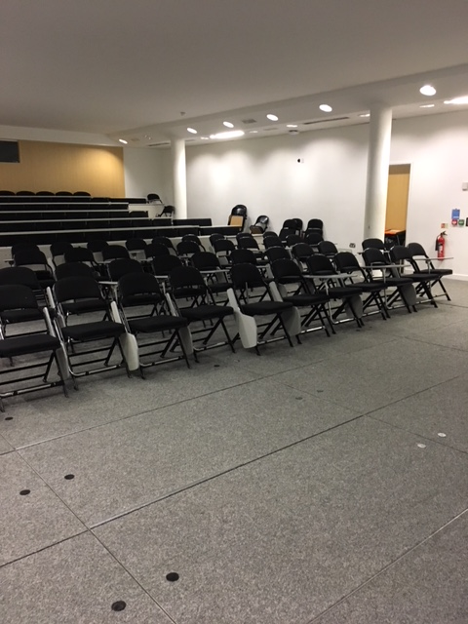

Slide 17
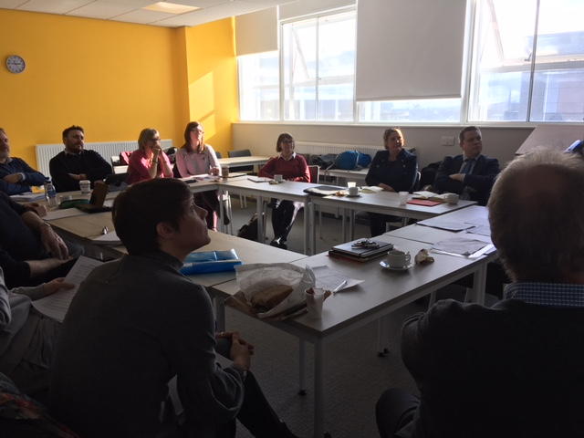

Slide 18
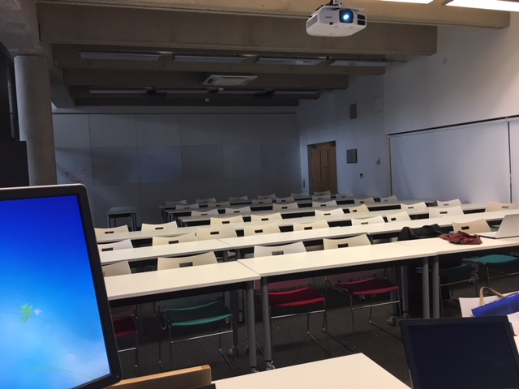

Slide 19
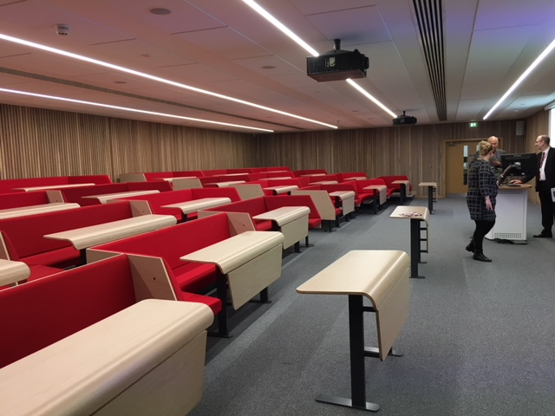

Slide 20
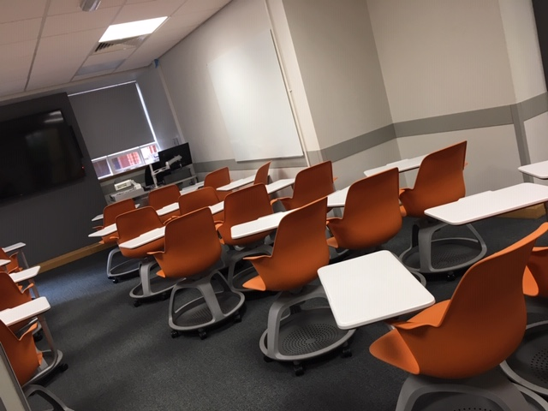

Slide 22
Thinking about your personal agency: how can you keep yourself energised and thoughtful: 6 ideas
1. Take calculated risks: It is often said that for good health that we should exert ourselves sufficiently to be out of breath at least three times a day and should frighten ourselves once a week! Without gambling with students’ futures, are there activities that you can use in your teaching and learning support that you find challenging, that you could try out in your classes to help you see the world of teaching with fresh eyes? If you always start classes in the same way, for example, could you devise a different type of opening? If you always use the same presentation software e.g. PowerPoint, could you use Prezi instead? Or simply use no slides? Work out who in your class might be negatively implicated, think through remediation, and then go for it!

Slide 23
Spring clean and ask a friend
2. Do a spring clean: at least annually, rigorously review your curriculum offer and be particularly assiduous in following the contemporary trend of ‘decluttering’, that is stripping out elements that no longer serve a useful purpose and making way for fresh new activities and approaches.
3. Ask a friend: Among your close colleagues, find someone who is amenable to undertaking a paired activity where you ask each other searching questions, not just about the ‘What’ of your teaching, but also the ‘So what’ (impact) and the ‘Then what’ (outcomes) as well as the ‘What else?’ (future directions). A trusted friend who knows you well is likely to help you interrogate your practice thoroughly while at the same time help you keep a sense of proportion by recognizing which aspects of your work you do really well.

Slide 24
Involve students
4. Use students as partners: Seale et al argue that students working in partnership with us can have diverse roles including as story-tellers, teachers/facilitators, evaluators/informants, stakeholders/representatives and customers/consumers. How can you work alongside, with and through students to help authentic student voices shape your teaching and learning activities? How can you use students productively to help you learn from and with students as active collaborators, not just from traditional evaluations but also form active and participatory approaches that go well beyond satisfaction surveys?

Slide 25
Help out a newbie
5. Become a mentor: this may seem counterintuitive if you are relatively new in role or already finding your workload heavy, but actually having a supportive conversation with a new(er) colleague can not only give you the benefits of academic altruism, but it can sometimes cause you to look at your own approaches in new ways, particularly if your mentee asks searching questions about your rationale for certain course of action, or approaches. Everyone I know finds being a mentor gives you back more than you input, in terms of new ways of looking at how you work. And even people relatively new in post can be helpful to colleagues right at the start of their teaching journeys, since your initial problems will remain very fresh in your mind.

Slide 26
Carpe Diem
6. Lift your head above the parapet: some of us working in teaching, learning, assessment and learning support become so encultured within the higher education context that we forget to look beyond. We may lose sight of the fact that it is a privilege to work in a domain where we can influence and shape the future of our society, even if only in a small way, by helping our learners gain broader perspectives and grow to achieve a potential neither they nor we had envisaged earlier. Even on the days when we may feel bogged down in the morass of bureaucracy and managerialism we need to take a moment to celebrate our roles and seize the day (after Race 2020, The Lecturer’s toolkit, 5th Edition)

Slide 27
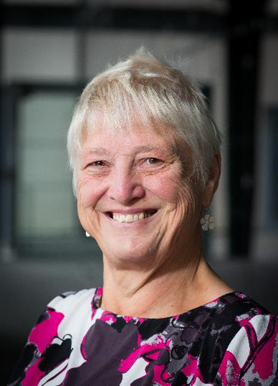
These and other slides are available on my website at http://sally-brown.net

Slide 28
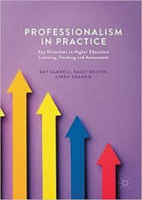
Sambell, K, Brown, S and Graham, L. (2017) Professionalism in Practice: Key directions in higher education: Learning, Teaching and Assessment, Basingstoke: Palgrave-Macmillan.

Slide 29
References 1
Brown, S. (2015) Learning, teaching and assessment in higher education: global perspectives, London: Palgrave-MacMillan.(p98-101)
Sambell, K., Brown, S. and Graham, L. (2017) Professionalism in Practice: key directions in higher education learning, teaching and assessment Chapter 5). London, New York, Palgrave Macmillan
Winstone, N. and Nash, R., (2016) The “Developing Engagement with Feedback Toolkit (DEFT)”: Integrating Assessment Literacy into Course Design. Transforming Assessment In Higher Education, p.48.
Carless, D., Joughin, G., Ngar-Fun Liu et al (2006) How Assessment supports learning: Learning orientated assessment in action Hong Kong: Hong Kong University Press.
David Carless & David Boud (2018): The development of student feedback literacy: enabling uptake of feedback, Assessment & Evaluation in Higher Education, DOI:10.1080/02602938.2018.1463354
Carroll, J. and Ryan, J. (2005) Teaching International students: improving learning for all. London: Routledge SEDA series.

Slide 30
Useful references: 2
Crosling, G., Thomas, L. and Heagney, M. (2008) Improving student retention in Higher Education, London and New York: Routledge.
Falchikov, N. (2004) Improving Assessment through Student Involvement: Practical Solutions for Aiding Learning in Higher and Further Education, London: Routledge.
Mentkowski, M. and associates (2000) p.82 Learning that lasts: integrating learning development and performance in college and beyond, San Francisco: Jossey-Bass.
Meyer, J.H.F. and Land, R. (2003) ‘Threshold Concepts and Troublesome Knowledge 1 – Linkages to Ways of Thinking and Practising within the Disciplines’ in C. Rust (ed.) Improving Student Learning – Ten years on. Oxford: OCSLD.
Peelo, M. T., & Wareham, T. (Eds.). (2002). Failing students in higher education. Society for Research into Higher Education.

Slide 31
Useful references: 3
Race P. (2020) The lecturer’s toolkit (5th edition), London: Routledge.
Race, P. (2014) Making learning happen: 3rd edition, London: Sage.
Rust, C., Price, M. and O’Donovan, B. (2003) Improving students’ learning by developing their understanding of assessment criteria and processes, Assessment and Evaluation in Higher Education. 28 (2), 147-164. Ryan, J. (2000) A Guide to Teaching International Students, Oxford Centre for Staff and Learning Development.
Yale, A.T., (2019) The personal tutor–student relationship: student expectations and experiences of personal tutoring in higher education. Journal of Further and Higher Education, 43(4), pp.533-544.

