Slide 1
Improving the student experience at Solent University: assessment, feedback, engagements and community
A presentation for staff at Southampton Solent University
Autumn 2019
Sally Brown NTF, PFHEA, SFSEDA
@ProfSallyBrown http://sally-brown.net

Slide 2
Central to student satisfaction, retention and positive regard for our programmes are excellent curriculum design delivery and assessment.
This needs to be developed strategically using contemporary evidence-based approaches and research-informed principles, involving a constructively aligned programme level cycle comprising:
Determining and reviewing subject material: reviewing currency, relevance, level;
Designing and refining learning outcomes, which are the lifeblood of learning;
Considering delivery modes including face-to-face, online, PBL, and blended approaches;
Thinking through student support to maximise engagement;
Designing fit-for-purpose assessment methods and approaches;
Assuring quality, matching HEI, national and PRSB requirements;
Evaluating programmes, exploring strengths and areas for improvement;
Enhancing quality, seeking continuous improvement.

Slide 3
Determining and reviewing subject material: currency, relevance, level
Enhancing quality, seeking continuous improvement
Designing and refining learning outcomes
Evaluating programmes, strengths and areas for improvement
Curriculum
Design
Essentials
Considering delivery modes: face-to-face, online, PBL, blended…
Assuring quality, matching HEI, national and PRSB requirements
Thinking through student support
Designing fit for purpose assessment methods and approaches

Slide 5
What major changes have impacted on HE teaching and learning globally over the last decade and what’s coming up on the horizon?
The increased focus on student satisfaction and value for money leading to changing expectations about student engagement;
The availability of vast data sets institutionally and nationally;
The effect on institutional strategies of promoting the research agenda, often at the expense of support for teaching initiatives;
The intensification of encouragement to seek professional recognition for teaching expertise particularly HEA Fellowships;
Changes in learning paradigms and knowledge construction as the central role of ‘content delivery’ in curriculum development has been challenged.

Slide 6
Changing students’ attitudes to engagement. Is it true? How do we know?
Many suggest students are more demanding of staff time and have higher expectations than previously;
Many HEIs are reporting worsening attendance, there certainly seems to be an attitude among some students that “well, I am paying for it so it’s up to me if I come in or not”
Some report a more litigious approach among dissatisfied students and their parents.

Slide 7
Changing students’ behaviours. Is it true? How do we know?
Reading: Academic book sales seem to be dropping, students are said not to use library books as much as they did, more and more reading is on-line with consequential changes to tolerances of length, breadth and depth;
Writing: it is suggested that students (and HE staff!) often find writing with a pen and paper in exams and in lectures an alien concept, but our practices haven’t kept pace;
Learning: with the power of the internet at our fingers, many are querying the value of learning stuff. Isn’t it enough just to know how to find information? What do academic and professional staff think? What do students think?

Slide 8
Laurentius de Voltolina
2nd half of 14th Century
Italian Painter

Slide 9
Delivering content…..
is less like delivering a parcel (the postman model) and more like delivering a baby (the midwife model).
University staff can advise, guide, intervene when things so wrong, but in the end only the student can bring learning into life!!
Content can be gleaned from many sources (e.g. MIT and our UK Open University (as well as websites like mine and Phil’s) are putting more and more content into open access areas).

Slide 10
The Maieutic model
Maieutics is a complex procedure of research introduced by Socrates, embracing the Socratic method in its widest sense. It is based on the idea that the truth is latent in the mind of every human being due to her/his innate reason but has to be “given birth” by answering questions (or problems) intelligently proposed. The word is derived from the Greek “μαιευτικός”, pertaining to midwifery.

Slide 11
What are you aiming to teach?
Content knowledge?
Critical thinking?
Problem identification and solution-finding?
Left-field and creative thinking?
The ability to work with incomplete information and changing circumstances?
Application of knowledge to practical contexts?
Plus other things you can identify

Slide 12
What’s important in terms of professional skills?
Use of specialist equipment?
Manual dexterity?
Awareness of health and safety?
Financial/marketing skills?
Self-awareness, stress management, resilience?
What else?

Slide 13
What’s important in terms of social and interactive capabilities?
The ability to form and work effectively in teams?
Leadership (and followership/collective responsibility)?
Emotional intelligence and the capability to recognise and work with the needs, strengths and weaknesses, and limitations of others?
Resilience in the face of failure, self-awareness, stress management, resilience, coping strategies and the ability to bounce-back?
The capability to recognise when additional support/guidance/advice is needed and to seek it out?
Plus other things you can identify

Slide 14
What does the concept of “resilience” mean to you? How can resilience help us to understand “productive failure”?
I always think of trees. To withstand the storm they need deep roots and a healthy support system. They bend and perhaps lose the odd branch...but they don’t break and continue to grow. (Paul Kleiman)

Slide 15
What’s important in terms of effective communication?
Writing accuracy including grammar, spelling and punctuation?
Writing effectiveness including fluency, coherence, logical sequencing, expressing complex ideas simply?
Oral communication including formal presentations, interviews, questioning and responding?
Empathy with fellow humans?
Effective use of digital communication (websites, blogs, social media etc?
Plus other things you can identify

Slide 16
And what else?
Information management?
Information retrieval and storage?
Data collection and usage?
Effective use of data bases, packages, and appropriate technologies?
Plus other things you can identify

Slide 17
Curriculum design for learning and wellbeing

Slide 18
Good curriculum design considers the whole student experience including:
The ways in which we organise students’ learning opportunities;
Coherence and logical sequencing of content teaching, skills development and practical and other activities;
Progression from initial support to growing independence of learning;
Systematic opportunities for students to develop the various academic literacies they need;
This implies using a programme focused approach to curriculum design, delivery and assessment and the end of the cantonisation of the curriculum.

Slide 19
Programme learning outcomes should reflect what students should achieve
Making it clear to students what is expected of them;
Making it clear to teachers what students are expected to learn in their own and other modules;
Helping teachers to select the most appropriate teaching strategy for the intended learning outcomes e.g. lecture, seminar, tutorial, group work, discussion, student presentation, laboratory work;
Helping teachers to select the most appropriate assessment style to assess the achievement of the learning outcomes, e.g. project, essay, performance assessment, multiple‐choice questions, exam;
Having a focus on programme learning outcomes – staff therefore need time to collaborate;
Are you confident that students being marked by different people or the same people at different times (inter & intra-tutor reliability) will achieve equivalent marks?

Slide 20
Mapping out the programme as a whole:
Are you ensuring that students are immersed in the subject they have come to study from the outset?
Is induction a valuable and productive introduction to the course and the assessment methods in use?
Do students have a positive and balanced assessment experience across the programme?
Are there points in the academic year when there doesn’t seem to be much going on (e.g. an extended Christmas break) when going home (and not coming back) seems like a good option?

Slide 21
Programme level approaches to assessment: why do we need them?
In small programmes where course teams know one another and their students, it is relatively straightforward to help students believe they are studying on coherent programmes with clear pathways through the curriculum. However, the larger the institution and the cohort, the more likely it is that modules and other curriculum delivery components are designed and delivered in isolation, without clear thinking going into what the overall programme experience is like for the students undertaking them.

Slide 22
Peter Hartley’s NTFS Bradford-led project on Programme Level Assessment
It set out to focus on redressing problems including:
not assessing learning outcomes holistically at a programme level;
the atomisation of assessment, often resulting in too much summative and not enough formative feedback and over-standardisation in regulations.
This results in students and staff failing to see the links between disparate elements of the programme, over-assessment and multiple assignments using repetitive formats.
Modules were often too short for complex learning and this tended to lead to surface learning and ‘tick-box’ mentality.

Slide 23
What do we mean by Programme Focused Assessment?
“The first and most critical point is that the assessment is specifically designed to address major programme outcomes rather than very specific or isolated components of the course. It follows then that such assessment is integrative in nature, trying to bring together understanding and skills in ways which represent key programme aims. As a result, the assessment is likely to be more authentic and meaningful to students, staff and external stakeholders.”
Chris Rust. See also PASS project at http://www.pass.brad.ac.uk/position-paper.pdf

Slide 24
Programme Focused Assessment: potential benefits include:
Integrated learning and assessment at the meta-level, ensuring assessment of programme outcomes.
Students taking a deep approach to their learning.
Increased self and peer-assessment, developing assessment literacy.
Greater responsibility of the student for their learning and assessment, developing self-regulated learners.
The possibility of slow learning.

Slide 25
Mapping progression
Is there a coherent model of progression across the student life-cycle from induction to ‘outduction’?
Do you manage transitions from year one to year two and year two to year three to ensure students remain committed and engaged?
Is there some continuity in the sources of student support throughout the course (e.g. personal tutors)?
Are students offered support and guidance in relation to personal development and employability?

Slide 26
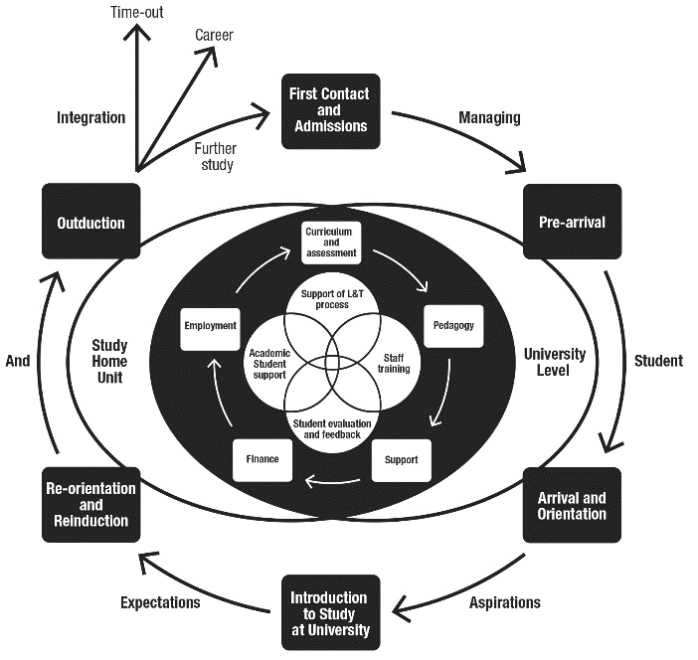
Source: Supporting Student Diversity – A practical guide (Morgan, 2013) p61

Slide 27
Inter-year transitions: avoiding the sophomore slump (Yorke, 2014, Zaitseva et al)
The three-months between the end of the 1st year and the start of the 2nd (and to a lesser extent between 2nd and 3rd years) provides lacunae for lost motivation and decreased engagement;
Energy, thought and resources need to be deployed to counteract this tendency and to maintain student engagement;
This can be undertaken in three ways:
Through linking study from year to year through assignments and other activities set to bridge the gap;
By maintaining contact (live or virtual);
By using peer groups and networks for mutual support.

Slide 28
Developing engagement among your students
Is there a coherent model of progression across the student life-cycle from induction to ‘outduction’ (Morgan, 2011)?
Do you manage transitions from year one to year two, and year two to year three, to ensure students remain committed and engaged?
Is there some continuity in the sources of student support throughout the course (e.g. personal tutors)?
Are students offered support and guidance in relation to personal development and employability?
Are students using critical thinking and high levels of analytical thought sufficiently at each level of a programme?
Are students working autonomously as well?
Do students have meaningful and purposeful opportunities of working together?

Slide 29
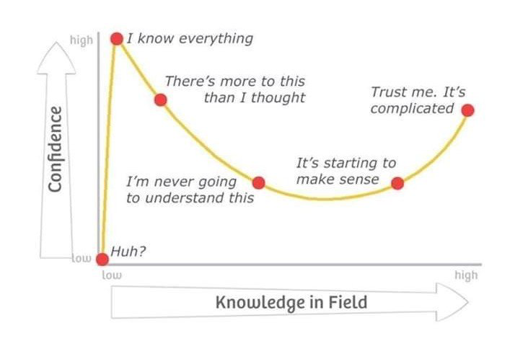
Adapted from Kruger, J. and Dunning, D., 2009

Slide 30
Confidence, achievement and retention
Crudely, student achievement is linked to students own beliefs about their abilities, whether these are fixed or malleable;
Students who subscribe to an entity (fixed) theory of intelligence (Dweck, 2000) need support to confirm their ability and thereby become less fearful of learning goals as these involves an element of risk and personal failure.
Learning and assessment for these students are all-encompassing activities that defines them as people. If they fail at an assignment, they see themselves as failures.

Slide 31
Students who believe that intelligence is malleable may be more robust
Students who believe that intelligence is incremental have little or no fear of failure. A typical response from such a student is ‘The harder it gets, the harder I need to try’. These students do not see failure as an indictment of themselves and [can] separate their self-image from their academic achievement. When faced with a challenge, these students are more likely to continue in the face of adversity because they have nothing to prove. (after Clegg in Peelo and Wareham 2002).

Slide 32
What can we do in the first six weeks?
Enable students to feel part of a cohort rather than a number of a list;
Help students acclimatise to the new learning context in which they find themselves;
Familiarise them with the language and culture of the subject area they are studying (Northedge, 2003);
Foster the information literacy and other skills that students will need to succeed;
Guide them on where to go for help as necessary;
Offer them immersive experiences.

Slide 33
The concept of universal design
“Instead of retrofitting curriculum for students via accommodations and modifications, the principles of UDL prompt teachers to design curriculum that is flexible and adaptable to multiple forms of learning and engagement to facilitate the learning of all students.” (Lancaster, 2008)
“The ‘universal’ in UDL does not mean there is a single optimal solution for everyone. Instead, it underscores the need for flexible approaches to teaching and learning that meet the needs of different kinds of learners. ” (Rose and Meyer, 2006)

Slide 34
Are your learning outcomes SMART or VASCULAR? The usual ‘requirements’ are that they be:
Specific;
Measurable;
Achievable;
Realistic;
Time constrained.

Slide 35
VASCULAR learning outcomes
Verifiable: Can we tell when they’ve been achieved? And can students?
Action orientated: Do they lead to real and useful activity?
Singular: i.e. not portmanteau outcomes combining two or more into one, making it difficult to assess if differently achieved, but readily matchable to student work produced?
Constructively aligned? (Biggs and Tang, 2011) so that there is clear alignment between aims (What do students need to be able to know and do?), what is taught/ learned, how these are assessed and evaluated);
Understandable i.e. using language codes that are meaningful to all stakeholders?
Level-appropriate? Suitable and differentiable between1st year, 2nd year, 3rd year, Masters, other PG?
Affective-inclusive i.e. not just covering actions but capabilities in the affective domain?
Regularly reviewed? Not just stuck in history and always fit-for-purpose.

Slide 36
Phil Race is concerned we need to go beyond learning outcomes and include:
Learning incomes: all the things learners are bringing to the learning situation:
Emergent learning outcomes: those we didn’t (and maybe couldn’t) predict, which may surprise and astound us!:
Intended learning outgoings: helping them link the intended learning outcomes to the wider world of future learning and employment;
See http://phil-race.co.uk/2018/05/beyond-learning-outcomes/

Slide 37
Designing assessment as a central part of curriculum design
Assessment is a complex, nuanced and highly important process​ and if we want students to engage fully, we must make it really meaningful to them and convince them that there is merit in the activities we ask them to undertake. To focus students’ effort and improve their engagement with learning, we need to take a fresh look at our current practice to make sure assessment is for rather than just of learning, with students learning while they are being assessed rather than it being merely a summative end process. We also need to ensure that we make assessment practices and the giving of feedback manageable for staff and valuable for students.

Slide 39
Enhancing Assessment and Feedback
Effective assessment is crucial for student satisfaction and achievement. This session will explore how we can review and revise our assessment approaches so that students have the best possible chance of success, particularly by:
building students' assessment literacy and thereby enabling them better to understand how criteria and assessment practices work;
ensuring that assessment is for not just of learning;
fostering approaches to feedback that mean students take good note of and use the comments and advice provided by their assessors.
By the end of the session, participants will have had opportunities to come to grips with typical problematic aspects of assessment and feedback, and to devise strategies to ensure their own practices and approaches are fit-for-purpose and manageable by students and themselves.

Slide 40
Underpinning premises for A4L
Assessment can be a powerful means of focusing student effort and enhancing achievement if it is well designed and constructively aligned (Biggs and Tang, 2011);
We need to deploy a diverse range of tactics to our assessment and feedback to ensure that they work to enhance and extend student learning;
Students need to achieve assessment literacy to ensure they understand and can benefit from our assessment systems;
Assessment needs to be manageable for staff and students if it is going to engage students in learning activities.

Slide 41
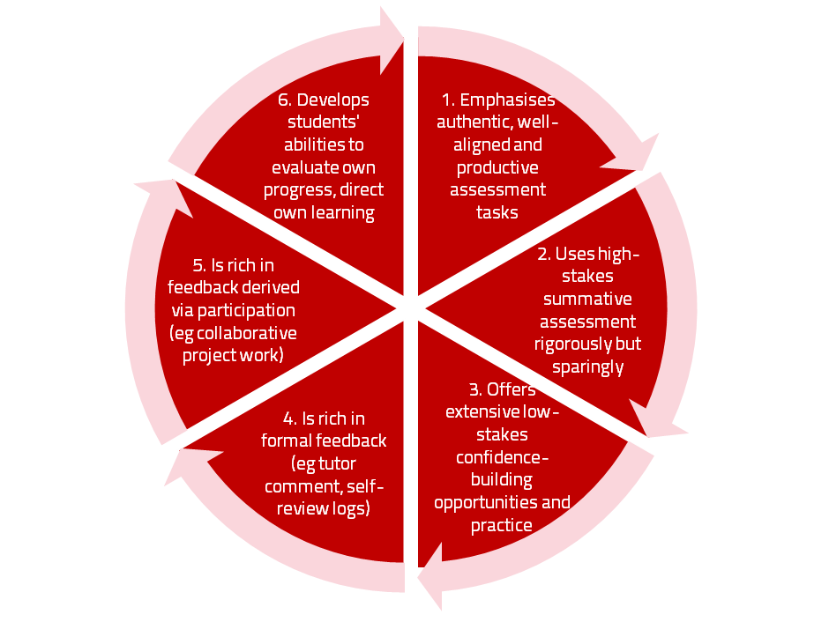
A4L the Northumbria model

Slide 42
Using assessment for learning (Sambell et al, 2012)
Assessment that is meaningful to students can provide them with a framework for activity;
“Students can escape bad teaching but they can’t escape bad assessment” (Boud, 1995);
Where assessment is fully part of the learning process and integrated within it, the act of being assessed can help students to make sense of their learning;
Assessment should be formative, informative, developmental and remediable.

Slide 43
My fit-for-purpose model of assessment: the key questions
Why are we assessing?
What is it we are actually assessing?
How are we assessing?
Who is best placed to assess?
When should we assess?
Notes:
43

Slide 44
For any assessment activity, we need to be clear about:
Aims: is this an early stage assignment, that is principally about building confidence and helping students see what is required of them, or is it a key element of their summative assessment, designment to gauge fitness to progress, or fitness-to-practice?
Scope: is this testing low level outcomes, like demonstrating recollection of key terms, or is it cognitively more demanding requiring synthesis of multiple elements, critical analysis, evaluation and reflection?
Scale: is this a small scale or a substantial task carrying a heavy weighting? Do students know how much effort and energy is needed to achieve at least a satisfactory level?
Orientation: Is the key aim to demonstrate the achievement of skills and competences, and/or to produce a definite product or is it primarily about demonstrating mastery of appropriate processes?
Constructive alignment: To what extent does the assessment closely link to the learning outcomes (and specifically the verbs used in them)?

Slide 45
So to help us focus on assessment criteria and developing students’ assessment literacy, a game!
This game is designed to help you think about how we can explain the importance of taking assessment criteria seriously in assessment to help students really understand what they need to do to succeed;
Biscuits are a metaphor!

Slide 46
Thinking through the issues raised in the biscuit game
It is often useful to start from individual perspectives at the outset of an assignment and clarify preconceptions;
Assessment is a complex nuanced task with grey areas, and just as agreed definitions of biscuits are not always readily achievable, so also assignments benefit from dialogue to clarify expectations;
Category definitions can sometimes be complicated when setting assignments. It’s helpful in advance of an assessment to agree definitions of what is, for example, a portfolio;
It’s helpful to face the fact that although criteria may be considered to be explicit, the way people grade using criteria can differ substantially;
Assigning grades is an imprecise and inexact activity, and we need to recognise that absolute certainty about grades is not always achievable;
Generic discussion about assessment, and how we grade can help develop assessment literacy.

Slide 47
Formative and summative assessment
Formative assessment is primarily concerned with feedback aimed at prompting improvement, is often continuous and usually involves words.
Summative assessment is concerned with making evaluative judgments, is often end point and involves numbers.

Slide 48
The importance of dialogic feedback (Sadler)
Students need to be exposed to, and gain experience in making judgements about, a variety of works of different quality... They need planned rather than random exposure to exemplars, and experience in making judgements about quality. They need to create verbalised rationales and accounts of how various works could have been done better. Finally, they need to engage in evaluative conversations with teachers and other students.

Slide 49
Assessment literacy: students do better if they can:
Make sense of key terms such as criteria, weightings, and level;
Encounter a variety of assessment methods (e.g. presentations, portfolios, posters, assessed web participation, practicals, vivas etc) and get practice in using them;
Be strategic in their behaviours, putting more work into aspects of an assignment with high weightings, interrogating criteria to find out what is really required and so on;
Gain clarity on how the assessment regulations work in their HEI, including issues concerning submission, resubmission, pass marks, condonement etc.

Slide 50
Students tend to be more convinced about the fairness of the assessment process if
Requirements and procedures are transparent and made readily available to them;
They believe that the tasks they are asked to do are worthwhile and are closely linked to what course documentation indicates they should be able to know and do at the end of the programme i.e. authentic assessment;
They fully understand the ‘rules of the game’.

Slide 51
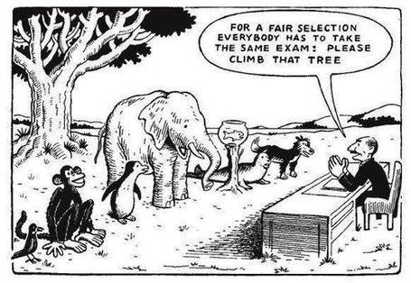

Slide 52
Assessment for learning: some useful thoughts
1. Tasks should be challenging, demanding higher order learning and integration of knowledge learned in both the university and other contexts;
2. Learning and assessment should be integrated, assessment should not come at the end of learning but should be part of the learning process;
3. Students are involved in self assessment and reflection on their learning, they are involved in judging performance;
4. Assessment should encourage metacognition, promoting thinking about the learning process not just the learning outcomes;
5. Assessment should have a formative function, providing ‘feedforward’ for future learning which can be acted upon. There is opportunity and a safe context for students to expose problems with their study and get help; there should be an opportunity for dialogue about students’ work;

Slide 53
Assessment for learning
6. Assessment expectations should be made visible to students as far as possible;
7. Tasks should involve the active engagement of students developing the capacity to find things out for themselves and learn independently;
8. Tasks should be authentic; worthwhile, relevant and offering students some level of control over their work;
9. Tasks are fit for purpose and align with important learning outcomes;
10. Assessment should be used to evaluate teaching as well as student learning.
(Bloxham and Boyd)

Slide 54
Do your international students understand UK assessment approaches?
Have you clarified the ground rules on issues like pass marks, criterion-referenced assessment and grading systems?
Have you explained how extensions, condonements, and university assessment regulations work?
Are the assignments built around a curriculum international in scope and content? Are tasks and case studies globally orientated?

Slide 55
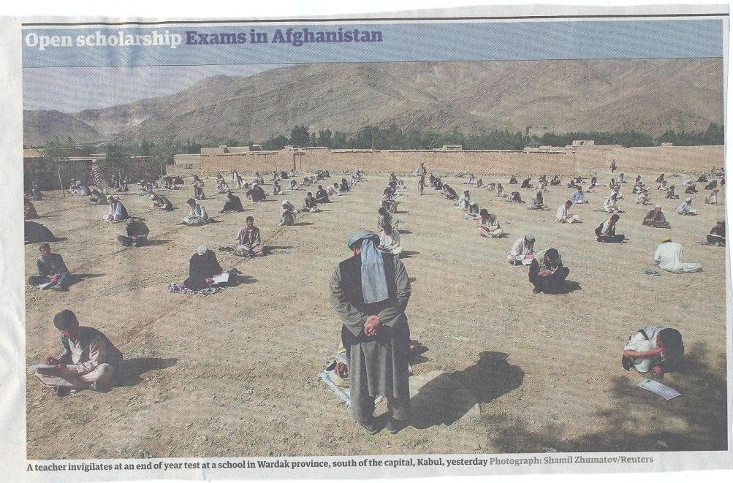

Slide 56
What do we mean by ‘traditional assessment formats”?
At least 80% of UK higher education assessment uses three main forms;
Unseen time constrained exams of some sort;
Essays where students respond to a stimulus question or title;
Reports of some kind.
These are not necessarily authentic or useful means of assessing students knowledge, capabilities and understanding.

Slide 57
Authentic assessment: what are the principal benefits for stakeholders?
Students undertaking authentic assessments tend to be more fully engaged in learning and hence tend to achieve more highly because they see the sense of what they are doing (Sadler, 2005).
University teachers adopting authentic approaches can use realistic and live contexts within which to frame assessment tasks, which help to make theoretical elements of the course come to life.
Employers value students who can quickly engage in real-life tasks immediately on employment, having practiced and developed relevant skills and competences through their assignments.

Slide 58
Wiggins (1990) says assessment can be regarded as authentic if we can draw valid inferences about quality from the work students produce
He proposes that we should aim to offer students assignments that present the student with the full array of tasks that mirror the priorities and challenges found in the best [teaching] activities and that attend to whether the student can craft polished, thorough and justifiable answers, performances or products.
He says they must involve students being able to cope with potentially ill-structured challenges and roles, with incomplete information, that help them rehearse for the complex ambiguities of adult and professional life.

Slide 59
We often assess what is easy to assess, or proxies of what’s been learned, rather than the learning itself
A valid assessment is one that has close relevance to the criteria, which are in turn constructively aligned to the stated learning outcomes of a programme.
Effective assessment is highly relevant to ensuring that graduates can demonstrate the knowledge, behaviours, qualities and attributes that were described in the course outline or programme specification.
Assignments that require students to write about something, rather than be or do something, may not always be fit-for-purpose.

Slide 60
How can authentic assessment engage students?
Using types of assessment that are much more like the ‘real things’ that academics or professionals do in their chosen fields can engage students in much more meaningful ways.
A useful way to help you ascertain how authentic your assessment is could be to ask yourself where in the programme you help students answer questions in job interviews (Sambell, Brown and Graham, 2017)

Slide 61
Questions employers might ask at interview that might help us frame some of our assignments
Can you tell us about an occasion when:
you worked together with colleagues in a group to produce a collective outcome;
you had to work autonomously with incomplete information and self-derived data sources;
you developed strategies to solve real life problems and tested them out;
you had a leadership role in a team, and could you tell us your strategies to influence and persuade your colleagues to achieve a collective task;
you had to communicate outcomes from your project work orally, in writing, through social media and/or through a visual medium?"

Slide 62
Diverse format assignments for authenticity could include:
Simulations (paper-based or computer-based) .
Multiple choice questions , with subsequent questions seeking out rationales for answers.
Scripts for Business/Elevator pitches.
Case studies for interrogation.
The requirement to write executive summaries of complex documents.
Reports of Project outputs.
Action plans based on project activity undertaken.
In-tray exercises where students are required to prioritise and use a variety of documents, graphs, tables etc in real time.
Short-answer questions which can be marked electronically.
Reflective commentaries of practical experience. Critical incident accounts, where students are asked, for example following a placement or project, to write say 200 words on Context, Action taken, Rationale for action, Literature review guiding choice of action, Report of outturn, Indication of what has been learned and what would be done differently next time.

Slide 63
Fostering student engagement with feedback
Students tend to regard marks like money, and so will put more energy into things that ‘count’ than those they see as options;
Formative feedback, that is developmental and supportive, and given at the right stage so that it guides future performance can be exceptionally powerful in improving achievement and retention;
Feedback and ‘feed-forward’ must be integral to student learning programmes, rather than something that students opt into, so needs to be within live or virtual face-to-face interaction.

Slide 64
Encouraging better use of feedback
Emphasise early on the importance to students of formative feedback;
Consider how best to provide them with feedback.
Provide them with training on why and how feedback is provided;
Get students to practise drafting and delivering feedback;
Get students to focus on comments rather than marks;
Help students to believe they have the agency to improve their work;
Encourage students to think of feedback as a trigger to them taking action;
Give them some examples of helpful feedback as a prompt to discussion.

Slide 65
Good feedback: (after Brown, S. (2015), Assessment, learning and teaching in higher education: global perspectives, London: Palgrave-MacMillan)
Is dialogic, rather than mono-directional, giving students chances to respond to comments from their markers and seek clarification where necessary.
Helps clarify what good work looks like, so students are really clear about goals, criteria and expected standards, and provides opportunities to close the gap between current and desired performance.

Slide 66
Good feedback:
Actively facilitates students reviewing their own work and reflecting on it, so that they become good judges of the quality of their own work.
Doesn’t just correct errors and indicate problems, potentially leaving students discouraged and demotivated, but also highlights good work and encourages them to believe they can improve and succeed.

Slide 67
Good feedback:
Delivers high-quality information to students about their achievements to date and how they can improve their future work. Where there are errors, students should be able to see what needs to be done to remediate them, and where they are undershooting in terms of achievement, they should be able to perceive how to make their work even better.

Slide 68
Good feedback:
Offers ‘feed-forward’ aiming to ‘increase the value of feedback to the students by focusing comments not only on the past and present … but also on the future – what the student might aim to do, or do differently in the next assignment or assessment if they are to continue to do well or to do better’ (Hounsell, 2008, p.5).
Ensures that the mark isn’t the only thing that students take note of when work is returned, but that they are encouraged to read and use the advice given in feedback and apply it to future assignments.

Slide 69
Slides from Carless and Boud 2018
To cite this article: David Carless & David Boud (2018): The development of student feedback literacy: enabling uptake of feedback, Assessment & Evaluation in Higher Education, DOI:10.1080/02602938.2018.1463354
To link to this article: https://doi.org/10.1080/02602938.2018.1463354
(Mostly direct quotes from the article, not all included).

Slide 70
Processes for developing feedback literacy Slides based on Carless and Boud 2018
Two well-established learning activities:
Peer feedback
Analysing exemplars

Slide 71
Are teachers absolved from managing feedback? Slides based on Carless and Boud 2018
It is unrealistic and ineffective to expect teachers to provide more and more comments to large numbers of learners. This is not to absolve teachers of responsibility for managing feedback processes and designing the curriculum in ways in which feedback can be used.
It is only students who can act to improve their learning.

Slide 72
What is feedback literacy? Slides based on Carless and Boud 2018
One of the main barriers to effective feedback is generally low levels of student feedback literacy. Students’ feedback literacy involves
an understanding of what feedback is and how it can be managed effectively;
capacities and dispositions to make productive use of feedback;
appreciation of the roles of teachers and themselves in these processes.

Slide 73
What is feedback? Slides based on Carless and Boud 2018
Building on previous definitions (Boud and Molloy 2013; Carless 2015), feedback is defined as a process through which learners make sense of information from various sources and use it to enhance their work or learning strategies.
This definition goes beyond notions that feedback is principally about teachers informing students about strengths, weaknesses and how to improve, and highlights the centrality of the student role in sense-making and using comments to improve subsequent work. Information may come from different sources e.g. peers, teachers, friends, family members or automated computer-based systems to support student self-evaluation of progress.

Slide 74
Present dissatisfaction with feedback Slides based on Carless and Boud 2018
There is also a wide range of evidence from the National Student Survey in England and Wales (Higher Education Funding Council for England 2016) and the Student Experience Survey in Australia (Quality Indicators for Learning and Teaching 2017) that students are not particularly satisfied with feedback and the broader assessment regimes within which feedback is commonly organised.
For feedback processes to be enhanced, students need both appreciation of how feedback can operate effectively and opportunities to use feedback within the curriculum.

Slide 75
Student appreciation of feedback processes Slides based on Carless and Boud 2018
Appreciating feedback refers to both students recognising the value of feedback and understanding their active role in its processes. Students have various conceptions of feedback and these are often not particularly sophisticated, mainly focusing on feedback as telling (McLean, Bond, and Nicholson 2015).
Students sometimes fail to recognise or appreciate forms of feedback other than written comments on submitted work (Price, Handley, and Millar 2011). Based on their secondary school experience, students may have limited absolutist beliefs about knowledge and prefer to receive unequivocal corrective feedback (O’Donovan 2017).

Slide 76
Students as consumers? Slides based on Carless and Boud 2018
Increasingly common discourses of students as consumers may also reinforce instrumental attitudes to learning and inhibit students from taking responsibility for developing their own knowledge and skills (Bunce, Baird, and Jones 2017).
This may lead to passive student reactions to feedback and perceptions that it is the teacher’s role to tell students what to do to achieve high grades.

Slide 77
Why ‘feedback as telling’ is not enough Slides based on Carless and Boud 2018
Approaches that emphasise feedback as telling are insufficient because students are often not equipped to decode or act on statements satisfactorily, so key messages remain invisible (Sadler 2010).
Feedback literacy demands that learners acquire the academic language necessary for understanding, interpreting and thinking with complex ideas (Sutton 2012).

Slide 78
Can learning analytics help? Slides based on Carless and Boud 2018
Recent developments in learning analytics enable information based on learning logs and digital traces to provide timely personalised feedback at scale and enhance student satisfaction with feedback processes (Pardo 2018; Pardo et al. 2017).
Within these promising technology-enabled approaches, there remain risks that the process may still be dominated by feedback as telling, learner agency may be lacking and productive action may not ensue unless there are designs for student uptake.

Slide 79
Making judgements Slides based on Carless and Boud 2018
To make the most of feedback processes, students need to be developing evaluative judgment: capability to make decisions about the quality of work of oneself and others (Tai et al. 2017). Lower achieving students are often relatively weak at self-evaluating their performance and frequently conflate effort with quality (Boud, Lawson, and Thompson 2013).
In order to become more accurate in judging the standards of their own performance, students need extended opportunities for self-evaluation so that they can improve their judgment over time (Boud, Lawson, and Thompson 2013, 2015).

Slide 80
Engaging students in making judgements Slides based on Carless and Boud 2018
Engaging students in improving their capacity to make sound judgments is challenging unless there are sustained opportunities for comparison with the views of others (Boud, Lawson, and Thompson 2013).
Peer feedback is a key means of encouraging students’ sharing of judgments. Making judgments involves the implicit or explicit application of criteria.
Students often find assessment criteria too dense and abstract to enable them to make judgments about quality, preferring instead exemplars which they perceive as more accessible illustrations of quality (Carless 2015).

Slide 81
Managing the ‘affect’ of feedback Slides based on Carless and Boud 2018
Affect refers to feelings, emotions and attitudes. Students often exhibit defensive responses to feedback, particularly when comments are critical or grades are low (Robinson, Pope, and Holyoak 2013).Under these circumstances, feedback often provokes negative affective reactions and threats to identity, so how students manage their emotional equilibrium impacts on their engagement with critical commentary (To 2016). Affective responses to feedback are mediated by students’ relationships with their teacher and with other participants as they construct meanings together (Esterhazy and Damsa 2017).

Slide 82
Affect, and tone of feedback Slides based on Carless and Boud 2018
An aim of feedback is to challenge students to adopt new perspectives, but students often do not welcome this challenge (Forsythe and Johnson 2017). Critical feedback can have positive or negative impacts depending on a range of factors, including student self-efficacy, motivation and ability to handle emotions constructively (Pitt and Norton 2017).
The tone in which feedback is shared is one of the most critical aspects of how students react to feedback (Lipnevich, Berg, and Smith 2016). When teachers signify in writing and speech that they care about their learners, then student engagement with feedback is enhanced (Sutton 2012).

Slide 83
Affect: developing confidence Slides based on Carless and Boud 2018
If a trusting atmosphere is established, learners are more likely to develop the confidence and faith to reveal what they do not fully understand (Carless 2013).
Student dispositions to engage with feedback are often not optimal. Students seem to recognise that feedback can facilitate progress but underplay their own responsibility to actualise this improvement (Winstone et al. 2017a).
Capable students are often pro-active in seeking out feedback and striving to understand what teachers look for in assignments; i.e. cue-conscious or cue-seeking behaviours identified in the literature (Miller and Parlett 1974; Yang and Carless 2013).

Slide 84
Motivating students to take action Slides based on Carless and Boud 2018
Feedback literacy requires learners to act upon comments that they have received (Sutton 2012).
Students need to engage actively in making sense of information and use it to inform their later work, thereby closing a feedback loop (Boud and Molloy 2013).
This imperative for students to take action is a critical aspect of feedback processes which is sometimes underplayed. Students need motivation, opportunities and means to act on feedback (Shute 2008).

Slide 85
Hattie and Timperley’s model Slides based on Carless and Boud 2018
Hattie and Timperley’s (2007) model of feedback to enhance learning suggests that feedback operates at four levels.
Feedback at the self-regulation level and feedback at the process level are generally most likely to lead to learner uptake and improvement.
Feedback at the level of the self is least effective because it focuses on the person rather than improving learning.
The main limitation of feedback at the task level is the difficulty for students to generalise messages to other tasks and take subsequent action (Hattie and Timperley 2007).

Slide 86
The problem of feedback on final tasks Slides based on Carless and Boud 2018
When assessment tasks are not well-aligned or are only submitted at the end of modules, there is limited scope for students to apply insights fromteacher comments (Carless et al. 2011).
End-of-semester comments on assignments often focus on future development beyond the immediate context involving a temporal dimension relating to slowly-learnt aspects of course outcomes, and requiring sustained student action over an extended period of time (Price, Handley, and Millar 2011).

Slide 87
Features of student feedback literacy Slides based on Carless and Boud 2018
We now propose a set of inter-related features that serve as a framework underpinning student feedback literacy.
Students with well-developed feedback literacy appreciate their own active role in feedback processes; are continuously developing capacities in making sound judgments about academic work; and manage affect in positive ways.
These three features are inter-related as represented in Figure 1 by bi-directional arrows. It is proposed that a combination of the three features at the top of the figure maximises potential for students to take action as illustrated at the base of the figure.

Slide 88
How the factors relate to each other Slides based on Carless and Boud 2018
Appreciating Feedback
Making Judgements
Managing
Affect
Taking Action
Features of student feedback literacy

Slide 89
Feedback literate students: (summary slide)
Appreciating feedback
understand and appreciate the role of feedback in improving work and the active learner role in these processes;
recognise that feedback information comes in different forms and from different sources;
use technology to access, store and revisit feedback.
Making judgements
develop capacities to make sound academic judgments about their own work and the work of others;
participate productively in peer feedback processes;
refine self-evaluative capacities over time in order to make more robust judgments.
Managing affect
maintain emotional equilibrium and avoid defensiveness when receiving critical feedback;
are proactive in eliciting suggestions from peers or teachers and continuing dialogue with them as needed;
develop habits of striving for continuous improvement on the basis of internal and external feedback.
Taking action
are aware of the imperative to take action in response to feedback information;
draw inferences from a range of feedback experiences for the purpose of continuous improvement;
develop a repertoire of strategies for acting on feedback.
Carless and Boud: 2018

Slide 90
Streamlining assessment: why would we wish to do it?
Huge pressure on resources in higher education;
Larger numbers of students in cohorts;
Ever-increasing demands on staff time;
Staff indicate they spend a disproportionate time on assessment drudgery;
The means exist nowadays to undertake some aspects of assessment more effectively and efficiently.

Slide 91
To give feedback more effectively & efficiently, we can:
Feedback orally to groups of students;
Write an assignment report;
Use model answers;
Use assignment return sheets;
Use statement banks;
Use technologies for delivering and managing assessment.

Slide 92
Feeding back orally to groups of students: why?
Face-to-face feedback uses tone of voice, emphasis, body language;
Students learn from feedback to each others’ work;
Students can ask questions;
Makes feedback a shared experience.

Slide 93
Written assignment reports: why?
Provides feedback to a group as a whole;
Allows students to know how they are doing by comparison with the rest of the course;
Offers a chance to illustrate good practice;
Minimal comments can be put on scripts.

Slide 94
Assignment return sheets: why?
Proformas save assessors writing the same thing repeatedly;
Helps to keep assessors’ comments on track;
Shows how criteria match up to performance and how marks are derived;
Helps students to see what is valued;
Provides a useful written record.

Slide 95
Assignment reports: how?
Staff mark assignments with minimal in-text comment and provide grades/marks as normal;
Notes are made of similar points from several students’ work;
A report is compiled which identifies examples of good practice, areas where a number of students made similar errors and additional reading suggestions.

Slide 96
Sample assignment return proforma
Criterion no | Criterion | Mark (0-5 marks) | Tutor comments and suggestions for further work | Student response
1 | Demonstrates ability to present information clearly logically, accurately and fluently | 3 | This work is written reasonably fluently but there are some typos that would not slip in if spell checker used properly. Also note you don’t use the definite and indefinite articles (‘a’ and ‘the’ appropriately: please refer to the language guidance 17.3 on the VLE | This is something I’ve had problems with over the years but am still working on it
2 | Demonstrates ability to choose and use appropriate software | 5 | Made excellent choices and used it well to suit the context of the problem being addressed | Thank you
3 | Demonstrates ability to use a range of reference materials and cite them appropriately | 1 | Cited only one reference and did so inaccurately Please refer to the ifs referencing guide on the VLE and ensure that you provide all the information required | I've checked it out and see where I was going wrong

Slide 97
Statement banks: why?
Harnesses a resource of comments you already use;
Avoids writing same comments repeatedly;
Allows you to give individual comments additionally to the students who really need them;
Can be automated with use of technology.

Slide 98
Using model answers: why?
They give students a good idea of what can be expected of them;
It is sometimes easier to show students than tell them what we are after;
They can be time efficient;
They show how solutions have been reached;
They demonstrate good practice;
The commentary can indicate why an answer is good.

Slide 99
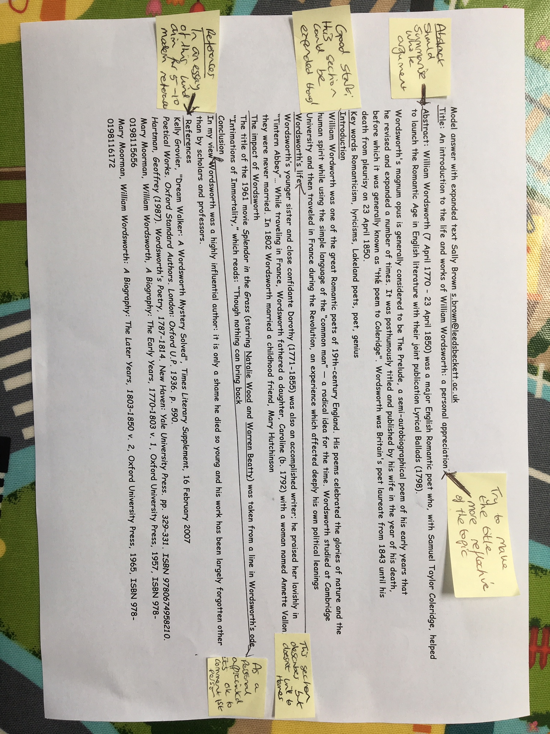

Slide 100
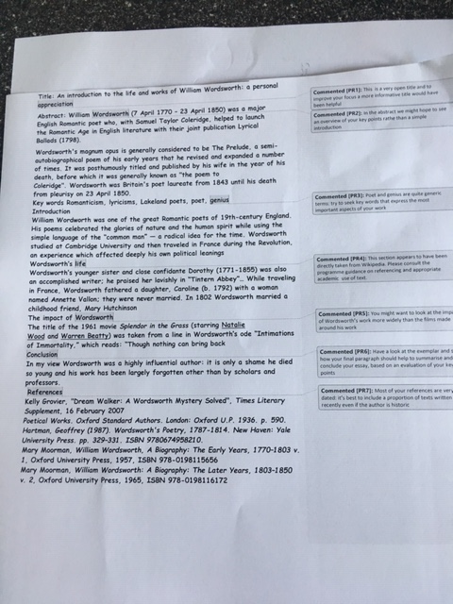

Slide 101
Using model answers: how?
Staff preparing an assignment can draft a model answer;
Student work (or extracts from several student’s answers) can be anonymised and (with permission) used as a model;
Text can be placed on page with explanatory comments appended (‘exploded text’);
However, caution should be exercised in order to lead students to think only one approach is acceptable.

Slide 102
Feeding back orally to groups of students: how?
Staff mark assignments with minimal in-text comment and provide grades/marks as normal;
At the start of a lecture or seminar, the tutor provides an overview of class performance and orally remediates errors ,clarifies misunderstandings, and praises good practice;
Students have a chance to ask and answer questions.

Slide 103
Computer-assisted assessment: why?
Enables feedback to be given regularly and incrementally;
Saves tutor time for large cohorts and repeated classes;
Can allow instant (or rapid) on screen feedback to e.g. MCQ options;
Saves drudgery, (but not a quick fix);
Can track the performance of test items.

Slide 104
Computer-assisted assessment: how?
This should not be a cottage industry!
Training and support both in designing questions and applying the relevant technology are essential;
Testing and piloting of CAA items is also imperative;
Make use of existing test packages (e.g. from publishers), colleagues with expertise and advice from software companies (e.g. QuestionMark).

Slide 105
Giving feedback electronically: you can use
Emailed comments from you to students on their individual work.
Overall comments delivered by email to the whole cohort of students or through a computer conference.
Computer-delivered feedback. (There is an interesting research project currently being undertaken to give formative feedback to students on electronically submitted work).

Slide 106
Helping students better understand what is needed of them through anticipatory feedback
This can be achieved in a variety of ways, including:
Using games (like the Biscuit game) can help make students think hard about criteria and required outcomes;
Ensuring that briefings (in the form of documentation, and more importantly, live/ face-to-face briefings, where students can actively interrogate criteria) are useful;
Getting students to self-assess to start a feedback dialogue;
Using exemplars to show students what high quality work in this domain comprises, and what features and aspects are crucial for success.

Slide 107
Briefings for students: setting the context
Early-stage students are likely to need more reassurance in your briefings in which the tone of your language may be crucial;
We should aim for as much transparency as possible: no student should be having to guess what you are looking for at any stage of their academic careers;
Whenever we use what may be to them an unfamiliar format, briefings should be linked to trial-runs, risk-free rehearsals and Q&A opportunities to clarify any areas of misconceptions;
This is not ‘spoonfeeding’ but instead giving them the knives and forks to feed themselves!

Slide 108
Essential components of an effective assignment brief I would suggest include:
Housekeeping arrangements: when does it have to be completed? How must it be submitted? Are you setting limitations around format and layout (e.g. font size, margins, use of figures, tables etc)?
Clarifying the scope of the task: how big is the task? How many words? Approximately how much time would you intend an average student to spend on this work? How many and what kinds of references should they use?
Support: Where can students go for help? How much and what kind of support can they get? (e.g. checking drafts, proofreading);
Good academic conduct: what do they need to know about the appropriate levels of peer support? How might plagiarism regulations impact on them?
Choosing the right medium: is an oral or video briefing best? What kinds of documentary detail do they need? Is the briefing a dialogue or monologue?

Slide 109
What are exemplars, and how can we use them productively?
Exemplars are not model answers. They are carefully selected examples of authentic student work from previous cohorts (anonymised and with permission) or teacher-constructed examples (based on your extensive experience of the kinds of responses and common mistakes students make). They are chosen to typify and illustrate designated levels of quality or competence.
The concrete nature of exemplars means that they are able to convey messages in a way that nothing else can (Sadler, 2002). Carefully selected examples can not only help students to ‘see’ what the teacher expects with regard to the task in hand (Scoles et al, 2013), but also guide their action.

Slide 110
Exemplars can enable students to:
gain a feel for what the final product looks like in terms of layout, structure and language;
develop their insights into the nature of academic writing;
raise awareness of the diverse ways a task might fruitfully (or erroneously) be tackled;
hone students’ evaluative skills.
Act as powerful learning tools (Sadler, 2010), helping students gain insight into the nature of quality and standards, ideally through close analysis and discussion (Hendry et al, 2016). Students typically find exemplars to be more useful than standalone lists of criteria, grids and rubrics (Hawe et al, 2017).

Slide 111
What can we do when using exemplars?
Choose examples which will help students firmly grasp task requirements;
Help students practice applying criteria to samples of work;
Enable students to reflect deeply on, and discuss, what high quality work looks like;
Choose examples to promote self-efficacy;
Carefully orchestrate discussion activities to promote understanding of fruitful learning strategies and approaches;
Use exemplars-based activities to develop students’ skills to monitor their own work while they are producing it;
Help them rate their work by comparison with their peers.

Slide 112
Involving students in their own assessment: why?
Available research indicates that involving students in their own assessment makes them better learners (deep not surface learning);
S &PA have the potential to save some time for staff (but effort is front loaded);
With the growth of independent learning, an element of independent assessment makes sense.

Slide 113
More reasons
Students learning how to give feedback take the feedback they receive more seriously;
Students can get inside the criteria and start to work out what they really mean;
They are valuable for developing lifelong learning capabilities (“How do I know how I’m doing?”).

Slide 114
However:
Criteria need to be explicit and clear to all concerned from the outset;
Assessment must use evidence matched against the criteria;
Students and staff need training and rehearsal before it is implemented ‘for real’.

Slide 115
Involving students in their own assessment
Get students to peer each other’s work in class (drafts, posters);
Ask them to critique an assignment they hand in, using the same assignment return form as you;
Get students to peer assess each other’s presentations
Get students to rate their contributions to a group activity.

Slide 116
Implementing self and peer assessment
There are no quick fixes in assessment;
Effective implementation needs careful briefing of all parties , rehearsal and unpacking;
Self and peer assessment rely on the provision of appropriate evidence against clear explicit and readily-available criteria;
You need to decide who (self, intra-peer, inter-peer) and how (formatively or summatively) you will implement it.

Slide 117
Students giving feedback to peers
Can be hugely beneficial if managed effectively (but there are no quick fixes!);
Students will need training or refreshing in purposes and practices of peer feedback;
Work on language use is crucial;
Building students’ expertise in giving peer feedback helps them get more from the feedback they receive.

Slide 118
Five things students really hate about poor feedback
Poorly written comments that are nigh on impossible to decode, especially when impenetrable acronyms or abbreviations are used, or where handwriting is in an unfamiliar alphabet and is illegible.
Cursory and derogatory remarks that leave them feeling demoralised ‘Weak argument’, ‘Shoddy work’, ‘Hopeless’, ‘Under-developed’, and so on.
Value judgements on them as people rather than on the work in hand.

Slide 119
Five things students really hate about poor feedback
Vague comments which give few hints on how to improve or remediate errors: ‘OK as far as it goes’, ‘Needs greater depth of argument’, ‘Inappropriate methodology used’, ‘Not written at the right level’.
Feedback that arrives so late that there are no opportunities to put into practice any guidance suggested in time for the submission of the next assignment.

Slide 120
Encouraging students to recognise and use the feedback we provide for them
Delivery of feedback should not be left to chance, so its best to avoid asking students to pick up marked hard copy assignments from departmental offices;
Electronic submission of assignments has benefits and disadvantages but on balance the former outweigh the latter;
Perhaps require students to guestimate expected marks having read your feedback early in their programmes;
‘Assignment handler’ can deliver feedback electronically and only release marks once students have responded;
Audio files of audio feedback can be highly successful in enabling students to capture ‘live’ oral feedback, and can replace written feedback (e.g. JISC project ‘Sounds good’).

Slide 121
To better engage learners through feedback and assessment we can:
Make use of real examples and hot-off-the-press data to keep content and tasks current and relevant;
Provide challenges to students’ thinking without letting individuals feel publicly exposed or humiliated;
Relate their learning in class to the forthcoming/ongoing assignment (without slavishly teaching to the exam);
Make spaces for dialogue through formative assessment;
Give them real problems to solve and issues with which to engage;
Identify the skills they need to succeed and provide opportunities to rehearse and develop them;
Never compromise on the quality of the demands we make of them.

Slide 122
Making assessment work well
Intra-tutor and Inter-tutor reliability need to be assured;
Practices and processes need to be transparently fair to all students;
Cheats and plagiarisers need to be deterred/punished;
Assessment needs to be manageable for both staff and students;
Assignments should assess what has been taught/learned, not what it is easy to assess.

Slide 123
Are your students aware of all the processes and procedures we use to ensure fair assessment?
Do they know how we require assessors to match grades to achievement of assessment criteria?
Are they familiar with the steps we take to ensure inter-assessor reliability?
Do they understand that moderation processes are in place, for example through exam boards, to ensure that justice is done to each individual?
Do they get to hear about the work of external examiners (or even get to meet them?)?

Slide 124
Planning to implement enhancements in assessment & feedback in your module/programme
As an individual, are there changes you would like to make to your assessment practices?
Thinking about the teams you work with, are there ways in which you could use ideas from today’s session to help make your assessment more authentic?
How could your influence impact more widely on colleagues across the university?

Slide 125
NSS 2019 Core questionnaire (1) Response scale: Definitely agree; Mostly agree; Neither agree nor disagree; Mostly disagree; Definitely disagree; Not applicable
The teaching on my course
1. Staff are good at explaining things.
2. Staff have made the subject interesting.
3. The course is intellectually stimulating.
4. My course has challenged me to achieve my best work.
Learning opportunities
5. My course has provided me with opportunities to explore ideas or concepts in depth.
6. My course has provided me with opportunities to bring information and ideas together from different topics.
7. My course has provided me with opportunities to apply what I have learnt.

Slide 126
NSS 2019 Core questionnaire (2) Response scale: Definitely agree; Mostly agree; Neither agree nor disagree; Mostly disagree; Definitely disagree; Not applicable
Assessment and feedback
8. The criteria used in marking have been clear in advance.
9. Marking and assessment has been fair.
10. Feedback on my work has been timely.
11. I have received helpful comments on my work.
Academic support
12. I have been able to contact staff when I needed to.
13. I have received sufficient advice and guidance in relation to my course.
14. Good advice was available when I needed to make study choices on my course.

Slide 127
NSS 2019 Core questionnaire (3) Response scale: Definitely agree; Mostly agree; Neither agree nor disagree; Mostly disagree; Definitely disagree; Not applicable
Organisation and management
15. The course is well organised and is running smoothly.
16. The timetable works efficiently for me.
17. Any changes in the course or teaching have been communicated effectively.
Learning resources
18. The IT resources and facilities provided have supported my learning well.
19. The library resources (e.g. books, online services and learning spaces) have supported my learning well.
20. I have been able to access course-specific resources (e.g. equipment, facilities, software, collections) when I needed to.

Slide 128
NSS 2019 Core questionnaire (4) Response scale: Definitely agree; Mostly agree; Neither agree nor disagree; Mostly disagree; Definitely disagree; Not applicable
Student voice
23. I have had the right opportunities to provide feedback on my course.
24. Staff value students’ views and opinions about the course.
25. It is clear how students’ feedback on the course has been acted on.
26. The students’ union (association or guild) effectively represents students’ academic interest.
27. Overall, I am satisfied with the quality of the course.

Slide 129
Useful references: 1
Assessment Reform Group (1999) Assessment for Learning: Beyond the black box, Cambridge UK, University of Cambridge School of Education.
Bain, K. (2004) What the best College Teachers do, Cambridge: Harvard University Press.
Biggs, J. and Tang, C. (2011) Teaching for Quality Learning at University, Maidenhead: Open University Press.
Bloxham, S. and Boyd, P. (2007) Developing effective assessment in higher education: a practical guide, Maidenhead, Open University Press.
Boud, D. (1995) Enhancing learning through self-assessment, London: Routledge.
Boud, D. and Associates (2010) Assessment 2020: seven propositions for assessment reform in higher education Sydney: Australian Learning and Teaching Council.

Slide 130
Useful references: 2
Brown, S. (2012) Assimilate compendium, Leeds, Leeds Met Press
Brown, S. (2012) ‘What are the perceived differences between assessing at Masters level and undergraduate level assessment? Some findings from an NTFS–funded project’ Innovations in Education and Teaching International, forthcoming
Brown, S., Deignan, T. Race, P. and Priestley, J. (2012) ‘Assessing students at Masters Level: learning points for Educational Developers’ Educational Developments, SEDA, Birmingham.
Brown, S (2012) ‘Diverse and innovative assessment at Masters Level: alternatives to conventional written assignments’ in AISHE-J: The All Ireland Journal of Teaching and Learning in Higher Education Vol 4, No 2.
Brown, S. (2014) Learning, teaching and assessment in higher education: global perspectives. London: Palgrave Macmillan.

Slide 131
Useful references: 3
Brown, S. and Glasner, A. (eds.) (1999) Assessment Matters in Higher Education, Choosing and Using Diverse Approaches, Maidenhead: Open University Press.
Brown, S. and Knight, P. (1994) Assessing Learners in Higher Education, London: Kogan Page.
Brown, S. and Race, P. (2012) Using effective assessment to promote learning in Hunt, L. and Chambers, D. (2012) University Teaching in Focus, Victoria, Australia, Acer Press. P74-91
Brown, S. Rust, C. & Gibbs, G. (1994) Strategies for Diversifying Assessment, Oxford: Oxford Centre for Staff Development.

Slide 132
Useful references: 4
Carless, D., Joughin, G., Ngar-Fun Liu et al (2006) How Assessment supports learning: Learning orientated assessment in action Hong Kong: Hong Kong University Press.
David Carless & David Boud (2018): The development of student feedback literacy: enabling uptake of feedback, Assessment & Evaluation in Higher Education, DOI:10.1080/02602938.2018.1463354
Carroll, J. and Ryan, J. (2005) Teaching International students: improving learning for all. London: Routledge SEDA series.
Crooks, T. (1988) Assessing student performance, HERDSA Green Guide No 8 HERDSA (reprinted 1994).
Crosling, G., Thomas, L. and Heagney, M. (2008) Improving student retention in Higher Education, London and New York: Routledge.
Falchikov, N. (2004) Improving Assessment through Student Involvement: Practical Solutions for Aiding Learning in Higher and Further Education, London: Routledge.

Slide 133
Useful references: 5
Gibbs, G. (1999) Using assessment strategically to change the way students learn, in Brown S. & Glasner, A. (eds.), Assessment Matters in Higher Education: Choosing and Using Diverse Approaches, Maidenhead: SRHE/Open University Press.
Higher Education Academy (2012) A marked improvement; transforming assessment in higher education, York: HEA.
Hounsell, D. (2008). The trouble with feedback: New challenges, emerging strategies, Interchange, Spring, Accessed at www.tla.ed.ac.uk/interchange.
Knight, P. and Yorke, M. (2003) Assessment, learning and employability Maidenhead, UK: SRHE/Open University Press.

Slide 134
Useful references: 6
McDowell, L. and Brown, S. (1998) Assessing students: cheating and plagiarism, Newcastle: Red Guide 10/11 University of Northumbria.
Mentkowski, M. and associates (2000) p.82 Learning that lasts: integrating learning development and performance in college and beyond, San Francisco: Jossey-Bass.
Meyer, J.H.F. and Land, R. (2003) ‘Threshold Concepts and Troublesome Knowledge 1 – Linkages to Ways of Thinking and Practising within the Disciplines’ in C. Rust (ed.) Improving Student Learning – Ten years on. Oxford: OCSLD.
Morgan, C., Dunn, L., Parry, S. and O'Reilly, M. (2004) The student assessment handbook: New directions in traditional and online assessment, London, Routledge.

Slide 135
Useful references: 7
Newstead, S. E., Franklyn-Stokes, A., & Armstead, P. (1996) Individual differences in student cheating, Journal of Educational Psychology, 88(2), 229-241
Nicol, D. J. and Macfarlane-Dick, D. (2006) Formative assessment and self-regulated learning: A model and seven principles of good feedback practice, Studies in Higher Education Vol 31(2), 199-218.
PASS project Bradford http://www.pass.brad.ac.uk/ Accessed November 2013.
Peelo, M. T., & Wareham, T. (Eds.). (2002). Failing students in higher education. Society for Research into Higher Education.
Pickford, R. and Brown, S. (2006) Assessing skills and practice, London: Routledge.

Slide 136
Useful references: 8
Race P. (2020) The lecturer’s toolkit (5th edition), London: Routledge.
Race, P. (2001) A Briefing on Self, Peer & Group Assessment, in LTSN Generic Centre Assessment Series No 9, LTSN York.
Race, P. (2014) Making learning happen: 3rd edition, London: Sage.
Rotheram, B. (2009) Sounds Good, JISC project http://www.jisc.ac.uk/whatwedo/programmes/usersandinnovation/soundsgood.aspx
Rust, C., Price, M. and O’Donovan, B. (2003) Improving students’ learning by developing their understanding of assessment criteria and processes, Assessment and Evaluation in Higher Education. 28 (2), 147-164.

Slide 137
Useful references: 9
Ryan, J. (2000) A Guide to Teaching International Students, Oxford Centre for Staff and Learning Development.
Sadler, D. R. (2010) Beyond feedback: Developing student capability in complex appraisal. Assessment & Evaluation in Higher Education, 35(5), 535-550.
Seymour, D. (2005) Learning Outcomes and Assessment: developing assessment criteria for Masters-level dissertations. Brookes eJournal of Learning and Teaching 1(2).
Winstone, N. and Carless, D. (2020) ‘Designing effective feedback processes in Higher Education: a learning-focussed approach’ Routledge London and New York
Yorke, M. (1999) Leaving Early: Undergraduate Non-completion in Higher Education, London: Routledge.

