Slide 1
Coherent curriculum design, delivery and assessment to promote learning and wellbeing
Royal Veterinary College, July 2019
Sally Brown @ProfSallyBrown
sally@sally-brown.net
NTF, PFHEA, SFSEDA
Emerita Professor, Leeds Beckett University
Visiting Professor University of Plymouth, Edge Hill University, University of South Wales & Liverpool John Moores University.

Slide 2
A note about the slides
All available on my website at http://sally-brown.net;
All, like everything I do, are open educational resources so use them with colleagues and students as you wish (except the images of people);
Far too many slides here for us to use today: regard them like the bonus features on a DVD (or your homework!). I will select from them what I consider to be the most helpful as the day emerges, and will not go in a straight line!

Slide 3
Central to student satisfaction, retention and positive regard for our programmes are excellent curriculum design delivery and assessment.
This needs to be developed strategically using contemporary evidence-based approaches and research-informed principles, involving a constructively aligned programme level cycle comprising:
Determining and reviewing subject material: reviewing currency, relevance, level;
Designing and refining learning outcomes, which are the lifeblood of learning;
Considering delivery modes including face-to-face, online, PBL, and blended approaches;
Thinking through student support to maximise engagement;
Designing fit-for-purpose assessment methods and approaches;
Assuring quality, matching HEI, national and PRSB requirements;
Evaluating programmes, exploring strengths and areas for improvement;
Enhancing quality, seeking continuous improvement.

Slide 4
Determining and reviewing subject material: currency, relevance, level
Enhancing quality, seeking continuous improvement
Designing and refining learning outcomes
Evaluating programmes, strengths and areas for improvement
Curriculum
Design
Essentials
Considering delivery modes: face-to-face, online, PBL, blended…
Assuring quality, matching HEI, national and PRSB requirements
Thinking through student support
Designing fit for purpose assessment methods and approaches

Slide 5
In this highly interactive session, participants will have opportunities to:
Review how these design elements can be systematically enhanced;
Discuss how both student and staff satisfaction can be fostered through manageable and feasible strategies;
Plan collectively and individually to build in improvements.

Slide 6
What major changes have impacted on HE teaching and learning globally over the last decade and what’s coming up on the horizon?
The increased focus on student satisfaction and value for money leading to changing expectations about student engagement;
The availability of vast data sets institutionally and nationally;
The effect on institutional strategies of promoting the research agenda, often at the expense of support for teaching initiatives;
The intensification of encouragement to seek professional recognition for teaching expertise particularly HEA Fellowships;
Changes in learning paradigms and knowledge construction as the central role of ‘content delivery’ in curriculum development has been challenged.

Slide 7
Changing students’ attitudes to engagement. Is it true? How do we know?
Many suggest students are more demanding of staff time and have higher expectations than previously;
Many HEIs are reporting worsening attendance, there certainly seems to be an attitude among some students that “well, I am paying for it so it’s up to me if I come in or not”
Some report a more litigious approach among dissatisfied students and their parents.

Slide 8
Changing students’ behaviours. Is it true? How do we know?
Reading: Academic book sales seem to be dropping, students are said not to use library books as much as they did, more and more reading is on-line with consequential changes to tolerances of length, breadth and depth;
Writing: it is suggested that students (and HE staff!) often find writing with a pen and paper in exams and in lectures an alien concept, but our practices haven’t kept pace;
Learning: with the power of the internet at our fingers, many are querying the value of learning stuff. Isn’t it enough just to know how to find information? What do academic and professional staff think? What do students think?

Slide 9
Laurentius de Voltolina
2nd half of 14th Century
Italian Painter

Slide 10
Delivering content…..
is less like delivering a parcel (the postman model) and more like delivering a baby (the midwife model).
University staff can advise, guide, intervene when things so wrong, but in the end only the student can bring learning into life!!
Content can be gleaned from many sources (e.g. MIT and our UK Open University (as well as websites like mine and Phil’s) are putting more and more content into open access areas).

Slide 11
The Maieutic model
Maieutics is a complex procedure of research introduced by Socrates, embracing the Socratic method in its widest sense. It is based on the idea that the truth is latent in the mind of every human being due to her/his innate reason but has to be “given birth” by answering questions (or problems) intelligently proposed. The word is derived from the Greek “μαιευτικός”, pertaining to midwifery.

Slide 12
So what and how do you want to teach to ensure that content is:
Current?
Relevant?
At the right level?
Engaging?
Linked to graduate attributes?
Useful to you students in whatever they do after graduation to become good citizens and competent and fulfilled professionals?

Slide 13
What are you aiming to teach?
Content knowledge?
Critical thinking?
Problem identification and solution-finding?
Left-field and creative thinking?
The ability to work with incomplete information and changing circumstances?
Application of knowledge to practical contexts?
Plus other things you can identify

Slide 14
What’s important in terms of professional skills?
Love of animals? (!!!!??)
Use of specialist equipment?
Manual dexterity?
Awareness of health and safety?
Financial/marketing skills?
Self-awareness, stress management, resilience?
What else?

Slide 15
What’s important in terms of social and interactive capabilities?
The ability to form and work effectively in teams?
Leadership (and followership/collective responsibility)?
Emotional intelligence and the capability to recognise and work with the needs, strengths and weaknesses, and limitations of others?
Resilience in the face of failure, self-awareness, stress management, resilience, coping strategies and the ability to bounce-back?
The capability to recognise when additional support/guidance/advice is needed and to seek it out?
Plus other things you can identify

Slide 16
What does the concept of “resilience” mean to you? How can resilience help us to understand “productive failure”?
I always think of trees. To withstand the storm they need deep roots and a healthy support system. They bend and perhaps lose the odd branch...but they don’t break and continue to grow. (Paul Kleiman)

Slide 17
What’s important in terms of effective communication?
Writing accuracy including grammar, spelling and punctuation?
Writing effectiveness including fluency, coherence, logical sequencing, expressing complex ideas simply?
Oral communication including formal presentations, interviews, questioning and responding?
Empathy with human owners?
Effective use of digital communication (websites, blogs, social media etc?
Plus other things you can identify

Slide 18
And what else?
Information management?
Information retrieval and storage?
Data collection and usage?
Effective use of data bases, packages, and appropriate technologies?
Plus other things you can identify

Slide 19
Curriculum design for learning and wellbeing

Slide 20
Good curriculum design considers the whole student experience including:
The ways in which we organise students’ learning opportunities;
Coherence and logical sequencing of content teaching, skills development and practical and other activities;
Progression from initial support to growing independence of learning;
Systematic opportunities for students to develop the various academic literacies they need;
This implies using a programme focused approach to curriculum design, delivery and assessment and the end of the cantonisation of the curriculum.

Slide 21
Programme Learning outcomes should reflect what students should achieve
Making it clear to students what is expected of them;
Making it clear to teachers what students are expected to learn in their own and other modules;
Helping teachers to select the most appropriate teaching strategy for the intended learning outcomes e.g. lecture, seminar, tutorial, group work, discussion, student presentation, laboratory work;
Helping teachers to select the most appropriate assessment style to assess the achievement of the learning outcomes, e.g. project, essay, performance assessment, multiple‐choice questions, exam;
Having a focus on programme learning outcomes – staff therefore need time to collaborate;
Are you confident that students being marked by different people or the same people at different times (inter & intra-tutor reliability) will achieve equivalent marks?

Slide 22
Mapping out the programme as a whole:
Are you ensuring that students are immersed in the subject they have come to study from the outset?
Is induction a valuable and productive introduction to the course and the assessment methods in use?
Do students have a positive and balanced assessment experience across the programme?
Are there points in the academic year when there doesn’t seem to be much going on (e.g. an extended Christmas break) when going home (and not coming back) seems like a good option?

Slide 23
Programme level approaches to assessment: why do we need them?
In small programmes where course teams know one another and their students, it is relatively straightforward to help students believe they are studying on coherent programmes with clear pathways through the curriculum. However, the larger the institution and the cohort, the more likely it is that modules and other curriculum delivery components are designed and delivered in isolation, without clear thinking going into what the overall programme experience is like for the students undertaking them.

Slide 24
Peter Hartley’s NTFS Bradford-led project on Programme Level Assessment
It set out to focus on redressing problems including:
not assessing learning outcomes holistically at a programme level;
the atomisation of assessment, often resulting in too much summative and not enough formative feedback and over-standardisation in regulations.
This results in students and staff failing to see the links between disparate elements of the programme, over-assessment and multiple assignments using repetitive formats.
Modules were often too short for complex learning and this tended to lead to surface learning and ‘tick-box’ mentality.

Slide 25
What do we mean by Programme Focused Assessment?
“The first and most critical point is that the assessment is specifically designed to address major programme outcomes rather than very specific or isolated components of the course. It follows then that such assessment is integrative in nature, trying to bring together understanding and skills in ways which represent key programme aims. As a result, the assessment is likely to be more authentic and meaningful to students, staff and external stakeholders.”
Chris Rust. See also PASS project at http://www.pass.brad.ac.uk/position-paper.pdf

Slide 26
Programme Focused Assessment: potential benefits include:
Integrated learning and assessment at the meta-level, ensuring assessment of programme outcomes.
Students taking a deep approach to their learning.
Increased self and peer-assessment, developing assessment literacy.
Greater responsibility of the student for their learning and assessment, developing self-regulated learners.
The possibility of slow learning.

Slide 27
Ensuring our approaches are inclusive

Slide 28
Diverse learners need diverse support, taking into account diverse forms of disadvantage, including:
Social and Cultural capital disadvantage, e.g. First-in-Family;
Mode of study (part-time, distance, blended) and commuter students.
Financial disadvantages (including family expectations of contributions);
Diverse disadvantages by ethnicity, race, (including language issues) gender, sexual orientation;
Disadvantages covered by Special Educational Needs legislation including physical impairments and neurodiversity;
Health and well-being disadvantages, including mental health.
Tutors pay a key role in helping HEIs address and to some extent redress disadvantage.

Slide 29
Offering programme-wide support for learners

Slide 30
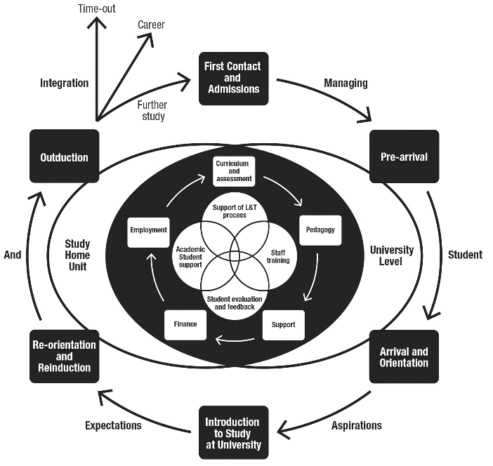
Source: Supporting Student Diversity – A practical guide (Morgan, 2013) p61

Slide 31
Mapping progression
Is there a coherent model of progression across the student life-cycle from induction to ‘outduction’?
Do you manage transitions from year one to year two and year two to year three to ensure students remain committed and engaged?
Is there some continuity in the sources of student support throughout the course (e.g. personal tutors)?
Are students offered support and guidance in relation to personal development and employability?

Slide 32
Inter-year transitions: avoiding the sophomore slump (Yorke, 2014, Zaitseva et al)
The three-months between the end of the 1st year and the start of the 2nd (and to a lesser extent between 2nd and 3rd years) provides lacunae for lost motivation and decreased engagement;
Energy, thought and resources need to be deployed to counteract this tendency and to maintain student engagement;
This can be undertaken in three ways:
Through linking study from year to year through assignments and other activities set to bridge the gap;
By maintaining contact (live or virtual);
By using peer groups and networks for mutual support.

Slide 33
Developing engagement among your students
Is there a coherent model of progression across the student life-cycle from induction to ‘outduction’ (Morgan, 2011)?
Do you manage transitions from year one to year two, and year two to year three, to ensure students remain committed and engaged?
Is there some continuity in the sources of student support throughout the course (e.g. personal tutors)?
Are students offered support and guidance in relation to personal development and employability?
Are students using critical thinking and high levels of analytical thought sufficiently at each level of a programme?
Are students working autonomously as well?
Do students have meaningful and purposeful opportunities of working together?

Slide 34
Matheson, Tangney and Sutcliffe (2018) recognise that:
Initial steps into undergraduate education mark only a beginning for students;
The journey involves other significant transition points that students need to negotiate;
Engagement needs nurturing if students are to develop into autonomous reflective learners;
There is significant international research exploring transition towards, into, through, up out and beyond (Lizzio, 2011, Morgan 2013);
We can learn much from the international case studies in this collection.

Slide 35
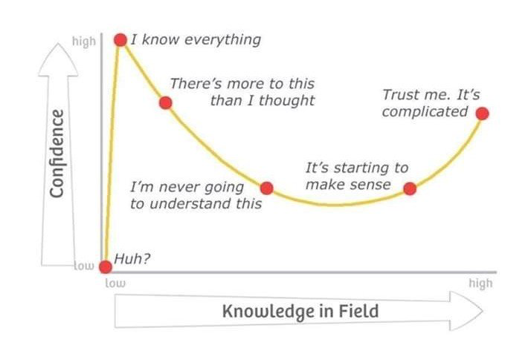
Adapted from Kruger, J. and Dunning, D. 2009

Slide 36
For inclusive practice we should:
Build in awareness of inclusivity issues in induction for staff and students;
Include relevant elements in Post Graduate courses in HE learning and teaching;
Include robust requirements re inclusive practice in institutional assessment, learning and teaching strategies;
Make questions re inclusivity part of validation and review of all programmes.

Slide 37
We can also:
Make sure that EO/inclusivity/disability committees/working parties are fully integrated into HEI’s systems;
Use staff development workshops to foster awareness of specific issues;
Encourage discussion of the language used when describing inclusivity issues;
Make best use of University colleagues with specialist knowledge to promote inclusivity.

Slide 38
Cotton et al propose three particular issues which warrant further attention
The possibility that both BME students and some male students might be more likely to use surface learning approaches, thereby lowering attainment.
The tension between integration into university life and the potential negative impact of over-involvement in clubs or societies. This seems to be a delicate balance which could have divergent impacts on different student groups.
The importance for students of having an accurate understanding of their achievement levels. For whatever reason, both male and BME students were not effectively judging likely success.

Slide 39
Confidence, achievement and retention
Crudely, student achievement is linked to students own beliefs about their abilities, whether these are fixed or malleable;
Students who subscribe to an entity (fixed) theory of intelligence (Dweck, 2000) need support to confirm their ability and thereby become less fearful of learning goals as these involves an element of risk and personal failure.
Learning and assessment for these students are all-encompassing activities that defines them as people. If they fail at an assignment, they see themselves as failures.

Slide 40
Students who believe that intelligence is malleable may be more robust
Students who believe that intelligence is incremental have little or no fear of failure. A typical response from such a student is ‘The harder it gets, the harder I need to try’. These students do not see failure as an indictment of themselves and [can] separate their self-image from their academic achievement. When faced with a challenge, these students are more likely to continue in the face of adversity because they have nothing to prove. (after Clegg in Peelo and Wareham 2002).

Slide 41
What can we do in the first six weeks?
Enable students to feel part of a cohort rather than a number of a list;
Help students acclimatise to the new learning context in which they find themselves;
Familiarise them with the language and culture of the subject area they are studying (Northedge, 2003);
Foster the information literacy and other skills that students will need to succeed;
Guide them on where to go for help as necessary;
Offer them immersive experiences.

Slide 42
The concept of universal design
“Instead of retrofitting curriculum for students via accommodations and modifications, the principles of UDL prompt teachers to design curriculum that is flexible and adaptable to multiple forms of learning and engagement to facilitate the learning of all students.” (Lancaster, 2008)
“The ‘universal’ in UDL does not mean there is a single optimal solution for everyone. Instead, it underscores the need for flexible approaches to teaching and learning that meet the needs of different kinds of learners. ” (Rose and Meyer, 2006)

Slide 43
Meaningful and useful learning outcomes

Slide 44
Are your learning outcomes SMART or VASCULAR? The usual ‘requirements’ are that they be:
Specific;
Measurable;
Achievable;
Realistic;
Time constrained.

Slide 45
VASCULAR learning outcomes
Verifiable: Can we tell when they’ve been achieved? And can students?
Action orientated: Do they lead to real and useful activity?
Singular: i.e. not portmanteau outcomes combining two or more into one, making it difficult to assess if differently achieved, but readily matchable to student work produced?
Constructively aligned? (Biggs and Tang, 2011) so that there is clear alignment between aims (What do students need to be able to know and do?), what is taught/ learned, how these are assessed and evaluated);
Understandable i.e. using language codes that are meaningful to all stakeholders?
Level-appropriate? Suitable and differentiable between1st year, 2nd year, 3rd year, Masters, other PG?
Affective-inclusive i.e. not just covering actions but capabilities in the affective domain?
Regularly reviewed? Not just stuck in history and always fit-for-purpose.

Slide 46
Phil Race is concerned we need to go beyond learning outcomes and include:
Learning incomes: all the things learners are bringing to the learning situation:
Emergent learning outcomes: those we didn’t (and maybe couldn’t) predict, which may surprise and astound us!:
Intended learning outgoings: helping them link the intended learning outcomes to the wider world of future learning and employment;
See https://phil-race.co.uk/2018/05/beyond-learning-outcomes/

Slide 47
Designing fit-for-purpose assessment

Slide 48
Designing assessment as a central part of curriculum design
Assessment is a complex, nuanced and highly important process​ and if we want students to engage fully, we must make it really meaningful to them and convince them that there is merit in the activities we ask them to undertake. To focus students’ effort and improve their engagement with learning, we need to take a fresh look at our current practice to make sure assessment is for rather than just of learning, with students learning while they are being assessed rather than it being merely a summative end process. We also need to ensure that we make assessment practices and the giving of feedback manageable for staff and valuable for students.

Slide 49
Formative and summative assessment
Formative assessment is primarily concerned with feedback aimed at prompting improvement, is often continuous and usually involves words.
Summative assessment is concerned with making evaluative judgments, is often end point and involves numbers.

Slide 51
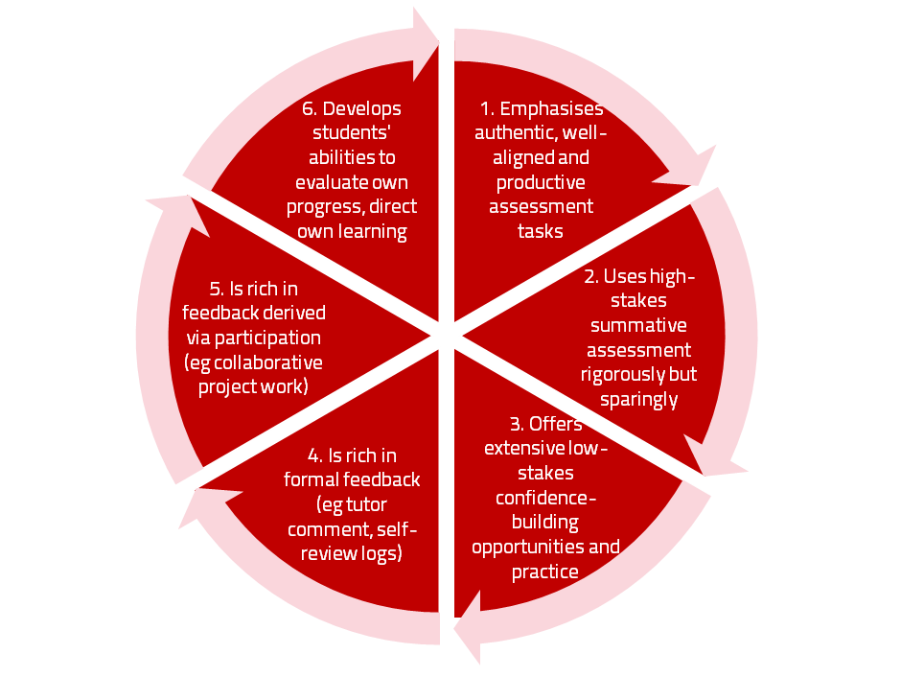
A4L the Northumbria model

Slide 52
Underpinning premises for A4L
Assessment can be a powerful means of focusing student effort and enhancing achievement if it is well designed and constructively aligned (Biggs and Tang, 2011);
We need to deploy a diverse range of tactics to our assessment and feedback to ensure that they work to enhance and extend student learning;
Students need to achieve assessment literacy to ensure they understand and can benefit from our assessment systems;
Assessment needs to be manageable for staff and students if it is going to engage students in learning activities.

Slide 53
My fit-for-purpose model of assessment: the key questions
Why are we assessing?
What is it we are actually assessing?
How are we assessing?
Who is best placed to assess?
When should we assess?
Notes:
53

Slide 54
For any assessment activity, we need to be clear about:
Aims: is this an early stage assignment, that is principally about building confidence and helping students see what is required of them, or is it a key element of their summative assessment, designment to gauge fitness to progress, or fitness-to-practice?
Scope: is this testing low level outcomes, like demonstrating recollection of key terms, or is it cognitively more demanding requiring synthesis of multiple elements, critical analysis, evaluation and reflection?
Scale: is this a small scale or a substantial task carrying a heavy weighting? Do students know how much effort and energy is needed to achieve at least a satisfactory level?
Orientation: Is the key aim to demonstrate the achievement of skills and competences, and/or to produce a definite product or is it primarily about demonstrating mastery of appropriate processes?
Constructive alignment: To what extent does the assessment closely link to the learning outcomes (and specifically the verbs used in them)?

Slide 55
Students tend to be more convinced about the fairness of the assessment process if:
Requirements and procedures are transparent and made readily available to them;
They believe that the tasks they are asked to do are worthwhile and are closely linked to what course documentation indicates they should be able to know and do at the end of the programme i.e. authentic assessment;
They fully understand the ‘rules of the game’.

Slide 56
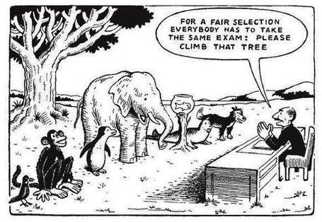

Slide 57
Do your international students understand UK assessment approaches?
Have you clarified the ground rules on issues like pass marks, criterion-referenced assessment and grading systems?
Have you explained how extensions, condonements, and university assessment regulations work?
Are the assignments built around a curriculum international in scope and content? Are tasks and case studies globally orientated?

Slide 58
Authentic assessment: what are the principal benefits for stakeholders?
Students undertaking authentic assessments tend to be more fully engaged in learning and hence tend to achieve more highly because they see the sense of what they are doing (Sadler, 2005).
University teachers adopting authentic approaches can use realistic and live contexts within which to frame assessment tasks, which help to make theoretical elements of the course come to life.
Employers value students who can quickly engage in real-life tasks immediately on employment, having practised and developed relevant skills and competences through their assignments.

Slide 59
We often assess what is easy to assess, or proxies of what’s been learned, rather than the learning itself
A valid assessment is one that has close relevance to the criteria, which are in turn constructively aligned to the stated learning outcomes of a programme.
Effective assessment is highly relevant to ensuring that graduates can demonstrate the knowledge, behaviours, qualities and attributes that were described in the course outline or programme specification.
Assignments that require students to write about something, rather than be or do something, may not always be fit-for-purpose.

Slide 60
Feedback has the potential to transform student outcomes by:
Helping students to get a good measure of how they are doing against programme requirements;
Focusing on the work rather than the person (particularly avoiding ‘final language’;
Identifying strengths in the assignment worth celebrating and areas that need action;
Encouraging students to see feedback not as ‘corrections’ but as supportive learning opportunities requiring specified action to be taken;

Slide 61
The importance of dialogic feedback to involve students as partners in assessment
Students need to be exposed to, and gain experience in making judgements about, a variety of works of different quality... They need planned rather than random exposure to exemplars, and experience in making judgements about quality. They need to create verbalised rationales and accounts of how various works could have been done better. Finally, they need to engage in evaluative conversations with teachers and other students. (Sadler, 2010)

Slide 62
Encouraging students to recognise and use the feedback we provide for them
Delivery of feedback should not be left to chance, so its best to avoid asking students to pick up marked hard copy assignments from departmental offices;
Electronic submission of assignments has benefits and disadvantages but on balance the former outweigh the latter;
Perhaps require students to guestimate expected marks having read your feedback early in their programmes;
‘Assignment handler’ can deliver feedback electronically and only release marks once students have responded;
Audio files of audio feedback can be highly successful in enabling students to capture ‘live’ oral feedback, and can replace written feedback (e.g. JISC project ‘Sounds good’).

Slide 63
Encouraging better use of feedback
Emphasise early on the importance to students of formative feedback;
Consider how best to provide them with feedback;
Provide them with training on why and how feedback is provided;
Get students to practise drafting and delivering feedback;
Get students to focus on comments rather than marks;
Help students to believe they have the agency to improve their work;
Encourage students to think of feedback as a trigger to them taking action;
Give them some examples of helpful feedback as a prompt to discussion.

Slide 64
Making assessment work well
Intra-tutor and Inter-tutor reliability need to be assured;
Practices and processes need to be transparently fair to all students;
Cheats and plagiarisers need to be deterred/punished;
Assessment needs to be manageable for both staff and students;
Assignments should assess what has been taught/learned, not what it is easy to assess.

Slide 65
Planning for action
As an individual, are there changes you would like to make to your curriculum design, delivery and assessment practices?
Thinking about the teams you work with, are there ways in which you could use ideas from today’s session to make your curriculum more authentic?
How could your influence impact more widely on colleagues across the university? And what can the university do to help make this happen?

Slide 66
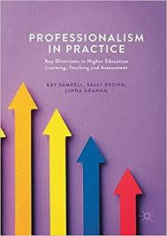
Sambell, K, Brown, S and Graham, L. (2017) Professionalism in Practice: Key directions in higher education: Learning, Teaching and Assessment, Basingstoke: Palgrave-Macmillan.

Slide 67
These and other slides are available on my website at http://sally-brown.net

Slide 68
Useful references: 1
Assessment Reform Group (1999) Assessment for Learning: Beyond the black box, Cambridge UK, University of Cambridge School of Education.
Bain, K. (2004) What the best College Teachers do, Cambridge: Harvard University Press.
Biggs, J. and Tang, C. (2011) Teaching for Quality Learning at University, Maidenhead: Open University Press.
Bloxham, S. and Boyd, P. (2007) Developing effective assessment in higher education: a practical guide, Maidenhead, Open University Press.
Boud, D. (1995) Enhancing learning through self-assessment, London: Routledge.
Boud, D. and Associates (2010) Assessment 2020: seven propositions for assessment reform in higher education Sydney: Australian Learning and Teaching Council.

Slide 69
Useful references: 2
Brown, S. (2012) Assimilate compendium, Leeds, Leeds Met Press
Brown, S. (2012) ‘What are the perceived differences between assessing at Masters level and undergraduate level assessment? Some findings from an NTFS–funded project’ Innovations in Education and Teaching International, forthcoming
Brown, S., Deignan, T. Race, P. and Priestley, J. (2012) ‘Assessing students at Masters Level: learning points for Educational Developers’ Educational Developments, SEDA, Birmingham.
Brown, S (2012) ‘Diverse and innovative assessment at Masters Level: alternatives to conventional written assignments’ in AISHE-J: The All Ireland Journal of Teaching and Learning in Higher Education Vol 4, No 2.
Brown, S. (2014) Learning, teaching and assessment in higher education: global perspectives. London: Palgrave Macmillan.

Slide 70
Useful references: 3
Brown, S. and Glasner, A. (eds.) (1999) Assessment Matters in Higher Education, Choosing and Using Diverse Approaches, Maidenhead: Open University Press.
Brown, S. and Knight, P. (1994) Assessing Learners in Higher Education, London: Kogan Page.
Brown, S. and Race, P. (2012) Using effective assessment to promote learning in Hunt, L. and Chambers, D. (2012) University Teaching in Focus, Victoria, Australia, Acer Press. P74-91
Brown, S. Rust, C. & Gibbs, G. (1994) Strategies for Diversifying Assessment, Oxford: Oxford Centre for Staff Development.

Slide 71
Useful references: 4
Carless, D., Joughin, G., Ngar-Fun Liu et al (2006) How Assessment supports learning: Learning orientated assessment in action Hong Kong: Hong Kong University Press.
Carroll, J. and Ryan, J. (2005) Teaching International students: improving learning for all. London: Routledge SEDA series.
Crooks, T. (1988) Assessing student performance, HERDSA Green Guide No 8 HERDSA (reprinted 1994).
Crosling, G., Thomas, L. and Heagney, M. (2008) Improving student retention in Higher Education, London and New York: Routledge.
Dweck, C. S. (2000) Self Theories: Their Role in Motivation, Personality and Development, Lillington, NC: Taylor & Francis.
Falchikov, N. (2004) Improving Assessment through Student Involvement: Practical Solutions for Aiding Learning in Higher and

Slide 72
Useful references: 5
Gibbs, G. (1999) Using assessment strategically to change the way students learn, in Brown S. & Glasner, A. (eds.), Assessment Matters in Higher Education: Choosing and Using Diverse Approaches, Maidenhead: SRHE/Open University Press.
Higher Education Academy (2012) A marked improvement; transforming assessment in higher education, York: HEA.
Hounsell, D. (2008). The trouble with feedback: New challenges, emerging strategies, Interchange, Spring, Accessed at www.tla.ed.ac.uk/interchange.
Knight, P. and Yorke, M. (2003) Assessment, learning and employability Maidenhead, UK: SRHE/Open University Press.
Kotze, T.G. and Du Plessis, P.J., 2003. Students as “co-producers” of education: a proposed model of student socialisation and participation at tertiary institutions. Quality assurance in education, 11(4), pp.186-201.

Slide 73
Useful references: 6
Lizzio, A., 2011. The student lifecycle: An integrative framework for guiding practice. Brisbane: Griffith University.
McDowell, L. and Brown, S. (1998) Assessing students: cheating and plagiarism, Newcastle: Red Guide 10/11 University of Northumbria.
Mentkowski, M. and associates (2000) p.82 Learning that lasts: integrating learning development and performance in college and beyond, San Francisco: Jossey-Bass.
Meyer, J.H.F. and Land, R. (2003) ‘Threshold Concepts and Troublesome Knowledge 1 – Linkages to Ways of Thinking and Practising within the Disciplines’ in C. Rust (ed.) Improving Student Learning – Ten years on. Oxford: OCSLD.
Morgan, C., Dunn, L., Parry, S. and O'Reilly, M. (2004) The student assessment handbook: New directions in traditional and online assessment, London: Routledge.

Slide 74
Useful references: 7
Morgan, M. ed., 2013. Improving the student experience: A practical guide for universities and colleges. Routledge.
Newstead, S. E., Franklyn-Stokes, A., & Armstead, P. (1996) Individual differences in student cheating, Journal of Educational Psychology, 88(2), 229-241
Nicol, D. J. and Macfarlane-Dick, D. (2006) Formative assessment and self-regulated learning: A model and seven principles of good feedback practice, Studies in Higher Education Vol 31(2), 199-218.
PASS project Bradford http://www.pass.brad.ac.uk/ Accessed November 2013.
Peelo, M. T., & Wareham, T. (Eds.). (2002). Failing students in higher education. Society for Research into Higher Education.
Pickford, R. and Brown, S. (2006) Assessing skills and practice, London: Routledge.

Slide 75
Useful references: 8
Race P. (2015) The lecturer’s toolkit (4th edition), London: Routledge.
Race, P. (2001) A Briefing on Self, Peer & Group Assessment, in LTSN Generic Centre Assessment Series No 9, LTSN York.
Race, P. (2014) Making learning happen: 3rd edition, London: Sage.
Rotheram, B. (2009) Sounds Good, JISC project http://www.jisc.ac.uk/whatwedo/programmes/usersandinnovation/soundsgood.aspx
Rust, C., Price, M. and O’Donovan, B. (2003) Improving students’ learning by developing their understanding of assessment criteria and processes, Assessment and Evaluation in Higher Education. 28 (2), 147-164.

Slide 76
Useful references: 9
Quality Assurance Agency (QAA), 2010. Master's degree characteristics. Gloucester: The Quality Assurance Agency for Higher Education
Ryan, J. (2000) A Guide to Teaching International Students, Oxford Centre for Staff and Learning Development.
Sadler, D. R. (2010) Beyond feedback: Developing student capability in complex appraisal. Assessment & Evaluation in Higher Education, 35(5), 535-550.
Seymour, D. (2005) Learning Outcomes and Assessment: developing assessment criteria for Masters-level dissertations. Brookes eJournal of Learning and Teaching 1(2).
Yorke, M. (1999) Leaving Early: Undergraduate Non-completion in Higher Education, London: Routledge.

