Slide 1
Effectively encouraging more activity within small group classes, seminars and problem sessions
Royal Agricultural University, Friday 12th July
Sally Brown @ProfSallyBrown
sally@sally-brown.net
NTF, PFHEA, SFSEDA
Emerita Professor, Leeds Beckett University
Visiting Professor University of Plymouth, Edge Hill University,
University of South Wales & Liverpool John Moores University.

Slide 2
A note about the slides
All available on my website at http://sally-brown.net;
All, like everything I do, open educational resources so use them with colleagues and students as you wish (except the images);
There may be too many slides here for use today: regard them like the bonus features on a DVD (or your homework!).

Slide 4
Task one: Brainstorm
How can small group work help students feel more positive and engaged?

Slide 5
Rules of brainstorming (here today)
Quantity over quality: lets get lots of ideas (but one at a time please so I can jot them down);
Freewheel: you are allowed to make random comments;
Build on other people’s ideas;
Suspend judgment: you may chortle but please withhold your comments if you think other people’s idea are rubbish.
Head or heart: score a NAF rating, Novelty, Attractiveness, Feasibility (10= very attractive, 1= not attractive)

Slide 6
Task two: crossover By letter
Why should you use small groups with students? Why shouldn't you?

Slide 7
Five reasons why you shouldn’t do small group work
It can be more complicated to organise and may involve more liaison with managers, timetablers and others who might prefer you just to give lectures;
Not all HE teachers and supporters of learning are comfortable with managing group work and, in particular, the perceived loss of control that comes from handing over activities to student groups for enactment;
It’s quite difficult to give students equivalent (if not identical experience) when they are working in diverse groups;
There are often concerns about differential workloads by students resulting in the same mark for every student in the group;
Students often really dislike group work at the time they are doing it and it can be a significant cause of complaints (but see the first point on next slide).

Slide 8
And five reasons why you should
When you ask students several years down the line what was the most productive experiences they had while, learning, they will often refer to group activities;
Group work can be helpful in preventing students feeling isolated, which can be the case if all their study time is solitary, especially in subject areas (e.g. Literature studies) where there is traditionally quite a low proportion of their time is in class contact;
Group work can provide contexts in which theory learned on their courses can be applied to practical contexts, and can help to bring the learning to life for students;
The ability to manage interpersonal issues that often arise within group work are key graduate attributes required by almost every career or profession;
Employers have been telling us for years that they want to employ people capable of working straightaway as team members, often in interdisciplinary units.

Slide 9
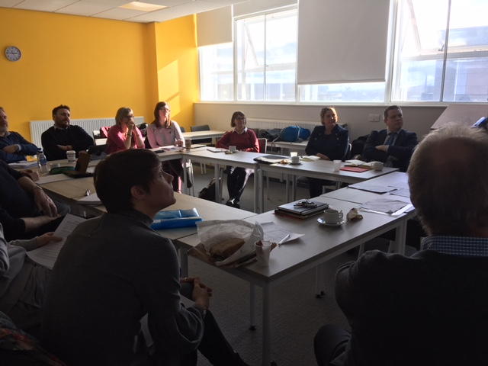

Slide 10
Task three: by number
How do small group tasks develop employability skills?

Slide 11
Small-group skills are precisely those required in employment and research, where graduates need to be able to:
work in teams;
listen to others’ ideas sympathetically and critically;
think creatively and originally;
formulate and ask questions skilfully;
show skills in explaining things fluently and convincingly;
build on others’ existing work;
collaborate on projects;
contribute skillfully to producing reports, publications and action plans;
work together online with fellow-learners;
manage time and processes effectively;
see projects through to a conclusion;
cope with the normal difficulties of face-to-face interactions between human beings.

Slide 12
When students go for interview by prospective employers, questions they might be asked include: Can you tell us about an occasion when:
you worked together with colleagues in a group to produce a collective outcome?
you had to work autonomously with incomplete information and self-derived data sources, and check with other people whether you were on the right lines?
you developed strategies to solve real life problems and tested them out by discussion them with colleagues?
you had a leadership role in a team, and could you tell us about your strategies to influence and persuade your colleagues to achieve a collective task?
you had to communicate outcomes from your project work orally, and collectively put these outcomes into writing, or disseminate them through social media or through a visual medium?

Slide 13
TASk four: by symbol
What size of group works best to get maximum participation of students?

Slide 14
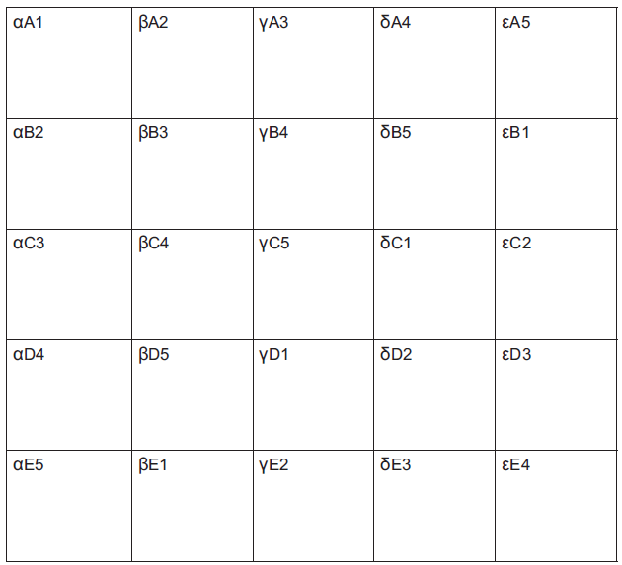
Cross overs using Greek letters
A cross over for 25 people (Can be scaled up to hundreds!)

Slide 15
Crossovers
Crossovers are useful in making sure everyone in the group is active and also helps to mix students up outside their normal friendship, ethnic or gender groups.
It takes a little forethought to get the numbers and letters right for the cohort you are working with.
It can be useful to have some templates of the different number-letter combinations, so that you can cut up a sheet of paper or card and give students their individual numbers;
You can, however, do crossovers on the spur of the moment using post-it labels and quick calculations.
It can also be useful to have ‘wildcard’ or blank labels for a few of the students, who can be allowed to go into any group when group membership changes.

Slide 16
Task Five: Individual reflection
What are some of the hazards of working in tiny groups? Very big groups?

Slide 17
Deciding on group size for tasks: each has benefits and disadvantages
Pairs;
Threes (triads);
Fours;
Fives;
Six or sevens;
More (bad idea!)

Slide 18
TASK six: in PAirs
What means do you use to compose groups for group tasks: what are the benefits and hazards?

Slide 19
Forming groups:
Friendship groups;
Locational groups;
Alphabetical (family name) groups;
Random groups;
Number groups:
Astrological star sign groups;
Learning teams
Hybrid teams.

Slide 20
TASk seven: in Fours
Looking at the UKPSF on the next slide, for which elements could you use these kinds of activities as evidence?

Slide 22
Snowballing aka pyramiding
Start by giving students an individual task of a fairly straightforward nature such as listing features, noting questions, or identifying problems.
Then ask them to share initial thoughts and work in pairs on a slightly more complex task, such as prioritising issues or suggesting strategies.
Next ask them to come together in larger groups, fours or even sixes for example, and undertake a more complex task involving, perhaps, synthesis, assimilation or evaluation.
Feedback sampling can be done in plenary: there is no need to hear report backs from every group.

Slide 23
Task eight: Round
What kinds of behaviours sabotage small group work

Slide 24
Rounds
People often use rounds as icebreakers or equally as part of the winding up of a session, when it can be productive to ask students for (for example) ‘one thing you learned, one thing you liked, and one thing you did not like’;
It helps to let people have a couple of minutes to prepare an answer to the lead question;
In big rounds, students can be quite nervous, so make it clear that it’s acceptable to say ‘pass’ and if people at the beginning have made your point, that concurrence with ideas expressed already is sufficient;
Don’t do it with huge groups.

Slide 25
Task Nine: Fishbowl
What kinds of ground rules can small groups set?

Slide 26
Fishbowls
If starting off a task in ‘fishbowl’ mode, ask for a small group of up to half a dozen or so volunteers to sit in the middle of a larger circle comprising the rest of the group.
Give the inner circle a task to undertake a relatively simple task that involves discussion, problem solving or decision-making, with the group around the outside asking as observers;
Have ground rules to allow someone from the outer circle to take the place of someone in the inner group, e.g. only when both agree on the exchange;
The levels of the tasks can be enhanced once students have had practice and become more confident.

Slide 27
Ground rules could include:
Respect the opinions and viewpoints of others, listening and responding appropriately;
Respect for each other’s valid reasoning: the ability to detect poor argument and to engage in respectful dialogue;
A commitment to regular attendance and to cooperation with others in independent group work involving debate and dialogue;
Active use of concepts and modes of reasoning that have been introduced in the module content;
A commitment to shared reflection;
A commitment to collective responsibility once decisions have been made.
* Adapted from Foreman-Peck (2010) p32

Slide 29
Of the techniques used today, which do you think has been i. most fun and ii. most productive of learning?
Brainstorming:
Cross overs;
Snowballing;
Rounds
Fishbowls
What other techniques can we use with small groups?

Slide 30
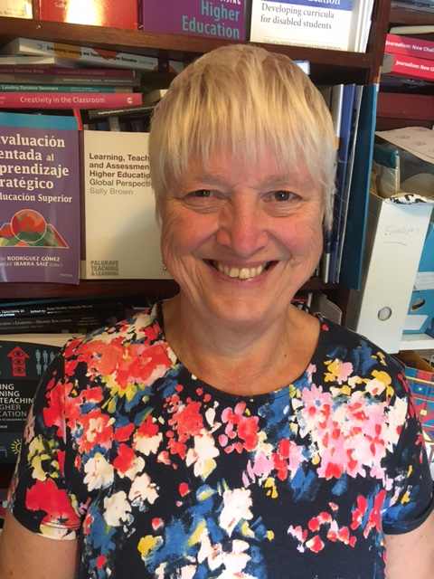
These and other slides are available on my website at http://sally-brown.net

Slide 31
References and other reading
Creme, P. (2008) A space for academic play: Student learning journals as transitional writing. Arts and Humanities in Higher Education, 7(1), pp.49-64.
Curran, V.R., Sharpe, D., Forristall, J. and Flynn, K. (2008) Student satisfaction and perceptions of small group process in case-based interprofessional learning. Medical Teacher, 30(4), pp.431-433.
Foreman-Peck. L. (2010) ‘Fairness in group-work assessment in higher education; an action case study’ in Foreman-Peck, L. and McDowell, L. (2010) Aims Ethics and Values in group work assessment, Newcastle, Northumbria University.

Slide 32
More references
James, A. and Nerantzi, C. (eds) (2019) The Power of Play in Higher Education: Creativity in Tertiary Learning. Palgrave-Macmillan.
Jaques, D. and Salmon, G., (2007) Learning in groups: A handbook for face-to-face and online environments. Routledge.
Kleiman, P. (2008) Towards transformation: conceptions of creativity in higher education. Innovations in Education and Teaching International, 45(3), pp.209-217.
Race, P. (2019) The Lecturers Toolkit 5th Edition, Chapter 5 ‘Making small group teaching work’, Abingdon, Routledge.

