Slide 1
Assessment for life and the love of learning: using assessment and feedback to foster students’ self-efficacy and capabilities
Coordinador del Congreso de Evaluación Formativa y Compartida (Segovia, 2019)
July 2019
Sally Brown NTF, PFHEA, SFSEDA
@ProfSallyBrown http://sally-brown.net

Slide 2
In this session I aim to provide opportunities to:
Discuss Assessment for Learning and Lifelong learning;
Consider how to make assessment truly integrated with the learning process;
Review what kinds of feedback can be helpful to students in achieving their potential;
Discuss how best to engage students with feedback, so that they benefit from all the hard work put in by their assessors;
Consider how assessment and feedback can foster students’ confidence and self efficacy.

Slide 3
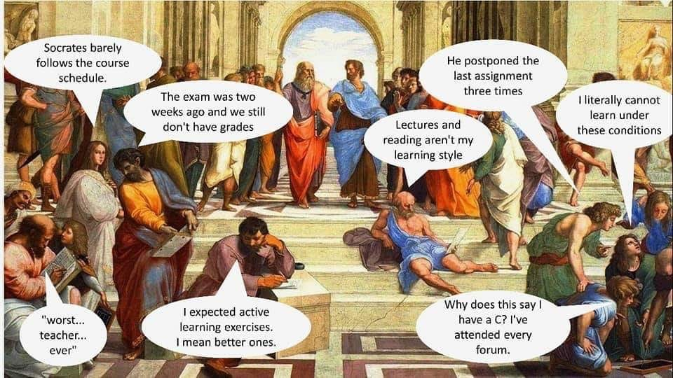

Slide 4
A reminder of the underpinning premises for Assessment for learning (A4L)
Assessment can be a powerful means of focusing student effort and enhancing achievement if it is well designed and constructively aligned (Biggs and Tang, 2011);
We need to deploy a diverse range of tactics to our assessment and feedback to ensure that they work to enhance and extend student learning;
Students need to achieve assessment literacy to ensure they understand and can benefit from our assessment systems;
Assessment needs to be manageable for staff and students if it is going to engage students in learning activities.

Slide 5
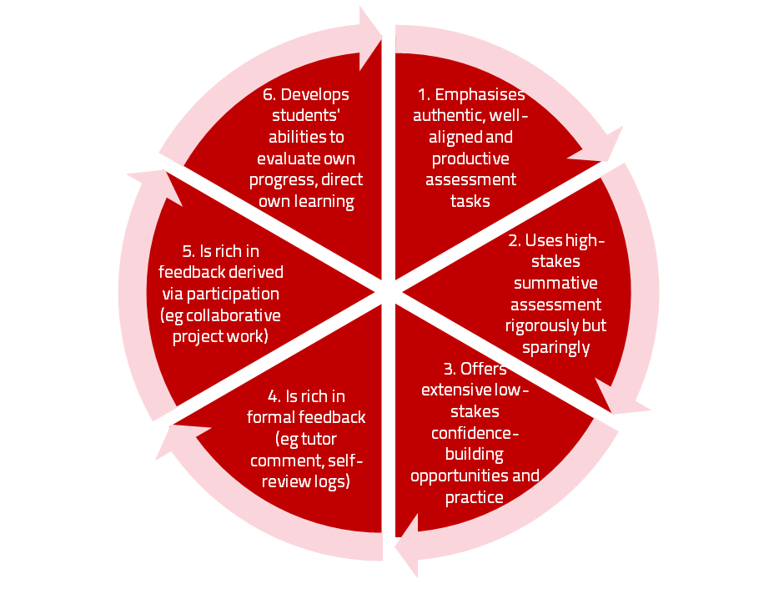
A4L the Northumbria model

Slide 6
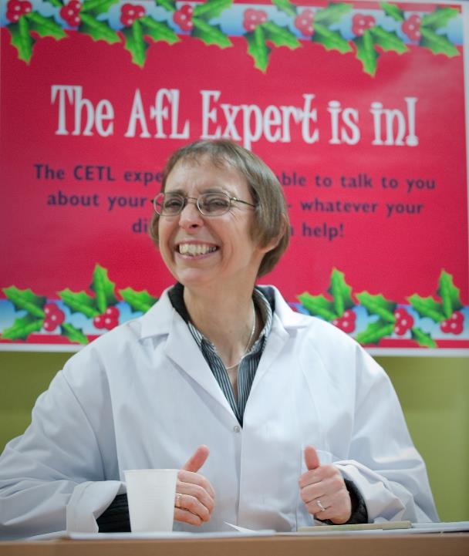

Slide 7
Formative and summative assessment
Formative assessment is primarily concerned with feedback aimed at prompting improvement, is often continuous and usually involves words.
Summative assessment is concerned with making evaluative judgments, is often end point and involves numbers.

Slide 8
For any assessment activity, we need to be clear about:
Aims: is this an early stage assignment, that is principally about building confidence and helping students see what is required of them, or is it a key element of their summative assessment, designment to gauge fitness to progress, or fitness-to-practice?
Scope: is this testing low level outcomes, like demonstrating recollection of key terms, or is it cognitively more demanding requiring synthesis of multiple elements, critical analysis, evaluation and reflection?
Scale: is this a small scale or a substantial task carrying a heavy weighting? Do students know how much effort and energy is needed to achieve at least a satisfactory level?
Orientation: Is the key aim to demonstrate the achievement of skills and competences, and/or to produce a definite product or is it primarily about demonstrating mastery of appropriate processes?
Constructive alignment: To what extent does the assessment closely link to the learning outcomes (and specifically the verbs used in them)?

Slide 9
What are you aiming to assess?
Content knowledge?
Critical thinking?
Problem identification and solution-finding?
Left-field and creative thinking?
The ability to work with incomplete information and changing circumstances?
Application of knowledge to practical contexts?
Plus other things you can identify

Slide 10
And what else?
Information management?
Information retrieval and storage?
Data collection and usage?
Effective use of data bases, packages, and appropriate technologies?
Plus other things you can identify

Slide 11
What’s important in terms of effective communication?
Writing accuracy including grammar, spelling and punctuation?
Writing effectiveness including fluency, coherence, logical sequencing, expressing complex ideas simply?
Oral communication including formal presentations, interviews, questioning and responding?
Effective use of digital communication (websites, blogs, social media etc?
Plus other things you can identify

Slide 12
What’s important in terms of social and interactive capabilities?
The ability to form and work effectively in teams?
Leadership (and followership/collective responsibility)?
Emotional intelligence and the capability to recognise and work with the needs, strengths and weaknesses, and limitations of others?
Resilience in the face of failure, coping strategies and the ability to bounce-back?
The capability to recognise when additional support/guidance/advice is needed and to seek it out?
Plus other things you can identify

Slide 13
We often assess what is easy to assess, or proxies of what’s been learned, rather than the learning itself
A valid assessment is one that has close relevance to the criteria, which are in turn constructively aligned to the stated learning outcomes of a programme.
Effective assessment is highly relevant to ensuring that graduates can demonstrate the knowledge, behaviours, qualities and attributes that were described in the course outline or programme specification.
Assignments that require students to write about something, rather than be or do something, may not always be fit-for-purpose.

Slide 14
What is feedback? (after Carless and Boud 2018)
Building on previous definitions (Boud and Molloy 2013; Carless 2015), feedback is defined as “a process through which learners make sense of information from various sources and use it to enhance their work or learning strategies.”
This definition goes beyond notions that feedback is principally about teachers informing students about strengths, weaknesses and how to improve, and highlights the centrality of the student role in sense-making and using comments to improve subsequent work. Information may come from different sources e.g. peers, teachers, friends, family members or automated computer-based systems to support student self-evaluation of progress.

Slide 15
What is feedback literacy? (after Carless and Boud 2018)
One of the main barriers to effective feedback is generally low levels of student feedback literacy. Students’ feedback literacy involves
an understanding of what feedback is and how it can be managed effectively;
capacities and dispositions to make productive use of feedback;
appreciation of the roles of teachers and themselves in these processes.

Slide 16
Assessment literacy: students do better if they can:
Make sense of key terms such as criteria, weightings, and level;
Encounter a variety of assessment methods (e.g. presentations, portfolios, posters, assessed web participation, practicals, vivas etc) and get practice in using them;
Be strategic in their behaviours, putting more work into aspects of an assignment with high weightings, interrogating criteria to find out what is really required and so on;
Gain clarity on how the assessment regulations work in their HEI, including issues concerning submission, resubmission, pass marks, condonement etc.

Slide 17
Feedback literate students:
Appreciating feedback
understand and appreciate the role of feedback in improving work and the active learner role in these processes;
recognise that feedback information comes in different forms and from different sources;
use technology to access, store and revisit feedback.
Making judgements
develop capacities to make sound academic judgments about their own work and the work of others;
participate productively in peer feedback processes;
refine self-evaluative capacities over time in order to make more robust judgments.
Managing affect
maintain emotional equilibrium and avoid defensiveness when receiving critical feedback;
are proactive in eliciting suggestions from peers or teachers and continuing dialogue with them as needed;
develop habits of striving for continuous improvement on the basis of internal and external feedback.
Taking action
are aware of the imperative to take action in response to feedback information;
draw inferences from a range of feedback experiences for the purpose of continuous improvement;
develop a repertoire of strategies for acting on feedback.
Carless and Boud: 2018

Slide 18
Do your students:
Really understand what they need to do (both in terms of assessment literacy about terms such as criteria, weightings and condonements and specific task briefings)?
Have structured introductions to any innovative forms of assessment with rehearsal and Q&A opportunities to help them have risk-free learning opportunities?
Experience good inter-assessor and intra-assessor reliability?
Have dialogic rather than monologic opportunities to learn from the feedback they receive?

Slide 19
Do they:
Have equal guidance and support in understanding what they need to do (e.g. through one-to-one encounters, on-line activities, Q&A surgeries)?
Have fair access to support from those who teach and assessment prior to completing assignment (e.g. in terms of seeing/practicing with past papers or guidance on drafts)?
Have equivalent opportunities to learn from feedback in ways that can help them with future tasks?

Slide 20
Are your students aware of all the processes and procedures we use to ensure fair assessment?
Do they know how we require assessors to match grades to achievement of assessment criteria?
Are they familiar with the steps we take to ensure inter-assessor reliability?
Do they understand that moderation processes are in place, for example through exam boards, to ensure that justice is done to each individual?
Do they get to hear about the work of external examiners (or even get to meet them?)?

Slide 21
To better engage learners through feedback and assessment we can:
Make use of real examples and hot-off-the-press data to keep content and tasks current and relevant;
Provide challenges to students’ thinking without letting individuals feel publicly exposed or humiliated;
Relate their learning in class to the forthcoming/ongoing assignment (without slavishly teaching to the exam);
Make spaces for dialogue through formative assessment;
Give them real problems to solve and issues with which to engage;
Identify the skills they need to succeed and provide opportunities to rehearse and develop them;
Never compromise on the quality of the demands we make of them.

Slide 22
Helping students better understand what is needed of them
This can be achieved in a variety of ways, including:
Using games and activities to help make students think hard about criteria and required outcomes;
Ensuring that briefings (in the form of documentation, and more importantly, live/ face-to-face briefings, where students can actively interrogate criteria) are useful;
Getting students to self-assess to start a feedback dialogue;
Using exemplars to show students what high quality work in this domain comprises, and what features and aspects are crucial for success.

Slide 23
Briefings for students: setting the context
Early-stage students are likely to need more reassurance in your briefings in which the tone of your language may be crucial;
We should aim for as much transparency as possible: no student should be having to guess what you are looking for at any stage of their academic careers;
Whenever we use what may be to them an unfamiliar format, briefings should be linked to trial-runs, risk-free rehearsals and Q&A opportunities to clarify any areas of misconceptions;
This is not ‘spoonfeeding’ but instead giving them the knives and forks to feed themselves!

Slide 24
Essential components of an effective assignment brief I would suggest include:
Housekeeping arrangements: when does it have to be completed? How must it be submitted? Are you setting limitations around format and layout (e.g. font size, margins, use of figures, tables etc)?
Clarifying the scope of the task: how big is the task? How many words? Approximately how much time would you intend an average student to spend on this work? How many and what kinds of references should they use?
Support: Where can students go for help? How much and what kind of support can they get? (e.g. checking drafts, proofreading);
Good academic conduct: what do they need to know about the appropriate levels of peer support? How might plagiarism regulations impact on them?
Choosing the right medium: is an oral or video briefing best? What kinds of documentary detail do they need? Is the briefing a dialogue or monologue?

Slide 25
What are exemplars, and how can we use them productively?
Exemplars are not model answers. They are carefully selected examples of authentic student work from previous cohorts (anonymised and with permission) or teacher-constructed examples (based on your extensive experience of the kinds of responses and common mistakes students make). They are chosen to typify and illustrate designated levels of quality or competence.
The concrete nature of exemplars means that they are able to convey messages in a way that nothing else can (Sadler, 2002). Carefully selected examples can not only help students to ‘see’ what the teacher expects with regard to the task in hand (Scoles et al, 2013), but also guide their action.

Slide 26
Exemplars can enable students to:
gain a feel for what the final product looks like in terms of layout, structure and language;
develop their insights into the nature of academic writing;
raise awareness of the diverse ways a task might fruitfully (or erroneously) be tackled;
hone students’ evaluative skills.
Act as powerful learning tools (Sadler, 2010), helping students gain insight into the nature of quality and standards, ideally through close analysis and discussion (Hendry et al, 2016). Students typically find exemplars to be more useful than standalone lists of criteria, grids and rubrics (Hawe et al, 2017).

Slide 27
Authentic assessment: what are the principal benefits for stakeholders?
Students undertaking authentic assessments tend to be more fully engaged in learning and hence tend to achieve more highly because they see the sense of what they are doing (Sadler, 2005).
University teachers adopting authentic approaches can use realistic and live contexts within which to frame assessment tasks, which help to make theoretical elements of the course come to life.
Employers value students who can quickly engage in real-life tasks immediately on employment, having practiced and developed relevant skills and competences through their assignments.

Slide 28
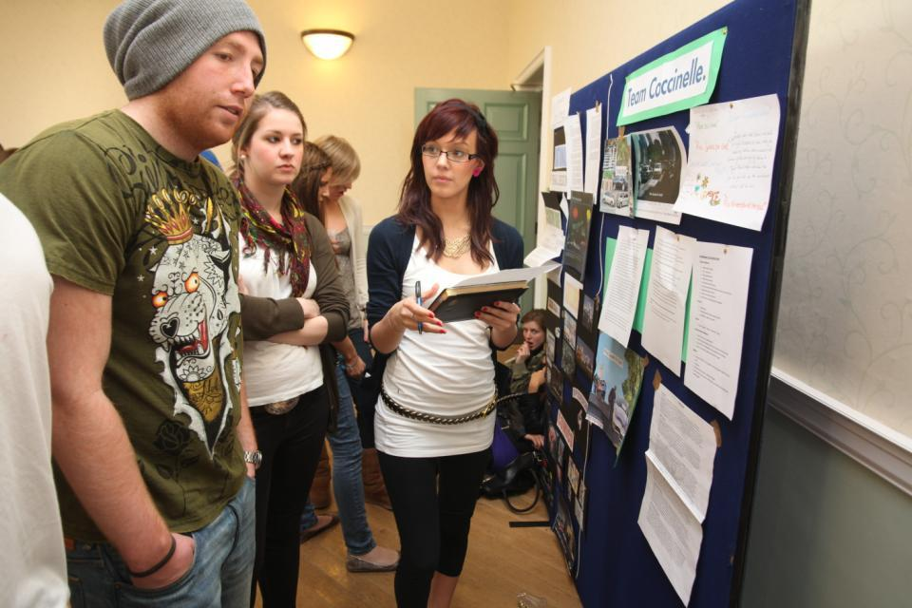
Assessing posters

Slide 29
How can authentic assessment engage students?
Using types of assessment that are much more like the ‘real things’ that academics or professionals do in their chosen fields can engage students in much more meaningful ways.
A useful way to help you ascertain how authentic your assessment is could be to ask yourself where in the programme you help students answer questions in job interviews (Sambell, Brown and Graham, 2017)

Slide 30
Questions employers might ask at interview that might help us frame some of our assignments
Can you tell us about an occasion when:
you worked together with colleagues in a group to produce a collective outcome;
you had to work autonomously with incomplete information and self-derived data sources;
you developed strategies to solve real life problems and tested them out;
you had a leadership role in a team, and could you tell us your strategies to influence and persuade your colleagues to achieve a collective task;
you had to communicate outcomes from your project work orally, in writing, through social media and/or through a visual medium?"

Slide 31
Assessment must engage students in active tasks, e.g.:
Studio critiques
Simulations
Multiple choice questions in class
Oral report (individual or group)
Business/Elevator pitches
Case studies
Annotated bibliographies
Executive summaries
Performances
Artefacts e.g. Paintings, sculptures, engineering drawings
Objective structured clinical exams (OSCEs)
Conference presentations
student-led and managed conferences
Action plans
Reports
Portfolios
Live projects
Final shows
In-tray exercises
Assessed placements
Field work notebooks
Lab books produced in real time
Short-answer questions
Reflective diaries
Logs
Vivas (live oral tests)
Storyboards
Critical incident accounts
Teaching packs
Group process tasks
Procedure manuals
Software designs
Presentations (individual or group)
Posters

Slide 32
Fostering student engagement with feedback
Students tend to regard marks like money, and so will put more energy into things that ‘count’ than those they see as options;
Formative feedback, that is developmental and supportive, and given at the right stage so that it guides future performance can be exceptionally powerful in improving achievement and retention;
Feedback and ‘feed-forward’ must be integral to student learning programmes, rather than something that students opt into, so needs to be within live or virtual face-to-face interaction.

Slide 33
Why ‘feedback as telling’ is not enough
Approaches that emphasise feedback as telling are insufficient because students are often not equipped to decode or act on statements satisfactorily, so key messages remain invisible (Sadler 2010).
Feedback literacy demands that learners acquire the academic language necessary for understanding, interpreting and thinking with complex ideas (Sutton 2012).

Slide 34
The importance of dialogic feedback (Sadler)
Students need to be exposed to, and gain experience in making judgements about, a variety of works of different quality... They need planned rather than random exposure to exemplars, and experience in making judgements about quality. They need to create verbalised rationales and accounts of how various works could have been done better. Finally, they need to engage in evaluative conversations with teachers and other students.

Slide 35
Sample assignment return proforma
Criterion no | Criterion | Mark (0-5 marks) | Tutor comments and suggestions for further work | Student response
1 | Demonstrates ability to present information clearly logically, accurately and fluently | 3 | This work is written reasonably fluently but there are some typos that would not slip in if spell checker used properly. Also note you don’t use the definite and indefinite articles (‘a’ and ‘the’ appropriately: please refer to the language guidance 17.3 on the VLE | This is something I’ve had problems with over the years but am still working on it
2 | Demonstrates ability to choose and use appropriate software | 5 | Made excellent choices and used it well to suit the context of the problem being addressed | Thank you
3 | Demonstrates ability to use a range of reference materials and cite them appropriately | 1 | Cited only one reference and did so inaccurately Please refer to the ifs referencing guide on the VLE and ensure that you provide all the information required | I've checked it out and see where I was going wrong

Slide 36
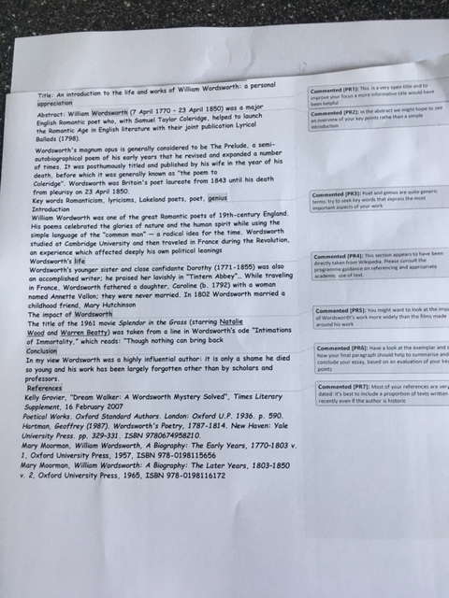

Slide 37
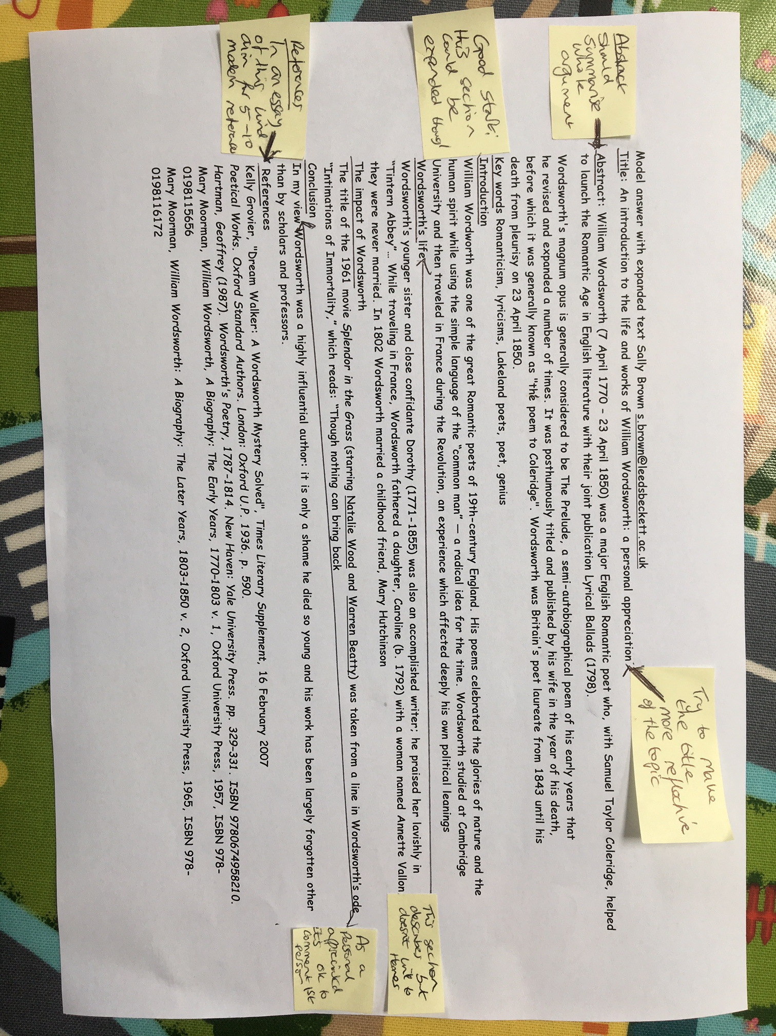

Slide 38
Encouraging better use of feedback
Emphasise early on the importance to them of formative feedback;
Consider how best to provide them with feedback.
Provide them with training on why and how feedback is provided;
Get students to practise drafting and delivering feedback;
Get students to focus on comments rather than marks;
Help students to believe they have the agency to improve their work;
Encourage students to think of feedback as a trigger to them taking action;
Give them some examples of helpful feedback as a prompt to discussion.

Slide 39
Five things students really hate about poor feedback
Poorly written comments that are nigh on impossible to decode, especially when impenetrable acronyms or abbreviations are used, or where handwriting is in an unfamiliar alphabet and is illegible.
Cursory and derogatory remarks that leave them feeling demoralised ‘Weak argument’, ‘Shoddy work’, ‘Hopeless’, ‘Under-developed’, and so on.
Value judgements on them as people rather than on the work in hand.

Slide 40
Five things students really hate about poor feedback
Vague comments which give few hints on how to improve or remediate errors: ‘OK as far as it goes’, ‘Needs greater depth of argument’, ‘Inappropriate methodology used’, ‘Not written at the right level’.
Feedback that arrives so late that there are no opportunities to put into practice any guidance suggested in time for the submission of the next assignment.

Slide 41
Feedback: a summary acrostic
Formative, helping to shape and improve future performances, that is Feed-forward;
Energising: helping students to feel motivated and inclined to work towards Enhancement;
Efficient: enabling you to maximise your helpful commentary while minimising your Effort;
Dialogic, involving interaction with and between students, plus Developmental comments;
Benevolent: students should Believe you have their Best interests at heart;
Action-orientated: that is leading students to Actually Advancing their Achievement;
Constructive rather than destructive, taking note of the affective impact of our Comments;
Kindly: when putting across tough messages, we need to remember the affective impact. (Sally Brown, 2019)

Slide 42
My predictions for the future:
Cyber-invigilation using eye-tracking while students are working on screen will mean we have greater confidence that students’ submitted work is their own (see WISEflow @UNIwiseDK).
This will mean we no longer have to have invigilated exams, and our worries about course-work authorship will be diminished;
This in turns it will be easier to move towards students being able to submit when they are ready rather than on submission dates;
Assessment data management systems will make management of marks less of a chore;
This will enable the development of personalised learning pathways to become more common.

Slide 43

These and other slides are available on my website at http://sally-brown.net

Slide 44
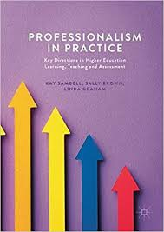
Sambell, K, Brown, S and Graham, L. (2017) Professionalism in Practice: Key directions in higher education: Learning, Teaching and Assessment, Basingstoke: Palgrave-Macmillan.

Slide 45
Useful references: 1
Assessment Reform Group (1999) Assessment for Learning: Beyond the black box, Cambridge UK, University of Cambridge School of Education.
Bain, K. (2004) What the best College Teachers do, Cambridge: Harvard University Press.
Biggs, J. and Tang, C. (2011) Teaching for Quality Learning at University, Maidenhead: Open University Press.
Bloxham, S. and Boyd, P. (2007) Developing effective assessment in higher education: a practical guide, Maidenhead, Open University Press.
Boud, D. (1995) Enhancing learning through self-assessment, London: Routledge.
Boud, D. and Associates (2010) Assessment 2020: seven propositions for assessment reform in higher education Sydney: Australian Learning and Teaching Council.

Slide 46
Useful references: 2
Brown, S. (2012) Assimilate compendium, Leeds, Leeds Met Press
Brown, S. (2012) ‘What are the perceived differences between assessing at Masters level and undergraduate level assessment? Some findings from an NTFS–funded project’ Innovations in Education and Teaching International, forthcoming
Brown, S., Deignan, T. Race, P. and Priestley, J. (2012) ‘Assessing students at Masters Level: learning points for Educational Developers’ Educational Developments, SEDA, Birmingham.
Brown, S (2012) ‘Diverse and innovative assessment at Masters Level: alternatives to conventional written assignments’ in AISHE-J: The All Ireland Journal of Teaching and Learning in Higher Education Vol 4, No 2.
Brown, S. (2014) Learning, teaching and assessment in higher education: global perspectives. London: Palgrave Macmillan.

Slide 47
Useful references: 3
Brown, S. and Glasner, A. (eds.) (1999) Assessment Matters in Higher Education, Choosing and Using Diverse Approaches, Maidenhead: Open University Press.
Brown, S. and Knight, P. (1994) Assessing Learners in Higher Education, London: Kogan Page.
Brown, S. and Race, P. (2012) Using effective assessment to promote learning in Hunt, L. and Chambers, D. (2012) University Teaching in Focus, Victoria, Australia, Acer Press. P74-91
Brown, S. Rust, C. & Gibbs, G. (1994) Strategies for Diversifying Assessment, Oxford: Oxford Centre for Staff Development.

Slide 48
Useful references: 4
Carless, D., Joughin, G., Ngar-Fun Liu et al (2006) How Assessment supports learning: Learning orientated assessment in action Hong Kong: Hong Kong University Press.
Carless, D. and Boud, D., 2018. The development of student feedback literacy: enabling uptake of feedback. Assessment & Evaluation in Higher Education, 43(8), pp.1315-1325.
Crooks, T. (1988) Assessing student performance, HERDSA Green Guide No 8 HERDSA (reprinted 1994).
Crosling, G., Thomas, L. and Heagney, M. (2008) Improving student retention in Higher Education, London and New York: Routledge.
Falchikov, N. (2004) Improving Assessment through Student Involvement: Practical Solutions for Aiding Learning in Higher and Further Education, London: Routledge.

Slide 49
Useful references: 5
Gibbs, G. (1999) Using assessment strategically to change the way students learn, in Brown S. & Glasner, A. (eds.), Assessment Matters in Higher Education: Choosing and Using Diverse Approaches, Maidenhead: SRHE/Open University Press.
Higher Education Academy (2012) A marked improvement; transforming assessment in higher education, York: HEA.
Hounsell, D. (2008). The trouble with feedback: New challenges, emerging strategies, Interchange, Spring, Accessed at www.tla.ed.ac.uk/interchange.
Knight, P. and Yorke, M. (2003) Assessment, learning and employability Maidenhead, UK: SRHE/Open University Press.

Slide 50
Useful references: 6
McDowell, L. and Brown, S. (1998) Assessing students: cheating and plagiarism, Newcastle: Red Guide 10/11 University of Northumbria.
Mentkowski, M. and associates (2000) p.82 Learning that lasts: integrating learning development and performance in college and beyond, San Francisco: Jossey-Bass.
Meyer, J.H.F. and Land, R. (2003) ‘Threshold Concepts and Troublesome Knowledge 1 – Linkages to Ways of Thinking and Practising within the Disciplines’ in C. Rust (ed.) Improving Student Learning – Ten years on. Oxford: OCSLD.
Morgan, C., Dunn, L., Parry, S. and O'Reilly, M. (2004) The student assessment handbook: New directions in traditional and online assessment, London, Routledge.

Slide 51
Useful references: 7
Newstead, S. E., Franklyn-Stokes, A., & Armstead, P. (1996) Individual differences in student cheating, Journal of Educational Psychology, 88(2), 229-241
Nicol, D. J. and Macfarlane-Dick, D. (2006) Formative assessment and self-regulated learning: A model and seven principles of good feedback practice, Studies in Higher Education Vol 31(2), 199-218.
PASS project Bradford http://www.pass.brad.ac.uk/ Accessed November 2013.
Peelo, M. T., & Wareham, T. (Eds.). (2002). Failing students in higher education. Society for Research into Higher Education.
Pickford, R. and Brown, S. (2006) Assessing skills and practice, London: Routledge.

Slide 52
Useful references: 8
Race P. (2015) The lecturer’s toolkit (4th edition), London: Routledge.
Race, P. (2001) A Briefing on Self, Peer & Group Assessment, in LTSN Generic Centre Assessment Series No 9, LTSN York.
Race, P. (2014) Making learning happen: 3rd edition, London: Sage.
Rotheram, B. (2009) Sounds Good, JISC project http://www.jisc.ac.uk/whatwedo/programmes/usersandinnovation/soundsgood.aspx
Rust, C., Price, M. and O’Donovan, B. (2003) Improving students’ learning by developing their understanding of assessment criteria and processes, Assessment and Evaluation in Higher Education. 28 (2), 147-164.

Slide 53
Useful references: 9
QAA (2010) Masters Degree Characteristics
https://www.qaa.ac.uk/docs/qaa/quality-code/master's-degree-characteristics-statement.pdf?sfvrsn=6ca2f981_10
Ryan, J. (2000) A Guide to Teaching International Students, Oxford Centre for Staff and Learning Development.
Sadler, D. R. (2010) Beyond feedback: Developing student capability in complex appraisal. Assessment & Evaluation in Higher Education, 35(5), 535-550.
Sambell ,K., Brown, S. and Race, P (2018) Quick Guides on Exemplars and briefings at Edinburgh Napier DLTE https://staff.napier.ac.uk/services/dlte/ENhance/Pages/ENhanceQuickGuides.aspx
Seymour, D. (2005) Learning Outcomes and Assessment: developing assessment criteria for Masters-level dissertations. Brookes eJournal of Learning and Teaching 1(2).
Yorke, M. (1999) Leaving Early: Undergraduate Non-completion in Higher Education, London: Routledge.

