Slide 1
Making assessment work for you: pragmatic ways of assessing students in large classes
7th International AHE Conference
June 2019
Sally Brown NTF, PFHEA, SFSEDA
@ProfSallyBrown http://sally-brown.net

Slide 2
This workshop aims to offer a range of practical ways of assessing effectively and efficiently :
Increasingly staff in universities and colleges are finding assessment workloads difficult to manage, as cohort sizes rise and there is pressure to provide students with more and better feedback;
Feedback that is developmental, supportive and timely can be immensely powerful in improving achievement and retention;
Feedback and feedforward must be integral to programmes rather than opt-in so needs to be within live or virtual face-to-face sessions;
Systems to do so need to be strategically designed and delivered.

Slide 3
3 ways of making assessment & feedback work well, particularly for 1st half of 1st semester of Year 1:
Pre-empt feedback by providing effective briefings and exemplars so that students produce good work from the outset;
Use techniques to streamline the giving of feedback;
Find manageable ways of coordinating assessment and feedback with others.

Slide 4
Some underpinning premises: formative and summative assessment
Formative assessment is primarily concerned with feedback aimed at prompting improvement, is often continuous and usually involves words.
Summative assessment is concerned with making evaluative judgments, is often end point and involves numbers.

Slide 5
Using assessment for learning (Sambell et al, 2012)
Assessment that is meaningful to students can provide them with a framework for activity;
“Students can escape bad teaching but they can’t escape bad assessment” (Boud, 1995);
Where assessment is fully part of the learning process and integrated within it, the act of being assessed can help students to make sense of their learning;
Assessment should be formative, informative, developmental and remediable.

Slide 6
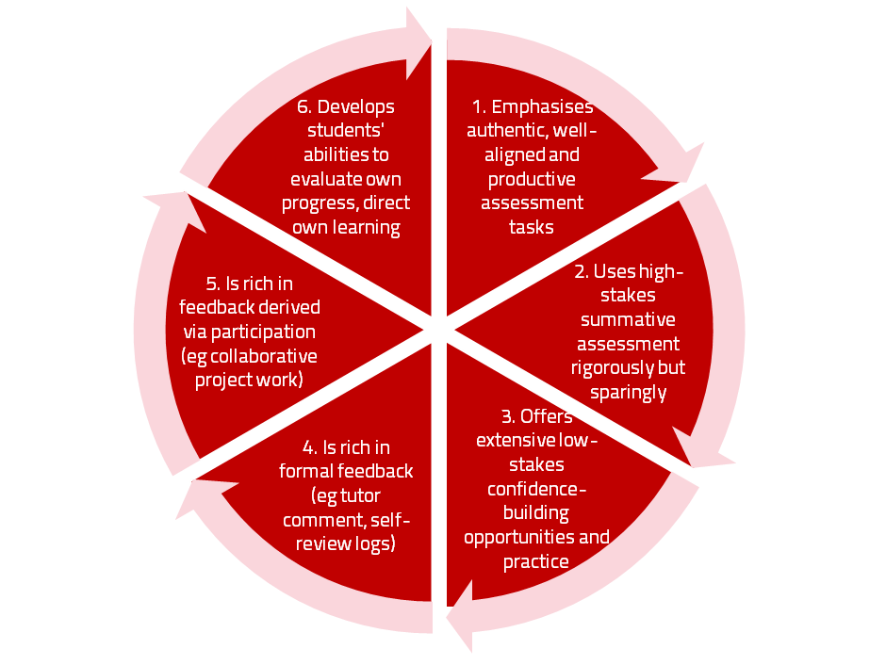
A4L the Northumbria model

Slide 7
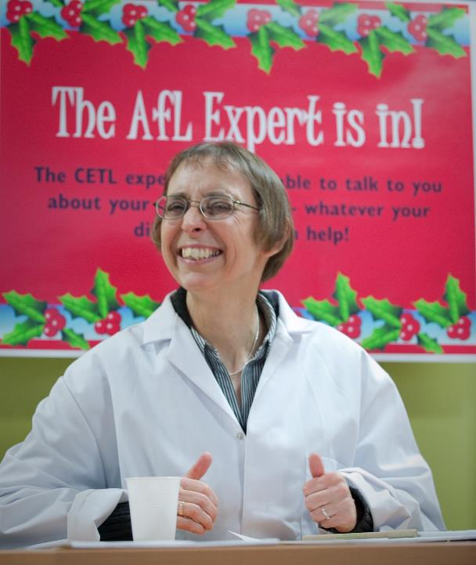

Slide 8
For any assessment activity, we need to be clear about:
Aims: is this an early stage assignment, that is principally about building confidence and helping students see what is required of them, or is it a key element of their summative assessment, designed to gauge fitness to progress, or fitness-to-practice?
Scope: is this testing low level outcomes, like demonstrating recollection of key terms, or is it cognitively more demanding requiring synthesis of multiple elements, critical analysis, evaluation and reflection?
Scale: is this a small scale or a substantial task carrying a heavy weighting? Do students know how much effort and energy is needed to achieve at least a satisfactory level?
Orientation: Is the key aim to demonstrate the achievement of skills and competences, and/or to produce a definite product, or is it primarily about demonstrating mastery of appropriate processes?
Constructive alignment: To what extent does the assessment closely link to the learning outcomes (and specifically the verbs used in them)?

Slide 9
The importance of dialogic feedback (Sadler)
Students need to be exposed to, and gain experience in making judgements about, a variety of works of different quality... They need planned rather than random exposure to exemplars, and experience in making judgements about quality. They need to create verbalised rationales and accounts of how various works could have been done better. Finally, they need to engage in evaluative conversations with teachers and other students.

Slide 10
Feedback literate students: (summary slide)
Appreciating feedback
understand and appreciate the role of feedback in improving work and the active learner role in these processes;
recognise that feedback information comes in different forms and from different sources;
use technology to access, store and revisit feedback.
Making judgements
develop capacities to make sound academic judgments about their own work and the work of others;
participate productively in peer feedback processes;
refine self-evaluative capacities over time in order to make more robust judgments.
Managing affect
maintain emotional equilibrium and avoid defensiveness when receiving critical feedback;
are proactive in eliciting suggestions from peers or teachers and continuing dialogue with them as needed;
develop habits of striving for continuous improvement on the basis of internal and external feedback.
Taking action
are aware of the imperative to take action in response to feedback information;
draw inferences from a range of feedback experiences for the purpose of continuous improvement;
develop a repertoire of strategies for acting on feedback.
Carless and Boud: 2018

Slide 11
Encouraging better use of feedback
Emphasise early on the importance to students of formative feedback;
Consider how best to provide them with feedback.
Provide them with training on why and how feedback is provided;
Get students to practise drafting and delivering feedback;
Get students to focus on comments rather than marks;
Help students to believe they have the agency to improve their work;
Encourage students to think of feedback as a trigger to them taking action;
Give them some examples of helpful feedback as a prompt to discussion.

Slide 12
To better engage learners through feedback and assessment we can:
Make use of real examples and hot-off-the-press data to keep content and tasks current and relevant;
Provide challenges to students’ thinking without letting individuals feel publicly exposed or humiliated;
Relate their learning in class to the forthcoming/ongoing assignment (without slavishly teaching to the exam);
Make spaces for dialogue through formative assessment;
Give them real problems to solve and issues with which to engage;
Identify the skills they need to succeed and provide opportunities to rehearse and develop them;
Never compromise on the quality of the demands we make of them.

Slide 13
Strategy 1. Get ahead by offering briefings on assignments because:
Early-stage students are likely to need more reassurance in your briefings in which the tone of your language may be crucial;
We should aim for as much transparency as possible: no student should be having to guess what you are looking for at any stage of their academic careers;
Whenever we use what may be to them an unfamiliar format, briefings should be linked to trial-runs, risk-free rehearsals and Q&A opportunities to clarify any areas of misconceptions;
This is not ‘spoonfeeding’ but instead giving them the knives and forks to feed themselves!
So what might a good briefing look like?

Slide 14
Essential components of an effective assignment brief I would suggest include:
Housekeeping arrangements: when does it have to be completed? How must it be submitted? Are you setting limitations around format and layout (e.g. font size, margins, use of figures, tables etc)?
Clarifying the scope of the task: how big is the task? How many words? Approximately how much time would you intend an average student to spend on this work? How many and what kinds of references should they use?
Support: Where can students go for help? How much and what kind of support can they get? (e.g. checking drafts, proofreading);
Good academic conduct: what do they need to know about the appropriate levels of peer support? How might plagiarism regulations impact on them?
Choosing the right medium: is an oral or video briefing best? What kinds of documentary detail do they need? Is the briefing a dialogue or monologue?

Slide 15
Up-front exemplars can be used productively
Exemplars are not model answers. They are carefully selected examples of authentic student work from previous cohorts (anonymised and with permission) or teacher-constructed examples (based on your extensive experience of the kinds of responses and common mistakes students make). They are chosen to typify and illustrate designated levels of quality or competence.
The concrete nature of exemplars means that they are able to convey messages in a way that nothing else can (Sadler, 2002). Carefully selected examples can not only help students to ‘see’ what the teacher expects with regard to the task in hand (Scoles et al, 2013), but also guide their action.

Slide 16
Exemplars can enable students to:
gain a feel for what the final product looks like in terms of layout, structure and language;
develop their insights into the nature of academic writing;
raise awareness of the diverse ways a task might fruitfully (or erroneously) be tackled;
hone students’ evaluative skills.
Act as powerful learning tools (Sadler, 2010), helping students gain insight into the nature of quality and standards, ideally through close analysis and discussion (Hendry et al, 2016). Students typically find exemplars to be more useful than standalone lists of criteria, grids and rubrics (Hawe et al, 2017).

Slide 17
What can we do when using exemplars?
Choose examples which will help students firmly grasp task requirements;
Help students practice applying criteria to samples of work;
Enable students to reflect deeply on, and discuss, what high quality work looks like;
Choose examples to promote self-efficacy;
Carefully orchestrate discussion activities to promote understanding of fruitful learning strategies and approaches;
Use exemplars-based activities to develop students’ skills to monitor their own work while they are producing it;
Help them rate their work by comparison with their peers.

Slide 18
Strategy 2: streamlining assessment: why would we wish to do it?
Huge pressure on resources in higher education;
Larger numbers of students in cohorts;
Ever-increasing demands on staff time;
Staff indicate they spend a disproportionate time on assessment drudgery;
The means exist nowadays to undertake some aspects of assessment more effectively and efficiently.

Slide 19
To give feedback more effectively & efficiently, we can:
Feedback orally to groups of students;
Write an assignment report;
Use assignment return sheets;
Use statement banks;
Use technologies for delivering and managing assessment.

Slide 20
Feeding back orally to groups of students: why?
Face-to-face feedback uses tone of voice, emphasis, body language;
Students learn from feedback to each others’ work;
Students can ask questions;
Makes feedback a dialogic and shared experience.

Slide 21
Feeding back orally to groups of students: how?
Staff mark assignments with minimal in-text comment and provide grades/marks as normal;
At the start of a lecture or seminar, the tutor provides an overview of class performance and orally remediates errors, clarifies; misunderstandings, and praises good practice;
Students have a chance to ask and answer questions;
For further reference and for students who couldn't be there, make a video of yourself live in action and put it on the VLE.

Slide 22
Written assignment reports: why?
Provides feedback to a group as a whole;
Allows students to know how they are doing by comparison with the rest of the course;
Offers a chance to illustrate good practice;
Minimal comments can be put on scripts;
Generic reports can be delivered quickly electronically before moderation.

Slide 23
Assignment reports: how?
Staff mark assignments with minimal in-text comment and provide grades/marks as normal;
Notes are made of similar points from several students’ work;
A report is compiled which identifies examples of good practice, areas where a number of students made similar errors and additional reading suggestions.

Slide 24
Using ‘expanded’ model answers: why?
They give students a good idea of what can be expected of them;
It is sometimes easier to show students than tell them what we are after;
They can be time efficient;
They show how solutions have been reached;
They demonstrate good practice;
The commentary can indicate why an answer is good.

Slide 25
Using model answers: how?
Staff preparing an assignment can draft a model answer;
Student work (or extracts from several student’s answers) can be anonymised and (with permission) used as a model;
Text can be placed on page with explanatory comments appended (‘exploded text’);
However, caution should be exercised in order to lead students to think only one approach is acceptable.

Slide 26
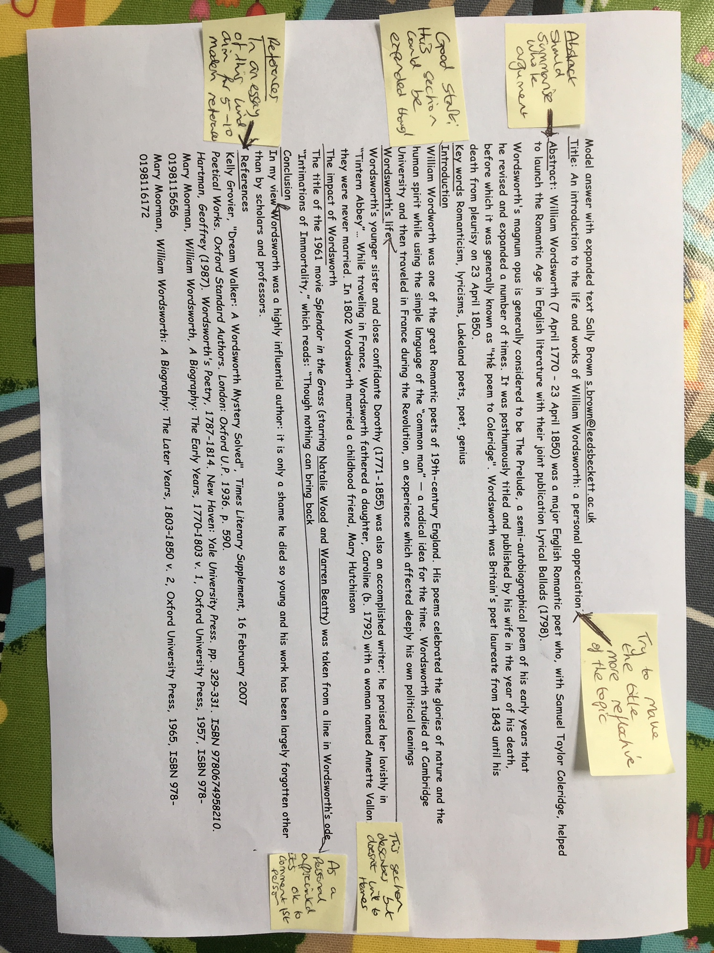

Slide 27
Assignment return sheets: why?
Proformas save assessors writing the same thing repeatedly;
Helps to keep assessors’ comments on track;
Shows how criteria match up to performance and how marks are derived;
Helps students to see what is valued;
Provides a useful written record.

Slide 28
Assignment return sheets: how?
Criteria presented in assignment brief can be utilised in a proforma;
Variations in weighting can be clearly identified;
A Likert scale or boxes can be used to speed tutor’s responses;
Space can be provided for individual comments.

Slide 29
Sample assignment return proforma
Criterion no | Criterion | Mark (0-5 marks) | Tutor comments and suggestions for further work | Student response
1 | Demonstrates ability to present information clearly logically, accurately and fluently | 3 | This work is written reasonably fluently but there are some typos that would not slip in if spell checker used properly. Also note you don’t use the definite and indefinite articles (‘a’ and ‘the’ appropriately: please refer to the language guidance 17.3 on the VLE | This is something I’ve had problems with over the years but am still working on it
2 | Demonstrates ability to choose and use appropriate software | 5 | Made excellent choices and used it well to suit the context of the problem being addressed | Thank you
3 | Demonstrates ability to use a range of reference materials and cite them appropriately | 1 | Cited only one reference and did so inaccurately Please refer to the ifs referencing guide on the VLE and ensure that you provide all the information required | I've checked it out and see where I was going wrong

Slide 30
Statement banks: why?
Harnesses a resource of comments you already use;
Avoids writing same comments repeatedly;
Allows you to give individual comments additionally to the students who really need them;
Can be automated with use of technology.

Slide 31
Statement banks: how?
Tutor identifies a range of regularly used comments written on students’ work;
These are collated and numbered;
Tutor marks work and writes numbers on text of assignment where specific comments apply, or provides a written (or emailed) detailed commentary which pulls together the appropriate items into continuous prose;
Moodle and other platforms can do much of the drudgery in terms of collating marks, returning work etc. ‘Assignment handler’ and most VLEs nowadays can return comments and only release marks when students have commented.

Slide 32
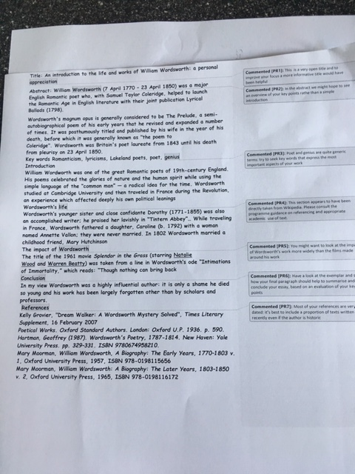

Slide 33
Computer-assisted assessment: why?
Enables feedback to be given regularly and incrementally;
Saves tutor time for large cohorts and repeated classes;
Can allow instant (or rapid) on screen feedback to e.g. MCQ options;
Saves drudgery, (but not a quick fix);
Is really worth while for large cohorts and where content doesn’t alter fast.

Slide 34
Computer-assisted assignments: how?
Designing them should not be a cottage industry!
Training and support both in designing questions and applying the relevant technology are essential;
Testing and piloting of CAA items is also imperative;
We can make use of existing test packages (e.g. from publishers), colleagues with expertise and advice from software companies (e.g. Moodle, Turnitin, QuestionMark).

Slide 35
Use CAA for rather than of learning
We can employ computer-assisted formative assessment with responses to student work automatically generated by email;
Students seem to really like having the chance to find out how they are doing, and attempt tests several times in an environment where no one else is watching how they do;
We can monitor what is going on across a cohort, so we can concentrate our energies either on students who are repeatedly doing badly or those who are not engaging at all in the activity; Note that Computer-supported assessment can include use of audio feedback via digital sound files, video commentaries and other means of using course Virtual Learning Environments.

Slide 36
Strategy 3: The first two of five manageable ways of coordinating assessment and feedback with others.
There is no substitute for holding shared sessions with all who will be assessing an assignment in order to:
Work out as a team what you are wanting to assess, so you have shared understandings from the outset;
Discuss what work at various levels should look like, and sharing practice through shared protocols;

Slide 37
What might you want to assess?
Content knowledge?
Critical thinking?
Problem identification and solution-finding?
Left-field and creative thinking?
The ability to work with incomplete information and changing circumstances?
Application of knowledge to practical contexts?
Information management?
Information retrieval and storage?
Data collection and usage?
Effective use of data bases, packages, and appropriate technologies?

Slide 38
What’s important in terms of effective communication?
Writing accuracy including grammar, spelling and punctuation?
Writing effectiveness including fluency, coherence, logical sequencing, expressing complex ideas simply?
Oral communication including formal presentations, interviews, questioning and responding?
Effective use of digital communication (websites, blogs, social media etc?
Plus other things you can identify

Slide 39
What’s important in terms of social and interactive capabilities?
The ability to form and work effectively in teams?
Leadership (and followership/collective responsibility)?
Emotional intelligence and the capability to recognise and work with the needs, strengths and weaknesses, and limitations of others?
Resilience in the face of failure, coping strategies and the ability to bounce-back?
The capability to recognise when additional support/guidance/advice is needed and to seek it out?
Plus other things you can identify

Slide 40
Level | Fantastic, just what we had in mind (or even better) | Very good but could be improved in minor ways | Good but some significant gaps | Just about good enough | Not good enough
Year 1 UG
Year 2 UG
Year 3 UG
Masters level
PhD

Slide 41
More ways to coordinate assessment and feedback with others
Make sure that all who are assessing have been trained to assess, either through formal training or through supportive mentoring by more experienced staff;
Discuss the amount, type and format of feedback all students can expect to receive, so that some are not significantly advantaged over others;
Undertake moderating activities.

Slide 42
None of this is easy…….but the alternatives are feeling as if you are drowning under a rising tide of marking and student demands on your time, plus poor student satisfaction outcomes, complaints and grievances, and not feeling as if you are doing a good job. What are you going to do?

Slide 43
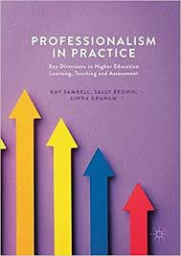
Sambell, K, Brown, S and Graham, L. (2017) Professionalism in Practice: Key directions in higher education: Learning, Teaching and Assessment, Basingstoke: Palgrave-Macmillan.

Slide 44
Feedback
Formative, helping to shape and improve future performances, that is Feed-forward;
Energising: helping students to feel motivated and inclined to work towards Enhancement;
Efficient: enabling you to maximise your helpful commentary while minimising your Effort;
Dialogic, involving interaction with and between students, plus Developmental comments;
Benevolent: students should Believe you have their Best interests at heart;
Action-orientated: that is leading students to Actually Advancing their Achievement;
Constructive rather than destructive, taking note of the affective impact of our Comments;
Kindly: when putting across tough messages, we need to remember the affective impact. (Sally Brown, 2019)

Slide 45
These and other slides are available on my website at http://sally-brown.net

Slide 46
Useful references: 1
Assessment Reform Group (1999) Assessment for Learning: Beyond the black box, Cambridge UK, University of Cambridge School of Education.
Bain, K. (2004) What the best College Teachers do, Cambridge: Harvard University Press.
Biggs, J. and Tang, C. (2011) Teaching for Quality Learning at University, Maidenhead: Open University Press.
Bloxham, S. and Boyd, P. (2007) Developing effective assessment in higher education: a practical guide, Maidenhead, Open University Press.
Boud, D. (1995) Enhancing learning through self-assessment, London: Routledge.
Boud, D. and Associates (2010) Assessment 2020: seven propositions for assessment reform in higher education Sydney: Australian Learning and Teaching Council.

Slide 47
Useful references: 2
Brown, S. (2012) Assimilate compendium, Leeds, Leeds Met Press
Brown, S. (2012) ‘What are the perceived differences between assessing at Masters level and undergraduate level assessment? Some findings from an NTFS–funded project’ Innovations in Education and Teaching International, forthcoming
Brown, S., Deignan, T. Race, P. and Priestley, J. (2012) ‘Assessing students at Masters Level: learning points for Educational Developers’ Educational Developments, SEDA, Birmingham.
Brown, S (2012) ‘Diverse and innovative assessment at Masters Level: alternatives to conventional written assignments’ in AISHE-J: The All Ireland Journal of Teaching and Learning in Higher Education Vol 4, No 2.

Slide 48
Useful references: 3
Brown, S. (2014) Learning, teaching and assessment in higher education: global perspectives. London: Palgrave Macmillan.
Brown, S. and Glasner, A. (eds.) (1999) Assessment Matters in Higher Education, Choosing and Using Diverse Approaches, Maidenhead: Open University Press.
Brown, S. and Knight, P. (1994) Assessing Learners in Higher Education, London: Kogan Page.
Brown, S. and Race, P. (2012) Using effective assessment to promote learning in Hunt, L. and Chambers, D. (2012) University Teaching in Focus, Victoria, Australia, Acer Press. P74-91
Brown, S. Rust, C. & Gibbs, G. (1994) Strategies for Diversifying Assessment, Oxford: Oxford Centre for Staff Development.

Slide 49
Useful references: 4
Carless, D., Joughin, G., Ngar-Fun Liu et al (2006) How Assessment supports learning: Learning orientated assessment in action Hong Kong: Hong Kong University Press.
Carroll, J. and Ryan, J. (2005) Teaching International students: improving learning for all. London: Routledge SEDA series.
Crooks, T. (1988) Assessing student performance, HERDSA Green Guide No 8 HERDSA (reprinted 1994).
Crosling, G., Thomas, L. and Heagney, M. (2008) Improving student retention in Higher Education, London and New York: Routledge.
Falchikov, N. (2004) Improving Assessment through Student Involvement: Practical Solutions for Aiding Learning in Higher and Further Education, London: Routledge.

Slide 50
Useful references: 5
Gibbs, G. (1999) Using assessment strategically to change the way students learn, in Brown S. & Glasner, A. (eds.), Assessment Matters in Higher Education: Choosing and Using Diverse Approaches, Maidenhead: SRHE/Open University Press.
Higher Education Academy (2012) A marked improvement; transforming assessment in higher education, York: HEA.
Hounsell, D. (2008). The trouble with feedback: New challenges, emerging strategies, Interchange, Spring, Accessed at www.tla.ed.ac.uk/interchange.
Knight, P. and Yorke, M. (2003) Assessment, learning and employability Maidenhead, UK: SRHE/Open University Press.

Slide 51
Useful references: 6
McDowell, L. and Brown, S. (1998) Assessing students: cheating and plagiarism, Newcastle: Red Guide 10/11 University of Northumbria.
Mentkowski, M. and associates (2000) p.82 Learning that lasts: integrating learning development and performance in college and beyond, San Francisco: Jossey-Bass.
Meyer, J.H.F. and Land, R. (2003) ‘Threshold Concepts and Troublesome Knowledge 1 – Linkages to Ways of Thinking and Practising within the Disciplines’ in C. Rust (ed.) Improving Student Learning – Ten years on. Oxford: OCSLD.
Morgan, C., Dunn, L., Parry, S. and O'Reilly, M. (2004) The student assessment handbook: New directions in traditional and online assessment, London, Routledge.

Slide 52
Useful references: 7
Newstead, S. E., Franklyn-Stokes, A., & Armstead, P. (1996) Individual differences in student cheating, Journal of Educational Psychology, 88(2), 229-241
Nicol, D. J. and Macfarlane-Dick, D. (2006) Formative assessment and self-regulated learning: A model and seven principles of good feedback practice, Studies in Higher Education Vol 31(2), 199-218.
PASS project Bradford http://www.pass.brad.ac.uk/ Accessed November 2013.
Peelo, M. T., & Wareham, T. (Eds.). (2002). Failing students in higher education. Society for Research into Higher Education.
Pickford, R. and Brown, S. (2006) Assessing skills and practice, London: Routledge.

Slide 53
Useful references: 8
Race P. (2015) The lecturer’s toolkit (4th edition), London: Routledge.
Race, P. (2001) A Briefing on Self, Peer & Group Assessment, in LTSN Generic Centre Assessment Series No 9, LTSN York.
Race, P. (2014) Making learning happen: 3rd edition, London: Sage.
Rotheram, B. (2009) Sounds Good, JISC project http://www.jisc.ac.uk/whatwedo/programmes/usersandinnovation/soundsgood.aspx
Rust, C., Price, M. and O’Donovan, B. (2003) Improving students’ learning by developing their understanding of assessment criteria and processes, Assessment and Evaluation in Higher Education. 28 (2), 147-164.

Slide 54
Useful references: 9
QAA (2010) Masters Degree Characteristics
https://www.qaa.ac.uk/docs/qaa/quality-code/master's-degree-characteristics-statement.pdf?sfvrsn=6ca2f981_10
Ryan, J. (2000) A Guide to Teaching International Students, Oxford Centre for Staff and Learning Development.
Sadler, D. R. (2010) Beyond feedback: Developing student capability in complex appraisal. Assessment & Evaluation in Higher Education, 35(5), 535-550.
Sambell ,K., Brown, S. and Race, P (2018) Quick Guides on Exemplars and briefings at Edinburgh Napier DLTE https://staff.napier.ac.uk/services/dlte/ENhance/Pages/ENhanceQuickGuides.aspx
Seymour, D. (2005) Learning Outcomes and Assessment: developing assessment criteria for Masters-level dissertations. Brookes eJournal of Learning and Teaching 1(2).
Yorke, M. (1999) Leaving Early: Undergraduate Non-completion in Higher Education, London: Routledge.

