Slide 1
Fostering First-Year students’ engaging and retention through developing assessment and feedback
European First Year Experience Conference
Cork, June 18th 2019: 12-1pm
Sally Brown NTF, PFHEA, SFSEDA
@ProfSallyBrown http://sally-brown.net

Slide 2
A note about the slides
All available on my website at sally-brown.net;
All, like everything I do, are open educational resources so use them with colleagues and students as you wish (except the images of people);
There are far too many in the full presentation for us to use today: regard them like the bonus features on a DVD (or your homework!). I will select from them what I consider to be the most helpful as the session develops, and will not go in a straight line!

Slide 3
Rationale
This session focuses on ways in which enhancing assessment and feedback practice can improve the overall student experience by diminishing anxiety and uncertainty, and building self-efficacy. We will explore five ways in which staff in a variety of roles working with First-Year students can significantly improve students' understanding of the assessment practices and approaches they are likely to encounter in HEIs, aiming to improve clarity, constructive alignment, learning by doing, authenticity and the means by which students are supported in taking note of and using feedback and feed-forward

Slide 4
Assessment is the crucial locus of interaction between students and the Higher Education Institutions and can be the ‘make-or-break’ element of the first-year experience.
Yorke and Longden (2004) tell us that students who drop out are most likely to do so in the first year, and that the end of the first six weeks of the first semester of the first year, when students are submitting their first assignments, is a flash point for students feeling that higher education isn’t for them.
This workshop will propose five areas in which assessment literacy can be fostered within programmes as a means of fostering engagement and supporting those potentially dropping-out.

Slide 5
In this session, participants with have opportunities to consider
Articulation of the diverse purposes of assessment;
Alignment of assignments with learning outcomes so that students see the sense of what they are being asked to achieve;
Activities (e.g. games and fun tasks) to promote a better understanding of what students need to do to be successful in assignments;
Authenticity of assessment activities;
Anticipatory and timely feedback (e.g. using briefings, rehearsals and exemplars) so students can realistically judge the quality of their own work prior to submitting it

Slide 7
1. Articulation of the diverse purposes of assessment
Assessment should be formative, informative, developmental and remediable.

Slide 8
Overall purposes of assessment include:
Assessment that is meaningful to students which can provide them with a framework for activity;
Where assessment is fully part of the learning process and integrated within it, the act of being assessed can help students to make sense of their learning, Ensuring that assessment is for not just of learning;
Building students' assessment literacy and enables them better to understand how criteria and assessment practices work;
Fostering approaches to feedback that mean students take good note of and use the comments and advice provided by their assessors
Helping universities and colleagues make decisions about award levels/grades;
Providing data for institutional, regional, national and international metrics and supporting quality assurance and enhancement.

Slide 9
Purposes: the reasons for assessment: as programme level may include:
Enabling students to get the measure of their achievement and helping consolidate their learning;
Providing feedback so they can improve and remedy any deficiencies;
Motivating students to engage in their learning;
Providing them with opportunities to relate theory and practice;
Helping students make sensible choices about option alternatives and directions for further study;
Demonstrating student employability and fitness-to-practice.
Notes:
9

Slide 10
Orientation: choosing what we assess
product or process?
theory or practice (HE particularly)?
knowledge, skills and attitude (all sectors)?
subject knowledge or application?
what we’ve always assessed?
what it’s easy to assess?
Because “Students can escape bad teaching but they can’t escape bad assessment” (Boud, 1995);
Notes:
10

Slide 11
For any assessment activity, we need to be clear about:
Aims: is this an early stage assignment, that is principally about building confidence and helping students see what is required of them, or is it a key element of their summative assessment, designment to gauge fitness to progress, or fitness-to-practice?
Scope: is this testing low level outcomes, like demonstrating recollection of key terms, or is it cognitively more demanding requiring synthesis of multiple elements, critical analysis, evaluation and reflection?
Scale: is this a small scale or a substantial task carrying a heavy weighting? Do students know how much effort and energy is needed to achieve at least a satisfactory level?
Orientation: Is the key aim to demonstrate the achievement of skills and competences, and/or to produce a definite product or is it primarily about demonstrating mastery of appropriate processes?
Constructive alignment: To what extent does the assessment closely link to the learning outcomes (and specifically the verbs used in them)?

Slide 12
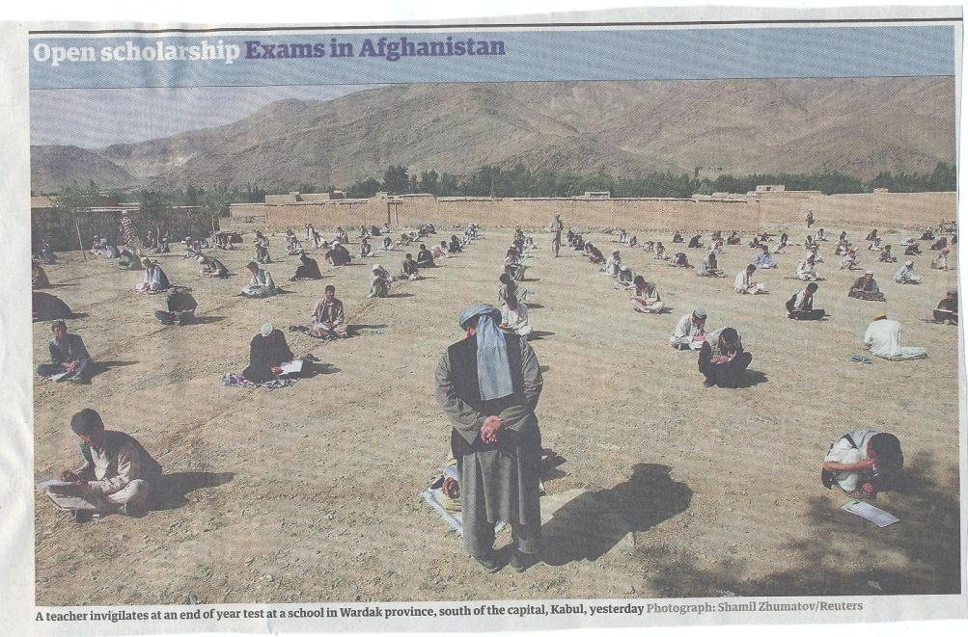

Slide 13
Formative and summative assessment
Formative assessment is primarily concerned with feedback aimed at prompting improvement, is often continuous and usually involves words.
Summative assessment is concerned with making evaluative judgments, is often end point and involves numbers.

Slide 14
Underpinning premises for A4L
Assessment can be a powerful means of focusing student effort and enhancing achievement if it is well designed and constructively aligned (Biggs and Tang, 2011);
We need to deploy a diverse range of tactics to our assessment and feedback to ensure that they work to enhance and extend student learning;
Students need to achieve assessment literacy to ensure they understand and can benefit from our assessment systems;
Assessment needs to be manageable for staff and students if it is going to engage students in learning activities.

Slide 15
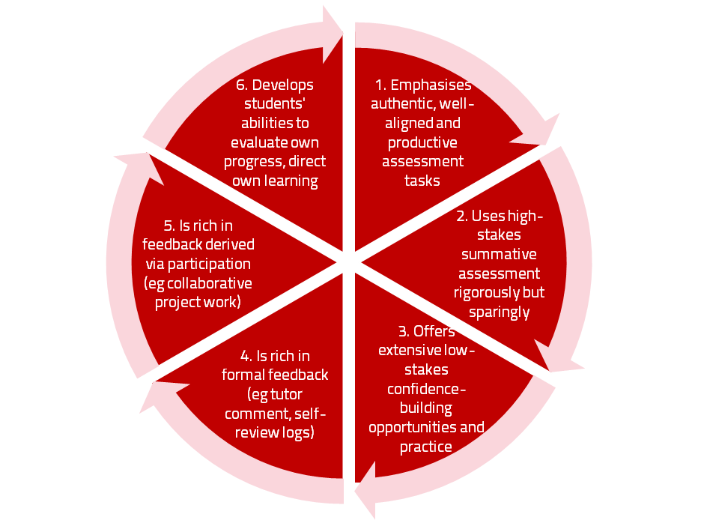
A4L the Northumbria model

Slide 16
The importance of dialogic feedback to involve students as partners in assessment
Students need to be exposed to, and gain experience in making judgements about, a variety of works of different quality... They need planned rather than random exposure to exemplars, and experience in making judgements about quality. They need to create verbalised rationales and accounts of how various works could have been done better. Finally, they need to engage in evaluative conversations with teachers and other students. (Sadler, 2010)

Slide 17
2. Alignment of assignments with learning outcomes so that students see the sense of what they are being asked to achieve

Slide 18
Designing assessment as a central part of curriculum design
Assessment is a complex, nuanced and highly important process​ and if we want students to engage fully, we must make it really meaningful to them and convince them that there is merit in the activities we ask them to undertake. To focus students’ effort and improve their engagement with learning, we need to take a fresh look at our current practice to make sure assessment is for rather than just of learning, with students learning while they are being assessed rather than it being merely a summative end process. We also need to ensure that we make assessment practices and the giving of feedback manageable for staff and valuable for students.

Slide 19
Determining and reviewing subject material: currency, relevance, level
Enhancing quality, seeking continuous improvement
Designing and refining learning outcomes
Evaluating programmes, strengths and areas for improvement
Curriculum
Design
Essentials
Considering delivery modes: face-to-face, online, PBL, blended…
Assuring quality, matching HEI, national and PRSB requirements
Thinking through student support
Designing fit for purpose assessment methods and approaches

Slide 20
Are your learning outcomes SMART or VASCULAR? The usual ‘requirements’ are that they be:
Specific;
Measurable;
Achievable;
Realistic;
Time constrained?

Slide 21
VASCULAR learning outcomes help make assessment effective
Verifiable: Can we tell when they’ve been achieved? And can students?
Action orientated: Do they lead to real and useful activity?
Singular: i.e. not portmanteau outcomes combining two or more into one, making it difficult to assess if differently achieved, but readily matchable to student work produced?
Constructively aligned? (Biggs and Tang, 2011) so that there is clear alignment between aims (What do students need to be able to know and do?), what is taught/ learned, how these are assessed and evaluated);
Understandable i.e. using language codes that are meaningful to all stakeholders?
Level-appropriate? Suitable and differentiable between1st year, 2nd year, 3rd year, Masters, other PG?
Affective-inclusive i.e. not just covering actions but capabilities in the affective domain?
Regularly reviewed? Not just stuck in history and always fit-for-purpose.

Slide 22
3. Activities (e.g. games and fun tasks) to promote a better understanding of what students need to do to be successful in assignments

Slide 23
Assessment literacy: students do better if they can:
Make sense of key terms such as criteria, weightings, and level;
Encounter a variety of assessment methods (e.g. presentations, portfolios, posters, assessed web participation, practicals, vivas etc) and get practice in using them;
Be strategic in their behaviours, putting more work into aspects of an assignment with high weightings, interrogating criteria to find out what is really required and so on;
Gain clarity on how the assessment regulations work in their HEI, including issues concerning submission, resubmission, pass marks, condonement etc.

Slide 24
We can do this for example in the first-year by:
Using games and other light-hearted activities; e.g. cat game, biscuit game see https://staff.napier.ac.uk/services/dlte/ENhance/Documents/Quick%20Guides/Activity%201%20The%20Biscuit%20Game.pdf
Enabling students to see examples of completed work, for example, dissertations and projects;
Using detailed briefings to guide early stage students in what to expect in a higher education assignment;
Involving students in discussing exemplars, comments in text and ‘expanded text’ model answers;
Providing then with detailed in-text comments to review.

Slide 25
Essential components of an effective assignment brief I would suggest include:
Housekeeping arrangements: when does it have to be completed? How must it be submitted? Are you setting limitations around format and layout (e.g. font size, margins, use of figures, tables etc)?
Clarifying the scope of the task: how big is the task? How many words? Approximately how much time would you intend an average student to spend on this work? How many and what kinds of references should they use?
Support: Where can students go for help? How much and what kind of support can they get? (e.g. checking drafts, proofreading);
Good academic conduct: what do they need to know about the appropriate levels of peer support? How might plagiarism regulations impact on them?
Choosing the right medium: is an oral or video briefing best? What kinds of documentary detail do they need? Is the briefing a dialogue or monologue?

Slide 26
An activity for staff on building a briefing activity
Imagine this is an early assignment for a First-Year undergraduate cohort;
In groups, list some essential components of an effective assignment brief;
Discuss how your briefings would be different if these were Final Year UGs or PG students;
Use this activity to help you build a checklist of what to include in your future briefings.

Slide 27
What are exemplars, and how can we use them productively?
Exemplars are not model answers. They are carefully selected examples of authentic student work from previous cohorts (anonymised and with permission) or teacher-constructed examples (based on your extensive experience of the kinds of responses and common mistakes students make). They are chosen to typify and illustrate designated levels of quality or competence.
The concrete nature of exemplars means that they are able to convey messages in a way that nothing else can (Sadler, 2002). Carefully selected examples can not only help students to ‘see’ what the teacher expects with regard to the task in hand (Scoles et al, 2013), but also guide their action.

Slide 28
Exemplars can enable 1st-year students to:
gain a feel for what the final product looks like in terms of layout, structure and language;
develop their insights into the nature of academic writing;
raise awareness of the diverse ways a task might fruitfully (or erroneously) be tackled;
hone students’ evaluative skills.
Act as powerful learning tools (Sadler, 2010), helping students gain insight into the nature of quality and standards, ideally through close analysis and discussion (Hendry et al, 2016). Students typically find exemplars to be more useful than standalone lists of criteria, grids and rubrics (Hawe et al, 2017).

Slide 29
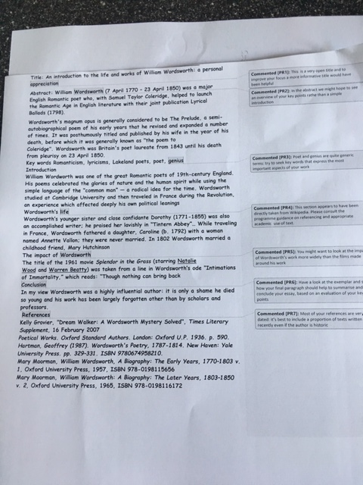

Slide 30
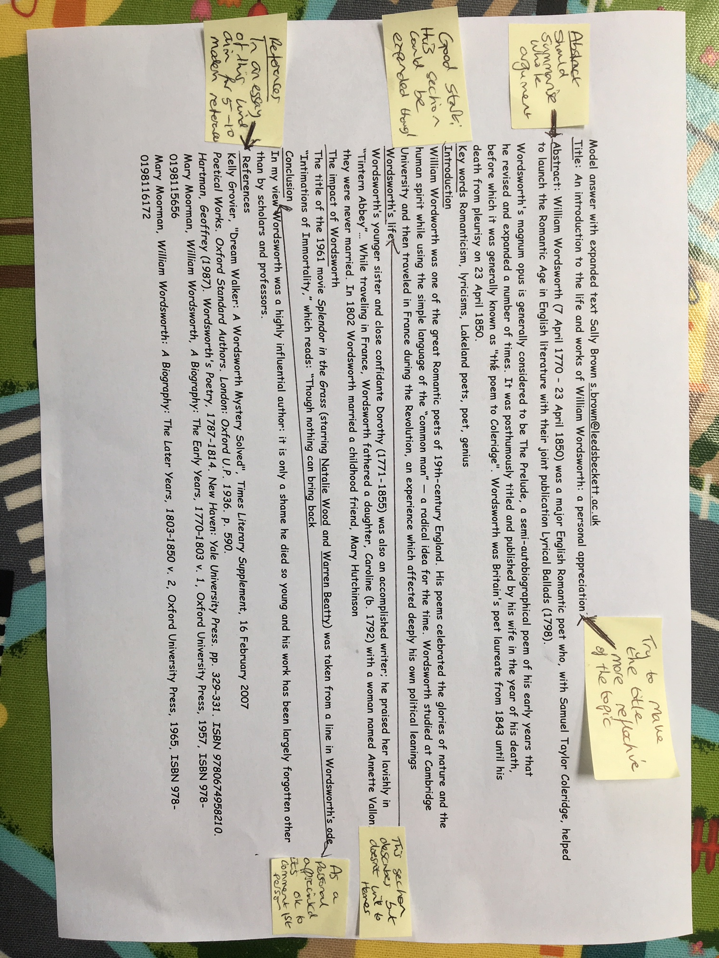

Slide 31
4. Authenticity of assessment activities
Going beyond traditional assessment formats

Slide 32
What do we mean by ‘traditional assessment formats’?
At least 80% of higher education assessment in most countries uses three main forms:
Unseen time constrained exams of some sort;
Essays where students respond to a stimulus question or title;
Reports of some kind.
Multiple-choice tests are also widely used in many nations.
These are not necessarily authentic or useful means of assessing students knowledge, capabilities and understanding.

Slide 34
We often assess what is easy to assess, or proxies of what’s been learned, rather than the learning itself
A valid assessment is one that has close relevance to the criteria, which are in turn constructively aligned to the stated learning outcomes of a programme.
Effective assessment is highly relevant to ensuring that graduates can demonstrate the knowledge, behaviours, qualities and attributes that were described in the course outline or programme specification.
Assignments that require students to write about something, rather than be or do something, may not always be fit-for-purpose.

Slide 35
Authentic assessment: what are the principal benefits for stakeholders?
Students undertaking authentic assessments tend to be more fully engaged in learning and hence tend to achieve more highly because they see the sense of what they are doing (Sadler, 2005).
University teachers adopting authentic approaches can use realistic and live contexts within which to frame assessment tasks, which help to make theoretical elements of the course come to life.
Employers value students who can quickly engage in real-life tasks immediately on employment, having practiced and developed relevant skills and competences through their assignments.

Slide 36
Wiggins (1990) says assessment can be regarded as authentic if we can draw valid inferences about quality from the work students produce
He proposes that we should aim to offer students assignments that present the student with the full array of tasks that mirror the priorities and challenges found in the best [teaching] activities and that attend to whether the student can craft polished, thorough and justifiable answers, performances or products.
He says they must involve students being able to cope with potentially ill-structured challenges and roles, with incomplete information, that help them rehearse for the complex ambiguities of adult and professional life.

Slide 37
How can authentic assessment engage students?
Using types of assessment that are much more like the ‘real things’ that academics or professionals do in their chosen fields can engage students in much more meaningful ways.
A useful way to help you ascertain how authentic your assessment is could be to ask yourself where in the programme you help students answer questions in job interviews (Sambell, Brown and Graham, 2017)

Slide 38
Questions employers might ask at interview that might help us frame some of our assignments
“Can you tell us about an occasion when:
you worked together with colleagues in a group to produce a collective outcome;
you had to work autonomously with incomplete information and self-derived data sources;
you developed strategies to solve real life problems and tested them out;
you had a leadership role in a team, and could you tell us your strategies to influence and persuade your colleagues to achieve a collective task;
you had to communicate outcomes from your project work orally, in writing, through social media and/or through a visual medium?”

Slide 39
5. Anticipatory and timely feedback (e.g. using briefings, rehearsals and exemplars) so students can realistically judge the quality of their own work prior to submitting it

Slide 40
Feedback
Formative, helping to shape and improve future performances, that is Feed-forward;
Energising: helping students to feel motivated and inclined to work towards Enhancement;
Efficient: enabling you to maximise your helpful commentary while minimising your Effort;
Dialogic, involving interaction with and between students, plus Developmental comments;
Benevolent: students should Believe you have their Best interests at heart;
Action-orientated: that is leading students to Actually Advancing their Achievement;
Constructive rather than destructive, taking note of the affective impact of our Comments;
Kindly: when putting across tough messages, we need to remember the affective impact. (Sally Brown, 2019)

Slide 41
Fostering better use of feedback
Emphasise early on the importance to students of formative feedback;
Consider how best to provide them with feedback.
Provide them with training on why and how feedback is provided;
Get students to practise drafting and delivering feedback;
Get students to focus on comments rather than marks;
Help students to believe they have the agency to improve their work;
Encourage students to think of feedback as a trigger to them taking action;
Give them some examples of helpful feedback as a prompt to discussion.

Slide 42
Good feedback: (after Brown, S. (2015), Assessment, learning and teaching in higher education: global perspectives, London: Palgrave-MacMillan)
Is dialogic, rather than mono-directional, giving students chances to respond to comments from their markers and seek clarification where necessary.
Helps clarify what good work looks like, so students are really clear about goals, criteria and expected standards, and provides opportunities to close the gap between current and desired performance.

Slide 43
Good feedback:
Actively facilitates students reviewing their own work and reflecting on it, so that they become good judges of the quality of their own work.
Doesn’t just correct errors and indicate problems, potentially leaving students discouraged and demotivated, but also highlights good work and encourages them to believe they can improve and succeed.

Slide 44
Good feedback:
Delivers high-quality information to students about their achievements to date and how they can improve their future work. Where there are errors, students should be able to see what needs to be done to remediate them, and where they are undershooting in terms of achievement, they should be able to perceive how to make their work even better.

Slide 45
Good feedback:
Offers ‘feed-forward’ aiming to ‘increase the value of feedback to the students by focusing comments not only on the past and present … but also on the future – what the student might aim to do, or do differently in the next assignment or assessment if they are to continue to do well or to do better’ (Hounsell, 2008, p.5).
Ensures that the mark isn’t the only thing that students take note of when work is returned, but that they are encouraged to read and use the advice given in feedback and apply it to future assignments.

Slide 46
Five things students really hate about poor feedback
Poorly written comments that are nigh on impossible to decode, especially when impenetrable acronyms or abbreviations are used, or where handwriting is in an unfamiliar alphabet and is illegible.
Cursory and derogatory remarks that leave them feeling demoralised ‘Weak argument’, ‘Shoddy work’, ‘Hopeless’, ‘Under-developed’, and so on.
Value judgements on them as people rather than on the work in hand.

Slide 47
Five things students really hate about poor feedback
Vague comments which give few hints on how to improve or remediate errors: ‘OK as far as it goes’, ‘Needs greater depth of argument’, ‘Inappropriate methodology used’, ‘Not written at the right level’.
Feedback that arrives so late that there are no opportunities to put into practice any guidance suggested in time for the submission of the next assignment.

Slide 48
Encouraging students to recognise and use the feedback we provide for them
Delivery of feedback should not be left to chance, so its best to avoid asking students to pick up marked hard copy assignments from departmental offices;
Electronic submission of assignments has benefits and disadvantages but on balance the former outweigh the latter;
Perhaps require students to guestimate expected marks having read your feedback early in their programmes;
‘Assignment handler’ can deliver feedback electronically and only release marks once students have responded;
Audio files of audio feedback can be highly successful in enabling students to capture ‘live’ oral feedback, and can replace written feedback (e.g. JISC project ‘Sounds good’).

Slide 49
Planning for action
As an individual, are there changes you would like to make to your curriculum design, delivery and assessment practices?
Thinking about the teams you work with, are there ways in which you could use ideas from today’s session to make your curriculum more authentic?
How could your influence impact more widely on colleagues across the university? And what can the university do to help make this happen?

Slide 50
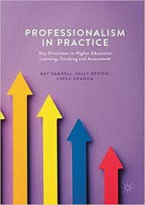
Sambell, K, Brown, S and Graham, L. (2017) Professionalism in Practice: Key directions in higher education: Learning, Teaching and Assessment, Basingstoke: Palgrave-Macmillan.

Slide 51
Useful references: 1
Assessment Reform Group (1999) Assessment for Learning: Beyond the black box, Cambridge UK, University of Cambridge School of Education.
Bain, K. (2004) What the best College Teachers do, Cambridge: Harvard University Press.
Biggs, J. and Tang, C. (2011) Teaching for Quality Learning at University, Maidenhead: Open University Press.
Bloxham, S. and Boyd, P. (2007) Developing effective assessment in higher education: a practical guide, Maidenhead, Open University Press.
Boud, D. (1995) Enhancing learning through self-assessment, London: Routledge.
Boud, D. and Associates (2010) Assessment 2020: seven propositions for assessment reform in higher education Sydney: Australian Learning and Teaching Council.

Slide 52
Useful references: 2
Brown, S. (2012) Assimilate compendium, Leeds, Leeds Met Press
Brown, S. (2012) ‘What are the perceived differences between assessing at Masters level and undergraduate level assessment? Some findings from an NTFS–funded project’ Innovations in Education and Teaching International, forthcoming
Brown, S., Deignan, T. Race, P. and Priestley, J. (2012) ‘Assessing students at Masters Level: learning points for Educational Developers’ Educational Developments, SEDA, Birmingham.
Brown, S (2012) ‘Diverse and innovative assessment at Masters Level: alternatives to conventional written assignments’ in AISHE-J: The All Ireland Journal of Teaching and Learning in Higher Education Vol 4, No 2.
Brown, S. (2014) Learning, teaching and assessment in higher education: global perspectives. London: Palgrave Macmillan.

Slide 53
Useful references: 3
Brown, S. and Glasner, A. (eds.) (1999) Assessment Matters in Higher Education, Choosing and Using Diverse Approaches, Maidenhead: Open University Press.
Brown, S. and Knight, P. (1994) Assessing Learners in Higher Education, London: Kogan Page.
Brown, S. and Race, P. (2012) Using effective assessment to promote learning in Hunt, L. and Chambers, D. (2012) University Teaching in Focus, Victoria, Australia, Acer Press. P74-91
Brown, S. Rust, C. & Gibbs, G. (1994) Strategies for Diversifying Assessment, Oxford: Oxford Centre for Staff Development.

Slide 54
Useful references: 4
Carless, D., Joughin, G., Ngar-Fun Liu et al (2006) How Assessment supports learning: Learning orientated assessment in action Hong Kong: Hong Kong University Press.
Carroll, J. and Ryan, J. (2005) Teaching International students: improving learning for all. London: Routledge SEDA series.
Crooks, T. (1988) Assessing student performance, HERDSA Green Guide No 8 HERDSA (reprinted 1994).
Crosling, G., Thomas, L. and Heagney, M. (2008) Improving student retention in Higher Education, London and New York: Routledge.
Falchikov, N. (2004) Improving Assessment through Student Involvement: Practical Solutions for Aiding Learning in Higher and Further Education, London: Routledge.
Kay, J., Dunne, E. and Hutchinson, J., (2010). Rethinking the values of higher education-students as change agents?.

Slide 55
Useful references: 5
Gibbs, G. (1999) Using assessment strategically to change the way students learn, in Brown S. & Glasner, A. (eds.), Assessment Matters in Higher Education: Choosing and Using Diverse Approaches, Maidenhead: SRHE/Open University Press.
Higher Education Academy (2012) A marked improvement; transforming assessment in higher education, York: HEA.
Hounsell, D. (2008). The trouble with feedback: New challenges, emerging strategies, Interchange, Spring, Accessed at www.tla.ed.ac.uk/interchange.
Knight, P. and Yorke, M. (2003) Assessment, learning and employability Maidenhead, UK: SRHE/Open University Press.
Kotze, T.G. and Du Plessis, P.J., (2003) Students as “co-producers” of education: a proposed model of student socialisation and participation at tertiary institutions. Quality assurance in education, 11(4), pp.186-201.

Slide 56
Useful references: 6
Lizzio, A., 2011. The student lifecycle: An integrative framework for guiding practice. Brisbane: Griffith University.
McDowell, L. and Brown, S. (1998) Assessing students: cheating and plagiarism, Newcastle: Red Guide 10/11 University of Northumbria.
Mentkowski, M. and associates (2000) p.82 Learning that lasts: integrating learning development and performance in college and beyond, San Francisco: Jossey-Bass.
Morgan, C., Dunn, L., Parry, S. and O'Reilly, M. (2004) The student assessment handbook: New directions in traditional and online assessment, London, Routledge.

Slide 57
Useful references: 7
Morgan, M. ed., 2013. Improving the student experience: A practical guide for universities and colleges. Routledge.
Nicol, D. J. and Macfarlane-Dick, D. (2006) Formative assessment and self-regulated learning: A model and seven principles of good feedback practice, Studies in Higher Education Vol 31(2), 199-218.
PASS project Bradford http://www.pass.brad.ac.uk/ Accessed November 2013.
Peelo, M. T., & Wareham, T. (Eds.). (2002). Failing students in higher education. Society for Research into Higher Education.
Pickford, R. and Brown, S. (2006) Assessing skills and practice, London: Routledge.

Slide 58
Useful references: 8
Race P. (2015) The lecturer’s toolkit (4th edition), London: Routledge.
Race, P. (2001) A Briefing on Self, Peer & Group Assessment, in LTSN Generic Centre Assessment Series No 9, LTSN York.
Race, P. (2014) Making learning happen: 3rd edition, London: Sage.
Rotheram, B. (2009) Sounds Good, JISC project http://www.jisc.ac.uk/whatwedo/programmes/usersandinnovation/soundsgood.aspx
Rust, C., Price, M. and O’Donovan, B. (2003) Improving students’ learning by developing their understanding of assessment criteria and processes, Assessment and Evaluation in Higher Education. 28 (2), 147-164.

Slide 59
Useful references: 9
Ryan, J. (2000) A Guide to Teaching International Students, Oxford Centre for Staff and Learning Development.
Sadler, D. R. (2010) Beyond feedback: Developing student capability in complex appraisal. Assessment & Evaluation in Higher Education, 35(5), 535-550.
Sambell, K, Brown, S and Graham, L. (2017) Professionalism in Practice: Key directions in higher education: Learning, Teaching and Assessment, Basingstoke: Palgrave-Macmillan.
Seymour, D. (2005) Learning Outcomes and Assessment: developing assessment criteria for Masters-level dissertations. Brookes eJournal of Learning and Teaching 1(2).
Yorke, M. (1999) Leaving Early: Undergraduate Non-completion in Higher Education, London: Routledge.

