Slide 1
Breathing life into your small group teaching: some ideas you can nick!
Lincoln University, 12th June 2019
Sally Brown @ProfSallyBrown
sally@sally-brown.net
NTF, PFHEA, SFSEDA
Emerita Professor, Leeds Beckett University
Visiting Professor University of Plymouth, Edge Hill University,
University of South Wales & Liverpool John Moores University.

Slide 2
A note about the slides
All available on my website at http://sally-brown.net;
All, like everything I do, open educational resources so use them with colleagues and students as you wish (except the images);
There may be too many slides here for use today: regard them like the bonus features on a DVD (or your homework!).

Slide 3

Introducing Ideas Knickers

Slide 4
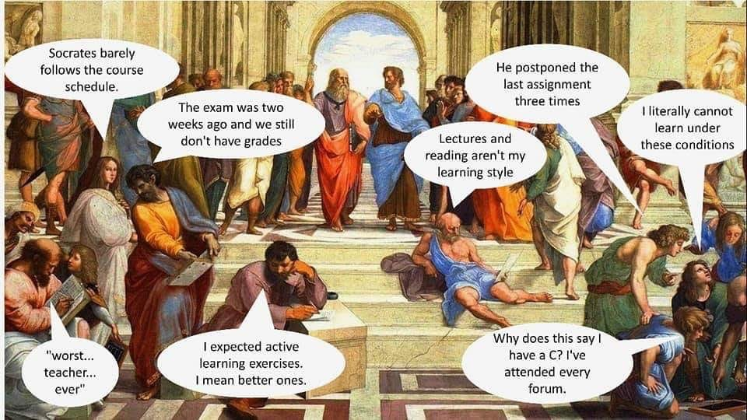

Slide 5
Task one: Brainstorm
How can small group work help students feel more positive and engaged

Slide 6
Task two: By letter
Why should you use small groups with students? Why shouldn't you?

Slide 7
Five reasons why you shouldn’t do small group work
It can be more complicated to organise and may involve more liaison with managers, time-tablers and others who might prefer you just to give lectures;
Not all HE teachers and supporters of learning are comfortable with managing group work and, in particular, the perceived loss of control that comes from handing over activities to student groups for enactment;
It’s quite difficult to give students equivalent (if not identical experience) when they are working in diverse groups;
There are often concerns about differential workloads by students resulting in the same mark for every student in the group;
Students often really dislike group work at the time they are doing it and it can be a significant cause of complaints (but see the first point on next slide).

Slide 8
And five reasons why you should
When you ask students several years down the line what was the most productive experiences they had while, learning, they will often refer to group activities;
Group work can be helpful in preventing students feeling isolated, which can be the case if all their study time is solitary, especially in subject areas (e.g. Literature studies) where there is traditionally quite a low proportion of their time is in class contact;
Group work can provide contexts in which theory learned on their courses can be applied to practical contexts, and can help to bring the learning to life for students;
The ability to manage interpersonal issues that often arise within group work are key graduate attributes required by almost every career or profession;
Employers have been telling us for years that they want to employ people capable of working straightaway as team members, often in interdisciplinary units.

Slide 9
Task three: by number
How do small group tasks develop employability Skills?

Slide 10
Small-group skills are precisely those required in employment and research, where graduates need to be able to:
work in teams;
listen to others’ ideas sympathetically and critically;
think creatively and originally;
formulate and ask questions skilfully;
show skills in explaining things fluently and convincingly;
build on others’ existing work;
collaborate on projects;
contribute skillfully to producing reports, publications and action plans;
work together online with fellow-learners;
manage time and processes effectively;
see projects through to a conclusion;
cope with the normal difficulties of face-to-face interactions between human beings.

Slide 11
When students go for interview by prospective employers, questions they might be asked include: Can you tell us about an occasion when:
you worked together with colleagues in a group to produce a collective outcome?
you had to work autonomously with incomplete information and self-derived data sources, and check with other people whether you were on the right lines?
you developed strategies to solve real life problems and tested them out by discussion them with colleagues?
you had a leadership role in a team, and could you tell us about your strategies to influence and persuade your colleagues to achieve a collective task?
you had to communicate outcomes from your project work orally, and collectively put these outcomes into writing, or disseminate them through social media or through a visual medium?

Slide 12
TASk four: by symbol
What size of group works best to get maximum participation of students?

Slide 13
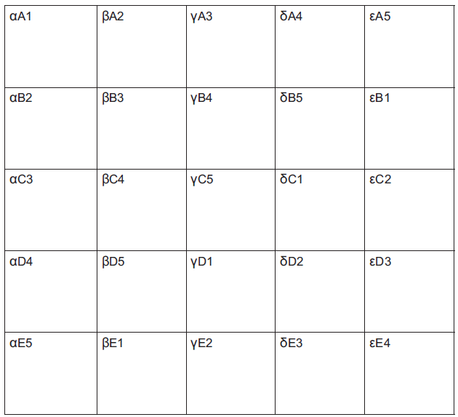
Cross overs using Greek letters
A cross over for 25 people
Can be scaled up to hundreds!

Slide 14
Task Five: Individual reflection
What are some of the hazards of working in tiny groups? Very big groups?

Slide 15
Deciding on group size for tasks: each has benefits and disadvantages
Pairs;
Threes (triads);
Fours;
Fives;
Six or sevens;
More (bad idea!)

Slide 16
TASK six: in PAirs
What means do you use to compose groups for group tasks: what are the benefits and hazards?

Slide 17
Forming groups:
Friendship groups;
Locational groups;
Alphabetical (family name) groups;
Random groups;
Number groups:
Astrological star sign groups;
Learning teams
Hybrid teams.

Slide 18
Task seven: in Fours
Looking at the UKPSF on the next slide, for which elements could you use these kinds of activities as evidence?

Slide 19


Slide 20
Task eight: Brainstorm
What kinds of behaviours sabotage small group work

Slide 21
Task Nine: Fishbowl
What kinds of ground rules can small groups set?

Slide 22
Ground rules could include:
Respect the opinions and viewpoints of others, listening and responding appropriately;
Respect for each other’s valid reasoning: the ability to detect poor argument and to engage in respectful dialogue;
A commitment to regular attendance and to cooperation with others in independent group work involving debate and dialogue;
Active use of concepts and modes of reasoning that have been introduced in the module content;
A commitment to shared reflection;
A commitment to collective responsibility once decisions have been made.
* Adapted from Foreman-Peck (2010) p32

Slide 23
Of the techniques used today, which do you think has been 1. most fun and 2. most productive of learning?
Brainstorming:
Cross overs;
Buzz groups …. Leading into Snowballing;
Fishbowls
What else can we use?

Slide 24

These and other slides are available on my website at http://sally-brown.net

Slide 25
References and other reading
Creme, P., 2008. A space for academic play: Student learning journals as transitional writing. Arts and Humanities in Higher Education, 7(1), pp.49-64.
Curran, V.R., Sharpe, D., Forristall, J. and Flynn, K., 2008. Student satisfaction and perceptions of small group process in case-based interprofessional learning. Medical Teacher, 30(4), pp.431-433.
Foreman-Peck. L (2010) ‘Fairness in group-work assessment in higher education; an action case study’ in Foreman-Peck, L. and McDowell, L. (2010) Aims Ethics and Values in group work assessment, Newcastle, Northumbria University

Slide 26
More references
James, A., The Power of Play in Higher Education: Creativity in Tertiary Learning. Springer.
Jaques, D. and Salmon, G., 2007. Learning in groups: A handbook for face-to-face and online environments. Routledge.
Kleiman, P., 2008. Towards transformation: conceptions of creativity in higher education. Innovations in Education and Teaching International, 45(3), pp.209-217.
Race, P. (2019) The Lecturers Toolkit 5th Edition Chapter 5 ‘Making small group teaching work’, Abingdon, Routledge.

