Slide 1
Who are you, and who do you want to be?
Solstice Conference: 5th-6th June 2019
Edge Hill University
Sally Brown NTF, PFHEA, SFSEDA
@ProfSallyBrown
http://sally-brown.net
Emerita Professor, Leeds Beckett University
Visiting Professor: University of Plymouth, University of South Wales, Edge Hill University & Liverpool John Moores University.

Slide 2
Who are you, and what do you want to be?
Professional identity is not a fixed entity: we are likely to have a number over the course of our careers and often hold several simultaneously, so how can we manage these and maintain balance in our lives?
How can we shape and direct these perceptions purposefully and positively?
In the workshop we will consider, inter alia how to:
avoid self-doubt and reject succumbing to the imposter syndrome;
focus on capability rather than what we can’t do;
affirm and integrate the values we espouse;
challenge ourselves to stretch beyond safe and comfortable zones of endeavour;
create a collation of liveable and mutually supportive identities for ourselves, rather than have these imposed upon us by other people’s expectations.
The workshop will be highly interactive and will include practical play-based activities.

Slide 3
What this session all about?
Drawing on Carol Dweck’s work on fostering self-efficacy and Boyer’s concepts of enabling scholarships, by the end of this session, delegates will be able to:
Make informed choices about the kinds of professional identity that work best for you in different contexts;
Identify some strategies for positive self-identification in relation to professional competences;
Determine personal strategies for making working lives not just manageable but also enjoyable and affirming.

Slide 4
Shaping your life in higher education
Over a career in higher education, many of us will adopt and use a range of professional identities.
We need to be fluid in our approaches and fluent in a range of discourses to enable us to undertake these different (and sometimes conflicting) roles effectively.
Through the decisions we make about how we look, how we speak, how we behave in professional contexts, and what we choose to do or not do, we can have an element of control over how others respond to us, although extraneous factors can impact too in sometimes unpredictable ways.

Slide 5
How do you see yourself?
As time passes and new roles are accrued, we commonly keep adding tasks without necessarily trimming out any which we may in any case see as being central to our professional identities (“I will always see myself at heart as a teacher” “Mentoring to me is a key way in which I can pay forward all the support I have received myself over the years” “If I am not perceived as an innovator, I might as well stay at home”)
But this can come at a high personal cost if we relinquish nothing while expanding our professional remits. We also want always to be true to our core beliefs, while nevertheless sometimes needing to compromise to some extent to achieve our goals.

Slide 6
The T-shirt activity
Only take a T-shirt if you promise to use it again for gardening, sleeping, running, wearing around the house etc. If you won’t, take a piece of flip-chart paper and draw yourself a life-size T-shirt;
Using the fabric pens (T-shirt) or flip-chard pens (paper), draw some bold images that you consider emblematic of you, and label them with key words;
Wear your T-shirt or hold up your paper and talk to at least three people about what you have drawn/written.

Slide 7
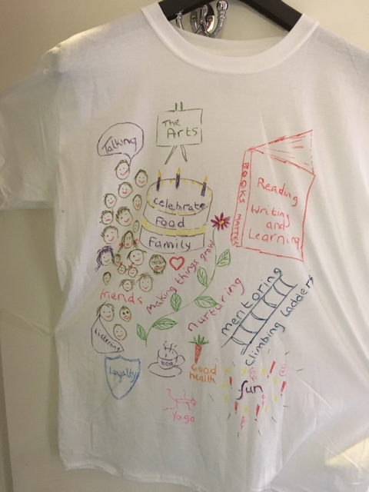
Do you need some ideas?

Slide 8
Boyer’s four scholarships
The scholarship of Discovery;
The scholarship of Application;
The scholarship of Integration;
The scholarship of Teaching.
How do you fit into this model of scholarship?

Slide 9
All apply to me to some extent but mostly I see myself as involved in Scholarship of Integration
Royce Sadler described me as being like a museum curator: I collect items of interest from lots of places and group them together in new and interesting ways, then curate them, i.e. I spotlight, highlight, label and group them.
For me the creativity and innovation relies on a synthesis of diverse elements.
How do you see yourself?

Slide 10
And some of the issues I've faced over the years (and how I’ve got past them):
Imposter syndrome and lack of confidence: I’m a second daughter, a second wife and at times have felt second class. In my family a common expression was ‘Who do you think you are?’;
I didn’t believe until my forties that I was a finisher so I couldn’t write: it took rigorous and supportive mentors to get me through that. I peaked late. Nowadays that’s why I mentor career-younger people;
I worked part-time for years and in service functions: I and had to fight for parity of esteem (and never breached the gender pay gap);
Working part-time and in service functions I had to face down those who saw me as a ‘non-academic’ member of staff. To survive I always felt I had to work longer and harder than peers;
When I was in leadership roles, I didn’t want to conform to standard expectations and therefore chose to dress as a female rather than a suit-wearing clone. This sometimes impacted on how people saw me.
And these issues remain today.

Slide 11
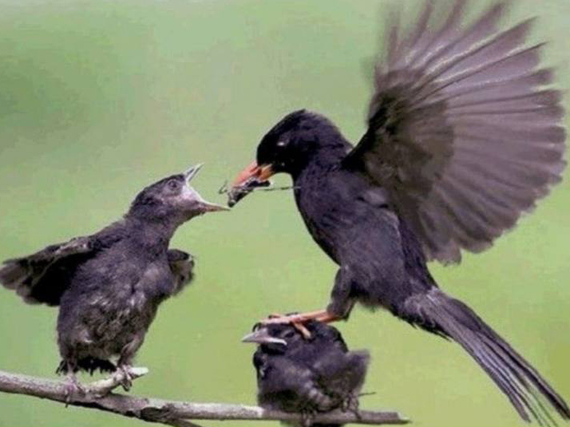
Nurturing the next generation
Copyright CC2.0
Notes:
The effect on institutional strategies of promoting the research agenda, often at the expense of support for teaching initiatives
Favouristism

Slide 12
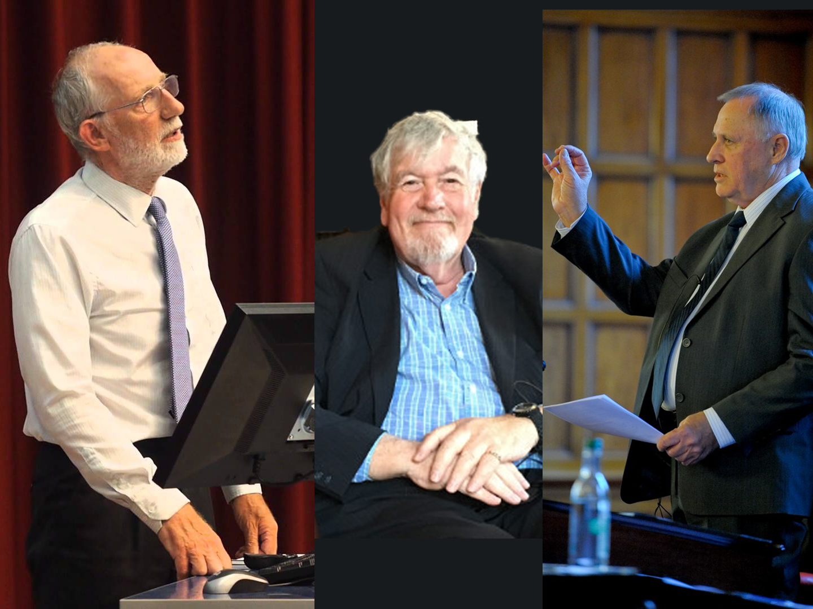
Important influences
Copyright CC2.0
Notes:
And some more heroes

Slide 13
Who are you today?
Lecturer, supporter of student learning, guide, supervisor, mentor, programme leader, curriculum designer, appraiser, line manager, friend, challenger, enabler, facilitator, senior manager, educational developer, supportive colleague, ‘grit in the oyster’, representative, ‘joy-bringer’, Cassandra, ……………..
And who do you want to be?

Slide 14
Fostering self-efficacy (after Dweck)
Crudely, student achievement is linked to students own beliefs about their abilities, whether these are fixed or malleable;
Students who subscribe to an entity (fixed) theory of intelligence (Dweck, 2000) need support to confirm their ability and thereby become less fearful of learning goals as these involves an element of risk and personal failure.
Assessment for these students is an all-encompassing activity that defines them as people. If they fail at the task, they are failures.

Slide 15
People who believe that intelligence is malleable may be more robust
Those who believe that intelligence is incremental have little or no fear of failure. A typical response from such a student is ‘The harder it gets, the harder I need to try’. These students do not see failure as an indictment of themselves and [can] separate their self-image from their academic achievement. When faced with a challenge, these students are more likely to continue in the face of adversity because they have nothing to prove. (after Clegg in Peelo and Wareham 2002).

Slide 16
Academics need to negotiate our professional identities
Professional identity is not a stable entity, it is complex, personal, and shaped by contextual factors.
What comprises success in an academic career?
What does authenticity look like?
How can academics position ourselves, and how much are we positioned by issues including race, gender, status and social class?
What constructs inform our professional identities’?
(Archer, 2008, Clarke, Hyde and Drennan, 2013)

Slide 17
How do you look in your professional world? How do you want to be perceived?
Have a look at the next group of slides and decide which is/are the PVC(s)?

Slide 18
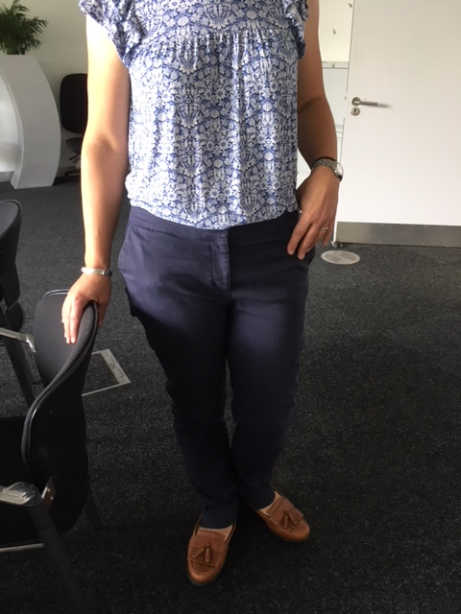

Slide 19
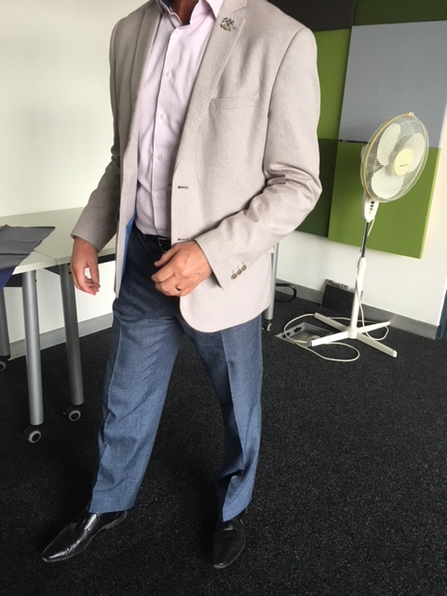

Slide 20
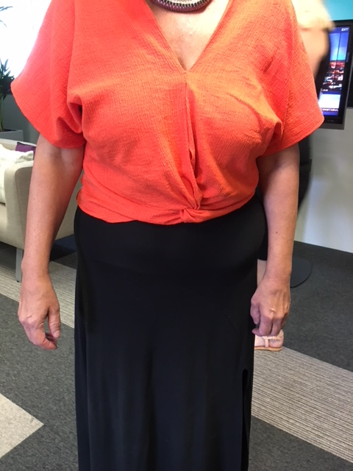

Slide 21
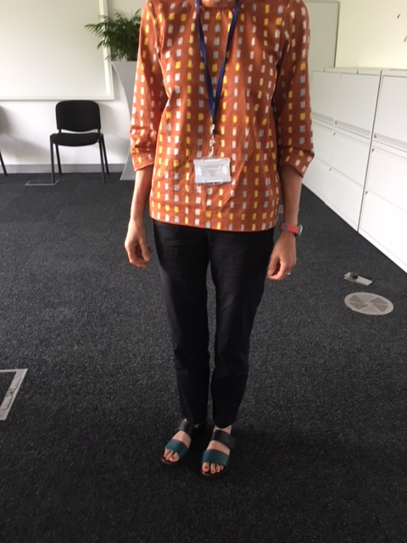

Slide 22
What do you want to be more like?
During the course of this activity you may wish to add some images or text to your T-shirt

Slide 23
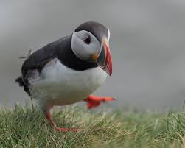
Be more puffin

Slide 24
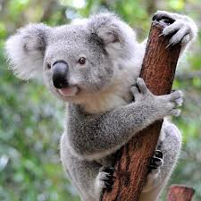
Be more koala

Slide 25

Be more shark

Slide 26

Be more lion

Slide 27
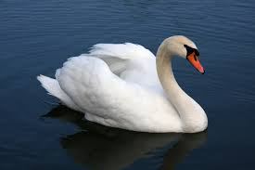
Be more swan

Slide 28
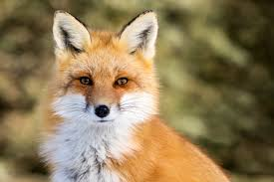
Be more fox

Slide 29
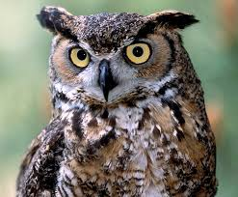
Be more owl

Slide 30
Going forward
What advice would you give to your early career self based on your thinking during the activities today?
How can you help the next generation coming up the ladder behind you to avoid some of the false steps and discomfort you have experienced yourself?

Slide 31
References
Archer, L., 2008. Younger academics’ constructions of ‘authenticity’,‘success’ and professional identity. Studies in Higher Education, 33(4), pp.385-403.
Boyer, E. L. (1990, reprinted 1997), Scholarship reconsidered: priorities of the professoriate, San Francisco: Jossey Bass, The Carnegie Foundation for the Advancement of Teaching.
Clarke, M., Hyde, A. and Drennan, J., 2013. Professional identity in higher education. In The academic profession in Europe: New tasks and new challenges (pp. 7-21). Springer, Dordrecht.
Dweck, C. S. (2000) Self Theories: Their Role in Motivation, Personality and Development, Lillington, NC: Taylor & Francis.
Nerantzi, C. and James, A., 2015. Waterfall of questions or can we afford not to play in HE?. Exploring Play in Higher Education.
Nixon, J., 1996. Professional identity and the restructuring of higher education. Studies in Higher education, 21(1), pp.5-16.
Trede, F., Macklin, R. and Bridges, D., 2012. Professional identity development: a review of the higher education literature. Studies in Higher Education, 37(3), pp.365-384.

