Slide 1
Planning ahead for applying for a Professorship/Associate Professorship
Edinburgh Napier University, 22 May 2019
Sally Brown @ProfSallyBrown
sally@sally-brown.net
NTF, PFHEA, SFSEDA
Emerita Professor, Leeds Beckett University
Visiting Professor University of Plymouth, Edge Hill University,
University of South Wales & Liverpool John Moores University.

Slide 2
This session is designed to help people thinking of following this pathway to:
​Consider what kinds of evidence help to make a convincing case for promotions on the grounds of teaching and learning, including learning support and professional services staff;
​Explore low cost/no cost opportunities about how to gain addition professional development in support of your case;
Review networking opportunities and how you can use them;
Discuss how you can get and use a mentor to strengthen your submission.

Slide 3
A note about the slides
All available on my website at http://sally-brown.net;
All, like everything I do, open educational resources so use them with colleagues and students as you wish (except the images of people);
Far too many slides here for us to use today: regard them like the bonus features on a DVD (or your homework!). I will select from them what I consider to be the most helpful as the day emerges, and will not go in a straight line!

Slide 4

From Jason Elsom
(@Jason Elsom)

Slide 5
What are you doing to transform teaching?

Slide 6
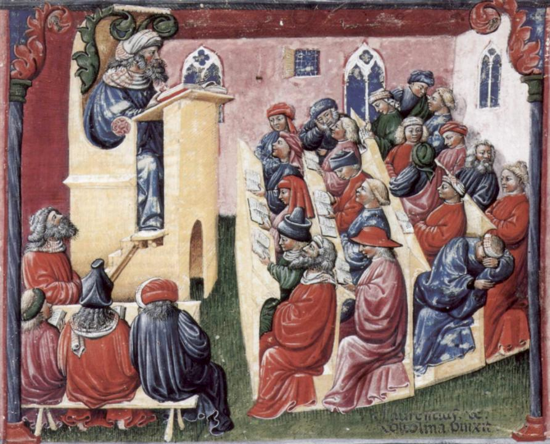
Laurentius de Voltolina
2nd half of 14th Century
Italian Painter

Slide 7
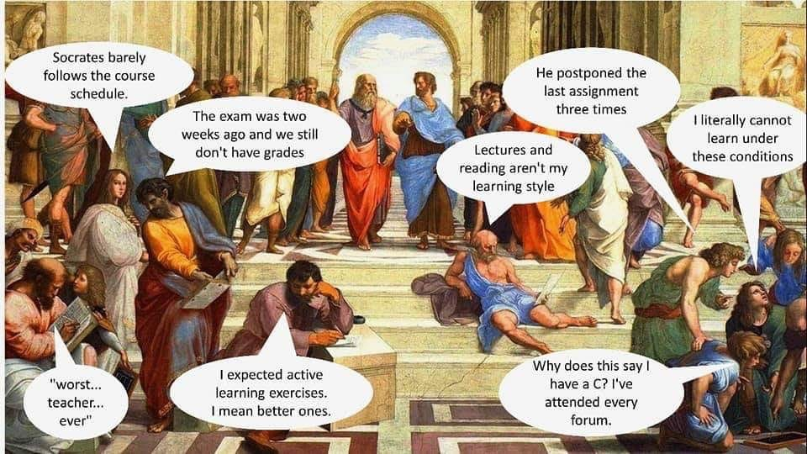

Slide 8


Slide 9
If you are going to make a case that you have significantly impacted on student learning, what have you done to change:
Teaching in various modes?
Learning environments?
Assessment and feedback?
Technologies to support learning?
Partnership with students?
Employability/ Entrepreneurship/ Personal Development Planning?
Equal opportunities/ Diversity/ Inclusivity and Widening participation?

Slide 10
What kinds of evidence help you make a convincing case for promotions on the grounds of teaching and learning? Look for chances to gain:
Internal awards for teaching offered by your own university, including student-led awards;
Awards for teaching offered by Professional, Subject or Regulatory Bodies and networks;
National awards, including perhaps Student Engagement Awards, National Teaching Fellowships and Times Higher Outstanding Teacher of the Year Awards;
HEA Fellowships: many universities nowadays expect Senior or Principal Fellowship for a professorship in Teaching and Learning. Look at the wording and see for example on PF they are asking for ‘Successful strategic leadership to enhance student learning’, evidence of ‘establishing organisational policies or strategies for supporting and promoting others’, mentoring and a sustained commitment to your own and others CPD: just what you need for a professorship too!

Slide 12


“Many universities are nowadays regarding achievement of a National Teaching Fellowship as prima facie evidence of excellence for candidates making a case for professorships through the learning and teaching route.”

Slide 13

The three NTFS award criteria
Criterion 1: Individual excellence:
Evidence of enhancing and transforming student outcomes and/or the teaching profession: demonstrating impact commensurate with the individual’s context and the opportunities afforded by it.
Criterion 2: Raising the profile of excellence:
Evidence of supporting colleagues and influencing support for student learning and/or the teaching profession; demonstrating impact and engagement beyond the nominee’s immediate academic or professional role.
Criterion 3: Developing excellence:
Show the nominee’s commitment to and impact of ongoing professional development with regard to teaching and learning and/or learning support.

Slide 14
What other kinds of evidence can be helpful?
Extracts from your ‘plaudits’ file from students, colleagues, peer observers, appraisers, line-managers, employers of your evidencing your impact as a teacher including internal and external student evaluations, particularly NSS and PTES;
Demonstration that under your leadership student recruitment, retention, engagement, employability and student achievement have improved. This means keeping good records over say a five year period so you can demonstrate sustained impact;
Demonstrable impact within your School/ Faculty/ Institution/ Nation and Internationally (the latter can come from citations of your publications for example).
Membership of university committees, working groups & boards.

Slide 15
What low cost/no cost opportunities exist to help you gain addition professional development in support of your case?
There isn’t a lot of money around for anyone to go to expensive conferences or on study visits abroad so you will need to be creative. You can, however:
create your own CPD opportunities by working with mates;
make your own mini-sabbaticals e.g. by writing for the day at another campus of your own HEI;
offer to do ‘freebies’ in other HEIs for expenses only, or reciprocally;
get involved in free online learning opportunities including webchats e.g. Transforming Assessment webinars m.hillier@uq.edu.au and Tweetchats e.g. @LTHEchat

Slide 16

#LTHEchat is held on Wednesdays, term-time,
8-9 pm:, one hour, one or two convenors,
6 questions, c200 international participants.

Slide 17
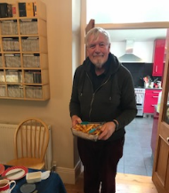
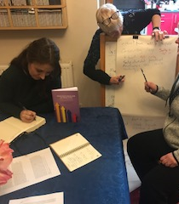
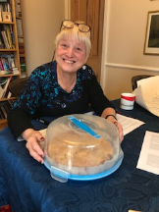

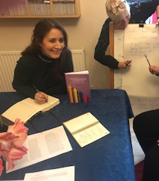
Conservatory Days: Self-led cost-free mutual self-development
Notes:
a. Conservatory days: Kay to talk about the concept of self-led cost-free mutual self-development and illustrate it with a photo of our book as an output. It’s possible to do all this for free and without permission

Slide 18

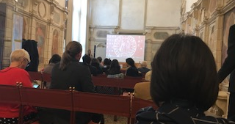
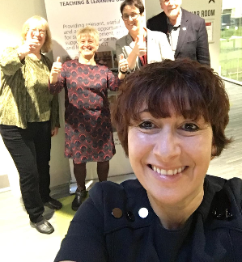
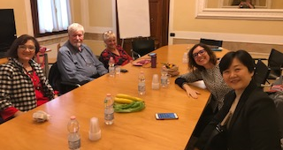
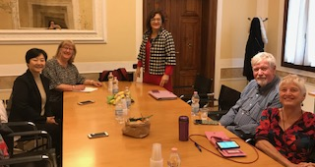
Can you input to conferences and thereby earn your conference fee?
Notes:
Four go mad in Padua/Cork/ the world: Sally talk about collectively contributing to things here no one pays us, just covers expenses or we pay out of our own money and there’s lots in it for everyone. Talk about outputs including the Padua journals

Slide 19
Publishing about learning and teaching is a must if you want to make a strong case for a Chair:
Books (monographs, co-authored, edited, co-edited);
Journal articles (high powered international journals with high citation indices or more local institutional ones);
Conferences and workshops outputs;
Informal publications like newspaper and magazine articles (THES can give you lots of profile for example);
Media and press exposure;
Social media.
How might these variously add value? Which ones are best for you? Which make your case most strongly?

Slide 20
Evidence you can provide from the national context, working with:
Your professional and disciplinary networks e.g. contributing to or leading a strand within it on teaching, learning and assessment;
Governmental agencies where you gain a reputation and experience that feeds into your teaching;
QAA/QAA Scotland e.g. contributing to themed activities or chairing Benchmarking groups;
Scottish Funding Council / Office for Students etc., e.g. leading an Enhancement theme;
AdvanceHE.

Slide 21
Working with AdvanceHE: evidence to support your T&L-based case might include being:
An Associate/Consultant;
Accreditor for HEA Fellowships;
Assessor for National Teaching Fellowships, Collaborative Awards for Teaching Excllence, and their Global teaching Excellence Awards;
Leader of a funded project;
Leader or contributor to a webinar or Tweetchat;
Presenter at one of their (very expensive) conferences.

Slide 22
Networking opportunities: how you can use formal & informal networks to build profile and evidence
Internal networks within your university e.g. Teaching Fellows and university committees / working parties;
Organisations like the Staff and Educational Development Association, Society for Research in Higher Education, the Association of Learning Developers in Higher Education, CILIP, the Library and Information Association;
Discipline and Subject groups e.g. Association of Law Teachers, Division of Academics, Researchers and Teachers in Psychology (DARTP) within BPS etc.

Slide 23
Also look out for the ‘Professors in Preparation’ network
This is a network convened by inter alia Liz Mossop, Debbie Locke, Julie Hulme, and me to a lesser extent;
There are regular regional meetings and a new mentoring brokerage system;
You can join the online network, which is hosted by OneHE, by filling in the form here: http://eepurl.com/gbXd3r

Slide 24
Mentors and Mentoring
To advance your career, it’s a great idea to have one or more mentors to guide, advise and support you and mean that you have one or more person to turn to at times of stress, other than your significant other, close colleagues or line managers. In this section we are planning on looking at effective bases for:

Slide 25
Mentors and coaches
Typically, a difference is made between a mentor who instructs others in specific knowledge and skills and values and a coach who is likely to be adept in sharing knowledge skills and perspectives that influence the personal and professional growth of others .
How you work with your mentor will be a matter for mutual negotiation, but it is well to do this from the outset, so you are both clear what you are trying to achieve. Some, with lots of experience will jump straight into giving advice on things you can do, and others will work hard at drawing from you personal approaches that can help you reach your own decisions.

Slide 26
What kinds of activities can a mentor engage in with you (from directive to undirective)?
Telling you specific information;
Instructing you in particular directions;
Giving directive advice;
Offering more general advice for you to do with as you wish;
Giving feedback on your ideas;
Making open suggestions;
Asking questions that raise awareness;
Summarising what you have said to help you clarify your ideas;
Paraphrasing your ideas;
Reflecting back to you what you have said.

Slide 27
When you are looking for a mentor you could:
Look for people who you admire, who are likely to have perspectives you don’t have and who you think might have useful insights into your professional area;
Look around for people known in your field, that you admire and you would genuinely like to work with but be realistic about how much availability your potential mentor is lively to have;
Look around for people who are in the roles/at the career stage in five years and consider if they might be a good mentor for you, or if they can advise you who might be suitable and available;
Ask others who have been successfully been mentored and see if they can suggest someone who could work well with you;
Ask your line manager/boss/appraiser if they know anyone who might be prepared to take you on.

Slide 28
Matters you are likely to need to consider when choosing a mentor will include:
what skills, qualities and experience they have to offer and how these could be useful to you;
at what career stage is a mentor likely to have most to offer: relatively close to your current stage or much more senior?
what time commitment you hope you would be able to gain from them realistically;
what modes of communication that might suit you both best: face-to-face? Virtual e.g. by Skype or What’s App etc.? Mainly by email?
What they are likely to be able to get back from you, (since mentoring works best if there is an element of reciprocity). For example, can you help them by updating them with new ideas and techniques, and maintaining currency in particular domains.

Slide 29
Why would anyone want to be a mentor?
Mentoring is not a minor commitment, and the best mentors tend to be very busy people so you need to be quite realistic about what you can expect to gain from a mentor. Most do it for no personal or professional benefit, and the fact that the driving force is their academic altruism needs to be borne in mind from the start.
If you are too demanding or have unrealistic expectations of what they will do for you, it is likely that they will, kindly or otherwise, terminate the arrangement. It is best treated as a professional relationship where the ‘rules of engagement’ need establishing early on.

Slide 30
Rules of engagement: what can a mentor do?
Help you formulate your ideas;
Facilitate you to work out what your goals should be;
Advise on useful reference material and other sources;
Help you network effectively;
Help you find outlets for publication;
Advise you on relevant conferences and workshops for you to attend, and help you prepare for any at which you are selected to present, giving you pointers about who to talk to (and who to avoid) when you are there;
Co-author with you, to help you get your feet on the publishing ladder. If this is something your mentor is happy to do, it can be hugely beneficial to you (and indeed them) but the ground rules, for example, who gets lead authorship, who will do the data analysis etc need to be established form the outset;
Help you get over setbacks and imposter syndrome, by giving you confidence in your own achievements and capabilities (but be aware that their job is not to be your counsellor in all eventualities).

Slide 31
Mentors are unlikely to be able to help you by:
Proofreading or significantly redrafting your work;
Giving you answers to all your questions;
Making all the running to make the mentoring relationship work. It’s likely to be up to you to contact them about convenient times and places for conversations for example, and you may need to be quite flexible if your mentor is someone with high demands on their time;
Being on-call perpetually, or for an excessive number of occasions;
Solving problems beyond the professional relationship;
Being your best friend (although after a mentoring relationship finishes, friendship often remains).

Slide 32
You need to discuss with your mentor in advance:
What will each party gain from the mentoring relationship?
What are your expectations of levels of confidentiality?
What level of contact will work for both of you? How often will you interact? Will meetings be live or virtual or both? If live, where works best for you both? How much email traffic is acceptable?
Who will keep records (if any) of meetings / action notes about what you/they said they would do? You can’t expect them to progress-chase you on these, however.
How long will the mentoring relationship last? It’s a good idea to see how things go for a month or two, for example, with a review after 6 months or a year, to see how things are working out, but it’s unlikely that any mentor will give an open-ended commitment, after which they (or you) should probably be helping someone else. But it’s worth clarifying whether mentors be happy to help after that period e.g. with promotion, UKPSF or other references.
What you will do if the mentoring relationship doesn’t work out for either of you?

Slide 33
Paying forward
A good mentoring relationship is likely to be one of the richest of your professional life and a great privilege which can help to set the course of your career. In my view, you can never repay the generosity of a good mentor other than, when you are in an advanced career portion later, paying the favour forward by mentoring new-comers to the profession yourself, when you can help to make the next generations’ lives less stressful

Slide 34
Planning for action
What do you need to do right now to start planning your progression to Chair?
What do you need to do this academic year, next academic year, in the next five years?
Who can help you in building your case? And what can you do to help make this happen?

Slide 35
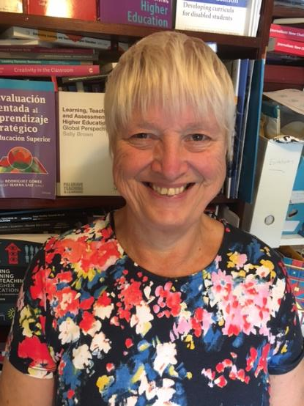
These and other slides are available on my website at http://sally-brown.net

Slide 36
References and wider reading
Clutterbuck, D. (2014) Everyone needs a mentor. Kogan Page Publishers.
Darwin, A. and Palmer, E. (2009) Mentoring circles in higher education. Higher Education Research & Development, 28(2), pp.125-136.
Megginson, D. and Clutterbuck, D. (2010) Further techniques for coaching and mentoring. Routledge.

