Slide 1
Inspiring teaching: fostering student engagement, achievement and retention
Royal Agricultural University, April 2019
Sally Brown @ProfSallyBrown
sally@sally-brown.net
NTF, PFHEA, SFSEDA
Emerita Professor, Leeds Beckett University
Visiting Professor University of Plymouth, Edge Hill University, University of South Wales & Liverpool John Moores University.

Slide 2
Focus of the workshop
Students really want teachers who are good at explaining things and who make learning intellectually stimulating and interesting, as NSS scores indicate. Almost everyone remembers a great lecturer who inspired them at university and far too many remember some awful ones! Many teachers, however, were fine but uninspiring. This workshop aims to explore what works to lift the mundane into the inspirational. By the end of the session participants will have had opportunities to:
Discuss what comprises inspiring teaching;
Review some descriptions of outstanding teachers;
Debate how we can breathe life into our teaching and plan how to better engage and stimulate students.

Slide 3
From Jason Elsom
(@Jason Elsom)

Slide 4
Task: are you an excellent teacher?
Think of an inspiring educator you’ve learned from (this could be a teacher, a peer or someone whose work you admire on television or elsewhere);
Identify up to five characteristics of an inspiring teacher using this role model as a case in point;
Now identify up to five characteristics of a disappointing or uninspiring teacher of your acquaintance;
Reflect on your own characteristics and identify a couple of areas for improvement.

Slide 5
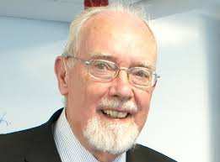
John Cowan

Slide 6
Peter Knight

Slide 7
Important influences on me
Copyright CC2.0
Notes:
And some more heroes

Slide 8
Rex and Wendy Stainton-Rogers

Slide 9
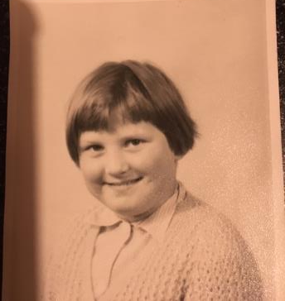
Always a teacher?

Slide 10
Some characteristics of excellent university teachers:
Knows subject material thoroughly
Adopts a scholarly approach to the practice of teaching
Is reflective and regularly reviews own practice
Is well organised and plans curriculum effectively
Is passionate about teaching
Has a student-centred orientation to teaching
Regularly reviews innovations in learning and teaching and tries out ones relevant to own context
Ensures that assessment practices are fit for purpose and contribute to learning
Demonstrates empathy and emotional intelligence

Slide 11
Characteristics of excellent university teachers: diamond-9
1
2
2
3
3
3
4
4
5

Slide 12
What makes an inspiring teacher?
Inspiring teachers tend to be systematic, consistent, well-prepared and compelling: they can usually work well at different levels and in diverse contexts;
There are no standard recipes by which we can cook up inspiring teaching, but there are some features we can combine in imaginative ways to create tasty and satisfying outcomes;
Inspiring teaching comes in many different forms, and inspiring teachers develop their own styles and approaches that suit them (and their learners) well.

Slide 13
High quality teaching…
…“implies recognising that students must be engaged with the content of learning tasks in a way that is likely to enable them to reach understanding…Sharp engagement, imaginative inquiry and finding of a suitable level and style are all more likely to occur if teaching methods that necessitate student energy, problem solving and cooperative learning are employed”. (Ramsden, 2003, p97)

Slide 14
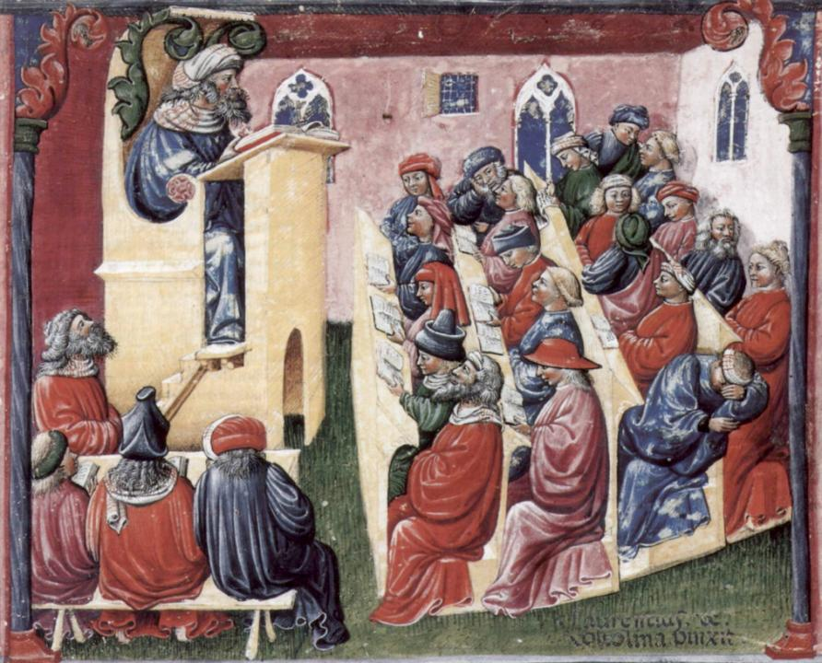
Laurentius de Voltolina
2nd half of 14th Century
Italian Painter

Slide 15
Boyer’s four scholarships
The scholarship of Discovery;
The scholarship of Application;
The scholarship of Integration;
The scholarship of Teaching.
How do you fit into this model of scholarship?

Slide 16
A tall order?
Effective lecturers combine the talents of a scholar, writer, producer, comedian, showman and teacher in ways that contribute to student learning. Nevertheless it is also true that few college professors combine these talents in optimal ways and that even the best lecturers are not always on top form.
McKeachie et al p.53

Slide 17
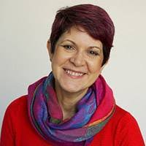
Ruth Pickford
Pickford, R., 2016. Student Engagement: Body, Mind and Heart–A Proposal for an Embedded Multi-Dimensional Student Engagement Framework. Journal of Perspectives in Applied Academic Practice, 4(2).

Slide 18
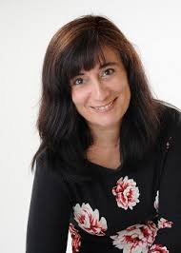
Chrissi Nerantzi
Vasant, S., Nerantzi, C., Beckingham, S., Lewin-Jones, J., Sellers, R., Turner, S. and Withnell, N., 2018. LTHEchat – The Story of a Community of Practice through Twitter. Association for Learning Technology Blog.

Slide 19
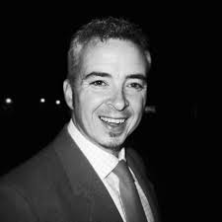
Simon Thomson
Thomson, S., 2014. Policy to Practice in OER. https://oer14. oerconf. org/archive/14/oer14/28/view/index. html.
Thomson, S., 2010. Unicycle Project Report.
Leeds Beckett University

Slide 20
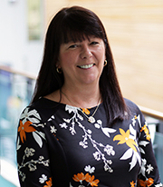
Sue
Beckingham
Middleton, A. and Beckingham, S., 2015. Social media for learning: a framework to inspire innovation. Sheffield Hallam University

Slide 21
Why are they great teachers?
Unafraid to take risks but leave nothing to chance;
Articulate a clear rationale of what s/he is trying to achieve in her teaching and makes detailed plans on how to achieve it;
Worry less about what students think about them than how much they are learning;
Capable of being seriously quirky without being ‘up themselves’;
Continuously challenge students out of their comfort zones.

Slide 22
What makes an inspiring teacher?
Inspiring teachers tend to be systematic, consistent, well-prepared and compelling: they can usually work well at different levels and in diverse contexts;
There are no standard recipes by which we can cook up inspiring teaching, but there are some features we can combine in imaginative ways to create tasty and satisfying outcomes;
Inspiring teaching comes in many different forms, and inspiring teachers develop their own styles and approaches that suit them (and their learners) well.

Slide 23
The three NTFS award criteria
Criterion 1: Individual excellence:
Evidence of enhancing and transforming student outcomes and/or the teaching profession: demonstrating impact commensurate with the individual’s context and the opportunities afforded by it.
Criterion 2: Raising the profile of excellence:
Evidence of supporting colleagues and influencing support for student learning and/or the teaching profession; demonstrating impact and engagement beyond the nominee’s immediate academic or professional role.
Criterion 3: Developing excellence:
Show the nominee’s commitment to and impact of ongoing professional development with regard to teaching and learning and/or learning support.

Slide 24
Criterion 1: Individual excellence: Evidence of enhancing and transforming student outcomes and/or the teaching profession; demonstrating impact commensurate with the individual’s context and the opportunities afforded by it.
This may, for example, be demonstrated by providing evidence of the impact of:
stimulating students’ curiosity and interest in ways which inspire a commitment to learning;
organising and presenting high quality resources in accessible, coherent and imaginative ways which in turn clearly enhance students’ learning;
recognising and actively supporting the full diversity of student learning requirements;
drawing upon the outcomes of relevant research, scholarship and professional practice in ways which add value to teaching and students’ learning;
engaging with and contributing to the established literature or to the nominee’s own evidence base for teaching and learning.

Slide 25
Criterion 2: Raising the profile of excellence Evidence of supporting colleagues and influencing support for student learning and/or the teaching profession; demonstrating impact and engagement beyond the nominee’s immediate academic or professional role
This may, for example, be demonstrated by providing evidence of the impact of:
making outstanding contributions to colleagues’ professional development in relation to promoting and enhancing student learning;
contributing to departmental/faculty/institutional/national initiatives to facilitate students’ learning;
contributing to and/or supporting meaningful and positive change with respect to pedagogic practice, policy and/or procedure.

Slide 26
Criterion 3: Developing excellence Show the nominee’s commitment to and impact of ongoing professional development with regard to teaching and learning and/or learning support.
This may, for example, be demonstrated by providing evidence of the impact of:
on-going review and enhancement of individual professional practice;
engaging in professional development activities which enhance the nominee’s expertise in teaching and learning support;
specific contributions to enable significant improvements in students’ outcomes and/or experience.

Slide 27
Ken Bain says great teachers...
Are willing to spend time with students, to nurture their learning.
Don’t foster a feeling of power over, but investment in, students.
Ensure their practices stem from a concern for learning.
Make the class user-friendly by fostering trust.
Employ various pedagogical tools in a search for the best way to help each student.
Have the attitude that “There is no such thing as a stupid question.”
Ensure that everyone can contribute and each contribution is unique.
8. Do not behave as a “high priest of arcane mysteries”.
9. Do not make the classroom an “an arena for expertise, a ledger book for the ego”.
10. Don’t expect students to see science as a “frozen body of dogma” that must be memorized and regurgitated.
11. Foster the feeling that teachers are fellow students/ human beings struggling with mysteries of the universe.

Slide 28
Ken Bain says excellent teachers ask these questions as they prepare to teach:
What should my students be able to do intellectually, physically, or emotionally as a result of their learning?
How can I best help and encourage them to develop those abilities and habits of the heart and to use them?
How can my students and I best understand the nature, quality, and progress of their learning?
How can I evaluate my efforts to foster that learning? (Bain, 2004 p. 49)

Slide 29
How do we know if we are offering excellent teaching?
Students are satisfied, learn well, achieve highly and have fulfilling learning experiences;
We as teachers are satisfied, motivated and find their workloads manageable;
Quality assurers and Professional and Subject bodies like what we do and have no complaints about systems and processes;
University managers are confident that the student experience offered is of high quality (and deal with few complaints).

Slide 30
Where is your impact felt?
Department?
Faculty?
Institution?
Regional?
National?
International?
Discipline / cross-discipline?
Professional bodies / wider sector?
And in these contexts, how does it explicitly relate to teaching and student learning?
How are you measuring / evaluating impact?

Slide 31
What types of evidence do you have that show impact?
Longitudinal?
Quantitative?
Qualitative?
Short, concise quotes from students, colleagues, others?
Scholarly, pedagogic evidence?
Improved student attainment results?
Improved student outcomes (e.g. retention, employability, etc.)?
Evidence of the impact of your practice / research / publications on the teaching and learning practices of others leading to enhanced student learning?

Slide 32
What kinds of evidence are convincing?
Anything that gives external validation to your claim, so that evidence of impact is supported rather than being mere assertion;
This is likely to involve raiding your ‘plaudits file’ for verbatim quotes demonstrating your excellence;
Possible use of evidence gathered from module evaluations, feedback forums, student comments, letters and emails;
Aim to collect a range of concise quotes from current and past students at different levels, past and current colleagues, managers, employers who take your students on placement, external examiners etc.
You don’t need to provide full detail of each originator of quotes: ‘former 2nd-year student’ ‘previous line-manager’, ‘employer of our graduates’ etc is sufficient detail.

Slide 33
Collecting and using evidence
Quantitative data can be really useful: it’s helpful to include statements such as ‘Over the past five years my student evaluations have averaged 80+ who said I was good or excellent, and this is higher than average within my department’;
You are not expected (or allowed) to provide supporting documentation but your own institution is expected to assure the validity of your application;
You should aim to match your evidence with the three criteria, so you can add quotes and data to each section.

Slide 34
You need to demonstrate scholarship and commitment to reflection
Your application should (we think) include reference to a handful of texts (books, journal articles etc) from which your educational philosophy and teaching approaches have derived;
The application, however, is all about you, so you need to use the first person singular and refer to your achievements rather than your teams’, (‘Shy bairns get nowt!’);
It’s helpful to include examples of where you’ve changed your practices in the light of experience or where your scholarship has guided you to change.

Slide 35
Reflective teachers
If we are to be effective university teachers, we need to review our own practices regularly and reflectively. This can ensure we not only keep ourselves up to date with curriculum content but also with relevant and current approaches to teaching.
Reflection on practice, when practiced regularly, can have a positive impact on teachers’ effectiveness as teachers and can enhance their engagement and enjoyment.
Research indicates that those engaged in peer review of teaching not only benefit from opportunities to discuss their own practices, but also significantly learn a great deal from watching others teach and discussing alternative approaches.

Slide 36
What kind of a teacher are you?
Think about your three greatest strengths as a university teacher: how did these come about?
Think about metrics that tell you how good you are as a teacher: what do you learn from them?
Think about three ways in which you teaching in university has changed since you started out: what was the rationale?
Think about three things you would like to do in your teaching; what might help you achieve these?
Think about the people who have helped you become effective as a teacher and assessor: how can you similarly help others?

Slide 37
Reflection on my teaching
What areas of my teaching practice do I want to develop?
What new technologies would I like to incorporate in my teaching?
How much do I need to update the subject content of my teaching?
Who could I usefully learn from about inspiring teaching?
Who can I help to be a good teacher by mentoring them?
What reading and further study about pedagogy might benefit my teaching?

Slide 39
Fostering self-efficacy (after Dweck)
Crudely, student achievement is linked to students own beliefs about their abilities, whether these are fixed or malleable;
Students who subscribe to an entity (fixed) theory of intelligence (Dweck, 2000) need support to confirm their ability and thereby become less fearful of learning goals as these involves an element of risk and personal failure.
Assessment for these students is an all-encompassing activity that defines them as people. If they fail at the task, they are failures.

Slide 40
People who believe that intelligence is malleable may be more robust
Those who believe that intelligence is incremental have little or no fear of failure. A typical response from such a student is ‘The harder it gets, the harder I need to try’. These students do not see failure as an indictment of themselves and [can] separate their self-image from their academic achievement. When faced with a challenge, these students are more likely to continue in the face of adversity because they have nothing to prove. (after Clegg in Peelo and Wareham 2002).

Slide 41
How can you use colleagues to help you energise classes?
Explore the extent to which you can use live or virtual ‘expert witnesses’ and ‘guest appearances’ in your classes;
Can you plant a well-prepared ‘interrupter’ in a session who challenges your point of view, offers alternative perspectives and proposes different perspectives?
Try out team teaching occasionally, with reciprocal support for colleagues;
Use peer review to help you improve your own teaching and assessment practice.

Slide 42
And what about leaders of learning and teaching?
Have vision and can imagine ways that great ideas can be taken forward pragmatically
Can be strategic and instrumental without ever losing sight of the passion for teaching that drives them;
Are good at judging the zeitgeist and trend spotting, with an excellent filter for fashionable foppery;
Retain a focus on enhancing the student experience at all times;
Remember that the colleagues being led have real lives and multiple demands on their time.

Slide 43
How can we breathe life into our teaching?
Work out what are your key strengths and play to them: find your individual teaching voice;
Challenge yourself regularly to try new things in the classroom, including things that frighten you a little;
While content knowledge is important, put as much effort into planning process as you do delivery;
Vary the technologies you use (for example, why not try ‘clickers’ one week, and low tech in-class tests another and replace PowerPoint with Pressi?);
Sometimes plan the tasks and resources but have no formal presentation element.

Slide 44
Thinking about mentors

Slide 45
Who can be a mentor? How can you find one?
Look for people who you admire, who are likely to have perspectives you don’t have and who you think might have useful insights into your professional area;
It’s said ‘if you want a job done, ask a busy person’ but be realistic about how much availability your potential mentor is lively to have;
Look around for people who are in the roles/at the career stage in five years and consider if they might be a good mentor for you, or if they can advise you who might be suitable and available;
And?......

Slide 46
What worked for me in terms of having mentors and being mentored?
Mentee: I found I needed reassurance I was working on the right lines, some challenges that moved me beyond my comfort zone, quite a few cups of tea, very targeted advice and guidance on things I was finding difficult, the occasional ‘word to the wise’ where I wasn’t aware of everything going on, and above all, their confidence that I could succeed;
Mentor: I gain a great deal from having mentees as I am very committed to bringing on the next generation. I set time limits e.g. six months to see how things settle down, I tell mentees they need to make the arrangements, I’m not afraid of saying when the relationship has served its purpose.

Slide 47
What can you expect from a mentor?
Mentors can:
Mentors are unlikely to be able to:
Help you formulate your ideas;
Facilitate you to work out what your goals should be;
Advise on useful reference material and other sources;
Help you network effectively;
Help you get over setbacks and imposter syndrome.
Proof read your work;
Do all the running to make the mentoring relationship work;
Be on call perpetually;
Solve problems beyond the professional relationship;
Be your best friend.

Slide 48
From the draft PiP documentation
Mentor’s role
Active listening – ensuring the mentees agenda is elicited and attended to.
Being a critical friend – challenging assumptions and asking the right questions.
Encouraging broad reflection – ensuring views are not siloed and the “big picture” is considered.
Reframing of challenges – within the reflective process other perspectives should be considered and issues reframed as appropriate.
Championing and promoting – where possible/appropriate, networks and contacts can be highlighted.
Commitment – to give a small amount of time to attend discussions remotely or face to face and behave professionally at all times.
Mentee’s role
Expectations – the process is not designed to give “the answers” and expectations should be set accordingly.
Openness – to new ideas and challenges.
Commitment – to attend and shape discussions, and behave professionally at all times.

Slide 49
Why undertake peer observation?
“I have always found peer observation of teaching invaluable. I have learned a lot from watching other colleagues teaching. Consequently, I am able to be a better teacher with improved style of teaching and classroom practice. Likewise, others who had observed my teaching had commented how this experience had helped them. I have been teaching for 28 years and I find each peer observation adding to my teaching skills.” Dr Aru Narayanasamy, National Teaching Fellow (NTF), Associate Professor, University of Nottingham.
“The reward for me is the discovery of new approaches and constructive feedback on what I think I am doing. We think we are self aware but you can’t replace the reality of other people’s observation. What a learning experience.” David Gibson, NTF, Enterprise Education, Queen’s University Belfast.
“I enjoy receiving valuable feedback as it is in a supportive and constructive manner. It's great to see my teaching from another peer's perspective, linking this with student feedback makes it a much more robust review of my own teaching.” Sunita Morris, Leeds Met Teacher Fellow.

Slide 50
Why is peer review so beneficial? The purposes of peer review include:
providing us with opportunities, both through observing and being observed in teaching sessions, to reflect on and review our teaching skills with the assistance of our colleagues
identifying good practice, and needs which we can address, to ensure our ongoing personal and professional development
helping us to continue to learn from each other, towards developing shared understandings of best practices in assessment, learning and teaching
giving us continuing opportunities to observe students as they learn in colleagues’ teaching sessions, and reflect on how we can enhance their learning in our own sessions
allowing us to gain from mutually beneficial learning experiences through the processes of observing colleagues and being observed ourselves
helping us to learn new tricks from one another (old colleagues learn much from new staff and they in turn can teach new colleagues old tricks!)
identifying generic development needs, to feed into ongoing and future staff development activities.

Slide 51
Several useful things emerge from peer review, including the following:
increased confidence of all involved, derived from feedback on being observed and good ideas picked up while observing others’ teaching;
identification of good practice, so that it is more easily shared and built upon;
identification of commonly experienced problems and needs, so that these can be made the basis of staff development opportunities;
Opportunities for focused ‘learning conversations’ between observed and observers, mutually helping both parties to continue to develop professional skills relating to teaching and learning.

Slide 52
What can you gain from being an observer?
You see colleagues doing things that you can emulate;
You may learn much from watching others use learning technologies, conferencing software or equipment unfamiliar to you;
You see other ways of going about teaching;
You can feel you are supporting new colleagues by watching
them teach;
You get time out to watch and reflect;
You can learn from how people do things in completely different disciplines;
You may see things to avoid doing yourself!
You get the luxury of holding a ‘learning conversation’ with your colleague about teaching and learning.
The process of giving feedback to colleagues on their teaching helps you become more receptive to feedback on your own teaching.

Slide 53
Eight stages of dialogic peer observation
Seek out partners for observation who, like you are interested in trying it out;
Discuss the kind of approach you wish to take and the extent to which your aim is to be developmental:
Discuss the ground rules for your observation and agree what kind of records you will keep;
Make up a schedule for who will observe whom when;
Hold paired pre-observation meetings where you clarify particular objectives
Undertake the peer observations;
Hold paired debriefing discussion sessions;
Convene a meeting after all the observations have been undertaken at which you collectively discuss arising issues

Slide 54
What kinds of prompts can you use during observations?
Strengths
Areas for development
Clarity of objectives/intended learning outcomes
Planning and organisation
Methods/approach
Delivery and pace
Content (currency, accuracy, relevance, use of examples, level, match to student needs)
Student participation
Use of the learning environment and learning resources

Slide 55
The purpose of the meeting held after the observation
To allow you to gain feedback from your observer;
To allow you to receive your observer’s notes, and store them or your own information and use;
To allow your observer to explain things included in these notes;
To allow you to explain to your observer any things that need elaboration;
To discuss any action points you may wish to take.
“Make sure you have a debrief as soon as possible after the session and get the observed colleague to do most of the talking. If they wait for you to give them a ‘ruling’ on how ‘good’ the session was, take the initiative and say ‘How did you think that went? What were the best bits about it?’” Sue Smith, Leeds Met Teacher Fellow.

Slide 56
Peer observation can be problematic if:
The process is undertaken in ways that make observer and observee uncomfortable or nervous;
Ground rules are not clarified in advance and expectations are mismatched;
Hierarchical differences lead to an inspectorial model being adopted;
Feedback is not given positively and supportively;
Colleagues undertake peer observations under duress and then self-sabotage.

Slide 57
What kinds of ground rules might you adopt?
Purpose: “Let’s agree that we will focus on the students’ behaviour” or “I would really like you to observe how I interact with students” or “I would like you to comment on how I ask and answer questions”
Confidentiality: “The outcomes of our triad are confidential to the three of us” or “We are happy to share our experiences with our wider group of colleagues”
Record keeping: “Let’s keep detailed notes to which we can refer back next year” or “Let’s keep on record only the summaries of outcomes”
Nature of feedback: “I’m new to teaching so would welcome gentle feedback about what I could do better” or “I’ve taught for years and would welcome robust comments”
Mutuality: “Let’s only undertake observations with people who are prepared both to observe and be observed”

Slide 58
Explain to your students what is going on during observations. Tell them:
that you have indeed got a colleague observing your session;
that it is a regular occurrence and that it is good practice for teaching staff to do this from time to time;
who the observer is and what the observer will be trying to do;
that the observer will primarily be watching what you do – or watching what the students are doing as well, but not in any way judging them.

Slide 59
How can you keep yourself energised and thoughtful: six ideas
1. Take calculated risks: It is often said that for good health that we should exert ourselves sufficiently to be out of breath at least three times a day and should frighten ourselves once a week! Without gambling with students’ futures, are there activities that you can use in your teaching and learning support that you find challenging, that you could try out in your classes to help you see the world of teaching with fresh eyes? If you always start classes in the same way, for example, could you devise a different type of opening? If you always use the same presentation software e.g. PowerPoint, could you use Prezi instead? Or simply use no slides? Work out who in your class might be negatively implicated, think through remediation, and then go for it!

Slide 60
Spring clean and ask a friend
2. Do a spring clean: at least annually, rigorously review your curriculum offer and be particularly assiduous in following the contemporary trend of ‘decluttering’, that is stripping out elements that no longer serve a useful purpose and making way for fresh new activities and approaches.
3. Ask a friend: Among your close colleagues, find someone who is amenable to undertaking a paired activity where you ask each other searching questions, not just about the ‘What’ of your teaching, but also the ‘So what’ (impact) and the ‘Then what’(outcomes) as well as the ‘What else?’ (future directions). A trusted friend who knows you well is likely to help you interrogate your practice thoroughly while at the same time help you keep a sense of proportion by recognizing which aspects of your work you do really well.

Slide 61
Involve students
4. Use students as partners: Seale et al argue that students working in partnership with us can have diverse roles including as story-tellers, teachers/facilitators, evaluators/informants, stakeholders/representatives and customers/consumers. How can you work alongside, with and through students to help authentic student voices shape your teaching and learning activities? How can you use students productively to help you learn from and with students as active collaborators, not just from traditional evaluations but also form active and participatory approaches that go well beyond satisfaction surveys?

Slide 62
Help out a newbie
5. Become a mentor: this may seem counterintuitive if you are relatively new in role or already finding your workload heavy, but actually having a supportive conversation with a new(er) colleague can not only give you the benefits of academic altruism, but it can sometimes cause you to look at your own approaches in new ways, particularly if your mentee asks searching questions about your rationale for certain course of action, or approaches. Everyone I know finds being a mentor gives you back more than you input, in terms of new ways of looking at how you work. And even people relatively new in post can be helpful to colleagues right at the start of their teaching journeys, since your initial problems will remain very fresh in your mind.

Slide 63
Carpe Diem
6. Lift your head above the parapet: some of us working in teaching, learning, assessment and learning support become so encultured within the higher education context that we forget to look beyond. We may lose sight of the fact that it is a privilege to work in a domain where we can influence and shape the future of our society, even if only in a small way, by helping our learners gain broader perspectives and grow to achieve a potential neither they nor we had envisaged earlier. Even on the days when we may feel bogged down in the morass of bureaucracy and managerialism we need to take a moment to need to celebrate our roles and seize the day (after Race 2019, The Lecturer’s toolkit, 5th Edition)

Slide 64
Academics need to negotiate our professional identities
Professional identity is not a stable entity, it is complex, personal, and shaped by contextual factors.
What comprises success in an academic career?
What does authenticity look like?
How can academics position ourselves, and how much are we positioned by issues including race, gender, status and social class?
What constructs inform our professional identities’?
(Archer, 2008, Clarke, Hyde and Drennan, 2013)

Slide 65
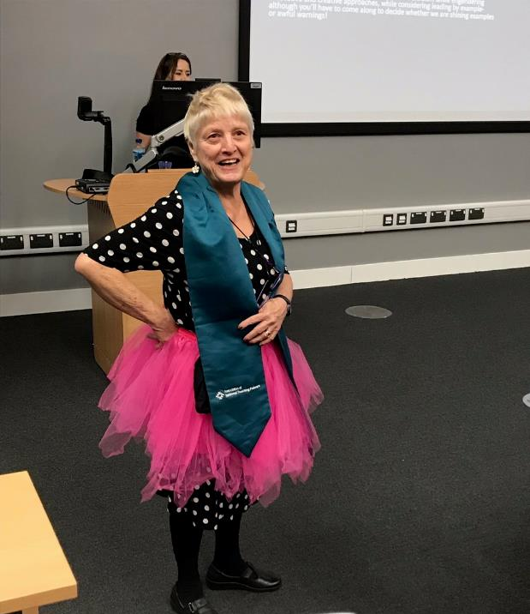
Maybe send yourself up sometimes?

Slide 66
So what are you going to do?
To refresh your own practice?
To gain more satisfaction from teaching?
To improve your teaching techniques and practices?
To mentor and support new colleagues?
To learn from the long-serving members of staff who may be about to leave?

Slide 67
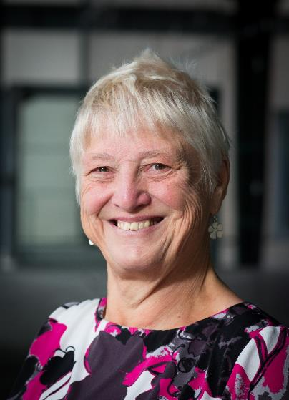
These and other slides are available on my website at http://sally-brown.net

Slide 68
References and further reading
Bain, K.(2004) What the Best College Teachers Do, Cambridge Massachusetts, Harvard University Press, http://www.vetmed.wsu.edu/courses-jmgay/documents/SynopsisWhatBestCollegeTeachersDo.pdf
Blackwell, R. and McLean, M. (1996) Peer Observation of Teaching and Staff Development. Higher Education Quarterly 50(2).
Brown, S., Jones, G. and Rawnsley, S. (eds) (1993) Observing teaching. SEDA Paper 79. London: Staff and Educational Development Association. [A collection of articles on good practice, with example forms.]
Brown, S. (2011) Bringing about positive change in higher education; a case study Quality Assurance in Education Vol 19 No 3 pp.195-207.
Brown, S. and Race, P. (2002) Lecturing – a practical guide, London: Kogan Page
Colin Bryson & Len Hand (2007): The role of engagement in inspiring teaching and learning, Innovations in Education and Teaching International, 44:4, 349-362
Boyer, E.L. (1990, reprinted 1997) Scholarship reconsidered: priorities of the professoriate, San Francisco: Jossey Bass, The Carnegie Foundation for the Advancement of Teaching.
Debowski, S., Stefani, L., Cohen, M. and Ho, A (2011) Sustaining and championing teaching and learning in good times or bad in Groccia, J., Alsudairi, M. and Bukist, B., (eds.) A handbook of College and University Teaching: global perspectives, London: Sage Publications.

Slide 69
References and further reading (2)
Gosling, D. (2000) Guidelines for Peer Observation of Learning andTeaching. ESCalate Regional Networking Seminars. Bristol: ESCalate. Available at: http://www.escalate.ac.uk/resources/peerobservation
Hammersley-Fletcher, L. and Orsmond, P. (2004) Evaluating our peers: is peer observation a meaningful process? Studies in Higher Education 29(4), 489-503.
Hodgkinson, M. (1994) Peer Observation of Teaching Performance by Action Enquiry. Quality Assurance in Education 2(2), 26-31.
McKeachie, W. J. (1951) Teaching Tips: Strategies, Research and Theory for College and University Teachers, Lexington MA: D. C. Heath and Company.
Parkin, D. (2017) Leading Learning and teaching in higher education: the key guide to designing and delivering courses, London and New York, Routledge
Race, P. Using peer observation to enhance teaching Leeds Met press (see http://www.leedsbeckett.ac.uk/publications/files/090505-36477_PeerObsTeaching_LoRes.pdf accessed November 2014)
Race, P. (2019) The lecturer’s toolkit (5th edition) London: Routledge.
Ramsden , P.(2003) Learning to teach in higher education (2nd edition) London, Routledge Falmer.
Seale, J., Gibson, S., Haynes, J. and Potter, A., 2015. Power and resistance: Reflections on the rhetoric and reality of using participatory methods to promote student voice and engagement in higher education. Journal of further and Higher Education, 39(4), pp.534-552.

