Slide 1
Professors in Preparation:
ANTF symposium
Developing mentoring skills:
top tips on helping others to succeed
Professors Sally Brown and Liz Mossop
10.45-12.10 Friday 29th March

Slide 2
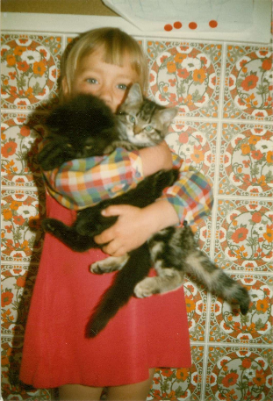
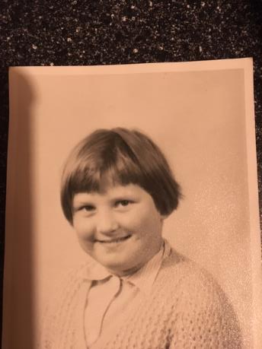
Mentors help us become who we are!

Slide 3
Session outline
PiP – reminder (Debbie/Julie)
Role of mentors and mentees (Liz)
Finding a mentor and/or mentee (Sally)
What works – personal stories (all)
Task – defining what mentors can help others do/be (all)
Establishing ground rules for mentors and mentees (Sally)
The PiP mentoring scheme – next steps (Liz)

Slide 4
Teaching vs mentoring
Instructing others in specific knowledge and skills (and values?)
Sharing knowledge skills and perspectives that influence the personal and professional growth of others
Is it as clear a division as this for you?
Why (not)?

Slide 5
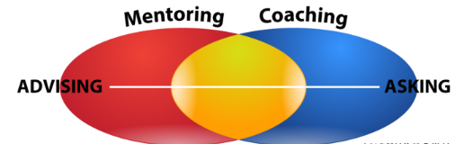
Coach vs mentor
You are at point A and you want to get to B…a mentor advises through expertise and experience which way to go…..
“sharing knowledge”
You are at point A and you want to get to B…a coach helps you find your own way…. “unlocking potential”

Slide 7
Session outline
PiP – reminder (Debbie/Julie)
Role of mentors and mentees (Liz)
Finding a mentor and/or mentee (Sally)
What works – personal stories (all)
Task – defining what mentors can help others do/be (all)
Establishing ground rules for mentors and mentees (Sally)
The PiP mentoring scheme – next steps (Liz)

Slide 8
Who can be a mentor? How can you find one?
Look for people who you admire, who are likely to have perspectives you don’t have and who you think might have useful insights into your professional area;
It’s said ‘if you want a job done, ask a busy person’ but be realistic about how much availability your potential mentor is lively to have;
Look around for people who are in the roles/at the career stage in five years and consider if they might be a good mentor for you, or if they can advise you who might be suitable and available;
And?......

Slide 9
And if you want to be a mentor?
Consider what skills, qualities and experience you have to offer and who might find these useful;
Review to what career stage you are likely to have something to offer: relatively close to your current stage or much more junior?
Think about what time commitment you are likely to have available (it often takes more than you think!):
Think about modes that might suit you and your mentee best: face-to-face? Virtual e.g. by Skype or What’s App etc? Mainly by email?
In my experience, just let it be known you are happy to consider mentoring and you may well be inundated!

Slide 10
And if someone approaches you wanting you to be their mentor:
You don’t have to say yes!
Think about what each party can bring to the other: the best mentoring has an element of two-way benefits e.g. updating and maintaining currency for the more experienced member;
Be realistic about your workload: can you realistically mentor more than one person at a time? Can an element of ‘group mentoring’ work?
Think about how you can manage it if things don’t work out as expected.

Slide 11
Session outline
PiP – reminder (Debbie/Julie)
Role of mentors and mentees (Liz)
Finding a mentor and/or mentee (Sally)
What works – personal stories (all)
Task – defining what mentors can help others do/be (all)
Establishing ground rules for mentors and mentees (Sally)
The PiP mentoring scheme – next steps (Liz)

Slide 12
What worked for us having mentors and being mentored?
Sally as a mentee: I found I needed reassurance I was working on the right lines, some challenges that moved me beyond my comfort zone, quite a few cups of tea, very targeted advice and guidance on things I was finding difficult, the occasional ‘word to the wise’ where I wasn’t aware of everything going on, and above all, their confidence that I could succeed;
Sally as a mentor: I gain a great deal from having mentees as I am very committed to bringing on the next generation. I set time limits e.g. six months to see how things settle down, I tell mentees they need to make the arrangements, I’m not afraid of saying when the relationship has served its purpose.

Slide 13
What worked for us having mentors and being mentored?
Liz as a mentee: having time to chat about everything and anything, honest feedback, pragmatic advice, a good laugh/commiserate when things went wrong, “insider” view…..and most of all being told to accept some help!
Liz as a mentor: always honoured to be asked, love learning about others career paths and challenges and celebrating successes! Equally happy to share frustrations and disasters. I always learn more than I expect when mentoring.

Slide 14
Session outline
PiP – reminder (Debbie/Julie)
Role of mentors and mentees (Liz)
Finding a mentor and/or mentee (Sally)
What works – personal stories (all)
Task – defining what mentors can help others do/be (all)
Establishing ground rules for mentors and mentees (Sally)
The PiP mentoring scheme – next steps (Liz)

Slide 15
Task: What can mentors help others do/be?
Reflect on your activities and career trajectory
List five things a mentor could help you with
Feedback

Slide 16
What can you expect from a mentor?
Mentors can:
Mentors are unlikely to be able to:
Help you formulate your ideas;
Facilitate you to work out what your goals should be;
Advise on useful reference material and other sources;
Help you network effectively;
Help you get over setbacks and imposter syndrome.
Proof read your work;
Do all the running to make the mentoring relationship work;
Be on call perpetually;
Solve problems beyond the professional relationship;
Be your best friend.

Slide 17
From the draft PiP documentation
Mentor’s role
Active listening – ensuring the mentees agenda is elicited and attended to
Being a critical friend – challenging assumptions and asking the right questions
Encouraging broad reflection – ensuring views are not siloed and the “big picture” is considered
Reframing of challenges – within the reflective process other perspectives should be considered and issues reframed as appropriate
Championing and promoting – where possible/appropriate, networks and contacts can be highlighted
Commitment – to give a small amount of time to attend discussions remotely or face to face and behave professionally at all times
Mentee’s role
Expectations – the process is not designed to give “the answers” and expectations should be set accordingly
Openness – to new ideas and challenges
Commitment – to attend and shape discussions, and behave professionally at all times
Anything missing?

Slide 18
Session outline
PiP – reminder (Debbie/Julie)
Role of mentors and mentees (Liz)
Finding a mentor and/or mentee (Sally)
What works – personal stories (all)
Task – defining what mentors can help others do/be (all)
Establishing ground rules for mentors and mentees (Sally)
The PiP mentoring scheme – next steps (Liz)

Slide 19
Establishing ground rules for mentors and mentees
What will each party gain from the mentoring relationship?
What are your expectations of levels of confidentiality?
What level of contact will work for both of you? How often will you interact? Will meetings be live or virtual or both? If live, where works best for you both? How much email traffic is acceptable?
Who will keep records of meetings / action notes?
Duration: How long will the mentoring relationship last? Will mentors be happy to help after that period e.g. with promotion or other references?
What plans do you have to cope if things don’t work out?
And?......

Slide 20
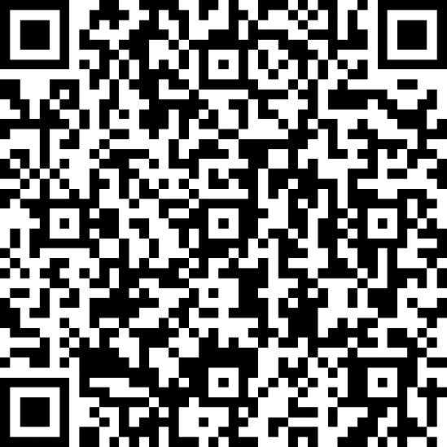
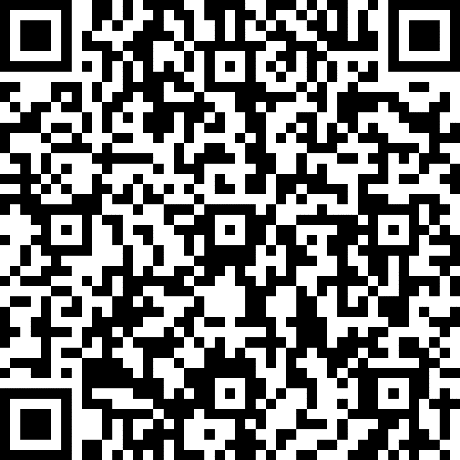
Next steps – PiP scheme
Form to complete
Matching process
Documentation and over to you…..
To request a mentor
https://bit.ly/2UIVerL
To volunteer as a mentor
https://bit.ly/2CsbKoV

Slide 21
Selected references
Clutterbuck, D., 2014. Everyone needs a mentor. Kogan Page Publishers.
Darwin, A. and Palmer, E., 2009. Mentoring circles in higher education. Higher Education Research & Development, 28(2), pp.125-136.
Megginson, D. and Clutterbuck, D., 2010. Further techniques for coaching and mentoring. Routledge.

