Slide 1
Refreshing and rationalising the curriculum
Manchester University School of Midwifery
15th February 2019
Sally Brown NTF, PFHEA, SFSEDA
@ProfSallyBrown http://sally-brown.net

Slide 2
This workshop
The School of Midwifery has an opportunity now to review and refresh its programme design, delivery, assessment, student support and quality enhancement in collaborative ways that can engender a good sense of collective ownership by staff and student representatives through this facilitated session. Today will provide opportunities for participants to:
Evaluate strengths and opportunities for improvement on current programmes, ready for the next phase of delivery;
Consider how the programme can incorporate good practice across the student lifecycle, from pre-entry, induction/acclimatisation, learning and well-being at every level and transition between levels, as well as ‘outduction’ into the employment context;
Discuss how to engage students as partners in and co-producers of learning in ways that are empowering and productive;
Review ways of assessing students through approaches that foster and integrate learning;
Manage the feedback process effectively and efficiently.

Slide 3
A note about the slides
All available on my website at http://sally-brown.net;
All, like everything I do, open educational resources so use them with colleagues and students as you wish (except the images of people);
Far too many here for us to use today: regard them like the bonus features on a DVD (or your homework!). I will select from them what I consider to be the most helpful as the day emerges, and will not go in a straight line!

Slide 4
Curriculum design for active learning and engagement

Slide 5
Determining and reviewing subject material: currency, relevance, level
Enhancing quality, seeking continuous improvement
Designing and refining learning outcomes
Evaluating programmes, strengths and areas for improvement
Curriculum
Design
Essentials
Considering delivery modes: face-to-face, online, PBL, blended…
Assuring quality, matching HEI, national and PRSB requirements
Thinking through student support
Designing fit for purpose assessment methods and approaches

Slide 6
What major changes have impacted on HE teaching and learning globally over the last decade and what’s coming up on the horizon?
The increased focus on student satisfaction and value for money leading to changing expectations about student engagement;
The availability of vast data sets institutionally and nationally;
The effect on institutional strategies of promoting the research agenda, often at the expense of support for teaching initiatives;
The intensification of encouragement to seek professional recognition for teaching expertise and the new Irish framework for CPD;
Changes in learning paradigms and knowledge construction as the central role of ‘content delivery’ in curriculum development has been challenged.

Slide 7

Laurentius de Voltolina
2nd half of 14th Century
Italian Painter

Slide 8
Delivering content…..
is less like delivering a parcel (the postman model) and more like delivering a baby (the midwife model).
University staff can advise, guide, intervene when things so wrong, but in the end only the student can bring learning into life!!
Content can be gleaned from many sources (e.g. MIT and our UK Open University (as well as websites like mine and Phil’s) are putting more and more content into open access areas).

Slide 9
The Maieutic model
Maieutics is a complex procedure of research introduced by Socrates, embracing the Socratic method in its widest sense. It is based on the idea that the truth is latent in the mind of every human being due to her/his innate reason but has to be “given birth” by answering questions (or problems) intelligently proposed. The word is derived from the Greek “μαιευτικός”, pertaining to midwifery.

Slide 10
Bridging the attainment gap (Cotton et al, 2013)
We need to look beyond ‘the deficit model’ to explain the attainment gap and to undertake faculty development, since the lack of explicit consideration of ethnicity and gender may act as a barrier to cultural change.
A research study conducted at the University of Wolverhampton revealed a lack of adequate awareness of the needs of non-traditional students and underdeveloped student support systems (Pinnock, 2008).
There are significant differences in motivation and confidence speaking English for different ethnic groups and a divergence in attendance and study time by gender and male and BME students tended to over-estimate their likelihood of achieving a good degree outcome.

Slide 11
Understanding the attainment gap: gender
Female students achieve better degree classifications than male students, except when it comes to attaining a first class degree, where there is no significant difference (Broecke & Nicholls, 2008; HEFCE, 2014).
Claims have also been made that exams favour males and coursework females (Martin, 1997). At Oxford University, where many courses are assessed on the basis of exams at the end of the final year, the gender gap is reversed – at least in terms of the proportion of students achieving first class degrees (Trigwell & Ashwin, 2003).

Slide 12
Understanding attainment gap: ethnicity
Students from most ethnic minority backgrounds obtain poorer degree results than white students, even when controlling for prior attainment, age, gender and discipline.
Leslie (2005) suggested that the reasons for low attainment of BME groups may be connected to their relatively higher participation rates, which resulted in lower prior attainment. Richardson (2008) showed that the likelihood of BME students attaining a good degree increased by roughly 50% when the effects of entry qualifications were controlled.
The study also found that the effects of age, gender, mode and subject of study all interacted with ethnicity (Richardson, 2008) making it problematic to discern causality with respect to any single factor. (Cotton et al 2013)

Slide 13
Cotton et al propose 3 issues which warrant further attention
The possibility that both BME students and male students might be more likely to use surface learning approaches, thereby lowering attainment.
The tension between integration into university life and the potential negative impact of over-involvement in clubs or societies. This seems to be a delicate balance which could have divergent impacts on different student groups.
The importance for students of having an accurate understanding of their achievement levels. For whatever reason, both male and BME students were not effectively judging likely success.

Slide 14
Changing students’ attitudes to engagement. Is it true? How do we know?
Many suggest students are more demanding of staff time and have higher expectations than previously (although colleagues in Scotland report similar trends);
Many HEIs are reporting worsening attendance, there certainly seems to be an attitude among some students that “well, I am paying for it so it’s up to me if I come in or not”
Some report a more litigious approach among dissatisfied students and their parents.

Slide 15
Changing students’ behaviours. Is it true? How do we know?
Reading: Academic book sales seem to be dropping, students are said not to use library books as much as they did, more and more reading is on-line with consequential changes to tolerances of length, breadth and depth;
Writing: it is suggested that students (and HE staff!) often find writing with a pen and paper in exams and in lectures an alien concept, but our practices haven’t kept pace;
Learning: with the power of the internet at our fingers, many are querying the value of learning stuff. Isn’t it enough just to know how to find information? What do academic and professional staff think? What do students think?

Slide 16

Transition in, through and out of higher education – international case studies and best practice
Edited by Ruth Matheson, Sue Tangney and Mark Sutcliffe
Routledge, 2018

Slide 17
Matheson, Tangney and Sutcliffe (2018) recognise that:
Initial steps into undergraduate education mark only a beginning for students;
The journey involves other significant transition points that students need to negotiate;
Engagement needs nurturing if students are to develop into autonomous reflective learners;
There is significant international research exploring transition towards, into, through, up out and beyond (Lizzio, 2011, Morgan 2013);
We can learn much from the international case studies in this collection (including my own Chapter 2, 17-30, ‘Identifying student need’ and ‘Biscuit game’ p127-129!).

Slide 18
Applying Lizzio’s approach in Australia
Griffith Learning and Teaching Capabilities Framework. This framework recognises that high quality student learning experience depends on remarkable staff; and the framework seeks to define the capabilities that underpin different roles in learning and teaching - helping us identify how we can support the development of individuals within these roles.https://www.griffith.edu.au/__data/assets/pdf_file/0026/359540/Griffith-Learning-and-Teaching-Capabilities-Framework-2018.pdf. This framework directs many of the Unit’s activities but also enables individual reflection and the development of a CPD plan. The Framework utilises extensive research and staff consultation to not only identify capabilities but also the values that underpin practice.

Slide 19
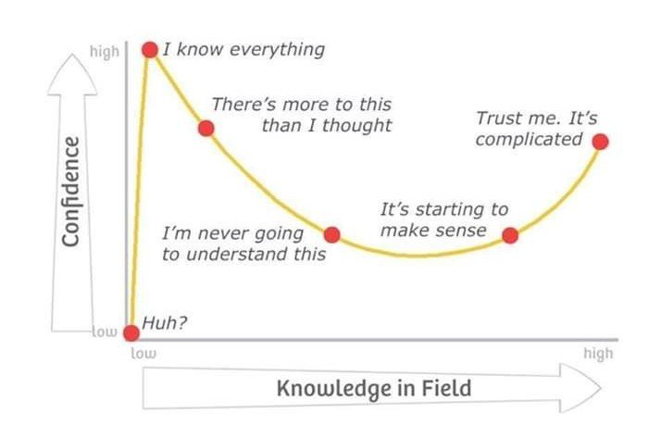
Adapted from Kruger, J. and Dunning, D. 2009

Slide 20
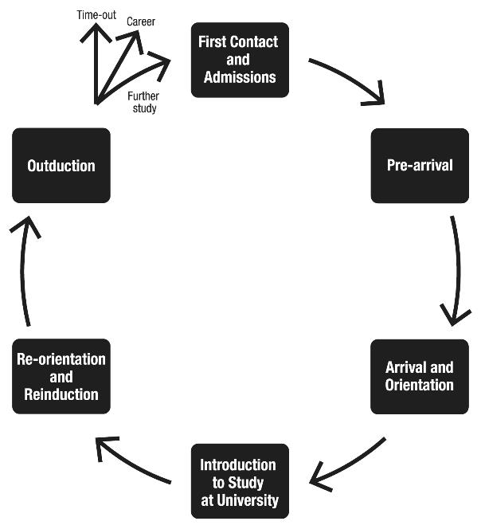
Source: Supporting student diversity – A practical guide (2013) p45

Slide 21
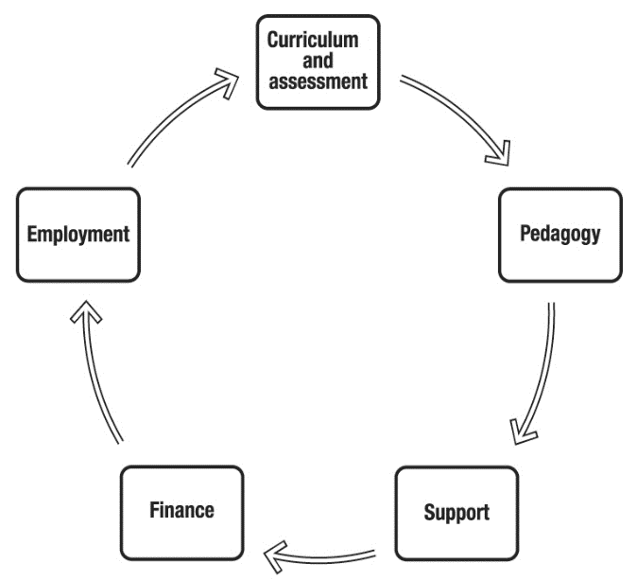
Themes within the Student Experience Transition Model

Slide 22
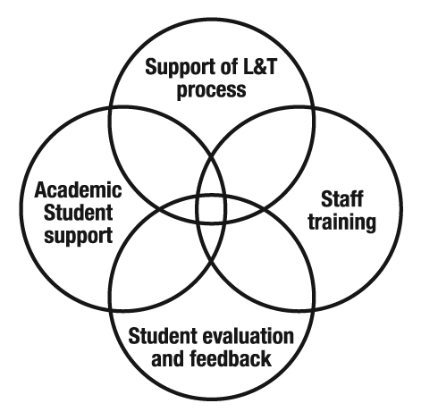
Activities to support the SET Model

Slide 23
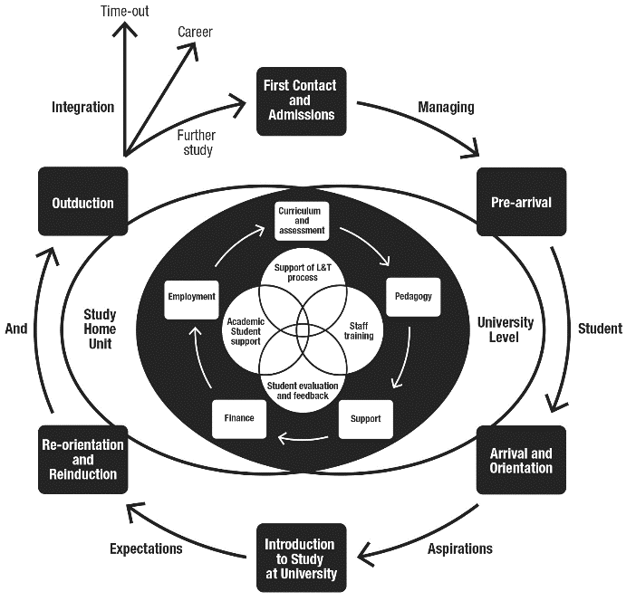
Source: Supporting Student Diversity – A practical guide (2013) p61

Slide 24

Michelle Morgan on commuter students
Michelle Morgan says “Research suggests that not only does the commuter student have a different university experience to on-campus students but they may also be disadvantaged because they do not have access to the same academic and social opportunities as campus-based students”. Is that true?
Morgan, M. ed., 2013. Improving the student experience: A practical guide for universities and colleges. Routledge.

Slide 25
Commuter students (after Morgan, 2013)
Commuter students are students who live off-campus, not in university accommodation, are often mature students from lower socioeconomic groups, have a broad age-range and represent a significantly higher portion of minorities;
Research suggests that not only do commuter students have a different university experience to on-campus students but they may also be disadvantaged because they do not have access to the same academic and social opportunities as campus-based students
They are likely to have life demands e.g. paid employment, caring or parenting responsibilities which compete with their studies and engagement in extracurricular activities so may struggle to integrate into university social support systems and to develop a sense of belonging which can impact on student persistence and degree attainment as well as their overall university experience satisfaction.
A 2012 study looking at all early leavers from 108 English universities found that 48% of early leavers were commuter students but there are no significant differences between commuter and non-commuter students in terms of cognitive growth and other academic success outcomes.

Slide 26
Developing engagement among your students
Is there a coherent model of progression across the student life-cycle from induction to ‘outduction’ (Morgan, 2011)?
Do you manage transitions from year one to year two, and year two to year three, to ensure students remain committed and engaged?
Is there some continuity in the sources of student support throughout the course (e.g. personal tutors)?
Are students offered support and guidance in relation to personal development and employability?
Are students using critical thinking and high levels of analytical thought sufficiently at each level of a programme?
Are students working autonomously as well?
Do students have meaningful and purposeful opportunities of working together?

Slide 27
What can we do in the first six weeks?
Enable students to feel part of a cohort rather than a number of a list;
Help students acclimatise to the new learning context in which they find themselves;
Familiarise them with the language and culture of the subject area they are studying (Northedge, 2003);
Foster the information literacy and other skills that students will need to succeed;
Guide them on where to go for help as necessary;
Offer them immersive experiences.

Slide 28
Transitions between years and levels: the First Year
Much can be done to engage students pre-entry both virtually and live;
Induction in many HEIs is grim: lots of talking heads and loads of information, and all over in a week!
For me, induction is a process not an event, and information and support needs to be incremental
Many see the whole of the First Year experience as a programme of orientation;
Immersive programmes can be extremely helpful (e.g. see Pauline Kneale et al’s work at Plymouth university, Turner et al 2017).

Slide 29
Inter-year transitions: avoiding the sophomore slump
(Yorke, 2014, Zaitseva et al)
The three-months between the end of the 1st year and the start of the 2nd (and to a lesser extent between 2nd and 3rd years) provides lacunae for lost motivation and decreased engagement;
Energy, thought and resources need to be deployed to counteract this tendency and to maintain student engagement;
This can be undertaken in three ways:
  Through linking study from year to year through assignments and other activities set to bridge the gap;
  By maintaining contact (live or virtual);
  By using peer groups and networks for mutual support.

Slide 30
Mapping progression
Is there a coherent model of progression across the student life-cycle from induction to ‘outduction’?
Do you manage transitions from year one to year two and year two to year three to ensure students remain committed and engaged?
Is there some continuity in the sources of student support throughout the course (e.g. personal tutors)?
Are students offered support and guidance in relation to personal development and employability?

Slide 31
Diverse pedagogic approaches and contexts: what are your students expecting?
Is your principal model of teaching one of transmission of knowledge or do you review learning as a partnership between teachers and students (student –centred learning c.f. woman-centred birthing)?
Is the knowledge base you use ubiquitous or transactional?
Do you value robust discussion in class, or is it more important to achieve consensus?
Is there a significant power distance between academics and students, or is the pedagogic context quite informal? E.g. What do your students call you?

Slide 32
Fostering inclusive classroom practice
Arguably the commonest locus of discrimination against disabled students can be fellow students e.g. in group work;
Student induction and modelling of good practice are crucial;
Use all available sources of information and advice: disability officers, national agencies, specialist groups and charities and disabled students themselves;
Disabled students are often the best sources of information about their own particular needs.

Slide 33
Inclusive curriculum delivery
Staff may need weaning off excessively flashy presentations with split screens, lots of moving pictures, tiny text and masses of colour (however much they love it!);
Staff must review their own practices in relation to accessibility of language, audibility and visibility;
Inclusive curriculum materials recognise social and cultural differences;
Course teams should scrutinise all course materials with a specific eye for inclusivity.

Slide 34
Dyslexia is a huge issue in HE assessment: some tips for inclusive assessment:
Try to separate the assessment of the content from the assessment of the expression of language.
When marking students with dyslexia, decide the extent to which spelling / grammar/ logical ordering should impact on the marks given.
Decide the extent to which these aspects of work should be the subject of formative feedback and how it will impact on summative grades.

Slide 35
Provide printed instructions for all assignments in advance. Check with individual students which print fonts, sizes and paper colours are easiest for them to handle.
Find out whether affected students may work best on-screen rather than on paper.
Consider the suitability of mind maps and other alternatives to written communication, when students are being assessed on how well they can organise ideas.

Slide 36
For inclusive practice we should:
Build in awareness of inclusivity issues in induction for staff and students;
Include relevant elements in Post Graduate courses in HE learning and teaching;
Include robust requirements re inclusive practice in institutional assessment, learning and teaching strategies;
Make questions re inclusivity part of validation and review of all programmes.

Slide 37
We can also:
Make sure that EO/inclusivity/disability committees/working parties are fully integrated into HEI’s systems;
Use staff development workshops to foster awareness of specific issues;
Encourage discussion of the language used when describing inclusivity issues;
Make best use of University colleagues with specialist knowledge to promote inclusivity.

Slide 38
And also
In making tutor comments on students’ work, pay particular attention to the legibility of your own writing.
Remember that different dyslexic students will be helped by different adjustments.
Extracted from Pickford, R. and Brown, S. (2006) Assessing skills and practice, London: Routledge

Slide 39
Supportiveness: we must
Adopt a holistic approach to the development of skills, particularly the ‘literacies’ (academic, assessment, digital, information and social/interpersonal literacies, (Brown, 2015), so that these are fully integrated into the learning programme;
Enable students to become self-aware and reflexive learners who become robust in the face of problems;
Help students build resilience through ‘a diet of early successes’ and positive reinforcement (Dweck, 2000);
Ensure that assessment, particularly in the early stages, is fully part of the learning process.

Slide 40
Inclusive curriculum design, delivery and assessment
In this session we will be exploring some of the key underpinning issues including considerations of:
How we can support and engage diverse ‘non-traditional’ students, often termed ‘Widening Participation students’ (is there such a thing as a traditional student nowadays?);
How we can be inclusive of the needs of ‘commuter students’ in curriculum design, delivery and assessment;
How our practices can celebrate the benefits of including international students in our teaching environments and support their learning and other needs;
Making inclusive curriculum design delivery and assessment manageable.

Slide 41
What kinds of diversity might we encounter in our work here?
Diverse cultural, faith and social backgrounds;
Diverse capabilities, for example, with understandings of learning, information literacies and language;
Diversity of experience and backgrounds: mature, international, neural atypical and other students often bring a wealth of life experiences with them;
Diversities of expectations: social and cultural capital: understandings of higher education gained from films?
Diversities of family responsibilities and home contexts;
And? (By the way, what kind of diverse are you?)

Slide 42
The concept of universal design
“Instead of retrofitting curriculum for students via accommodations and modifications, the principles of UDL prompt teachers to design curriculum that is flexible and adaptable to multiple forms of learning and engagement to facilitate the learning of all students.” (Lancaster, 2008)
“The ‘universal’ in UDL does not mean there is a single optimal solution for everyone. Instead, it underscores the need for flexible approaches to teaching and learning that meet the needs of different kinds of learners. ” (Rose and Meyer, 2006)

Slide 43
Meaningful and useful learning outcomes

Slide 44
Are your learning outcomes SMART or VASCULAR? The usual ‘requirements’ are that they be:
Specific;
Measurable;
Achievable;
Realistic;
Time constrained.

Slide 45
VASCULAR learning outcomes
Verifiable: Can we tell when they’ve been achieved? And can students?
Action orientated: Do they lead to real and useful activity?
Singular: i.e. not portmanteau outcomes combining two or more into one, making it difficult to assess if differently achieved, but readily matchable to student work produced?
Constructively aligned? (Biggs and Tang, 2011) so that there is clear alignment between aims (What do students need to be able to know and do?), what is taught/ learned, how these are assessed and evaluated);
Understandable i.e. using language codes that are meaningful to all stakeholders?
Level-appropriate? Suitable and differentiable between1st year, 2nd year, 3rd year, Masters, other PG?
Affective-inclusive i.e. not just covering actions but capabilities in the affective domain?
Regularly reviewed? Not just stuck in history and always fit-for-purpose.

Slide 46
Phil Race is concerned we need to go beyond learning outcomes and include:
Learning incomes: all the things learners are bringing to the learning situation:
Emergent learning outcomes: those we didn’t (and maybe couldn’t) predict, which may surprise and astound us!:
Intended learning outgoings: helping them link the intended learning outcomes to the wider world of future learning and employment;
See https://phil-race.co.uk/2018/05/beyond-learning-outcomes/

Slide 47
Engaging students as partners in curriculum design

Slide 48
What kinds of roles can students take as partners in curriculum design?
Code check: is the language we use in documentation meaningful to students or does it sound like jargon/gobbledegook to them?
Reality / practicality check: do they see what we are requiring them to do as achievable and viable?
Authenticity check: Are the tasks we require of them worthwhile? Do they see them as related to their expectations about roles on graduation?
Expectations check: does what they are being offered match what they were led to believe from the prospectus and other pre-entry information?

Slide 49
Students as partners in shaping and leading their own educational experiences
Students are not passive recipients of educational services. Through their participation in an array of learning activities, students actually co-produce their education. At the same time, they also contribute directly to their own satisfaction, quality and value perceptions. (Kotze et al 2003).
The concept of the student voice can be passive and disempowered, governed and operated by the institution rather than by students themselves. For many years, students have been members of university committees, though not necessarily full members, and often expected to disappear at 'reserved business'. Student involvement in structures and systems, like student-staff liaison committees, once highlighted as good practice in Subject review and Institutional audit, is now routine. (Kay et al, 2010)

Slide 50
The Exeter approach (Kay et al, 2010) offers roles for students
Students as evaluators: represents those means by which the institution, or external bodies, drive change through listening to students;
Students as participants: represents a more student-led approach, including showing commitment to change through student/staff dialogue and offering solutions:
Students as partners, co-creators and experts: emphasises active student engagement and collaboration, e.g. students training staff in new skills, as with new technologies; designing curricula and resources – negotiating examination questions or writing question banks; setting assignments; redesigning module provision and delivery; producing induction material.
Students as change agents: actively engaged with the processes of change.

Slide 51
Key questions from Exeter about students as change agents (after Kay et al, 2010)
Which students? Whose voice? Enthusiasts, the volunteers, ‘faint voices’, culturally diverse? The ‘usual suspects’ or wider representation? How can this be achieved?
Is the concept of students bringing about change threatening? Some staff perceive student-led explorations as a direct challenge.
How to keep the idea of students as Change Agents fresh as an idea, so that people, whatever their role, do not switch off as soon as they hear the words, but can adapt them to their own contexts.
What to do about 'students who just want to follow their course and have a good time. Should all students be involved or is it more important that students understand the language and the message, and feel empowered even if they do not want to engage with change management?

Slide 52
How can students act as partners and co-producers for Manchester School of Midwifery? By:
Working alongside staff in curriculum design workshops, offering insights and making suggestions?
Reviewing documentation produced by academic and professional services colleagues, and checking it for code, reality/practicality, authenticity and matching expectations?
‘Destruction testing’ assessment tasks, briefs and activities to see how things might go wrong in time for remediation?
Advising on wider implementation of technologies in teaching and assessment?
Contributing to quality assurance and enhancement activities?
And what else?

Slide 53

Students as partners in research
Mick Healey says partnership is essentially a process for engaging students. It is a way of doing things, rather than an outcome in itself. Students may be engaged as partners through:
Learning, teaching and assessment;
Subject-based research and inquiry;
Scholarship of teaching and learning; and
Curriculum design and pedagogic advice and consultancy.
.

Slide 54
Designing assessment as a central part of curriculum design

Slide 55
Students as partners in assessment
Often involves them in self and peer assessment;
Can pay high dividends in terms of student satisfaction;
Can be highly resource intensive if a strategic approach is not adopted;
Often requires a significant process of rethinking the processes and practices of assessment;
Usually implies increasing the amount of formative assessment and sometimes slimming down the volume of summative assessment;
Can change students’ lives.
See HEA (2012): A Marked Improvement: transforming assessment in higher education.

Slide 56
Designing assessment as a central part of curriculum design
Assessment is a complex, nuanced and highly important process​ and if we want students to engage fully, we must make it really meaningful to them and convince them that there is merit in the activities we ask them to undertake. To focus students’ effort and improve their engagement with learning, we need to take a fresh look at our current practice to make sure assessment is for rather than just of learning, with students learning while they are being assessed rather than it being merely a summative end process. We also need to ensure that we make assessment practices and the giving of feedback manageable for staff and valuable for students.

Slide 57


Slide 58
Enhancing Assessment and Feedback
Effective assessment is crucial for student satisfaction and achievement. This session will explore how we can review and revise our assessment approaches so that students have the best possible chance of success, particularly by:
building students' assessment literacy and thereby enabling them better to understand how criteria and assessment practices work;
ensuring that assessment is for not just of learning;
fostering approaches to feedback that mean students take good note of and use the comments and advice provided by their assessors.
By the end of the session, participants will have had opportunities to come to grips with typical problematic aspects of assessment and feedback, and to devise strategies to ensure their own practices and approaches are fit-for-purpose and manageable by students and themselves.

Slide 59
Underpinning premises for A4L
Assessment can be a powerful means of focusing student effort and enhancing achievement if it is well designed and constructively aligned (Biggs and Tang, 2011);
We need to deploy a diverse range of tactics to our assessment and feedback to ensure that they work to enhance and extend student learning;
Students need to achieve assessment literacy to ensure they understand and can benefit from our assessment systems;
Assessment needs to be manageable for staff and students if it is going to engage students in learning activities.

Slide 60
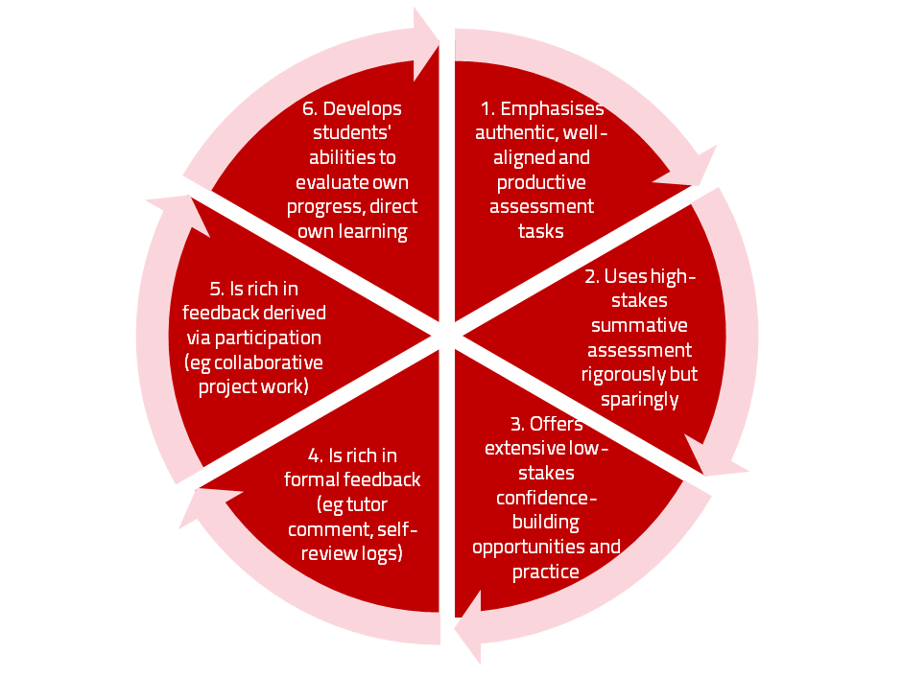
A4L the Northumbria model

Slide 61
Using assessment for learning
(Sambell et al, 2012)
Assessment that is meaningful to students can provide them with a framework for activity;
“Students can escape bad teaching but they can’t escape bad assessment” (Boud, 1995);
Where assessment is fully part of the learning process and integrated within it, the act of being assessed can help students to make sense of their learning;
Assessment should be formative, informative, developmental and remediable.

Slide 62
My fit-for-purpose model of assessment: the key questions
Why are we assessing?
What is it we are actually assessing?
How are we assessing?
Who is best placed to assess?
When should we assess?
Notes:
62

Slide 63
For any assessment activity, we need to be clear about:
Aims: is this an early stage assignment, that is principally about building confidence and helping students see what is required of them, or is it a key element of their summative assessment, designment to gauge fitness to progress, or fitness-to-practice?
Scope: is this testing low level outcomes, like demonstrating recollection of key terms, or is it cognitively more demanding requiring synthesis of multiple elements, critical analysis, evaluation and reflection?
Scale: is this a small scale or a substantial task carrying a heavy weighting? Do students know how much effort and energy is needed to achieve at least a satisfactory level?
Orientation: Is the key aim to demonstrate the achievement of skills and competences, and/or to produce a definite product or is it primarily about demonstrating mastery of appropriate processes?
Constructive alignment: To what extent does the assessment closely link to the learning outcomes (and specifically the verbs used in them)?

Slide 64
Formative and summative assessment
Formative assessment is primarily concerned with feedback aimed at prompting improvement, is often continuous and usually involves words.
Summative assessment is concerned with making evaluative judgments, is often end point and involves numbers.

Slide 65
The importance of dialogic feedback to involve students as partners in assessment
Students need to be exposed to, and gain experience in making judgements about, a variety of works of different quality... They need planned rather than random exposure to exemplars, and experience in making judgements about quality. They need to create verbalised rationales and accounts of how various works could have been done better. Finally, they need to engage in evaluative conversations with teachers and other students. (Sadler, 2010)

Slide 66
Assessment literacy: students do better if they can:
Make sense of key terms such as criteria, weightings, and level;
Encounter a variety of assessment methods (e.g. presentations, portfolios, posters, assessed web participation, practicals, vivas etc) and get practice in using them;
Be strategic in their behaviours, putting more work into aspects of an assignment with high weightings, interrogating criteria to find out what is really required and so on;
Gain clarity on how the assessment regulations work in their HEI, including issues concerning submission, resubmission, pass marks, condonement etc.

Slide 67
Students tend to be more convinced about the fairness of the assessment process if
Requirements and procedures are transparent and made readily available to them;
They believe that the tasks they are asked to do are worthwhile and are closely linked to what course documentation indicates they should be able to know and do at the end of the programme i.e. authentic assessment;
They fully understand the ‘rules of the game’.

Slide 68
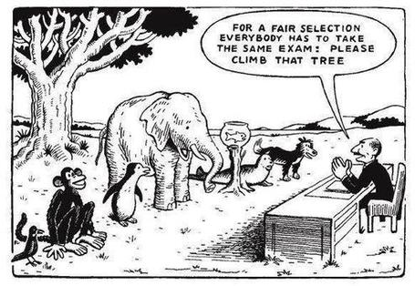

Slide 69
Helping students better understand what is needed of them
This can be achieved in a variety of ways, including:
Using games (like the Biscuit game) can help make students think hard about criteria and required outcomes;
Ensuring that briefings (in the form of documentation, and more importantly, live/ face-to-face briefings, where students can actively interrogate criteria) are useful;
Getting students to self-assess to start a feedback dialogue;
Using exemplars to show students what high quality work in this domain comprises, and what features and aspects are crucial for success.

Slide 70
Assessment for learning: some useful thoughts
1. Tasks should be challenging, demanding higher order learning and integration of knowledge learned in both the university and other contexts;
2. Learning and assessment should be integrated, assessment should not come at the end of learning but should be part of the learning process;
3. Students are involved in self assessment and reflection on their learning, they are involved in judging performance;
4. Assessment should encourage metacognition, promoting thinking about the learning process not just the learning outcomes;
5. Assessment should have a formative function, providing ‘feedforward’ for future learning which can be acted upon. There is opportunity and a safe context for students to expose problems with their study and get help; there should be an opportunity for dialogue about students’ work;

Slide 71
Assessment for learning
6. Assessment expectations should be made visible to students as far as possible;
7. Tasks should involve the active engagement of students developing the capacity to find things out for themselves and learn independently;
8. Tasks should be authentic; worthwhile, relevant and offering students some level of control over their work;
9. Tasks are fit for purpose and align with important learning outcomes;
10. Assessment should be used to evaluate teaching as well as student learning.
(Bloxham and Boyd)

Slide 72
Do your international students understand UK assessment approaches?
Have you clarified the ground rules on issues like pass marks, criterion-referenced assessment and grading systems?
Have you explained how extensions, condonements, and university assessment regulations work?
Are the assignments built around a curriculum international in scope and content? Are tasks and case studies globally orientated?

Slide 73
What do we mean by ‘traditional assessment formats”?
At least 80% of UK higher education assessment uses three main forms;
Unseen time constrained exams of some sort;
Essays where students respond to a stimulus question or title;
Reports of some kind.
These are not necessarily authentic or useful means of assessing students knowledge, capabilities and understanding.

Slide 74
Authentic assessment: what are the principal benefits for stakeholders?
Students undertaking authentic assessments tend to be more fully engaged in learning and hence tend to achieve more highly because they see the sense of what they are doing (Sadler, 2005).
University teachers adopting authentic approaches can use realistic and live contexts within which to frame assessment tasks, which help to make theoretical elements of the course come to life.
Employers value students who can quickly engage in real-life tasks immediately on employment, having practised and developed relevant skills and competences through their assignments.

Slide 75
Wiggins (1990) says assessment can be regarded as authentic if we can draw valid inferences about quality from the work students produce
He proposes that we should aim to offer students assignments that present the student with the full array of tasks that mirror the priorities and challenges found in the best [teaching] activities and that attend to whether the student can craft polished, thorough and justifiable answers, performances or products.
He says they must involve students being able to cope with potentially ill-structured challenges and roles, with incomplete information, that help them rehearse for the complex ambiguities of adult and professional life.

Slide 76
We often assess what is easy to assess, or proxies of what’s been learned, rather than the learning itself
A valid assessment is one that has close relevance to the criteria, which are in turn constructively aligned to the stated learning outcomes of a programme.
Effective assessment is highly relevant to ensuring that graduates can demonstrate the knowledge, behaviours, qualities and attributes that were described in the course outline or programme specification.
Assignments that require students to write about something, rather than be or do something, may not always be fit-for-purpose.

Slide 77
How can authentic assessment engage students?
Using types of assessment that are much more like the ‘real things’ that academics or professionals do in their chosen fields can engage students in much more meaningful ways.
A useful way to help you ascertain how authentic your assessment is could be to ask yourself where in the programme you help students answer questions in job interviews (Sambell, Brown and Graham, 2017)

Slide 78
Questions employers might ask at interview that might help us frame some of our assignments
“Can you tell us about an occasion when:
you worked together with colleagues in a group to produce a collective outcome;
you had to work autonomously with incomplete information and self-derived data sources;
you developed strategies to solve real life problems and tested them out;
you had a leadership role in a team, and could you tell us your strategies to influence and persuade your colleagues to achieve a collective task;
you had to communicate outcomes from your project work orally, in writing, through social media and/or through a visual medium?"

Slide 79
Giving feedback effectively and efficiently

Slide 80
Students as partners feedback
Students tend to regard marks like money, and so will put more energy into things that ‘count’ than those they see as options;
Formative feedback, that is developmental and supportive, and given at the right stage so that it guides future performance can be exceptionally powerful in improving achievement and retention;
Feedback and ‘feed-forward’ must be integral to student learning programmes, rather than something that students opt into, so needs to be within live or virtual face-to-face interaction.

Slide 81
Encouraging better use of feedback
Emphasise early on the importance to students of formative feedback;
Consider how best to provide them with feedback;
Provide them with training on why and how feedback is provided;
Get students to practise drafting and delivering feedback;
Get students to focus on comments rather than marks;
Help students to believe they have the agency to improve their work;
Encourage students to think of feedback as a trigger to them taking action;
Give them some examples of helpful feedback as a prompt to discussion.

Slide 82
Good feedback:
(after Brown, S. (2015), Assessment, learning and teaching in higher education: global perspectives, London: Palgrave-MacMillan)
Is dialogic, rather than mono-directional, giving students chances to respond to comments from their markers and seek clarification where necessary.
Helps clarify what good work looks like, so students are really clear about goals, criteria and expected standards, and provides opportunities to close the gap between current and desired performance.

Slide 83
Good feedback:
Actively facilitates students reviewing their own work and reflecting on it, so that they become good judges of the quality of their own work.
Doesn’t just correct errors and indicate problems, potentially leaving students discouraged and demotivated, but also highlights good work and encourages them to believe they can improve and succeed.

Slide 84
Good feedback:
Delivers high-quality information to students about their achievements to date and how they can improve their future work. Where there are errors, students should be able to see what needs to be done to remediate them, and where they are undershooting in terms of achievement, they should be able to perceive how to make their work even better.

Slide 85
Good feedback:
Offers ‘feed-forward’ aiming to ‘increase the value of feedback to the students by focusing comments not only on the past and present … but also on the future – what the student might aim to do, or do differently in the next assignment or assessment if they are to continue to do well or to do better’ (Hounsell, 2008, p.5).
Ensures that the mark isn’t the only thing that students take note of when work is returned, but that they are encouraged to read and use the advice given in feedback and apply it to future assignments.

Slide 86
Streamlining assessment: why would we wish to do it?
Huge pressure on resources in higher education;
Larger numbers of students in cohorts;
Ever-increasing demands on staff time;
Staff indicate they spend a disproportionate time on assessment drudgery;
The means exist nowadays to undertake some aspects of assessment more effectively and efficiently.

Slide 87
To give feedback more effectively
& efficiently, we can:
Feedback orally to groups of students;
Write an assignment report;
Use model answers;
Use assignment return sheets;
Use statement banks;
Use technologies for delivering and managing assessment.

Slide 88
Five things students really hate about poor feedback
Poorly written comments that are nigh on impossible to decode, especially when impenetrable acronyms or abbreviations are used, or where handwriting is in an unfamiliar alphabet and is illegible.
Cursory and derogatory remarks that leave them feeling demoralised ‘Weak argument’, ‘Shoddy work’, ‘Hopeless’, ‘Under-developed’, and so on.
Value judgements on them as people rather than on the work in hand.

Slide 89
Five things students really hate about poor feedback
Vague comments which give few hints on how to improve or remediate errors: ‘OK as far as it goes’, ‘Needs greater depth of argument’, ‘Inappropriate methodology used’, ‘Not written at the right level’.
Feedback that arrives so late that there are no opportunities to put into practice any guidance suggested in time for the submission of the next assignment.

Slide 90
Encouraging students to recognise and use the feedback we provide for them
Delivery of feedback should not be left to chance, so its best to avoid asking students to pick up marked hard copy assignments from departmental offices;
Electronic submission of assignments has benefits and disadvantages but on balance the former outweigh the latter;
Perhaps require students to guestimate expected marks having read your feedback early in their programmes;
‘Assignment handler’ can deliver feedback electronically and only release marks once students have responded;
Audio files of audio feedback can be highly successful in enabling students to capture ‘live’ oral feedback, and can replace written feedback (e.g. JISC project ‘Sounds good’).

Slide 91
To better engage learners through feedback and assessment we can:
Make use of real examples and hot-off-the-press data to keep content and tasks current and relevant;
Provide challenges to students’ thinking without letting individuals feel publicly exposed or humiliated;
Relate their learning in class to the forthcoming/ongoing assignment (without slavishly teaching to the exam);
Make spaces for dialogue through formative assessment;
Give them real problems to solve and issues with which to engage;
Identify the skills they need to succeed and provide opportunities to rehearse and develop them;
Never compromise on the quality of the demands we make of them.

Slide 92
Making assessment work well
Intra-tutor and Inter-tutor reliability need to be assured;
Practices and processes need to be transparently fair to all students;
Cheats and plagiarisers need to be deterred/punished;
Assessment needs to be manageable for both staff and students;
Assignments should assess what has been taught/learned, not what it is easy to assess.

Slide 93
Are your students aware of all the processes and procedures we use to ensure fair assessment?
Do they know how we require assessors to match grades to achievement of assessment criteria?
Are they familiar with the steps we take to ensure inter-assessor reliability?
Do they understand that moderation processes are in place, for example through exam boards, to ensure that justice is done to each individual?
Do they get to hear about the work of external examiners (or even get to meet them?)?

Slide 94
Planning for action
As an individual, are there changes you would like to make to your curriculum design, delivery and assessment practices?
Thinking about the teams you work with, are there ways in which you could use ideas from today’s session to make your curriculum more authentic?
How could your influence impact more widely on colleagues across the university? And what can the university do to help make this happen?

Slide 95
Useful references: 1
Assessment Reform Group (1999) Assessment for Learning: Beyond the black box, Cambridge UK, University of Cambridge School of Education.
Bain, K. (2004) What the best College Teachers do, Cambridge: Harvard University Press.
Biggs, J. and Tang, C. (2011) Teaching for Quality Learning at University, Maidenhead: Open University Press.
Bloxham, S. and Boyd, P. (2007) Developing effective assessment in higher education: a practical guide, Maidenhead, Open University Press.
Boud, D. (1995) Enhancing learning through self-assessment, London: Routledge.
Boud, D. and Associates (2010) Assessment 2020: seven propositions for assessment reform in higher education Sydney: Australian Learning and Teaching Council.

Slide 96
Useful references: 2
Brown, S. (2012) Assimilate compendium, Leeds, Leeds Met Press
Brown, S. (2012) ‘What are the perceived differences between assessing at Masters level and undergraduate level assessment? Some findings from an NTFS–funded project’ Innovations in Education and Teaching International, forthcoming
Brown, S., Deignan, T. Race, P. and Priestley, J. (2012) ‘Assessing students at Masters Level: learning points for Educational Developers’ Educational Developments, SEDA, Birmingham.
Brown, S (2012) ‘Diverse and innovative assessment at Masters Level: alternatives to conventional written assignments’ in AISHE-J: The All Ireland Journal of Teaching and Learning in Higher Education Vol 4, No 2.
Brown, S. (2014) Learning, teaching and assessment in higher education: global perspectives. London: Palgrave Macmillan.

Slide 97
Useful references: 3
Brown, S. and Glasner, A. (eds.) (1999) Assessment Matters in Higher Education, Choosing and Using Diverse Approaches, Maidenhead: Open University Press.
Brown, S. and Knight, P. (1994) Assessing Learners in Higher Education, London: Kogan Page.
Brown, S. and Race, P. (2012) Using effective assessment to promote learning in Hunt, L. and Chambers, D. (2012) University Teaching in Focus, Victoria, Australia, Acer Press. P74-91
Brown, S. Rust, C. & Gibbs, G. (1994) Strategies for Diversifying Assessment, Oxford: Oxford Centre for Staff Development.

Slide 98
Useful references: 4
Carless, D., Joughin, G., Ngar-Fun Liu et al (2006) How Assessment supports learning: Learning orientated assessment in action Hong Kong: Hong Kong University Press.
Carroll, J. and Ryan, J. (2005) Teaching International students: improving learning for all. London: Routledge SEDA series.
Crooks, T. (1988) Assessing student performance, HERDSA Green Guide No 8 HERDSA (reprinted 1994).
Crosling, G., Thomas, L. and Heagney, M. (2008) Improving student retention in Higher Education, London and New York: Routledge.
Falchikov, N. (2004) Improving Assessment through Student Involvement: Practical Solutions for Aiding Learning in Higher and Further Education, London: Routledge.
Kay, J., Dunne, E. and Hutchinson, J., (2010). Rethinking the values of higher education-students as change agents?. https://dera.ioe.ac.uk/1193/1/StudentsChangeAgents.pdf

Slide 99
Useful references: 5
Gibbs, G. (1999) Using assessment strategically to change the way students learn, in Brown S. & Glasner, A. (eds.), Assessment Matters in Higher Education: Choosing and Using Diverse Approaches, Maidenhead: SRHE/Open University Press.
Higher Education Academy (2012) A marked improvement; transforming assessment in higher education, York: HEA.
Hounsell, D. (2008). The trouble with feedback: New challenges, emerging strategies, Interchange, Spring, Accessed at www.tla.ed.ac.uk/interchange.
Knight, P. and Yorke, M. (2003) Assessment, learning and employability Maidenhead, UK: SRHE/Open University Press.
Kotze, T.G. and Du Plessis, P.J., 2003. Students as “co-producers” of education: a proposed model of student socialisation and participation at tertiary institutions. Quality assurance in education, 11(4), pp.186-201.

Slide 100
Useful references: 6
Lizzio, A., 2011. The student lifecycle: An integrative framework for guiding practice. Brisbane: Griffith University.
McDowell, L. and Brown, S. (1998) Assessing students: cheating and plagiarism, Newcastle: Red Guide 10/11 University of Northumbria.
Mentkowski, M. and associates (2000) p.82 Learning that lasts: integrating learning development and performance in college and beyond, San Francisco: Jossey-Bass.
Meyer, J.H.F. and Land, R. (2003) ‘Threshold Concepts and Troublesome Knowledge 1 – Linkages to Ways of Thinking and Practising within the Disciplines’ in C. Rust (ed.) Improving Student Learning – Ten years on. Oxford: OCSLD.
Morgan, C., Dunn, L., Parry, S. and O'Reilly, M. (2004) The student assessment handbook: New directions in traditional and online assessment, London: Routledge.

Slide 101
Useful references: 7
Morgan, M. ed., 2013. Improving the student experience: A practical guide for universities and colleges. Routledge.
Newstead, S. E., Franklyn-Stokes, A., & Armstead, P. (1996) Individual differences in student cheating, Journal of Educational Psychology, 88(2), 229-241
Nicol, D. J. and Macfarlane-Dick, D. (2006) Formative assessment and self-regulated learning: A model and seven principles of good feedback practice, Studies in Higher Education Vol 31(2), 199-218.
PASS project Bradford http://www.pass.brad.ac.uk/ Accessed November 2013.
Peelo, M. T., & Wareham, T. (Eds.). (2002). Failing students in higher education. Society for Research into Higher Education.
Pickford, R. and Brown, S. (2006) Assessing skills and practice, London: Routledge.

Slide 102
Useful references: 8
Race P. (2015) The lecturer’s toolkit (4th edition), London: Routledge.
Race, P. (2001) A Briefing on Self, Peer & Group Assessment, in LTSN Generic Centre Assessment Series No 9, LTSN York.
Race, P. (2014) Making learning happen: 3rd edition, London: Sage.
Rotheram, B. (2009) Sounds Good, JISC project http://www.jisc.ac.uk/whatwedo/programmes/usersandinnovation/soundsgood.aspx
Rust, C., Price, M. and O’Donovan, B. (2003) Improving students’ learning by developing their understanding of assessment criteria and processes, Assessment and Evaluation in Higher Education. 28 (2), 147-164.

Slide 103
Useful references: 9
Quality Assurance Agency (QAA), 2010. Master's degree characteristics. Gloucester: The Quality Assurance Agency for Higher Education
Ryan, J. (2000) A Guide to Teaching International Students, Oxford Centre for Staff and Learning Development.
Sadler, D. R. (2010) Beyond feedback: Developing student capability in complex appraisal. Assessment & Evaluation in Higher Education, 35(5), 535-550.
Seymour, D. (2005) Learning Outcomes and Assessment: developing assessment criteria for Masters-level dissertations. Brookes eJournal of Learning and Teaching 1(2).
Yorke, M. (1999) Leaving Early: Undergraduate Non-completion in Higher Education, London: Routledge.

