Slide 1


Thinking about applying for a National Teaching Fellowship? A series of workshops run by the Association of National Teaching Fellows in association with Advance HE January-February 2019

Slide 2
Purpose of workshop
A series of regional and online support workshops in January and February 2019:
Workshops facilitated by members of the Association of National Teaching Fellows (ANTF);
Aim is to provide additional advice and guidance for potential nominees and those supporting nominees based on the knowledge and experience of the ANTF members – i.e. NTFS winners, experienced reviewers, nominee mentors, long-standing champions of the NTF scheme;
Opportunity for delegates to further examine the award criteria and to consider how the impact of nominees’ practice might best be evidenced within the nomination.

Slide 3

Background to the National Teaching Fellowship Scheme

Slide 4

National Teaching Fellowship Scheme
The purpose of the National Teaching Fellowship Scheme (NTFS) is to recognise, reward and celebrate individuals who make an outstanding impact on student outcomes and the teaching profession;
The NTFS is organised and run by Advance HE and has been running since 2000;
Up to 55 National Teaching Fellowships NTFs are awarded each year and more than 860 NTFs have been awarded since the start of the scheme;
Until 2018 the NTFS was centrally funded and prize money was awarded to winners. Advance HE continue to run the scheme without central funding but no longer any prize money for winners.

Slide 5

What are the benefits to individuals?
Recognised widely in UK and internationally as an indicator of teaching excellence; an accolade that is difficult to achieve – maximum 55 NTFs awarded each year from a large number of nominations;
It opens doors: many NTFs find they can use the award as a springboard to progress their careers;
NTFs join a national community of like-minded professionals who are passionate about teaching and learning;
The ANTF network is a fantastically supportive community of learning and their annual symposia are enjoyable networking events;

Slide 6
Benefits to individuals continued:
Provides opportunity to disseminate practice internally/externally; e.g. ‘becoming an NTF had offered them a transformative experience that had resulted in tangible benefits for student experience across the sector’ (Jones-Devitt & Quinsee, 2018; p22);
It can enable staff to cross boundaries, collaborating with colleagues in other disciplines and forging links with other institutions nationally and internationally;
It can be a focal point for discussions about professional development – past awards have enabled NTFs to capitalise on their status and bid for extra funding for research and projects to enhance learning and teaching.

Slide 7
What some people say: (ANTF advice)
‘Being a National Teaching Fellow has changed my life, my career, everything!’
‘I am certain my NTF directly contributed to me getting my promotion and my professorship!’
‘I’ve just loved the travel, the networking and the opportunities being an NTF has given me!’
‘[The celebratory dinner was] the best occasion (other than my wedding) in my life!’
‘It’s been fantastic to have my teaching recognised as much as my research!’

Slide 8
What are the benefits for institutions?
Demonstrates an institutional commitment to learning and teaching; e.g. used in TEF narratives;
Used within strategic approaches to meeting institutional objectives and ambitions around raising the status and standards of teaching and providing an excellent learning experience for students;
Means of recognising and rewarding excellent practice – links to internal award schemes, promotion pathways and PDR processes;
Increases links with other HEPs and the wider sector to lead to enhancement of teaching and learning.

Slide 9
NTFS 2019 Timeline

Slide 10
Timeline for 2019 NTFS
Date | Milestone
Wednesday 9 January | Call for NTFS nominations opens and all NTFS guidelines available. Institutional contacts can register to receive access to Advance HE’s VLE from this date.
Wednesday 3 April | NTFS Nominations close All electronic copies of nomination documents should be uploaded by 15:00 (BST). Access to the VLE for institutional contacts will close at this time.
Week commencing 15 July | Individual outcomes released Nominees and Vice-Chancellor (or equivalent) of the nominating institution will be informed of the outcome of their nomination. Please note that this information is embargoed until the official announcement in week commencing 5 August 2019.
Week commencing 5 August | Official announcement released Advance HE releases the official announcement of 2019 National Teaching Fellows and Collaborative Award for Teaching Excellence winners (exact date to be confirmed).
October | Awards Ceremony The awards ceremony will be held in October 2019 (date to be confirmed).

Slide 11
Eligibility and
selection of nominees

Slide 12
Eligibility for NTFS
All UK Higher Education Providers (HEPs) are invited to nominate up to three individual members of staff who clearly demonstrate having an outstanding impact on student outcomes and/or the teaching profession;
Advance HE Teaching and Learning Stand Member Institutions have access to NTFS scheme as a member benefit in 2019. Non-member institutions pay a fee of £1,500 per nominee (max three nominees);
Nominees can be employed full time, part-time, fixed-term or permanent and can be in a wide variety of teaching and learning support roles;
Advance HE is committed to promoting equality and diversity and the review process is free from discrimination;
Full NTFS (2019) guidance is available on the Advance HE website.

Slide 13
Selecting nominees
Institutions encouraged to consider the full diversity of their staff body;
Institutions expected to ensure that processes for selecting nominees do not discriminate against individuals on the grounds of equality and diversity and are inclusive;
Individuals can be nominated at any stage of their career but should demonstrate impact on student learning over a sustained period;
Institutions encouraged to consider :
how internal selection processes can be used to celebrate achievement and to create a positive profile for all nominees;
how they will support successful nominees to maximise the impact of their NTF;
how they will support those who do not win a (highly competitive) NTF.

Slide 14
NTFS Institutional Contacts and
nomination requirements 2019

Slide 15
NTFS Institutional Contact
Nominations are submitted by a central contact at the institution (NTFS Institutional Contact) through an online system hosted by Advance HE’s Virtual Learning Environment (VLE);
The VLE contains all the relevant forms and links to online surveys required for the full nomination;
The NTFS Institutional Contact will have been issued with a username and password for this system. Full instructions will be provided (contact NTFS@advance-he.ac.uk with any queries);
ANTF advice: institutional contacts need to familiarise yourselves with the portal soon!

Slide 16
NTFS nomination documents 2019
Nominations consist of a series of documents that are co-ordinated by the NTFS Institutional Contact. Only full nominations made by the final deadline will be reviewed;
The ‘Claim’ must be written by the nominee and contains the evidence of the individual’s practice against the three NTFS Award Criteria;
The institutional Statement of Support is also an important part of the nomination; this is to be written and signed by the Vice Chancellor or equivalent;
Other information submitted in the nomination is for publicity, equality monitoring and payment (if relevant) purposes.

Slide 17
Nomination requirements 2019: note new for 2019
Institutional Contact Checklist: a form to be downloaded from the Advance HE VLE, completed and uploaded for each nominee to confirm that all the nomination documents have been submitted and checked by the institutional contact;
Claim: a statement completed by the nominee describing their outstanding impact in relation to each of the three award criteria (1500 words each) plus an overarching Context Statement (up to 300 words) and a Reference List for citations used within the Claim (excluded from the word count);
Signed Statement of Support: a statement providing endorsement and institutional perspective to support the Claim made and signed by the institution’s Vice-Chancellor (or equivalent);
Nomination Form: an online form completed by the nominee This covers background information about the nominee, personal profile, summary profile and two 20 word quotes;
Photos: three high resolution photographs of 1Mb and 300dpi (minimum) in JPEG format;
Equal Opportunities Monitoring Form: an online form completed by the nominee and available via this link. This data will be used anonymously to report on equality and diversity.

Slide 18
Submission and receipt of nominations
The nomination documents must be uploaded to the HEA VLE by the NTFS institutional contact (who will have been issued with a VLE username and password);
Formatting requirements are set out on p5 of the Advance HE NTFS guidance – must be adhered to;
If the institution is submitting more than one nomination, the Institutional Contact can upload the multiple documents using the same username and password for each nomination, so it is essential that the correct file naming convention is adopted;
Receipt of uploaded nomination will be acknowledged by an automated email to the Institutional Contact. Advance HE will check contents and confirm full receipt by 17 April 2019 (refer to p6 Advance HE NTFS guidance).

Slide 19
The nominee Claim

Slide 20
The ‘Claim’ for National Teaching Fellowship:
Nominees, you will present evidence in a personal ‘Claim’ for the award of NTF against the three NTFS award criteria;
Three parts to the nominee ‘Claim’:
Section A: Context Statement (max 300 words) – new for 2019
Section B: Claim against the three NTFS award criteria (max 1500 words per criterion)
Section C: Reference List (excluded from word count in 2019)
Only Section B of the Claim is scored by reviewers – each of the NTFS award criteria (1-3) is scored separately;
The Claim must be written by the nominee.

Slide 21
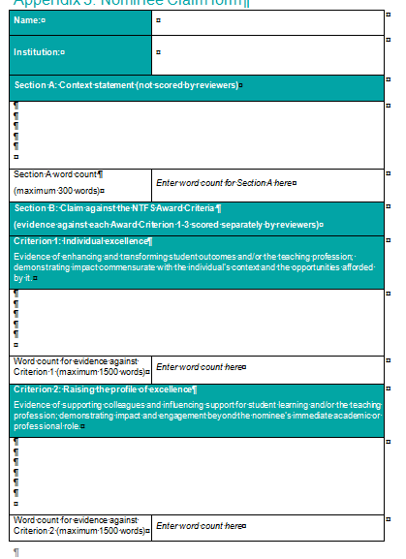
Use the Claim pro-forma
available in Advance HE VLE

Slide 22
Claim Section A: Context Statement

Slide 23
Section A: Context Statement (new in 2019)
The (new for 2019) Context Statement (max 300 words) enables reviewers to orientate themselves to the context of the nominee’s practice outside of the scoring section of the Claim;
Excellence in teaching and learning support will be situated within specific academic, professional and institutional contexts. Hence the nature of the institutional context and each individual nominee’s opportunity to contribute will be taken into account;
The scheme recognises impact and engagement beyond a nominee’s immediate academic or professional role. A nominee may, for example, have made a significant contribution to learning and teaching in an area that falls outside his/her substantive role.

Slide 24
Writing the Context Statement
Do use this section to articulate the explain the context of your institution and your professional role(s) and responsibility within it;
Do make clear the nature of your teaching and learning practice (e.g. types of learners, discipline/specialist area, outline of scope and scale of your practice);
Do include information about work in a previous institution/ work external to your institution if /where you are going to use evidence from this work within your Claim;
Do not include information that might constitute useful evidence against the award criteria (Section B) as the Context Statement is not scored.

Slide 25
Claim Section B: Nominee claim against the three NTFS award criteria

Slide 26
The three NTFS award criteria
Criterion 1: Individual excellence:
Evidence of enhancing and transforming student outcomes and/or the teaching profession: demonstrating impact commensurate with the individual’s context and the opportunities afforded by it.
Criterion 2: Raising the profile of excellence:
Evidence of supporting colleagues and influencing support for student learning and/or the teaching profession; demonstrating impact and engagement beyond the nominee’s immediate academic or professional role.
Criterion 3: Developing excellence:
Show the nominee’s commitment to and impact of ongoing professional development with regard to teaching and learning and/or learning support.

Slide 27
Making a ‘Claim’ in Section B
You need to include evidence of the reach, value and impact of your practice against the three NTFS award criteria in turn within Section B;
You should demonstrate impact on student outcomes and/or the teaching profession over a sustained period;
Possible sources of appropriate evidence (not restricted to):
student feedback and evaluations;
feedback from peer observations;
feedback from other national engagements;
student support materials;
work with other partner institutions and organisations;
quantitative data to indicate the scale, reach and impact of the your work.

Slide 28
Different styles/types of evidence
Individuals from various academic disciplines inevitably demonstrate different communication and analytical styles and this will be accounted for in the assessment process. As such there is no ‘style’ that is expected in applications and examples will be assessed and marked for their contribution to the criteria as a whole;
The decision of what constitutes appropriate evidence rests with the nominating institution and the individual nominee but nominees are encouraged to ensure that the student voice is explicit in their nomination;
Nominees should demonstrate that they are applying the principles of equality, diversity and inclusion to their practice.

Slide 29
Criterion 1: Individual excellence: Evidence of enhancing and transforming student outcomes and/or the teaching profession; demonstrating impact commensurate with the individual’s context and the opportunities afforded by it.
This may, for example, be demonstrated by providing evidence of the impact of:
stimulating students’ curiosity and interest in ways which inspire a commitment to learning;
organising and presenting high quality resources in accessible, coherent and imaginative ways which in turn clearly enhance students’ learning;
recognising and actively supporting the full diversity of student learning requirements;
drawing upon the outcomes of relevant research, scholarship and professional practice in ways which add value to teaching and students’ learning;
engaging with and contributing to the established literature or to the nominee’s own evidence base for teaching and learning.

Slide 30
Criterion 2: Raising the profile of excellence Evidence of supporting colleagues and influencing support for student learning and/or the teaching profession; demonstrating impact and engagement beyond the nominee’s immediate academic or professional role
This may, for example, be demonstrated by providing evidence of the impact of:
making outstanding contributions to colleagues’ professional development in relation to promoting and enhancing student learning;
contributing to departmental/faculty/institutional/national initiatives to facilitate students’ learning;
contributing to and/or supporting meaningful and positive change with respect to pedagogic practice, policy and/or procedure.

Slide 31
Criterion 3: Developing excellence Show the nominee’s commitment to and impact of ongoing professional development with regard to teaching and learning and/or learning support.
This may, for example, be demonstrated by providing evidence of the impact of:
on-going review and enhancement of individual professional practice;
engaging in professional development activities which enhance the nominee’s expertise in teaching and learning support;
specific contributions to enable significant improvements in students’ outcomes and/or experience.

Slide 32
Where is your impact felt?
Department?
Faculty?
Institution?
Regional?
National?
International?
Discipline/cross-discipline?
Professional bodies/wider sector?
And in these contexts, how does it explicitly relate to teaching and student learning?
How are you measuring/evaluating impact?

Slide 33
What types of evidence do you have that show impact?
Longitudinal?
Quantitative?
Qualitative?
Short, concise quotes from students, colleagues, others?
Scholarly, pedagogic evidence?
Improved student attainment results?
Improved student outcomes (e.g. retention, employability, etc.)?
Evidence of the impact of your practice/research/publications on the teaching and learning practices of others leading to enhanced student learning?

Slide 34
What kinds of evidence are convincing? (ANTF advice)
Anything that gives external validation to your claim, so that evidence of impact is supported rather than being mere assertion;
This is likely to involve raiding your ‘plaudits file’ for verbatim quotes demonstrating your excellence;
Possible use of evidence gathered from module evaluations, feedback forums, student comments, letters and emails;
Aim to collect a range of concise quotes from current and past students at different levels, past and current colleagues, managers, employers who take your students on placement, external examiners etc.
You don’t need to provide full detail of each originator of quotes: ‘former 2nd-year student’ ‘previous line-manager’, ‘employer of our graduates’ etc is sufficient detail.

Slide 35
Collecting and using evidence (ANTF advice)
Quantitative data can be really useful: it’s helpful to include statements such as ‘Over the past five years my student evaluations have averaged 80+ who said I was good or excellent, and this is higher than average within my department’;
You are not expected (or allowed) to provide supporting documentation but your own institution is expected to assure the validity of your application;
You should aim to match your evidence with the three criteria, so you can add quotes and data to each section.

Slide 36
You need to demonstrate scholarship and commitment to reflection (ANTF advice)
Your application should (we think) include reference to a handful of texts (books, journal articles etc) from which your educational philosophy and teaching approaches have derived;
The application, however, is all about you, so you need to use the first person singular and refer to your achievements rather than your teams’, (‘Shy bairns get nowt!’);
It’s helpful to include examples of where you’ve changed your practices in the light of experience or where your scholarship has guided you to change.

Slide 37
ANTF advice for people thinking of applying in future years:
If you are thinking of applying, it’s worth thinking about building your profile further over the next year or so;
Particularly think about the kinds of evidence you could produce of your impact under each of the three criteria;
Start collecting positive feedback from a range of stakeholders including students, peers, colleagues, line managers, external examiners and so on;
Keep yourself up-to-date by regularly scrutinising the Advance HE website for information.

Slide 38
Claim Section C: Reference List

Slide 39
Section C: Reference List
Purpose is to allow reviewers to find sources and to provide appropriate credit to an author who has inspired areas of the nominee’s practice evidenced in the Claim;
Excluded from the word count in 2019;
Not scored by reviewers;
Provide a list of references which you have drawn upon in your Claim;
Do not include any citations not directly referred to within the Claim.

Slide 40
Statement of Support

Slide 41
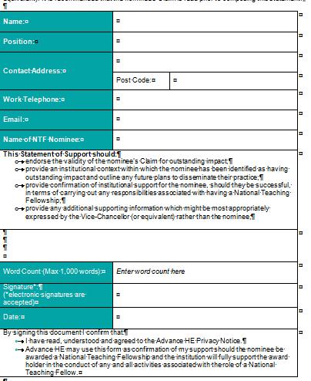
Signed Statement of Support:
A statement made and signed by your institution’s Vice Chancellor (or equivalent) using the downloadable pro-forma (max 1,000 words);
Purpose is to endorse the nominee’s claim from an institutional viewpoint. Provides complementary not supplementary information;
Recommended that the nominee’s Claim is read prior to composing the institutional supporting statement.

Slide 42
In particular, the statement should:
endorse the validity of the nominee’s Claim for outstanding impact;
provide an institutional context within which the nominee has been identified as having outstanding impact and outline any future plans to further disseminate their practice;
provide confirmation of institutional support for the nominee, should they be successful, in terms of carrying out any responsibilities associated with having a National Teaching Fellowship;
provide any additional supporting information which might be most appropriately expressed by the Vice-Chancellor (or equivalent) rather than the nominee;
provide the name, job title and signature of the VC (or equivalent).

Slide 43
Other nomination documents that must be submitted
Institutional Contact Checklist – confirmation that all parts of the nomination have been completed
Nomination form – online form completed by nominee and used for publicity relating to award winners
Photos – used for publicity
Equality monitoring form – online form completed by nominee; data used anonymously to monitor and report on equality and diversity.

Slide 44
The review process

Slide 45
Review of nominations
Nominations are considered by independent, external peer reviewers who will judge nominations against the three NTFS award criteria. No information other than the Claim and the signed Statement of Support will be provided to reviewers;
The reviewers are all experienced in criteria-based assessment and have undertaken Advance HE training before they review nominations;
All nominations are independently scored by three reviewers and a 10% sample is reviewed by a fourth reviewer as part of Advance HE’s Quality Assurance process;
Scores are allocated (0-5) by each reviewer to each of the three parts of Section B of the Claim.

Slide 46
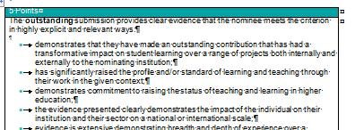
Reviewer scoring
In allocating scores to the evidence provided within Section B of the Claim, the reviewers will consider the following:
Reach - the scale of influence (department, faculty, institution, national, global)
Value - benefit derived for students and staff
Impact – the difference that has been made to policy, practice and/or student outcomes.
Reviewers are provided with the scoring profiles (p19-20 Advance HE NTFS 2019 guidance) to support them in differentiating between the possible scores (0-5) to be awarded to the evidence provided in Section B of the nominee Claim.

Slide 47
Scoring rubric and rankings
Reviewers use a scoring rubric (p21-22 Advance HE NTFS guidance) to ‘score’ each of the three parts to Section B of the nominee’s Claim against each of the three NTFS award criteria (i.e. an overall maximum score of 45 – up to 15 from each of the three reviewers)
Overall scores used to rank nominees
Additional algorithms and analysis of feedback used to determine final ranking
Results presented to UK Teaching Excellence Awards Advisory Panel (senior representatives from all four nations) in June 2019
Panel makes recommendations for award winners – ratified by Advance HE Chief Executive Group

Slide 48
Outcomes and publicity
All nominees will be informed of the outcome via email in w/c 15 July 2019. The Vice-Chancellor or equivalent will also be informed;
The announcement of NTFS winners is strictly embargoed until 5th August 2019. A condition of the competition is that nominees do not share news of their success before this date in order to ensure maximum publicity. Contravention of this requirement could lead to the award being revoked;
The names of the award winners will be officially announced on Advance HE’s website and in a press release.
ANTF advice: keep it under your hat!

Slide 49
Feedback
The NTFS is a competition (and attracts large numbers of nominations) and thus the Panel’s decision is final. No appeals can be made against the decision. Advance HE has a complaints procedure to address issues of fair treatment in the administration of nominations;
Following the publication of the outcome of the 2019 NTFS Award, Advance HE will issue individual written feedback to all nominees. Please note that this may take some time after the announcement of the outcome;
Reviewer scores and rankings will not be shared.

Slide 50
Award ceremony and briefing event
The individual awards will be presented at a celebratory dinner, to which successful nominees, their personal guest, and the Vice-Chancellor (or equivalent) will be invited.
All new National Teaching Fellows will also be invited to a briefing and networking event on the day of the award ceremony. The briefing and the ceremony will be held in October 2019 (date/venue to be confirmed).
ANTF advice: it’s a fabulous event: if you win, don’t miss it at any cost and the briefing provides great networking opportunities.

Slide 51
Further tips for success

Slide 52
Features of successful past Claims (NB these are not a tick list!)
Clearly defined context
Structured narrative
Use of different sources of evidence, considering reach, value and impact
Use of publications
Selective use of scholarly references, relevant to the nominee’s context and claim
Plain English
Clearly expressed, reflective narrative
Balance of both qualitative and quantitative evidence
Use of cross-references within the claim.

Slide 53
Going back in time, unsuccessful nominations often:
were not explicit in terms of addressing the criteria;
offered little in the way of explicit evidence to underpin claims of excellence;
lacked breadth or depth;
failed to make clear how the nominee’s practice was excellent and/or transformative;
focused on research rather than teaching and learning;
included details of work or projects that were in the early stages of implementation with little detail of evaluation or impact;
failed to give equal weighting to each of the three criteria or combined elements of different criteria into a single section.

Slide 54
Some common misconceptions about NTF applications:
NTF is only for experienced professionals (No, it is open to staff at all stages of their career including early career)
To be successful you need to have published (No, you can evidence impact without having done so)
An NTF needs to evidence that their practice is innovative or creative (No, some practices are indeed innovative in a particular context but assessing outstanding impact, doesn’t depend on an individual being innovative or indeed creative)
It is easier to get an NTF if you are using technology enhanced learning (No, some nominees are using TEL but others are not and having TEL doesn’t enhance a nominee’s chance of being successful)
NTFs need to have had international reach and impact (No, nominees can evidence high impact locally to be successful and this can be backed by the institutional support statement from the VC).

Slide 55
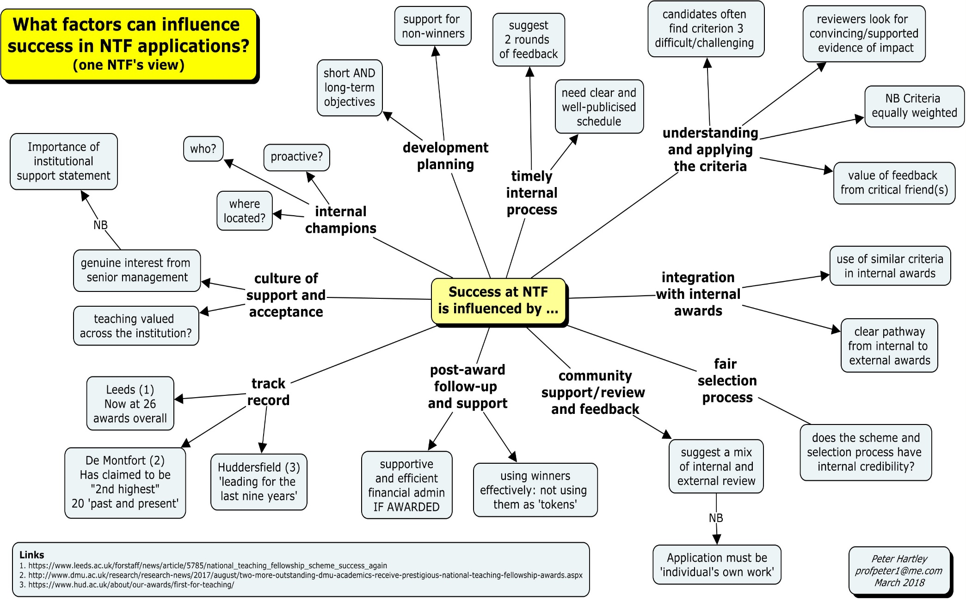

Slide 56
A reminder about what being an NTF could mean for you

Slide 57
Peter Hartley - NTF 2000, Education
The NTF changed my life – enabling me to gain a Professorship (Sheffield Hallam) and focus on educational development. This enabled my move to lead the Educational Development Unit at Bradford where we managed to influence institutional policy and bring in over one million pounds worth of project funding (HEA, Jisc) to investigate sector issues such as e-portfolios, student transitions, computer-aided assessment and assessment feedback, as well as being involved in two collaborative CETLs. I was Project Director on the PASS project, investigating programme assessment, and materials from this project are used by a number of universities to inform current plans. This project is continuing to develop post-funding, and we will have chapters in two new publications issued in 2018 (co-author with Ruth Whitfield from Bradford). Along with other initiatives which my NTF stimulated, this has enabled me to extend my career into semi-retirement.

Slide 58
Debbie Holley - NTF 2014, Digital Innovation
My NTF was of huge personal and professional benefit. It took three institutions and five attempts to finally gain this so much desired and valued award, and meeting the other NTFs in Liverpool Cathedral, and sharing the time with senior staff from my institution and my family was an evening I will never forget, as we walked across the candle lit walkway, pianist playing, to enjoy our meal together. No, it is not about financial award, it is about building community, having an expert body to reach out to for inspiration when times get tough and you have a deadline. It is about being welcomed in most universities across the UK, there is a kindred spirit who aims high and puts the students at the heart of learning.

Slide 59

Good luck! All these award winners were all once potential ‘nominees’ ………
Remember: refer closely to the Advance HE NTFS 2019 guidance as you prepare your nomination

