Slide 1
Applying to be a Fellow of the Higher Education Academy (FHEA), now part of Advance HE
Wednesday, 9th January 2019 from 1:00pm to 2:30pm Cork IT
Sally Brown NTF, PFHEA, SFSEDA
@ProfSallyBrown
sally@sally-brown.net
Emerita Professor, Leeds Beckett University
Visiting Professor: University of Plymouth, University of South Wales, Liverpool John Moores University and Edge Hill University

Slide 2
The basis of this workshop
Advance H E is the new name for the UK Higher Education Academy, formed by its merger with the Leadership Foundation and the Equalities Challenge Unit, and this session is all about helping those considering submitting an application to them for Associate Fellowship, Fellowship, Senior Fellowship or Principal Fellowship, depending on your role, your experience and your personal track record. This participative workshop is designed to:
explain the process by which you could do so;
help you decide which category is best for you;
explain what is meant by Areas of Activity, Core Knowledge and Professional Values, all of which you would need to evidence in your submission;
help you start drafting at least part of your application;
clarify where the UK scheme fits alongside the emergent Irish National Professional Development Framework.

Slide 3
Recognising and rewarding Professional Development: why should we do it?
Recognising and rewarding Professional Development in Higher Education is a matter of global concern, particularly given a strong focus on student-centred learning;
There is significant interest in not just helping those new to teaching in higher education become competent and confident, but also to ensure that practitioners retain currency not only in their subject areas but also in HE pedagogic approaches;
Many nations and HEIs also want to recognise outstanding achievement in supporting effective student learning, often in the form of Excellence Awards;
Many individuals are also keen to have their commitment to teaching recognised.

Slide 4
Recognising and rewarding Professional Development: how can it be done?
For most schemes, it is necessary for individuals to provide evidence against criteria within a framework in a variety of formats;
In some cases, completion of an accredited programme of study leads to recognition, other organisations require direct applications;
Some but not all accreditors require evidence of a commitment to specified values (which can be highly variable);
Some require/offer progression routes;
Many require ongoing CPD individuals to remain in good standing.

Slide 5

From Jason Elsom
(@Jason Elsom)

Slide 6
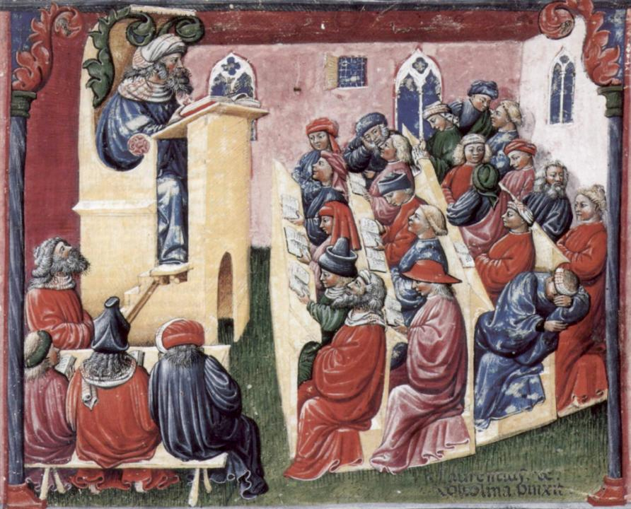
Laurentius de Voltolina
2nd half of 14th Century
Italian Painter

Slide 7
The Higher Education Academy Fellowship Scheme
With its origins in the ILTHE in 2000, the HEA now has almost 100,000 individuals from across the world who have achieved one of their four categories of Fellowship (Associate Fellowship, Fellowship, Senior Fellowship and Principal Fellowship);
It’s an evidence-based process that recognises achievement against the UK Professional Standards Framework, which is a sector devised/owned framework;
Each descriptor requires evidencing of the three dimensions, Areas of Activity, Core Knowledge and Professional Values;
While the UKPSF remains the foundation of the scheme, there has been some evolution within the HEA requirements;
Accredited PD courses can lead to the achieving of Associate/ Fellowships.

Slide 9
The UK Professional Standards Framework:
Supports the initial and continuing professional development of staff engaged in teaching and supporting learning;
Fosters dynamic approaches to teaching and learning through creativity, innovation and continuous development in diverse academic and/or professional settings;
Demonstrates to students and other stakeholders the professionalism that staff and institutions bring to teaching and support for student learning;
Acknowledges the variety and quality of teaching, learning and assessment practices that support and underpin student learning;
Facilitates individuals and institutions in gaining formal recognition for quality enhanced approaches to teaching and supporting learning, often as part of wider responsibilities that may include research and/or management activities.

Slide 10
Why might you want to become HEA-recognised? The HEA says:
It provides national recognition of your commitment to professionalism in teaching and learning in higher education;
It demonstrates that your practice is aligned with the UKPSF;
It provides an indicator of professional identity for higher education practitioners, including the entitlement to use post-nominal letters
AFHEA – Associate Fellow of the Higher Education Academy
FHEA – Fellow of the Higher Education Academy
SFHEA – Senior Fellow of the Higher Education Academy
PFHEA – Principal Fellow of the Higher Education Academy
It is a portable asset, that has UK-wide relevance and which is increasingly recognised by higher and further education institutions;
An increasing number of nations are also exploring HEA professional recognition.

Slide 11
And we say also because:
It’s a chance to gain recognition for the work you do teaching and supporting students;
Many advertised posts in UK and some international HEIs now specify HEA recognition as among the criteria for appointment;
Your institution gains benefits from being able to claim its staff are appropriately qualified and recognised and your achievement can be recoded as part of the institutional Key Information Set (KIS) data;
Your students are likely to be pleased to be taught by a nationally-recognised teacher.

Slide 12
Tricky issues for those applying for HEA fellowships
How do I know which level to apply for?
How can I compress everything I want to say into the word count on the application form?
Who are the best people for me to use as referees/advocates?
How current must my activities be to count in this application?

Slide 13
Self-review of teaching and supporting learning? What evidence demonstrates how well you:
teach in a variety of contexts including, for example lectures, seminars, field work, lab work, studio work, on-line teaching, doctoral supervision ……?
foster employability, provide inclusive learning environments, promote inter-cultural experiences….?
assess and give feedback to your students?
act as a mentor to colleagues?
use technology to support your teaching?
maintain your professional competence through CPD?
disseminate your good pedagogic practice through publications and conferences?
evaluate yourself in all of these roles?

Slide 14
What impact has professional development recognition had in the UK?
From the 1990s recognition of PD has been available to UK academics and supporters of student learning;
Take-up spread from modest origins: around half a dozen HEIs had courses for new lecturers in the 1990s and by 2005 all but a handful of UK HEIs ran courses themselves or made use of courses provided by other HEIs;
Since the establishment of the Higher Education Academy in 2005, many HEIs across the ‘mission groups’ have included such recognition among evidence for appointment and career progression;
Many (including me) argue that the integration of PD expectations has enhanced the pedagogic climate across the nation and made talking about T&L not just OK but cool!

Slide 15
The impact of the increasingly professionalised nature of HE in the UK
Whereas in the past training for research was seen as essential for academics, training for teaching was often seen as optional;
Our internal Performance Indicators and QAA nowadays expect or require both initial and ongoing CPD but this is not as yet a metric in our Teaching Excellence Framework;
Many universities now have career advancement routes up to Professorships for staff who focus their careers on teaching (but not all use them and there is a growing divide between those on ‘normal’ contracts and those on teaching-only contracts which are often regrettably perceived to be of lower status).

Slide 16
Processes available to encourage engagement with generic/discipline-specific CPD. We can advocate:
The take-up of formal, recognised Professional Development courses and programmes leading to professional recognition;
Making best use of institutional, discipline-specific and national/international conferences and workshops;
Engaging with live and virtual learning communities (including, for example, AMEE, AISHE, SEDA, ALDinHE, HERDSA, NF4EofT&LinHE, and how about #lthechat on Wednesday evenings 8-9 pm GMT?);
Working with (and being) mentors and buddies;
Undertaking dialogic peer review of teaching and other practices;
Systematic, team-based review processes;
Reflection and self-review.

Slide 17
So how can you make a start on applying for FHEA?
Go to https://www.advance-he.ac.uk/ then https://www.heacademy.ac.uk/ then https://www.heacademy.ac.uk/ukpsf then https://www.heacademy.ac.uk/individuals/fellowship then https://www.heacademy.ac.uk/individuals/fellowship#section-4 then https://www.heacademy.ac.uk/individuals/fellowship/application#section-2 to request an application pack
You need this https://www.heacademy.ac.uk/system/files/downloads/FHEA%20Guidance%20Notes%20for%20Applicants.pdf
It will cost you £400 if applying for direct entry from a non-subscribing institution

Slide 18
Your APP
The overall word count for the Fellow APP is 3,000 words + scholarly references. This is your combined evidence across the whole claim, working to 600 words per section. Throughout your application, the quality of reflection on and of your professional practice should be the focus of your narrative, rather than description.
It should be selective, relevant and personal, ensuring you address all dimensions of the UKPSF structured around the 5 Areas of Activity: you should incorporate relevant subject and pedagogic research and/or scholarship;
It is centred round a process of CPD which demonstrates your broad understanding of effective approaches to teaching and/or learning support.

Slide 19
Your referees
Your application must be supported by statements from two referees. The function of your referees is to provide an informed peer review of your eligibility for Fellowship using their knowledge of your work and the context in which you teach and/or support learning. The referees should be individuals who are in a position to comment and substantiate your record of effectiveness in relation to teaching, and the support of learning in higher education.
Referees are expected to comment directly on the content of your APP and will need to view your application to enable them to provide an effective reference. They should be provided with a copy of the Guidance Notes for Referees.
At least one of your references should either be a Fellow, Senior Fellow or Principal Fellow of the HEA, or an appropriate experienced member of staff working for a higher education institution. All referees need to be familiar with the UKPSF.

Slide 20
Fellowship: There are two main parts to your application:
An Account of Professional Practice (APP). In this account you should explain how you meet the requirements outlined in Descriptor 2 of the UK Professional Standards Framework.
Supporting statements from two referees who should be colleagues who are in a position to comment on your record of effectiveness in relation to teaching and the support of learning.
Your application also needs to be endorsed by a signatory who will confirm that your application has institutional approval.

Slide 21

Sambell, K, Brown, S and Graham, L. (2017) Professionalism in Practice: Key directions in higher education: Learning, Teaching and Assessment, Basingstoke: Palgrave-Macmillan.

Slide 22
The Irish National Professional Development Framework. Key underlying thinking:
The creation of such a framework has been a core strand in the National Forum’s work since its inception.
It is informed by parallel research findings on work for building digital capacity, on teaching for transitions and outcomes from the Learning Impact Awards;
Evaluation of excellent teaching must include listening to what students value.
The work is the subject of extensive cross-sectoral consultation and builds on snapshots of professional development across HEIs in all sectors for those who teach;
International perspectives are also being drawn upon.

Slide 23
Kennedy (2005 p 248) suggests nine models of professional development leading to increasing capacity for professional autonomy
Model of CPD | Purpose of model
The training model The award-bearing model The deficit model The cascade model | Transmission
The standards based model The coaching/mentoring model The community of practice model | Transitional
The action research model The transformative model | Transformative

Slide 24
Professional development
The Forum recognises the importance of both formal and informal activities which might include inter alia engaging with accredited modules/programmes, participating in workshops, presenting at conferences, and undertaking pedagogic research;
The levels in Kennedy's model are not mutually exclusive and a professional development model might recognise a range of activities across them;
What is crucial is the different purposes of these activities;
Central to the Forum’s vision for a national professional development framework for HE teachers is an understanding that ‘CPD nurtures the expert within’ rather than ‘filling empty vessels’.

Slide 25
Possible domains for a PD framework for teaching in higher education
Domain | Professional practice/skills | Professional knowledge | Professional values/ attributes
Examples | * Reflective practice * Integration of research, teaching and learning * Online pedagogy | * Theories of education * Scholarship of Teaching * Digital literacies | * Inclusive pedagogy * Commitment to Civic Engagement * Leadership

Slide 26
Developing 4 models for an Irish Framework
The Forum proposes that these routes and domains be established and agreed upon through national consultation with all stakeholders in higher education teaching: students, lecturers, administrators, policy bodies, disciplinary groups, teaching and learning networks.
Teaching is more than the acquisition of skills and that engagement with teaching over time is more complex than a linear progression from novice to expert.
Professional development frameworks can take a variety of formats, a linear model from novice to expert is the most familiar, its focus on skill acquisition/development falls short of encompassing the reflective and iterative nature of teaching.

Slide 27
Model 1: A linear model
Such a model takes practitioners in an arc from novice, through advanced beginner, to competent, proficient and finally expert;
Opportunities of such an approach are that it offers clear progression which is easy to interpret for those engaged, those assessing and those developing CPD activities, and by offering an ‘expert level’ potential prestige and motivation, as well as enabling accredited and non-accredited activities to be incorporated;
Challenges include a single pathway lacking flexibility which could be challenging to those with diverse career pathways, processes for remaining in good standing would need development, an implied progression of skills to be achieved which in turn implies stages of excellence in teaching, and the danger that once ‘Expert’ is achieved, there is no obvious further CPD.

Slide 28
Model 2 ‘Foundation to specialist’ and Model 3 ‘Staged’ to specialist
The second model implies a single entry foundation point, assuring baseline levels of expertise, followed by non-hierarchical specialist options enabling flexibility and opportunities for individuals to follow their own interests, but administrative burdens might be heavy and senior staff might not welcome the flatter hierarchy;
The third model combines the previous two, with flexible opportunities to develop specialist extension activities for those reaching Expert level.
In all cases Recognition of Prior Learning and how best to evidence remaining in good standing are issues for consideration.

Slide 29
Model 4: Central requirement leading to institutional implementation
This model offers flexibility for different institutions where, for example, one institution might require Induction and assert minimum of CPD engagement, another might expect participants to complete CPD activities over a two-year period, including a required Induction period and a third where there are Departmental CPD targets and flexible CPD provision;
This model would allow for institutional flexibility/freedom on how to meet national standards and minimises the need for central resources to monitor and evaluate the process, but its approach is one of monitoring, with a focus on assurance rather than enhancement, and on institutional quality rather than individual CPD, with one set of standards for the diversity of teaching roles and no evident career pathways.

Slide 30
Possible objectives for a national framework
Recognising teaching excellence, not just competence;
Providing accreditation to individuals committed to teaching and learning through a transparent system of recognition and assessment;
Enabling and assisting Departments, Schools and institutions to develop strategic approaches to PD and to build their reputations internationally as leaders in HE teaching;
Reflecting the HE sector’s public commitment to teaching excellence in all areas of Irish HE;
Supporting and guiding those who teach, and their HEIs to ensure teaching and learning within their contexts are characterised by internationally recognised excellence and rigour and impact.

Slide 31
The Irish PD framework should be:
Inclusive of diversity in recognising the variety of roles that contribute to teaching (including librarians, administrators, international officers etc), incorporating all stages of HE careers from entry to senior posts, accessible to the full range of HEI types and missions, accommodating of disciplinary statutory and professional bodies and recognising the diversity of teaching approaches and methods;
Clear in its aims, objectives and mechanisms and in communicating its implications to all stakeholders, transparent in its recognition and assessment processes and systems enabling of individualised PD pathways;
Sustainable in terms of resources, support and evaluation.

Slide 32
It should also be
Flexible in the face of changing contexts and practices and approaches to teaching and learning, recognising staff mobility across disciplines, roles, HEIs and countries and cognisant that staff already participate in disciplinary PD (e.g. nursing, engineering, law);
Research-informed by drawing on a deep understanding of scholarly research on teaching and learning, and informed by existing national surveys including the Irish Survey of Student Engagement;
Connected to practice and thereby capable of enhancing practice and having a demonstrable impact on practitioner experience.

Slide 33
Recognition of Professional Development for those who teach in diverse disciplines
A number of disciplines including Nursing, Midwifery and Health Studies have longstanding expectations of initial training in relation to HE teaching in the UK and elsewhere and expectations of CPD/remaining in good standing are sometimes involved;
Many PSRBs require regular CPD to remain in good standing, using for example, required numbers of CPD points annually e.g. Medicine and Law;
Many Disciplinary bodies hold teaching and learning strands or separate components within their main conferences, that focus on teaching and learning, e.g. Engineering, Psychology;
Some subject groupings e.g. STEM in the UK run their own disciplinary training for new lecturers e.g. via the HEA.

Slide 34
The role of Heads of Department and Heads of School in change management
HoDs and HoSs have a crucial role in helping their teams recognise the value of both initial and continuing PD re teaching, because they often make key decisions at a local level around matters like deployment and staffing. For example:
Should inexperienced or your most highly experienced teachers be concentrated in first year teaching?
What do you do about experienced staff who are demonstrably in need of support to help them be adequate at teaching?
How do you recognise and reward the crucial role of mentors for teaching and assessment?
How do you support colleagues supervising research degrees for the first time?

Slide 35
Challenges of implementing change and promulgating best practice
Colleagues won’t be keen to change their teaching and assessment practices and to undertake PD unless they can really see that what you are asking brings real benefits for students, and doesn’t result in massive additional work for them;
We can’t be successful if we rely on dictat or fiat, we need to use evidence-based scholarship to demonstrate that our suggested approaches can be highly successful, especially if we can demonstrate that these are being used well in other HEIs;
We may need to look hard at resourcing and deployment to ensure that requiring PD and CPD do not add to staff workloads inappropriately.

Slide 36
What have we got to help us lead effective change in terms of PD?
Workshops and collective sessions like those running today;
On-line and other published and virtual resources from HEIs where PD has been fully embedded;
Examples of good practice from across the sector in global nations.

Slide 37
Undertaking dialogic peer review of teaching and other practices? The purposes of peer review include:
providing us with opportunities, both through observing and being observed in teaching sessions, to reflect on and review our teaching skills with the assistance of our colleagues;
identifying good practice, and needs which we can address, to ensure our ongoing personal and professional development;
helping us to continue to learn from each other, towards developing shared understandings of best practices in assessment, learning and teaching;
giving us continuing opportunities to observe students as they learn in colleagues’ teaching sessions, and reflect on how we can enhance their learning in our own sessions;
allowing us to gain from mutually beneficial learning experiences through the processes of observing colleagues and being observed ourselves;
helping us to learn new tricks from one another (old colleagues learn much from new staff and they in turn can teach new colleagues old tricks!);
identifying generic development needs, to feed into ongoing and future staff development activities.

Slide 38
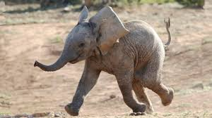
Team-based review processes can encourage us to ask:
How effective and fit-for-purpose is curriculum design for the current era?
How valid and reliable are our teaching, learning support and assessment systems and processes at genuinely reflecting student achievement?
How good are the university’s admin and technical systems at fostering a positive learning environment?
How committed is the university to offering thoughtful and inclusive student support environment?
How strong are the teams who undertake teaching, and who lead and manage universities?

Slide 39
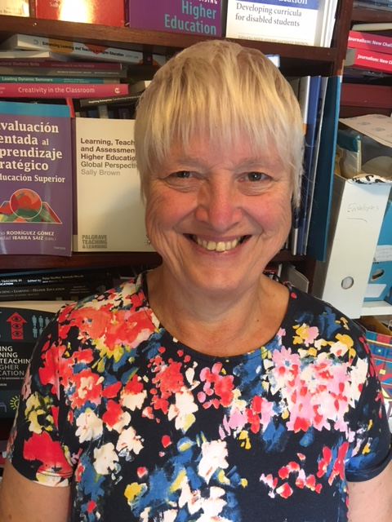
These and other slides are available on my website at http://sally-brown.net

Slide 40
Useful references and further reading
Bain, K. (2004) “What the best College Teachers do” Cambridge Harvard University Press
Biggs, J. and Tang, C. (2011) Teaching for Quality Learning at University, Maidenhead: Open University Press.
Brown, S. (2015) Learning , Teaching and Assessment in Higher Education: Global perspectives, London, Palgrave
Kennedy, A. (2005) ‘Models of Continuing Professional Development: A Framework for Analysis’. Journal of In-service Education, 31: 235–250. Available at: http://www.tandfonline.com/doi/ pdf/10.1080/13674580500200277 [Accessed January 2017].
McKeachie, W. J. (1951) Teaching Tips: Strategies, Research and Theory for College and University Teachers, Lexington MA: D. C. Heath and Company.
Meyer, J.H.F. and Land, R. (2003) ‘Threshold Concepts and Troublesome Knowledge 1 – Linkages to Ways of Thinking and Practising within the Disciplines’ in C. Rust (ed.) Improving Student Learning – Ten years on. Oxford: OCSLD.
The National Forum for the Enhancement of Teaching and Learning in Higher Education (2015) ‘Mapping professional Development Pathways’.
Race P. (2015) The lecturer’s toolkit (4th edition), London: Routledge.
Ramsden, P, (1991)A performance indicator of teaching quality in higher education: The Course Experience Questionnaire Studies in Higher Education Volume 16, 1991 – Issue 2
Sambell, K, Brown, S and Graham, L. (2017) Professionalism in Practice: Key directions in higher education: Learning, Teaching and Assessment, Basingstoke: Palgrave-Macmillan.
Yorke, M. (1999) Leaving Early: Undergraduate Non-completion in Higher Education, London: Routledge.

