Slide 1
Dialogues on assessment for learning: opportunities and challenges
University of Padua 13 November 2018
15.30-16.30
Phil Race, Kay Sambell and Sally Brown
Phil: 1: Assessment as learning.
Kay: 2: Authentic assessment tasks
Sally: 3: Assessment Design for Learning

Slide 2
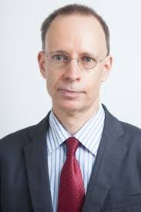

Assessment as learning
The danger with traditional methods of assessment and feedback is that assessment tends to be done on student’s work by staff, and feedback tends to be one-directional from staff to students.
Carless and Boud (2018) stress that we want students to gain skills in making ‘evaluative judgements’ themselves on their work, rather than staff doing this.
David Carless & David Boud (2018): The development of student feedback literacy: enabling uptake of feedback, Assessment & Evaluation in Higher Education, https://doi.org/10.1080/02602938.2018.1463354

Slide 3
We need to open the ‘black box’ of assessment to students
Students often don’t know how it works, and may guess wrongly.
The best way to let students into the assessment process is to use our face-to-face time with them to lead them through assessing:
  Their own work
  Each other’s work
  Good, bad and in-between examples we give them to assess

Slide 4
Seven factors underpinning successful learning: (Race, 2015)
Verbalising
Assessing
Feedback
Making sense
Doing
Wanting/
Needing
Race, P. (2015) The Lecturer’s Toolkit, 4th Edition: Chapter 1 (Routledge)

Slide 5

Seven factors underpinning successful learning (#rracw, 2015)
Verbalising
Assessing
Feedback
Making sense
Doing
Wanting/
Needing

Slide 6
Getting students applying criteria
When they use assessment criteria to make evaluative judgements on work, they internalise the criteria much more deeply than when we just explain the criteria to them.
Even better, we can get students themselves to design assessment criteria, and refine them by discussing them with each other.
When students design criteria, they build a feeling of ‘ownership’ of the processes of assessing.

Slide 7


We can’t carry on trying to use traditional assessment and feedback processes
We can’t continue trying to give students lots of feedback in traditional ways, as there are more students, and research shows that merely ‘telling’ them what to do with their work does not work.
There is now a great deal of work on ‘contract cheating’, for example Newton, P. (2018) https://www.frontiersin.org/articles/10.3389/feduc.2018.00067/full
And traditional written feedback doesn’t work: “Approaches that emphasise feedback as telling are insufficient because students are often not equipped to decode or act on statements satisfactorily, so key messages remain invisible” (Sadler 2010).

Slide 8
Factors underpinning feedback literacy
Carless and Boud (2018) examine in detail:
Appreciating feedback
Making judgements
Managing affect
Taking action
We need to enable our students to optimise each of these processes, if we wish to use assessment to promote their learning. They suggest that involving students in giving and receiving peer feedback, and in analysing exemplars, should be essential parts of the curriculum.

Slide 9
Kay’s response to Phil
It can be incredibly useful and efficient to introduce students systematically to developing their feedback literacy in the first year
Research conducted with our own students revealed that dialogic analysis of samples of formative writing about a threshold concept helped students appreciate the feedback process by enabling them to learn to
  Make judgements (52% out of alignment)
  Manage affect (persistence, learning goals)
  Take action
  “When we discussed the task in class I realised that what I had written didn’t focus on the question! It was this that made me read around the subject more.”
Notes:
Recognise own role in feedback processes: “Once I’d realised I could give feedback and I knew how, then I was like “Yeah, look at mine and I’ll look at yours.” And then we swapped. There was no way she was looking at it before I’d done that! You know, once we’d got into the process of marking someone else’s.”
Make judgments: 52% out of alignment with tutors: caused them to reflect (on learning goals and own learning strategies)
Manage affect: “What was a nice surprise was that they’re.. looking for merit, not to pull it to shreds. So I was, come on, just get going.
“So we felt more comfortable and we thought: well it’s not impossible. We are going to get there in the end.”
Take action: “When we discussed the task in class I realised that what I had written didn’t focus on the question! It was this that made me read around the subject more.”

Slide 10
Sally’s responses to Phil: Involving students in their own and each other’s assessment
We can involve students in a spectrum of activities including:
self- and peer- review, especially where correct answers can be supplied;
Self- and peer-evaluation, where students make judgments about the quality of the work presented;
Self- and peer-assessment, where the marks given count towards a summative outcome;
Students can assess students in other groups (intra-peer assessment and their own group (inter-peer assessment);
All these activities can help students become better at judging the quality of their own work during its actual production.

Slide 11
Authentic assessment tasks
Prof Kay Sambell
Edinburgh Napier University
Dialogues on assessment for learning: strengths and challenges.
University of Padova,
November 13th-14th 2018
Notes:
Kay will lead on theme 2: Authentic assessment tasks
(Max 5 slides on how lots of students see tasks as hurdles, just about getting marks/surface learning. More productive ways of designing tasks as being valuable in longer term and prompting deep learning.)
Phil’s response- this approach avoids contract cheating
Sally- authenticity helps employability
A major concern of AfL is not only to support student success within the university, but also to promote approaches to learning and dispositions which, in the longer term, prioritize the development of autonomous individuals who are well-equipped to navigate the complexities of an ever-changing future world (Mclean, 2018).

Slide 12


Some problems: tradition of viewing summative assessment as a necessary evil
“Normal assignments have no audience. I don’t know what happens when they go in: they get read and they get sent back.”
“Summative bad/formative good” (Carver and Wilder, 2018)
Notes:
Sts’ views of backwash
-All about being measured
Performance goals rather than learning goals
Alienation rather than egt
Widespread assumptions of AfL as being ‘just’ about formative assessment- without altering summative tasks

Slide 13
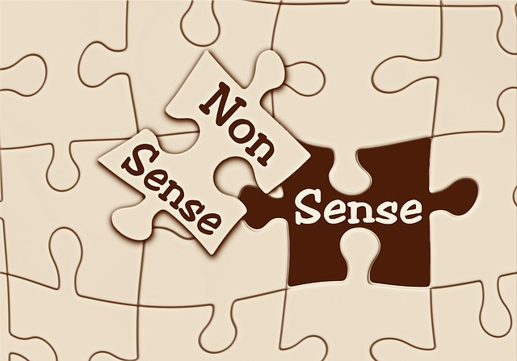

Authentic assessments: a key strength in promoting learning-oriented approaches
(Villaroel et al, 2018)
Productive assessment tasks, which students view as meaningful or relevant beyond ‘being marked,’ are a major feature of effective AfL environments
Notes:
Authenticity is a key characteristic of assessment that promotes learning
-it aims to replicate the tasks and performance standards typically found in the world of work
-has a positive impact on student learning, autonomy,
motivation, self-regulation and metacognition; abilities highly related to
employability.
(Villaroel et al, 2018)
Emphasizes authenticity and complexity in the content and methods of assessment rather than reproduction of knowledge and reductive measurement
Uses high stakes summative assessment rigorously but sparingly rather than as the main driver for learning

Slide 14


Students receive powerful backwash messages from authentic assessment tasks
[With this] you have to see for yourself. Make decisions. You’ve got some..techniques and you have to think about whether you use them or not, and what kind. I think that’s what you have to do in your job. The boss doesn’t come and say ‘Come on, I will now explain to you how to do this.’ You just have to find out how to do it. And so I think it’s more helpful for reality.”
“We definitely discovered working together you’re giving so much more. You’re pulling things out of each other you didn’t realise you had!”
Notes:
In CETL AfL emphasis was placed on collaborative activities to draw upon the social learning potential of the student group and to limit both demands and dependence upon the lecturer to ‘deliver’ feedback, fostering autonomous learning within a community. This was supported by a strong move away from ‘traditional’ end-point summative assessment formats (such as the essay and the time-constrained exam) to more authentic project-based assignments that allowed a degree of personalisation and choice within given parameters. Students worked on these assignments in a staged way during each module and the self and peer review activities were used to support students’ progress with developmental formative tasks.
Sense of authenticity relates to the general sense of the overall realism (Villarroel et al, 2017) that the AfL environment appeared to afford to the engineers. This realism was embodied by the authenticity of the problem-solving assignment

Slide 15
Key challenge: creating authentic assessment tasks in courses not tightly tied to a vocational area
Davison (2011) explored students' ‘definitions’:
  Authentic to the subject or discipline – “doing this I feel like a real [sociologist/historian..]”
  Authentic to the real world – “when you’re walking about you notice things and you can put them in to your work. You see how your subject applies to everyday life.”
  Authentic to personal interests – “when you’re following your interests you’re more keen and you can get to feel like an expert”
  Authentic in process – “It’s more realistic to pool your ideas as a group.”

Slide 16
Different ways of framing authenticity
Burton (2011) cautions against overly focusing on workplace as may not be relevant in future:
“a relative notion contingent on what happens in practice, which varies across disciplines”
May link to citizenship (McClean, 2017),
Ways of Thinking and Practicing (Meyer & Land, 2005)
Research cultures/cultures of inquiry (Fung, 2017)
Critical thinking, information literacy, working with ‘messy’ knowledge in practice (Burton, 2011)
Personal constructions (Davison, 2011)
Notes:
Burton, K. “A Framework for Determining the Authenticity of Assessment Tasks: Applied to an Example in
Law” (2011) 4(2) Journal of Learning Design 20, pp. 20–21.
Mclean, H. (2018). This is the way to teach: Insights from academics and students about assessment that supports learning. Assessment & Evaluation in Higher Education, 1-13.
Fung, Dilly. (2017). A Connected Curriculum for Higher Education. UCL Press.
Davison, Gillian (2011) Investigating the Relationships Between Authentic
Assessment and the Development of Learner Autonomy. Doctoral thesis, Northumbria
University.

Slide 17
Sally’s responses to Kay: Do your assignments prepare students to answer interview questions?
Can you tell us about an occasion when:
you worked together with colleagues in a group to produce a collective outcome;
you had to work autonomously with incomplete information and self-derived data sources;
you developed strategies to solve real life problems and tested them out;
you had a leadership role in a team, and could you tell us your strategies to influence and persuade your colleagues to achieve a collective task;
you had to communicate outcomes from your project work orally, in writing, through social media and/or through a visual medium?

Slide 18
Phil’s response to Kay
Authentic assessment brings the following benefits to students:
Students can see the point, and how it links not just to the subject content, but to the world outside the course.
Students feel a greater sense of ownership of the assessment, and invest more in it.
They can then derive more value from feedback on authentic assessment tasks.

Slide 19
Assessment Design for Learning
University of Padua 13 November 2018
Sally Brown NTF, PFHEA, SFSEDA
@ProfSallyBrown
http://sally-brown.net
Emerita Professor, Leeds Beckett University
Visiting Professor: University of Plymouth, University of South Wales, Edge Hill University & Liverpool John Moores University.

Slide 20
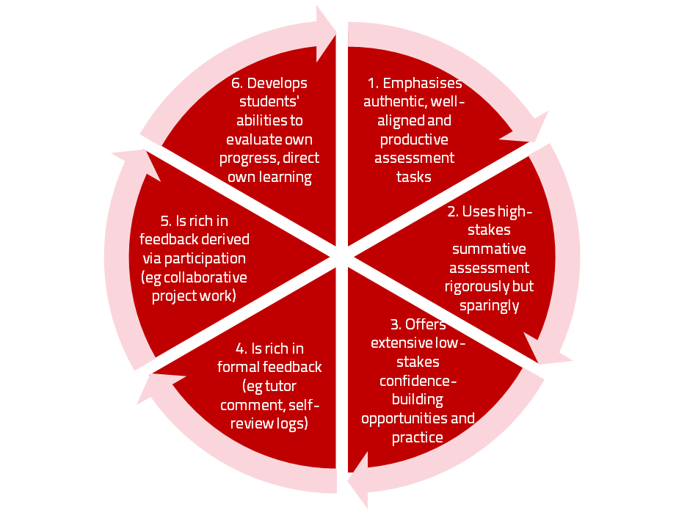
AfL the Northumbria model

Slide 21
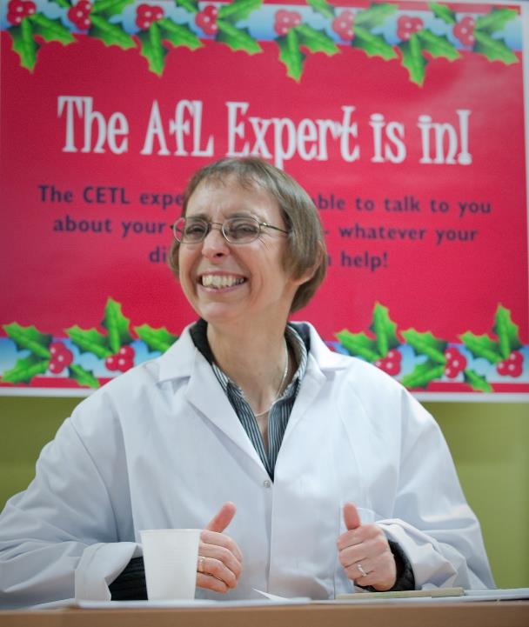

Slide 22
Underpinning premises
Assessment can be a powerful means of focusing student effort and enhancing achievement if it is well designed and constructively aligned (Biggs and Tang, 2011);
We need to deploy a diverse range of tactics to our assessment and feedback to ensure that they work to enhance and extend student learning;
Assessment needs to be manageable for staff and students if it is going to engage students in learning activities, which requires a systematic overview of tasks;
We need to design assessment strategies at programme-level rather than module by module.

Slide 23
Peter Hartley’s NTFS Bradford-led project on Programme Level Assessment sets out to redress problems including:
not assessing learning outcomes holistically at a programme level;
the atomisation of assessment, often resulting in too much summative and not enough formative feedback and over-standardisation in regulations.
This results in students and staff failing to see the links between disparate elements of the programme, over-assessment and multiple assignments using repetitive formats. Modules were often too short for complex learning and this tended to lead to surface learning and ‘tick-box’ mentality.
http://www.pass.brad.ac.uk/position-paper.pdf

Slide 24
Potential benefits of Programme Focused Assessment include:
Integrated learning and assessment at the meta-level, ensuring assessment of programme outcomes;
Students taking a deep approach to their learning.
Increased self and peer-assessment, developing assessment literacy.
Greater responsibility of the student for their learning and assessment, developing self-regulated learners.
Reduced summative assessment workload for staff.
Possible greater opportunity to allow for ‘slow-learning’.

Slide 25
To better engage learners through feedback and assessment we can:
Make use of real examples and hot-off-the-press data to keep content and tasks current and relevant;
Provide challenges to students’ thinking without letting individuals feel publicly exposed or humiliated;
Relate their learning in class to the forthcoming/ongoing assignment (without slavishly teaching to the exam);
Make spaces for dialogue through formative assessment;
Give them real problems to solve and issues with which to engage;
Identify the skills they need to succeed and provide opportunities to rehearse and develop them;
Never compromise on the quality of the demands we make of them.

Slide 26
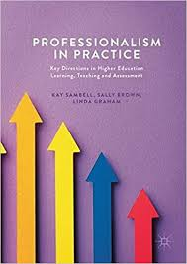
Sambell, K, Brown, S and Graham, L. (2017) Professionalism in Practice: Key directions in higher education: Learning, Teaching and Assessment, Basingstoke: Palgrave-Macmillan.

Slide 27
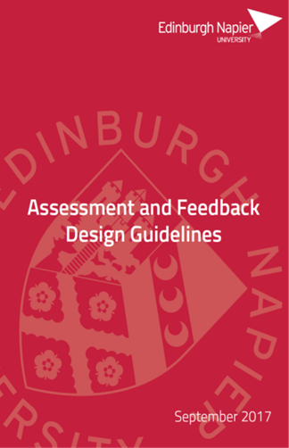

Kay’s response to Sally
Designing assessment and feedback with a programme-focus
Opportunities
Challenges
Encouraging teams to think holistically about assessment and feedback design issues
  Considering balance and sequencing of summative and formative activities
  Focusing attention on ‘future horizons’ of feedback/feedforward
Culture shifts: module silos, ownership, assessment ‘arms race’ (Harland et al, 2015)
Scale
Notes:
Designing assessment within a Programme Focus
Programme Leaders and programme teams should consider assessment and feedback holistically from a student perspective.
Think about the cumulative effect of the individual assessment tasks and feedback at module level across a student’s programme of study, looking at how and when assessment and feedback occur.
Consider the balance of a student’s assessment workload, including bunching of deadlines, variety of assessment tasks and opportunities for students’ engagement with feedback (and feedforward) across a level of study and across years.
Give consideration to the balance of formative work and summative assessment and the balance and sequencing of assessment types across the programme, such that students are enabled progressively to master required skills, learn from feedback and demonstrate all the intended learning outcomes.
Review how modules build on each other and align effectively to demonstrate appropriate outcomes, and develop appropriate learning and graduate attributes.
Within modules, consider the ways in which students will be supported to gauge the progress they’re making towards the learning outcomes, understand assessment criteria and standards and develop and improve their learning as the module unfolds.
Harland, Tony, McLean, Angela, Wass, Rob, Miller, Ellen, & Sim, Kwong Nui. (2015). An Assessment Arms Race and Its Fallout: High-Stakes Grading and the Case for Slow Scholarship. Assessment & Evaluation in Higher Education, 40(4), 528-541.

Slide 28
Phil’s response to Sally
Making assessment really work for learning requires face-to-face time, or online dialogue with students.
Rather than fill teaching time with content, we need to give them the content quite quickly, then spend teaching time explaining it, discussing it and answering their questions.
We also need to find out from students what they already know about the subject content, and build on this whenever possible.
When face-to-face time has high learning payoff for students, they are more likely to attend and be attentive.

Slide 29
References and further reading: 1
Biggs, J. and Tang, C. (2011) Teaching for Quality Learning at University, Maidenhead: Open University Press.
Bloxham, S. and Boyd, P. (2007) Developing effective assessment in higher education: a practical guide, Maidenhead, Open University Press.
Boud, D. and Associates (2010) Assessment 2020: seven propositions for assessment reform in higher education Sydney: Australian Learning and Teaching Council.
Brown, S. (2014) Learning, teaching and assessment in higher education: global perspectives. London: Palgrave Macmillan.
Brown, S. and Race, P. (2012) Using effective assessment to promote learning in Hunt, L. and Chambers, D. (2012) University Teaching in Focus, Victoria, Australia, Acer Press. P74-91
Burton, K. A Framework for Determining the Authenticity of Assessment Tasks: Applied to an Example in Law (2011) 4(2) Journal of Learning Design 20, pp. 20–21.
Carless, D. and Boud, D. (2018) The development of student feedback literacy: enabling uptake of feedback, Assessment & Evaluation in Higher Education, https://doi.org/10.1080/02602938.2018.1463354

Slide 30
References and further reading: 2
Carless, D., Joughin, G., Ngar-Fun Liu et al (2006) How Assessment supports learning: Learning orientated assessment in action Hong Kong: Hong Kong University Press.
Carver, M., & Wilder, K. (2018). Book review of Excellence in university assessment: Learning from award-winning practice. Assessment & Evaluation in Higher Education, 43(2), 339-340.
Davison, Gillian (2011) Investigating the Relationships Between Authentic Assessment and the Development of Learner Autonomy. Doctoral thesis, Northumbria University.
Fung, Dilly. (2017). A Connected Curriculum for Higher Education. London: UCL Press.
Gibbs, G. (1999) Using assessment strategically to change the way students learn, in Brown S. & Glasner, A. (eds.), Assessment Matters in Higher Education: Choosing and Using Diverse Approaches, Maidenhead: SRHE/Open University Press.
Harland, Tony, McLean, Angela, Wass, Rob, Miller, Ellen, & Sim, Kwong Nui. (2015). An Assessment Arms Race and Its Fallout: High-Stakes Grading and the Case for Slow Scholarship. Assessment & Evaluation in Higher Education, 40(4), 528-541.

Slide 31
References and further reading: 3
Hartley, P. PASS project Bradford http://www.pass.brad.ac.uk/ http://www.pass.brad.ac.uk/position-paper.pdf
Higher Education Academy (2012) A marked improvement; transforming assessment in higher education, York: HEA.
Mclean, H. (2018). This is the way to teach: Insights from academics and students about assessment that supports learning. Assessment & Evaluation in Higher Education, 1-13.
Newton, P. (2018) https://www.frontiersin.org/articles/10.3389/feduc.2018.00067/full
Race, P. (2015) The Lecturer’s Toolkit, 4th Edition: Chapter 1 (Routledge)
Sadler, D. R., (2010) Beyond feedback: Developing student capability in complex appraisal. Assessment & Evaluation in Higher Education, 35(5), pp.535-550.
Sambell, K, Brown, S and Graham, L. (2017) Professionalism in Practice: Key directions in higher education: Learning, Teaching and Assessment, Basingstoke: Palgrave-Macmillan.

Slide 32
References and further reading: 4
Sambell, Kay. 2016 Assessment and feedback in higher education: considerable room for improvement? Student Engagement in Higher Education Journal, [S.l.], 1, (1). ISSN 2399-1836. Available at:https://journals.gre.ac.uk/index.php/raise/article/view/392/350
Villarroel, Verónica, Bloxham, Susan, Bruna, Daniela, Bruna, Carola, & Herrera-Seda, Constanza. (2018). Authentic assessment: Creating a blueprint for course design. Assessment & Evaluation in Higher Education, 43(5), 840-854.

