Slide 1
Making a difference through assessment
ABMS Academy day
4th July 2018
Sally Brown NTF, PFHEA, SFSEDA
@ProfSallyBrown
http://sally-brown.net
Emerita Professor, Leeds Beckett University
Visiting Professor: University of Plymouth, University of South Wales, Edge Hill University & Liverpool John Moores University.

Slide 2
The purpose of the keynote today
Sometimes a fresh look at our current practices is needed to make sure assessment is for rather than just of learning, with students learning while they are being assessed rather than it being merely a summative end process.
We also need to ensure that we provide explicit and implicit messages to students and indeed all other stakeholders about how we assess.
This session is all about thinking through how effective are our assessment approaches and how we can make them really impact on learning

Slide 3
Enhancing Assessment and Feedback to improve student engagement and achievement
Effective assessment is crucial for student satisfaction and achievement. This session will explore how we can review and revise our assessment approaches so that students have the best possible chance of success, particularly by:
building students' assessment literacy and thereby enabling them better to understand how criteria and assessment practices work;
ensuring that assessment is for not just of learning;
fostering approaches to feedback that mean students take good note of and use the comments and advice provided by their assessors.

Slide 4
Underpinning premises
Assessment can be a powerful means of focusing student effort and enhancing achievement if it is well designed and constructively aligned (Biggs and Tang, 2011);
We need to deploy a diverse range of tactics to our assessment and feedback to ensure that they work to enhance and extend student learning;
Students need to achieve assessment literacy to ensure they understand and can benefit from our assessment systems;
Assessment needs to be manageable for staff and students if it is going to engage students in learning activities.

Slide 6
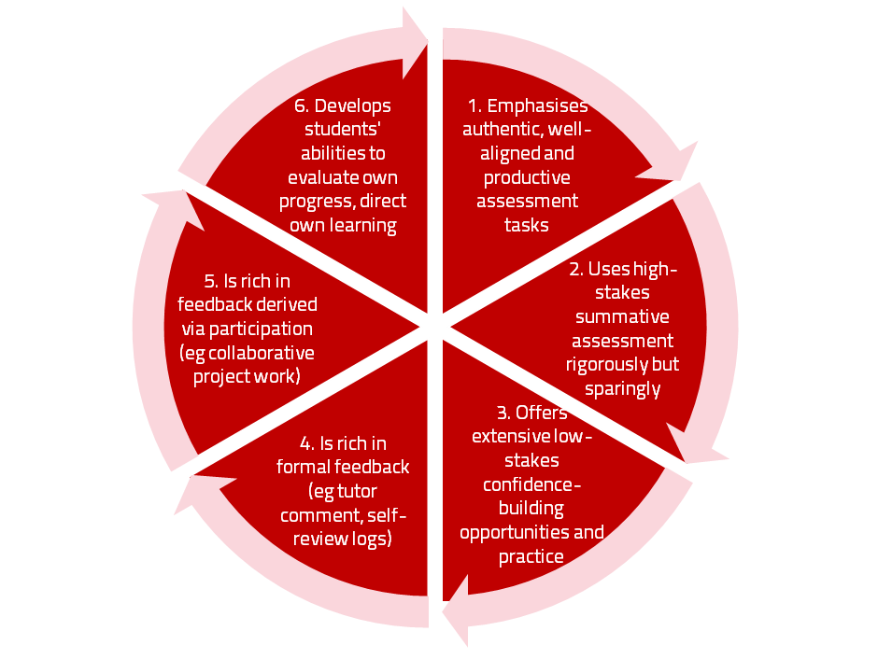
A4L the Northumbria model

Slide 7
Using assessment for learning (Sambell et al, 2012)
Assessment that is meaningful to students can provide them with a framework for activity;
“Students can escape bad teaching but they can’t escape bad assessment” (Boud, 1995);
Where assessment is fully part of the learning process and integrated within it, the act of being assessed can help students to make sense of their learning;
Assessment should be formative, informative, developmental and remediable.

Slide 8
Formative and summative assessment
Formative assessment is primarily concerned with feedback aimed at prompting improvement, is often continuous and usually involves words.
Summative assessment is concerned with making evaluative judgments, is often end point and involves numbers.

Slide 9
The importance of dialogic feedback (Sadler)
Students need to be exposed to, and gain experience in making judgements about, a variety of works of different quality... They need planned rather than random exposure to exemplars, and experience in making judgements about quality. They need to create verbalised rationales and accounts of how various works could have been done better. Finally, they need to engage in evaluative conversations with teachers and other students.

Slide 10
Assessment literacy: students do better if they can:
Make sense of key terms such as criteria, weightings, and level;
Encounter a variety of assessment methods (e.g. presentations, portfolios, posters, assessed web participation, practicals, vivas etc) and get practice in using them;
Be strategic in their behaviours, putting more work into aspects of an assignment with high weightings, interrogating criteria to find out what is really required and so on;
Gain clarity on how the assessment regulations work in their HEI, including issues concerning submission, resubmission, pass marks, condonement etc.

Slide 11
Students tend to be more convinced about the fairness of the assessment process if
Requirements and procedures are transparent and made readily available to them;
They believe that the tasks they are asked to do are worthwhile and are closely linked to what course documentation indicates they should be able to know and do at the end of the programme i.e. authentic assessment;
They fully understand the ‘rules of the game’.

Slide 12
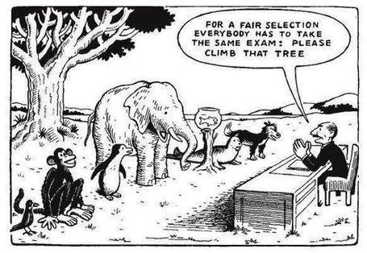

Slide 13
Aspects of fairness:
Thinking about the students you teach, consider particular constituencies who might be discriminated against by different elements of your assessment, and think through some reasonable adjustments.

Slide 14
Assessment for learning: some useful thoughts
1. Tasks should be challenging, demanding higher order learning and integration of knowledge learned in both the university and other contexts;
2. Learning and assessment should be integrated, assessment should not come at the end of learning but should be part of the learning process;
3. Students are involved in self assessment and reflection on their learning, they are involved in judging performance;
4. Assessment should encourage metacognition, promoting thinking about the learning process not just the learning outcomes;
5. Assessment should have a formative function, providing ‘feedforward’ for future learning which can be acted upon. There is opportunity and a safe context for students to expose problems with their study and get help; there should be an opportunity for dialogue about students’ work;

Slide 15
Assessment for learning
6. Assessment expectations should be made visible to students as far as possible;
7. Tasks should involve the active engagement of students developing the capacity to find things out for themselves and learn independently;
8. Tasks should be authentic; worthwhile, relevant and offering students some level of control over their work;
9. Tasks are fit for purpose and align with important learning outcomes;
10. Assessment should be used to evaluate teaching as well as student learning.
(Bloxham and Boyd)

Slide 17
Ensuring assessment focuses efforts and promotes engagement means including reference to:
methodologies: which methods and approaches are most appropriate and efficient for the arts and design context?
agency: who should be undertaking assessment? Tutors, peers, students themselves, employers and clients can all participate in student assessment to good effect, but which is right for particular assessment activities?
timing: end point and continuous assessment can both be valuable, when should we assess students to maximise impact on student learning?
orientation: to what extent in each task would we wish to focus particularly on process or outcomes, or both?
inclusivity: how can we enable all students to achieve their highest personal potential?
efficiency: what can we do to make assessment fully embedded in learning for students?

Slide 18
Making a difference through assessment: to what extent does your assessment strategy:
Work at a programme level, rather than having assessment occur in module-shaped silos?
Maximise fast, formative feedback opportunities without driving your markers into the ground?
Support student transition and retention by making assessment integral to learning?
Enable the development of digital literacy by providing tasks that use social and digital media?
Make the process of assessing and being assessed enjoyable for staff and students?
Subject or professional body benchmarks?

Slide 19
Authentic assessment: what are the principal benefits for stakeholders?
Students undertaking authentic assessments tend to be more fully engaged in learning and hence tend to achieve more highly because they see the sense of what they are doing (Sadler, 2005).
University teachers adopting authentic approaches can use realistic and live contexts within which to frame assessment tasks, which help to make theoretical elements of the course come to life.
Employers value students who can quickly engage in real-life tasks immediately on employment, having practiced and developed relevant skills and competences through their assignments.

Slide 20
Wiggins (1990) says assessment can be regarded as authentic if we can draw valid inferences about quality from the work students produce
He proposes that we should aim to offer students assignments that present the student with the full array of tasks that mirror the priorities and challenges found in the best [teaching] activities and that attend to whether the student can craft polished, thorough and justifiable answers, performances or products.
He says they must involve students being able to cope with potentially ill-structured challenges and roles, with incomplete information, that help them rehearse for the complex ambiguities of adult and professional life.

Slide 21
We often assess what is easy to assess, or proxies of what’s been learned, rather than the learning itself
A valid assessment is one that has close relevance to the criteria, which are in turn constructively aligned to the stated learning outcomes of a programme.
Effective assessment is highly relevant to ensuring that graduates can demonstrate the knowledge, behaviours, qualities and attributes that were described in the course outline or programme specification.
Assignments that require students to write about something, rather than be or do something, may not always be fit-for-purpose.

Slide 22
How can authentic assessment engage students?
Using types of assessment that are much more like the ‘real things’ that academics or professionals do in their chosen fields can engage students in much more meaningful ways.
A useful way to help you ascertain how authentic your assessment is could be to ask yourself where in the programme you help students answer questions in job interviews (Sambell, Brown and Graham, 2017)

Slide 23
Questions employers might ask at interview that might help us frame some of our assignments
Can you tell us about an occasion when:
you worked together with colleagues in a group to produce a collective outcome;
you had to work autonomously with incomplete information and self-derived data sources;
you developed strategies to solve real life problems and tested them out;
you has a leadership role in a team, and could you tell us your strategies to influence and persuade your colleagues to achieve a collective task;
you had to communicate outcomes from your project work orally, in writing, through social media and/or through a visual medium?"

Slide 24
Review practice: what can we do to build authenticity in to our assessment?
We need to design assignments that stretch students beyond mechanistic tasks and make assessment fully integral to the learning experience (Sambell et al, 2012). Such authentic assignments and activities could include:
Action-orientated tasks, that are underpinned by relevant evidence-based scholarship and where students are learning by doing (Race, 2014);
Ones that are truly representative of student effort, maximising time-on-task, with marks reflecting the achievement of learning outcomes specified in the programme outlines and which are coherent, constructively aligned (Biggs and Tang, 2011) and challenging;
Processes that are nuanced, clearly articulated and transparent in demonstrating the way that decisions are reached on assessment grades (QAA, 2014);
Assessment strategies that work at a programme rather than a module level (McDowell, 2012)

Slide 25
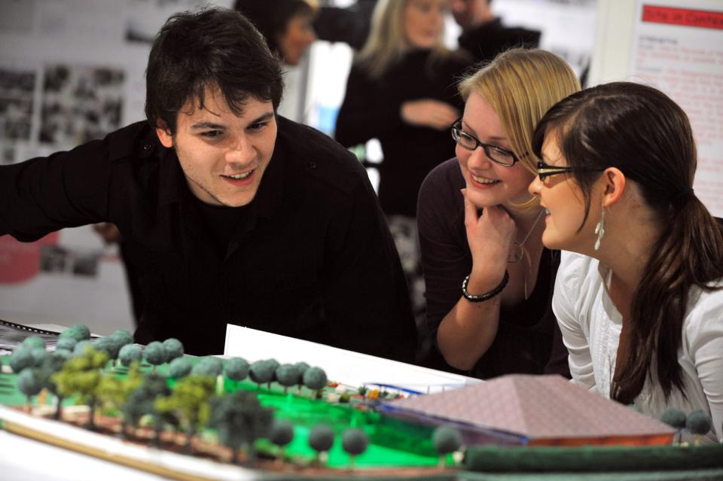
Working together interactively

Slide 26
Assessment must engage students in active tasks, e.g.:
Studio critiques
Simulations
Multiple choice questions in class
Oral report (individual or group)
Business/Elevator pitches
Case studies
Annotated bibliographies
Executive summaries
Performances
Artefacts e.g. Paintings, sculptures, engineering drawings
Objective structured clinical exams (OSCEs)
Conference presentations
student-led and managed conferences
Action plans
Reports
Portfolios
Live projects
Final shows
In-tray exercises
Assessed placements
Field work notebooks
Lab books produced in real time
Short-answer questions
Reflective diaries
Logs
Vivas (live oral tests)
Storyboards Critical incident accounts
Teaching packs
Group process tasks
Procedure manuals
Software designs
Presentations (individual or group)
Posters

Slide 27
Making authentic choices: how can we build in authentic assessment? We can use
Team assignments where students work together and independently in a productive, effective and professional way to meet a team goal or achieve a shared objective?
Live projects which require students to gain, develop and demonstrate an understanding of the importance of leadership skills;
Information acquisition and management tasks where they actively access alternative or additional resources from a variety of sources in a wide -range of media;
Multi-element composite tasks such as ePortfolios, (Stefani et al, 2007) which enable students to demonstrate not just final outcomes but also the processes by which these have been achieved

Slide 28
Some further examples of authentic assessment tasks
Research projects, working alongside their lecturers on genuine data collection tasks which result in advances in knowledge and practice relevant to work-based contexts;
Activities that involve students assessing their peers and themselves both as a means of better understanding what is required in terms of standards of performance (Falchikov, 2004) and as processes that involve the development of assessment literacy (Price et al, 2012);
Tasks where the means of presentation of the outcomes form key parts of the assignment, involving them in developing a range of means of communication, e.g. Audio/video packs, teaching packs, social

Slide 29
And…
Provide incremental assessment opportunities?
Use assessment activities that can engage students and be integral to learning?
Constructively align (Biggs 2003) assignments with planned learning outcomes and the curriculum taught?
Provide realistic tasks: students are likely to put more energy into assignments they see as authentic and worth bothering with?
Maximise the dialogic opportunities of student feedback?

Slide 30
Making a difference though using good feedback
Students tend to regard marks like money, and so will put more energy into things that ‘count’ than those they see as options;
Formative feedback, that is developmental and supportive, and given at the right stage so that it guides future performance can be exceptionally powerful in improving achievement and retention;
Feedback and ‘feed-forward’ must be integral to student learning programmes, rather than something that students opt into, so needs to be within live or virtual face-to-face interaction.

Slide 31
Encouraging better use of feedback
Emphasise early on the importance to them of formative feedback;
Consider how best to provide them with feedback.
Provide them with training on why and how feedback is provided;
Get students to practise drafting and delivering feedback;
Get students to focus on comments rather than marks;
Help students to believe they have the agency to improve their work;
Encourage students to think of feedback as a trigger to them taking action;
Give them some examples of helpful feedback as a prompt to discussion.

Slide 32
Good feedback: (after Brown, S. (2015), Assessment, learning and teaching in higher education: global perspectives, London: Palgrave-MacMillan)
Is dialogic, rather than mono-directional, giving students chances to respond to comments from their markers and seek clarification where necessary.
Helps clarify what good work looks like, so students are really clear about goals, criteria and expected standards, and provides opportunities to close the gap between current and desired performance.

Slide 33
Good feedback:
Actively facilitates students reviewing their own work and reflecting on it, so that they become good judges of the quality of their own work.
Doesn’t just correct errors and indicate problems, potentially leaving students discouraged and demotivated, but also highlights good work and encourages them to believe they can improve and succeed.

Slide 34
Good feedback:
Delivers high-quality information to students about their achievements to date and how they can improve their future work. Where there are errors, students should be able to see what needs to be done to remediate them, and where they are undershooting in terms of achievement, they should be able to perceive how to make their work even better.

Slide 35
Good feedback:
Offers ‘feed-forward’ aiming to ‘increase the value of feedback to the students by focusing comments not only on the past and present … but also on the future – what the student might aim to do, or do differently in the next assignment or assessment if they are to continue to do well or to do better’ (Hounsell, 2008, p.5).
Ensures that the mark isn’t the only thing that students take note of when work is returned, but that they are encouraged to read and use the advice given in feedback and apply it to future assignments.

Slide 36
Five things students really hate about poor feedback
Poorly written comments that are nigh on impossible to decode, especially when impenetrable acronyms or abbreviations are used, or where handwriting is in an unfamiliar alphabet and is illegible.
Cursory and derogatory remarks that leave them feeling demoralised ‘Weak argument’, ‘Shoddy work’, ‘Hopeless’, ‘Under-developed’, and so on.
Value judgements on them as people rather than on the work in hand.

Slide 37
Five things students really hate about poor feedback
Vague comments which give few hints on how to improve or remediate errors: ‘OK as far as it goes’, ‘Needs greater depth of argument’, ‘Inappropriate methodology used’, ‘Not written at the right level’.
Feedback that arrives so late that there are no opportunities to put into practice any guidance suggested in time for the submission of the next assignment.

Slide 38
Making assessment work well
Intra-tutor and Inter-tutor reliability need to be assured;
Practices and processes need to be transparently fair to all students;
Cheats and plagiarisers need to be deterred/punished;
Assessment needs to be manageable for both staff and students;
Assignments should assess what has been taught/learned, not what it is easy to assess.

Slide 39
Planning to implement enhancements in assessment & feedback in your module/programme
As an individual, are there changes you would like to make to your assessment practices?
Thinking about the teams you work with, are there ways in which you could use ideas from today’s session to help make your assessment more authentic?
How could your influence impact more widely on colleagues across the university?

Slide 40
Assessment for engagement with large groups of students: Q & A
Room 3.036 12.00 to 13.00

Slide 41
What is a large cohort?
Larger than last year/ five years ago/ ten years ago/ ‘when I was a student’?
Groups which seem unmanageable to individuals in terms of their workload relating to assessment?
Cohort sizes where it is possible for individuals to feel their lack of participation will not be noticed?
Groups where tracking the progress of an individual through a curriculum pathway becomes (or seems to become) impossible?
Groups where it is not readily possible to get all students physically in to the same space?

Slide 42
What do we know doesn’t work too well?
Trying to scale up what worked well for manageable numbers of students when numbers triple, quadruple or more;
Overloading individuals with too much marking, thereby causing stress and (probably) intra-assessor unreliability;
Cutting out or drastically reducing the amount and quality of feedback given to students;
Sharing out assessment with large numbers of co-markers without establishing shared standards.

Slide 43
So what do we know can work well?
Giving generic feedback to cohorts communally in person or on line and encouraging active participation by students in activities and questions;
Making feedback a shared rather than individual activity by avoiding email tennis and using discussion boards or shared electronic spaces for extended dialogue;
Developing resources such as exemplars, expanded model answers with commentaries, and frequently needed comments (FNCs), that is guidance on what previous cohorts had struggled with to help the current cohort avoid making the same mistakes.

Slide 44
How can we ensure inter-assessor reliability? Which of these works best?
Undertaking practice activities together where examples of work of various quality is assessed by all markers and then marks are shared and discussed;
Asking assessors to contribute to a shared pool of exemplars with commentaries, and discuss any anomalies;
Involving all assessors in marking during shared assessment days, as used by Pauline Kneale;
Having in place sampling and moderation systems whereby one person can review marks/grades awarded by all markers;
Splitting the marking into separate components or questions, thereby ensuring all students have some work assessed by each marker.

Slide 45
How to give feedback effectively and efficiently
Room 3.036 14.40-15.20

Slide 46
Efficient assessment: we need to:
Stop marking, start assessing!
Explore ways to maximise student ‘time on task’ (Gibbs) and minimise staff drudgery;
Note that feedback is crucial to student learning and find ways to ensure it can change student behaviour and outcomes;
Explore ways of giving feedback effectively and efficiently.

Slide 47
Streamlining assessment: why would we wish to do it?
Huge pressure on resources in higher education;
Larger numbers of students in cohorts;
Ever-increasing demands on staff time;
Staff indicate they spend a disproportionate time on assessment drudgery;
The means exist nowadays to undertake some aspects of assessment more effectively and efficiently.

Slide 48
To give feedback more effectively and efficiently, we can:
Feedback orally to groups of students;
Write an assignment report;
Use model answers;
Use assignment return sheets;
Use statement banks;
Use technologies for delivering and managing assessment.

Slide 49
Feeding back orally to groups of students: why?
Face-to-face feedback uses tone of voice, emphasis, body language;
Students learn from feedback to each others’ work;
Students can ask questions;
Makes feedback a shared experience.

Slide 50
Feeding back orally to groups of students: how?
Staff mark assignments with minimal in-text comment and provide grades/marks as normal;
At the start of a lecture or seminar, the tutor provides an overview of class performance and orally remediates errors, clarifies; misunderstandings, and praises good practice;
Students have a chance to ask and answer questions;
An audio file can be made available on the VLE.

Slide 51
Written assignment reports: why?
Provides feedback to a group as a whole;
Allows students to know how they are doing by comparison with the rest of the course;
Offers a chance to illustrate good practice;
Minimal comments can be put on scripts;
Generic reports can be delivered quickly electronically before moderation.

Slide 52
Assignment reports: how?
Staff mark assignments with minimal in-text comment and provide grades/marks as normal;
Notes are made of similar points from several students’ work;
A report is compiled which identifies examples of good practice, areas where a number of students made similar errors and additional reading suggestions.

Slide 53
Using ‘expanded’ model answers: why?
They give students a good idea of what can be expected of them;
It is sometimes easier to show students than tell them what we are after;
They can be time efficient;
They show how solutions have been reached;
They demonstrate good practice;
The commentary can indicate why an answer is good.

Slide 54
Using model answers: how?
Staff preparing an assignment can draft a model answer;
Student work (or extracts from several student’s answers) can be anonymised and (with permission) used as a model;
Text can be placed on page with explanatory comments appended (‘exploded text’);
However, caution should be exercised in order to lead students to think only one approach is acceptable.

Slide 55
Assignment return sheets: why?
Proformas save assessors writing the same thing repeatedly;
Helps to keep assessors’ comments on track;
Shows how criteria match up to performance and how marks are derived;
Helps students to see what is valued;
Provides a useful written record.

Slide 56
Assignment return sheets: how?
Criteria presented in assignment brief can be utilised in a proforma;
Variations in weighting can be clearly identified;
A Likert scale or boxes can be used to speed tutor’s responses;
Space can be provided for individual comments.

Slide 57
Sample assignment return proforma
Criterion no | Criterion | Mark (0-5 marks) | Tutor comments and suggestions for further work | Student response
1 | Demonstrates ability to present information clearly logically, accurately and fluently | 3 | This work is written reasonably fluently but there are some typos that would not slip in if spell checker used properly. Also note you don’t use the definite and indefinite articles (‘a’ and ‘the’ appropriately: please refer to the language guidance 17.3 on the VLE | This is something I’ve had problems with over the years but am still working on it
2 | Demonstrates ability to choose and use appropriate software | 5 | Made excellent choices and used it well to suit the context of the problem being addressed | Thank you
3 | Demonstrates ability to use a range of reference materials and cite them appropriately | 1 | Cited only one reference and did so inaccurately Please refer to the referencing guide on the VLE and ensure that you provide all the information required | I've checked it out and see where I was going wrong

Slide 58
Statement banks: why?
Harnesses a resource of comments you already use;
Avoids writing same comments repeatedly;
Allows you to give individual comments additionally to the students who really need them;
Can be automated with use of technology.

Slide 59
Statement banks: how?
Tutor identifies a range of regularly used comments written on students’ work;
These are collated and numbered;
Tutor marks work and writes numbers on text of assignment where specific comments apply, or provides a written (or emailed) detailed commentary which pulls together the appropriate items into continuous prose;
Moodle and other platforms can do much of the drudgery in terms of collating marks, returning work etc. Assignment handler can return comments and only release marks when students have commented.

Slide 60
Computer-assisted assessment: why?
Enables feedback to be given regularly and incrementally;
Saves tutor time for large cohorts and repeated classes;
Can allow instant (or rapid) on screen feedback to e.g. MCQ options;
Saves drudgery, (but not a quick fix);
Is really worth while for large cohorts and where content doesn’t alter fast.

Slide 61
Computer-assisted assignments: how?
Designing them should not be a cottage industry!
Training and support both in designing questions and applying the relevant technology are essential;
Testing and piloting of CAA items is also imperative;
We can make use of existing test packages (e.g. from publishers), colleagues with expertise and advice from software companies (e.g. Moodle, Turnitin, QuestionMark).

Slide 62
Use CAA for rather than of learning
We can employ computer-assisted formative assessment with responses to student work automatically generated by email;
Students seem to really like having the chance to find out how they are doing, and attempt tests several times in an environment where no one else is watching how they do;
We can monitor what is going on across a cohort, so we can concentrate our energies either on students who are repeatedly doing badly or those who are not engaging at all in the activity; Note that Computer-supported assessment can include use of audio feedback via digital sound files, video commentaries and other means of using course Virtual Learning Environments.

Slide 63
Getting students to make effective use of the feedback we provide Q&A
15.30-16.10

Slide 64
To better engage learners through feedback and assessment we can:
Make use of real examples and hot-off-the-press data to keep content and tasks current and relevant;
Provide challenges to students’ thinking without letting individuals feel publicly exposed or humiliated;
Relate their learning in class to the forthcoming/ongoing assignment (without slavishly teaching to the exam);
Make spaces for dialogue through formative assessment;
Give them real problems to solve and issues with which to engage;
Identify the skills they need to succeed and provide opportunities to rehearse and develop them;
Never compromise on the quality of the demands we make of them.

Slide 65
Encouraging students to use the feedback we provide for them: learning through doing
Students gain substantial learning benefit through early informal activities where they peer review each other’s work, maybe with a simple practical exercise;
You can then ask them to think through how each performance against criteria could be improved;
Next you can get them to practice writing feedback comments on each other’s work;
Students learn a lot by seeing how much care goes into crafting effective and useful feedback, so they are likely then to take yours more seriously.

Slide 66
We need to provide opportunities for active learning through feedback
You could:
Give them activities early on in their programmes of earning asking them to work out which feedback comments matched well to particular marks or grades;
Require students to guestimate expected marks having read your feedback on an assingment;
Use ‘Assignment handler’ which can deliver feedback electronically and only release marks once students have responded;
Audio files of audio feedback can be highly successful in enabling students to capture ‘live’ oral feedback, and can replace written feedback (e.g. JISC project ‘Sounds good’).

Slide 67
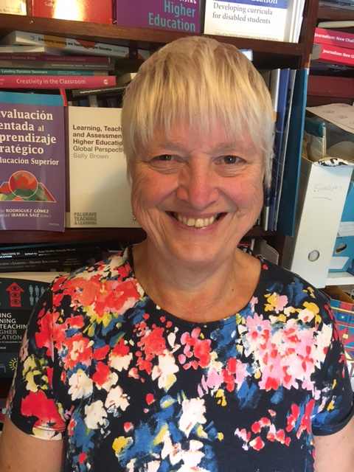
These and other slides are available on my website at http://sally-brown.net

Slide 68
Useful references: 1
Assessment Reform Group (1999) Assessment for Learning: Beyond the black box, Cambridge UK, University of Cambridge School of Education.
Bain, K. (2004) What the best College Teachers do, Cambridge: Harvard University Press.
Biggs, J. and Tang, C. (2011) Teaching for Quality Learning at University, Maidenhead: Open University Press.
Bloxham, S. and Boyd, P. (2007) Developing effective assessment in higher education: a practical guide, Maidenhead, Open University Press.
Boud, D. (1995) Enhancing learning through self-assessment, London: Routledge.
Boud, D. and Associates (2010) Assessment 2020: seven propositions for assessment reform in higher education Sydney: Australian Learning and Teaching Council.

Slide 69
Useful references: 2
Brown, S. (2014) Learning, teaching and assessment in higher education: global perspectives. London: Palgrave Macmillan.
Brown, S. and Glasner, A. (eds.) (1999) Assessment Matters in Higher Education, Choosing and Using Diverse Approaches, Maidenhead: Open University Press.
Brown, S. and Knight, P. (1994) Assessing Learners in Higher Education, London: Kogan Page.
Brown, S. and Race, P. (2012) Using effective assessment to promote learning in Hunt, L. and Chambers, D. (2012) University Teaching in Focus, Victoria, Australia, Acer Press. P74-91
Brown, S. Rust, C. & Gibbs, G. (1994) Strategies for Diversifying Assessment, Oxford: Oxford Centre for Staff Development.

Slide 70
Useful references: 3
Carless, D., Joughin, G., Ngar-Fun Liu et al (2006) How Assessment supports learning: Learning orientated assessment in action Hong Kong: Hong Kong University Press.
Carroll, J. and Ryan, J. (2005) Teaching International students: improving learning for all. London: Routledge SEDA series.
Crooks, T. (1988) Assessing student performance, HERDSA Green Guide No 8 HERDSA (reprinted 1994).
Crosling, G., Thomas, L. and Heagney, M. (2008) Improving student retention in Higher Education, London and New York: Routledge.
Falchikov, N. (2004) Improving Assessment through Student Involvement: Practical Solutions for Aiding Learning in Higher and Further Education, London: Routledge.

Slide 71
Useful references: 4
Gibbs, G. (1999) Using assessment strategically to change the way students learn, in Brown S. & Glasner, A. (eds.), Assessment Matters in Higher Education: Choosing and Using Diverse Approaches, Maidenhead: SRHE/Open University Press.
Higher Education Academy (2012) A marked improvement; transforming assessment in higher education, York: HEA.
Hounsell, D. (2008). The trouble with feedback: New challenges, emerging strategies, Interchange, Spring, Accessed at www.tla.ed.ac.uk/interchange.
Knight, P. and Yorke, M. (2003) Assessment, learning and employability Maidenhead, UK: SRHE/Open University Press.

Slide 72
Useful references: 5
McDowell, L. and Brown, S. (1998) Assessing students: cheating and plagiarism, Newcastle: Red Guide 10/11 University of Northumbria.
Mentkowski, M. and associates (2000) p.82 Learning that lasts: integrating learning development and performance in college and beyond, San Francisco: Jossey-Bass.
Meyer, J.H.F. and Land, R. (2003) ‘Threshold Concepts and Troublesome Knowledge 1 – Linkages to Ways of Thinking and Practising within the Disciplines’ in C. Rust (ed.) Improving Student Learning – Ten years on. Oxford: OCSLD.
Morgan, C., Dunn, L., Parry, S. and O'Reilly, M. (2004) The student assessment handbook: New directions in traditional and online assessment, London, Routledge.

Slide 73
Useful references: 6
Newstead, S. E., Franklyn-Stokes, A., & Armstead, P. (1996) Individual differences in student cheating, Journal of Educational Psychology, 88(2), 229-241
Nicol, D. J. and Macfarlane-Dick, D. (2006) Formative assessment and self-regulated learning: A model and seven principles of good feedback practice, Studies in Higher Education Vol 31(2), 199-218.
PASS project Bradford http://www.pass.brad.ac.uk/ Accessed July 2018.
Peelo, M. T., & Wareham, T. (Eds.). (2002). Failing students in higher education. Society for Research into Higher Education.
Pickford, R. and Brown, S. (2006) Assessing skills and practice, London: Routledge.

Slide 74
Useful references: 7
Race P. (2015) The lecturer’s toolkit (4th edition), London: Routledge.
Race, P. (2001) A Briefing on Self, Peer & Group Assessment, in LTSN Generic Centre Assessment Series No 9, LTSN York.
Race, P. (2014) Making learning happen: 3rd edition, London: Sage.
Rotheram, B. (2009) Sounds Good, JISC project http://www.jisc.ac.uk/whatwedo/programmes/usersandinnovation/soundsgood.aspx
Rust, C., Price, M. and O’Donovan, B. (2003) Improving students’ learning by developing their understanding of assessment criteria and processes, Assessment and Evaluation in Higher Education. 28 (2), 147-164.

Slide 75
Useful references: 8
Ryan, J. (2000) A Guide to Teaching International Students, Oxford Centre for Staff and Learning Development.
Sadler, D. R. (2010) Beyond feedback: Developing student capability in complex appraisal. Assessment & Evaluation in Higher Education, 35(5), 535-550.
Yorke, M. (1999) Leaving Early: Undergraduate Non-completion in Higher Education, London: Routledge.

