Slide 1
Inspiring and stimulating teaching to foster engagement and achievement
DARTP conference
June 2018
Sally Brown
@ProfSallyBrown sally-brown.net
Emerita Professor, Leeds Beckett University
Visiting Professor University of Plymouth, University of South Wales ,Liverpool John Moores & Edge Hill Universities.

Slide 2
Students really want teachers who are good at explaining things and who make learning intellectually stimulating and interesting, as NSS scores and other indicators of student satisfaction indicate. Almost everyone remembers a great lecturer who inspired them at university and far too many remember some awful ones too! Many teachers, however, were fine but uninspiring. This interactive keynote aims to explore what really works to lift the mundane into the inspirational. Among the topics under consideration will be:
what comprises inspiring teaching in a variety of settings, including lectures, seminars, virtual teaching and one-to-one contexts;
features that characterise outstanding teachers according to literature in the field and various schemes to recognise excellence;
Discussion of how we can inspire (and literally breathe life into) our teaching and plan how to better engage and stimulate students.

Slide 3

From Jason Elsom
(@Jason Elsom)

Slide 4
Task: are you an excellent teacher?
Think of an inspiring educator you’ve learned from (this could be a teacher, a peer or someone whose work you admire on television or elsewhere);
Identify up to five characteristics of an inspiring teacher using this role model as a case in point;
Now identify up to five characteristics of a disappointing or uninspiring teacher of your acquaintance;
Reflect on your own characteristics and identify a couple of areas for improvement.

Slide 5
Some characteristics of excellent university teachers:
Knows subject material thoroughly
Adopts a scholarly approach to the practice of teaching
Is reflective and regularly reviews own practice
Is well organised and plans curriculum effectively
Is passionate about teaching
Has a student-centred orientation to teaching
Regularly reviews innovations in learning and teaching and tries out ones relevant to own context
Ensures that assessment practices are fit for purpose and contribute to learning
Demonstrates empathy and emotional intelligence

Slide 6
Characteristics of excellent university teachers: diamond-9
1
2
2
3
3
3
4
4
5

Slide 7

Laurentius de Voltolina
2nd half of 14th Century
Italian Painter

Slide 8
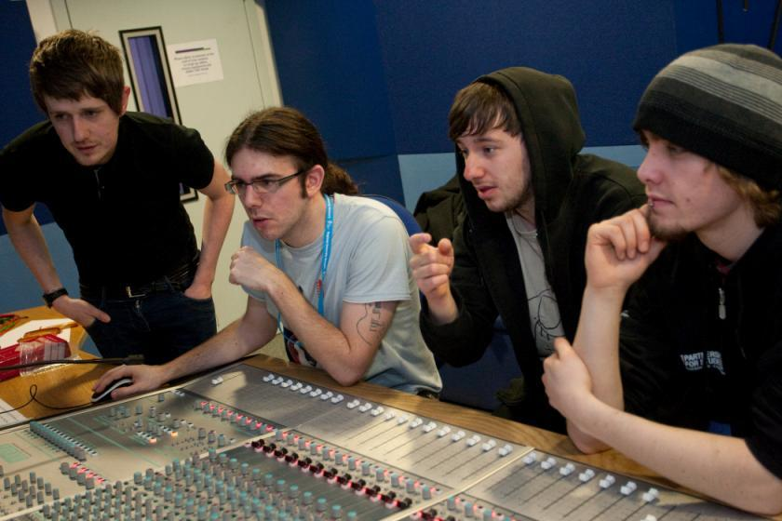

Slide 9
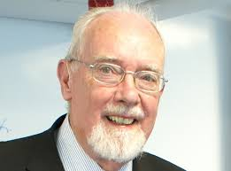
John Cowan

Slide 10
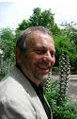
Peter Knight

Slide 11
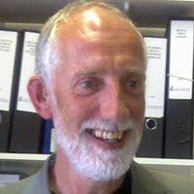
Graham Gibbs

Slide 12
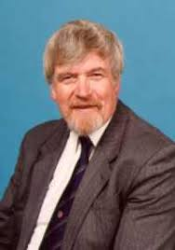
Phil Race

Slide 13
What makes an inspiring teacher?
Inspiring teachers tend to be systematic, consistent, well-prepared and compelling: they can usually work well at different levels and in diverse contexts;
There are no standard recipes by which we can cook up inspiring teaching, but there are some features we can combine in imaginative ways to create tasty and satisfying outcomes;
Inspiring teaching comes in many different forms, and inspiring teachers develop their own styles and approaches that suit them (and their learners) well.

Slide 14

The three National Teaching Fellowship criteria
Criterion 1: Individual excellence:
Evidence of enhancing and transforming student outcomes and/or the teaching profession: demonstrating impact commensurate with the individual’s context and the opportunities afforded by it.
Criterion 2: Raising the profile of excellence:
Evidence of supporting colleagues and influencing support for student learning and/or the teaching profession; demonstrating impact and engagement beyond the nominee’s immediate academic or professional role.
Criterion 3: Developing excellence:
Evidence of the nominee’s commitment to and impact of ongoing professional development with regard to teaching and learning and/or learning support.

Slide 15
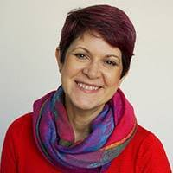
Ruth Pickford Pickford, R., 2016. Student Engagement: Body, Mind and Heart–A Proposal for an Embedded Multi-Dimensional Student Engagement Framework. Journal of Perspectives in Applied Academic Practice, 4(2).

Slide 16
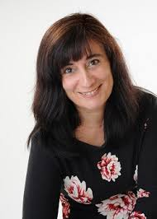
Chrissi Nerantzi
Vasant, S., Nerantzi, C., Beckingham, S., Lewin-Jones, J., Sellers, R., Turner, S. and Withnell, N., 2018. LTHEchat–The Story of a Community of Practice through Twitter. Association for Learning Technology Blog.

Slide 17
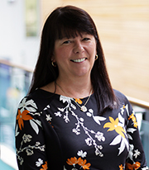
Sue
Beckingham

Slide 18
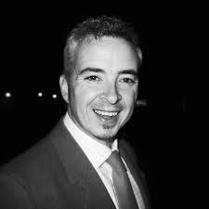
Simon Thomson

Slide 19
Why are they great teachers?
Unafraid to take risks but leave nothing to chance;
Articulate a clear rationale of what s/he is trying to achieve in her teaching and makes detailed plans on how to achieve it;
Worry less about what students think about them than how much they are learning;
Capable of being seriously quirky without being ‘up themselves’;
Continuously challenge students out of their comfort zones.

Slide 20
High quality teaching…
…“implies recognising that students must be engaged with the content of learning tasks in a way that is likely to enable them to reach understanding…Sharp engagement, imaginative inquiry and finding of a suitable level and style are all more likely to occur if teaching methods that necessitate student energy, problem solving and cooperative learning are employed”. (Ramsden, 2003, p97)

Slide 21
A tall order?
Effective lecturers combine the talents of a scholar, writer, producer, comedian, showman and teacher in ways that contribute to student learning. Nevertheless it is also true that few college professors combine these talents in optimal ways and that even the best lecturers are not always on top form.
McKeachie et al p.53

Slide 22
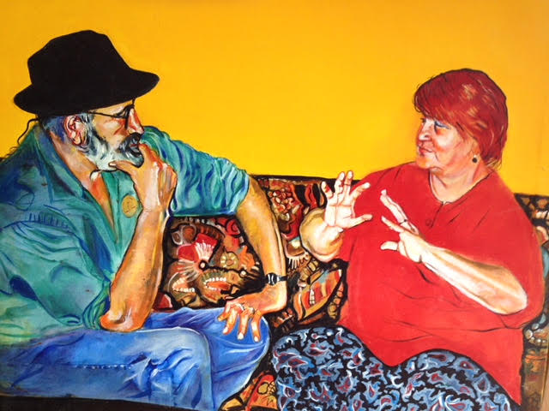
Rex and Wendy Stainton-Rogers

Slide 23
Ken Bain says great teachers...
Are willing to spend time with students, to nurture their learning.
Don’t foster a feeling of power over, but investment in, students.
Ensure their practices stem from a concern for learning.
Make the class user-friendly by fostering trust.
Employ various pedagogical tools in a search for the best way to help each student.
Have the attitude that “There is no such thing as a stupid question.”
Ensure that everyone can contribute and each contribution is unique.
8. Do not behave as a “high priest of arcane mysteries”.
9. Do not make the classroom an “an arena for expertise, a ledger book for the ego”.
10. Don’t expect students to see science as a “frozen body of dogma” that must be memorized and regurgitated.
11. Foster the feeling that teachers are fellow students/ human beings struggling with mysteries of the universe.

Slide 24
Ken Bain says excellent teachers ask these questions as they prepare to teach:
What should my students be able to do intellectually, physically, or emotionally as a result of their learning?
How can I best help and encourage them to develop those abilities and habits of the heart and to use them?
How can my students and I best understand the nature, quality, and progress of their learning?
How can I evaluate my efforts to foster that learning? (Bain, 2004 p. 49)

Slide 25
What kind of a teacher are you?
Think about your three greatest strengths as a university teacher: how did these come about?
Think about metrics that tell you how good you are as a teacher: what do you learn from them?
Think about three ways in which you teaching in university has changed since you started out: what was the rationale?
Think about three things you would like to do in your teaching; what might help you achieve these?
Think about the people who have helped you become effective as a teacher and assessor: how can you similarly help others?

Slide 26
How can we breathe life into our teaching?
Work out what are your key strengths and play to them: find your individual teaching voice;
Challenge yourself regularly to try new things in the classroom, including things that frighten you a little;
While content knowledge is important, put as much effort into planning process as you do delivery;
Vary the technologies you use (for example, why not try ‘clickers’ one week, and low tech in-class tests another and replace PowerPoint with Prezi?);
Sometimes plan the tasks and resources but have no formal presentation element.

Slide 27
How can you use colleagues to help you energise classes?
Explore the extent to which you can use live or virtual ‘expert witnesses’ and ‘guest appearances’ in your classes;
Can you plant a well-prepared ‘interrupter’ in a session who challenges your point of view, offers alternative perspectives and proposes different perspectives?
Try out team teaching occasionally, with reciprocal support for colleagues;
Use peer review to help you improve your own teaching and assessment practice.

Slide 28
Reflective teachers
If we are to be effective university teachers, we need to review our own practices regularly and reflectively. This can ensure we not only keep ourselves up to date with curriculum content but also with relevant and current approaches to teaching.
Reflection on practice, when practiced regularly, can have a positive impact on teachers’ effectiveness as teachers and can enhance their engagement and enjoyment.
Research indicates that those engaged in peer review of teaching not only benefit from opportunities to discuss their own practices, but also significantly learn a great deal from watching others teach and discussing alternative approaches.

Slide 29
Reflection on my teaching
What areas of my teaching practice do I want to develop?
What new technologies would I like to incorporate in my teaching?
How much do I need to update the subject content of my teaching?
Who could I usefully learn from about inspiring teaching?
Who can I help to be a good teacher by mentoring them?
What reading and further study about pedagogy might benefit my teaching?

Slide 30
And what about leaders of learning and teaching?
Have vision and can imagine ways that great ideas can be taken forward pragmatically
Can be strategic and instrumental without ever losing sight of the passion for teaching that drives them;
Are good at judging the zeitgeist and trend spotting, with an excellent filter for fashionable foppery;
Retain a focus on enhancing the student experience at all times;
Remember that the colleagues being led have real lives and multiple demands on their time.

Slide 31
How do we know if we are offering excellent teaching?
Students are satisfied, learn well, achieve highly and have fulfilling learning experiences;
We as teachers are satisfied, motivated and find our workloads manageable;
Quality assurers and Professional and Subject bodies like what we do and have no complaints about systems and processes;
University managers are confident that the student experience offered is of high quality (and deal with few complaints).

Slide 32
So what are you going to do?
To refresh your own practice?
To gain more satisfaction from teaching?
To improve your teaching techniques and practices?
To mentor and support new colleagues?
To learn from the long-serving members of staff who may be about to leave?

Slide 33

These and other slides will be available on my website at http://sally-brown.net

Slide 34
References and further reading
Bain, K.(2004) What the Best College Teachers Do, Cambridge Massachusetts, Harvard University Press, http://www.vetmed.wsu.edu/courses-jmgay/documents/SynopsisWhatBestCollegeTeachersDo.pdf
Blackwell, R. and McLean, M. (1996) Peer Observation of Teaching and Staff Development. Higher Education Quarterly 50(2).
Brown, S., Jones, G. and Rawnsley, S. (eds) (1993) Observing teaching. SEDA Paper 79. London: Staff and Educational Development Association. [A collection of articles on good practice, with example forms.]
Brown, S. (2011) Bringing about positive change in higher education; a case study Quality Assurance in Education Vol 19 No 3 pp.195-207.
Brown, S. and Race, P. (2002) Lecturing – a practical guide, London: Kogan Page
Colin Bryson & Len Hand (2007): The role of engagement in inspiring teaching and learning, Innovations in Education and Teaching International, 44:4, 349-362
Boyer, E.L. (1990, reprinted 1997) Scholarship reconsidered: priorities of the professoriate, San Francisco: Jossey Bass, The Carnegie Foundation for the Advancement of Teaching.
Debowski, S., Stefani, L., Cohen, M. and Ho, A (2011) Sustaining and championing teaching and learning in good times or bad in Groccia, J., Alsudairi, M. and Bukist, B., (eds.) A handbook of College and University Teaching: global perspectives, London: Sage Publications.

Slide 35
References and further reading (2)
Gosling, D. (2000) Guidelines for Peer Observation of Learning andTeaching. ESCalate Regional Networking Seminars. Bristol: ESCalate. Available at: http://www.escalate.ac.uk/resources/peerobservation
Hammersley-Fletcher, L. and Orsmond, P. (2004) Evaluating our peers: is peer observation a meaningful process? Studies in Higher Education 29(4), 489-503.
Hodgkinson, M. (1994) Peer Observation of Teaching Performance by Action Enquiry. Quality Assurance in Education 2(2), 26-31.
McKeachie, W. J. (1951) Teaching Tips: Strategies, Research and Theory for College and University Teachers, Lexington MA: D. C. Heath and Company.
Parkin, D. (2017) Leading Learning and teaching in higher education: the key guide to designing and delivering courses, London and New York, Routledge
Race, P. Using peer observation to enhance teaching Leeds Met press (see http://www.leedsbeckett.ac.uk/publications/files/090505-36477_PeerObsTeaching_LoRes.pdf accessed November 2014)
Race, P. (2015) The lecturer’s toolkit (4th edition) London: Routledge.
Ramsden , P.(2003) Learning to teach in higher education (2nd edition) London, Routledge Falmer.

