Slide 1
Leading in learning and teaching
Crannog project: Dublin, Limerick, Galway, Ireland: May 2018
Sally Brown @ProfSallyBrown
sally@sally-brown.net
NTF, PFHEA, SFSEDA
Emerita Professor, Leeds Beckett University
Visiting Professor University of Plymouth, University of South Wales & Liverpool John Moores University.

Slide 2
The roles of Heads of School, Deans and other middle managers in higher education is complex:
Many posts require strategic leadership and management but aligning local needs with institutional ones and sometimes managing upwards, often without significant autonomy can be challenging. This workshop is designed to help set directions confidently and to steer your course through sometimes choppy waters and will include interactions on:
Working with your teams to encourage student engagement;
Making effective and evidence-informed decisions on curriculum design, delivery and assessment;
Working with teaching and learning and other institutional committees;
Balancing the competing demands of the job.

Slide 3
What are you doing?
Leading?
Managing?
Directing?
Supporting?
Waving or drowning?

Slide 4
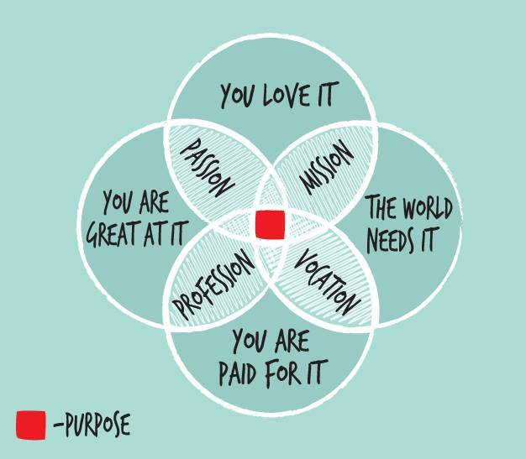
From Jason Elsom
(@Jason Elsom)

Slide 5
What major changes have impacted on HE teaching and learning globally over the last decade and what’s coming up on the horizon?
The increased focus on student satisfaction and value for money leading to changing expectations about student engagement;
The effect on institutional strategies of promoting the research agenda, often at the expense of support for teaching initiatives;
The intensification of encouragement to seek professional recognition for teaching expertise and the new Irish framework for CPD;
Changes in learning paradigms and knowledge construction as the central role of ‘content delivery’ in curriculum development has been challenged.

Slide 6
Sambell, K, Brown, S and Graham, L. (2017) Professionalism in Practice: Key directions in higher education: Learning, Teaching and Assessment, Basingstoke: Palgrave-Macmillan.

Slide 7
Implementing change to foster engagement: key questions in changing times to align with national/ institutional imperatives
In what ways can middle and senior managers in higher education effect change within their organisations?
What kinds of drivers for change are available to senior staff charged with the task of making change happen?
What kinds of strategies work to encourage changes of practice in learning and teaching?
How can real engagement in change management be embedded, rather than just superficial compliance?

Slide 8
Change doesn’t just happen by fiat or dictat!
Implementing change in higher education is complex and challenging, and its results are difficult to measure;
A top-down approach is insufficient to bring about rapid changes in a difficult context;
Students and staff needed to be fully involved in the processes of change and to be fully engaged with it, rather than seeing it as an imposition;
Change management needs effective leadership, appropriate strategies, grass-roots advocacy and a sense of realism.

Slide 9
Preparing for change
“Although changes may seem to come upon us without warning, experience shows this is rarely the case. Unfortunately we often disregard or misinterpret the signals of change. We tend to spend our time on issues we perceive to be most important right now; we fail to scan our surroundings for changes that are in the early stages of development. The flood of problems that forces us to into crisis management makes concern for emerging issues to appear to be a luxury. It is not. It is a necessity.” (Renfro and Morrison 1983, p.1)

Slide 10
Gaining momentum
Marshall and Massey (2010) argue that when leading in turbulent times, the first step to be taken is to:
“Create a sense of urgency about the crisis. While it’s easy to scare people, the aim is to at the same time present a plan about how, by doing things differently, the university can break the momentum taking it in the wrong direction and work its way out of the problem. The key is to create a sense of urgency without instilling a feeling of hopelessness. ” (Marshall and Massey, p.68)

Slide 11
Change doesn’t only happen when it is driven from the top:
“It is a very wrong-headed notion, too, one that is, ironically in an ‘age of empowerment’ and ‘flatter organisations’, not only deeply disempowering, (in that it implies the way to empowerment can only be achieved by recourse to hierarchical authority), but also, even more importantly, that overlooks the crucial fact that values are only values if they are chosen voluntarily and as such cannot be imposed from the top. Thus initiatives that are solely top down are at best likely to evoke compliance with change rather than a genuine commitment to it.” McCaffery (2004, p.237)

Slide 12
The way institutional change is introduced is of high importance
To bring about genuine improvements to an institution, it is not sufficient to direct, require or issue edicts which are unlikely to be effective, especially where demoralised staff are the people who need to take the actions necessary for improvement.
“Too often new approaches are introduced by executive fiat or though a centralist management strategy, or, at worst through ad hoc and hurried planning interventions in response to years of benign neglect. It seems a rarity indeed for academics to genuinely feel that they are part of a meaningful, participatory decision-making process that values their experience or even their instinct for seeing potential pitfalls.” (Lueddeke, 1999, p. 236)

Slide 13
Scott argues we must convince staff and bring them with us to effect change
“Staff will not engage in a change effort and the learning that goes with it unless they can personally see that doing so is relevant, desirable, clear, distinctive and importantly feasible. Being appropriately involved in shaping an agreed change project and being clear on what is envisaged are also powerful motivators. Right from the outset, staff affected by each change will be weighing up the benefits of engaging and persevering with it against the costs. This is a process that carries on over the whole life cycle of every change effort”.
(Scott, 2004, p.4).

Slide 14
Enacting change
Trowler suggested that staff’s responses to top down change directives may include ‘compliance (both enthusiastic and reluctant, with resistance, coping strategies and with attempts to reconstruct the policy during the implementation phase’.
(Trowler, 1998, p.153).
For this reason, ‘the perceived profitability of an innovation for those charged with implementing it must be clear and apparent’.

Slide 15
Ways of working with people
Trowler (1998, p.152) described ‘the difficulty of shining visionary light from the top in large, complex institutions like universities’ and argues that a precondition for effective change in universities is to understand the multiple cultures within universities and to: ‘Conceptualise organisations as open systems, and cultural configurations within them as multiple complex and shifting’ (Trowler, 1998, p.150).
He further argued that:
‘The pre-existing values and attitudes of staff, both academics and others, need to be understood and addressed when considering change. Individuals and groups are far from ‘empty-headed’, especially those in universities.’ (Trowler, 1998, p.151).

Slide 16
Making things happen
If leaders are to bring colleagues with them in institutional change processes, it is necessary to:
Identify for all stakeholders what are the purposes of making changes: what is transparent to leaders may not be apparent to the individuals charged with making the changes;
Clarify mutual expectations, so all concerned know what is required of them;
Recognise that most academics have the well-being of the university and the students learning there at heart, so clarify the benefits for all concerned of changes.

Slide 17
Ten leverage points for strategic change at institutional level within HEIs
Have new visions/new plans;
Foreground the preparation of new/continuing academic staff;
Provide a compulsory casual teaching development program;
Offer just-in-time professional development;
Foster communities of practice;
Strategic funding for developments;
Support teaching excellence through awards and fellowships;
Disseminate exemplary practice online;
Recognise and use ‘education experts’;
Renew leadership.
(proposed by Holt, Palmer and Challis, Deakin University, Australia 2011, pp.9-15)

Slide 18
Making change happen: a summary
In coming years, teaching and learning look set to becoming ever more prominent in HE priorities;
Change management is tough and slow, but often essential;
Inevitably, change management cannot be viewed as an event but more as an ongoing iterative and dynamic process taking account of changing circumstances;
In most cases effective change requires not just changes in practice but also changes in orientation across the university towards particular goals, for example, satisfying students, improving facilities or improving the financial status of the HEI.

Slide 19
Making effective and evidence-informed decisions on curriculum design, delivery and assessment
Your leadership can make a substantial difference to the student experience and to their engagement if you support your teams to make well-informed and positive decisions about curriculum design, delivery and assessment;
It’s important to consider how the curriculum can be constructively designed (Biggs and Tang, 2011) so all elements work well together;
It’s important to ensure your strategies are manageable: think ahead around staff deployment, assessment workloads, alignment with your academic year and quality assurance requirements.

Slide 20
Determining and reviewing subject material: currency, relevance, level
Enhancing quality, seeking continuous improvement
Designing and refining learning outcomes
Evaluating programmes, strengths and areas for improvement
Curriculum
Design
Essentials
Considering delivery modes: face-to-face, online, PBL, blended…
Assuring quality, matching HEI, national and PRSB requirements
Thinking through student support
Designing fit for purpose assessment methods and approaches

Slide 21
Mapping out the programme as a whole: some questions
Are you ensuring that students are immersed in the subject they have come to study from the outset?
Is induction a valuable and productive introduction to the course?
Do students have a positive and balanced experience across the programme?
Are there points in the academic year when there doesn’t seem to be much going on (e.g. an extended Christmas break) when going home (and not coming back) seems like a good option?

Slide 22
Changing programmes
Some worried that with mass HE, degrees would be devalued;
We feared that face-to-face teaching would be replaced by programmed learning, all done with algorithmic programmes;
Academics worried about loss of status within massive universities e.g. the loss of individual office spaces;
Some worried about the loss of academic freedom with the rise of managerialism.
How many of these came true?

Slide 23
Mapping progression
Is there a coherent model of progression across the student life-cycle from induction to ‘outduction’?
Do you manage transitions from year one to year two and year two to year three to ensure students remain committed and engaged?
Is there some continuity in the sources of student support throughout the course (e.g. personal tutors)?
Are students offered support and guidance in relation to personal development and employability?

Slide 24
Mapping assessment
Are summative assessments undertaken throughout the course, or is everything ‘sudden death’ end-point?
Is there excessive bunching of assignments in different modules that is highly stressful for students and unmanageable staff?
Are there plenty of opportunities for formative assessment, especially early on?
Are students over-assessed?
When you have introduced innovative assignments, have they been introduced instead of existing ones or simply added to the assessment diet?
Are students encouraged to make good use of the feedback they receive?

Slide 25
Changing assessment
Some thought assessment would become automatic and the drudgery of marking would be largely eliminated;
Some expected HE to be a great leveller of disadvantage, since widening participation was opening up opportunities for more;
Multimedia curriculum delivery would be the norm, and we could use whizzy flexible learning packages to enhance our teaching;
Bureaucratic hindrances would be ironed out as technologies supported administrative functions.
How many of these were realised?

Slide 26
To enact change in curriculum design and delivery, we can:
Explore how we can best use the first half of the first semester to induct students into good study patterns and practices to enhance learning and improve retention (Yorke 2009);
Reconsider the kinds so activities students engage with the maximum ‘learning by doing’;
Rethink the way in which we use lecture periods to include activity as well as delivery;
Consider how we can best make use of technologies to support learning and engagment.

Slide 27
Working with your teams to encourage student engagement: who are your teams?
People you directly manage, for whom you undertake performance reviews or appraisals;
People you loosely manage but who are not your direct reports, and over whom you can have influence rather than control;
Your peers and colleagues, who are by no means beholden to you, but with whom you regularly work;
Your own managers, who you can upwardly influence or ‘manage-up’;
Other key stakeholders around you, like students, who can work with you.
These are your key constituencies who can help you effect change.

Slide 28
Engagement: Why talk about it? Because:
Academics and learning support staff report increasing levels of disengagement by students of the ‘iGeneration’;
The nature of the transaction seems to be changing in the light of high fees in many nations;
Potentially the nature of student behaviour in higher education is changing radically in terms of academic and other literacies;
Institutions need to ensure that new students enter with, or have the opportunity to acquire, the skills needed for academic success;
HEIs must devise programmes in which the emphasis is on maximising students’ development.

Slide 29
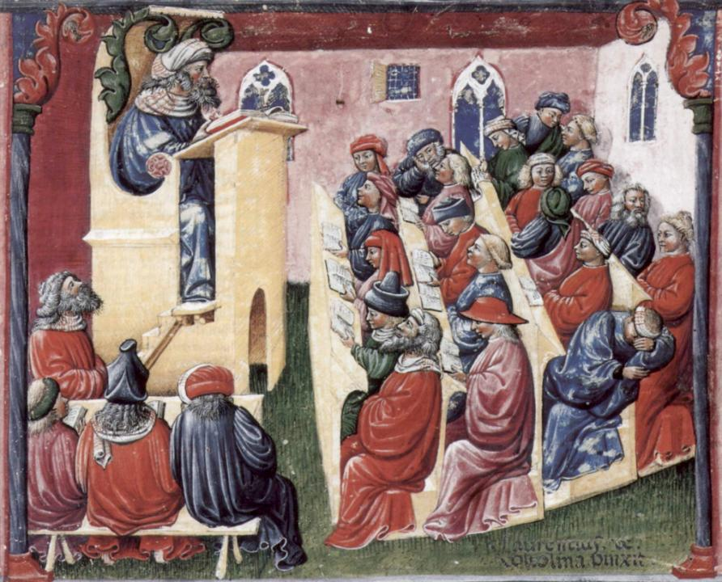
Laurentius de Voltolina
2nd half of 14th Century
Italian Painter

Slide 31
Delivering content…..
is less like delivering a parcel (the postman model) and more like delivering a baby (the midwife model).
University staff can advise, guide, intervene when things so wrong, but in the end only the student can bring learning into life!!
Content can be gleaned from many sources (e.g. MIT and our UK Open University are putting more and more content into open access areas).

Slide 32
The Maieutic model
Maieutics is a complex procedure of research introduced by Socrates, embracing the Socratic method in its widest sense. It is based on the idea that the truth is latent in the mind of every human being due to her/his innate reason but has to be “given birth” by answering questions (or problems) intelligently proposed. The word is derived from the Greek “μαιευτικός”, pertaining to midwifery.

Slide 33
Changing students’ attitudes to engagement
Many suggest students are more demanding of staff time and have higher expectations than previously (although colleagues in Scotland report similar trends);
Many HEIs are reporting worsening attendance here certainly seems to be an attitude among some students that “well, I am paying for it so it’s up to me if I come in or not”
Some report a more litigious approach among dissatisfied students and their parents.

Slide 34
Changing students’ behaviours
Reading: Academic book sales are dropping, students don’t use library books as much as they did, more and more reading is on-line with consequential changes to tolerances of length, breadth and depth;
Writing: students (and HE staff!) often find writing with a pen and paper in exams and in lectures an alien concept but our practices haven’t kept pace;
Learning: with the power of the internet at our fingers, many are querying the value of learning stuff. Isn’t it enough just to know how to find information?

Slide 35
Strategies to encourage teams to enhance students’ learning experiences
Use internal advocates across the organisation to promulgate institutional aims at a local level.
Enable them to build on positive outcomes where an innovation or a different approach has been used to good effect by showing others what worked for them.
Regularly access institutional and course level data;
Use the committee structure of an institution to publicise and gain consensus for change;
Build learning communities across the HEI.

Slide 36
How can we get students to fully engage? Some suggestions
Provide opportunities for students to get involved in authentic learning environments on campus or off;
Keep the curriculum current and life-relevant, without losing historical perspectives;
Give them real problems to solve and issues with which to engage;
Identify the skills they need to succeed and provide opportunities to rehearse and develop them;
Never compromise on the quality of the demands we make of them.

Slide 37
Fostering graduate skills and employability
By providing authentic assignments, students can progressively develop a range of skills which include inter alia:
Effective oral, written and digital communication;
Creativity and problem-solving capabilities;
Inter-personal and social skills;
Effective group membership, leadership and ‘followership’;
Manipulation and presentation of data;
Locating, verifying and effectively using a range of information sources;
Good presentation of work in visual and written forms.

Slide 38
Questions employers might ask at interview that might help us frame some of our assignments
Can you tell us about an occasion when:
you worked together with colleagues in a group to produce a collective outcome;
you had to work autonomously with incomplete information and self-derived data sources;
you developed strategies to solve real life problems and tested them out;
you has a leadership role in a team, and could you tell us your strategies to influence and persuade your colleagues to achieve a collective task;
you had to communicate outcomes from your project work orally, in writing, through social media and/or through a visual medium?

Slide 39
How can we get students to fully engage? Some suggestions
Provide opportunities for students to get involved in authentic learning environments on campus or off;
Keep the curriculum current and life-relevant, without losing historical perspectives;
Give them real problems to solve and issues with which to engage;
Identify the skills they need to succeed and provide opportunities to rehearse and develop them;
Never compromise on the quality of the demands we make of them.

Slide 40
Engagement of international students: some important considerations
Is recruitment undertaken to ensure students have the potential to succeed?
Is induction framed appropriately to welcome international students?
Are steps taken proactively to ensure international students have a good chance of integrating with their study cohorts?
Is the curriculum international is scope and content? Are examples and case studies global?
Is the right kind of support offered (language, crisis support, befriending etc.)?

Slide 41
Working with teaching and learning and other institutional committees;
Committees are often a key locus of power in HEIs (as well as being a huge consumer of time and energy);
If you want to implement a change in practice, it’s a good idea to take your proposal/plan/strategy up through the committees in your organisation through from Subject Group to Faculty (or equivalent) to top-level committees including governance;
This takes careful planning and considerable time but is likely to have high impact if your work it right;
Don’t expect to simply put a paper to a committee and expect it to get agreed: there is a lot of behind-the-scenes work to do first!

Slide 42
Gaining consensus for change
It’s a good idea to start with a few rough ideas and talking to a few friends and allies, encouraging them to see the potential pitfalls before you go public;
Scrutinise your plans to see who will benefit and who is likely to be inconvenienced or disrupted by the changes you are planning;
Work through those people in advance (coffee and cake help!), trying to ensure you explain/convince/reassure colleagues well in advance of any committee meeting (and you need to do this at every stage);
Avoid if possible presenting your idea unless you are reasonably confident you have enough people on side to support you.

Slide 43
Work with the influencers, potential blockers and those who have power (structural or hidden)
Marshall your arguments, including from the vast scholarly literature on teaching and learning, so that you are confident of the value of the changes you want to make;
Think through possible objections and plan how you will counter them;
Encourage allies and supporters of your ideas to lobby alongside you;
Ensure, if at all possible, that you have at least one very senior colleague who will stand with you;
Think carefully about timing: a great idea will founder if the time isn’t right.

Slide 44
Your committee paper should be:
Formatted appropriately: committee administrators often reject outright anything that doesn’t look right for the context;
Meticulously proofread: people often make judgments about the quality of ideas based on the quality of of the presentation;
Succinct: people get very bored reading through too much detail;
Thoroughly researched: making use of the best evidence;
Visually attractive: use images, diagrams, tables and graphs to strengthen your case.

Slide 45
Balancing the competing demands of the job.
If it’s important and urgent make time and space to do it now and don’t rush it;
If it’s important and not urgent, be sure to block out time to do it properly (and no backsliding!);
If it’s urgent but not very important, do it fast and do it now quickly and move on, or delegate it;
If it’s not urgent or important delegate it or dump it, unless it’s close to your heart, in which case save it for a day when you are unexpectedly free.

Slide 46
How can you achieve a good work-life balance?
Think about what gives you pleasure and focus on it (and if you hate something don’t do it!);
Remember that being strategic about your future and making time to achieve it isn’t selfish: it will have long term benefits for those who depend on you;
No one survives an academic career unscathed if they don’t find ways to carve out personal down time whatever that looks like for you;
To achieve this, work out what your personal best professional habits are and cultivate them

Slide 47
Balancing the competing demands of the job
Urgent and important
Not urgent but important
Not urgent
nor important
Urgent but not important

Slide 48
Getting a good work/life balance, a few tips:
Think about how you can stop the email monster ruling your life: filter, file, focus and fling!
Be strategic about meeting attendance: work out if you are making a positive difference by being there and if there is doubt in your mind, send apologies, see if you can ask someone else to represent you or Skype in if it saves travelling time;
Recognise that the more senior you get, the less likely it is you can have direct control over everything so trust your colleagues to do a good job, while giving them plenty of support.

Slide 49
Planning your future
Keep really good records of you achievements and successes (including a’ plaudits’ file even though it feels mildly embarrassing);
Make reflection a very regular part of your professional activity;
Find a mentor who can not only advise and support you but can look out for opportunities for you;
Make the most of professional, subject, institutional, national and international networks as well as your personal ones to help you keep abreast of upcoming trends and to contribute to your communities;
Consider gaining professional accreditation for your role.

Slide 51
Professorships in assessment, learning and teaching
Building your case over 5-10 years has high benefits;
You need to study your institutional criteria carefully and also look at those of other HEIs where you might like to work;
Almost all HEIs have criteria for Chairs based on a learning and teaching route (and most ignore them!);
This means that researching, writing, publishing and disseminating work about assessment learning and teaching are likely to form the core of your case;
You also need to network effectively: the likelihood is that when your university is reviewing your case they will involve external referees. You need to be sure they have heard of you.

Slide 52
Planning ahead for your career in senior management
Volunteer/get elected for university and national committees since this is where you can start to make a real impact. Choose an area where you can become a recognised advocate e.g. EO, funding sources, TEL;
Take up every bit of leadership training you can, read what you can about HE leadership and reflect on your learning;
Watch university leaders in action and emulate the practices and behaviours you admire and see to be successful, and note to avoid the opposite;
Stay out of internecine battles but learn from them;
Work hard at knowing when to take a principled stance (and when it becomes counter productive);
Seek out a mentor, coach or champion and make sure support is mutual.

Slide 53
Useful references:
Biggs, J. and Tang, C. (2011) Teaching for Quality Learning at University: 4th edition, Maidenhead: SRHE/Open University Press.
Brown, S. (2012) Managing change in universities: a Sisyphean task? Quality in Higher Education, Vol18 No 1 pp.139-46.
Brown, S. (2011) Bringing about positive change in higher education; a case study Quality Assurance in Education Vol 19 No 3 pp.195-207.
Harvey, L. (2005) A history and critique of quality evaluation in the United Kingdom, Quality Assurance in Education, 13(4) pp.263–76.
Holt, D., Palmer, S. and Challis, D. (2011) Changing perspectives: teaching and learning centres’ strategic contributions to academic development in Australian higher education, International Journal for Academic Development 16(1), pp.5–17.
Lueddeke, G. (1999) Toward a constructivist framework for guiding change and innovation in higher education, Journal of Higher Education, 70(3), pp. 235-60.
McCafffery, P. (2004) The Higher Education Manager’s Handbook: Effective leadership and management in universities and colleges (Abingdon, Routledge Falmer).

Slide 54
More references
Marshall, P and Massy, W (2010) ‘Managing in turbulent times’ in Forum for the Future of Higher Education, papers from the 2009 Aspen symposium Massachusetts Institute of Technology Cambridge USA
Renfro, W. L. and Morrison, J. L. (1983) Anticipating and managing change in educational organisations, Educational Leadership, Association of Supervision and Curriculum Development Beaufort Southern Carolina
Scott, G. (2004) Change matters: making a difference in higher education, keynote given at the European Universities Association Leadership Forum in Dublin, available at http://www.uws.edu.au/data/assets/pdf_file/0007/6892/AUQF_04_Paper_Scott.pdf (accessed 6 April 2013).
Trowler, P. (1998) Academics Responding to Change: New higher education frameworks and academic cultures, Buckingham: SRHE and Open University Press.

