Slide 1
Professionalism in Practice and Researching your Teaching Practice
Edge Hill University
24th April 2018
Sally Brown NTF, PFHEA, SFSEDA
@ProfSallyBrown
http://sally-brown.net
Emerita Professor, Leeds Beckett University
Visiting Professor: University of Plymouth, University of South Wales, Edge Hill University & Liverpool John Moores University.

Slide 2
Rationale
Recognising and rewarding Professional Development in Higher Education is a matter of global concern, particularly given a strong focus on student-centred learning;
There is significant interest in not just helping those new to teaching in higher education become competent and confident, but also to ensure that practitioners retain currency not only in their subject areas but also in HE pedagogic approaches;
Many HEIs also want to recognise outstanding achievement in supporting effective student learning, and individuals are also keen to have their commitment to teaching recognised. This workshop will explore these issues and look at how teachers and learning support staff can research their own practice.

Slide 3
In this participative workshop, participants will have opportunities to:
discuss drivers for change in higher education, the professionalisation of the higher education sector, and the benefits of working towards professional recognition;
review ways of advancing your own professional practice through ongoing CPD;
Discuss how your activities in teaching, assessment and learning support can form a basis for scholarship.

Slide 4
Activities in this session
Introductions and welcome + mini-presentation
Discussion activity in groups of issues arising from the background reading and the presentation
Thinking about researching your own practice
Personal target setting
(But not necessarily in that order)

Slide 5
Task
What is the most helpful thing you’ve learned since you started working in your current post, that you wish you had known about from the outset?

Slide 6
Passing it on
Can you say whether these were
practical (e.g. like finding out where various facilities or resources were located),
technical (e.g. how to get email working, use lecture capture or get hold of software),
administrative (e.g. how to get permission to go to events or get expenses signed off),
social (how to find people with shared interests to yourself, where to go for fun, what kind of sporting facilities you can use),
or emotional (e.g. who to turn to if you felt you were struggling or had made a big mistake).
How can you ensure that new colleagues starting to work alongside you don’t have such as steep learning curve as you?

Slide 7
Why do we need to professionalise our practice?
Not only will the subject matter of your teaching/ learning support change during your career in HE, but so also will approaches to pedagogy over time (think about the major changes of the last 20 years, for example?);
This is often reflected in the learning environments we use;
You wouldn’t want to keep on doing the ‘same-old same-old’ would you?
We are expected by our managers to keep up to date;
Students’ opinions matter;
More importantly, we need to do it for ourselves, for our own proper pride!

Slide 8
New environments for learning?
The rooms we work in impact on how we teach, but we can at the same time be creative in our use;
We need to work with university Estates departments to make the most of the places we have available;
We always need to consider how to make our learning environments inclusive;
Our learning environments are virtual as well as physical.

Slide 9
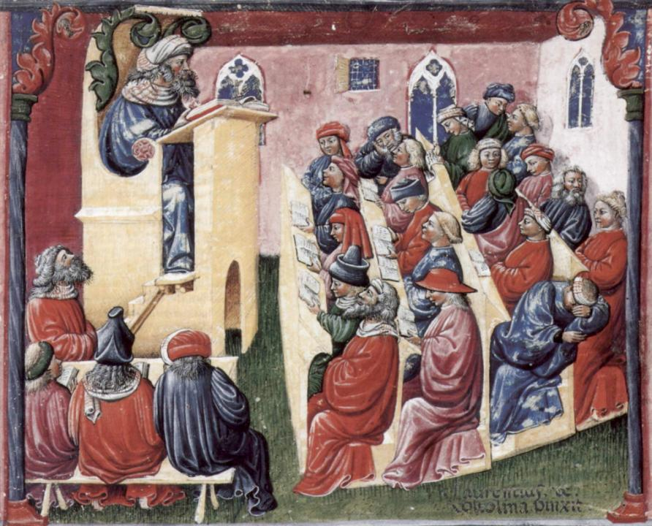
Laurentius de Voltolina
2nd half of 14th Century
Italian Painter

Slide 10
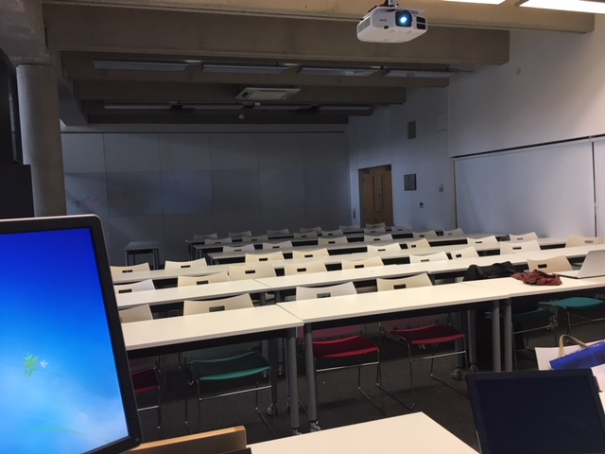

Slide 11
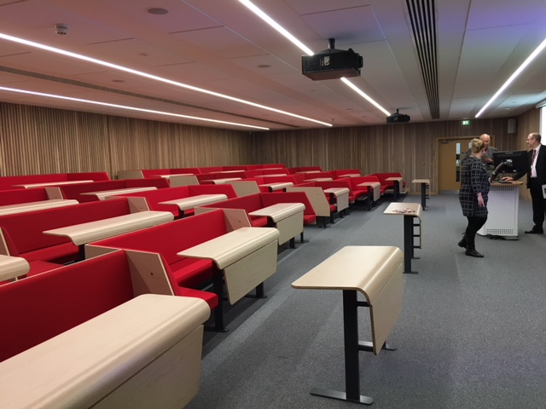

Slide 12
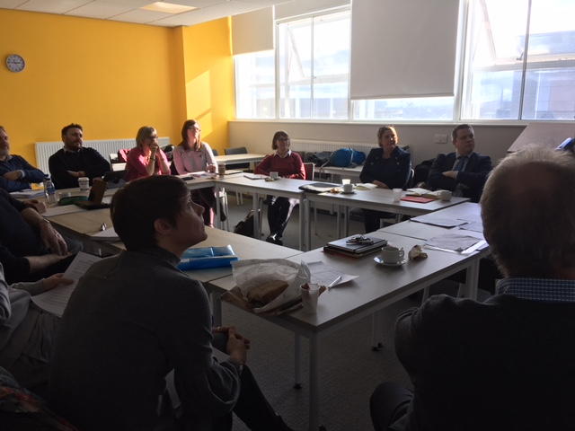

Slide 13
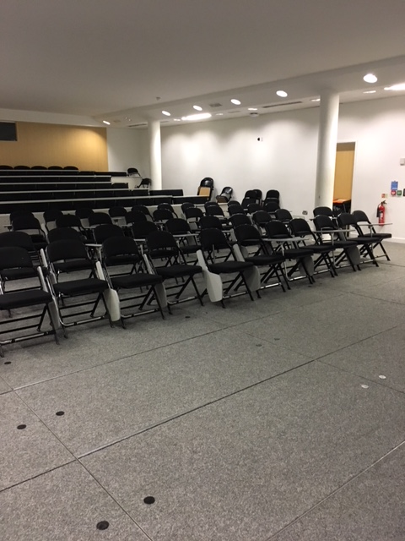

Slide 14
An alphabet soup of drivers for change
The National Student Survey (NSS);
The Taught PostGraduate Experience Survey (PTES);
The Office for Students (OFFA, HEFCE et al as were);
The Quality Assurance Agency (QAA);
The Higher Education Academy (now Advance HE);
The UK Professional Standards Framework (UKPSF);
The Teaching Excellence Framework (TEF);
Your own Professional, Regulatory and Subject Bodies (PRSBs);
And more!

Slide 15
Task: You’ve read the paper*, what did you learn?
Of the types of CPD in that chapter, what are your principal means of learning about HE learning, teaching and assessment, and how do you keep yourself up to date? e.g. Teaching Inductions, PGCertHE/PGCAP, HEA Fellowships at different levels, Institutional workshops, engagement with projects, internal and external conferences and workshops, including those run by your PSRBs and organisations like SEDA, engagement through social media eg #lthechat on Twitter, SRHE, HEA, ALDinHE, Leadership development, reading and writing for publication as self-development, qualifications like Masters degrees and PhDs, working with a mentor, peer observation of teaching, personal reflection through blogs and journals.
* Chapter 7 of Sambell, K., Brown, S. and Graham, L. (2017) Professionalism in Practice: key directions in higher education learning, teaching and assessment. London, New York, Palgrave Macmillan

Slide 16
What have gubernatorial imperatives ever done for our personal and professional development? Some examples:
Data collection by the Higher Education Statistics Agency means that HEIs may be more likely to find out whether their staff have accreditation to teach/support learning;
The Teaching Excellence Framework has promised much and not delivered a great deal lately, but has at least encouraged senior managers to think hard about things like UKPSF, National Teaching Fellowships and support for new staff;
The Apprenticeship levy has caused some universities to seek ways to claw back money they are paying out
The QAA Code of practice on assessment indicated a requirement for support/ training for those new to HE assessment;
PSRBs e.g. in Medicine and Law may mandate regular updating.

Slide 17
Six things you can (relatively) painlessly do to keep yourself up to date?
Keep a reflective diary or write a blog so you are continuously reflecting on your own practice and thinking how to improve it;
Take part in Tweetchats e.g. #lthechat on Wednesdays at 8pm GMT;
Find a mentor with whom you can share your triumphs, tears and concerns (and be a mentor too);
Set yourself a manageable reading target of articles, posts and book chapters that cover areas you are interested in, and keep a record of what you learn;
Get involved in research/writing for publication about your practice;
Gain professional recognition of your practice.

Slide 18
Why might you want to become HEA-recognised? They say:
It provides national recognition of your commitment to professionalism in teaching and learning in higher education;
It demonstrates that your practice is aligned with the UKPSF;
It provides an indicator of professional identity for higher education practitioners, including the entitlement to use post-nominal letters AFHEA – Associate Fellow of the Higher Education Academy FHEA – Fellow of the Higher Education Academy SFHEA – Senior Fellow of the Higher Education Academy PFHEA – Principal Fellow of the Higher Education Academy
It is a portable asset, that has UK-wide and international relevance and which is increasingly recognised by higher and further education institutions;
An increasing number of nations are also exploring HEA professional recognition.

Slide 20
How could you make a start on achieving this?
Review the grid to see where you think you best fit in with the level descriptors;
Talk to internal colleagues about the best route for you.
Accumulate evidence of your achievement that you can cite in your submission (NB: you are not expected to submit a portfolio);
Think about how you can ensure your evidence is not just self-assertion;
Think ahead about who you will use as your Referees/Advocates, to avoid delay;
Download the forms from the HEA website and match your evidence to the descriptors.

Slide 21
Part 2: How can we research our teaching practice (and why should we do it)?
In previous years it was relatively easy to get substantial funding to undertake projects related to assessment, learning and teaching, but such funding opportunities are rare nowadays;
Nevertheless for practitioners who are keen to learn more, advance practice and undertake pedagogic research, it can be an extremely valuable and worthwhile activity since it can make a real difference to student learning and can benefit our own professional development too.

Slide 22
What kinds of features make for effective funded bids?
Use of relevant literature in the field to underpin the planned research;
Good value for money;
Clear plan for action, with milestones and timelines;
Appropriate research plan/methodology;
Clear deliverables;
Track record of successful project completion;
Clear plan of action for the future/ sustainability.

Slide 23
Evaluating your project: Murray Saunders’ RUFDATA evaluation*
What are our Reasons and Purposes for evaluation?
What will be our Uses of our evaluation?
What will be the Foci for our evaluations?
What will be our Data and Evidence for our evaluations?
Who will be the Audience for our evaluations?
What will be the Timing for our evaluations?
Who should be the Agency conducting the evaluations?
* Saunders, M., (2000) Beginning an evaluation with RUFDATA: theorizing a practical approach to evaluation planning. Evaluation, 6(1), pp.7-21.

Slide 24
Disseminating your project
Who is your prime dissemination audience? (institutional, other HEIs, national, International?)
What is really exciting, innovative or helpful about what your project has discovered?
Not just another website: what is going to draw people into clicking through to your findings?
So what? What difference does your work make to anyone? How could it change practice?
You can invite them to your conference but who will come: why would people want to spend time/money to come and listen to/work with you?
Why should anyone bother to read your published outputs? Who else is going to find your results interesting?
What is unique, special or useful about what you have discovered?

Slide 25
Output | Benefits | Disadvantages
Refereed article in international journal | High prestige, potentially REF-able Potentially broad readership | Very competitive domain, hard to get into, long wait to know if it will be published and see it in print published, not many actually read journal articles
Other type of journal e.g. an institutional T&L journal e.g. Greenwich or Napier | Relatively easy to get published, often welcome inputs from staff at other HEIs, relatively fast output | Less prestigious than high-rated journals
Book chapter in edited collection | Can be more readily accepted than a journal article, contacting your networks may help you locate upcoming publications which might welcome your work | Often long wait to see it published, lower status than elite journals
University magazine or website | Will demonstrate your impact internally, tend to be fast to publish, in most HEIs you are likely to get work accepted readily | Low external benefit, unlikely to make much impact on your CV
Times Higher or Guardian Education | Quick to get published, will give your project national/international profile. May pay cash | Less prestigious, tends to be ephemeral,
SEDA Paper/ Educational Developments or other less formal publication | SEDA are keen to support new authors to publish, often quick turnaround | Relatively low number of readers, probably not REF-able
Website | You are in control of production so can make outputs available fast and cheaply | Refreshing of websites is often neglected, so many websites around
Conference | Visible output, often enjoyable, effective showcase, can give you institutional visibility | Hard work to organise, risk of people not coming if free and financial risk if charged
Social media | No gatekeepers to stop you publishing, quick and easy to get out there, can have high impact if goes viral | Ephemeral, low status
Project compendium/ publication | You control publication and can make it visually interesting. Makes a good workshop resource | Circulation/availability can be limited. Costs fall to you once project ended. You may get left with boxes of materials if you go for paper versions

Slide 26
So what are you going to do to further professionalise your practice?
Your goal
Learn something new;
Refresh your current skills;
Use your current networks and build new ones;
Challenge yourself beyond your normal boundaries;
Research your own practice;
Help someone else develop
How you will achieve it

Slide 27
Don’t be constrained by other people's rules

Slide 28
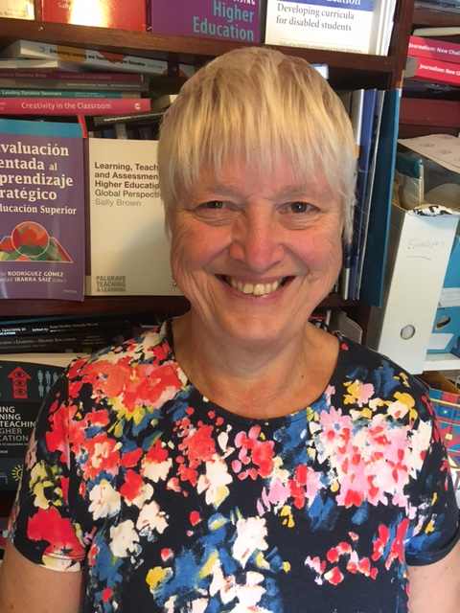
These and other slides are available on my website at http://sally-brown.net

Slide 29
Useful references and further reading
Bain, K. (2004) What the best College Teachers do, Cambridge: Harvard University Press.
Biggs, J. and Tang, C. (2011) Teaching for Quality Learning at University, Maidenhead: Open University Press.
Brown, S. (2014) Learning, teaching and assessment in higher education: global perspectives. London: Palgrave Macmillan.
Denton, S. and Brown, S. (2009) Beyond bureaucracy: managing the university year, London: Routledge
Mentkowski, M. and associates (2000) p.82 Learning that lasts: integrating learning development and performance in college and beyond, San Francisco: Jossey-Bass.
Meyer, J.H.F. and Land, R. (2003) ‘Threshold Concepts and Troublesome Knowledge 1 – Linkages to Ways of Thinking and Practising within the Disciplines’ in C. Rust (ed.) Improving Student Learning – Ten years on. Oxford: OCSLD.

Slide 30
More useful references
Morgan, C., Dunn, L., Parry, S. and O'Reilly, M. (2004) The student assessment handbook: New directions in traditional and online assessment, London, Routledge.
Race P. (2015) The lecturer’s toolkit (4th edition), London: Routledge.
Race, P. (2014) Making learning happen: 3rd edition, London: Sage.
Ryan, J. (2000) A Guide to Teaching International Students, Oxford Centre for Staff and Learning Development.
Saunders, M., 2000. Beginning an evaluation with RUFDATA: theorizing a practical approach to evaluation planning. Evaluation, 6(1), pp.7-21.
Sambell, K., Brown, S. and Graham, L. (2017) Professionalism in Practice: key directions in higher education learning, teaching and assessment. London, New York, Palgrave Macmillan
Smith, S. (2015) PhD by Published works: a practical guide for success Palgrave Macmillan

