Slide 1
Making a difference through assessment
University of Gloucestershire
21st February 2018
Sally Brown
PFHEA, SFSEDA, NTF
Emerita Professor, Leeds Beckett University
Visiting Professor: University of Plymouth, Liverpool John Moores University, Edge Hill University and University of South Wales.

Slide 2
Focus of this workshop
If we want to help students’ engagement with learning, a key locus of enhancement can be refreshing our approaches to assessment. Sometimes we need thoroughly to review our current practice to make sure assessment is for rather than just of learning since assessment is a complex, nuanced and highly important process.
In addition, we as educators in HE understand the importance of giving good feedback to students, both to maximise achievement and to support retention. Research in the field suggests that good feedback has a significant impact on student commitment and outcomes, enabling students to become adept at judging the quality of their own work during its production.

Slide 3
In this session, participants will have opportunities to:
Think playfully about the serious issues that underpin assessment that makes a difference;
Consider how we provide explicit and implicit messages to students and other stakeholders through how we assess;
Review how we can ensure that feedback and assessment strategies programme-wide integrate assessment with learning;
Plan ways to enhance current practice at an individual, module and institutional level that can make our assessment authentic, effective and time efficient.

Slide 4
Why is assessment such a big issue?
Good feedback and assessment practices are essential to student transition, learning and retention;
Student satisfaction surveys frequently highlight significant dissatisfaction around these issues;
Commuter students and others who have extra-study pressures often really value support with assessment;
In tough times, staff often find the pressure of achieving fast and formative feedback a heavy chore, especially when cohorts are large;
A key locus for engagement is assessment, since assignments give students cues about what we value, and they tend to regard marks like money.

Slide 5
So to help us focus on assessment criteria and developing students’ assessment literacy, a game!
This game is designed to help you think about how we can explain the importance of taking assessment criteria seriously in assessment to help students really understand what they need to do to succeed;
Biscuits are a metaphor!

Slide 6
Thinking through the issues raised in the biscuit game
It is often useful to start from individual perspectives at the outset of an assignment and clarify preconceptions;
Assessment is a complex nuanced task with grey areas, and just as agreed definitions of biscuits are not always readily achievable, so also assignments benefit from dialogue to clarify expectations;
Category definitions can sometimes be complicated when setting assignments. It’s helpful in advance of an assessment to agree definitions of what is, for example, a portfolio;
It’s helpful to face the fact that although criteria may be considered to be explicit, the way people grade using criteria can differ substantially;
Assigning grades is an imprecise and inexact activity, and we need to recognise that absolute certainty about grades is not always achievable;
Generic discussion about assessment, and how we grade can help develop assessment literacy.

Slide 7
Why does assessment matter so much?
“Assessment methods and requirements probably have a greater influence on how and what students learn than any other single factor. This influence may well be of greater importance than the impact of teaching materials” (Boud 1988)

Slide 8
Assessment linked to learning
Effective assessment significantly and positively impacts on student learning, (Boud, Mentkowski, Knight and Yorke and many others).
Assessment shapes student behaviour and poor assessment encourages strategic behaviour (Kneale). Clever course developers utilise this tendency and design assessment tools that foster the behaviours we would wish to see (for example, logical sequencing, fluent writing, effective referencing and good time management) and discourage others (‘rummage-sale’ data sourcing, aimless cutting and pasting and plagiarism).

Slide 9
Formative and summative assessment
Formative assessment is primarily concerned with feedback aimed at prompting improvement, is often continuous and usually involves words.
Summative assessment is concerned with making evaluative judgments, is often end point and involves numbers.

Slide 10
Determining and reviewing subject material: currency, relevance, level
Enhancing quality, seeking continuous improvement
Designing and refining learning outcomes
Evaluating programmes, strengths and areas for improvement
Curriculum
Design
Essentials
Considering delivery modes: face-to-face, online, PBL, blended…
Assuring quality, matching HEI, national and PRSB requirements
Thinking through student support
Designing fit for purpose assessment methods and approaches

Slide 11
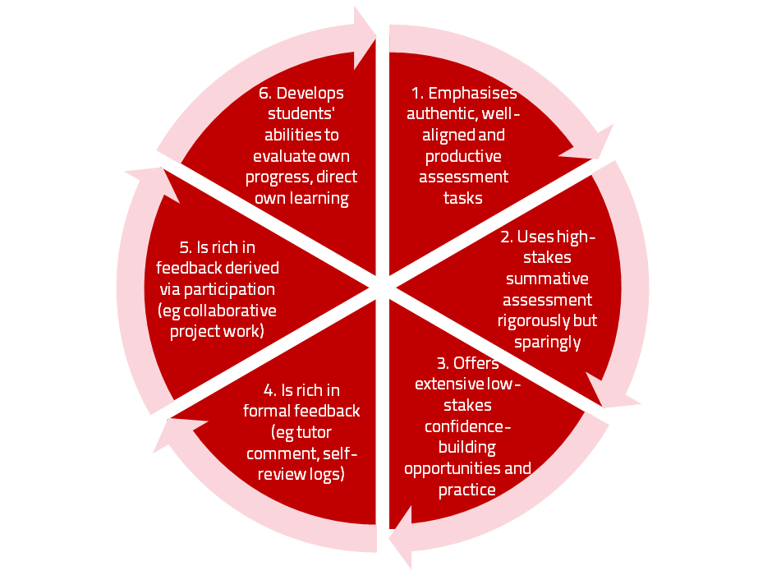
A4L the Northumbria model

Slide 12
Assessment literacy: students do better if they can:
Make sense of key terms such as criteria, weightings, and level;
Encounter a variety of assessment methods (e.g. presentations, portfolios, posters, assessed web participation, practicals, vivas etc) and get practice in using them;
Be strategic in their behaviours, putting more work into aspects of an assignment with high weightings, interrogating criteria to find out what is really required and so on;
Gain clarity on how the assessment regulations work in their HEI, including issues concerning submission, resubmission, pass marks, condonement etc.
Challenge: how are you developing students’ assessment literacy?

Slide 13
Assessment for learning
1. Tasks should be challenging, demanding higher order learning and integration of knowledge learned in both the university and other contexts;
2. Learning and assessment should be integrated, assessment should not come at the end of learning but should be part of the learning process;
3. Students are involved in self assessment and reflection on their learning, they are involved in judging performance;
4. Assessment should encourage metacognition, promoting thinking about the learning process not just the learning outcomes;
5. Assessment should have a formative function, providing ‘feedforward’ for future learning which can be acted upon. There is opportunity and a safe context for students to expose problems with their study and get help; there should be an opportunity for dialogue about students’ work;

Slide 14
Assessment for learning
6. Assessment expectations should be made visible to students as far as possible;
7. Tasks should involve the active engagement of students developing the capacity to find things out for themselves and learn independently;
8. Tasks should be authentic; worthwhile, relevant and offering students some level of control over their work;
9. Tasks are fit for purpose and align with important learning outcomes;
10. Assessment should be used to evaluate teaching as well as student learning.
(Bloxham and Boyd)

Slide 15
Fit-for-purpose assessment
Why do we assess?
How can we best assess?
What exactly are we assessing?
Who is best placed to assess?
When should we assess?

Slide 16
Ensuring assessment focuses efforts and promotes engagement means including reference to:
Assessment methodologies: which methods and approaches are most appropriate and efficient for the arts and design context?
Assessment agency: who should be undertaking assessment? Tutors, peers, students themselves, employers and clients can all participate in student assessment to good effect, but which is right for particular assessment activities?
Assessment timing: end point and continuous assessment can both be valuable, when should we assess students to maximise impact on student learning?
Assessment orientation: to what extent in each task would we wish to focus particularly on process or outcomes, or both?
Assessment inclusivity: how can we enable all students to achieve their highest personal potential?
Assessment efficiency: what can we do to make assessment fully embedded in learning for students?

Slide 17
Authentic assessment implies using assessment for learning (Sambell et al, 2017)
Assessment that is meaningful to students can provide them with a framework for activity;
“Students can escape bad teaching but they can’t escape bad assessment” (Boud, 1995);
Where assessment is fully part of the learning process and integrated within it, the act of being assessed can help students make sense of their learning;
Assessment should be formative, informative, developmental and remediable.
Challenge: how are you making your assignments authentic?

Slide 18


Slide 19
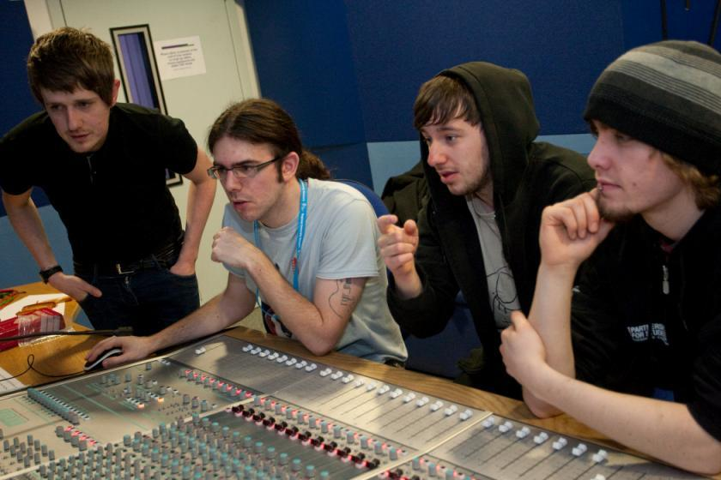
Authentic assessment can engage and motivate students

Slide 20
The benefits of authentic assessment can be significant for all stakeholders
Students undertaking authentic assessments tend to be more fully engaged in learning and hence tend to achieve more highly because they see the sense of what they are doing (Sadler, 2005).
University teachers adopting authentic approaches can use realistic and live contexts within which to frame assessment tasks, which help to make theoretical elements of the course come to life.
Employers value students who can quickly engage in real-life tasks immediately on employment, having practiced and developed relevant skills and competences through their assignments.

Slide 21
Questions employers might ask at interview that might help us frame some of our assignments
Can you tell us about an occasion when:
you worked together with colleagues in a group to produce a collective outcome?
you had to work autonomously with incomplete information and self-derived data sources?
you developed strategies to solve real life problems and tested them out?
you has a leadership role in a team, and could you tell us your strategies to influence and persuade your colleagues to achieve a collective task?
you had to communicate outcomes from your project work orally, in writing, through social media and/or through a visual medium?

Slide 22
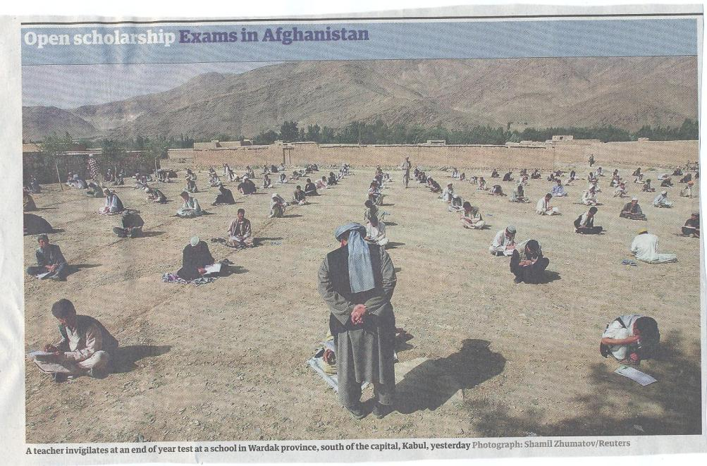

Slide 23
Encouraging students to take assessment more seriously
All assessment needs to be seen to be fair, consistent, reliable, valid and manageable;
Many assessment systems fail to clarify for students the purposes of different kinds of assessment activity;
Low-stakes early formative assessment helps students, especially those from disadvantaged backgrounds, understand the rules of the game.

Slide 24
The importance of dialogic assessment
Students need to be exposed to, and gain experience in making judgements about, a variety of works of different quality... They need planned rather than random exposure to exemplars, and experience in making judgements about quality. They need to create verbalised rationales and accounts of how various works could have been done better. Finally, they need to engage in evaluative conversations with teachers and other students. Together, these three provide the means by which students can develop a concept of quality that is similar in essence to that which the teacher possesses, and in particular to understand what makes for high quality. Although providing these experiences for students may appear to add more layers to the task of teaching, it is possible to organise this approach to peer assessment so that it becomes a powerful strategy for higher education teaching. (Sadler 2010)

Slide 25
How are you assessing in the first 6 weeks of the first semester of the 1st year to support transition?
Yorke and others argue that this is the crucial period in which we can set good learning and study patterns for the rest of undergraduate study;
No assessment or the wrong assessment can sabotage the transition into HE study;
We need to build in assessment that helps students develop assessment literacy, get the measure of their abilities, find out what they can’t yet do, and at the same time build rather than diminish confidence.
Challenge: what could you do in the first 6 weeks of semester one to build developmental assessment literacies into your programmes?

Slide 26
Good feedback practice:
Helps clarify what good performance is (goals, criteria, expected standards);
Facilitates the development of self-assessment (reflection) in learning;
Delivers high quality information to students about their learning;
Encourages teacher and peer dialogue around learning;
Encourages positive motivational beliefs and self-esteem;
Provides opportunities to close the gap between current and desired performance;
Provides information to teachers that can be used to help shape the teaching.
(after Nicol and MacFarlane-Dick, 2006)

Slide 27
To improve assessment we should realign it by:
Exploring ways in which assessment can engage students and be integral to learning;
Constructively aligning (Biggs 2011) assignments with planned learning outcomes and the curriculum taught;
Providing realistic tasks: students are likely to put more energy into assignments they see as authentic and worth bothering with;
Maximise the dialogic opportunities of student feedback.

Slide 28
Sound and frequent assessment
Good assessment is valid, reliable, practical, developmental, manageable, cost-effective, fit for purpose, relevant, authentic, inclusive, closely linked to learning outcomes and fair.
Is it possible also to make it enjoyable for staff and students?
Incremental assessment has more value in promoting student learning than end-point ‘sudden death’ approaches.

Slide 29
Planning checklist: to what extent does your assessment strategy:
Work at a programme level, rather than having assessment occur in module-shaped silos?
Maximise fast, formative feedback opportunities without driving your markers into the ground?
Support student transition and retention by making assessment integral to learning?
Enable the development of digital literacy by providing tasks that use social and digital media?
Make the process of assessing and being assessed enjoyable for staff and students?
Assure the standards of assessment against national and PSRB benchmarks?

Slide 30
And…
Provide incremental assessment opportunities?
Use assessment activities that can engage students and be integral to learning?
Constructively align (Biggs 2011) assignments with planned learning outcomes and the curriculum taught?
Provide realistic tasks: students are likely to put more energy into assignments they see as authentic and worth bothering with?
Maximise the dialogic opportunities of student feedback?

Slide 31
Conclusions and further challenges
If we are strategic in assessment design, it can be a powerful tool to support transition, focus student effort and ensure students are both engaged and achieve well. How can you improve yours?
Many assessment strategies are often under-designed, so we need to consider the fitness for purpose of each element of the assessment programme. Is yours fit-for-purpose?
Good assessment design includes careful planning of the assignment questions/tasks themselves, the briefings, the marking criteria, the moderation process and the feedback. How are you doing with yours?
Do you also scrutinise how the assignments align with one another, whether students are over or under-assessed, how far we are creating log-jams for students and markers, whether we are assessing authentically, and whether our processes are fair and sensible. How would you rate yourselves?

Slide 32
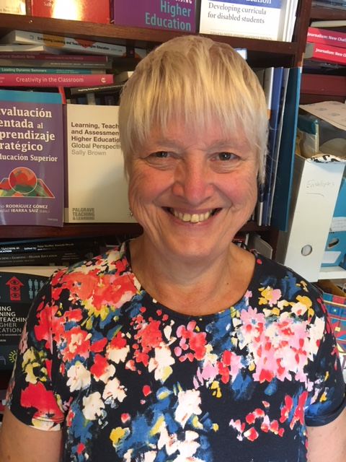
These and other slides are available on my website at http://sally-brown.net

Slide 33
Useful references: 1
Assessment Reform Group (1999) Assessment for Learning : Beyond the black box, Cambridge UK, University of Cambridge School of Education.
Biggs, J. and Tang, C. (2011) Teaching for Quality Learning at University, Maidenhead: Open University Press.
Bloxham, S. and Boyd, P. (2007) Developing effective assessment in higher education: a practical guide, Maidenhead, Open University Press.
Brown, S. Rust, C. & Gibbs, G. (1994) Strategies for Diversifying Assessment, Oxford: Oxford Centre for Staff Development.
Boud, D. (1995) Enhancing learning through self-assessment, London: Routledge.
Brown, S. and Glasner, A. (eds.) (1999) Assessment Matters in Higher Education, Choosing and Using Diverse Approaches, Maidenhead: Open University Press.
Brown, S. and Knight, P. (1994) Assessing Learners in Higher Education, London: Kogan Page.
Brown, S. and Race, P. (2012) Using effective assessment to promote learning in Hunt, L. and Chambers, D. (2012) University Teaching in Focus, Victoria, Australia, Acer Press. P74-91

Slide 34
Useful references 2
Carless, D., Joughin, G., Ngar-Fun Liu et al (2006) How Assessment supports learning: Learning orientated assessment in action Hong Kong: Hong Kong University Press.
Carroll, J. and Ryan, J. (2005) Teaching International students: improving learning for all. London: Routledge SEDA series.
Crosling, G., Thomas, L. and Heagney, M. (2008) Improving student retention in Higher Education, London and New York: Routledge
Crooks, T. (1988) Assessing student performance, HERDSA Green Guide No 8 HERDSA (reprinted 1994).
Falchikov, N. (2004) Improving Assessment through Student Involvement: Practical Solutions for Aiding Learning in Higher and Further Education, London: Routledge.
Gibbs, G. (1999) Using assessment strategically to change the way students learn, in Brown S. & Glasner, A. (eds.), Assessment Matters in Higher Education: Choosing and Using Diverse Approaches, Maidenhead: SRHE/Open University Press.
Higher Education Academy (2012) A marked improvement; transforming assessment in higher education, York: HEA.

Slide 35
Useful references 3
Knight, P. and Yorke, M. (2003) Assessment, learning and employability Maidenhead, UK: SRHE/Open University Press.
Mentkowski, M. and associates (2000) p.82 Learning that lasts: integrating learning development and performance in college and beyond, San Francisco: Jossey-Bass.
McDowell, L. and Brown, S. (1998) Assessing students: cheating and plagiarism, Newcastle: Red Guide 10/11 University of Northumbria.
Nicol, D. J. and Macfarlane-Dick, D. (2006) Formative assessment and self-regulated learning: A model and seven principles of good feedback practice, Studies in Higher Education Vol 31(2), 199-218.
PASS project Bradford http://www.pass.brad.ac.uk/ Accessed November 2013.
Pickford, R. and Brown, S. (2006) Assessing skills and practice, London: Routledge.
Race, P. (2001) A Briefing on Self, Peer & Group Assessment, in LTSN Generic Centre Assessment Series No 9, LTSN York.
Race P. (2015) The lecturer’s toolkit (4th edition), London: Routledge.

Slide 36
Useful references 4
Rust, C., Price, M. and O’Donovan, B. (2003) Improving students’ learning by developing their understanding of assessment criteria and processes, Assessment and Evaluation in Higher Education. 28 (2), 147-164.
Ryan, J. (2000) A Guide to Teaching International Students, Oxford Centre for Staff and Learning Development
Stefani, L. and Carroll, J. (2001) A Briefing on Plagiarism http://www.ltsn.ac.uk/application.asp?app=resources.asp&process=full_record&section=generic&id=10
Sadler, D. Royce (2010) Beyond feedback: developing student capability in complex appraisal,
Assessment & Evaluation in Higher Education, 35: 5, 535-550
Yorke, M. (1999) Leaving Early: Undergraduate Non-completion in Higher Education, London: Routledge.
Yorke, M., 2013. Using research findings to inform quality enhancement. Enhancing Quality in Higher Education: International Perspectives, p.49.
Zaitseva, E., Darwent, S. and Thompson, S., 2014. Implications for student support. Stepping Up to the Second Year at University: Academic, Psychological and Social Dimensions, p.68.

