Slide 1
Recent developments in assessment and feedback methodologies
Cork IT
January 2018
Sally Brown
PFHEA, SFSEDA, NTF
Emerita Professor, Leeds Beckett University
Visiting Professor: University of Plymouth, Liverpool John Moores University, Edge Hill University and University of South Wales.

Slide 2
Workshop focus
If we want to help students’ engagement with learning, a key locus of enhancement can be refreshing our approaches to assessment. Sometimes we need thoroughly to review our current practice to make sure assessment is for rather than just of learning since assessment is a complex, nuanced and highly important process.
In addition, we as educators in HE understand the importance of giving good feedback to students, both to maximise achievement and to support retention. Research in the field suggests that good feedback has a significant impact on student outcomes, enabling students to become adept at judging the quality of their own work during its production

Slide 3
In this workshop, participants will have opportunities to consider:
Fit-for-Purpose assessment, designing assessment to promote student learning;
Assessing more students: ways of using productive assessment with large numbers;
Assessing first year students well to promote retention;
Streamlining assessment: giving feedback effectively abnd efficiently.

Slide 4
Why is assessment such a big issue?
Good feedback and assessment practices are essential to student transition, learning and retention;
Student satisfaction surveys frequently highlight significant dissatisfaction around these issues;
In tough times, staff often find the pressure of achieving fast and formative feedback a heavy chore, especially when cohorts are large;
A key locus for engagement is assessment, since assignments give students cues about what we value, and they tend to regard marks like money.

Slide 5
Why does assessment matter so much?
“Assessment methods and requirements probably have a greater influence on how and what students learn than any other single factor. This influence may well be of greater importance than the impact of teaching materials” (Boud 1988)

Slide 6
Assessment linked to learning
Effective assessment significantly and positively impacts on student learning, (Boud, Mentkowski, Knight and Yorke and many others).
Assessment shapes student behaviour and poor assessment encourages strategic behaviour (Kneale). Clever course developers utilise this tendency and design assessment tools that foster the behaviours we would wish to see (for example, logical sequencing, fluent writing, effective referencing and good time management) and discourage others (‘rummage-sale’ data sourcing, aimless cutting and pasting and plagiarism).

Slide 7
Determining and reviewing subject material: currency, relevance, level
Enhancing quality, seeking continuous improvement
Designing and refining learning outcomes
Evaluating programmes, strengths and areas for improvement
Curriculum
Design
Essentials
Considering delivery modes: face-to-face, online, PBL, blended…
Assuring quality, matching HEI, national and PRSB requirements
Thinking through student support
Designing fit for purpose assessment methods and approaches

Slide 8
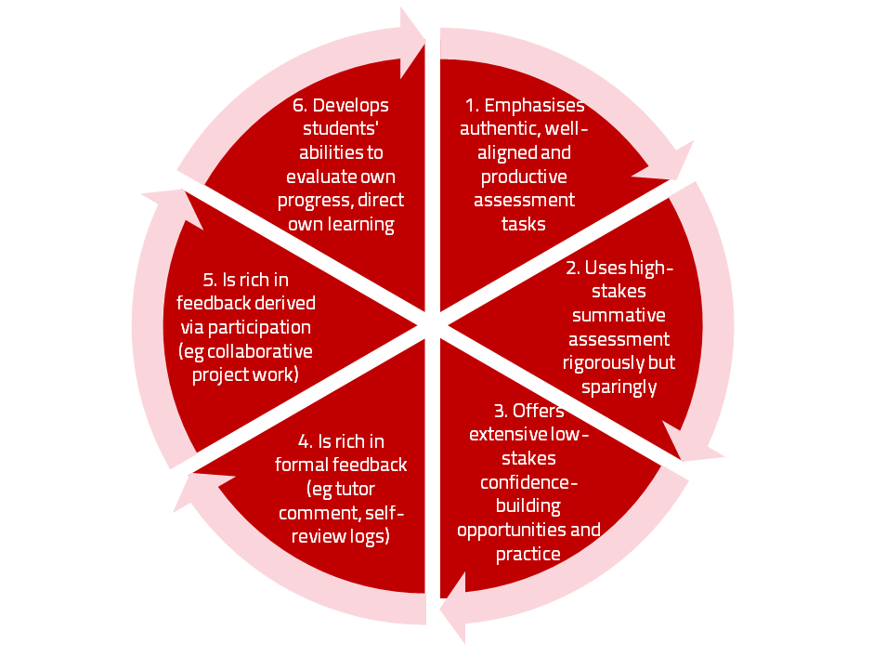
A4L the Northumbria model

Slide 9
Formative and summative assessment
Formative assessment is primarily concerned with feedback aimed at prompting improvement, is often continuous and usually involves words.
Summative assessment is concerned with making evaluative judgments, is often end point and involves numbers.

Slide 10
Assessment literacy: students do better if they can:
Make sense of key terms such as criteria, weightings, and level;
Encounter a variety of assessment methods (e.g. presentations, portfolios, posters, assessed web participation, practicals, vivas etc) and get practice in using them;
Be strategic in their behaviours, putting more work into aspects of an assignment with high weightings, interrogating criteria to find out what is really required and so on;
Gain clarity on how the assessment regulations work in their HEI, including issues concerning submission, resubmission, pass marks, condonement etc.

Slide 11
Assessment for learning
1. Tasks should be challenging, demanding higher order learning and integration of knowledge learned in both the university and other contexts;
2. Learning and assessment should be integrated, assessment should not come at the end of learning but should be part of the learning process;
3. Students are involved in self assessment and reflection on their learning, they are involved in judging performance;
4. Assessment should encourage metacognition, promoting thinking about the learning process not just the learning outcomes;
5. Assessment should have a formative function, providing ‘feedforward’ for future learning which can be acted upon. There is opportunity and a safe context for students to expose problems with their study and get help; there should be an opportunity for dialogue about students’ work;

Slide 12
Assessment for learning
6. Assessment expectations should be made visible to students as far as possible;
7. Tasks should involve the active engagement of students developing the capacity to find things out for themselves and learn independently;
8. Tasks should be authentic; worthwhile, relevant and offering students some level of control over their work;
9. Tasks are fit for purpose and align with important learning outcomes;
10. Assessment should be used to evaluate teaching as well as student learning.
(Bloxham and Boyd)

Slide 13
Fit-for-purpose assessment
Why do we assess?
How can we best assess?
What exactly are we assessing?
Who is best placed to assess?
When should we assess?

Slide 14
Ensuring assessment focuses efforts and promotes engagement means including reference to:
Assessment methodologies: which methods and approaches are most appropriate and efficient for the arts and design context?
Assessment agency: who should be undertaking assessment? Tutors, peers, students themselves, employers and clients can all participate in student assessment to good effect, but which is right for particular assessment activities?
Assessment timing: end point and continuous assessment can both be valuable, when should we assess students to maximise impact on student learning?
Assessment orientation: to what extent in each task would we wish to focus particularly on process or outcomes, or both?
Assessment inclusivity: how can we enable all students to achieve their highest personal potential?
Assessment efficiency: what can we do to make assessment fully embedded in learning for students?

Slide 15
Authentic assessment implies using assessment for learning (Sambell et al, 2017)
Assessment that is meaningful to students can provide them with a framework for activity;
“Students can escape bad teaching but they can’t escape bad assessment” (Boud, 1995);
Where assessment is fully part of the learning process and integrated within it, the act of being assessed can help students make sense of their learning;
Assessment should be formative, informative, developmental and remediable.

Slide 16


Slide 17

Authentic assessment can engage and motivate students

Slide 18
The benefits of authentic assessment can be significant for all stakeholders
Students undertaking authentic assessments tend to be more fully engaged in learning and hence tend to achieve more highly because they see the sense of what they are doing (Sadler, 2005).
University teachers adopting authentic approaches can use realistic and live contexts within which to frame assessment tasks, which help to make theoretical elements of the course come to life.
Employers value students who can quickly engage in real-life tasks immediately on employment, having practiced and developed relevant skills and competences through their assignments.

Slide 19
Questions employers might ask at interview that might help us frame some of our assignments
Can you tell us about an occasion when:
you worked together with colleagues in a group to produce a collective outcome?
you had to work autonomously with incomplete information and self-derived data sources?
you developed strategies to solve real life problems and tested them out?
you has a leadership role in a team, and could you tell us your strategies to influence and persuade your colleagues to achieve a collective task?
you had to communicate outcomes from your project work orally, in writing, through social media and/or through a visual medium?

Slide 20
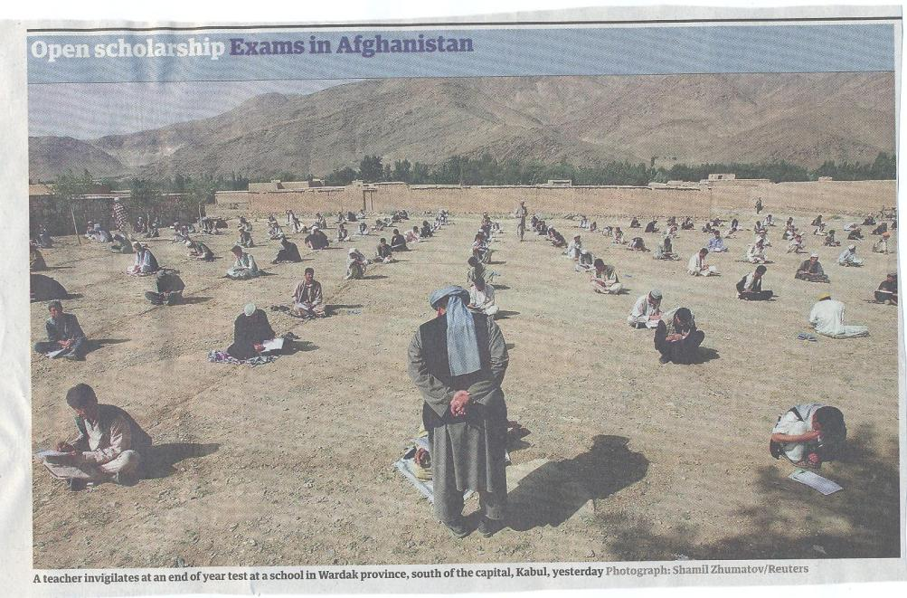

Slide 21
Encouraging students to take assessment more seriously
All assessment needs to be seen to be fair, consistent, reliable, valid and manageable;
Many assessment systems fail to clarify for students the purposes of different kinds of assessment activity;
Low-stakes early formative assessment helps students, especially those from disadvantaged backgrounds, understand the rules of the game.

Slide 22
The importance of dialogic assessment
Students need to be exposed to, and gain experience in making judgements about, a variety of works of different quality... They need planned rather than random exposure to exemplars, and experience in making judgements about quality. They need to create verbalised rationales and accounts of how various works could have been done better. Finally, they need to engage in evaluative conversations with teachers and other students. Together, these three provide the means by which students can develop a concept of quality that is similar in essence to that which the teacher possesses, and in particular to understand what makes for high quality. Although providing these experiences for students may appear to add more layers to the task of teaching, it is possible to organise this approach to peer assessment so that it becomes a powerful strategy for higher education teaching. (Sadler 2010)

Slide 23
How are you assessing in the first 6 weeks of the first semester of the 1st year to support transition?
Yorke and others argue that this is the crucial period in which we can set good learning and study patterns for the rest of undergraduate study;
No assessment or the wrong assessment can sabotage the transition into HE study;
We need to build in assessment that helps students develop assessment literacy, get the measure of their abilities, find out what they can’t yet do, and at the same time build rather than diminish confidence.

Slide 24
Good feedback practice:
Helps clarify what good performance is (goals, criteria, expected standards);
Facilitates the development of self-assessment (reflection) in learning;
Delivers high quality information to students about their learning;
Encourages teacher and peer dialogue around learning;
Encourages positive motivational beliefs and self-esteem;
Provides opportunities to close the gap between current and desired performance;
Provides information to teachers that can be used to help shape the teaching.
(after Nicol and MacFarlane-Dick, 2006)

Slide 25
To improve assessment we should realign it by:
Exploring ways in which assessment can engage students and be integral to learning;
Constructively aligning (Biggs 2007) assignments with planned learning outcomes and the curriculum taught;
Providing realistic tasks: students are likely to put more energy into assignments they see as authentic and worth bothering with;
Maximise the dialogic opportunities of student feedback.

Slide 26
Sound and frequent assessment
Good assessment is valid, reliable, practical, developmental, manageable, cost-effective, fit for purpose, relevant, authentic, inclusive, closely linked to learning outcomes and fair.
Is it possible also to make it enjoyable for staff and students?
Incremental assessment has more value in promoting student learning than end-point ‘sudden death’ approaches.

Slide 27
Efficient assessment; we need to:
Stop marking, start assessing!
Explore ways to maximise student ‘time on task’ (Gibbs) and minimise staff drudgery;
Remember that feedback is crucial to student learning but is the most time-consuming aspect of assessment: we need to explore ways of giving feedback effectively and efficiently;
Note that Computer-supported assessment can include use of audio feedback via digital sound files, video commentaries and other means of using course Virtual Learning Environments.

Slide 28
To give feedback more effectively
& efficiently, we can:
Feedback orally to groups of students;
Write an assignment report;
Use model answers;
Using exemplars;
Use assignment return sheets;
Use statement banks;
Use technologies for delivering and managing assessment.

Slide 29
Feeding back orally to groups of students: why?
Face-to-face feedback uses tone of voice, emphasis, body language;
Students learn from feedback to each others’ work;
Students can ask questions;
Makes feedback a shared experience.

Slide 30
Feeding back orally to groups of students: how?
Staff mark assignments with minimal in-text comment and provide grades/marks as normal;
At the start of a lecture or seminar, the tutor provides an overview of class performance and orally remediates errors, clarifies; misunderstandings, and praises good practice;
Students have a chance to ask and answer questions;
An audio file can be made available on the VLE.

Slide 31
Written assignment reports: why?
Provides feedback to a group as a whole;
Allows students to know how they are doing by comparison with the rest of the course;
Offers a chance to illustrate good practice;
Minimal comments can be put on scripts;
Generic reports can be delivered quickly electronically before moderation.

Slide 32
Assignment reports: how?
Staff mark assignments with minimal in-text comment and provide grades/marks as normal;
Notes are made of similar points from several students’ work;
A report is compiled which identifies examples of good practice, areas where a number of students made similar errors and additional reading suggestions.

Slide 33
Using ‘expanded’ model answers: why?
They give students a good idea of what can be expected of them;
It is sometimes easier to show students than tell them what we are after;
They can be time efficient;
They show how solutions have been reached;
They demonstrate good practice;
The commentary can indicate why an answer is good.

Slide 34
What are exemplars, and how can we use them productively?
Exemplars are not model answers. They are carefully selected examples of authentic student work from previous cohorts (anonymised and with permission) or teacher-constructed examples (based on your extensive experience of the kinds of responses and common mistakes students make). They are chosen to typify and illustrate designated levels of quality or competence.
The concrete nature of exemplars means that they are able to convey messages in a way that nothing else can (Sadler, 2002). Carefully selected examples can not only help students to ‘see’ what the teacher expects with regard to the task in hand (Scoles et al, 2013), but also guide their action.

Slide 35
Exemplars can enable students to:
gain a feel for what the final product looks like in terms of layout, structure and language;
develop their insights into the nature of academic writing;
raise awareness of the diverse ways a task might fruitfully (or erroneously) be tackled;
hone students’ evaluative skills.
Act as powerful learning tools (Sadler, 2010), helping students gain insight into the nature of quality and standards, ideally through close analysis and discussion (Hendry et al, 2016). Students typically find exemplars to be more useful than standalone lists of criteria, grids and rubrics (Hawe et al, 2017).

Slide 36
What can we do when using exemplars?
Choose examples which will help students firmly grasp task requirements;
Help students practice applying criteria to samples of work;
Enable students to reflect deeply on, and discuss, what high quality work looks like;
Choose examples to promote self-efficacy;
Carefully orchestrate discussion activities to promote understanding of fruitful learning strategies and approaches;
Use exemplars-based activities to develop students’ skills to monitor their own work while they are producing it;
Help them rate their work by comparison with their peers.

Slide 37
Using model answers: how?
Staff preparing an assignment can draft a model answer;
Student work (or extracts from several student’s answers) can be anonymised and (with permission) used as a model;
Text can be placed on page with explanatory comments appended (‘exploded text’);
However, caution should be exercised in order to lead students to think only one approach is acceptable.

Slide 38
Assignment return sheets: why?
Proformas save assessors writing the same thing repeatedly;
Helps to keep assessors’ comments on track;
Shows how criteria match up to performance and how marks are derived;
Helps students to see what is valued;
Provides a useful written record.

Slide 39
Assignment return sheets: how?
Criteria presented in assignment brief can be utilised in a proforma;
Variations in weighting can be clearly identified;
A Likert scale or boxes can be used to speed tutor’s responses;
Space can be provided for individual comments.

Slide 40
Sample assignment return proforma
Criterion no | Criterion | Mark (0-5 marks) | Tutor comments and suggestions for further work | Student response
1 | Demonstrates ability to present information clearly logically, accurately and fluently | 3 | This work is written reasonably fluently but there are some typos that would not slip in if spell checker used properly. Also note you don’t use the definite and indefinite articles (‘a’ and ‘the’ appropriately: please refer to the language guidance 17.3 on the VLE | This is something I’ve had problems with over the years but am still working on it
2 | Demonstrates ability to choose and use appropriate software | 5 | Made excellent choices and used it well to suit the context of the problem being addressed | Thank you
3 | Demonstrates ability to use a range of reference materials and cite them appropriately | 1 | Cited only one reference and did so inaccurately Please refer to the ifs referencing guide on the VLE and ensure that you provide all the information required | I've checked it out and see where I was going wrong

Slide 41
Statement banks: why?
Harnesses a resource of comments you already use;
Avoids writing same comments repeatedly;
Allows you to give individual comments additionally to the students who really need them;
Can be automated with use of technology.

Slide 42
Statement banks: how?
Tutor identifies a range of regularly used comments written on students’ work;
These are collated and numbered;
Tutor marks work and writes numbers on text of assignment where specific comments apply, or provides a written (or emailed) detailed commentary which pulls together the appropriate items into continuous prose;
Moodle and other platforms can do much of the drudgery in terms of collating marks, returning work etc. Assignment handler can return comments and only release marks when students have commented.

Slide 43
Computer-assisted assessment: why?
Enables feedback to be given regularly and incrementally;
Saves tutor time for large cohorts and repeated classes;
Can allow instant (or rapid) on screen feedback to e.g. MCQ options;
Saves drudgery, (but not a quick fix);
Is really worth while for large cohorts and where content doesn’t alter fast.

Slide 44
Checklist: to what extent does your assessment strategy:
Work at a programme level, rather than having assessment occur in module-shaped silos?
Maximise fast, formative feedback opportunities without driving your markers into the ground?
Support student transition and retention by making assessment integral to learning?
Enable the development of digital literacy by providing tasks that use social and digital media?
Make the process of assessing and being assessed enjoyable for staff and students?
Assure the standards of assessment against national and PSRB benchmarks?

Slide 45
And…
Provide incremental assessment opportunities?
Use assessment activities that can engage students and be integral to learning?
Constructively align (Biggs 2003) assignments with planned learning outcomes and the curriculum taught?
Provide realistic tasks: students are likely to put more energy into assignments they see as authentic and worth bothering with?
Maximise the dialogic opportunities of student feedback?

Slide 46
Conclusions
If we are strategic in assessment design, it can be a powerful tool to support transition, focus student effort and ensure students are both engaged and achieve well;
However, many assessment strategies are often under-designed, so we need to consider the fitness for purpose of each element of the assessment programme;
This will include the assignment questions/tasks themselves, the briefings, the marking criteria, the moderation process and the feedback;
We also need to scrutinise how the assignments align with one another, whether we are over or under-assessing, whether we are creating log-jams for students and markers, whether we are assessing authentically, and whether our processes are fair and sensible.
If we do all this, assessment can genuinely make a marked improvement in student learning.

Slide 47

These and other slides are available on my website at http://sally-brown.net

Slide 48
Useful references: 1
Assessment Reform Group (1999) Assessment for Learning : Beyond the black box, Cambridge UK, University of Cambridge School of Education.
Biggs, J. and Tang, C. (2007) Teaching for Quality Learning at University, Maidenhead: Open University Press.
Bloxham, S. and Boyd, P. (2007) Developing effective assessment in higher education: a practical guide, Maidenhead, Open University Press.
Brown, S. Rust, C. & Gibbs, G. (1994) Strategies for Diversifying Assessment, Oxford: Oxford Centre for Staff Development.
Boud, D. (1995) Enhancing learning through self-assessment, London: Routledge.
Brown, S. and Glasner, A. (eds.) (1999) Assessment Matters in Higher Education, Choosing and Using Diverse Approaches, Maidenhead: Open University Press.
Brown, S. and Knight, P. (1994) Assessing Learners in Higher Education, London: Kogan Page.
Brown, S. and Race, P. (2012) Using effective assessment to promote learning in Hunt, L. and Chambers, D. (2012) University Teaching in Focus, Victoria, Australia, Acer Press. P74-91

Slide 49
Useful references 2
Carless, D., Joughin, G., Ngar-Fun Liu et al (2006) How Assessment supports learning: Learning orientated assessment in action Hong Kong: Hong Kong University Press.
Carroll, J. and Ryan, J. (2005) Teaching International students: improving learning for all. London: Routledge SEDA series.
Crosling, G., Thomas, L. and Heagney, M. (2008) Improving student retention in Higher Education, London and New York: Routledge
Crooks, T. (1988) Assessing student performance, HERDSA Green Guide No 8 HERDSA (reprinted 1994).
Falchikov, N. (2004) Improving Assessment through Student Involvement: Practical Solutions for Aiding Learning in Higher and Further Education, London: Routledge.
Gibbs, G. (1999) Using assessment strategically to change the way students learn, in Brown S. & Glasner, A. (eds.), Assessment Matters in Higher Education: Choosing and Using Diverse Approaches, Maidenhead: SRHE/Open University Press.
Higher Education Academy (2012) A marked improvement; transforming assessment in higher education, York: HEA.

Slide 50
Useful references 3
Knight, P. and Yorke, M. (2003) Assessment, learning and employability Maidenhead, UK: SRHE/Open University Press.
Mentkowski, M. and associates (2000) p.82 Learning that lasts: integrating learning development and performance in college and beyond, San Francisco: Jossey-Bass.
McDowell, L. and Brown, S. (1998) Assessing students: cheating and plagiarism, Newcastle: Red Guide 10/11 University of Northumbria.
Nicol, D. J. and Macfarlane-Dick, D. (2006) Formative assessment and self-regulated learning: A model and seven principles of good feedback practice, Studies in Higher Education Vol 31(2), 199-218.
PASS project Bradford http://www.pass.brad.ac.uk/ Accessed November 2013.
Pickford, R. and Brown, S. (2006) Assessing skills and practice, London: Routledge.
Race, P. (2001) A Briefing on Self, Peer & Group Assessment, in LTSN Generic Centre Assessment Series No 9, LTSN York.
Race P. (2015) The lecturer’s toolkit (4th edition), London: Routledge.

Slide 51
Useful references 4
Rust, C., Price, M. and O’Donovan, B. (2003) Improving students’ learning by developing their understanding of assessment criteria and processes, Assessment and Evaluation in Higher Education. 28 (2), 147-164.
Ryan, J. (2000) A Guide to Teaching International Students, Oxford Centre for Staff and Learning Development
Stefani, L. and Carroll, J. (2001) A Briefing on Plagiarism http://www.ltsn.ac.uk/application.asp?app=resources.asp&process=full_record&section=generic&id=10
Sadler, D. Royce (2010) Beyond feedback: developing student capability in complex appraisal,
Assessment & Evaluation in Higher Education, 35: 5, 535-550
Yorke, M. (1999) Leaving Early: Undergraduate Non-completion in Higher Education, London: Routledge.
Yorke, M., 2013. Using research findings to inform quality enhancement. Enhancing Quality in Higher Education: International Perspectives, p.49.
Zaitseva, E., Darwent, S. and Thompson, S., 2014. Implications for student support. Stepping Up to the Second Year at University: Academic, Psychological and Social Dimensions, p.68.

