Slide 1
Enthusing and energising students: celebrating and recognising excellent teaching
University of Greenwich
5th January 2018
Sally Brown NTF, PFHEA, SFSEDA
@ProfSallyBrown
sally@sally-brown.net
Emerita Professor, Leeds Beckett University
Visiting Professor: University of Plymouth, University of South Wales, Liverpool John Moores University and Edge Hill University

Slide 2
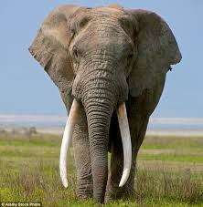
Everyone wants excellent teaching but what does it look like and how can we know it when we see it?

Slide 3
What is excellent teaching?
The claimed purposes of the Teaching Excellence Framework set up in 2015 were to “ensure all students receive an excellent teaching experience that encourages original thinking, drives up engagement and prepares them for the world of work”.
There is little consensus across the sector, however, on what Teaching Excellence actually comprises and how best it can be measured, since it manifests itself in many different forms.
Most agree nevertheless, that outcomes of outstanding teaching must relate directly to effective and productive learning, which many current metrics fail to evidence.

Slide 4
What’s this keynote about?
This keynote will include opportunities to
consider what are the fundamental characteristics of excellent teaching according to the research literature;
review a range of UK and other schemes that aim to recognize and reward it.
explore how all of us involved in teaching and supporting learning can ourselves work towards giving our students excellent learning opportunities through passion, preparation and a commitment to evidence-led approaches to innovation and good practice through continuous professional and personal development.

Slide 5
‘Teaching at the heart of the system’,
What Jo Johnson said (1 July 2015):
As well as aiming to ensure all students receive an excellent teaching experience that encourages original thinking, drives up engagement and prepares them for the world of work, the TEF was designed to:
build a culture where teaching has equal status with research, with great teachers enjoying the same professional recognition and opportunities for career and pay progression as great researchers;
stimulate a diverse HE market and provide students with the information they need to judge teaching quality – in the same way they can already compare a faculty’s research rating;
recognise those institutions that do the most to welcome students from a range of backgrounds and support their retention and progression to further study or a graduate job.

Slide 6
The OECD view
"Teaching excellence is about ensuring that the right mix of knowledge and skills is delivered in effective, equitable and efficient ways"
OECD @OECDEduSkills

Slide 7
What can a Teaching Excellence Framework measure?
People with different agendas define teaching excellence differently;
The TEF has thrown into sharp focus the complexity of defining metrics that actually measure the impact of excellent teaching rather than extraneous factors including prior advantage as measured by graduate salaries;
Is it the teaching we should be measuring, or is it the learning, or the added value/ ipsative development, or other things?
Is ‘Teaching Intensity’ a meaningful concept?
Is there any logic whatsoever in an institutional TEF score (and is subject-level TEF worth pursuing? Would it be simply reversion to old-style QAA subject review?)

Slide 8
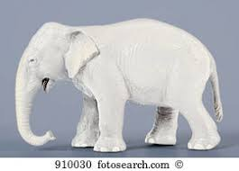
Some problems with TEF
Significantly reducing the impact of NSS on TEF scores means a diminution of the student voice in the exercise;
If there is no link with the ability of HEIs to increase fees above inflation, why would institutions, especially those who don’t think they will do well, bother to engage?
Sector concerns that the TEF is being manipulated to ensure that ‘the right universities’ will do best is making many of us cynical.

Slide 9
What about scholarly publications?
We can count the number of articles published in high reputation journals about aspects of teaching, learning and assessment by an individual or institution, but does this demonstrate teaching excellence on the ground?
However, a university like Plymouth that has a Pedagogical Research Institute (Pedrio) can evidence a critical mass of researchers committed to the scholarship of teaching, which is likely to be an outward and visible sign of a commitment to teaching excellence;
The position of authorship/editorship of books and textbooks and chapter authorship is contested. Is it more important to be scholarly or useful? (probably a mix of both!)
And what about THES, newspaper articles, government reports, project outcomes, websites, social media?

Slide 10

And evaluating just ‘teaching’ is only part of the job. We need also to ask:
How effective and fit-for-purpose is curriculum design for the current era?
How valid and reliable are the HEI’s assessment systems and processes at genuinely reflecting student achievement?
How good are the university’s admin and technical systems at fostering a positive learning environment?
How committed is the university to offering thoughtful and inclusive student support environment?
How strong are the teams who undertake teaching and who lead and manage universities?

Slide 11

Laurentius de Voltolina
2nd half of 14th Century
Italian Painter

Slide 12
How good are you at teaching and supporting learning?
What evidence demonstrates how well you:
teach in a variety of contexts including, for example lectures, seminars, field work, lab work, studio work, on-line teaching, doctoral supervision ……?
foster employability, provide inclusive learning environments, promote inter-cultural experiences….?
assess and give feedback to your students?
act as a mentor to colleagues?
use technology to support your teaching?
maintain your professional competence through CPD?
disseminate your good pedagogic practice through publications and conferences?
evaluate yourself in all of these roles?

Slide 13

From Jason Elsom
(@Jason Elsom)

Slide 14
High quality teaching…
…“implies recognising that students must be engaged with the content of learning tasks in a way that is likely to enable them to reach understanding…Sharp engagement, imaginative inquiry and finding of a suitable level and style are all more likely to occur if teaching methods that necessitate student energy, problem solving and cooperative learning are employed.” (Ramsden, 2003, p97)

Slide 15
A tall order?
Effective lecturers combine the talents of a scholar, writer, producer, comedian, showman and teacher in ways that contribute to student learning. Nevertheless it is also true that few college professors combine these talents in optimal ways and that even the best lecturers are not always on top form.
McKeachie et al p.53

Slide 16


Slide 17
Some characteristics of excellent teaching as described in the scholarly literature (inter alia Bain 2004, Biggs and Tang, 2011, Ramsden, 1991)
Knows subject material thoroughly
Adopts a scholarly approach to the practice of teaching
Is reflective and regularly reviews own practice
Is well organised and plans curriculum effectively
Is passionate about teaching
Has a student-centred orientation to teaching
Regularly reviews innovations in learning and teaching and tries out ones relevant to own context
Ensures that assessment practices are fit for purpose and contribute to learning
Demonstrates empathy and emotional intelligence

Slide 18
Characteristics of excellent university teachers: diamond-9
1
2
2
3
3
3
4
4
5

Slide 19
The HEA teaching excellence scheme is an umbrella scheme made up of a range of awards:
The National Teaching Fellows Scheme;
Collaborative Award for Teaching Excellence;
Teaching Excellence Ambassadors.
See the HEA website https://www.heacademy.ac.uk/individuals/national-teaching-fellowship-scheme/NTF?utm_source=CRM&utm_campaign=Professional%20Practice%20-%20NTFS&utm_medium=Email&utm_content=HEA%20Update%20March%202017

Slide 20
What does the National Teaching Fellowship scheme seek to identify?
The three criteria:
Individual excellence: evidence of enhancing and transforming the student learning experience commensurate with the individual’s context and the opportunities afforded by it.
Raising the profile of excellence: evidence of supporting colleagues and influencing support for student learning; demonstrating impact and engagement beyond the nominee’s immediate academic or professional role.
Developing excellence: evidence of the nominee’s commitment to her/his ongoing professional development with regard to teaching and learning and/or learning support.

Slide 21
What makes an inspiring teacher?
Inspiring teachers tend to be systematic, consistent, well-prepared and compelling: they can usually work well at different levels and in diverse contexts;
There are no standard recipes by which we can cook up inspiring teaching, but there are some features we can combine in imaginative ways to create tasty and satisfying outcomes;
Inspiring teaching comes in many different forms, and inspiring teachers develop their own styles and approaches that suit them (and their learners) well.

Slide 22
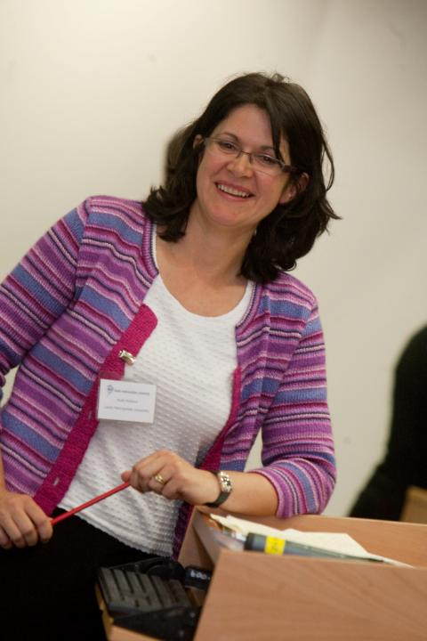
Here’s one! Ruth Pickford

Slide 23
Why is she a great teacher?
Unafraid to take risks but leaves nothing to chance;
Articulates a clear rationale of what she is trying to achieve in her teaching and makes detailed plans on how to achieve it;
Worries less about what students think about her than how much they are learning;
Capable of being seriously quirky without being ‘up herself’;
Continuously challenges students out of their comfort zones;
Continues to work at the cutting edge of pedagogic research.

Slide 24
How do HEIs know if we are offering excellent student experiences?
Students are satisfied, learn well, achieve highly and have fulfilling learning experiences;
Students develop a range of competences they need including problem solving, working with others and self-management;
We as practioners are satisfied, motivated and find our workloads manageable;
Quality assurers and Professional and Subject bodies like what we do and have no complaints about systems and processes;
University managers are confident that the student experience offered is of high quality (and deal with few complaints).

Slide 25
How can we breathe life into our teaching?
Work out what are your key strengths and play to them: find your individual teaching voice;
Challenge yourself regularly to try new things in the classroom, including things that frighten you a little;
While content knowledge is important, put as much effort into planning process as you do delivery;
Vary the technologies you use (for example, why not try ‘clickers’ one week, and low tech in-class tests another and replace PowerPoint with Prezi? (mmmmm!!!);
Sometimes plan the tasks and resources but have no formal presentation element.

Slide 26
How can you use colleagues to help you energise classes?
Explore the extent to which you can use live or virtual ‘expert witnesses’ and ‘guest appearances’ in your classes;
Can you plant a well-prepared ‘interrupter’ in a session who challenges your point of view, offers alternative perspectives and proposes different perspectives?
Try out team teaching occasionally, with reciprocal support for colleagues;
Use peer review to help you improve your own teaching and assessment practise.

Slide 27
Ken Bain says excellent teachers ask these questions as they prepare to teach:
What should my students be able to do intellectually, physically, or emotionally as a result of their learning?
How can I best help and encourage them to develop those abilities and habits of the heart and to use them?
How can my students and I best understand the nature, quality, and progress of their learning?
How can I evaluate my efforts to foster that learning? (Bain, 2004 p. 49)

Slide 28
Reflective teachers
If we are to be effective university teachers, we need to review our own practices regularly and reflectively. This can ensure we not only keep ourselves up to date with curriculum content but also with relevant and current approaches to teaching.
Reflection on practice, when practised regularly, can have a positive impact on teachers’ effectiveness as teachers and can enhance their engagement and enjoyment.
Research indicates that those engaged in peer review of teaching not only benefit from opportunities to discuss their own practices, but also significantly learn a great deal from watching others teach and discussing alternative approaches.

Slide 29
Why is peer review so beneficial? The purposes of peer review include:
providing us with opportunities, both through observing and being observed in teaching sessions, to reflect on and review our teaching skills with the assistance of our colleagues.
identifying good practice, and needs which we can address, to ensure our ongoing personal and professional development.
helping us to continue to learn from each other, towards developing shared understandings of best practices in assessment, learning and teaching.
giving us continuing opportunities to observe students as they learn in colleagues’ teaching sessions, and reflect on how we can enhance their learning in our own sessions.
allowing us to gain from mutually beneficial learning experiences through the processes of observing colleagues and being observed ourselves.
helping us to learn new tricks from one another (old colleagues learn much from new staff and they in turn can teach new colleagues old tricks!).
identifying generic development needs, to feed into ongoing and future staff development activities.

Slide 30
Reflection on my teaching
What areas of my teaching practice do I want to develop?
What new technologies would I like to incorporate in my teaching?
How much do I need to update the subject content of my teaching?
Who could I usefully learn from about inspiring teaching?
Who can I help to be a good teacher by mentoring them?
What reading and further study about pedagogy might benefit my teaching?

Slide 31
So what are you going to do?
To refresh your own practice?
To gain more satisfaction from teaching?
To improve your teaching techniques and practices?
To mentor and support new colleagues?
To learn from the long-serving members of staff who may be about to leave?

Slide 32

These and other slides are available on my website at http://sally-brown.net

Slide 33
Useful references and further reading
Bain, K. (2004) “What the best College Teachers do” Cambridge Harvard University Press.
Biggs, J. and Tang, C. (2011) Teaching for Quality Learning at University, Maidenhead: Open University Press.
Brown, S. (2015) Learning , Teaching and Assessment in Higher Education: Global perspectives, London, Palgrave.
McKeachie, W. J. (1951) Teaching Tips: Strategies, Research and Theory for College and University Teachers, Lexington MA: D. C. Heath and Company.
Meyer, J.H.F. and Land, R. (2003) ‘Threshold Concepts and Troublesome Knowledge 1 – Linkages to Ways of Thinking and Practising within the Disciplines’ in C. Rust (ed.) Improving Student Learning – Ten years on. Oxford: OCSLD.
Race P. (2015) The lecturer’s toolkit (4th edition), London: Routledge.
Ramsden, P. (1991) A performance indicator of teaching quality in higher education: The Course Experience Questionnaire, Studies in Higher Education, Volume 16, 1991 – Issue 2
Yorke, M. (1999) Leaving Early: Undergraduate Non-completion in Higher Education, London: Routledge.

