Slide 1
Enhancing assessment Focusing on what we are assessing and why, how we provide feedback and integrating this into our learning strategies
Edinburgh Napier University
School of Arts and Creative Industries
Wednesday 6 December, 2017 10.00-1.00
Sally Brown NTF, PFHEA, SFSEDA
@ProfSallyBrown sally@sally-brown.net
Emerita Professor, Leeds Beckett University
Visiting Professor: University of Plymouth, University of South Wales, Edge Hill University & Liverpool John Moores University.

Slide 2
The purpose of the sessions today on assessment and feedback
Edinburgh Napier University is working hard to improve feedback and assessment across the board;
Enhancing assessment and feedback is crucial for student satisfaction and achievement;
SACI NSS results on assessment and feedback are mixed, with some problems around clear marking criteria, marking and assessment fairness, timeliness of feedback and whether students are challenged to achieve their best work;
The sessions today aim to help staff design good assessments that genuinely are integrated with learning;
We aim to provide dialogic opportunities to improve assessment and feedback because this is proven to work!

Slide 3
This workshop will focus on
What we are assessing and why, leading to enhanced assessment design;
Integrating fully assessment and feedback within the learning strategy of a module/programme
Aiming for consistency across programmes;
Streamlining assessment and feedback;
Planning to implement enhancements.

Slide 4
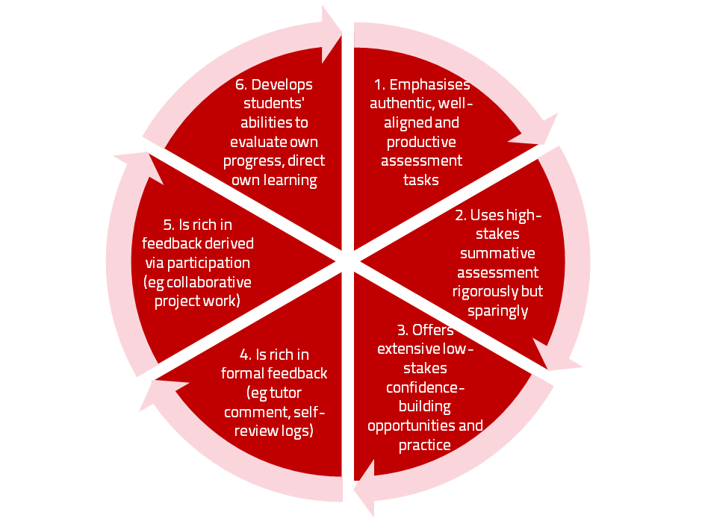
A4L the Northumbria model

Slide 5
Using assessment for learning (Sambell et al, 2012)
Assessment that is meaningful to students can provide them with a framework for activity;
“Students can escape bad teaching but they can’t escape bad assessment” (Boud, 1995);
Where assessment is fully part of the learning process and integrated within it, the act of being assessed can help students to make sense of their learning;
Assessment should be formative, informative, developmental and remediable.

Slide 6
Determining and reviewing subject material: currency, relevance, level
Enhancing quality, seeking continuous improvement
Designing and refining learning outcomes
Evaluating programmes, strengths and areas for improvement
Curriculum
Design
Essentials
Considering delivery modes: face-to-face, online, PBL, blended…
Assuring quality, matching HEI, national and PSRB requirements
Thinking through student support
Designing fit for purpose assessment methods and approaches

Slide 7
Programmes and modules need a learning strategy that incorporates all these elements so that:
It is clear to students how various elements articulate together;
All staff teaching and assessing can clearly see how their contribution fits within the overall module/programme;
Validation panels and PSRBs can recognise the coherence of the programme.
In terms of assessment, this requires a fit-for-purpose approach to offering assessment for learning

Slide 8
My fit-for-purpose model of assessment: the key questions
Why are we assessing?
What is it we are actually assessing?
How are we assessing?
Who is best placed to assess?
When should we assess?
Notes:
8

Slide 9
Purposes: the reasons for assessment: may include:
Enabling students to get the measure of their achievement;
Helping them consolidate their learning;
Providing feedback so they can improve and remedy any deficiencies;
motivating students to engage in their learning;
providing them with opportunities to relate theory and practice, especially in HE and FE.
Notes:
9

Slide 10
more purposes...
Helping students make sensible choices about option alternatives and directions for further study;
demonstrating student employability;
providing assurance of fitness to practice (in HE);
giving feedback to teachers on effectiveness;
providing statistics for internal and external agencies.
Notes:
10

Slide 11
Orientation: choosing what we assess
product or process?
theory or practice (HE particularly);
knowledge, skills and attitude (all sectors)?
subject knowledge or application?
what we’ve always assessed?
what it’s easy to assess?
Notes:
11

Slide 12
How: methods and approaches of assessment
We need to choose authentic and appropriate means of assessing;
Unseen exams, reports and essays are overused and there are many more methods in use in different universities in the UK and internationally which may be more fit-for-purpose;
These include in-seminar assessments, posters, assessed blogs, portfolios, case studies, vivas, short answer tests, multiple choice and other CAA tests, reflective accounts, logs, projects, presentations, learning packages, annotated bibliographies, in-tray exercises, live briefs, and many more.

Slide 13
Agency: choosing who is best placed to assess
tutor assessment
self-assessment
peer assessment, (either inter or intra peer)
employers, practice tutors and line managers
client assessment
Notes:
13

Slide 14
When: timing is crucial
If all assessment is left to the end of the programme or the end of module, there is a high risk of failure and under-performance;
Incremental activities leading to a culminative/ capstone assignment or multiple small assignments can help to avoid ‘sudden death’;
We should aim to avoid assessing students only when it fits our systems and instead strive to assess students as they become ready.

Slide 15
Designing fit for purpose assessment methods & approaches: 10 questions
Are your assignments fully and constructively aligned with your learning outcomes?
Do they comply with Harper Adams requirements in terms of number, word limits etc?
Are summative assessments undertaken throughout the course, or is everything ‘sudden death’ end-point?
Is there excessive bunching of assignments in different modules that is highly stressful for students and unmanageable staff?
Are there plenty of opportunities for formative assessment, especially early on?

Slide 16
And the next five:
Are students over-assessed?
Do staff have time to mark the assessments in time for moderation etc.?
When you have introduced innovative assignments, have they been introduced instead of existing ones, or simply added to the assessment diet?
Are students encouraged to make good use of the feedback they receive?
Do the students perceive your assessment diet to be fair and providing meaningful recognition of their achievements?

Slide 17
Peter Hartley’s NTFS Bradford-led project on Programme Level Assessment
It set out to focus on redressing problems including:
not assessing learning outcomes holistically at a programme level;
the atomisation of assessment, often resulting in too much summative and not enough formative feedback and over-standardisation in regulations.
This results in students and staff failing to see the links between disparate elements of the programme, over-assessment and multiple assignments using repetitive formats.
Modules were often too short for complex learning and this tended to lead to surface learning and ‘tick-box’ mentality.

Slide 18
Summative and formative assessment: getting the right mix in our modules. We know that:
Students tend to regard marks like money, and so will put more energy into things that ‘count’ than those they see as options;
Formative feedback, that is developmental and supportive, and given at the right stage so that it guides future performance can be exceptionally powerful in improving achievement and retention;
Feedback and ‘feed-forward’ must be integral to student learning programmes, rather than something that students opt into, so needs to be within live or virtual face-to-face interaction.

Slide 19
For any assessment activity, we need to be clear about:
Aims: is this an early stage assignment, that is principally about building confidence and helping students see what is required of them, or is it a key element of their summative assessment, designment to gauge fitness to progress, or fitness-to-practice?
Scope: is this testing low level outcomes, like demonstrating recollection of key terms, or is it cognitively more demanding requiring synthesis of multiple elements, critical analysis, evaluation and reflection?
Scale: is this a small scale or a substantial task carrying a heavy weighting? Do students know how much effort and energy is needed to achieve at least a satisfactory level?
Orientation: Is the key aim to demonstrate the achievement of skills and competences, and/or to produce a definite product or is it primarily about demonstrating mastery of appropriate processes?
Constructive alignment: To what extent does the assessment closely link to the learning outcomes (and specifically the verbs used in them)?

Slide 20
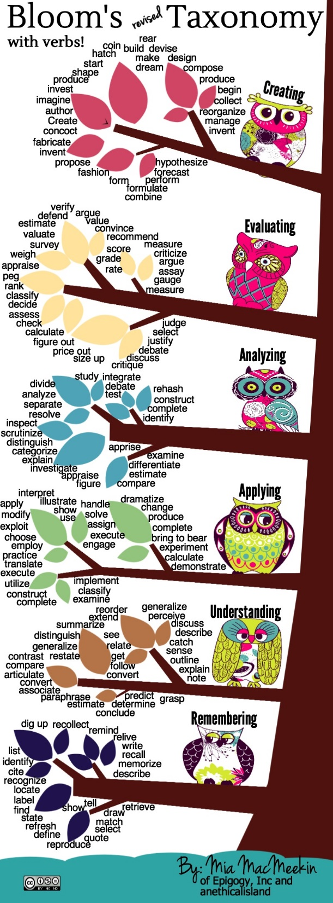

Slide 27
What needs to happen for us to better balance summative and formative assessment across a programme?
It’s as a good idea to map what assignments are being required where at each level of the programme, which programme outcomes they assess and what methods or approaches are being used, then ask are we:
Over-assessing summatively? Is any learning outcome assessed excessively often?
Offering sufficient formative guidance early enough so students can respond to feedback and improve their work?
Using sufficiently varied assessment methods, and do they demonstrate student development over a programme of learning?
Providing risk-free rehearsal opportunities so students can practice and ask questions when encountering new-to-them types of assignment?
Convinced that each assessment activity contributes actively to student learning?

Slide 28
Can we provide opportunities for staged assessment?
Consider allowing resubmissions of work as part of a planned programme early on;
Students often feel they could do better once they have seen the formative feedback and would like the chance to have another go;
Particularly at the early stages of a programme, we can consider offering them the chance to use formative feedback productively;
Feedback often involves a change of orientation, not just the remediation of errors.

Slide 29
Getting students to self-assess to deepen their learning & develop feedback dialogues (see handout)
The more we can foster autonomous behaviour in students, the better they are likely to perform and we want them to be confident about the quality of the work they submit. Such self-efficacy can be achieved through holding productive dialogues to help them build their evaluative capacities. So we can:
Make sure that we talk a class through the intended learning outcomes and illustrate how the assessment criteria will be used when we assess them;
Show examples of good, poor, and ‘in-between’ examples of responses to similar assignments, so they can see how the assessment criteria are used to grade them;
Get a class to grade three similar assignments achieving different grades and ask students what differences they notice.

Slide 30
We can also:
Follow this by asking students themselves to work out suitable criteria for judging the examples they have seen;
Ask students, when they submit their own work, to fill in a grid where they rate their own achievement of learning outcomes/ assessment criteria on a scale ‘fully met’, ‘partially met’ and ‘not well met’;
Require students to submit their responses to a short questionnaire with their assignments, where they reflect briefly on best and worst aspects, what they struggled with, what grades they expect etc, then respond briefly to their comments;
Avoid telling students about faults they already know about, but rather suggest how they might address such faults;
Check in plenary how useful students found our feedback on their self-assessment, e.g. by a show of hands.

Slide 31
Part two: Streamlining assessment: why would we wish to do it?
Huge pressure on resources in higher education;
Larger numbers of students in cohorts;
Ever-increasing demands on staff time;
Staff indicate they spend a disproportionate time on assessment drudgery;
The means exist nowadays to undertake some aspects of assessment more effectively and efficiently.

Slide 32
To give feedback more effectively & efficiently, we can:
Feedback orally to groups of students;
Write an assignment report;
Use model answers;
Use assignment return sheets;
Use statement banks;
Use technologies for delivering and managing assessment.

Slide 33
Feeding back orally to groups of students: why?
Face-to-face feedback uses tone of voice, emphasis, body language;
Students learn from feedback to each others’ work;
Students can ask questions;
Makes feedback a shared experience.

Slide 34
Feeding back orally to groups of students: how?
Staff mark assignments with minimal in-text comment and provide grades/marks as normal;
At the start of a lecture or seminar, the tutor provides an overview of class performance and orally remediates errors, clarifies; misunderstandings, and praises good practice;
Students have a chance to ask and answer questions;
An audio file can be made available on the VLE.

Slide 35
Written assignment reports: why?
Provides feedback to a group as a whole;
Allows students to know how they are doing by comparison with the rest of the course;
Offers a chance to illustrate good practice;
Minimal comments can be put on scripts;
Generic reports can be delivered quickly electronically before moderation.

Slide 36
Assignment reports: how?
Staff mark assignments with minimal in-text comment and provide grades/marks as normal;
Notes are made of similar points from several students’ work;
A report is compiled which identifies examples of good practice, areas where a number of students made similar errors and additional reading suggestions.

Slide 37
Using ‘expanded’ model answers: why?
They give students a good idea of what can be expected of them;
It is sometimes easier to show students than tell them what we are after;
They can be time efficient;
They show how solutions have been reached;
They demonstrate good practice;
The commentary can indicate why an answer is good.

Slide 38
Using model answers: how?
Staff preparing an assignment can draft a model answer;
Student work (or extracts from several student’s answers) can be anonymised and (with permission) used as a model;
Text can be placed on page with explanatory comments appended (‘exploded text’);
However, caution should be exercised in order to lead students to think only one approach is acceptable.

Slide 39
Assignment return sheets: why?
Proformas save assessors writing the same thing repeatedly;
Helps to keep assessors’ comments on track;
Shows how criteria match up to performance and how marks are derived;
Helps students to see what is valued;
Provides a useful written record.

Slide 40
Assignment return sheets: how?
Criteria presented in assignment brief can be utilised in a proforma;
Variations in weighting can be clearly identified;
A Likert scale or boxes can be used to speed tutor’s responses;
Space can be provided for individual comments.

Slide 41
Sample assignment return proforma
Criterion no | Criterion | Mark (0-5 marks) | Tutor comments and suggestions for further work | Student response
1 | Demonstrates ability to present information clearly logically, accurately and fluently | 3 | This work is written reasonably fluently but there are some typos that would not slip in if spell checker used properly. Also note you don’t use the definite and indefinite articles (‘a’ and ‘the’ appropriately: please refer to the language guidance 17.3 on the VLE | This is something I’ve had problems with over the years but am still working on it
2 | Demonstrates ability to choose and use appropriate software | 5 | Made excellent choices and used it well to suit the context of the problem being addressed | Thank you
3 | Demonstrates ability to use a range of reference materials and cite them appropriately | 1 | Cited only one reference and did so inaccurately Please refer to the ifs referencing guide on the VLE and ensure that you provide all the information required | I've checked it out and see where I was going wrong

Slide 42
Statement banks: why?
Harnesses a resource of comments you already use;
Avoids writing same comments repeatedly;
Allows you to give individual comments additionally to the students who really need them;
Can be automated with use of technology.

Slide 43
Statement banks: how?
Tutor identifies a range of regularly used comments written on students’ work;
These are collated and numbered;
Tutor marks work and writes numbers on text of assignment where specific comments apply, or provides a written (or emailed) detailed commentary which pulls together the appropriate items into continuous prose;
Moodle and other platforms can do much of the drudgery in terms of collating marks, returning work etc. Assignment handler can return comments and only release marks when students have commented.

Slide 44
Computer-assisted assessment: why?
Enables feedback to be given regularly and incrementally;
Saves tutor time for large cohorts and repeated classes;
Can allow instant (or rapid) on screen feedback to e.g. MCQ options;
Saves drudgery, (but not a quick fix);
Is really worth while for large cohorts and where content doesn’t alter fast.

Slide 45
Computer-assisted assignments: how?
Designing them should not be a cottage industry!
Training and support both in designing questions and applying the relevant technology are essential;
Testing and piloting of CAA items is also imperative;
We can make use of existing test packages (e.g. from publishers), colleagues with expertise and advice from software companies (e.g. Moodle, Turnitin, QuestionMark).

Slide 46
Use CAA for rather than of learning
We can employ computer-assisted formative assessment with responses to student work automatically generated by email;
Students seem to really like having the chance to find out how they are doing, and attempt tests several times in an environment where no one else is watching how they do;
We can monitor what is going on across a cohort, so we can concentrate our energies either on students who are repeatedly doing badly or those who are not engaging at all in the activity; Note that Computer-supported assessment can include use of audio feedback via digital sound files, video commentaries and other means of using course Virtual Learning Environments.

Slide 47
Making assessment work well
Intra-tutor and Inter-tutor reliability need to be assured;
Practices and processes need to be transparently fair to all students;
Cheat and plagiarisers need to be deterred/punished;
Assessment needs to be manageable for both staff and students;
Assignments should assess what has been taught/learned not what it is easy to assess.

Slide 48
Planning to implement enhancements in assessment &feedback in your module/programme
As an individual, are there changes you would like to make to your assessment practices?
Thinking about the teams you work with, are there ways in which you could use ideas from today’s session to help make your assessment more authentic?
How could your influence impact more widely on colleagues across the university?

Slide 49
Authentic assessment approaches to foster graduate skills and enhance employability
Assessment is a complex, nuanced and highly important process​ and if we want students to engage fully, we must make it really meaningful to them and convince them that there is merit in the activities we ask them to undertake. To focus students’ effort and improve their engagement with learning, we need to take a fresh look at our current practice to make sure assessment is for rather than just of learning, with students learning while they are being assessed rather than it being merely a summative end process. We also need to ensure that we provide explicit and implicit messages to students and indeed all other stakeholders about how we assess.

Slide 50
In this workshop participants can expect to:
discuss what authentic assessment comprises and what is involved in linking assignments to live and professional practices;
review how best to make assessment fit-for-purpose and engaging;
plan how to build in and assess skills development for employability within the curriculum.

Slide 51

These and other slides are available on my website at http://sally-brown.net

Slide 52
Useful references and further reading (1)
Bain, K. (2004) What the best College Teachers do, Cambridge: Harvard University Press.
Biggs, J. and Tang, C. (2007) Teaching for Quality Learning at University, Maidenhead: Open University Press.
Bloxham, S. and Boyd, P. (2007) Developing effective assessment in higher education: a practical guide, Maidenhead, Open University Press.
Boud, D. (1995) Enhancing learning through self-assessment, London: Routledge.
Brown, S. and Glasner, A. (eds.) (1999) Assessment Matters in Higher Education, Choosing and Using Diverse Approaches, Maidenhead: Open University Press.
Brown, S. and Race, P. (2012) Using effective assessment to promote learning in Hunt, L. and Chambers, D. (2012) University Teaching in Focus, Victoria, Australia, Acer Press. P74-91.
Brown, S. (2015) Learning , Teaching and Assessment in Higher Education: Global perspectives, London, Palgrave.

Slide 53
Useful references and further reading (2)
Carless, D., Joughin, G., Ngar-Fun Liu et al (2006) How Assessment supports learning: Learning orientated assessment in action Hong Kong: Hong Kong University Press.
Carroll, J. and Ryan, J. (2005) Teaching International students: improving learning for all. London: Routledge SEDA series.
Crosling, G., Thomas, L. and Heagney, M. (2008) Improving student retention in Higher Education, London and New York: Routledge
Crooks, T. (1988) Assessing student performance, HERDSA Green Guide No 8 HERDSA (reprinted 1994).
Falchikov, N. (2004) Improving Assessment through Student Involvement: Practical Solutions for Aiding Learning in Higher and Further Education, London: Routledge.
Gibbs, G. (1999) Using assessment strategically to change the way students learn, in Brown S. & Glasner, A. (eds.), Assessment Matters in Higher Education: Choosing and Using Diverse Approaches, Maidenhead: SRHE/Open University Press.
Higher Education Academy (2012) A marked improvement; transforming assessment in higher education, York: HEA.

Slide 54
Useful references and further reading (3)
McDowell, L. and Brown, S. (1998) Assessing students: cheating and plagiarism, Newcastle: Red Guide 10/11 University of Northumbria.
Meyer, J.H.F. and Land, R. (2003) ‘Threshold Concepts and Troublesome Knowledge 1 – Linkages to Ways of Thinking and Practising within the Disciplines’ in C. Rust (ed.) Improving Student Learning – Ten years on. Oxford: OCSLD.
Nicol, D. J. and Macfarlane-Dick, D. (2006) Formative assessment and self-regulated learning: A model and seven principles of good feedback practice, Studies in Higher Education Vol 31(2), 199-218.
PASS project Bradford http://www.pass.brad.ac.uk/ Accessed November 2013.
Peelo, M. T., & Wareham, T. (Eds.). (2002). Failing students in higher education. Society for Research into Higher Education.
Pickford, R. and Brown, S. (2006) Assessing skills and practice, London: Routledge.
Rotheram, B. (2009) Sounds Good, JISC project http://www.jisc.ac.uk/whatwedo/programmes/usersandinnovation/soundsgood.aspx

Slide 55
Useful references and further reading (4)
Race, P. (2001) A Briefing on Self, Peer & Group Assessment, in LTSN Generic Centre Assessment Series No 9, LTSN York.
Race P. (2015) The lecturer’s toolkit (4th edition), London: Routledge.
Rust, C., Price, M. and O’Donovan, B. (2003) Improving students’ learning by developing their understanding of assessment criteria and processes, Assessment and Evaluation in Higher Education. 28 (2), 147-164.
Ryan, J. (2000) A Guide to Teaching International Students, Oxford Centre for Staff and Learning Development.
Stefani, L. and Carroll, J. (2001) A Briefing on Plagiarism http://www.ltsn.ac.uk/application.asp?app=resources.asp&process=full_record&section=generic&id=10
Sadler, D. Royce (2010) Beyond feedback: developing student capability in complex appraisal, Assessment & Evaluation in Higher Education, 35: 5, 535-550.
Yorke, M. (1999) Leaving Early: Undergraduate Non-completion in Higher Education, London: Routledge.

