Slide 1
Enhancing assessment
Edinburgh Napier University
Business School
30th November, 2017
Sally Brown NTF, PFHEA, SFSEDA
@ProfSallyBrown sally@sally-brown.net
Emerita Professor, Leeds Beckett University
Visiting Professor: University of Plymouth, University of South Wales, Edge Hill University & Liverpool John Moores University.

Slide 2
The purpose of the sessions today on assessment and feedback
Edinburgh Napier University is working hard to improve feedback and assessment across the board;
Enhancing assessment and feedback is crucial for student satisfaction and achievement;
Upcoming AACBS accreditation requires a focus on Standard 8: Curricula Management and Assurance of Learning of the AACSB Accreditation Standards, and this can be fostered by using fit-for-purpose assessment for learning;
The sessions today aim to help staff design good assessments that genuinely are integrated with learning;
We aim to provide dialogic opportunities to improve assessment and feedback because this is proven to work!

Slide 3
Timetable for the Business School
9.30-10.45 Assessment criteria and setting fair assessments (Rivers suite)
11.00 -12.15 Summative and formative assessment: getting the right mix in our modules and programmes
1.15- 2.45 Challenges of implementing change and promulgating best practice/ assessment of programme learning outcomes with LTA leaders
3.00- 4.30 Enhancing our feedback

Slide 4
The context in the Business School
A disappointing drop in NSS scores, particularly around fairness and about whether marking criteria are clear;
The need to maintain or improve on rising scores for timeliness and helpful comments on work;
The focus on Assurance of learning and a programme wide approach, to ensure that students achieve as individuals the learning expectations of the programmes in which they participate, and with associated expectations of consistency of standards, skills development, and authentic assessment;
Approach assessment “as if learning matters most,” says Kathryn Martell, AACSB International.

Slide 5
Underpinning premises
Assessment can be a powerful means of focusing student effort and enhancing achievement if it is well designed and constructively aligned (Biggs and Tang, 2007);
We need to deploy a diverse range of tactics to our assessment and feedback to ensure that they work to enhance and extend student learning;
Students need to achieve assessment literacy to ensure they understand and can benefit from our assessment systems;
Assessment needs to be manageable for staff and students if it is going to engage students in learning activities.

Slide 6
So to help us focus on assessment criteria and developing students’ assessment literacy, a game!
This game is designed to help you think about how we can explain the importance of taking assessment criteria seriously in assessment to help students really understand what they need to do to succeed;
Biscuits are a metaphor!

Slide 7
Thinking through the issues raised in the biscuit game
It is often useful to start from individual perspectives at the outset of an assignment and clarify preconceptions;
Assessment is a complex nuanced task with grey areas, and just as agreed definitions of biscuits are not always readily achievable, so also assignments benefit from dialogue to clarify expectations;
Category definitions can sometimes be complicated when setting assignments. It’s helpful in advance of an assessment to agree definitions of what is, for example, a portfolio;
It’s helpful to face the fact that although criteria may be considered to be explicit, the way people grade using criteria can differ substantially;
Assigning grades is an imprecise and inexact activity, and we need to recognise that absolute certainty about grades is not always achievable;
Generic discussion about assessment, and how we grade can help develop assessment literacy.

Slide 8
Determining and reviewing subject material: currency, relevance, level
Enhancing quality, seeking continuous improvement
Designing and refining learning outcomes
Evaluating programmes, strengths and areas for improvement
Curriculum
Design
Essentials
Considering delivery modes: face-to-face, online, PBL, blended…
Assuring quality, matching HEI, national and PSRB requirements
Thinking through student support
Designing fit for purpose assessment methods and approaches

Slide 9
Peter Hartley’s NTFS Bradford-led project on Programme Level Assessment
It set out to focus on redressing problems including:
not assessing learning outcomes holistically at a programme level;
the atomisation of assessment, often resulting in too much summative and not enough formative feedback and over-standardisation in regulations.
This results in students and staff failing to see the links between disparate elements of the programme, over-assessment and multiple assignments using repetitive formats.
Modules were often too short for complex learning and this tended to lead to surface learning and ‘tick-box’ mentality.

Slide 10
Formative and summative assessment
Formative assessment is primarily concerned with feedback aimed at prompting improvement, is often continuous and usually involves words.
Summative assessment is concerned with making evaluative judgments, is often end point and involves numbers.

Slide 11
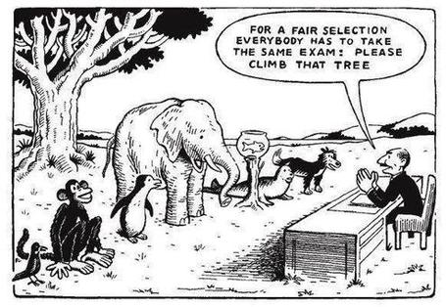

Slide 12
Students tend to be more convinced about the fairness of the assessment process if
Requirements and procedures are transparent and made readily available to them;
They believe that the tasks they are asked to do are worthwhile and are closely linked to what course documentation indicates they should be able to know and do at the end of the programme i.e. authentic assessment;
They fully understand the ‘rules of the game’.

Slide 13
The benefits of authentic assessment can be significant for all stakeholders
Students undertaking authentic assessments tend to be more fully engaged in learning and hence tend to achieve more highly because they see the sense of what they are doing (Sadler, 2005).
University teachers adopting authentic approaches can use realistic and live contexts within which to frame assessment tasks, which help to make theoretical elements of the course come to life.
Employers value students who can quickly engage in real-life tasks immediately on employment, having practiced and developed relevant skills and competences through their assignments.

Slide 14
How can authentic assessment engage students?
Using types of assessment that are much more like the ‘real things’ that academics or professionals do in their chosen fields can engage students in much more meaningful ways.
A useful way to help you ascertain how authentic your assessment is could be to ask yourself where in the programme you help students answer questions in job interviews (Sambell, Brown and Graham, 2017)

Slide 15

How authentic is this kind of assessment in your subject?

Slide 16
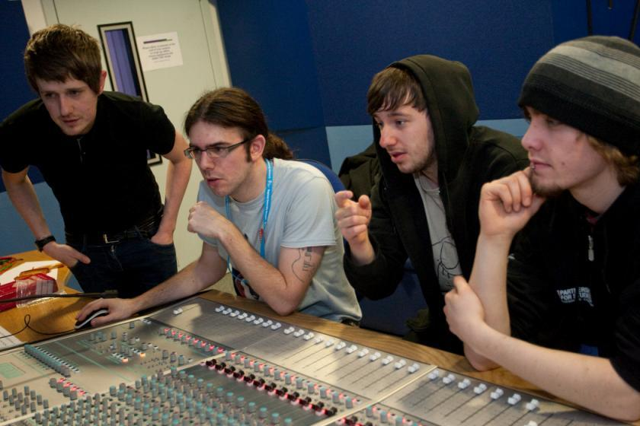
Does this look like an authentic assessment process?

Slide 17
Fostering graduate skills and employability
By providing authentic assignments, students can progressively develop a range of skills which include inter alia:
Effective oral, written and digital communication;
Creativity and problem-solving capabilities;
Inter-personal and social skills;
Effective group membership, leadership and ‘followership’;
Manipulation and presentation of data;
Locating, verifying and effectively using a range of information sources;
Good presentation of work in visual and written forms.

Slide 18
Questions employers might ask at interview that might help us frame some of our assignments
Can you tell us about an occasion when:
you worked together with colleagues in a group to produce a collective outcome;
you had to work autonomously with incomplete information and self-derived data sources;
you developed strategies to solve real life problems and tested them out;
you has a leadership role in a team, and could you tell us your strategies to influence and persuade your colleagues to achieve a collective task;
you had to communicate outcomes from your project work orally, in writing, through social media and/or through a visual medium?

Slide 19
Assessment must engage students in active tasks e.g.
Studio critiques
Simulations
Multiple choice questions in class
Oral report (individual or group)
Business/Elevator pitches
Case studies
Annotated bibliographies
Executive summaries
Performances
Artefacts e.g. Paintings, sculptures, engineering drawings
Objective structured clinical exams (OSCEs)
Conference presentations
student-led and managed conferences
Action plans
Reports
Portfolios
Live projects
Final shows
In-tray exercises
Assessed placements
Field work notebooks
Lab books produced in real time
Short-answer questions
Reflective diaries
Logs
Vivas (live oral tests)
Storyboards
Critical incident accounts
Teaching packs
Group process tasks
Procedure manuals
Software designs
Presentations (individual or group)
Posters

Slide 20
Making authentic choices: how can we build in authentic assessment? We can use
Team assignments where students work together and independently in a productive, effective and professional way to meet a team goal or achieve a shared objective?
Live projects which require students to gain, develop and demonstrate an understanding of the importance of leadership skills;
Information acquisition and management tasks where they actively access alternative or additional resources from a variety of sources in a wide range of media;
Multi-element composite tasks such as ePortfolios, (Stefani et al, 2007) which enable students to demonstrate not just final outcomes but also the processes by which these have been achieved.

Slide 21
Review practice: what can we do to build authenticity in to our assessment?
We need to design assignments that stretch students beyond mechanistic tasks and make assessment fully integral to the learning experience (Sambell et al, 2012). Such authentic assignments and activities could include:
Action-orientated tasks, that are underpinned by relevant evidence-based scholarship and where students are learning by doing (Race, 2014);
Ones that are truly representative of student effort, maximising time-on-task, with marks reflecting the achievement of learning outcomes specified in the programme outlines and which are coherent, constructively aligned (Biggs and Tang, 2007) and challenging;
Processes that are nuanced, clearly articulated and transparent in demonstrating the way that decisions are reached on assessment grades (QAA, 2014);
Assessment strategies that work at a programme rather than a module level (McDowell, 2012)

Slide 22
Some further examples of authentic assessment tasks
Research projects, working alongside their lecturers on genuine data collection tasks which result in advances in knowledge and practice relevant to work-based contexts;
Activities that involve students assessing their peers and themselves both as a means of better understanding what is required in terms of standards of performance (Falchikov, 2004) and as processes that involve the development of assessment literacy (Price et al, 2012);
Tasks where the means of presentation of the outcomes form key parts of the assignment, involving them in developing a range of means of communication, e.g. Audio/video packs, teaching packs, social media.

Slide 23
Helping students better understand what is needed of them
This can be achieved in a variety of ways, including:
Using games (like the Biscuit game) can help make students think hard about criteria and required outcomes;
Ensuring that briefings (in the form of documentation, and more importantly, live/ face-to-face briefings, where students can actively interrogate criteria) are useful;
Getting students to self-assess to start a feedback dialogue;
Using exemplars to show students what high quality work in this domain comprises, and what features and aspects are crucial for success.

Slide 24
Briefings for students: setting the context
Early-stage students are likely to need more reassurance in your briefings in which the tone of your language may be crucial;
We should aim for as much transparency as possible: no student should be having to guess what you are looking for at any stage of their academic careers;
Whenever we use what may be to them an unfamiliar format, briefings should be linked to trial-runs, risk-free rehearsals and Q&A opportunities to clarify any areas of misconceptions;
This is not ‘spoonfeeding’ but instead giving them the knives and forks to feed themselves!

Slide 25
Briefings activity
Imagine this is an early assignment for a First-Year undergraduate cohort;
In groups, list some essential components of an effective assignment brief;
Discuss how your briefings would be different if these were Final Year UGs or PG students;
Use this activity to help you build a checklist of what to include in your future briefings.

Slide 26
Essential components of an effective assignment brief I would suggest include:
Housekeeping arrangements: when does it have to be completed? How must it be submitted? Are you setting limitations around format and layout (e.g. font size, margins, use of figures, tables etc)?
Clarifying the scope of the task: how big is the task? How many words? Approximately how much time would you intend an average student to spend on this work? How many and what kinds of references should they use?
Support: Where can students go for help? How much and what kind of support can they get? (e.g. checking drafts, proofreading);
Good academic conduct: what do they need to know about the appropriate levels of peer support? How might plagiarism regulations impact on them?
Choosing the right medium: is an oral or video briefing best? What kinds of documentary detail do they need? Is the briefing a dialogue or monologue?

Slide 27
What are exemplars, and how can we use them productively?
Exemplars are not model answers. They are carefully selected examples of authentic student work from previous cohorts (anonymised and with permission) or teacher-constructed examples (based on your extensive experience of the kinds of responses and common mistakes students make). They are chosen to typify and illustrate designated levels of quality or competence.
The concrete nature of exemplars means that they are able to convey messages in a way that nothing else can (Sadler, 2002). Carefully selected examples can not only help students to ‘see’ what the teacher expects with regard to the task in hand (Scoles et al, 2013), but also guide their action.

Slide 28
Exemplars can enable students to:
gain a feel for what the final product looks like in terms of layout, structure and language;
develop their insights into the nature of academic writing;
raise awareness of the diverse ways a task might fruitfully (or erroneously) be tackled;
hone students’ evaluative skills.
Act as powerful learning tools (Sadler, 2010), helping students gain insight into the nature of quality and standards, ideally through close analysis and discussion (Hendry et al, 2016). Students typically find exemplars to be more useful than standalone lists of criteria, grids and rubrics (Hawe et al, 2017).

Slide 29
What can we do when using exemplars? (see handout)
Choose examples which will help students firmly grasp task requirements;
Help students practice applying criteria to samples of work;
Enable students to reflect deeply on, and discuss, what high quality work looks like;
Choose examples to promote self-efficacy;
Carefully orchestrate discussion activities to promote understanding of fruitful learning strategies and approaches;
Use exemplars-based activities to develop students’ skills to monitor their own work while they are producing it;
Help them rate their work by comparison with their peers.

Slide 30
Do your international students understand UK assessment approaches?
Have you clarified the ground rules on issues like pass marks, criterion-referenced assessment and grading systems?
Have you explained how extensions, condonements, and university assessment regulations work?
Are the assignments built around a curriculum international in scope and content? Are tasks and case studies globally orientated?

Slide 31
Are your students aware of all the processes and procedures we use to ensure fair assessment?
Do they know how we require assessors to match grades to achievement of assessment criteria?
Are they familiar with the steps we take to ensure inter-assessor reliability?
Do they understand that moderation processes are in place, for example through exam boards, to ensure that justice is done to each individual?
Do they get to hear about the work of external examiners (or even get to meet them?)?

Slide 32
Part 2: summative and formative assessment: getting the right mix in our modules.
We know that:
Students tend to regard marks like money, and so will put more energy into things that ‘count’ than those they see as options;
Formative feedback, that is developmental and supportive, and given at the right stage so that it guides future performance can be exceptionally powerful in improving achievement and retention;
Feedback and ‘feed-forward’ must be integral to student learning programmes, rather than something that students opt into, so needs to be within live or virtual face-to-face interaction.

Slide 33
For any assessment activity, we need to be clear about:
Purpose: is this an early stage assignment, that is principally about building confidence and helping students see what is required of them, or is it a key element of their summative assessment, designment to gauge fitness to progress, or fitness-to-practice?
Scope: is this testing low level outcomes, like demonstrating recollection of key terms, or is it cognitively more demanding requiring synthesis of multiple elements, critical analysis, evaluation and reflection?
Scale: is this a small scale or a substantial task carrying a heavy weighting? Do students know how much effort and energy is needed to achieve at least a satisfactory level?
Orientation: Is the key aim to demonstrate the achievement of skills and competences, and/or to produce a definite product or is it primarily about demonstrating mastery of appropriate processes?
Constructive alignment: To what extent does the assessment closely link to the learning outcomes (and specifically the verbs used in them)?

Slide 34
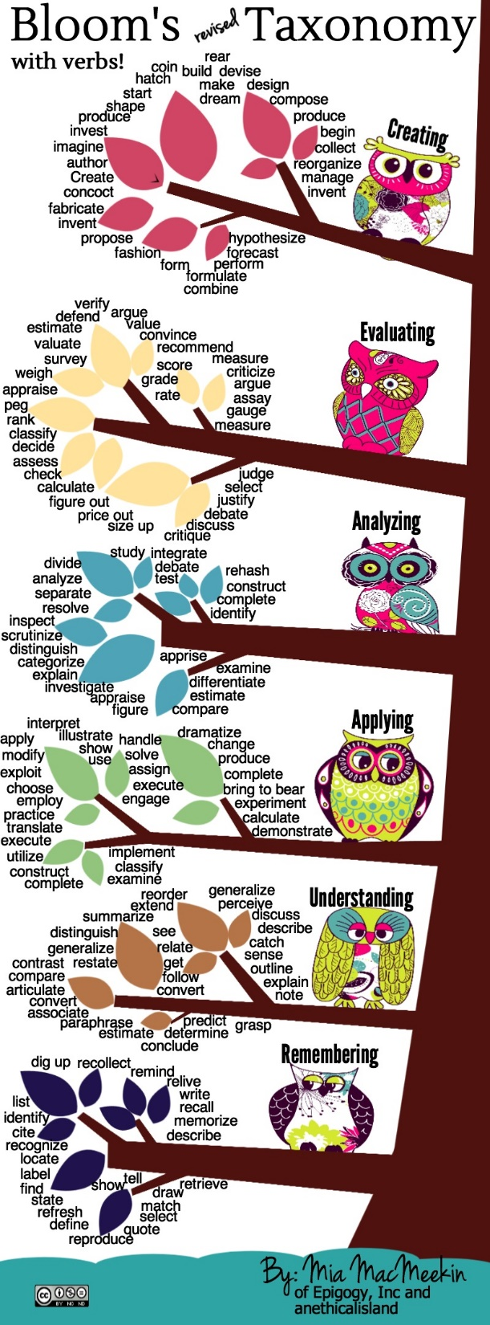

Slide 41
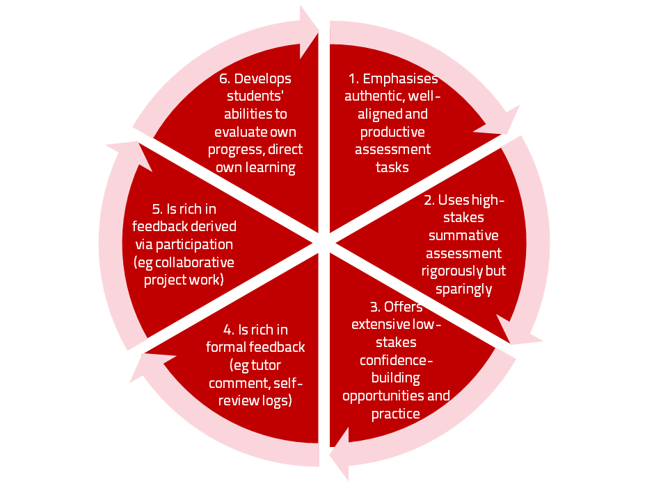
A4L the Northumbria model

Slide 42
Using assessment for learning
(Sambell et al, 2012)
Assessment that is meaningful to students can provide them with a framework for activity;
“Students can escape bad teaching but they can’t escape bad assessment” (Boud, 1995);
Where assessment is fully part of the learning process and integrated within it, the act of being assessed can help students to make sense of their learning;
Assessment should be formative, informative, developmental and remediable.

Slide 43
The importance of dialogic feedback (Sadler)
Students need to be exposed to, and gain experience in making judgements about, a variety of works of different quality... They need planned rather than random exposure to exemplars, and experience in making judgements about quality. They need to create verbalised rationales and accounts of how various works could have been done better. Finally, they need to engage in evaluative conversations with teachers and other students.

Slide 44
Assessment for learning: some useful thoughts
1. Tasks should be challenging, demanding higher order learning and integration of knowledge learned in both the university and other contexts;
2. Learning and assessment should be integrated, assessment should not come at the end of learning but should be part of the learning process;
3. Students are involved in self assessment and reflection on their learning, they are involved in judging performance;
4. Assessment should encourage metacognition, promoting thinking about the learning process not just the learning outcomes;
5. Assessment should have a formative function, providing ‘feedforward’ for future learning which can be acted upon. There is opportunity and a safe context for students to expose problems with their study and get help; there should be an opportunity for dialogue about students’ work;

Slide 45
Assessment for learning
6. Assessment expectations should be made visible to students as far as possible;
7. Tasks should involve the active engagement of students developing the capacity to find things out for themselves and learn independently;
8. Tasks should be authentic; worthwhile, relevant and offering students some level of control over their work;
9. Tasks are fit for purpose and align with important learning outcomes;
10. Assessment should be used to evaluate teaching as well as student learning.
(Bloxham and Boyd)

Slide 46
What needs to happen for us to better balance summative and formative assessment across a programme?
It’s as a good idea to map what assignments are being required where at each level of the programme, which programme outcomes they assess and what methods or approaches are being used, then ask are we:
Over-assessing summatively? Is any learning outcome assessed excessively often?
Offering sufficient formative guidance early enough so students can respond to feedback and improve their work?
Using sufficiently varied assessment methods, and do they demonstrate student development over a programme of learning?
Providing risk-free rehearsal opportunities so students can practice and ask questions when encountering new-to-them types of assignment?
Convinced that each assessment activity contributes actively to student learning?

Slide 47
Part three: Challenges of implementing change and promulgating best practice
Colleagues won’t be keen to change their assessments unless they can really see that what you are asking brings real benefits for students and doesn’t result in massive additional work for them;
We can’t be successful if we rely on dictat or fiat, we need to use evidence-based scholarship to demonstrate that different approaches to assessment and feedback can be highly successful, especially if we can demonstrate that these are being used well in other HEIs;
We may need to look hard at resourcing and deployment to ensure that we are not imposing silly conditions on our markers.

Slide 48
What have we got in the toolkit?
Workshops and collective sessions like those running today;
Resources from the Enhance initiative, including the Enhance guides and activities;
Examples of good practice being collected from within EN Business School and beyond by Kay Sambell and colleagues.

Slide 49
Designing fit-for-purpose assessment methods & approaches: 10 questions
Are your assignments fully and constructively aligned with your learning outcomes?
Do they comply with your university/PSRB requirements in terms of format, number, word limits etc?
Are summative assessments undertaken throughout the course, or is everything ‘sudden death’ end-point?
Is there excessive bunching of assignments in different modules, that is highly stressful for students and unmanageable for staff?
Are there plenty of opportunities for formative assessment, especially early on in the programme?

Slide 50
And the next five:
Are students over-assessed?
Do staff have time to mark the assessments in time for moderation etc.?
When you have introduced innovative assignments, have they been introduced instead of existing ones, or simply added to the assessment diet?
Are students encouraged to make good use of the feedback they receive?
Do the students perceive your assessment diet to be fair and providing meaningful recognition of their achievements?

Slide 51
Part four: enhancing our feedback
Good feedback can be helpful, motivating and can positively change students attitudes and performance, but it can also be discouraging, damaging, pointless and wasteful of staff energy when it is under-used;
You might consider a ‘feedback sandwich’: start with something positive in your comments, continue with detailed developmental comments that are informative and indicate specific actions the student needs to take to improve the quality of their work, and finish on a positive note that takes them forward;
Students don’t always recognise when they are being given feedback, especially if it is oral, or face-to-face, or informal.

Slide 52
Good feedback:
(after Brown, S. (2015), Assessment, learning and teaching in higher education: global perspectives, London: Palgrave-MacMillan)
Is dialogic, rather than mono-directional, giving students chances to respond to comments from their markers and seek clarification where necessary.
Helps clarify what good work looks like, so students are really clear about goals, criteria and expected standards, and provides opportunities to close the gap between current and desired performance.

Slide 53
Good feedback:
Actively facilitates students reviewing their own work and reflecting on it, so that they become good judges of the quality of their own work.
Doesn’t just correct errors and indicate problems, potentially leaving students discouraged and demotivated, but also highlights good work and encourages them to believe they can improve and succeed.

Slide 54
Good feedback:
Delivers high-quality information to students about their achievements to date and how they can improve their future work. Where there are errors, students should be able to see what needs to be done to remediate them, and where they are undershooting in terms of achievement, they should be able to perceive how to make their work even better.

Slide 55
Good feedback:
Offers ‘feed-forward’ aiming to ‘increase the value of feedback to the students by focusing comments not only on the past and present … but also on the future – what the student might aim to do, or do differently in the next assignment or assessment if they are to continue to do well or to do better’ (Hounsell, 2008, p.5).
Ensures that the mark isn’t the only thing that students take note of when work is returned, but that they are encouraged to read and use the advice given in feedback and apply it to future assignments.

Slide 56
Five things students really hate about poor feedback
Poorly written comments that are nigh on impossible to decode, especially when impenetrable acronyms or abbreviations are used, or where handwriting is in an unfamiliar alphabet and is illegible.
Cursory and derogatory remarks that leave them feeling demoralised ‘Weak argument’, ‘Shoddy work’, ‘Hopeless’, ‘Under-developed’, and so on.
Value judgements on them as people rather than on the work in hand.

Slide 57
Five things students really hate about poor feedback
Vague comments which give few hints on how to improve or remediate errors: ‘OK as far as it goes’, ‘Needs greater depth of argument’, ‘Inappropriate methodology used’, ‘Not written at the right level’.
Feedback that arrives so late that there are no opportunities to put into practice any guidance suggested in time for the submission of the next assignment.

Slide 58
Task
Which if any of these behaviours do you recognise from your own programmes and how could you stop them happening?

Slide 59
Task: Giving formative feedback prior to submitting summative tasks
Discuss the examples provided on the handout about how to give early formative feedback and agree 2-3 approaches you would be prepared to adopt:
Briefing students on assignment requirements in a face-to-face sessions;
Preparing a set of ‘Frequently Asked Questions’ at the assignment briefing;
Showing students examples of work of the required standard;
Letting them see worked examples;
Asking students to submit draft bibliographies;
Asking students to bring along drafts to a lecture and encouraging questions;
Providing opportunities for students to review each other’s drafts in pairs;
Running quizzes using audience response systems in class time;
Asking students to submit short work-in-progress for ‘quick and dirty’ comments;
Posting anonymised examples of submitted drafts with your commentaries;
Offering shared drop-in ‘surgeries’;
Offering on-line webinars or open chat sessions.

Slide 60
Encouraging better use of feedback
(see handout)
Emphasise early on the importance to them of formative feedback;
Consider how best to provide them with feedback.
Provide them with training on why and how feedback is provided;
Get students to practise drafting and delivering feedback;
Get students to focus on comments rather than marks;
Help students to believe they have the agency to improve their work;
Encourage students to think of feedback as a trigger to them taking action;
Give them some examples of helpful feedback as a prompt to discussion.

Slide 61
Encouraging students to recognise and use the feedback we provide for them
Delivery of feedback should not be left to chance, so its best to avoid asking students to pick up marked hard copy assignments from departmental offices;
Electronic submission of assignments has benefits and disadvantages but on balance the former outweigh the latter;
Perhaps require students to guestimate expected marks having read your feedback early in their programmes;
Audio files of audio feedback can be highly successful in enabling students to capture ‘live’ oral feedback, and can replace written feedback (e.g. JISC project ‘Sounds good’).

Slide 62
To better engage learners through feedback and assessment we can:
Make use of real examples and hot-off-the-press data to keep content and tasks current and relevant;
Provide challenges to students’ thinking without letting individuals feel publicly exposed or humiliated;
Relate their learning in class to the forthcoming/ongoing assignment (without slavishly teaching to the exam);
Make spaces for dialogue through formative assessment;
Give them real problems to solve and issues with which to engage;
Identify the skills they need to succeed and provide opportunities to rehearse and develop them;
Never compromise on the quality of the demands we make of them.

Slide 63
Assessment literacy: students do better if they can:
Make sense of key terms such as criteria, weightings, and level;
Encounter a variety of assessment methods (e.g. presentations, portfolios, posters, assessed web participation, practicals, vivas etc) and get practice in using them;
Be strategic in their behaviours, putting more work into aspects of an assignment with high weightings, interrogating criteria to find out what is really required and so on;
Gain clarity on how the assessment regulations work in their HEI, including issues concerning submission, resubmission, pass marks, condonement etc.

Slide 64
Getting students to self-assess to deepen their learning & develop feedback dialogues
(see handout)
The more we can foster autonomous behaviour in students, the better they are likely to perform and we want them to be confident about the quality of the work they submit. Such self-efficacy can be achieved through holding productive dialogues to help them build their evaluative capacities. So we can:
Make sure that we talk a class through the intended learning outcomes and illustrate how the assessment criteria will be used when we assess them;
Show examples of good, poor, and ‘in-between’ examples of responses to similar assignments, so they can see how the assessment criteria are used to grade them;
Get a class to grade three similar assignments achieving different grades and ask students what differences they notice.

Slide 65
We can also:
Follow this by asking students themselves to work out suitable criteria for judging the examples they have seen;
Ask students, when they submit their own work, to fill in a grid where they rate their own achievement of learning outcomes/ assessment criteria on a scale ‘fully met’, ‘partially met’ and ‘not well met’;
Require students to submit their responses to a short questionnaire with their assignments, where they reflect briefly on best and worst aspects, what they struggled with, what grades they expect etc, then respond briefly to their comments;
Avoid telling students about faults they already know about, but rather suggest how they might address such faults;
Check in plenary how useful students found our feedback on their self-assessment, e.g. by a show of hands.

Slide 66
Can we provide opportunities for staged assessment?
Consider allowing resubmissions of work as part of a planned programme early on;
Students often feel they could do better once they have seen the formative feedback and would like the chance to have another go;
Particularly at the early stages of a programme, we can consider offering them the chance to use formative feedback productively;
Feedback often involves a change of orientation, not just the remediation of errors.

Slide 67
Making assessment work well
Intra-tutor and Inter-tutor reliability need to be assured;
Practices and processes need to be transparently fair to all students;
Cheats and plagiarisers need to be deterred/punished;
Assessment needs to be manageable for both staff and students;
Assignments should assess what has been taught/learned, not what it is easy to assess.

Slide 68

These and other slides are available on my website at http://sally-brown.net

Slide 69
Useful references and further reading (1)
Bain, K. (2004) What the best College Teachers do, Cambridge: Harvard University Press.
Biggs, J. and Tang, C. (2007) Teaching for Quality Learning at University, Maidenhead: Open University Press.
Bloxham, S. and Boyd, P. (2007) Developing effective assessment in higher education: a practical guide, Maidenhead, Open University Press.
Boud, D. (1995) Enhancing learning through self-assessment, London: Routledge.
Brown, S. and Glasner, A. (eds.) (1999) Assessment Matters in Higher Education, Choosing and Using Diverse Approaches, Maidenhead: Open University Press.
Brown, S. and Race, P. (2012) Using effective assessment to promote learning in Hunt, L. and Chambers, D. (2012) University Teaching in Focus, Victoria, Australia, Acer Press. P74-91.
Brown, S. (2015) Learning , Teaching and Assessment in Higher Education: Global perspectives, London, Palgrave.

Slide 70
Useful references and further reading (2)
Carless, D., Joughin, G., Ngar-Fun Liu et al (2006) How Assessment supports learning: Learning orientated assessment in action Hong Kong: Hong Kong University Press.
Carroll, J. and Ryan, J. (2005) Teaching International students: improving learning for all. London: Routledge SEDA series.
Crosling, G., Thomas, L. and Heagney, M. (2008) Improving student retention in Higher Education, London and New York: Routledge
Crooks, T. (1988) Assessing student performance, HERDSA Green Guide No 8 HERDSA (reprinted 1994).
Falchikov, N. (2004) Improving Assessment through Student Involvement: Practical Solutions for Aiding Learning in Higher and Further Education, London: Routledge.
Gibbs, G. (1999) Using assessment strategically to change the way students learn, in Brown S. & Glasner, A. (eds.), Assessment Matters in Higher Education: Choosing and Using Diverse Approaches, Maidenhead: SRHE/Open University Press.
Higher Education Academy (2012) A marked improvement; transforming assessment in higher education, York: HEA.

Slide 71
Useful references and further reading (3)
McDowell, L. and Brown, S. (1998) Assessing students: cheating and plagiarism, Newcastle: Red Guide 10/11 University of Northumbria.
Meyer, J.H.F. and Land, R. (2003) ‘Threshold Concepts and Troublesome Knowledge 1 – Linkages to Ways of Thinking and Practising within the Disciplines’ in C. Rust (ed.) Improving Student Learning – Ten years on. Oxford: OCSLD.
Nicol, D. J. and Macfarlane-Dick, D. (2006) Formative assessment and self-regulated learning: A model and seven principles of good feedback practice, Studies in Higher Education Vol 31(2), 199-218.
PASS project Bradford http://www.pass.brad.ac.uk/ Accessed November 2013.
Peelo, M. T., & Wareham, T. (Eds.). (2002). Failing students in higher education. Society for Research into Higher Education.
Pickford, R. and Brown, S. (2006) Assessing skills and practice, London: Routledge.
Rotheram, B. (2009) Sounds Good, JISC project http://www.jisc.ac.uk/whatwedo/programmes/usersandinnovation/soundsgood.aspx

Slide 72
Useful references and further reading (4)
Race, P. (2001) A Briefing on Self, Peer & Group Assessment, in LTSN Generic Centre Assessment Series No 9, LTSN York.
Race P. (2015) The lecturer’s toolkit (4th edition), London: Routledge.
Rust, C., Price, M. and O’Donovan, B. (2003) Improving students’ learning by developing their understanding of assessment criteria and processes, Assessment and Evaluation in Higher Education. 28 (2), 147-164.
Ryan, J. (2000) A Guide to Teaching International Students, Oxford Centre for Staff and Learning Development.
Stefani, L. and Carroll, J. (2001) A Briefing on Plagiarism http://www.ltsn.ac.uk/application.asp?app=resources.asp&process=full_record&section=generic&id=10
Sadler, D. Royce (2010) Beyond feedback: developing student capability in complex appraisal,
Assessment & Evaluation in Higher Education, 35: 5, 535-550.
Yorke, M. (1999) Leaving Early: Undergraduate Non-completion in Higher Education, London: Routledge.

