Slide 1
Fostering autonomy in assessment and feedback
The Netherlands, 24 November, on behalf of Utrecht University
Sally Brown
@ProfSallyBrown http://sally-brown.net
PFHEA, SFSEDA, NTF
Emerita Professor, Leeds Beckett University
Visiting Professor: University of Plymouth, Liverpool John Moores University, Edge Hill University and University of South Wales.

Slide 2
Fostering autonomy in assessment and feedback
Assessment is a complex, nuanced and highly important process​ and if we want students to engage fully, we must make it really meaningful to them and convince them that there is merit in the activities we ask them to undertake. To focus students’ effort and improve their engagement with learning, we need to take a fresh look at our current practice to make sure assessment is for rather than just of learning, with students learning while they are being assessed rather than it being merely a summative end process. We also need to ensure that we provide explicit and implicit messages to students and indeed all other stakeholders about how we assess.

Slide 3
In this workshop participants can expect to:
discuss what authentic assessment comprises and what is involved in linking assignments to live and professional practices;
review how best to make assessment fit-for-purpose and engaging;
plan how to build in and assess skills development for employability within the curriculum.

Slide 4
Why is assessment such a big issue?
Good feedback and assessment practices are essential to student learning;
Globally, student satisfaction surveys frequently highlight significant dissatisfaction around these issues;
In tough times, staff often find the pressure of achieving fast and formative feedback a heavy chore, especially when cohorts are large;
A key locus for engagement is assessment, since assignments give students cues about what we value, and they tend to regard marks like money.

Slide 5
From ‘A marked improvement’ (HEA, 2012)
Assessment of student learning is a fundamental function of higher education. It is the means by which we assure and express academic standards and has a vital impact on student behaviour, staff time, university reputations, league tables and, most of all, students’ future lives. The National Student Survey, despite its limitations, has made more visible what researchers in the field have known for many years: assessment in our universities is far from perfect. (p.7)

Slide 6
Improving assessment improves learning
Assessment is largely dependent upon professional judgement, and confidence in such judgement requires the establishment of appropriate forums for the development and sharing of standards within and between disciplinary and professional communities. Assessment shapes what students study, when they study, how much work they do and the approach they take to their learning. Consequently, assessment design is influential in determining the quality and amount of learning achieved by students, and if we wish to improve student learning, improving assessment should be our starting point. ( HEA, 2012, p.9)

Slide 7
Determining and reviewing subject material: currency, relevance, level
Enhancing quality, seeking continuous improvement
Designing and refining learning outcomes
Evaluating programmes, strengths and areas for improvement
Curriculum
Design
Essentials
Considering delivery modes: face-to-face, online, PBL, blended…
Assuring quality, matching HEI, national and PSRB requirements
Thinking through student support
Designing fit for purpose assessment methods and approaches

Slide 8
Formative and summative assessment
Formative assessment is primarily concerned with feedback aimed at prompting improvement, is often continuous and usually involves words.
Summative assessment is concerned with making evaluative judgments, is often end point and involves numbers.

Slide 9
We need more formative, less summative
The change that has the greatest potential to improve student learning is a shift in the balance of summative and formative assessment. Summative assessment has important purposes in selection, certification and institutional accountability, but its dominance has distorted the potential of assessment to promote learning ( i.e. assessment for learning). (HEA, p.9)

Slide 10
Assessment for Learning
Emphasises authentic & complex assessment tasks
Develops students’ abilities to evaluate own progress, direct own learning
Is rich in informal feedback (e.g. peer review of draft writing, collaborative project work)
Uses high stakes summative assessment rigorously but sparingly
Offers extensive ‘low stakes’ confidence building opportunities and practice
Is rich in formal feedback (e.g. tutor comment, self-review logs)

Slide 11
Boud et al 2010: ‘Assessment 2020’
Assessment has most effect when...:
It is used to engage students in learning that is productive.
Feedback is used to actively improve student learning.
Students and teachers become responsible partners in learning and assessment.
Students are inducted into the assessment practices and cultures of higher education.
Assessment for learning is placed at the centre of subject and program design.
Assessment for learning is a focus for staff and institutional development.
Assessment provides inclusive and trustworthy representation of student achievement.

Slide 12
Assessment literacy: students do better if they can:
Make sense of key terms such as criteria, weightings, and level;
Encounter a variety of assessment methods (e.g. presentations, portfolios, posters, assessed web participation, practicals, vivas etc) and get practice in using them;
Be strategic in their behaviours, putting more work into aspects of an assignment with high weightings, interrogating criteria to find out what is really required and so on;
Gain clarity on how the assessment regulations work in their HEI, including issues concerning submission, resubmission, pass marks, condonement etc.

Slide 13
A rethink is needed
Universities face substantial change in a rapidly evolving global context. The challenges of meeting new expectations about academic standards in the next decade and beyond mean that assessment will need to be rethought and renewed. (Boud et al, 2010 p.1).

Slide 14
Fit-for-purpose assessment focuses efforts and promotes engagement through reference to:
methodologies: which methods and approaches are most appropriate and efficient for the arts and design context?
agency: who should be undertaking assessment? Tutors, peers, students themselves, employers and clients can all participate in student assessment to good effect, but which is right for particular assessment activities?
timing: end point and continuous assessment can both be valuable, when should we assess students to maximise impact on student learning?
orientation: to what extent in each task would we wish to focus particularly on process or outcomes, or both?
inclusivity: how can we enable all students to achieve their highest personal potential?
efficiency: what can we do to make assessment fully embedded in learning for students?

Slide 15
What is authentic assessment?
Authentic assessment sends signals to students which direct them towards the kinds of learning goals and processes that are representative of meaningful learning in their subject area.
It uses a range of methods and approaches that get students working hard on activities relevant to their life and career plans on graduation;
Authentic summative assessment tasks are designed to ensure that students learn what they need to learn in recognisably appropriate ways.

Slide 16

How authentic is this kind of assessment in your subject?

Slide 17
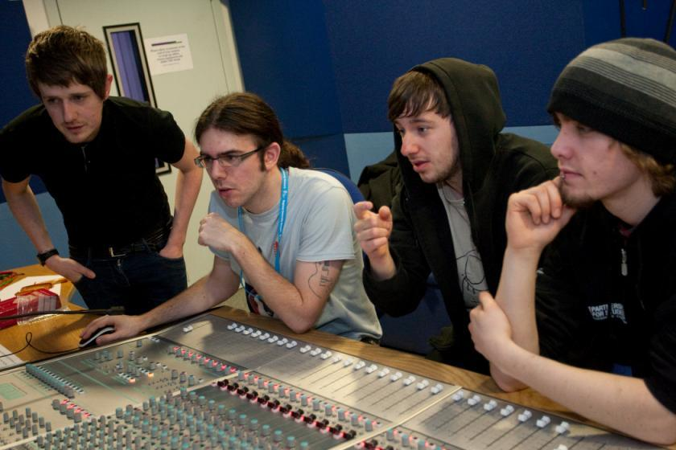
Does this look like an authentic assessment process?

Slide 18
We often assess what is easy to assess, or proxies of what’s been learned, rather than the learning itself
A valid assessment is one that has close relevance to the criteria, which are in turn constructively aligned to the stated learning outcomes of a programme.
Effective assessment is highly relevant to ensuring that graduates can demonstrate the knowledge, behaviours, qualities and attributes that were described in the course outline or programme specification.
Assignments that require students to write about something, rather than be or do something, may not always be fit-for-purpose.

Slide 19
Authentic assessment implies using assessment for learning (Sambell et al, 2012)
Assessment that is meaningful to students can provide them with a framework for activity;
“Students can escape bad teaching but they can’t escape bad assessment” (Boud, 1995);
Where assessment is fully part of the learning process and integrated within it, the act of being assessed can help students make sense of their learning;
Assessment should be formative, informative, developmental and remediable.

Slide 20
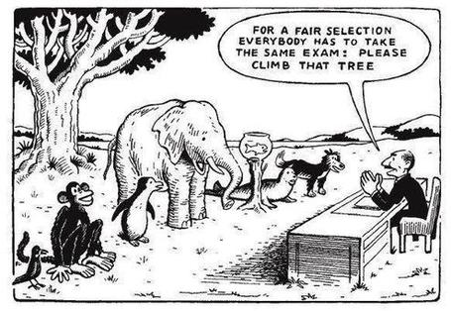

Slide 21
The benefits of authentic assessment can be significant for all stakeholders
Students undertaking authentic assessments tend to be more fully engaged in learning and hence tend to achieve more highly because they see the sense of what they are doing (Sadler, 2005).
University teachers adopting authentic approaches can use realistic and live contexts within which to frame assessment tasks, which help to make theoretical elements of the course come to life.
Employers value students who can quickly engage in real-life tasks immediately on employment, having practiced and developed relevant skills and competences through their assignments.

Slide 22
Engagement: why talk about it? Because:
Academics and learning support staff report increasing levels of disengagement by students of the ‘iGeneration’;
The nature of the transaction is changing in the light of high fees;
Potentially the nature of student behaviour in higher education is changing radically in terms of academic and other literacies;
Institutions need to ensure that new students enter with, or have the opportunity to acquire, the skills needed for academic success;
HEIs must devise programmes in which the emphasis is on maximising students’ development.

Slide 23
Disengaged students
Don’t live up to their potential and fail to achieve their very best;
Make life more difficult for the staff who teach and support them;
Don’t achieve as highly as they might & underperform;
Drop out of higher education, thereby damaging their own prospects and HEIs’ performance indicators;
HEIs suffer both financially and in terms of their status and reputation from high attrition rates.

Slide 24
How can authentic assessment engage students?
Using types of assessment that are much more like the ‘real things’ that academics or professionals do in their chosen fields can engage students in much more meaningful ways.
A useful way to help you ascertain how authentic your assessment is could be to ask yourself where in the programme you help students answer questions in job interviews (Sambell, Brown and Graham, 2017)

Slide 25
Fostering graduate skills and employability
By providing authentic assignments, students can progressively develop a range of skills which include inter alia:
Effective oral, written and digital communication;
Creativity and problem-solving capabilities;
Inter-personal and social skills;
Effective group membership, leadership and ‘followership’;
Manipulation and presentation of data;
Locating, verifying and effectively using a range of information sources;
Good presentation of work in visual and written forms.

Slide 26
Questions employers might ask at interview that might help us frame some of our assignments
Can you tell us about an occasion when:
you worked together with colleagues in a group to produce a collective outcome;
you had to work autonomously with incomplete information and self-derived data sources;
you developed strategies to solve real life problems and tested them out;
you has a leadership role in a team, and could you tell us your strategies to influence and persuade your colleagues to achieve a collective task;
you had to communicate outcomes from your project work orally, in writing, through social media and/or through a visual medium?

Slide 27
Review practice: what can we do to build authenticity in to our assessment?
We need to design assignments that stretch students beyond mechanistic tasks and make assessment fully integral to the learning experience (Sambell et al, 2012). Such authentic assignments and activities could include:
Action-orientated tasks, that are underpinned by relevant evidence-based scholarship and where students are learning by doing (Race, 2014);
Ones that are truly representative of student effort, maximising time-on-task, with marks reflecting the achievement of learning outcomes specified in the programme outlines and which are coherent, constructively aligned (Biggs and Tang, 2007) and challenging;
Processes that are nuanced, clearly articulated and transparent in demonstrating the way that decisions are reached on assessment grades (QAA, 2013);
Assessment strategies that work at a programme rather than a module level (McDowell, 2012).

Slide 28
Assessment must engage students in active tasks e.g.
Studio critiques
Simulations
Multiple choice questions in class
Oral report (individual or group)
Business/Elevator pitches
Case studies
Annotated bibliographies
Executive summaries
Performances
Artefacts e.g. Paintings, sculptures, engineering drawings
Objective structured clinical exams (OSCEs)
Conference presentations
student-led and managed conferences
Action plans
Reports
Portfolios
Live projects
Final shows
In-tray exercises
Assessed placements
Field work notebooks
Lab books produced in real time
Short-answer questions
Reflective diaries
Logs
Vivas (live oral tests)
Storyboards
Critical incident accounts
Teaching packs
Group process tasks
Procedure manuals
Software designs
Presentations (individual or group)
Posters

Slide 29
Making authentic choices: how can we build in authentic assessment? We can use
Team assignments where students work together and independently in a productive, effective and professional way to meet a team goal or achieve a shared objective?
Live projects which require students to gain, develop and demonstrate an understanding of the importance of leadership skills;
Information acquisition and management tasks where they actively access alternative or additional resources from a variety of sources in a wide range of media;
Multi-element composite tasks such as ePortfolios, (Stefani et al, 2007) which enable students to demonstrate not just final outcomes but also the processes by which these have been achieved.

Slide 30
Some further examples of authentic assessment tasks
Research projects, working alongside their lecturers on genuine data collection tasks which result in advances in knowledge and practice relevant to work-based contexts;
Activities that involve students assessing their peers and themselves both as a means of better understanding what is required in terms of standards of performance (Falchikov, 2004) and as processes that involve the development of assessment literacy (Price et al, 2012);
Tasks where the means of presentation of the outcomes form key parts of the assignment, involving them in developing a range of means of communication, e.g. Audio/video packs, teaching packs, social media.

Slide 31
Checklist: to what extent does your assessment strategy:
Work at a programme level, rather than having assessment occur in module-shaped silos?
Maximise fast, formative feedback opportunities without driving your markers into the ground?
Support student transition and retention by making assessment integral to learning?
Enable the development of digital literacy by providing tasks that use social and digital media?
Make the process of assessing and being assessed enjoyable for staff and students?
Assure the standards of assessment against national and PSRB benchmarks?

Slide 32
And…
Provide incremental assessment opportunities?
Use assessment activities that can engage students and be integral to learning?
Constructively align (Biggs 2007) assignments with planned learning outcomes and the curriculum taught?
Provide realistic tasks: students are likely to put more energy into assignments they see as authentic and worth bothering with?
Maximise the dialogic opportunities of student feedback?

Slide 33
The importance of dialogic feedback (Sadler)
Students need to be exposed to, and gain experience in making judgements about, a variety of works of different quality... They need planned rather than random exposure to exemplars, and experience in making judgements about quality. They need to create verbalised rationales and accounts of how various works could have been done better. Finally, they need to engage in evaluative conversations with teachers and other students.

Slide 34
Self and peer assessment can offer dialogic opportunities
We can involve students in a spectrum of activities including:
self- and peer- review, especially where correct answers can be supplied;
Self- and peer-evaluation, where students make judgments about the quality of the work presented;
Self- and peer- assessment, where the marks given count towards a summative outcome.
All these activities can help students become better at judging the quality of their own work during its actual production.

Slide 35
Royce Sadler argues that reviewing one's own and peers’ work is valuable:
“Students can develop a concept of quality that is similar in essence to that which the teacher possesses, and in particular to understand what makes for high quality. Although providing these experiences for students may appear to add more layers to the task of teaching, it is possible to organise this approach to peer assessment so that it becomes a powerful strategy for higher education teaching. (Sadler 2010)

Slide 36
A very simple form of self-review using a proforma
Criterion no | Criterion | Mark (0-5 marks) | Tutor comments and suggestions for further work | Student response
1 | Demonstrates ability to present information clearly logically, accurately and fluently | 3 | This work is written reasonably fluently but there are some typos that would not slip in if spell checker used properly. Also note you don’t use the definite and indefinite articles (‘a’ and ‘the’ appropriately: please refer to the language guidance 17.3 on the VLE | This is something I’ve had problems with over the years but am still working on it
2 | Demonstrates ability to choose and use appropriate software | 5 | Made excellent choices and used it well to suit the context of the problem being addressed | Thank you
3 | Demonstrates ability to use a range of reference materials and cite them appropriately | 1 | Cited only one reference and did so inaccurately Please refer to the ifs referencing guide on the VLE and ensure that you provide all the information required | I've checked it out and see where I was going wrong

Slide 37
Whenever involving students in assessing themselves or each other:
Criteria need to be explicit and clear to all concerned from the outset;
Assessment must use evidence matched against the criteria;
Students and staff need training and rehearsal before these approaches are implemented ‘for real’;
Rehearsal implies having the opportunity to practise giving marks and feedback in a non-threatening and supportive environment where issues can be raised and discussed freely and productively.

Slide 38
Using peer assessment in groups can be valuable because:
Available research indicates that involving students in their own and each other’s assessment makes them better learners (deep not surface learning);
If students feel they can get away with a free ride, then engagement may be harder to promote;
Assessing group participation really needs the involvement of peers to be meaningful;
Students can get inside the criteria and start to work out what they really mean in practice
Either inter-group of intra-group peer assessment can help to access individual contributions .

Slide 39
Peter Hartley’s NTFS Bradford-led project on Programme Level Assessment
It set out to focus on redressing problems including:
not assessing learning outcomes holistically at a programme level;
the atomisation of assessment, often resulting in too much summative and not enough formative feedback and over-standardisation in regulations.
This results in students and staff failing to see the links between disparate elements of the programme, over-assessment and multiple assignments using repetitive formats.
Modules were often too short for complex learning and this tended to lead to surface learning and ‘tick-box’ mentality.

Slide 40
In summary
No single method of assessment or giving feedback is likely to be ubiquitously successful, so it’s worth using a variety of approaches which mirror lifelike contexts;
Students can become more autonomous in their learning if the assessment approaches and methods we use are appropriate and targeted;
Getting students involved in their won and each other’s assessment fosters their assessment literacu and helps them to take our feedback more seriously.

Slide 41
Part 2 International perspectives on assessment and feedback

Slide 42
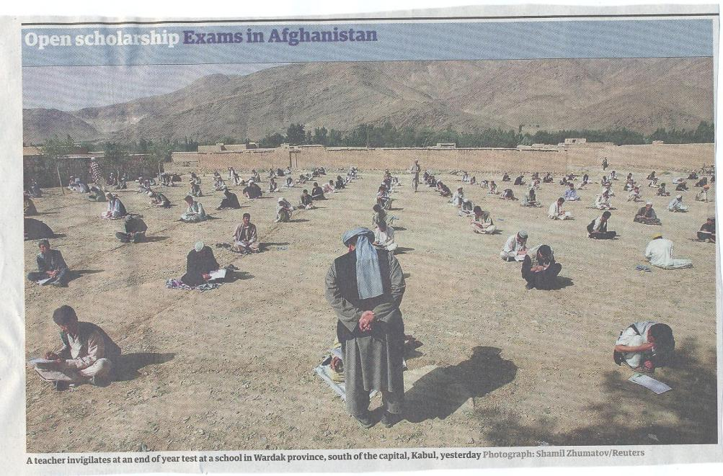

Slide 43
What does an internationalised curriculum mean?
‘The international classroom requires teachers to be skilled managers of a complex teaching and learning environment. They must not only possess the abilities associated with ‘good teaching’ but be efficient intercultural learners who use cultural diversity in the classroom as a learning resource’. (Leask, 2007, p.87).
‘The features of internationalised curricula reflect the varied rationales behind them: early and less developed models will focus exclusively on content, but more complex models encompass references to knowledge and skills, sometimes to behaviours and, where the rationale is values-based, to attitudes.’ (Jones and Killick, 2007, p.112).

Slide 44
But how does this apply to me?
Internationalised content refers to the selection of global and intercultural subject matter and the ways in which assignments focus on variations in professional practices across cultures;
There can be resistance in some subjects to seeing there is any need to internationalise the curriculum: indeed some see it as challenging to their professional integrity;
For example, a Science teacher quoted by Clifford in Trowler et al 2014 says: “Chemistry covers all cultures, there is no way it is culturally differentiating between chemistry here and chemistry in the US, Chemistry in Britain, in China in Nigeria in Columbia;
But cultural sensitivity becomes important in relation to the kinds of analogies we use in our explanations, and in our applications of theory to practical contexts.

Slide 45
Internationalising curriculum content
Do you present students with global examples in your teaching and assignments tasks, or are your case studies and examples drawn solely or principally from your own nation and maybe one or two others?
Do you consider the implications of some of your historical or cultural references which might be unfamiliar to students from diverse national backgrounds?
Do you make it possible for students to draw on their own subject-related experiences in classroom discussions and activities, for example, different legal or practical contexts?
Is there transferability of practices and capabilities to home contexts for students seeking employment post-graduation?

Slide 46
What do we expect our students to do?
For some students, argument and debate may be unfamiliar and profoundly uncomfortable if they are used to contexts where consensus is key;
If your home nation is one where dissent is highly unpopular/ dangerous, asking students to take a personal ( and perhaps controversial) position on an issue can be very frightening;
In Europe and some other nations, learning is seen as a partnership with high expectations of both partners, whereas for some students there is an expectations that teaching is active and learning is passive. However, just like in dancing, we need activity/agency by both partners!

Slide 47
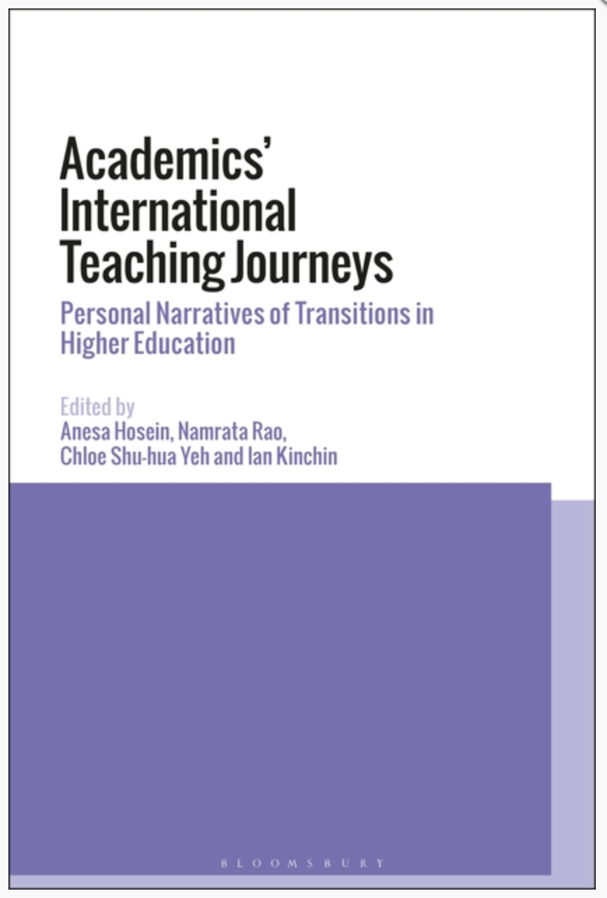
What about international academics?
Here are some perspectives from academics interviewed by Dr Anesa Hosein [a.hosein@surrey.ac.uk] and
Dr Namrata Rao [raon@hope.ac.uk]
whose work I acknowledge here.

Slide 48
Erik Blair – Procedural Differences in Work Practices
Initially, I felt a shock. I had come from a higher education environment in the UK where the general movement was towards openness – of data, of systems, of working and learning relationships. Everyone was expected to have a basic understanding of the photocopier and everyone was expected to complete their own paperwork. I had been conditioned into believing a specific set of expectations and norms of the teaching and learning environment and had an idea about what pedagogy, management, teamwork and university life should look like. However, the cultural and historical factors that informed the institution I now entered led to some tension as I tried to combine the old with the new. The established hierarchies of Trinidad and Tobago meant that management was not used to being questioned; teaching was content-heavy, and students were expected to be passive note-takers (Watson 2013). While I felt that I should do my own photocopying, my administrative colleagues felt that in doing so I was slighting them – so I learned to resist the urge to print, photocopy and staple resources and worked to become comfortable asking for documents that I was capable of finding for myself.
- Extract for Chapter 2. Contextualising the New Teaching Environment (by Erik Blair) taken from Hosein, A., Rao N., Kinchin I., and Yeh C. S.-H. ( due June 2018) Academics’ International Teaching Journeys: Personal Narratives of Transitions in Higher Education, London: Bloomsbury.
Notes:
Procedural differences – cultural differences in work practices and in how students work

Slide 49
Henry Kum – Questioning Professional Judgement
… In the NSS survey, students are asked to provide feedback on what it has been like to study on their course at their institution. There is no doubt that the NSS plays a huge role in shaping the classroom approaches and methods of teachers, especially after the implementation of tuition fees. From my experience as a student and tutor in Cameroon, it is possible to conclude that the culture in Cameroon puts the teachers above the students and students are not considered to have the required resources to make objective judgements about the professional competence of academics, who are considered to be well-read. This culture shaped my professional identity of a teacher always being ahead of the students in matters of content, method and professional judgement. The challenge to me as a migrant academic was on how to draw the balance between keeping students happy and maintaining standards of good practice like attendance, course work, assignments and course expectations.
- Extract for Chapter 3. Complexities and Cross Cultural Challenges of Foreign Lecturers: Personal Narrative Histories in Cameroon and England (by Henry Kum) taken from Hosein, A., Rao N., Kinchin I., and Yeh C. S.-H. ( due June 2018) Academics’ International Teaching Journeys: Personal Narratives of Transitions in Higher Education, London: Bloomsbury.

Slide 50
Jennifer Chung – keeping true to own ethos and beliefs
‘[S]tudents are strategic and define the curriculum by what is assessed rather than by what is taught … if universities are driven down the path of just pleasing the student, through market forces, league tables and an increasingly competitive global market, then the concept of quality learning is under serious threat’ (Norton 2007: 92). I felt that the wider, holistic teaching of our subjects was compromised by these assessments and led to a teach-to-the-test approach to each module. A by-product of this was the amount of support with assessments we were expected to give the students. This contrasted heavily with my own ethos and philosophy of higher education, influenced by the liberal arts tradition, which is to instil independence, self-reliance, and critical thinking in the students. I resisted the pressure to give extensive guidance to the students.
- Extract for Chapter 4. Cultural Shock of an International Academic: From a Liberal Arts Education in the USA to a Post-1992 University in the UK (by Jennifer Chung) taken from Hosein, A., Rao N., Kinchin I., and Yeh C. S.-H. ( due June 2018) Academics’ International Teaching Journeys: Personal Narratives of Transitions in Higher Education, London: Bloomsbury.
Notes:
cultural differences in how students work, Jennifer- Spoon feeding culture/too supportive,

Slide 51
Thushari Welikala – gender and norms
Once, after a team teaching session, a White male colleague mentioned: ‘Thushari, you should not walk around the classroom while teaching. In English universities, the teacher stands in front of the class’. Since White male insiderism is normalized within HE (Collins 2008) such comments could be (mis)interpreted merely as ‘peer feedback’ making cross-boundary conversations complicated (Appiah 2006). Such experiences consistently cautioned me about outsiderism: I am the ‘linguistic other’; ‘pedagogic other’ as well as ‘cultural other’. Similarly, there had been instances where minority women have engaged in othering, which made me feel severely segregated. Thus, the division between ‘us’ and ‘them’ can operate at different layers within institutional contexts, perhaps, due to the ‘dog-eat-dog’ mentality created within neo-liberal western academia (Bhopal 2016).
- Extract for Chapter 5. Being Women and being Migrant: Confronting Double Strangeness in UK Higher Education (by Thushari Welikala) taken from Hosein, A., Rao N., Kinchin I., and Yeh C. S.-H. ( due June 2018) Academics’ International Teaching Journeys: Personal Narratives of Transitions in Higher Education, London: Bloomsbury.

Slide 52
Chloe Shu-Hua Yeh – Teacher-Student relationship
Developing good teacher-student relationships is often a challenge for many teachers (Palmer 1998), including myself. I often wondered whether I was respected ‘enough’ by my students. For example, sometimes I received emails from students without any subject, without appropriate title and without any customary acknowledgements such as ‘thank you’. I felt surprised and puzzled when I received such emails, since in my culture, not addressing a teacher by title or name or indicating ‘thank you’ at the end of an email requesting for help from students to a lecturer is considered impolite and inappropriate.
- Extract for Chapter 6. Overcoming Doubts in an Intercultural Academic Journey from the East to the West (by Chloe Shu-Hua Yeh) taken from Hosein, A., Rao N., Kinchin I., and Yeh C. S.-H. ( due June 2018) Academics’ International Teaching Journeys: Personal Narratives of Transitions in Higher Education, London: Bloomsbury.
Notes:
cultural differences in how students work

Slide 53
Chloe Shu-Hua Yeh – teacher-student expectations
In another instance, on graduation day, I expected my students to meet me and express some kind words/gestures to convey their gratitude for the help I extended to them in their educational journeys – an experience I was familiar with in Taiwan. However, I did not receive even a “hi” on the day. I remember I felt very disappointed with incidences such as these and kept asking myself, have I not done enough to be seen as a good teacher for them? – am I respected enough? I wonder if such doubts and conflicts were amplified by the influence of my Chinese background and the changing educational climate in higher education in the UK in the last few decades.
- Extract for Chapter 6. Overcoming Doubts in an Intercultural Academic Journey from the East to the West (by Chloe Shu-Hua Yeh) taken from Hosein, A., Rao N., Kinchin I., and Yeh C. S.-H. ( due June 2018) Academics’ International Teaching Journeys: Personal Narratives of Transitions in Higher Education, London: Bloomsbury.
Notes:
cultural differences in work practices ; deprofessionalisation of the professional

Slide 54
Tanya Hathaway – Confidence Issues
The international experience swiftly became a test of endurance as I entered a prolonged period of face-to-face teaching that was to take up much of my working hours. In rural regional Australian universities, teacher educators typically experience large class sizes and associated teaching and marking responsibilities. As is often the way with international academics, I was expected to teach and become expert in subjects disconnected from my immediate research specialism (Shaikh 2009; Green and Myatt 2011). The conditions gave me little hope of writing up research and I never was able to carve out research time as proficiently as those around me (Green and Myatt: 39). Others must have been feeling the same pressure? I marvelled at how they were coping. How were they surviving, and seemingly thriving?
- Extract for Chapter 7. Negotiating Transitions in Academic Identity: Teacher or Researcher? (by Tanya Hathaway) taken from Hosein, A., Rao N., Kinchin I., and Yeh C. S.-H. ( due June 2018) Academics’ International Teaching Journeys: Personal Narratives of Transitions in Higher Education, London: Bloomsbury.
Notes:
cultural differences in work practices ; deprofessionalisation of the professional

Slide 55
And what about those of you who have worked or are working in a nation other than your home nation?
Do you have stories to tell about the adjustments you’ve had to make to your pedagogic practice?
Are there things that continue to surprise you?

Slide 56
Issues raised: students in the classroom
The differences in status gap (for example, as shown by physical position) between students and tutors from nation to nation can be disconcerting for students in new environments;
Levels of formality vary, for example, in how lecturers dress and how they expect to be addressed (‘Sally’ or ‘Professor Brown’?);
There can be issues around students who are not prepared to ask questions in class or seek support, for fear of ‘losing face’, or causing the teacher to ‘lose face’
Students from countries where the collective voice is predominant, or there is a culture of non-verbalised debate and unspoken thought sometimes find Dutch or UK classroom debates alienating.

Slide 57
Assessment practices vary hugely globally and this can perplex students. There are variations in:
Expectations on whether a correct answer is sought can be highly variable (Ryan);
Methodologies and approaches to assessment;
In N Europe/Scandinavia there is wider use of oral exams than in many other nations;
There are huge variations in the amount of computer-supported assessment across nations;
The expected word count of assignments and duration of exams is highly variable;
Pass marks, which are by no means standardised (40%-80% in my experience);
The level of support provided on pre-submission drafts.

Slide 58
In some nations, assessment is solely about judging outputs, but other purposes can include:
Determining readiness to progress to the next level of study;
Deciding with what grade or classification students will graduate;
Enabling a judgment to be made about whether a student is fit to practice in a clinical or other professional setting;
Determiningwhether professional requirements have been satisfied sufficiently to achieve professional accreditation;
Providing statistics for internal and external agencies.

Slide 59
What is being assessed?
In some nations accurately demonstrating the learning of by heart of tutor-delivered content is most highly prized, whereas elsewhere, use of that information in context is the prime expectation. As Beetham (2010) proposes:
‘When the focus is on accuracy of reproduction, learners will be given opportunities to practise the required concept or skill until they can reproduce it exactly as taught. When the focus is on internalisation, learners will be given opportunities to integrate a concept or skill with their existing beliefs and capabilities, to reflect on what it means to them, and to make sense of it in a variety of ways’ (Beetham, 2010, p.33)

Slide 60
There are considerable variations in expectations concerning feedback on:
Type (oral, written, in-person, face-to-face?);
Volume (just ticks, or detailed and extensive developmental comments?)
Timing (within a set period, eventually?)
Purpose of feedback (corrections, comments on effort, advice for improvement, pointers towards helpful resources?)
Explicitness of criteria and the amount of support students can expect if they are struggling with work.

Slide 61
Religious, social and ethnic considerations
For students from some cultures, making direct eye contact (with ‘superiors’, the opposite sex or anyone) may be unacceptable, and yet in presentations, it may be an assessment criteria;
Fasting is a key part of some religious observations, which can have real implications for concentration and capability in class and in exams, (so culturally sensitive HEIs bear this in mind);
Interaction in classrooms between students of diverse cultures can be problematic on occasions: groupwork can particularly be a locus of conflict or confusion;
In some nations what is regarded elsewhere as positive assertiveness and confidence can be seen as crass arrogance.

Slide 62
Do we have comparable technological environments? Do you expect your students to:
Have access to the internet at home?
Bring their own devices to class (BYOD) and use them in lessons?
Submit assignments and receive feedback electronically?
Access core subject content on-line before they come to classes?
These practices are ‘old hat’ in some places and deeply unfamiliar elsewhere.

Slide 63
Are there shared concepts of student support? Do you
Adopt a close, caring and nurturing approach to students where the teacher's role is akin to that of a parent?
Will you proof-read or copy edit student work?
Regularly stay after lectures for 30-60 minutes to answer questions?
Regard students as independent, autonomous adults, capable of making their own decisions of how much and how hard to study?
Principally have contact with students in lecture theatre or is there much contact on an individual level?
Do parents have a central role in the educational transaction?

Slide 64
HEIs and nations must recognise we work in a global environment
To succeed in a highly competitive global environment, HEIs have to behave inter-culturally and cross-culturally, and dominant cultures must be sensitive about not imposing their cultural, pedagogic and academic expectations on other parts of the world.
Student and staff mobility, the impact of transnational education, a readiness by some nations to teach undergraduates as well as postgraduates in a language other than their own to protect and enhance recruitment, and the ubiquity of international software and platform providers all mitigate against drawing up the barricades around our own national university systems.

Slide 65
Pedagogic terminological confusions
In the UK ‘assessment’ encompasses the act of marking, grading and giving feedback on assignments but in the US it means the comments students give on our teaching and vice versa with significant international variation;
‘Faculty’ in the UK is an organisational term to describe groups of subjects or departments,, but in the US the term means academic teachers;
The term ‘instructor’ is used in the US for teaching staff, but in the UK these are technicians;
‘Professor’ in the UK is a status only reached after extensive application processes, but is more widely used elsewhere;
University staff in the UK are all ‘employees’, but in the US it means professional and clerical administrators;
What in the US are termed ‘Administrators’ are called Senior Managers in the UK.

Slide 66
Cultural sensitivities
It’s necessary for all staff to recognise their personal and professional positions in relation to internationalisation, since none of us are coming from a culturally-neutral perspective;
International staff and home staff working transnationally tend to be more perceptive about their own personal locus for those who work solely in their home countries;
We must avoid the risks of cultural intrusion and perceived imperialism in our implied beliefs that our ways of curriculum delivery and quality assurance are always best.

Slide 67
Diverse pedagogic approaches and contexts across the world
Is your principal model of teaching one of transmission of knowledge or do you review learning as a partnership between teachers and students?
Is the knowledge base you use ubiquitous or transactional?
Do you value robust discussion in class, or is it more important to achieve consensus?
Is there a significant power distance between academics and students, or is the pedagogic context quite informal?

Slide 68
Diverse learning contexts: how far do you:
Socialise with students outside class time?
Encourage interruptions and questions in lectures?
Encourage students to express opposing views and disagree publicly with you?
Provide multiple submission opportunities for assessed work?
Allow students to negotiate higher marks?
Timetable required activities at weekends/ in the evening?
Expect students to stay away from home overnight e.g. on field trips?
Accept gifts from your students?

Slide 69
In conclusion
What benefits arise from working in an internationalised context, particularly in relation to assessment and feedback;
From the things we have discussed today, which pitfalls in relation to assessment and feedback do you particularly want to avoid?

Slide 70

These and other slides will be available on my website at http://sally-brown.net

Slide 71
Useful references and further reading (1)
Bain, K. (2004) What the best College Teachers do, Cambridge: Harvard University Press.
Biggs, J. and Tang, C. (2007) Teaching for Quality Learning at University, Maidenhead: Open University Press.
Bloxham, S. and Boyd, P. (2007) Developing effective assessment in higher education: a practical guide, Maidenhead, Open University Press.
Boud, D. (1995) Enhancing learning through self-assessment, London: Routledge.
Boud, D. and Associates (2010) Assessment 2020: Seven propositions for assessment reform in higher education, Sydney: Australian Learning and Teaching Council.
Brown, S. and Glasner, A. (eds.) (1999) Assessment Matters in Higher Education, Choosing and Using Diverse Approaches, Maidenhead: Open University Press.
Brown, S. and Race, P. (2012) Using effective assessment to promote learning in Hunt, L. and Chambers, D. (2012) University Teaching in Focus, Victoria, Australia, Acer Press. P74-91.
Brown, S. (2015) Learning , Teaching and Assessment in Higher Education: Global perspectives, London, Palgrave.

Slide 72
Useful references and further reading (2)
Carless, D., Joughin, G., Ngar-Fun Liu et al (2006) How Assessment supports learning: Learning orientated assessment in action Hong Kong: Hong Kong University Press.
Carroll, J. and Ryan, J. (2005) Teaching International students: improving learning for all. London: Routledge SEDA series.
Crosling, G., Thomas, L. and Heagney, M. (2008) Improving student retention in Higher Education, London and New York: Routledge
Crooks, T. (1988) Assessing student performance, HERDSA Green Guide No 8 HERDSA (reprinted 1994).
Falchikov, N. (2004) Improving Assessment through Student Involvement: Practical Solutions for Aiding Learning in Higher and Further Education, London: Routledge.
Gibbs, G. (1999) Using assessment strategically to change the way students learn, in Brown S. & Glasner, A. (eds.), Assessment Matters in Higher Education: Choosing and Using Diverse Approaches, Maidenhead: SRHE/Open University Press.
Higher Education Academy (2012) A marked improvement; transforming assessment in higher education, York: HEA.
Jones, E. and Killick, D. (2007) Internationalisation of the curriculum, in Jones, E. and Brown, S. (Eds) (2008) Internationalising Higher Education, Abingdon: Routledge.

Slide 73
Useful references and further reading (3)
Leask, B. (2007) International teachers and international learning, in Jones, E. and Brown, S. (Eds) Internationalising Higher Education, Abingdon: Routledge.
McDowell, L. and Brown, S. (1998) Assessing students: cheating and plagiarism, Newcastle: Red Guide 10/11 University of Northumbria.
McDowell, L. (2012) Programme focussed assessment Bradford: Bradford University http://www.pass.brad.ac.uk/short-guide.pdf
Meyer, J.H.F. and Land, R. (2003) ‘Threshold Concepts and Troublesome Knowledge 1 – Linkages to Ways of Thinking and Practising within the Disciplines’ in C. Rust (ed.) Improving Student Learning – Ten years on. Oxford: OCSLD.
Nicol, D. J. and Macfarlane-Dick, D. (2006) Formative assessment and self-regulated learning: A model and seven principles of good feedback practice, Studies in Higher Education Vol 31(2), 199-218.
PASS project Bradford http://www.pass.brad.ac.uk/ Accessed November 2013.
Pickford, R. and Brown, S. (2006) Assessing skills and practice, London: Routledge.
Price, M, Rust, C., Donovan, B., and Handley, K. with Bryant, R. (2012) Assessment Literacy: the foundation for Improving student learning, Oxford: Oxford Centre for Staff and learning Development.
QAA (2013) UK Quality Code for Higher Education: Chapter B6: Assessment of students and recognition of prior learning. http://www.qaa.ac.uk/publications/informationandguidance/pages/quality-code-b6.aspx
Rotheram, B. (2009) Sounds Good, JISC project http://www.jisc.ac.uk/whatwedo/programmes/usersandinnovation/soundsgood.aspx

Slide 74
Useful references and further reading (4)
Race P. (2014) Making Learning Happen (3rd edition), London: Sage..
Rust, C., Price, M. and O’Donovan, B. (2003) Improving students’ learning by developing their understanding of assessment criteria and processes, Assessment and Evaluation in Higher Education. 28 (2), 147-164.
Ryan, J. (2000) A Guide to Teaching International Students, Oxford Centre for Staff and Learning Development.
Sadler, D. R. (2010) Beyond feedback: developing student capability in complex appraisal, Assessment & Evaluation in Higher Education, 35: 5, 535-550.
Sadler, D. R. (2005) Interpretations of criteria‐based assessment and grading in higher education, Assessment & Evaluation in Higher Education, 30(2), pp.175-194.
Sambell, K., McDowell, L. and Montgomery, C. (2012) Assessment for Learning in Higher Education Abingdon, Routledge
Sambell, K, Brown, S. and Graham, L. (2017) Professionalism in practice: key directions in higher education learning, teaching and assessment, London: Palgrave-MacMillan.
Wiggins, G. (1990) The Case for Authentic Assessment. ERIC Digest.
Yorke, M. (1999) Leaving Early: Undergraduate Non-completion in Higher Education, London: Routledge.

