Slide 1
Using national and international networks and communities for development, dissemination (and dodging bullets)!
SEDA Conference 16-17th November 2017
Sally Brown, Phil Race and David Baume
@ProfSallyBrown http://sally-brown.net s.brown@leedsbeckett.ac.uk
@RacePhil http://phil-race.co.uk
phil@phil-race.co.uk
@David_Baume http://davidbaume.com david@davidbaume.com

Slide 2
Our focus
Whether you are new to teaching and development in universities and colleges or a seasoned practitioner, it can be an isolating and sometimes lonely experience. People working in teaching and development have access to a wide variety of supportive and helpful communities of practice (Wenger, 1998). But it is not always easy to work out how to select, join or participate in them. And once we are in one, we tend to stay there.

Slide 3
Key issues to be addressed in this session therefore include:
Locating and joining the most helpful communities with which to engage;
Deciding your level of commitment of time and energy to a particular community (“Should I volunteer as a committee member, or just sit on the side-lines?”);
Establishing how best to contribute to one or more groups and organisations (“Is this idea or practice good enough to share yet?”); and
Developing co-operation with development functions and organisations beyond your current one(s).
This session is designed both to celebrate the communities now available and to offer some experience-based suggestions on establishing new communities to fit as-yet-unserved needs.

Slide 4
By the end of this session, delegates will have had opportunities to:
Review and plan how best they can share and disseminate good practice through live and virtual networks, and
Identify new ways in which they can engage with and use learning and teaching networks and associations.
Our plan:
Introductions and initial presentations;
Small groups task;
Plenary panel

Slide 5
Your presenters representing 135 years of Educational Development!
David Baume was founding chair of SEDA and a co-founder of ICED, IJAD, HEDG and the UK National Coordination Team. He will talk about starting, working with and finding synergies with national and international development networks and associations.
Sally Brown has a long record of leadership within SEDA, she helped to set up the Institute for Learning and Teaching in Higher Education, a predecessor of the Higher Education Academy, and is now chair of the Association of National Teaching Fellows. She will talk about fostering member engagement.
Phil Race was very active in SEDA’s antecedent organisations, SCEDSIP, SCED and the Association of Educational and Training Technology and in SEDA itself, and historically in the Polytechnic Association for Continuing Education (PACE). He will talk about virtual networks for personal and professional development, including the SEDA and NTF mailbases and the Twitter community, particularly #LTHEchat.

Slide 6
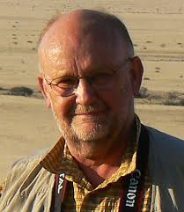
David
Baume

Slide 7
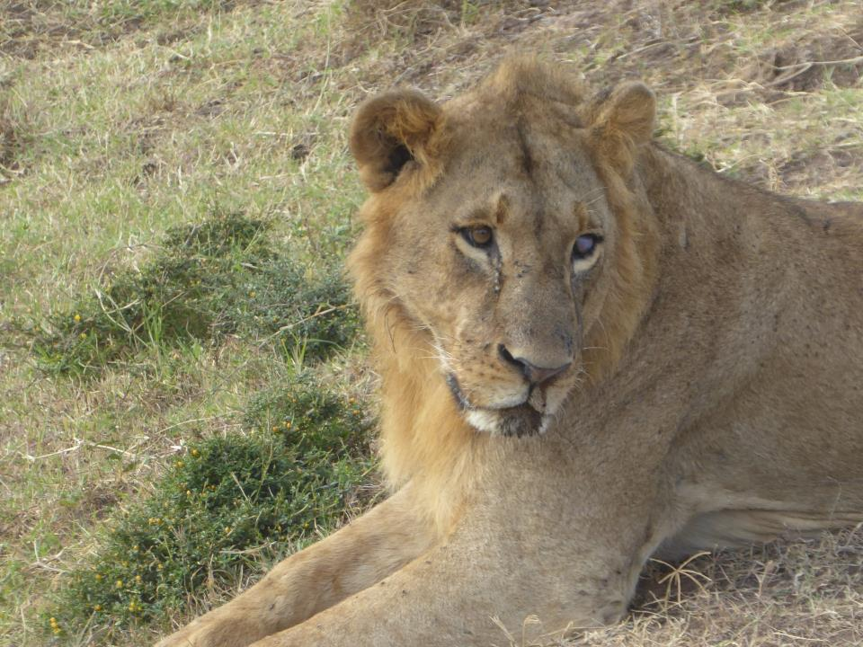

Slide 8
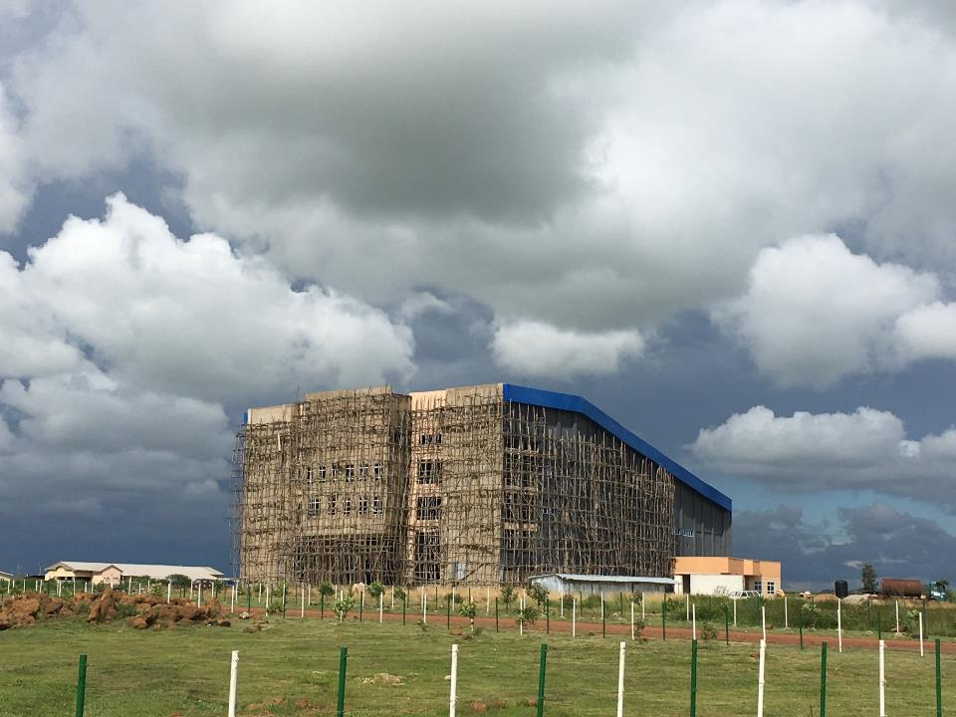

Slide 10
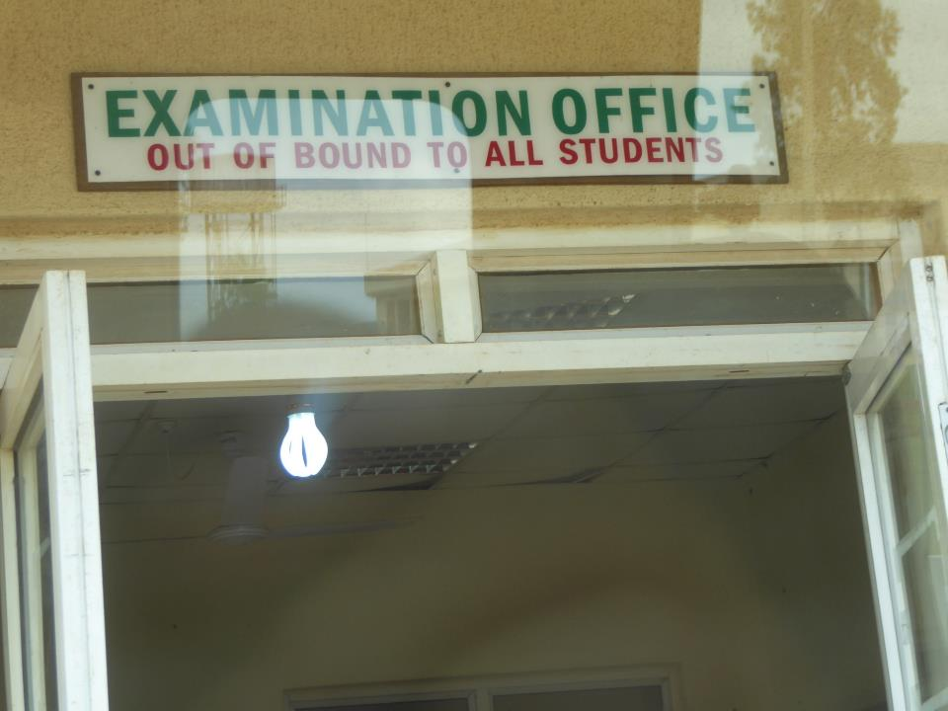

Slide 12
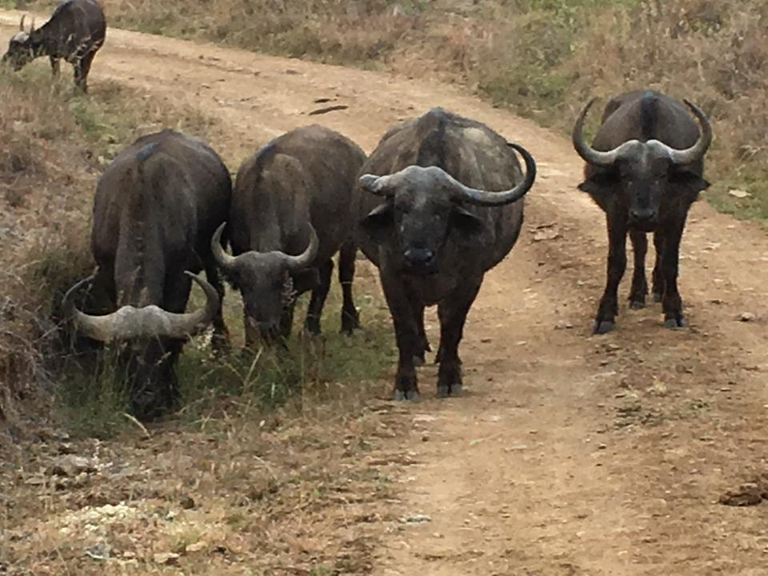

Slide 13
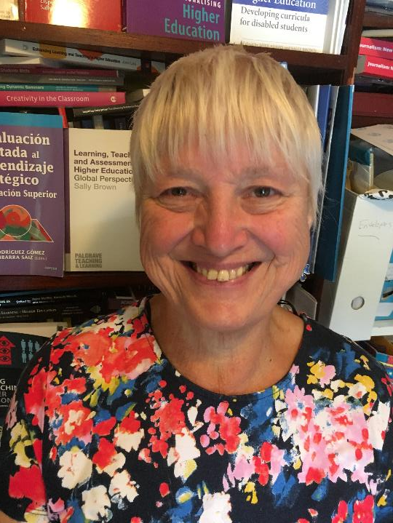
Sally Brown: a career forged through active networking, sustained by the generosity and challenges of peers, now dedicated to paying forward

Slide 14
SEDA: for me this is my home community through which I learned to publish, organise, network and grow personally. I still give energy, expertise and mentoring . I love the JISC-mail list & conferences, and I mentor.
The ILTHE: I helped to grow this, ab initio developing memberships services, publishing, conferences, membership engagement, virtual and live networking, members’ electronic resources and community building
HEA: the organisation with which I have a love/hate relationship: I am a (very) critical friend, an excellence awards reviewer, a sometime consultant on assessment and a contributor to various fora
ANTF: my current community of volition: as a committee member/Chair I help sustain a community through direction/ personal influence, networking, support and energisation. I value particularly the JISC-mail list and the symposia

Slide 15
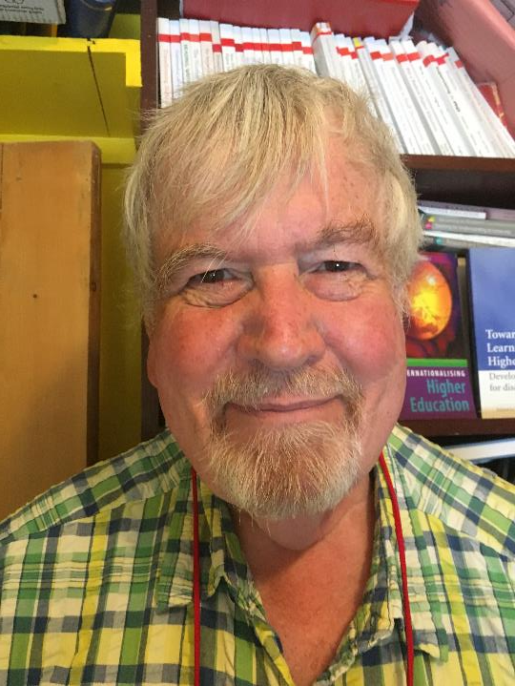
Phil Race
independent by role and choice, committed to open learning, open educational resources, open rail returns, open-mindedness and opening wine bottles

Slide 16
SCEDSIP, PACE, SCED, AETT, ILTHE, SEDA
Learning from and participating in educational communities of practice all my life!
Learned to write Minutes, papers and books!
Rail Users Consultative Committee for Wales:
Learned how important people’s specialisms and strengths can be.
SCI (South Wales Section)
Learned what not to do as Treasurer!
CET’s OTTSU Learned to escape from my institution and run workshops British Safety Council
Learned about risk and hazards, and how to make even COSHH training workshops fun, and a lot about MCQs
Online learning, Twitter@RacePhil, (especially #LTHEchat), FutureLearn MOOCs (Parliament, Weather), joining in webinars e.g. ‘Transforming Assessment’

Slide 17
With which professional association(s) and network(s) do you currently work?
What do you gain from them?
What more help / support / ideas / outlets do you need?
How will you investigate / work with one other professional association / network to provide more of what you need?

Slide 18
Some concluding thoughts on what makes networks and communities work well
Which of these things do you consider essential?
Funding/ sponsorship/ other form of finance?
A sensible organisational structure?
A clear mission?
Share mutual values?
Diversity of membership?
What else?

Slide 19
How can you really stuff up a network/community?
Exclusivity?
Failure to have succession planning?
Insufficient critical mass?
Financial mismanagement?
Running out of a reasons for existence?
Competitive organisations that work better?
What else?

Slide 20
The underpinnings of successful networking: be:
Generous with your time and energy, while taking care of boundaries;
Visible without being overpowering;
Challenging and unafraid to ask difficult questions;
Mindful of the needs of the wider community;
Resourceful in finding creative solutions to seemingly intractable problems;
Serendipitous, in being able to spot opportunities;
Grateful for the opportunities and support provided by your nurturing networks.

Slide 21
References
Baume, D. (2017)Remapping the Higher Education Development Community on his blogsite at
https://tinyurl.com/DBHEDC
Wenger, E, (1998) Communities of practice: learning, meaning and identity, Cambridge, MA: Harvard University Press.
UK National Development Associations – see https://davidbaume.com/2017/04/19/re-mapping-the-higher-education-development-community/

