Slide 1
Supporting student transition and engagement through effective assessment and feedback
University of Dundee
June 2017
Sally Brown
PFHEA, SFSEDA, NTF
Emerita Professor, Leeds Beckett University
Visiting Professor: University of Plymouth, Liverpool John Moores University, Edge Hill University and University of South Wales.

Slide 2
Assessment in context
If we want to help students’ successful transitions, focus students’ effort and improve their engagement with learning, a key locus of enhancement can be refreshing our approaches to assessment;
Sometimes we need to take a fresh look at our current practice to make sure assessment is for rather than just of learning;
Assessment is a complex, nuanced and highly important process;
We provide explicit and implicit messages to students and indeed all other stakeholders by how we assess.

Slide 3
Why is assessment such a big issue?
Good feedback and assessment practices are essential to student transition, learning and retention ;
Student satisfaction surveys frequently highlight significant dissatisfaction around these issues;
In tough times, staff often find the pressure of achieving fast and formative feedback a heavy chore, especially when cohorts are large;
A key locus for engagement is assessment, since assignments give students cues about what we value, and they tend to regard marks like money.

Slide 4
Assessment linked to learning
Effective assessment significantly and positively impacts on student learning, (Boud, Mentkowski, Knight and Yorke and many others).
Assessment shapes student behaviour and poor assessment encourages strategic behaviour (Kneale). Clever course developers utilise this tendency and design assessment tools that foster the behaviours we would wish to see (for example, logical sequencing, fluent writing, effective referencing and good time management) and discourage others (‘rummage-sale’ data sourcing, aimless cutting and pasting and plagiarism).

Slide 5
Why does assessment matter so much?
“Assessment methods and requirements probably have a greater influence on how and what students learn than any other single factor. This influence may well be of greater importance than the impact of teaching materials” (Boud 1988)

Slide 6
How are you assessing in the first 6 weeks of the first semester of the 1st year to support transition?
Yorke and others argue that this is the crucial period in which we can set good learning and study patterns for the rest of undergraduate study;
No assessment or the wrong assessment can sabotage the transition into HE study;
We need to build in assessment that helps students develop assessment literacy, get the measure of their abilities, find out what can’t yet do, and at the same time build rather than diminish confidence.

Slide 7
Assessment literacy: students do better if they can:
Make sense of key terms such as criteria, weightings, and level;
Encounter a variety of assessment methods (e.g. presentations, portfolios, posters, assessed web participation, practicals, vivas etc) and get practice in using them;
Be strategic in their behaviours, putting more work into aspects of an assignment with high weightings, interrogating criteria to find out what is really required and so on;
Gain clarity on how the assessment regulations work in their HEI, including issues concerning submission, resubmission, pass marks, condonement etc.

Slide 8
Assessment for Learning
Emphasises authentic & complex assessment tasks
Develops students’ abilities to evaluate own progress, direct own learning
Is rich in informal feedback (e.g. peer review of draft writing, collaborative project work)
Uses high stakes summative assessment rigorously but sparingly
Offers extensive ‘low stakes’ confidence building opportunities and practice
Is rich in formal feedback (e.g. tutor comment, self-review logs)

Slide 9
Assessment for learning
1. Tasks should be challenging, demanding higher order learning and integration of knowledge learned in both the university and other contexts;
2. Learning and assessment should be integrated, assessment should not come at the end of learning but should be part of the learning process;
3. Students are involved in self assessment and reflection on their learning, they are involved in judging performance;
4. Assessment should encourage metacognition, promoting thinking about the learning process not just the learning outcomes;
5. Assessment should have a formative function, providing ‘feedforward’ for future learning which can be acted upon. There is opportunity and a safe context for students to expose problems with their study and get help; there should be an opportunity for dialogue about students’ work;

Slide 10
Assessment for learning
6. Assessment expectations should be made visible to students as far as possible;
7. Tasks should involve the active engagement of students developing the capacity to find things out for themselves and learn independently;
8. Tasks should be authentic; worthwhile, relevant and offering students some level of control over their work;
9. Tasks are fit for purpose and align with important learning outcomes;
10. Assessment should be used to evaluate teaching as well as student learning.
(Bloxham and Boyd)

Slide 11

Authentic assessment can engage and motivate students

Slide 12
Authentic assessment implies using assessment for learning (Sambell et al, 2017)
Assessment that is meaningful to students can provide them with a framework for activity;
“Students can escape bad teaching but they can’t escape bad assessment” (Boud, 1995);
Where assessment is fully part of the learning process and integrated within it, the act of being assessed can help students make sense of their learning;
Assessment should be formative, informative, developmental and remediable.

Slide 13
The benefits of authentic assessment can be significant for all stakeholders.
Students undertaking authentic assessments tend to be more fully engaged in learning and hence tend to achieve more highly because they see the sense of what they are doing (Sadler, 2005).
University teachers adopting authentic approaches can use realistic and live contexts within which to frame assessment tasks, which help to make theoretical elements of the course come to life.
Employers value students who can quickly engage in real-life tasks immediately on employment, having practiced and developed relevant skills and competences through their assignments.

Slide 14
Questions employers might ask at interview that might help us frame some of our assignments
Can you tell us about an occasion when:
you worked together with colleagues in a group to produce a collective outcome;
you had to work autonomously with incomplete information and self-derived data sources;
you developed strategies to solve real life problems and tested them out;
you has a leadership role in a team, and could you tell us your strategies to influence and persuade your colleagues to achieve a collective task;
you had to communicate outcomes from your project work orally, in writing, through social media and/or through a visual medium?"

Slide 15
Ensuring assessment focuses efforts and promotes engagement means including reference to assessment
methodologies: which methods and approaches are most appropriate and efficient for the arts and design context?
agency: who should be undertaking assessment? Tutors, peers, students themselves, employers and clients can all participate in student assessment to good effect, but which is right for particular assessment activities?
timing: end point and continuous assessment can both be valuable, when should we assess students to maximise impact on student learning?
orientation: to what extent in each task would we wish to focus particularly on process or outcomes, or both?
inclusivity: how can we enable all students to achieve their highest personal potential?
efficiency: what can we do to make assessment fully embedded in learning for students?

Slide 16
Formative and summative assessment
Formative assessment is primarily concerned with feedback aimed at prompting improvement, is often continuous and usually involves words.
Summative assessment is concerned with making evaluative judgments, is often end point and involves numbers.

Slide 17
Inter-year transitions: avoiding the sophomore slump (Yorke, 2014, Zaitseva et al)
The three-month between the end of the 1st year and the start of the 2nd(and to a lesser extent between 2nd and 3rd years) provides lacunae for lost motivation and decreased engagement;
Energy, thought and resources need to be deployed to counteract this tendency and to maintain student engagement;
This can be undertaken in three ways:
  Through linking study from year to year through assignments and other activities set to bridge the gap;
  By maintaining contact (live or virtual);
  By using peer groups and networks for mutual support.

Slide 18
Designing fit for purpose assessment methods & approaches: 10 questions
Are your assignments fully and constructively aligned with your learning outcomes?
Do they comply with University requirements in terms of number, word limits etc?
Are summative assessments undertaken throughout the course, or is everything ‘sudden death’ end-point?
Is there excessive bunching of assignments in different modules that is highly stressful for students and unmanageable staff?
Are there plenty of opportunities for formative assessment, especially early on?

Slide 19
And the next five:
Are students over-assessed?
Do staff have time to mark the assessments in time for exam boards etc?
When you have introduced innovative assignments, have they been introduced instead of existing ones or simply added to the assessment diet?
Are students encouraged to make good use of the feedback they receive?
Do the students perceive your assessment diet to be fair and providing meaningful recognition of their achievements?

Slide 20
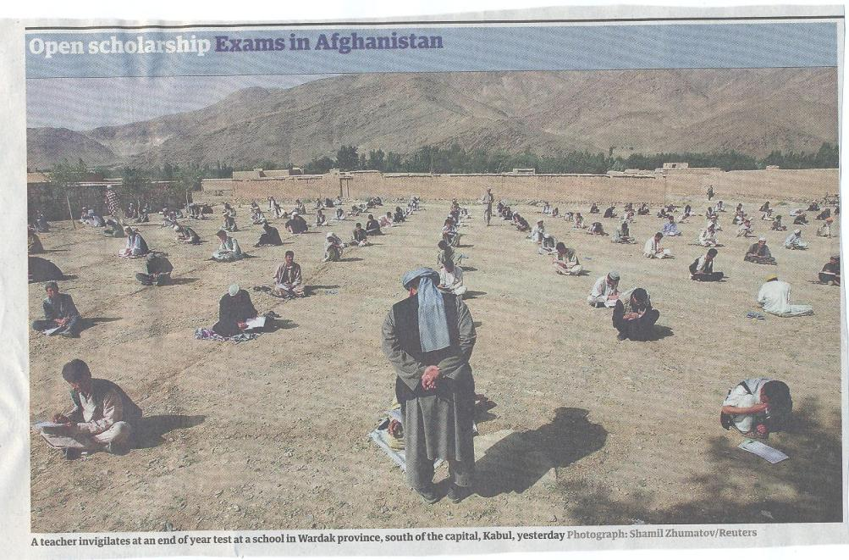

Slide 21
Encouraging students to take assessment more seriously
All assessment needs to be seen to be fair, consistent, reliable, valid and manageable;
Many assessment systems fail to clarify for students the purposes of different kinds of assessment activity;
Low-stakes early formative assessment helps students, especially those from disadvantaged backgrounds, understand the rules of the game.

Slide 22
The importance of dialogic assessment
Students need to be exposed to, and gain experience in making judgements about, a variety of works of different quality... They need planned rather than random exposure to exemplars, and experience in making judgements about quality. They need to create verbalised rationales and accounts of how various works could have been done better. Finally, they need to engage in evaluative conversations with teachers and other students. Together, these three provide the means by which students can develop a concept of quality that is similar in essence to that which the teacher possesses, and in particular to understand what makes for high quality. Although providing these experiences for students may appear to add more layers to the task of teaching, it is possible to organise this approach to peer assessment so that it becomes a powerful strategy for higher education teaching. (Sadler 2010)

Slide 23
Good feedback practice:
1. Helps clarify what good performance is (goals, criteria, expected standards);
2. Facilitates the development of self-assessment (reflection) in learning;
3. Delivers high quality information to students about their learning;
4. Encourages teacher and peer dialogue around learning;
5. Encourages positive motivational beliefs and self-esteem;
6. Provides opportunities to close the gap between current and desired performance;
7. Provides information to teachers that can be used to help shape the teaching.

Slide 24
To improve assessment we should realign it by:
Exploring ways in which assessment can engage students and be integral to learning;
Constructively aligning (Biggs 2003) assignments with planned learning outcomes and the curriculum taught;
Providing realistic tasks: students are likely to put more energy into assignments they see as authentic and worth bothering with;
Maximise the dialogic opportunities of student feedback.

Slide 25
Sound and frequent assessment
Good assessment is valid, reliable, practical, developmental, manageable, cost-effective, fit for purpose, relevant, authentic, inclusive, closely linked to learning outcomes and fair.
Is it possible also to make it enjoyable for staff and students?
Incremental assessment has more value in promoting student learning than end-point ‘sudden death’ approaches.

Slide 26
Efficient assessment; we need to:
Stop marking, start assessing!
Explore ways to maximise student ‘time on task’ (Gibbs) and minimise staff drudgery;
Remember that feedback is crucial to student learning but the most time-consuming aspect of assessment: we need to explore ways of giving feedback effectively and efficiently;
Note that Computer-supported assessment can include use of audio feedback via digital sound files, video commentaries and other means of using course Virtual Learning Environments.

Slide 27
Putting this in to practice. We need to:
design an assessment strategy that involves a diverse range of methods of assessment (as all forms of assessment disadvantage some students);
consider when designing assessment tasks how any students might be disadvantaged;
maximise the opportunities for each student to achieve at the highest possible level;
ensure the assurance of appropriate standards for all students.

Slide 28
Checklist: to what extent does your assessment strategy:
Work at a programme level, rather than having assessment occur in module-shaped silos?
Maximise fast, formative feedback opportunities without driving your markers into the ground?
Support student transition and retention by making assessment integral to learning?
Enable the development of digital literacy by providing tasks that use social and digital media?
Make the process of assessing and being assessed enjoyable for staff and students?
Assure the standards of assessment against national and PSRB benchmarks?

Slide 29
And…
Provide incremental assessment opportunities?
Use assessment activities that can engage students and be integral to learning?
Constructively align (Biggs 2003) assignments with planned learning outcomes and the curriculum taught?
Provide realistic tasks: students are likely to put more energy into assignments they see as authentic and worth bothering with?
Maximise the dialogic opportunities of student feedback?

Slide 30
Conclusions
If we are strategic in assessment design, it can be a powerful tool to support transition, focus student effort and ensure students are both engaged and achieve well;
However, many assessment strategies are often under-designed, so we need to consider the fitness for purpose of each element of the assessment programme;
This will include the assignment questions/tasks themselves, the briefings, the marking criteria, the moderation process and the feedback;
We also need to scrutinise how the assignments align with one another, whether we are over or under-assessing, whether we are creating log-jams for students and markers, whether we are assessing authentically, and whether our processes are fair and sensible.
If we do all this, assessment can genuinely make a marked improvement in student learning.

Slide 31

These and other slides will be available on my website at http://sally-brown.net

Slide 32
Useful references: 1
Assessment Reform Group (1999) Assessment for Learning : Beyond the black box, Cambridge UK, University of Cambridge School of Education.
Biggs, J. and Tang, C. (2007) Teaching for Quality Learning at University, Maidenhead: Open University Press.
Bloxham, S. and Boyd, P. (2007) Developing effective assessment in higher education: a practical guide, Maidenhead, Open University Press.
Brown, S. Rust, C. & Gibbs, G. (1994) Strategies for Diversifying Assessment, Oxford: Oxford Centre for Staff Development.
Boud, D. (1995) Enhancing learning through self-assessment, London: Routledge.
Brown, S. and Glasner, A. (eds.) (1999) Assessment Matters in Higher Education, Choosing and Using Diverse Approaches, Maidenhead: Open University Press.
Brown, S. and Knight, P. (1994) Assessing Learners in Higher Education, London: Kogan Page.
Brown, S. and Race, P. (2012) Using effective assessment to promote learning in Hunt, L. and Chambers, D. (2012) University Teaching in Focus, Victoria, Australia, Acer Press. P74-91

Slide 33
Useful references 2
Carless, D., Joughin, G., Ngar-Fun Liu et al (2006) How Assessment supports learning: Learning orientated assessment in action Hong Kong: Hong Kong University Press.
Carroll, J. and Ryan, J. (2005) Teaching International students: improving learning for all. London: Routledge SEDA series.
Crosling, G., Thomas, L. and Heagney, M. (2008) Improving student retention in Higher Education, London and New York: Routledge
Crooks, T. (1988) Assessing student performance, HERDSA Green Guide No 8 HERDSA (reprinted 1994).
Falchikov, N. (2004) Improving Assessment through Student Involvement: Practical Solutions for Aiding Learning in Higher and Further Education, London: Routledge.
Gibbs, G. (1999) Using assessment strategically to change the way students learn, in Brown S. & Glasner, A. (eds.), Assessment Matters in Higher Education: Choosing and Using Diverse Approaches, Maidenhead: SRHE/Open University Press.
Higher Education Academy (2012) A marked improvement; transforming assessment in higher education, York: HEA.

Slide 34
Useful references 3
Knight, P. and Yorke, M. (2003) Assessment, learning and employability Maidenhead, UK: SRHE/Open University Press.
Mentkowski, M. and associates (2000) p.82 Learning that lasts: integrating learning development and performance in college and beyond, San Francisco: Jossey-Bass.
McDowell, L. and Brown, S. (1998) Assessing students: cheating and plagiarism, Newcastle: Red Guide 10/11 University of Northumbria.
Nicol, D. J. and Macfarlane-Dick, D. (2006) Formative assessment and self-regulated learning: A model and seven principles of good feedback practice, Studies in Higher Education Vol 31(2), 199-218.
PASS project Bradford http://www.pass.brad.ac.uk/ Accessed November 2013.
Pickford, R. and Brown, S. (2006) Assessing skills and practice, London: Routledge.
Race, P. (2001) A Briefing on Self, Peer & Group Assessment, in LTSN Generic Centre Assessment Series No 9, LTSN York.
Race, P. (2015) The lecturer’s toolkit (4th edition), London: Routledge.
Sambell, K, Brown, S. and Graham, L. (2017) Professionalism in practice: key directions in higher education learning, teaching and assessment, London: Palgrave-MacMillan.

Slide 35
Useful references 4
Rust, C., Price, M. and O’Donovan, B. (2003) Improving students’ learning by developing their understanding of assessment criteria and processes, Assessment and Evaluation in Higher Education. 28 (2), 147-164.
Ryan, J. (2000) A Guide to Teaching International Students, Oxford Centre for Staff and Learning Development
Stefani, L. and Carroll, J. (2001) A Briefing on Plagiarism http://www.ltsn.ac.uk/application.asp?app=resources.asp&process=full_record&section=generic&id=10
Sadler, D. Royce (2010) Beyond feedback: developing student capability in complex appraisal,
Assessment & Evaluation in Higher Education, 35: 5, 535-550
Yorke, M. (1999) Leaving Early: Undergraduate Non-completion in Higher Education, London: Routledge.
Yorke, M., 2013. Using research findings to inform quality enhancement. Enhancing Quality in Higher Education: International Perspectives, p.49.
Zaitseva, E., Darwent, S. and Thompson, S., 2014. Implications for student support. Stepping Up to the Second Year at University: Academic, Psychological and Social Dimensions, p.68.

