Slide 1
Using good feedback and assessment practices to enhance student engagement and achievement
Utrecht university Science Faculty
15 March 2017
Sally Brown
PFHEA, SFSEDA, NTF
Emerita Professor, Leeds Beckett University
Visiting Professor: University of Plymouth, Liverpool John Moores University and University of South Wales.

Slide 2
Rationale
In this workshop, we will explore the five key factors that need to be taken into account when designing effective assessment which fosters student engagement and learning: purpose (why?), 'focus (what?) methodologies & approaches (how?), agency (who?) and timing (when?).
By the end of the workshop, participants will have had opportunities to consider how a concerted and holistic approach to assessment can help it to constructively align to learning outcomes and programme delivery, so that students value the process rather than just focusing on the resultant marks, as well as to identify some actions that could be taken to enhance assessment practice.

Slide 3
Determining and reviewing subject material: currency, relevance, level
Enhancing quality, seeking continuous improvement
Designing and refining learning outcomes
Evaluating programmes, strengths and areas for improvement
Curriculum
Design
Essentials
Considering delivery modes: face-to-face, online, PBL, blended…
Assuring quality, matching HEI, national and PSRB requirements
Thinking through student support
Designing fit for purpose assessment methods and approaches

Slide 4
Why is assessment such a big issue?
Good feedback and assessment practices are essential to student learning;
Globally, student satisfaction surveys frequently highlight significant dissatisfaction around these issues;
In tough times, staff often find the pressure of achieving fast and formative feedback a heavy chore, especially when cohorts are large;
A key locus for engagement is assessment, since assignments give students cues about what we value, and they tend to regard marks like money.

Slide 5
From ‘A marked improvement’ (HEA, 2012)
Assessment of student learning is a fundamental function of higher education. It is the means by which we assure and express academic standards and has a vital impact on student behaviour, staff time, university reputations, league tables and, most of all, students’ future lives. The National Student Survey, despite its limitations, has made more visible what researchers in the field have known for many years: assessment in our universities is far from perfect. (p.7)

Slide 6
Improving assessment improves learning
Assessment is largely dependent upon professional judgement, and confidence in such judgement requires the establishment of appropriate forums for the development and sharing of standards within and between disciplinary and professional communities. Assessment shapes what students study, when they study, how much work they do and the approach they take to their learning. Consequently, assessment design is influential in determining the quality and amount of learning achieved by students, and if we wish to improve student learning, improving assessment should be our starting point. (p.9)

Slide 7
Formative and summative assessment
Formative assessment is primarily concerned with feedback aimed at prompting improvement, is often continuous and usually involves words.
Summative assessment is concerned with making evaluative judgments, is often end point and involves numbers.

Slide 8
We need more formative, less summative
The change that has the greatest potential to improve student learning is a shift in the balance of summative and formative assessment. Summative assessment has important purposes in selection, certification and institutional accountability, but its dominance has distorted the potential of assessment to promote learning (assessment for learning). (p.9)

Slide 9
Boud et al 2010: ‘Assessment 2020’
Assessment has most effect when...:
It is used to engage students in learning that is productive.
Feedback is used to actively improve student learning.
Students and teachers become responsible partners in learning and assessment.
Students are inducted into the assessment practices and cultures of higher education.
Assessment for learning is placed at the centre of subject and program design.
Assessment for learning is a focus for staff and institutional development.
Assessment provides inclusive and trustworthy representation of student achievement.

Slide 10
Assessment for Learning
Emphasises authentic & complex assessment tasks
Develops students’ abilities to evaluate own progress, direct own learning
Is rich in informal feedback (e.g. peer review of draft writing, collaborative project work)
Uses high stakes summative assessment rigorously but sparingly
Offers extensive ‘low stakes’ confidence building opportunities and practice
Is rich in formal feedback (e.g. tutor comment, self-review logs)

Slide 11
‘Impact on learning’
Assessment is a central feature of teaching and the curriculum. It powerfully frames how students learn and what students achieve. It is one of the most significant influences on students’ experience of higher education and all that they gain from it. The reason for an explicit focus on improving assessment practice is the huge impact it has on the quality of learning. (Boud and Associates, 2010, p.1)

Slide 12
Assessment literacy: students do better if they can:
Make sense of key terms such as criteria, weightings, and level;
Encounter a variety of assessment methods (e.g. presentations, portfolios, posters, assessed web participation, practicals, vivas etc) and get practice in using them;
Be strategic in their behaviours, putting more work into aspects of an assignment with high weightings, interrogating criteria to find out what is really required and so on;
Gain clarity on how the assessment regulations work in their HEI, including issues concerning submission, resubmission, pass marks, condonement etc.

Slide 13
A rethink is needed
Universities face substantial change in a rapidly evolving global context. The challenges of meeting new expectations about academic standards in the next decade and beyond mean that assessment will need to be rethought and renewed. (Boud et al, 2010 p.1).

Slide 14
How can we engage students through assessment?

Slide 15
My fit-for-purpose model of assessment: the key questions
Why are we assessing? (Purpose)
What is it we are actually assessing? (Focus)
How are we assessing? (Methodologies and approaches);
Who is best placed to assess? (Agency);
When should we assess? (Timing).
Notes:
15

Slide 16
Purposes: the reasons for assessment: may include:
Enabling students to get the measure of their achievement;
Helping them consolidate their learning;
Providing feedback so they can improve and remedy any deficiencies;
motivating students to engage in their learning;
providing them with opportunities to relate theory and practice.
Notes:
16

Slide 17
more purposes...
Helping students make sensible choices about option alternatives and directions for further study;
demonstrating student employability;
providing assurance of fitness to practice;
giving feedback to teachers on effectiveness;
providing statistics for internal and external agencies.
Notes:
17

Slide 18
Orientation/focus: choosing what we assess
product or process?
theory or practice?
knowledge, skills and attitude (all sectors)?
subject knowledge or application?
what we’ve always assessed?
what it’s easy to assess?
Notes:
18

Slide 19
How: methods and approaches of assessment
We need to choose authentic and appropriate means of assessing;
Unseen exams, reports and essays are overused and there are many more methods in use in different universities in the UK and internationally which may be more fit-for-purpose;
These include in-seminar assessments, posters, assessed blogs, portfolios, case studies, vivas, short answer tests, multiple choice and other CAA tests, reflective accounts, logs, projects, presentations, learning packages, annotated bibliographies, in-tray exercises, live briefs, and many more.

Slide 20
Agency: choosing who is best placed to assess
tutor assessment
self-assessment
peer assessment, (either inter or intra peer)
employers, practice tutors and line managers
client assessment
Notes:
20

Slide 21
When: timing is crucial
If all assessment is left to the end of the programme or the end of module, there is a high risk of failure and under-performance;
Incremental activities leading to a culminative/ capstone assignment or multiple small assignments can help to avoid ‘sudden death’;
We should aim to avoid assessing students only when it fits our systems and instead strive to assess students as they become ready.

Slide 22
Designing fit for purpose assessment methods & approaches: 10 questions
Are your assignments fully and constructively aligned with your learning outcomes?
Do they comply with UU’s requirements in terms of number, word limits etc?
Are summative assessments undertaken throughout the course, or is everything ‘sudden death’ end-point?
Is there excessive bunching of assignments in different modules that is highly stressful for students and unmanageable staff?
Are there plenty of opportunities for formative assessment, especially early on?

Slide 23
And the next five:
Are students over-assessed?
Do staff have time to mark the assessments in time for exam boards etc?
When you have introduced innovative assignments, have they been introduced instead of existing ones or simply added to the assessment diet?
Are students encouraged to make good use of the feedback they receive?
Do the students perceive your assessment diet to be fair and providing meaningful recognition of their achievements?

Slide 24
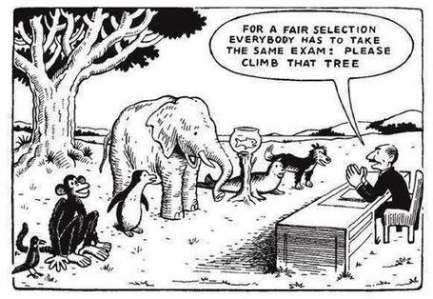

Slide 25
Good feedback:
Is dialogic, rather than mono-directional, giving students chances to respond to comments from their markers and seek clarification where necessary.
Helps clarify what good work looks like, so students are really clear about goals, criteria and expected standards, and provides opportunities to close the gap between current and desired performance.
after Brown, S. (2015), Assessment, learning and teaching in higher education: global perspectives, Palgrave

Slide 26
Good feedback:
Actively facilitates students reviewing their own work and reflecting on it, so that they become good judges of the quality of their own work.
Doesn’t just correct errors and indicate problems, potentially leaving students discouraged and demotivated, but also highlights good work and encourages them to believe they can improve and succeed.

Slide 27
Good feedback:
Delivers high-quality information to students about their achievements to date and how they can improve their future work. Where there are errors, students should be able to see what needs to be done to remediate them, and where they are undershooting in terms of achievement, they should be able to perceive how to make their work even better.

Slide 28
Good feedback:
Offers ‘feed-forward’ aiming to ‘increase the value of feedback to the students by focusing comments not only on the past and present … but also on the future – what the student might aim to do, or do differently in the next assignment or assessment if they are to continue to do well or to do better’ (Hounsell, 2008, p. 5).
Ensures that the mark isn’t the only thing that students take note of when work is returned, but that they are encouraged to read and use the advice given in feedback and apply it to future assignments.

Slide 29
Sadler, the most cited author on formative assessment argues:
“Students need to be exposed to, and gain experience in making judgements about, a variety of works of different quality... They need planned rather than random exposure to exemplars, and experience in making judgements about quality. They need to create verbalised rationales and accounts of how various works could have been done better. Finally, they need to engage in evaluative conversations with teachers and other students.”

Slide 30
Five things students really hate about feedback
Poorly written comments that are nigh on impossible to decode, especially when impenetrable acronyms or abbreviations are used, or where handwriting is in an unfamiliar alphabet and is illegible.
Cursory and derogatory remarks that leave them feeling demoralised ‘Weak argument’, ‘Shoddy work’, ‘Hopeless’, ‘Under-developed’, and so on.
Value judgements on them as people rather than on the work in hand.

Slide 31
Five things students really hate about feedback
Vague comments which give few hints on how to improve or remediate errors: ‘OK as far as it goes’, ‘Needs greater depth of argument’, ‘Inappropriate methodology used’, ‘Not written at the right level’.
Feedback that arrives so late that there are no opportunities to put into practice any guidance suggested in time for the submission of the next assignment.

Slide 32
Encouraging students to use the feedback we provide for them
Delivery of feedback should not be left to chance, so its best to avoid asking students to pick up marked hard copy assignments from departmental offices;
Electronic submission of assignments has benefits and disadvantages but on balance the former outweigh the latter;
Perhaps require students to guestimate expected marks having read your feedback early in their programmes;
‘Assignment handler’ can deliver feedback electronically and only release marks once students have responded;
Audio files of audio feedback can be highly successful in enabling students to capture ‘live’ oral feedback, and can replace written feedback (e.g. JISC project Sounds good).

Slide 33
Making assessment work well
Intra-tutor and Inter-tutor reliability need to be assured;
Practices and processes need to be transparently fair to all students;
Cheat and plagiarisers need to be deterred/punished;
Assessment needs to be manageable for both staff and students;
Assignments should assess what has been taught/learned not what it is easy to assess.

Slide 34
Assessment for learning
1. Tasks should be challenging, demanding higher order learning and integration of knowledge learned in both the university and other contexts;
2. Learning and assessment should be integrated, assessment should not come at the end of learning but should be part of the learning process;
3. Students are involved in self assessment and reflection on their learning, they are involved in judging performance;
4. Assessment should encourage metacognition, promoting thinking about the learning process not just the learning outcomes;
5. Assessment should have a formative function, providing ‘feedforward’ for future learning which can be acted upon. There is opportunity and a safe context for students to expose problems with their study and get help; there should be an opportunity for dialogue about students’ work;

Slide 35
Assessment for learning
6. Assessment expectations should be made visible to students as far as possible;
7. Tasks should involve the active engagement of students developing the capacity to find things out for themselves and learn independently;
8. Tasks should be authentic; worthwhile, relevant and offering students some level of control over their work;
9. Tasks are fit for purpose and align with important learning outcomes;
10. Assessment should be used to evaluate teaching as well as student learning.
(Bloxham and Boyd)

Slide 36
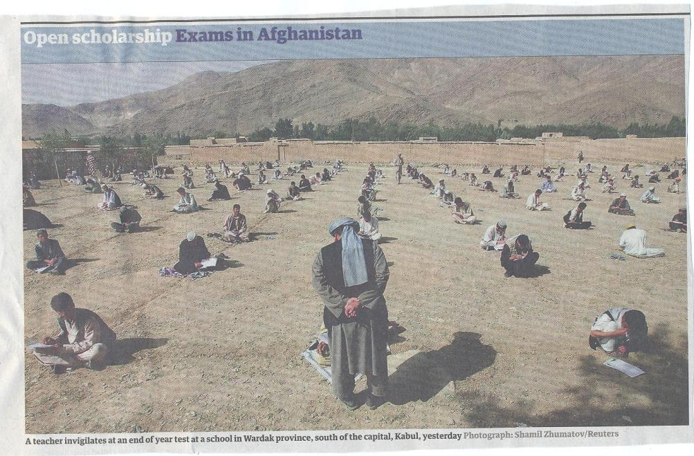

Slide 37
Putting this in to practice. We need to:
design a purposeful and rationalised assessment strategy that involves a diverse range of methods of assessment, that makes best use of a range of assessors and is timely in its execution;
consider when designing assessment tasks how any students might be disadvantaged;
maximise the opportunities for each student to achieve at the highest possible level;
ensure the assurance of appropriate standards for all students.

Slide 38
These and other slides will be available on my website at http://sally-brown.net

Slide 39
Useful references: 1
Assessment Reform Group (1999) Assessment for Learning : Beyond the black box, Cambridge UK, University of Cambridge School of Education.
Biggs, J. and Tang, C. (2007) Teaching for Quality Learning at University, Maidenhead: Open University Press.
Bloxham, S. and Boyd, P. (2007) Developing effective assessment in higher education: a practical guide, Maidenhead, Open University Press.
Brown, S. Rust, C. & Gibbs, G. (1994) Strategies for Diversifying Assessment, Oxford: Oxford Centre for Staff Development.
Boud, D. (1995) Enhancing learning through self-assessment, London: Routledge.
Brown, S. and Glasner, A. (eds.) (1999) Assessment Matters in Higher Education, Choosing and Using Diverse Approaches, Maidenhead: Open University Press.
Brown, S. and Knight, P. (1994) Assessing Learners in Higher Education, London: Kogan Page.
Brown, S. and Race, P. (2012) Using effective assessment to promote learning in Hunt, L. and Chambers, D. (2012) University Teaching in Focus, Victoria, Australia, Acer Press. P74-91

Slide 40
Useful references 2
Carless, D., Joughin, G., Ngar-Fun Liu et al (2006) How Assessment supports learning: Learning orientated assessment in action Hong Kong: Hong Kong University Press.
Carroll, J. and Ryan, J. (2005) Teaching International students: improving learning for all. London: Routledge SEDA series.
Crosling, G., Thomas, L. and Heagney, M. (2008) Improving student retention in Higher Education, London and New York: Routledge
Crooks, T. (1988) Assessing student performance, HERDSA Green Guide No 8 HERDSA (reprinted 1994).
Falchikov, N. (2004) Improving Assessment through Student Involvement: Practical Solutions for Aiding Learning in Higher and Further Education, London: Routledge.
Gibbs, G. (1999) Using assessment strategically to change the way students learn, in Brown S. & Glasner, A. (eds.), Assessment Matters in Higher Education: Choosing and Using Diverse Approaches, Maidenhead: SRHE/Open University Press.
Higher Education Academy (2012) A marked improvement; transforming assessment in higher education, York: HEA.

Slide 41
Useful references 3
Knight, P. and Yorke, M. (2003) Assessment, learning and employability Maidenhead, UK: SRHE/Open University Press.
Mentkowski, M. and associates (2000) p.82 Learning that lasts: integrating learning development and performance in college and beyond, San Francisco: Jossey-Bass.
McDowell, L. and Brown, S. (1998) Assessing students: cheating and plagiarism, Newcastle: Red Guide 10/11 University of Northumbria.
Nicol, D. J. and Macfarlane-Dick, D. (2006) Formative assessment and self-regulated learning: A model and seven principles of good feedback practice, Studies in Higher Education Vol 31(2), 199-218.
PASS project Bradford http://www.pass.brad.ac.uk/ Accessed November 2013.
Pickford, R. and Brown, S. (2006) Assessing skills and practice, London: Routledge.

Slide 42
Useful references 4
Race, P. (2001) A Briefing on Self, Peer & Group Assessment, in LTSN Generic Centre Assessment Series No 9, LTSN York.
Race P. (2015) The lecturer’s toolkit (4th edition), London: Routledge.
Rust, C., Price, M. and O’Donovan, B. (2003) Improving students’ learning by developing their understanding of assessment criteria and processes, Assessment and Evaluation in Higher Education. 28 (2), 147-164.
Ryan, J. (2000) A Guide to Teaching International Students, Oxford Centre for Staff and Learning Development
Stefani, L. and Carroll, J. (2001) A Briefing on Plagiarism http://www.ltsn.ac.uk/application.asp?app=resources.asp&process=full_record&section=generic&id=10
Sadler, D. Royce (2010) Beyond feedback: developing student capability in complex appraisal, Assessment & Evaluation in Higher Education, 35: 5, 535-550
Yorke, M. (1999) Leaving Early: Undergraduate Non-completion in Higher Education, London: Routledge.

