Slide 1



Webinar Series
1 March 2017: 07:00AM UTC/GMT
Getting Started with Assessment and Feedback in Higher Education
Presenter: Sally Brown (Emerita Professor, Leeds Beckett University, UK)
Preview session for Assessment in Higher Education Conference 2017
Your Webinar Hosts
Professor Geoff Crisp,
PVC Education, University of New South Wales
g.crisp[at]unsw.edu.au
Dr Mathew Hillier,
Office of the Vice-Provost Learning & Teaching,
Monash University
mathew.hillier[at]monash.edu
Just to let you know:
By participating in the webinar you acknowledge and agree that:
The session may be recorded, including voice and text chat communications (a recording indicator is shown inside the webinar room when this is the case).
We may release recordings freely to the public which become part of the public record.
We may use session recordings for quality improvement, or as part of further research and publications.
e-Assessment SIG

Slide 2
New to assessing in HE
March 1st 2017
Sally Brown NTF, PFHEA, SFSEDA
@ProfSallyBrown sally@sally-brown.net
Emerita Professor, Leeds Beckett University
Visiting Professor:
University of Plymouth,
University of South Wales &
Liverpool John Moores University.

Slide 3
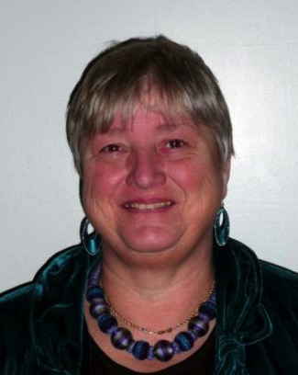
Hello!
These and other slides will be available on my website at http://sally-brown.net as Open Educational resources.

Slide 4
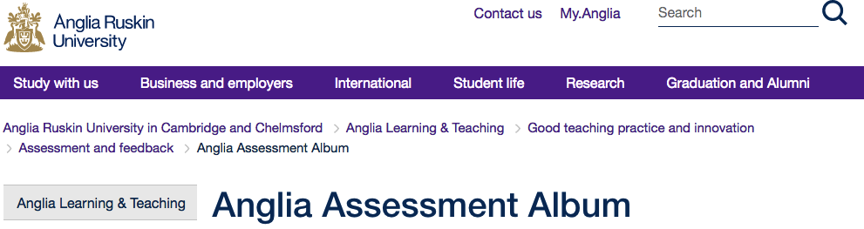
Thanks to Anglia Ruskin University!
The materials in this webinar are based on some in development for Anglia Ruskin University in the UK in a project led by Sharon Waller and delivered by me, Erica Morris and Margaret Price;
You will ultimately be able to find them among the OER resources at
http://www.anglia.ac.uk/anglia-learning-and-teaching/good-teaching-practice-and-innovation/assessment-and-feedback/anglia-assessment-album

Slide 5
I assert that doing assessment well is highly important…
This is not only because it impacts so substantially on student achievements, but because it is an important locus of directing student effort and focus (Price et al, 2012, Brown and Race, 2012).
Students’ lives and careers after graduation can be heavily impacted by poor assessment experiences, and these often link to student drop-out and failure to achieve potential. (Yorke and Longden, 2004).
Universities therefore have a commitment to students and the new assessors themselves to make the process of learning to assess well as positive and as effective as possible.
Poor quality and unreliable outcomes are the inevitable result of leaving new assessors to learn on-the-job without support.

Slide 6
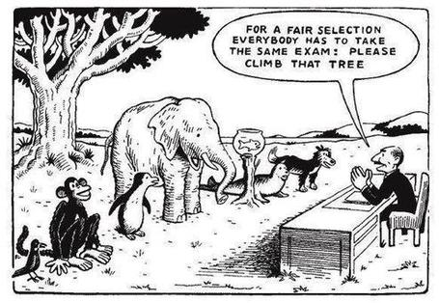

Slide 7
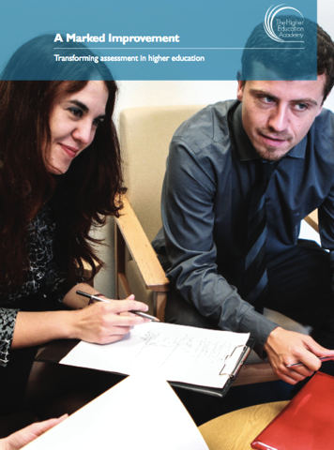
Assessment is a complex task
It takes experience to get it right, so early support is essential to ensure you become competent to assess ;
The HEA ‘A Marked Improvement’ project (HEA, 2012) emphasised the importance of ‘support mechanisms such as mentoring to help staff build confidence in the formation and reliability of their assessment judgments’ (Tenet B6.2);
It’s important to recognise that assessment can never be precise (Tenet 3);
Even highly experienced assessors often fail to agree completely on a mark, so it isn’t sensible to agonise about the margins between 66% and 67%;
Assessment needs to be for not just of learning!

Slide 8
A4L the Northumbria model
Develops students’ abilities to evaluate own progress, direct own learning
Emphasises authentic & complex assessment tasks
Is rich in informal feedback (e.g. peer review of draft writing, collaborative project work)
Uses high stakes summative assessment rigorously but sparingly
Is rich in formal feedback (e.g. tutor comment, self-review logs)
Offers extensive ‘low stakes’ confidence building opportunities and practice

Slide 9
Giving prompt, formative and developmental feedback is crucial
The language and tone of your feedback can make the difference between building or destroying confidence;
Students need to learn from this assignment and move confidently on to the next assignment (Nicol and McFarlane Dick, 2006).
The purpose of feedback is to [give enough information] to help students improve performance and change their practices to ensure they make the grade, rather than criticising them personally, so comments should focus on the work and how to make it better rather than personal comments (Boud, 2007);
It needs to be received in sufficient time to impact on the next assignment.

Slide 10
Making choices: a fit-for-purpose approach. For each assignment, the assessor needs to decide:
Why are you assessing: what is the purpose of this assignment? (to build confidence, to ensure standards are met, to help students know what they need to do to improve, to give a final grade?
What exactly is it being assessed? Process or product? Work in progress or final result? Theory and/or practice?
How should you assess: what are the most appropriate approaches and methods to use? (Exams, MCQs, essays, portfolios, posters, case studies, oral exams, computer simulations, patchwork texts?)
Who are the best agents for assessment? (tutors, peers, students themselves, employers, practice supervisors etc)
When should you be assessing? Early on to gauge progress? Mid-point to highlight issues? End point to assure standards have been met? Incrementally to allow a progressive build-up of achievement?
(Brown, 2016)

Slide 11
First steps in HE assessment
When designing new assignments, start by scrutinising the course outcomes and make sure you are mapping student performance against what is expected of them (these are usually described as ‘Learning Outcomes’).
From these, it is then possible to determine the criteria for assessment to ensure alignment, coverage and appropriate weighting of marks.
Next it is necessary to check assessment plans against Professional, Subject and Regulatory Bodies, national quality assurance agency and your university’s assessment regulations to ensure compliance with them.
It’s wise to check with more experienced colleagues about any aspects of assessment that you find puzzling or problematic.

Slide 12
Starting to assess
Review assignments against criteria after an initial read through and make really basic judgements: does this match the criteria brilliantly, well, adequately, just about, or not at all? This would enable you to start evaluating within five broad bands, and then marks can be assigned accordingly on a second read.
When you are doing this for the first time, it's best assess alongside an experienced marker who can show you the ropes and help you build confidence that you are marking to the right standard.
Aim to show to a more experienced marker early on some examples of your top graded assignments, a couple of reasonable ones in the middle of the mark scale and a couple if you can of work that you think just doesn't merit a pass so you can gauge standards together and check you aren't being over or under generous in your marking.

Slide 13
Starting to assess contd.
Don’t expect marks to conform to normal distribution curves unless you have a cohort of thousands.
Work systematically and logically and don’t work too long when you are tired (experts advise no more than three hour stretches including little breaks);
As you become more confident, continue to consult peers so you are steadily building shared standards within your subject community (HEA, 2012, op cit).

Slide 14
Giving feedback that helps students improve.
Marking, that is, making judgments on students work that result in a grade letter or number is important, but equally so is giving feedback that changes their practices for the better on future assignments;
Focus your comments on specific steps students can take to make their work better (so for example, don’t just write References! Beside unreferenced work, but point students towards guidance on how your part of the university prefers articles, books, websites and other publications to be acknowledged and referenced;
Ensure that the comments you make are sufficient in quantity to enable students to follow what you are advocating, but no extensive that you exhaust yourself and students;

Slide 15
Giving feedback well
Use the format that your university or Faculty expects markers to use for giving feedback (e.g. online, using proformas or rubrics, orally, face-to-face, by email and so on);
Make sure you mark and return work with feedback within the required turnaround time (which in many universities is 3 weeks);
Remember always that the recipients of your feedback are real people and consider the impact your critique will have on them.
It’s important to challenge all students to improve but not to undermine confidence in early-stage learners and those with low self-confidence and esteem.

Slide 16
Activity
Assessment task: the brief
Reflecting on your first semester on the BSc Nursing, write a 500-word (excluding references) critical reflection on one critical incident you have experienced while undertaking your placement on a ward, and for that particular occasion:
Describe the events as you understood them;
Describe your feelings about this event;
Outline what you have learned from this event about yourself and your chosen profession;
Given a similar situation in the future, what would you do the same and what would you do differently?
In what ways do the theories you’ve learned on the course help you to make sense of what you’ve observed on placement?
What do you now feel you need to do to help you be effective as a student and ultimately as a nurse?”

Slide 17
Activity
Assessment task: the criteria
30 marks: Ability to identify a relevant incident within your placement and to address it appropriately by demonstrating a commitment to professional practice.
20 marks: presentation and clarity of writing including grammar, punctuation, spelling and fluency as well as accurate referencing of relevant current literature.
50 marks: The ability to think critically, reflecting both in action (at the time of the incident but drawing on past experience or learning) and on action (after the event, for the purpose of learning more)

Slide 18
Activity
Assessment task: Aru (extract)
I am doing a nursing degree having spent five years working first as a care assistant and later as a nursing assistant. I'm really enjoying studying at University but I find it really hard, particularly in managing doing the studying alongside looking after my kids and caring for my 90-year-old mum. week I was nursing an old lady on the geriatric ward at St Mary’s. She was in a very poor way because she was dehydrated and kept blacking out. felt really upset about it as I wouldn’t have let my mum get into that state. You have to encourage them to drink, not just leave a cup of tea in front of them and then take it away when it gets cold. It is very clear when you read about dehydration that when patients don’t drink much they quite often get disorientated and actually get too confused to drink (Campbell, 1971, Norton et al, 1962) That’s how this lady had got and her urine was dark brown. I felt like giving the trolley woman a real ticking off for just taking the full cup away without mentioning it to anyone but I thought that might make trouble. But I did mention it to the senior nurse on duty as I was worried she might get even worse. What I did at the time was to sit down with the lady when the trolley came around and talked to her and pretended to drink myself and she watched me then had little sips herself.

Slide 19
Activity
Assessment task: Tena
Working on a geriatric ward has been a real challenge to me as I haven’t spent much time previously around elderly people and in the past I felt somewhat intimidated by the idea, worried about the smells and the confusion. I started six weeks ago on my placement on a 48-bed ward, with six sections each with eight patients. My duties have involved accompanying the senior nurse on ward rounds, taking regular temperatire and blood pressure checks and helping some of the patients to eat and drink, which is crucial to helping them thrive. I was fasinated to read an article about the importance of hydration and I learned a great deal from it. Nowadays I always make a mental note to watch how much each patient is eating and drinking after each meal and reporting it if I feel someone is not getting what they need. I know from looking after my own sick children that it isn’t just a matter of telling them to do it: they often take pursuasion to even lift a cup. My own attitude has changed a lot since I started on this ward. I’ve stopped worrying so much about the les pleasant bits, and encouraged by my mentor, started to think of all the pateints as indivudals, not just ‘Bed 7 by the window’ or ‘the asmatic diabetic’.

Slide 20
Activity
So what were your thoughts on these two assignments?
Aru would pass the assignment = a
Tena would pass the assignment = b
both would pass = c
neither would pass = d
undecided = e
Type comments in to the text box too!

Slide 21
Reviewing the activity
The examples have been designed so that neither is either completely disastrous or stupendously good. Aru is fluent and accurate in writing, while Tena’s work is full of errors. Aru uses references (correctly cited) but they are very old and Tena uses none. Both demonstrate honesty and a commitment to professionalism, but the extent differs;
It is likely that markers would give quite diverse marks for these examples depending on their context and experience.
Both have their flaws and these examples demonstrate that assessment is a complex, nuanced and demanding process, requiring the exercise of judgment by the assessors with outcomes that are rarely clear-cut.
It’s important when several people are assessing to ensure inter-assessor reliability and that everyone is marking to the same standard. This can only happen through dialogue and practice.

Slide 22
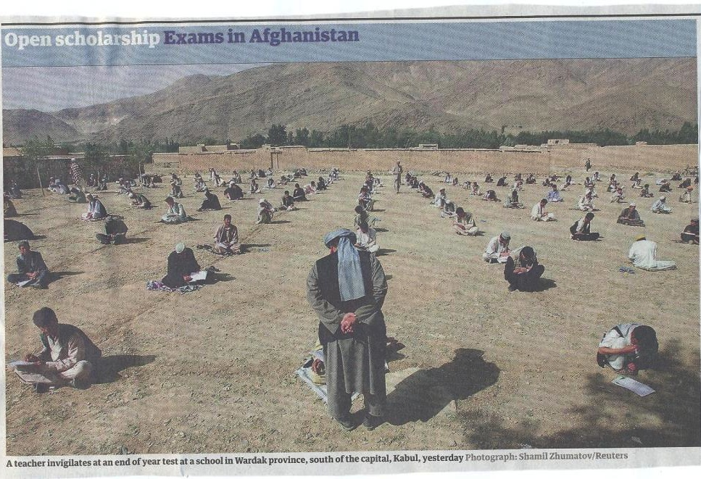

Slide 23
Some concluding thoughts
You are likely to encounter students and colleagues with very different experiences of assessment forms and approaches and no single nation has a monopoly on doing assessment well;
Assessing and giving feedback well is tough but becomes more manageable with practice, especially when you work alongside peers;
It is probably the most important job you do for peers, so worth investing time and effort in doing it well.

Slide 24
Some good stuff to read on assessment
Bloxham, S. and Boyd, P. (2007) Developing effective assessment in higher education: a practical guide, Maidenhead, Open University Press.
Boud, D. (2007) Reframing assessment as if learning were important. Rethinking assessment in higher education: Learning for the longer term, 14-25.
Brown, S. and Glasner, A. (eds.) (1999) Assessment Matters in Higher Education, Choosing and Using Diverse Approaches, Maidenhead: Open University Press.
Brown, S. and Race, P. (2012) Using effective assessment to promote learning in Hunt, L. and Chambers, D. (2012) University Teaching in Focus, Victoria, Australia, Acer Press. P74-91.
Brown, S. (2015) Learning , Teaching and Assessment in Higher Education: Global perspectives, London, Palgrave. Chapters 7&8
Carless, D., Joughin, G., Ngar-Fun Liu et al (2006) How Assessment supports learning: Learning orientated assessment in action Hong Kong: Hong Kong University Press.
Crooks, T. (1988) Assessing student performance, HERDSA Green Guide No 8 HERDSA (reprinted 1994).

Slide 25
More useful reading on assessment
Falchikov, N. (2004) Improving Assessment through Student Involvement: Practical Solutions for Aiding Learning in Higher and Further Education, London: Routledge.
Gibbs, G. (1999) Using assessment strategically to change the way students learn, in Brown S. & Glasner, A. (eds.), Assessment Matters in Higher Education: Choosing and Using Diverse Approaches, Maidenhead: SRHE/Open University Press.
Higher Education Academy (2012) A marked improvement; transforming assessment in higher education, York: HEA.
McDowell, L. (2012) Programme focussed assessment Bradford: Bradford University http://www.pass.brad.ac.uk/short-guide.pdf
Nicol, D. J. and Macfarlane-Dick, D. (2006) Formative assessment and self-regulated learning: A model and seven principles of good feedback practice, Studies in Higher Education Vol 31(2), 199-218.
PASS project Bradford http://www.pass.brad.ac.uk/ Accessed November 2013.
Pickford, R. and Brown, S. (2006) Assessing skills and practice, London: Routledge.

Slide 26
Yet more useful reading on assessment
Rotheram, B. (2009) Sounds Good, JISC project http://www.jisc.ac.uk/whatwedo/programmes/usersandinnovation/soundsgood.aspx
Rust, C., Price, M. and O’Donovan, B. (2003) Improving students’ learning by developing their understanding of assessment criteria and processes, Assessment and Evaluation in Higher Education. 28 (2), 147-164.
Sadler, D. Royce (2010) Beyond feedback: developing student capability in complex appraisal,
Assessment & Evaluation in Higher Education, 35: 5, 535-550.
Sadler, D.R., 2005. Interpretations of criteria‐based assessment and grading in higher education. Assessment & Evaluation in Higher Education, 30(2), pp.175-194
Wiggins, G. (1990) The Case for Authentic Assessment. ERIC Digest.
Yorke, M. and Longden, B. (2004) Retention and Student Success in Higher Education, Maidenhead, Open University Press.

Slide 27
Webinar Series
Webinar Session feedback
With thanks from your hosts
Professor Geoff Crisp,
PVC Education, University of New South Wales
g.crisp[at]unsw.edu.au
Dr Mathew Hillier,
Office of the Vice-Provost Learning & Teaching
Monash University
mathew.hillier[at]monash.edu
Recording available
http://transformingassessment.com
Register for AHE2017
https://aheconference.com/
6th-internationl-ahe-conference-2017/
e-Assessment SIG

