Slide 1
Engaging students, engaging staff
Prof Sally Brown
Making Learning Happen
Prof Phil Race
EuroCHRIE 2016, Budapest
27th October 2016

Slide 2
Plan for this session...
We will each present for about 30 mins, starting with Sally, then Phil.
Then we’ll discuss matters arising from both sessions for about 30 mins.
The we’ll all enjoy the refreshment break.

Slide 3
Engaging students, engaging staff: how can we foster high levels of staff and student motivation to produce excellence in learning and teaching
EuroCHRIE 2016 Budapest
Sally Brown @ProfSallyBrown
sally@sally-brown.net
NTF, PFHEA, SFSEDA
Emerita Professor, Leeds Beckett University
Visiting Professor University of Plymouth, University of South Wales & Liverpool John Moores University.

Slide 4
The context in which we work: what are your thoughts on:
Students;
Employability;
Staffing;
University finances;
Technologies to support learning and admin;
Learning paradigms;
Students as consumers;
Student satisfaction and other performance indicators

Slide 5
Engagement: Why talk about it? Because:
Academics and learning support staff report increasing levels of disengagement by students of the ‘iGeneration’;
The nature of the transaction seems to be changing in the light of high fees in many nations;
Potentially the nature of student behaviour in higher education is changing radically in terms of academic and other literacies;
Institutions need to ensure that new students enter with, or have the opportunity to acquire, the skills needed for academic success;
HEIs must devise programmes in which the emphasis is on maximising students’ development.

Slide 6
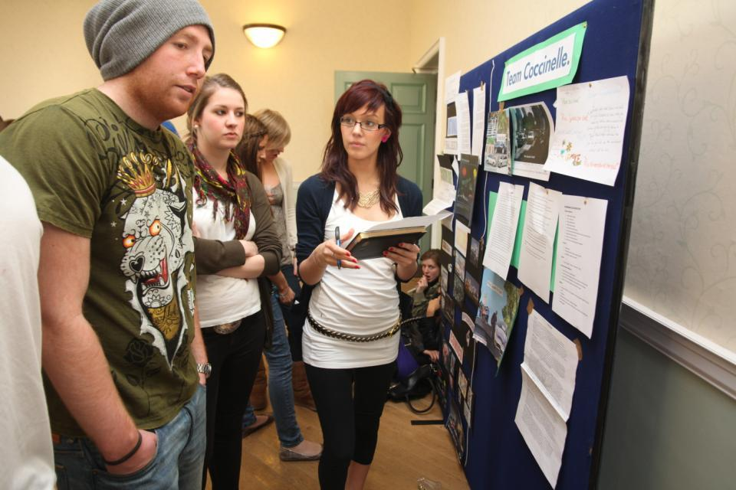
Do these students look engaged?

Slide 7
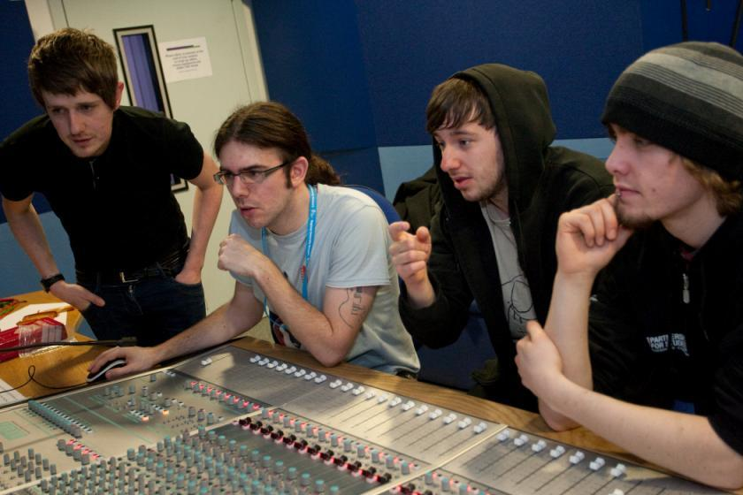
How about these?

Slide 8
And what about those of us engaged in teaching?
Is university teaching a highly paid and highly respected profession still?
Is our workload manageable?
What are our professional values?
What motivates us to do our jobs well?

Slide 9

From Jason Elsom
(@Jason Elsom)

Slide 10
Can you rate these characteristics of excellent teaching as described in the scholarly literature?
Knows subject material thoroughly
Adopts a scholarly approach to the practice of teaching
Is reflective and regularly reviews own practice
Is well organised and plans curriculum effectively
Is passionate about teaching
Has a student-centred orientation to teaching
Regularly reviews innovations in learning and teaching and tries out ones relevant to own context
Ensures that assessment practices are fit for purpose and contribute to learning
Demonstrates empathy and emotional intelligence

Slide 11
How do we know if we are offering excellent teaching?
We as teachers are satisfied, motivated and find our workloads manageable;
Students are satisfied, learn well, achieve highly and have fulfilling learning experiences;
Students develop a range of competences they need including problem solving, working with others and self-management;
Quality assurers and Professional and Subject bodies like what we do and have no complaints about systems and processes;
University managers are confident that the student experience offered is of high quality (and deal with few complaints).

Slide 12
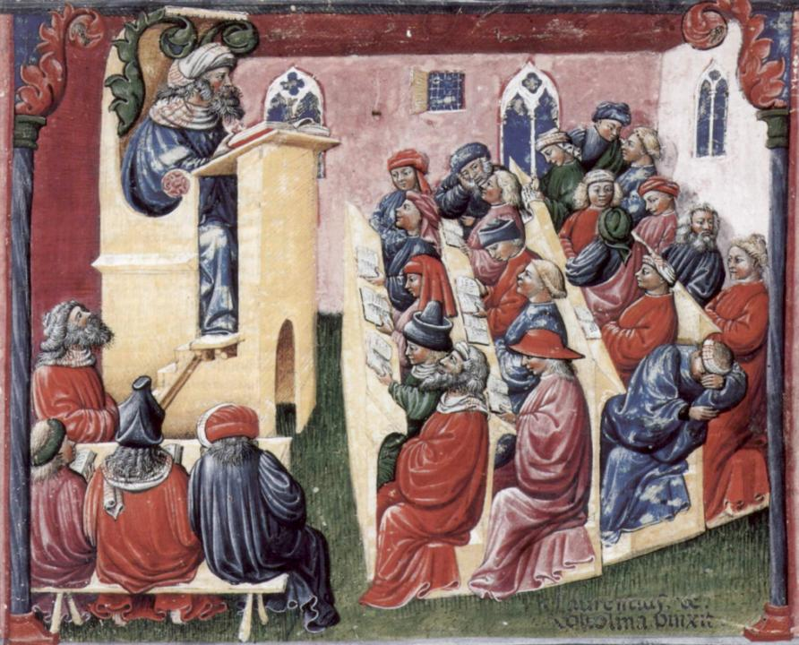
Laurentius de Voltolina
2nd half of 14th Century
Italian Painter

Slide 13
Delivering content…..
is less like delivering a parcel (the postman model) and more like delivering a baby (the midwife model).
University staff can advise, guide, intervene when things so wrong, but in the end only the student can bring learning into life!!
Content can be gleaned from many sources (e.g. MIT and our UK Open University are putting more and more content into open access areas).

Slide 14
The Maieutic model
Maieutics is a complex procedure of research introduced by Socrates, embracing the Socratic method in its widest sense. It is based on the idea that the truth is latent in the mind of every human being due to her/his innate reason but has to be “given birth” by answering questions (or problems) intelligently proposed. The word is derived from the Greek “μαιευτικός”, pertaining to midwifery.

Slide 15

William Hogarth
1736
‘Scholars at a lecture’
How would the lecturer be rated in the NSS?

Slide 16
A tall order?
Effective lecturers combine the talents of a scholar, writer, producer, comedian, showman and teacher in ways that contribute to student learning. Nevertheless it is also true that few college professors combine these talents in optimal ways and that even the best lecturers are not always on top form
McKeachie et al p.53

Slide 17


Slide 18
Assessment is crucial in helping students learn and to be engaged in their learning
Assessment must be for not just of learning;
Feedback is often the prime site for interaction between staff and students & hence a means by which students learn;
Good assessment design and practice is a prime motivator for engagement and poor assessment really alienates them;
Assessment must be demonstrably fair, valid and reliable if students are to engage with it fully;
Students need to perceive the value of the tasks they are being asked to undertake as part of the assessment programme, that is, they need to be authentic;
What tasks are you asking students to do, particularly in their final year, that will prepare them for job interviews?

Slide 19
To engage learners we can:
Make use of real examples and hot-off-the-press data to keep content current;
Give added-value to person who bothers to turn up. Provide resources and text on-line that back up classroom activities (including audio/video recordings of your lectures) without ever letting it be perceived that this is a substitute for being there!
Provide challenges to students’ thinking without letting individuals feel publicly exposed or humiliated;
Relate their work to the forthcoming/ongoing assignment (without slavishly teaching to the exam);
Make spaces for dialogue, through clickers/ twitter/ whatever, live and after the session.

Slide 20
How can we get students to fully engage? Some suggestions
Provide opportunities for students to get involved in authentic learning environments on campus or off;
Keep the curriculum current and life-relevant, without losing historical perspectives;
Give them real problems to solve and issues with which to engage;
Identify the skills they need to succeed and provide opportunities to rehearse and develop them;
Never compromise on the quality of the demands we make of them.

Slide 21
Robust quality: I argue that for engaged students we need
Rapid turnaround of assignments with detailed and useful feedback;
Proactive and positive initial training for teaching staff and ongoing CPD;
Regular developmental Peer Observation;
Teaching based on a supportive / reflective model;
Clear and widely publicised mutual expectations for students and staff;
Recognising and rewarding good teaching and learning support, and having obvious career pathways for those who dedicate their lives to enhancing the student experience;
Taking student feedback very seriously, and publicising widely action take as a result of feedback.

Slide 22
Conclusions
For engaged students we need engaged staff;
To help this, we need employment, promotion and reward systems that recognise the importance of teaching;
There is great value in identifying outstanding teachers and using them as advocates for commitment to teaching;
To achieve this, we need dialogues around what makes for excellent teaching, which may well include peer observation systems.
We must also promote a culture of scholarship of teaching, that encourages evidence-based dissemination of good practice;.

Slide 23
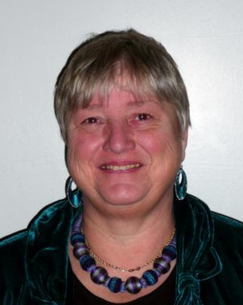
These and other slides are available on my website at http://sally-brown.net

Slide 24
Useful references and further reading (1)
Bain, K. (2004) “What the best College Teachers do” Cambridge Harvard University Press
Biggs, J. and Tang, C. (2007) Teaching for Quality Learning at University, Maidenhead: Open University Press.
Bloxham, S. and Boyd, P. (2007) Developing effective assessment in higher education: a practical guide, Maidenhead, Open University Press.
Boud, D. (1995) Enhancing learning through self-assessment, London: Routledge.
Brown, S. and Glasner, A. (eds.) (1999) Assessment Matters in Higher Education, Choosing and Using Diverse Approaches, Maidenhead: Open University Press.
Brown, S. and Race, P. (2012) Using effective assessment to promote learning in Hunt, L. and Chambers, D. (2012) University Teaching in Focus, Victoria, Australia, Acer Press. P74-91
Brown, S. (2015) Learning , Teaching and Assessment in Higher Education: Global perspectives, London, Palgrave

Slide 25
Useful references and further reading (2)
Carless, D., Joughin, G., Ngar-Fun Liu et al (2006) How Assessment supports learning: Learning orientated assessment in action Hong Kong: Hong Kong University Press.
Carroll, J. and Ryan, J. (2005) Teaching International students: improving learning for all. London: Routledge SEDA series.
Crosling, G., Thomas, L. and Heagney, M. (2008) Improving student retention in Higher Education, London and New York: Routledge
Crooks, T. (1988) Assessing student performance, HERDSA Green Guide No 8 HERDSA (reprinted 1994).
Falchikov, N. (2004) Improving Assessment through Student Involvement: Practical Solutions for Aiding Learning in Higher and Further Education, London: Routledge.
Gibbs, G. (1999) Using assessment strategically to change the way students learn, in Brown S. & Glasner, A. (eds.), Assessment Matters in Higher Education: Choosing and Using Diverse Approaches, Maidenhead: SRHE/Open University Press.
Higher Education Academy (2012) A marked improvement; transforming assessment in higher education, York: HEA.

Slide 26
Useful references and further reading (3)
McDowell, L. and Brown, S. (1998) Assessing students: cheating and plagiarism, Newcastle: Red Guide 10/11 University of Northumbria.
Meyer, J.H.F. and Land, R. (2003) ‘Threshold Concepts and Troublesome Knowledge 1 – Linkages to Ways of Thinking and Practising within the Disciplines’ in C. Rust (ed.) Improving Student Learning – Ten years on. Oxford: OCSLD.
Nicol, D. J. and Macfarlane-Dick, D. (2006) Formative assessment and self-regulated learning: A model and seven principles of good feedback practice, Studies in Higher Education Vol 31(2), 199-218.
PASS project Bradford http://www.pass.brad.ac.uk/ Accessed November 2013
Peelo, M. T., & Wareham, T. (Eds.). (2002). Failing students in higher education. Society for Research into Higher Education.
Pickford, R. and Brown, S. (2006) Assessing skills and practice, London: Routledge.
Rotheram, B. (2009) Sounds Good, JISC project http://www.jisc.ac.uk/whatwedo/programmes/usersandinnovation/soundsgood.aspx

Slide 27
Useful references and further reading (4)
Race, P. (2001) A Briefing on Self, Peer & Group Assessment, in LTSN Generic Centre Assessment Series No 9, LTSN York.
Race P. (2015) The lecturer’s toolkit (4th edition), London: Routledge.
Rust, C., Price, M. and O’Donovan, B. (2003) Improving students’ learning by developing their understanding of assessment criteria and processes, Assessment and Evaluation in Higher Education. 28 (2), 147-164.
Ryan, J. (2000) A Guide to Teaching International Students, Oxford Centre for Staff and Learning Development
Stefani, L. and Carroll, J. (2001) A Briefing on Plagiarism http://www.ltsn.ac.uk/application.asp?app=resources.asp&process=full_record&section=generic&id=10
Sadler, D. Royce (2010) Beyond feedback: developing student capability in complex appraisal,
Assessment & Evaluation in Higher Education, 35: 5, 535-550
Yorke, M. (1999) Leaving Early: Undergraduate Non-completion in Higher Education, London: Routledge.

Slide 28
Making Learning Happen
– inspiring students in and beyond the lecture room
EuroCHRIE 2016, Budapest
27th October 2016
Phil Race
(from Newcastle-upon-Tyne)
BSc PhD PGCE FCIPD PFHEA NTF
Follow Phil on Twitter: @RacePhil
Visiting Professor: University of Plymouth and University of Suffolk
Emeritus Professor, Leeds Beckett University and University of South Wales

Slide 29
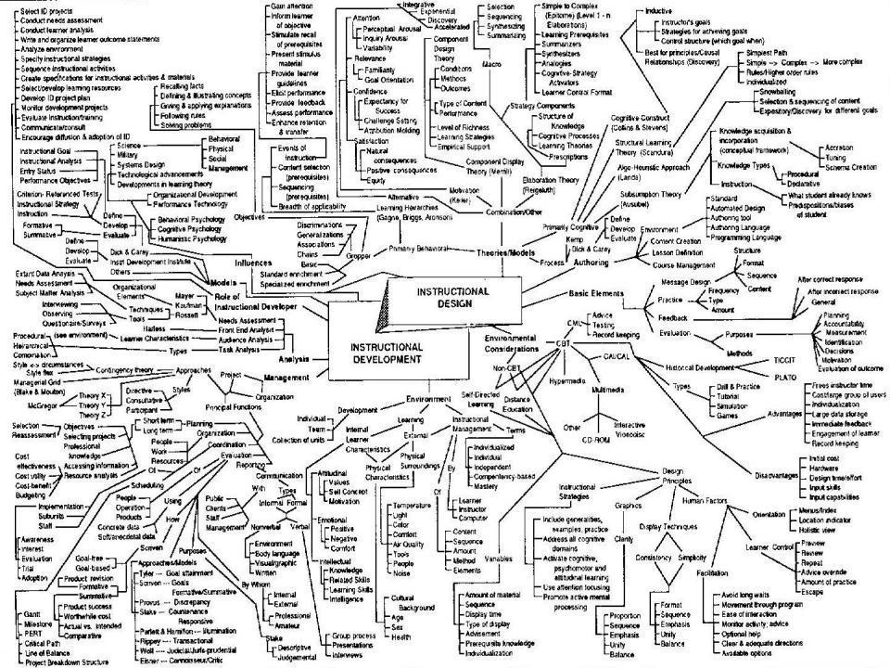
This slide has two purposes….
To focus the data projector, if necessary, and…
...to persuade colleagues never to put this sort of detail onto a slide!

Slide 30
Thoughts arising from yesterday...
We live in ‘generation rush’.
Digital detox: you can use your phones if you’d like to.
Stress management and reflection: you might enjoy my SEDA blog which you can get from my website....
Happiness blanket: love the idea.
Learning is presently being eclipsed by ‘wellness anxiety’?

Slide 31
Thanks to students
I could not do what I do nowadays if I did not continue to spend a fair bit of my time working with students – they’ve taught me most of what I know.
Students are
ahead of us...

Slide 32
You will be able to download my main slides
You don’t need to take notes.
I’ll put the main slides up on my website on Sunday or before (http://phil-race.co.uk/)
I won’t include pictures and video-clips, as this would make the file-size too large.
I may sometimes go through slides quite fast, but you can study them as you wish at your leisure.

Slide 33
Intended learning outcomes
After participating in this session you should be better able to:
Step back, and reflect on how learning really happens;
Work towards ‘learning wellness’ through engagement.
Address seven factors which underpin effective learning in and beyond teaching contexts.

Slide 34
Announcement about mobile phones and laptops...
Good morning everyone – please turn on your ‘phones and computers.
Please post your thoughts, comments and ideas to the hashtags @eurochrie, or #philatBudapest Thanks!
For learning beyond the lecture room each week you might try #LTHEchat on Wednesday evenings from 20.00-21.00 GMT, 21.00-22.00 Budapest time.

Slide 35
Downloadable resource materials
Expanded discussion of many aspects of my slides today can be found at:
Learning: https://phil-race.co.uk/2016/04/updated-powerpoint-ripples-model/
Assessment and feedback: https://phil-race.co.uk/assessment/
ETC Toolkit (Enhancing the Curriculum) www.etctoolkit.org.uk

Slide 36
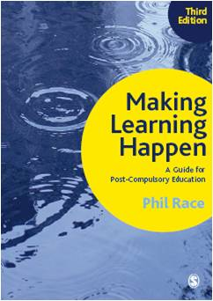
3rd edition
Phil Race
2014: Sage: London
Three short videos
(1) About making learning happen in general: http://tinyurl.com/l7yddya
(2) Five top tips for lecturers: http://tinyurl.com/nxhohe3
(3) On being an author, and the changes in the 3rd edition: http://tinyurl.com/oqfkkdc

Slide 37
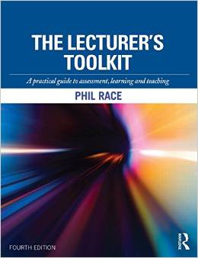
The Lecturer’s Toolkit
4th Edition
Phil Race
London: Routledge,
2015.

Slide 38
Post-it exercise
On a post-it, in your best handwriting, please write your own completion of the starter:
“making learning happen effectively in and beyond lecture rooms would be much better if only I…”
Please swap post-its so that you’ve no idea who has yours.
If chosen, please read out with passion and drama the post-it you now have.
Please place them all on the door as you leave.

Slide 39
Now, in many countries, is the decade of Higher Education Institutions’ dis-content!
Never mind the content – feel the learning

Slide 40

The read-write industry

Slide 41

In the exam room you’re on your own

Slide 42
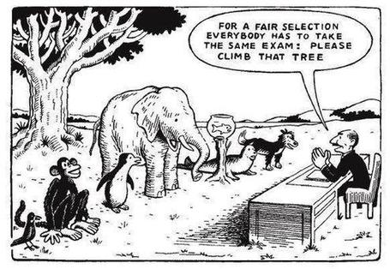

Slide 43

Face to face feedback

Slide 44

“[The] pupils got it all by heart; and, when Examination-time came, they wrote it down; and the Examiner said ‘Beautiful! What depth!’
They became teachers in their turn, and they said all these things over again; and their pupils wrote it down, and the examiner accepted it; and nobody had the ghost of an idea what it meant”
Lewis Carroll, 1893
Active
Experimentation
Abstract
Conceptualisation
Concrete
Experience
Reflective
Observation

Slide 45
So now, it’s time to re-think:
How students really learn – and how we can help make learning happen for them;
How to make feedback really work for students;
How best to measure and accredit students’ achievement (not just more of the same old tired methods).
In this session, we’re touch on the first of these areas (there’s a great deal more about the other two on my website and in my books).

Slide 46
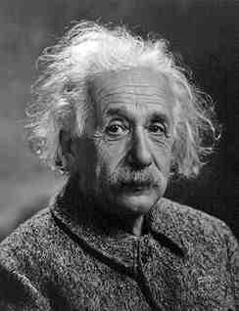
Albert Einstein
“It is simply madness to keep doing the same thing, and expect different results”

Slide 47
How Students Really Learn
‘Ripples’ model of learning
Phil Race

Slide 48
How students really learn
Evidence-based practice
– seven factors underpinning successful learning based on asking 200,000 people about their learning in the last 25 years

Slide 49
Learning
– a natural human process; engagement is everything

Slide 50
Learning wellbeing?

Slide 51
Learning well
= being

Slide 52
Seven factors underpinning successful learning
In this session, I’m going to get you engaged, by answering for me six questions about how you learn…

Slide 53
1: How do you learn well?
Think of something that you’re good at, something that you know you do well.
How did you become good at it?

Slide 54
Most people’s views...
practice
trial and error
having a go
repetition
experimenting

Slide 55
2: What makes you feel good?
Think of something about yourself that you feel good about.
How can you justify feeling good about this? What’s your evidence to support this feeling?

Slide 56
Most people’s views...
feedback
other people’s reactions
praise
gaining confidence
seeing the results

Slide 57
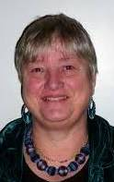
Fishing for feedback?
ice
Feedback is like fish.
If it is not used quickly, it becomes useless.
(Sally Brown).
Give a man a fish,
Feed him for a day.
Teach a man to fish,
Feed him for a lifetime.
(Maimonides: 1135-1204)
And he’ll learn to drink beer in boats
And you won’t see him for weeks!
(Australian proverb).

Slide 58
3: What can go wrong?
Think of something that you’re not good at, perhaps as a result of a bad learning experience.
What went wrong, and whose (if anyone’s) fault it may have been?

Slide 59
4: And if there isn’t a ‘want’?
Think of something that you did learn successfully, but at the time you didn’t want to learn it.
What kept you going, so that you did indeed succeed in learning it?

Slide 60
Most people’s views...
strong support and encouragement
did not want to be seen not able to do it
needed to do it for what I wanted next

Slide 61
Five of the seven factors underpinning successful learning
learning by doing
learning from feedback
wanting to learn
needing to learn
...

Slide 62
Five of the seven factors underpinning successful learning
learning by doing
learning from feedback
wanting to learn
needing to learn
making sense – ‘getting one’s head round it’

Slide 63
Ripples on a pond….
Wanting/
Needing

Slide 64
Ripples on a pond….
Wanting/
Needing
Doing

Slide 65
Ripples on a pond….
Wanting/
Needing
Doing
Making sense

Slide 66
Ripples on a pond….
Wanting/
Needing
Doing
Making sense
Feedback

Slide 67
But there are still two things missing
One has never really ‘got’ something until one has done both of two more things...

Slide 68
Question 5
Think of something you’ve taught for some time. Think back particularly to the first time you taught it.
To what extent did you find that you ‘had your head around it’ much better after teaching it for the first time?
  Very much better: raise two hands
  Somewhat better: raise one hand
  No better: touch left ear

Slide 69
Ripples on a pond….
Verbalising
Wanting/
Needing
Doing
Making sense
Feedback

Slide 70
Finally Question 6...
Still thinking of the first time you taught that particular topic, think back to the first time you measured students’ learning of the topic.
To what extent did you find that after assessing students work, you yourself had ‘made sense’ of the topic even more deeply?
  Very much better: raise two hands
  Somewhat better: raise one hand
  No better: touch left ear

Slide 71
Ripples on a pond….
Verbalising
Assessing
making informed judgements
Wanting/
Needing
Doing
Making sense
Feedback

Slide 72
Achieving learning wellness face-to-face...
What will I be expected to show for this?
What does a good one look like, and a bad one?
Where does this fit into the big picture?
When explaining assessment criteria to students, and when linking these to evidence of achievement of the intended learning outcomes, we need to make the most of face-to-face whole group contexts and...
  Tone of voice
  Body language
  Facial expression
  Eye contact
  The chance to repeat things
  The chance to respond to puzzled looks
Some things don’t work nearly so well just on paper or on screens.
Constructive Alignment: John Biggs
Some of the
tools we can
use in
face-to-face
contexts

Slide 73
Ripples on a pond….
Causing wellness in learning: we need to:
Verbalising
Assessing
making informed judgements
Strive to enhance our students’ want to learn;
Help students to develop ownership of the need to learn;
Keep students learning by doing, practice, trial-and-error, repetition;
Ensure students get quick and useful feedback – from us and from each other;
Help students to make sense of what they learn.
Get students deepening their learning by coaching other students, explaining things to them.
Allow students to further deepen their learning by assessing their own learning, and assessing others’ learning – making informed judgements.
Wanting/
Needing
Doing
Doing
Making sense
Feedback

Slide 74
Ripples on a pond….
Back to our intended learning outcomes…
Verbalising
Assessing
making informed judgements
Do you now feel better able to:
2 hands = very much better,
one hand = somewhat better,
touch left ear = no better...
Step back, and reflect on how learning really happens?
Address seven factors which underpin effective learning in and beyond teaching contexts?
Wanting/
Needing
Doing
Doing
Making sense
Feedback

Slide 75
Useful references: 1
Assessment Reform Group (1999) Assessment for Learning : Beyond the black box, Cambridge UK, University of Cambridge School of Education.
Biggs, J. and Tang, C. (2007) Teaching for Quality Learning at University, Maidenhead: Open University Press.
Bloxham, S. and Boyd, P. (2007) Developing effective assessment in higher education: a practical guide, Maidenhead, Open University Press.
Brown, S. Rust, C. & Gibbs, G. (1994) Strategies for Diversifying Assessment, Oxford: Oxford Centre for Staff Development.
Boud, D. (1995) Enhancing learning through self-assessment, London: Routledge.
Boud, D. and Associates (2010) Assessment 2020: seven propositions for assessment reform in higher education Sydney: Australian Learning and Teaching Council.
Brown, S. and Glasner, A. (eds.) (1999) Assessment Matters in Higher Education, Choosing and Using Diverse Approaches, Maidenhead: Open University Press.
Brown, S. and Knight, P. (1994) Assessing Learners in Higher Education, London: Kogan Page.

Slide 76
Useful references: 2
Brown, S. and Race, P. (2012) Using effective assessment to promote learning in Hunt, L. and Chambers, D. (2012) University Teaching in Focus, Victoria, Australia, Acer Press. P74-91
Brown, S. (2015) Learning, teaching and assessment in higher education: global perspectives, London: Palgrave-MacMillan.
Carless, D., Joughin, G., Ngar-Fun Liu et al (2006) How Assessment supports learning: Learning orientated assessment in action Hong Kong: Hong Kong University Press.
Carroll, J. and Ryan, J. (2005) Teaching International students: improving learning for all. London: Routledge SEDA series.
Crosling, G., Thomas, L. and Heagney, M. (2008) Improving student retention in Higher Education, London and New York: Routledge
Crooks, T. (1988) Assessing student performance, HERDSA Green Guide No 8 HERDSA (reprinted 1994).
Falchikov, N. (2004) Improving Assessment through Student Involvement: Practical Solutions for Aiding Learning in Higher and Further Education, London: Routledge.

Slide 77
Useful references: 3
Gibbs, G. (1999) Using assessment strategically to change the way students learn, in Brown S. & Glasner, A. (eds.), Assessment Matters in Higher Education: Choosing and Using Diverse Approaches, Maidenhead: SRHE/Open University Press.
Higher Education Academy (2012) A marked improvement; transforming assessment in higher education, York: HEA.
Hounsell, D. (2008). The trouble with feedback: New challenges, emerging strategies, Interchange, Spring, Accessed at www.tla.ed.ac.uk/interchange.
Knight, P. and Yorke, M. (2003) Assessment, learning and employability Maidenhead, UK: SRHE/Open University Press.
Mentkowski, M. and associates (2000) p.82 Learning that lasts: integrating learning development and performance in college and beyond, San Francisco: Jossey-Bass.
McDowell, L. and Brown, S. (1998) Assessing students: cheating and plagiarism, Newcastle: Red Guide 10/11 University of Northumbria.

Slide 78
Useful references: 4
Nicol, D. J. and Macfarlane-Dick, D. (2006) Formative assessment and self-regulated learning: A model and seven principles of good feedback practice, Studies in Higher Education Vol 31(2), 199-218.
NUS (2010) NUS Charter on Assessment and Feedback, http://www.nusconnect.org.uk/asset/news/6010/FeedbackCharter-toview.pdf).
PASS project Bradford http://www.pass.brad.ac.uk/ Accessed November 2013
Pickford, R. and Brown, S. (2006) Assessing skills and practice, London: Routledge.
QAA (2013) UK Quality Code for Higher Education: Part B: Assuring and enhancing academic quality, accessed at www.qaa.ac.uk (June 2014)
Race, P. (2001) A Briefing on Self, Peer & Group Assessment, in LTSN Generic Centre Assessment Series No 9, LTSN York.
Race, P. (2015) The lecturer’s toolkit (4th edition), London: Routledge.
Ryan, J. (2000) A Guide to Teaching International Students, Oxford Centre for Staff and Learning Development

Slide 79
Useful references: 5
Rust, C., Price, M. and O’Donovan, B. (2003) Improving students’ learning by developing their understanding of assessment criteria and processes, Assessment and Evaluation in Higher Education. 28 (2), 147-164.
Stefani, L. and Carroll, J. (2001) A Briefing on Plagiarism http://www.ltsn.ac.uk/application.asp?app=resources.asp&process=full_record&section=generic&id=10
Sadler, D. R. (2010a). Beyond feedback: Developing student capability in complex appraisal. Assessment & Evaluation in Higher Education, 35(5), 535-550.
Sadler, D. R. (2010b) Fidelity as a precondition for integrity in grading academic achievement. Assessment and Evaluation in Higher Education, 35, 727‑743.
Sadler, D. R. (2010c). Assessment in higher education. In P. Peterson, E. Baker, & B. McGaw (eds). International encyclopedia of education. Vol. 3, 249‑255. Oxford: Elsevier.
Sadler, D. R. (2013b). Opening up feedback: Teaching learners to see. In Merry, S., Price, M., Carless, D., & Taras, M. (Eds.) Reconceptualising feedback in higher education: Developing Yorke, M. (1999) Leaving Early: Undergraduate Non-completion in Higher Education, London: Routledge.

Slide 80
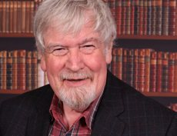
Thank you……
http://phil-race.co.uk
Follow Phil on Twitter
@RacePhil
e-mail:
phil@phil-race.co.uk

Slide 81
Some trigger questions for discussion
What do you think are the principal barriers to making learning happen for our students?
What do you think are our best opportunities to foster student engagement?
How is assessment helping and/or hindering genuine engagement?
What kinds of incentives can really motivate and engage teaching staff?

