Slide 1
Engaging students creatively to maximise student retention and achievement
Cardiff Met Alumni event
7th September 2016
Sally Brown @ProfSallyBrown
sally@sally-brown.net
NTF, PFHEA, SFSEDA
Emerita Professor, Leeds Beckett University
Visiting Professor: University of Plymouth, University of South Wales & Liverpool John Moores University.

Slide 2
Rationale
Engaged students are more successful, tend not to drop-out and have more positive experiences of higher education than the disenchanted ones who are wholly strategic in their behaviours or who switch off altogether. They also tend to be more enjoyable and rewarding to teach.
In this workshop I aim explore how we help our students to act in beneficial ways that aid their engagement/ employability and at the same time regenerate our own enthusiasm for teaching our subjects.

Slide 3
Waffle on for a bit about THE current HE context

Slide 4
So what have you got to say about:
Students;
The employment context;
Staffing;
University finances;
Technologies to support learning and admin;
Learning paradigms;
Students as consumers;
The NSS and other performance indicators e.g. a TEF

Slide 5
Engagement: Why talk about it? Because:
Academics and learning support staff report increasing levels of disengagement by students of the ‘iGeneration’;
The nature of the transaction is changing in the light of high fees;
Potentially the nature of student behaviour in higher education is changing radically in terms of academic and other literacies;
Institutions need to ensure that new students enter with, or have the opportunity to acquire, the skills needed for academic success;
HEIs must devise programmes in which the emphasis is on maximising students’ development.

Slide 6

Do these students look engaged?

Slide 7
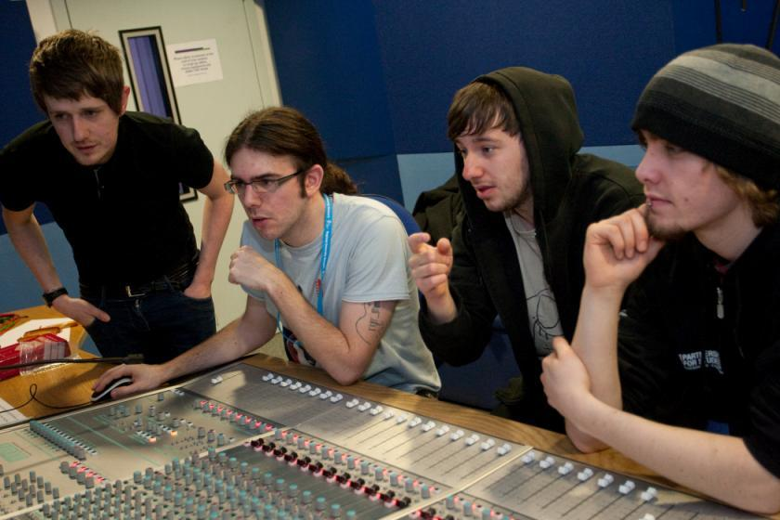
How about these?

Slide 8
Disengaged students
Don’t live up to their potential and fail to achieve their very best;
Make life more difficult for the staff who teach and support them;
Drop out of higher education, thereby damaging their own prospects and HEIs’ performance indicators;
HEIs suffer both financially and in terms of their status and reputation from high attrition rates.

Slide 9
Engagement of international students: some important considerations
Is recruitment undertaken to ensure students have the potential to succeed?
Is induction framed appropriately to welcome international students?
Are steps taken proactively to ensure international students have a good chance of integrating with their study cohorts?
Is the curriculum international is scope and content? Are examples and case studies global?
Is the right kind of support offered (language, crisis support, befriending etc.)?

Slide 10
What kinds of behaviours offer warning signs of risk of drop-out
Failure to register with the library, to download required resources, to return books on time;
Not engaging with fellow students live or virtually;
Not participating in group tasks;
Not submitting work on time (or at all);
Poor marks on early assignments;
Not picking up or responding to assessed work;
Non attendance, or very poor or intermittent attendance.

Slide 11
Risk factors that potentially predicate poor engagement and retention:
Students with no one to turn to when things go wrong e.g. those from Looked After backgrounds and First-in-Family students who have no one who ‘knows the ropes’;
Students who find the higher education environment alienating (e.g. students from disadvantaged backgrounds, those who have been out of education for a long time or who have come from a very different culture);
Those whose personal circumstances mean coping with university study is hard, e.g. students with disabilities or mental health problems, those with caring responsibilities, those facing bereavement and so on).

Slide 12
Why drop out? Yorke reported that for FT and sandwich students, factors include:
Poor quality of experience
Inability to cope with course demands
Unhappy with social environment
Wrong choice of course
Financial need
Dissatisfaction with some part of university provision.
(Yorke, 1999)

Slide 13
Additionally, withdrawal of failure is more probable when:
Students have chosen ‘the wrong programme’;
Students lack commitment and/or interest;
Students’ expectations are not met;
The quality of teaching is poor;
The academic culture is unsupportive (even hostile) to learning;
Students experience financial difficulty; and
Demands for other commitments supervene.
Peelo and Wareham pp 34-5

Slide 14
Mature students drop out too
The older female students were less likely than their younger peers were less likely to cite matters related to wrong choice of field of study. 'Mature' entrants tend to have taken time over a decision that is often buttressed by their experience of life outside the educational system. Basically, they know what they want to do. On the evidence of this study, however, these students more frequently run into difficulty with finance and family.
Peelo and Wareham p33

Slide 15
Poor attendance correlates with drop out and low engagement:
Research at Southampton institute (Lim), Glasgow Caledonian University (Begg) and University of Kent (Van der Velden) shows associations between weak attendance patterns and attrition;
Whatever the cause, not being there exacerbates other problems with study;
Endeavours to monitor and follow-up poor attendance have high pay off in terms of improving retention.

Slide 16
Drop out and assessment
“Roughly two-thirds of premature departures take place in, or at the end of, the first year of full-time study in the UK. Anecdotal evidence from a number of institutions indicates that early poor performance can be a powerful disincentive to continuation, with students feeling that perhaps they were not cut out for higher education after all – although the main problems are acculturation and acclimatisation to studying”. (Yorke p37)
Implications: assessment in the first semester is critical: it should be formative, informative, developmental and remediable.

Slide 17
Learning analytics can help us to:
Identify patterns of behaviour that indicate drop-out or under-performance is likely;
Students with backgrounds that suggest they might need a more careful watching eye kept on them by personal tutors;
Those who might need to be steered to additional sources of support.
However, there are clear issues involved around data protection and privacy that need discussion and resolution.

Slide 18
Enhancements to curriculum design and delivery to foster engagement, we can:
Explore how we can best use the first half of the first semester to induct students into good study patterns and practices to enhance learning and improve retention (Yorke 2009);
Reconsider the kinds of activities students engage with, to maximise ‘learning by doing’;
Rethink the way in which we use lecture periods to include activity as well as delivery;
Consider how we can best make use of technologies to support learning and engagement.

Slide 19
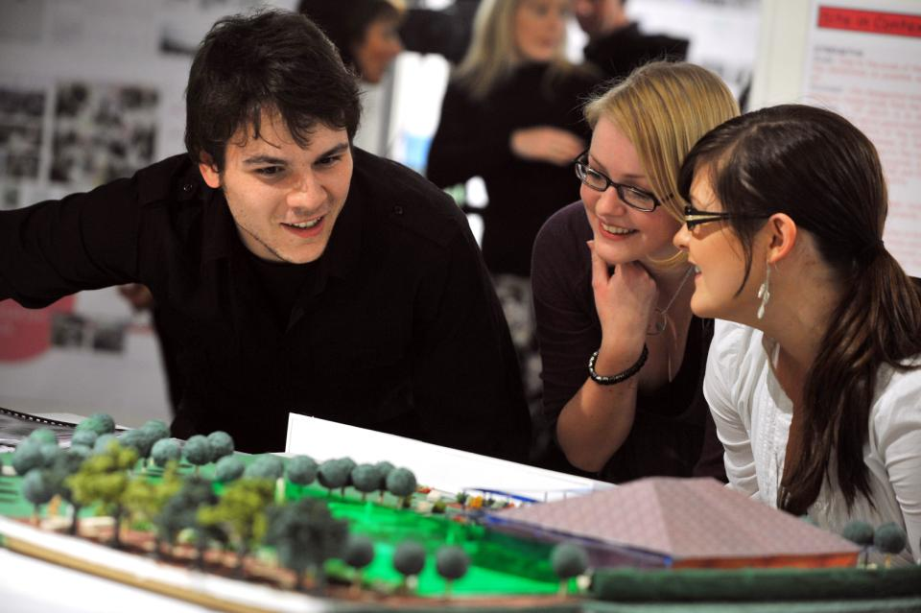
How can we make learning like this?

Slide 20
Developing students
Is there a coherent model of progression across the student life-cycle from induction to ‘outduction’?
Do you manage transitions from year one to year two, and year two to year three, to ensure students remain committed and engaged?
Is there some continuity in the sources of student support throughout the course (e.g. personal tutors)?
Are students offered support and guidance in relation to personal development and employability?
Are students using critical thinking and high levels of analytical thought sufficiently at each level of a programme?
Are students working autonomously as well?
Do students have meaningful and purposeful opportunities of working together?

Slide 21
To engage learners we can:
Make use of real examples and hot-off-the-press data to keep content current;
Give added-value to each person who bothers to turn up. Provide resources and text on-line that back up classroom activities (including audio/video recordings of your lectures) without ever letting it be perceived that this is a substitute for being there!
Provide challenges to students’ thinking, without letting individuals feel publicly exposed or humiliated;
Relate their work to the forthcoming/ongoing assignment (without slavishly teaching to the exam);
Make spaces for dialogue, through clickers/ twitter/ whatever, live and after the session.

Slide 22

Laurentius de Voltolina
2nd half of 14th Century
Italian Painter

Slide 23
Supportiveness: we must
Adopt a holistic approach to the development of skills, particularly information literacy, so that this is fully integrated into the learning programme;
Enable students to become self-aware and reflexive learners who become robust in the face of problems;
Help students build resilience through ‘a diet of early successes’ and positive reinforcement.

Slide 24
Engaging students through assessment
Pays high dividends in terms of student satisfaction;
Can be highly resource intensive if a strategic approach is not adopted;
Often requires a significant process of rethinking the processes and practices of assessment;
Usually implies increasing the amount of formative assessment and sometimes slimming down the volume of summative assessment;
Can change students’ lives.

Slide 25
Assessment, confidence and retention
Crudely, student achievement is linked to students own beliefs about their abilities, whether these are fixed or malleable;
Students who subscribe to an entity (fixed) theory of intelligence need ‘a diet of easy successes’ (Dweck, 2000:15) to confirm their ability and are fearful of learning goals as this involves an element of risk and personal failure. Assessment for these students is an all-encompassing activity that defines them as people. If they fail at the task, they are failures.

Slide 26
Students who believe that intelligence is malleable may be more robust
Students who believe that intelligence is incremental have little or no fear of failure. A typical response from such a student is ‘The harder it gets, the harder I need to try’. These students do not see failure as an indictment of themselves and [can] separate their self-image from their academic achievement. When faced with a challenge, these students are more likely to continue in the face of adversity because they have nothing to prove. (after Clegg in Peelo and Wareham 2002)

Slide 27
Helping students understand the rules of the game
The hardship was not understanding. When they give you an assignment and say it was on this handout. But my difficulty is not understanding what to do at first… I think that there’s a lack of my reading ability, which I can’t blame anyone for. I can only blame myself because I don’t like reading. And if you don’t read, you’re not going to learn certain things. So I suppose that’s to do with me…..it’s reading as well as putting what you read into your essay. You can read it and understand it. I can read and understand it, but then you have to incorporate it into your own words. But in the words they want you to say it in, not just: She said this, and this is the way it should be. The words, the proper language. (Bowl op cit 2003 p90).

Slide 28
What can we do as individuals to engage students through assessment?
Set small early assessed tasks (formative or summative) and turn them round fast in the crucial first semester;
Monitor student attendance and take action when students disappear and particularly when work is not handed in;
Make time available for student support, but know when to refer matters on when the problems are beyond our capabilities;
Do what we can to personalise the learning experience.

Slide 29
Making the most of feedback
Plan to maximise the impact of formative feedback. Make extra time helping students to understand the importance of feedback and the value of spending some of their time after receiving work back to learn from the experience.
Provide opportunities for students to respond to our feedback, for example, by giving students follow-up task or give them ‘feed-forward’ comments to improve their next piece of work.
Think about the means by which we deliver feedback, since this can be vital in determining how much notice students take of what you say.

Slide 30
The uses of computer-assisted formative assessment
While CAA is used in some contexts summatively, many would argue that it is most powerfully used to support formative feedback, especially where automatically generated by email.
Students seem to really like having the chance to find out how they are doing, and attempt tests several times in an environment where no one else is watching how they do.
Another benefit is that CAA systems allow you to monitor what is going on across a cohort, enabling you to concentrate your energies either on students who are repeatedly doing badly or those who are not engaging at all in the activity.

Slide 31
What kinds of management interventions can foster engaging teaching?
Promotion and reward systems that recognise the importance of teaching;
Identifying outstanding teachers and using them as advocates for commitment to teaching;
A culture of scholarship of teaching, that encourages evidence-based dissemination of good practice;
Dialogues around what makes for excellent teaching, particularly those associated with peer observation systems.

Slide 32
Enhancements to curriculum design and delivery: we can:
Explore how we can best use the first half of the first semester to induct students into good study patterns and practices to enhance learning and improve retention (Yorke 2009);
Reconsider the kinds so activities students engage with the maximum ‘learning by doing’;
Rethink the way in which we use lecture periods to include activity as well as delivery;
Consider how we can best make use of technologies to support learning and engagment.

Slide 33
For engaged students we need
Rapid turnaround of assignments with detailed and useful feedback;
Proactive and positive initial training for teaching staff and ongoing CPD;
Regular developmental Peer Observation;
Teaching based on a supportive / reflective model;
Clear and widely publicised mutual expectations for students and staff;
Recognising and rewarding good teaching and learning support, and having obvious career pathways for those who dedicate their lives to enhancing the student experience;
Taking student feedback very seriously, and publicising widely action taken as a result of feedback.

Slide 34
How can we get students to fully engage? Some final suggestions
Provide opportunities for students to get involved in authentic learning environments on campus or off;
Keep the curriculum current and life-relevant, without losing historical perspectives;
Give them real problems to solve and issues with which to engage;
Identify the skills they need to succeed and provide opportunities to rehearse and develop them;
Never compromise on the quality of the demands we make of them.

Slide 35

These and other slides are available on my website at http://sally-brown.net

Slide 36
Useful references and further reading (1)
Bain, K. (2004) “What the best College Teachers do” Cambridge Harvard University Press
Biggs, J. and Tang, C. (2007) Teaching for Quality Learning at University, Maidenhead: Open University Press.
Bloxham, S. and Boyd, P. (2007) Developing effective assessment in higher education: a practical guide, Maidenhead, Open University Press.
Boud, D. (1995) Enhancing learning through self-assessment, London: Routledge.
Bowl, M (2003) Non-traditional entrants to higher education ‘they talk about people like me’, Stoke on Trent, UK: Trentham Books.
Brown, S. and Race, P. (2012) Using effective assessment to promote learning in Hunt, L. and Chambers, D. (2012) University Teaching in Focus, Victoria, Australia, Acer Press. P74-91
Brown, S. (2015) Learning , Teaching and Assessment in Higher Education: Global perspectives, London, Palgrave

Slide 37
Useful references and further reading (2)
Carless, D., Joughin, G., Ngar-Fun Liu et al (2006) How Assessment supports learning: Learning orientated assessment in action Hong Kong: Hong Kong University Press.
Carroll, J. and Ryan, J. (2005) Teaching International students: improving learning for all. London: Routledge SEDA series.
Crosling, G., Thomas, L. and Heagney, M. (2008) Improving student retention in Higher Education, London and New York: Routledge
Crooks, T. (1988) Assessing student performance, HERDSA Green Guide No 8 HERDSA (reprinted 1994).
Falchikov, N. (2004) Improving Assessment through Student Involvement: Practical Solutions for Aiding Learning in Higher and Further Education, London: Routledge.
Gibbs, G. (1999) Using assessment strategically to change the way students learn, in Brown S. & Glasner, A. (eds.), Assessment Matters in Higher Education: Choosing and Using Diverse Approaches, Maidenhead: SRHE/Open University Press.
Higher Education Academy (2012) A marked improvement; transforming assessment in higher education, York: HEA.

Slide 38
Useful references and further reading (3)
McDowell, L. and Brown, S. (1998) Assessing students: cheating and plagiarism, Newcastle: Red Guide 10/11 University of Northumbria.
Meyer, J.H.F. and Land, R. (2003) ‘Threshold Concepts and Troublesome Knowledge 1 – Linkages to Ways of Thinking and Practising within the Disciplines’ in C. Rust (ed.) Improving Student Learning – Ten years on. Oxford: OCSLD.
Nicol, D. J. and Macfarlane-Dick, D. (2006) Formative assessment and self-regulated learning: A model and seven principles of good feedback practice, Studies in Higher Education Vol 31(2), 199-218.
PASS project Bradford http://www.pass.brad.ac.uk/ Accessed November 2013
Peelo, M. T., & Wareham, T. (Eds.). (2002). Failing students in higher education. Society for Research into Higher Education.
Pickford, R. and Brown, S. (2006) Assessing skills and practice, London: Routledge.
Rotheram, B. (2009) Sounds Good, JISC project http://www.jisc.ac.uk/whatwedo/programmes/usersandinnovation/soundsgood.aspx

Slide 39
Useful references and further reading (4)
Race, P. (2001) A Briefing on Self, Peer & Group Assessment, in LTSN Generic Centre Assessment Series No 9, LTSN York.
Race P. (2015) The lecturer’s toolkit (4th edition), London: Routledge.
Rust, C., Price, M. and O’Donovan, B. (2003) Improving students’ learning by developing their understanding of assessment criteria and processes, Assessment and Evaluation in Higher Education. 28 (2), 147-164.
Ryan, J. (2000) A Guide to Teaching International Students, Oxford Centre for Staff and Learning Development
Stefani, L. and Carroll, J. (2001) A Briefing on Plagiarism http://www.ltsn.ac.uk/application.asp?app=resources.asp&process=full_record&section=generic&id=10
Sadler, D. Royce (2010) Beyond feedback: developing student capability in complex appraisal, Assessment & Evaluation in Higher Education, 35: 5, 535-550
Yorke, M. (1999) Leaving Early: Undergraduate Non-completion in Higher Education, London: Routledge.

