Slide 1
Innovative curriculum and assessment
Sheffield University
30 June 2016
Sally Brown
@ProfSallyBrown sally@sally-brown.net
NTF, PFHEA, SFSEDA
Emerita Professor, Leeds Beckett University
Visiting Professor University of Plymouth, University of South Wales & Liverpool John Moores University.

Slide 2
The context: your thoughts about:
Students;
Staffing;
University finances;
Technologies and data analytics to support learning and admin;
Changing learning paradigms;
The necessity to develop students’ skills/literacies;
Students as consumers;
The NSS and other performance indicators e.g. a TEF?

Slide 3
What does an innovative approach to curriculum and assessment involve?
Being smart and fleet of foot in discerning trends from data and responding appropriately;
Foregrounding the student experience;
Building upon existing partnerships with students around quality assurance and enhancement;
Learning from experience about what works and doesn’t work, and using a scholarly approach to disseminating what we’ve discovered.

Slide 4
Designing relevant and appropriate curricula to enhance capability.
Curriculum design must be an ongoing process rather than a single event, with regular refreshment to keep it up-to-date, context contingent and in line with employers’ current needs;
Curriculum design can be seen as an eight-element process, which is often concurrent rather than cyclical;
The following diagram illustrates these eight dimensions of activity:

Slide 5
Determining and reviewing subject material: currency, relevance, level
Enhancing quality, seeking continuous improvement
Designing and refining learning outcomes
Evaluating programmes, strengths and areas for improvement
Curriculum
Design
Essentials
Considering delivery modes: face-to-face, online, PBL, blended…
Assuring quality, matching HEI, national and PSRB requirements
Thinking through student support
Designing fit for purpose assessment methods and approaches

Slide 6
Designing subject material: How can we:
Ensure that what we teach is current and up-to-date while retaining the core of the ‘canon’?
What would colleagues/external examiners/ employers be shocked to find we did not include in our curriculum?
How can we ensure our curriculum makes us attractive to a broad range of students including international ones?

Slide 7
Learning outcomes need to be:
fit-for- purpose and SMART;
Not so many in number that they are overwhelming;
Constructively aligned (Biggs and Tang, 2007);
Capable of being linked clearly to assessment;
Written in language that is meaningful to all stakeholders.

Slide 8
Content delivery methods that ensure that what is taught remains current, usable and valuable
Some elements of what we teach remain fixed over the years but interpretation often changes in many subjects, so our focus must be on establishing frameworks for knowledge that don’t involve crude ‘knowledge transmission’;
Extensive research (e.g. Entwistle and Ramsden, 2015) demonstrates that if students are to be deep rather than surface learners, they need to actively use what they learn in practical contexts as soon as possible after encountering it;
This has implications not only for what we teach but also for how we teach it: we may want to rethink (or ‘flip’) what we do in the classroom to focus on engaging with content already encountered virtually.

Slide 9
We need flexible learning resources which help students to engage fully by offering:
Live learning opportunities (face-to-face or virtual) where students can engage with academics, peers and others in activities that promote learning;
A range of readily available text-based and virtual resources (including textbooks, YouTube videos, TED talks, course readers, t.v. and radio programmes etc.) on which students can draw to support their live learning;
Support for students that enables them to locate, evaluate and use resources in a mature and responsible way.

Slide 10
Helping students to be flexible, adaptable, creative, empathetic and competent
This requires a focus on ‘learning by doing’: while subject content and knowledge are essential for competence, students in the digital age need less reliance on ‘learning by heart’ and a greater focus on ‘learning by use’;
Many argue that creativity can’t be taught, but it can be fostered by providing learning environments in which trying things out without a fear of failure is actively encouraged;
Similarly lessons in theories about empathy are less likely to be productive than getting students working in groups and finding out for themselves about conflict resolution and collegiality.

Slide 11
We need to offer flexible student support in which:
Students are provided with accessible advice on how to build the literacies they need for effective study including academic literacy, assessment literacy, interpersonal literacy, information management literacy and
Students are stretched to extend their boundaries but feel confident to experiment in supportive environments;
Independent, autonomous learning is encouraged as well as challenging group activities;
All students are offered diverse, inclusive and equivalent learning experiences which enable them to perform to their best abilities.

Slide 12

From Jason Elsom
(@Jason Elsom)

Slide 13
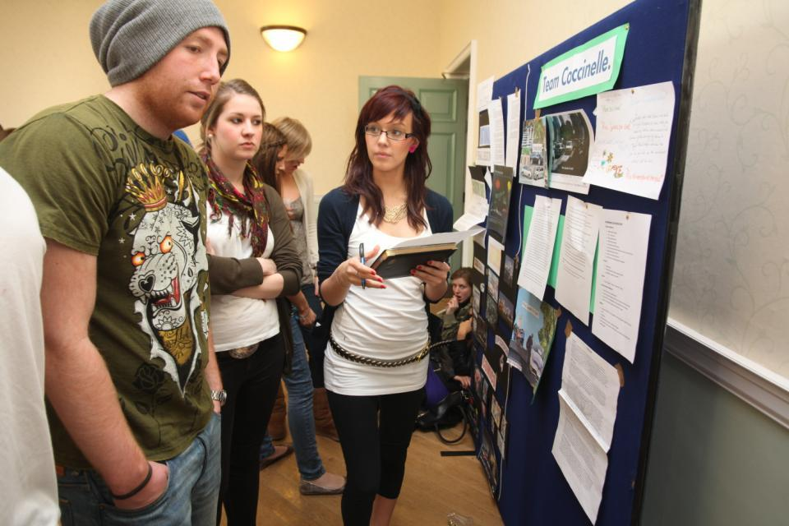
Do these students look engaged?

Slide 14
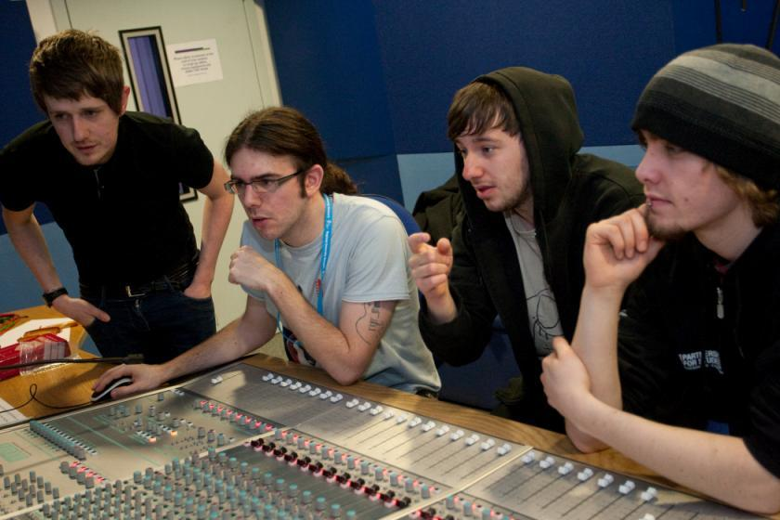
How about these?

Slide 15
How do we know if we are offering engaging and energising teaching?
Students are satisfied, learn well, achieve highly and have fulfilling learning experiences;
Students develop a range of competences they need including problem solving, working with others and self-management;
We as teachers are satisfied, motivated and find their workloads manageable;
Quality assurors and Professional and Subject bodies like what we do and have no complaints about systems and processes;
University managers are confident that the student experience offered is of high quality (and deal with few complaints).

Slide 16

Laurentius de Voltolina
2nd half of 14th Century
Italian Painter

Slide 17
Delivering content…..
is less like delivering a parcel (the postman model) and more like delivering a baby (the midwife model).
University staff can advise, guide, intervene when things so wrong, but in the end only the student can bring learning into life!!
Content can be gleaned from many sources (e.g. MIT and our UK Open University are putting more and more content into open access areas).

Slide 18
The Maieutic model
Maieutics is a complex procedure of research introduced by Socrates, embracing the Socratic method in its widest sense. It is based on the idea that the truth is latent in the mind of every human being due to her/his innate reason but has to be “given birth” by answering questions (or problems) intelligently proposed. The word is derived from the Greek “μαιευτικός,” pertaining to midwifery.

Slide 19
High quality teaching…
…“implies recognising that students must be engaged with the content of learning tasks in a way that is likely to enable them to reach understanding…Sharp engagement, imaginative inquiry and finding of a suitable level and style are all more likely to occur if teaching methods that necessitate student energy, problem solving and cooperative learning are employed”. (Ramsden, 2003, p.97)

Slide 20
To better engage learners we can:
Make use of real examples and hot-off-the-press data to keep content current;
Give added-value to person who bothers to turn up. Provide resources and text on-line that back up classroom activities (including audio/video recordings of your lectures) without ever letting it be perceived that this is a substitute for being there!
Provide challenges to students’ thinking without letting individuals feel publicly exposed or humiliated;
Relate their work to the forthcoming/ongoing assignment (without slavishly teaching to the exam);
Make spaces for dialogue, through clickers/ Twitter/ whatever, live and after the session.

Slide 21
How can we get students to fully engage? Some suggestions
Provide opportunities for students to get involved in authentic learning environments on campus or off;
Keep the curriculum current and life-relevant, without losing historical perspectives;
Give them real problems to solve and issues with which to engage;
Identify the skills they need to succeed and provide opportunities to rehearse and develop them;
Never compromise on the quality of the demands we make of them.

Slide 22
Engagement of international students: some important considerations
Is recruitment undertaken to ensure students have the potential to succeed?
Is induction framed appropriately to welcome international students?
Are steps taken proactively to ensure international students have a good chance of integrating with their study cohorts?
Is the curriculum international in scope and content? Are examples and case studies global?
Is the right kind of support offered (language, crisis support, befriending etc.)?

Slide 23


Slide 24
Innovative assessment: Why does assessment matter so much?
“Assessment methods and requirements probably have a greater influence on how and what students learn than any other single factor. This influence may well be of greater importance than the impact of teaching materials” (Boud 1988)
Notes:
Los métodos de evaluación influyen más en el aprendizaje del estudients que cualquier otro factor.

Slide 25
What is assessment for? What can it do? How much does it matter?
Many argue nowadays that assessment is crucially an integral part of the learning process rather than just a means of judging the extent to which learning has taken place;
Assessment activities can help students get the measure of their achievement and can motivate learning, but can also destroy confidence and undermine already disadvantaged students;
As far as I am concerned there is nothing we do for students that has as much impact as assessment and therefore it’s really worth thinking through how it adds value to the learning experience.

Slide 26
To improve assessment we should realign it by:
Exploring ways in which assessment can engage students and be integral to learning;
Constructively aligning (Biggs and Tang 2007) assignments with planned learning outcomes and the curriculum taught;
Providing realistic tasks: students are likely to put more energy into assignments they see as authentic and worth bothering with;
Maximise the dialogic opportunities of student feedback.
Notes:
La evaluación dbe ser parte íntegra del aprendizaje.
“Alineamiento constructivo” según Biggs
Los estudiantes prefieren tareas auténticas.

Slide 27
Formative and summative assessment
Formative assessment is primarily concerned with feedback aimed at prompting improvement, is often continuous and usually involves words.
Summative assessment is concerned with making evaluative judgments, is often end point and involves numbers.

Slide 28
Some thoughts on assessment and feedback
Academic staff frequently use a fairly limited range of assessment and feedback methods for individuals and groups, but international pedagogic research suggests that diversity benefits students greatly.
To maximise the benefits of formative feedback, a range of streamlined approaches including statement banks and computer based assessments can supplement traditional forms.
Students do not always recognize or use feedback well, but assessment dialogues can enhance learning.

Slide 29
The importance of dialogic assessment (Sadler)
Students need to be exposed to, and gain experience in making judgements about, a variety of works of different quality... They need planned rather than random exposure to exemplars, and experience in making judgements about quality. They need to create verbalised rationales and accounts of how various works could have been done better. Finally, they need to engage in evaluative conversations with teachers and other students.

Slide 30
Background: two major current UK initiatives on assessment to consider
The UK Quality Assurance Agency (QAA) Code of practice B6 on Assessment and APL.
The Higher Education Academy ‘A marked improvement’ project on bringing about change to institutional strategies on assessment.
Both groups have overlapping membership and therefore aligned perspectives.
Both initiatives draw on the work of previous generations of thinkers on assessment, and particularly the two Centres for Excellence in Teaching and Learning (CETLs) that focused on assessment, Oxford Brookes’ Assessment Knowledge Exchange (ASKe) and Northumbria's Assessment for Learning (A4L).

Slide 31
The HEA project: A marked improvement
A group of national experts worked on an intitiative designed to transform assessment in higher education;
The work of the Northumbria CETL, Assessment for learning (A4L), and the Oxford Brookes CETL Assessment Knowledge Exchange (ASKe) underpinned the work.
ASKe produced the Weston Manor Manifesto which provides a framework for A Marked Improvement;
The publication provides a rationale and groundwork for transformation, together with templates enabling institutions to review their own practices and implement change at a university level;

Slide 32
Assessment literacy: students do better if they can:
Make sense of key terms such as criteria, weightings, and level;
Encounter a variety of assessment methods (e.g. presentations, portfolios, posters, assessed web participation, practicals, vivas etc) and get practice in using them;
Be strategic in their behaviours, putting more work into aspects of an assignment with high weightings, interrogating criteria to find out what is really required and so on;
Gain clarity on how the assessment regulations work in their HEI, including issues concerning submission, resubmission, pass marks, condonement etc.

Slide 33
Peter Hartley’s NTFS Bradford-led project on Programme Level Assessment
It set out to focus on redressing problems including:
not assessing learning outcomes holistically at a programme level;
the atomisation of assessment, often resulting in too much summative and not enough formative feedback and over-standardisation in regulations.
This results in students and staff failing to see the links between disparate elements of the programme, over-assessment and multiple assignments using repetitive formats.
Modules were often too short for complex learning and this tended to lead to surface learning and ‘tick-box mentality.

Slide 34
Boud et al 2010: ‘Assessment 2020’:
Assessment has most effect when...:
It is used to engage students in learning that is productive.
Feedback is used to actively improve student learning.
Students and teachers become responsible partners in learning and assessment.
Students are inducted into the assessment practices and cultures of higher education.
Assessment for learning is placed at the centre of subject and program design.
Assessment for learning is a focus for staff and institutional development.
Assessment provides inclusive and trustworthy representation of student achievement.

Slide 35
Assessment for learning
1. Tasks should be challenging, demanding higher order learning and integration of knowledge learned in both the university and other contexts;
2. Learning and assessment should be integrated, assessment should not come at the end of learning but should be part of the learning process;
3. Students are involved in self assessment and reflection on their learning, they are involved in judging performance;
4. Assessment should encourage metacognition, promoting thinking about the learning process not just the learning outcomes;
5. Assessment should have a formative function, providing ‘feedforward’ for future learning which can be acted upon. There is opportunity and a safe context for students to expose problems with their study and get help; there should be an opportunity for dialogue about students’ work;

Slide 36
Assessment for learning
6. Assessment expectations should be made visible to students as far as possible;
7. Tasks should involve the active engagement of students developing the capacity to find things out for themselves and learn independently;
8. Tasks should be authentic; worthwhile, relevant and offering students some level of control over their work;
9. Tasks are fit for purpose and align with important learning outcomes;
10. Assessment should be used to evaluate teaching as well as student learning.
(Bloxham and Boyd)

Slide 37
What really impacts on learning?
Concentrating on giving students detailed and developmental formative feedback is the single most useful thing we can do for our students, particularly those from disadvantaged backgrounds.
Summative assessment may have to be rethought to make it fit for purpose;
To do these things may require considerable imagination and re-engineering, not just of our assessment processes but also of curriculum design as a whole if we are to move from considering delivering content the most important thing we do.

Slide 38
Strategies to implement assessment for learning in universities
Course leaders and others can impact on the assessment context by
Reviewing student experiences of assessment and feedback, seeking opportunities for enhancement;
Establishing some clear and consistent ground rules (for example, that assessed work must be returned within 3 weeks working for continuing students);
Monitoring compliance with ground rules and following up when good practice is not being achieved;
Providing opportunities for colleagues to share their own good practice together with staff development on innovations.

Slide 39
Making assessment work well
Intra-tutor and Inter-tutor reliability need to be assured;
Practices and processes need to be transparently fair to all students;
Cheat and plagiarisers need to be deterred/punished;
Assessment needs to be manageable for both staff and students;
Assignments should assess what has been taught/learned not what it is easy to assess.

Slide 40
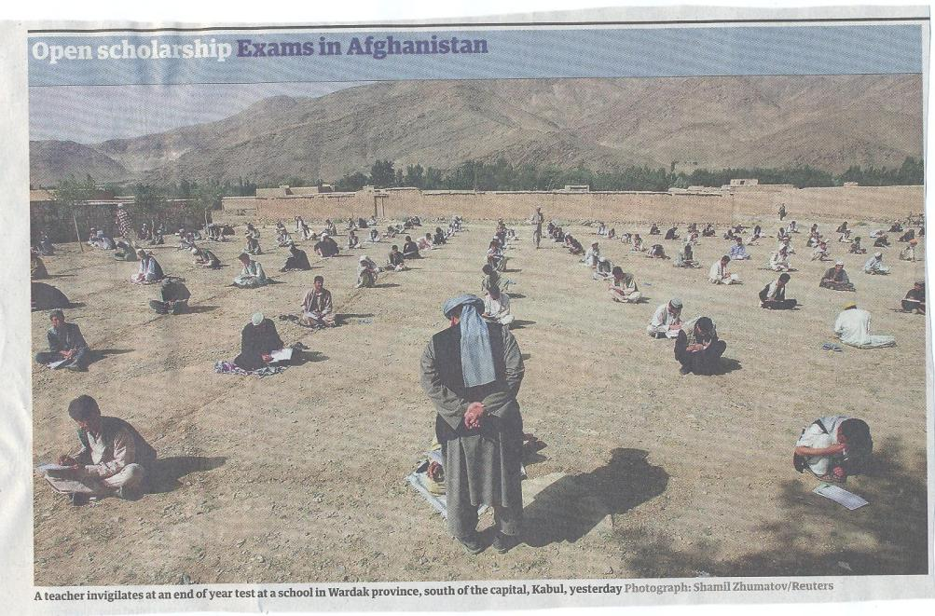

Slide 41

These and other slides will be available on my website at http://sally-brown.net

Slide 42
Useful references and further reading (1)
Bain, K. (2004) What the best College Teachers do, Cambridge: Harvard University Press.
Biggs, J. and Tang, C. (2007) Teaching for Quality Learning at University, Maidenhead: Open University Press.
Bloxham, S. and Boyd, P. (2007) Developing effective assessment in higher education: a practical guide, Maidenhead, Open University Press.
Boud, D. (1995) Enhancing learning through self-assessment, London: Routledge.
Brown, S. and Glasner, A. (eds.) (1999) Assessment Matters in Higher Education, Choosing and Using Diverse Approaches, Maidenhead: Open University Press.
Brown, S. and Race, P. (2012) Using effective assessment to promote learning in Hunt, L. and Chambers, D. (2012) University Teaching in Focus, Victoria, Australia, Acer Press. P74-91.
Brown, S. (2015) Learning , Teaching and Assessment in Higher Education: Global perspectives, London, Palgrave.

Slide 43
Useful references and further reading (2)
Carless, D., Joughin, G., Ngar-Fun Liu et al (2006) How Assessment supports learning: Learning orientated assessment in action Hong Kong: Hong Kong University Press.
Carroll, J. and Ryan, J. (2005) Teaching International students: improving learning for all. London: Routledge SEDA series.
Crosling, G., Thomas, L. and Heagney, M. (2008) Improving student retention in Higher Education, London and New York: Routledge
Crooks, T. (1988) Assessing student performance, HERDSA Green Guide No 8 HERDSA (reprinted 1994).
Falchikov, N. (2004) Improving Assessment through Student Involvement: Practical Solutions for Aiding Learning in Higher and Further Education, London: Routledge.
Gibbs, G. (1999) Using assessment strategically to change the way students learn, in Brown S. & Glasner, A. (eds.), Assessment Matters in Higher Education: Choosing and Using Diverse Approaches, Maidenhead: SRHE/Open University Press.
Higher Education Academy (2012) A marked improvement; transforming assessment in higher education, York: HEA.

Slide 44
Useful references and further reading (3)
McDowell, L. and Brown, S. (1998) Assessing students: cheating and plagiarism, Newcastle: Red Guide 10/11 University of Northumbria.
Meyer, J.H.F. and Land, R. (2003) ‘Threshold Concepts and Troublesome Knowledge 1 – Linkages to Ways of Thinking and Practising within the Disciplines’ in C. Rust (ed.) Improving Student Learning – Ten years on. Oxford: OCSLD.
Nicol, D. J. and Macfarlane-Dick, D. (2006) Formative assessment and self-regulated learning: A model and seven principles of good feedback practice, Studies in Higher Education Vol 31(2), 199-218.
PASS project Bradford http://www.pass.brad.ac.uk/ Accessed November 2013.
Peelo, M. T., & Wareham, T. (Eds.). (2002). Failing students in higher education. Society for Research into Higher Education.
Pickford, R. and Brown, S. (2006) Assessing skills and practice, London: Routledge.
Rotheram, B. (2009) Sounds Good, JISC project http://www.jisc.ac.uk/whatwedo/programmes/usersandinnovation/soundsgood.aspx

Slide 45
Useful references and further reading (4)
Race, P. (2001) A Briefing on Self, Peer & Group Assessment, in LTSN Generic Centre Assessment Series No 9, LTSN York.
Race P. (2015) The lecturer’s toolkit (4th edition), London: Routledge.
Rust, C., Price, M. and O’Donovan, B. (2003) Improving students’ learning by developing their understanding of assessment criteria and processes, Assessment and Evaluation in Higher Education. 28 (2), 147-164.
Ryan, J. (2000) A Guide to Teaching International Students, Oxford Centre for Staff and Learning Development.
Stefani, L. and Carroll, J. (2001) A Briefing on Plagiarism http://www.ltsn.ac.uk/application.asp?app=resources.asp&process=full_record&section=generic&id=10
Sadler, D. Royce (2010) Beyond feedback: developing student capability in complex appraisal, Assessment & Evaluation in Higher Education, 35: 5, 535-550.
Yorke, M. (1999) Leaving Early: Undergraduate Non-completion in Higher Education, London: Routledge.

