Slide 1
Innovative Assessment: Creative Feedback
Henley Business School Teaching and Learning day
June 24 2016
Sally Brown
NTF, SFSEDA, PFHEA
Emerita Professor, Leeds Beckett University
Visiting Professor University of Plymouth, University of South Wales & Liverpool John Moores University.

Slide 2
Why does assessment matter so much?
“Assessment methods and requirements probably have a greater influence on how and what students learn than any other single factor. This influence may well be of greater importance than the impact of teaching materials” (Boud 1988)
Notes:
Los métodos de evaluación influyen más en el aprendizaje del estudients que cualquier otro factor.

Slide 3
What is assessment for?
What can it do?
How much does it matter?
Many argue nowadays that assessment is crucially an integral part of the learning process rather than just a means of judging the extent to which learning has taken place;
Assessment activities can help students get the measure of their achievement and can motivate learning, but can also destroy confidence and undermine already disadvantaged students;
As far as I am concerned there is nothing we do for students that has as much impact as assessment and therefore it’s really worth thinking through how it adds value to the learning experience.

Slide 4
To improve assessment we should realign it by:
Exploring ways in which assessment can engage students and be integral to learning;
Constructively aligning (Biggs and Tang 2007) assignments with planned learning outcomes and the curriculum taught;
Providing realistic tasks: students are likely to put more energy into assignments they see as authentic and worth bothering with;
Maximising the dialogic opportunities of student feedback.
Notes:
La evaluación dbe ser parte íntegra del aprendizaje.
“Alineamiento constructivo” según Biggs
Los estudiantes prefieren tareas auténticas.

Slide 5
Some thoughts on assessment and feedback
Academic staff frequently use a fairly limited range of assessment and feedback methods for individuals and groups, but international pedagogic research suggests that diversity benefits students greatly.
To maximise the benefits of formative feedback, a range of streamlined approaches including statement banks and computer based assessments can supplement traditional forms.
Students do not always recognize or use feedback well, but assessment dialogues can enhance learning.

Slide 6
Formative and summative assessment
Formative assessment is primarily concerned with feedback aimed at prompting improvement, is often continuous and usually involves words.
Summative assessment is concerned with making evaluative judgments, is often end point and involves numbers.

Slide 7
Background: two major current UK initiatives on assessment to consider
The UK Quality Assurance Agency (QAA) Code of practice B6 on Assessment and APL.
The Higher Education Academy ‘A marked improvement’ project on bringing about change to institutional strategies on assessment.
Both groups have overlapping membership and therefore aligned perspectives.
Both initiatives draw on the work of previous generations of thinkers on assessment, and particularly the two Centres for Excellence in Teaching and Learning (CETLs) that focused on assessment, Oxford Brookes’ Assessment Knowledge Exchange (ASKe) and Northumbria's Assessment for Learning (A4L).

Slide 8
The HEA project: A marked improvement
A group of national experts worked on an intitiative designed to transform assessment in higher education;
The work of the Northumbria CETL, Assessment for learning (A4L), and the Oxford Brookes CETL Assessment Knowledge Exchange (ASKe) underpinned the work.
ASKe produced the Weston Manor Manifesto which provides a framework for A Marked Improvement;
The publication provides a rationale and groundwork for transformation, together with templates enabling institutions to review their own practices and implement change at a university level;

Slide 9
Assessment literacy: students do better if they can:
Make sense of key terms such as criteria, weightings, and level;
Encounter a variety of assessment methods (e.g. presentations, portfolios, posters, assessed web participation, practicals, vivas etc) and get practice in using them;
Be strategic in their behaviours, putting more work into aspects of an assignment with high weightings, interrogating criteria to find out what is really required and so on;
Gain clarity on how the assessment regulations work in their HEI, including issues concerning submission, resubmission, pass marks, condonement etc.

Slide 10
The importance of dialogic assessment (Sadler)
Students need to be exposed to, and gain experience in making judgements about, a variety of works of different quality... They need planned rather than random exposure to exemplars, and experience in making judgements about quality. They need to create verbalised rationales and accounts of how various works could have been done better. Finally, they need to engage in evaluative conversations with teachers and other students.

Slide 11
Sadler continued
Together, these three provide the means by which students can develop a concept of quality that is similar in essence to that which the teacher possesses, and in particular to understand what makes for high quality. Although providing these experiences for students may appear to add more layers to the task of teaching, it is possible to organise this approach to peer assessment so that it becomes a powerful strategy for higher education teaching. (Sadler 2010)

Slide 12
My fit-for-purpose model of assessment: the key questions
Why are we assessing?
What is it we are actually assessing?
How are we assessing?
Who is best placed to assess?
When should we assess?
Notes:
12

Slide 13
Sound and frequent assessment
Good assessment is valid, reliable, practical, developmental, manageable, cost-effective, fit for purpose, relevant, authentic, inclusive, closely linked to learning outcomes and fair.
Is it possible also to make it enjoyable for staff and students?
Incremental assessment has more value in promoting student learning than end-point ‘sudden death’ approaches.
Notes:
La evaluación eficaz es divertida para estudiantes y profesores.

Slide 14
Boud et al 2010: ‘Assessment 2020’:
Assessment has most effect when...:
It is used to engage students in learning that is productive.
Feedback is used to actively improve student learning.
Students and teachers become responsible partners in learning and assessment.
Students are inducted into the assessment practices and cultures of higher education.
Assessment for learning is placed at the centre of subject and program design.
Assessment for learning is a focus for staff and institutional development.
Assessment provides inclusive and trustworthy representation of student achievement.

Slide 15
A4L: the Northumbria model
Emphasises authentic & complex assessment tasks
Develops students’ abilities to evaluate own progress, direct own learning
Is rich in informal feedback (e.g. peer review of draft writing, collaborative project work)
Uses high stakes summative assessment rigorously but sparingly
Offers extensive ‘low stakes’ confidence building opportunities and practice
Is rich in formal feedback (e.g. tutor comment, self-review logs)

Slide 16
Assessment for learning
1. Tasks should be challenging, demanding higher order learning and integration of knowledge learned in both the university and other contexts;
2. Learning and assessment should be integrated, assessment should not come at the end of learning but should be part of the learning process;
3. Students are involved in self assessment and reflection on their learning, they are involved in judging performance;
4. Assessment should encourage metacognition, promoting thinking about the learning process not just the learning outcomes;
5. Assessment should have a formative function, providing ‘feedforward’ for future learning which can be acted upon. There is opportunity and a safe context for students to expose problems with their study and get help; there should be an opportunity for dialogue about students’ work;

Slide 17
Assessment for learning
6. Assessment expectations should be made visible to students as far as possible;
7. Tasks should involve the active engagement of students developing the capacity to find things out for themselves and learn independently;
8. Tasks should be authentic; worthwhile, relevant and offering students some level of control over their work;
9. Tasks are fit for purpose and align with important learning outcomes;
10. Assessment should be used to evaluate teaching as well as student learning.
(Bloxham and Boyd)

Slide 18
Assessment linked to learning
Effective assessment significantly and positively impacts on student learning, (Boud, Mentkowski, Knight and Yorke and many others).
Assessment shapes student behaviour (marks as money) and poor assessment encourages strategic behaviour (Kneale). Clever course developers utilise this tendency and design assessment tools that foster the behaviours we would wish to see (for example, logical sequencing, fluent writing, effective referencing and good time management) and discourage others (‘rummage-sale’ data sourcing, aimless cutting and pasting and plagiarism).

Slide 19
Strategies to implement assessment for learning in universities
Course leaders and others can impact on the assessment context by
Reviewing student experiences of assessment and feedback, seeking opportunities for enhancement;
Establishing some clear and consistent ground rules (for example, that assessed work must be returned within 3 weeks working for continuing students);
Monitoring compliance with ground rules and following up when good practice is not being achieved;
Providing opportunities for colleagues to share their own good practice together with staff development on innovations.

Slide 20
Streamlining assessment. Why would we wish to do it?
Huge pressure on resources in higher education;
Larger numbers of students in cohorts;
Ever-increasing demands on staff time;
Staff indicate they spend a disproportionate time on assessment drudgery;
The means exist nowadays to undertake some aspects of assessment more effectively and efficiently.

Slide 21
What really impacts on learning?
Concentrating on giving students detailed and developmental formative feedback is the single most useful thing we can do for our students, particularly those from disadvantaged backgrounds.
Summative assessment may have to be rethought to make it fit for purpose;
To do these things may require considerable imagination and re-engineering, not just of our assessment processes but also of curriculum design as a whole if we are to move from considering delivering content the most important thing we do.

Slide 22
Efficient assessment; we need to:
Stop marking, start assessing!
Explore ways to maximise student ‘time on task’ (Gibbs) and minimise staff drudgery;
Remember that feedback is crucial to student learning but the most time-consuming aspect of assessment: we need to explore ways of giving feedback effectively and efficiently.

Slide 23
To give feedback more effectively
& efficiently, we can:
Feedback orally to groups of students;
Write an assignment report;
Use model answers;
Use assignment return sheets;
Use statement banks;
Involve students in their own assessment;
Use technologies for delivering and managing assessment.

Slide 24
Making assessment work well
Intra-tutor and Inter-tutor reliability need to be assured;
Practices and processes need to be transparently fair to all students;
Cheat and plagiarisers need to be deterred/punished;
Assessment needs to be manageable for both staff and students;
Assignments should assess what has been taught/learned not what it is easy to assess.

Slide 25
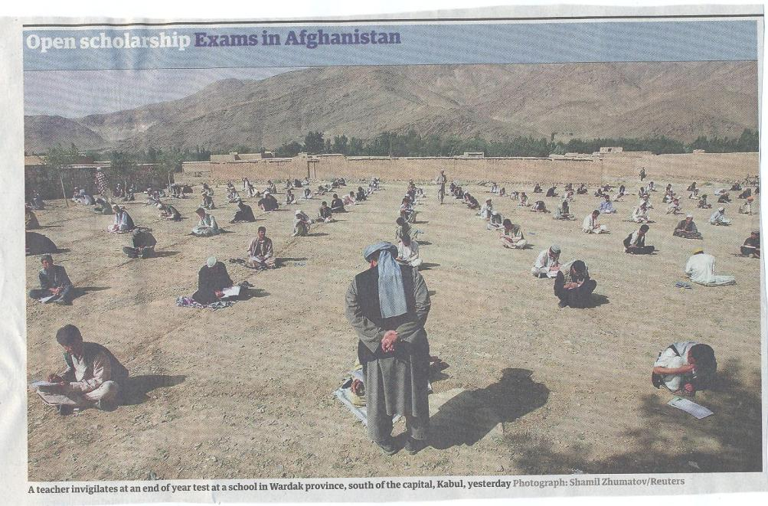

Slide 26
Conclusions
Assessment strategies are often under-designed;
We need to consider the fitness for purpose of each element of the assessment programme;
This will include the assignment questions/tasks themselves, the briefings, the marking criteria, the moderation process and the feedback;
We also need to scrutinise how the assignments align with one another, whether we are over or under-assessing, whether we are creating log-jams for students and markers, whether we are assessing authentically, and whether our processes are fair and sensible.
If we do this, assessment can contribute to improving student learning, thereby making a marked improvement.

Slide 27
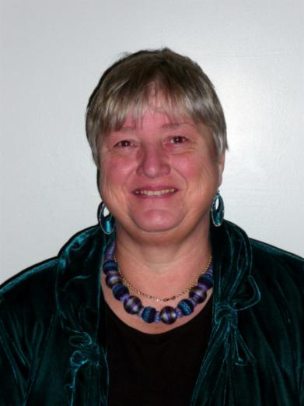
These and other slides will be available on my website at http://sally-brown.net

Slide 28
Parallel session A: Setting expectations and promoting engagement
How can we help students better understand why we assess in the way we do, and use this understanding to improve performance, deepen engagement and avoid complaints?
To what extent do we really understand students’ perceptions about assessment at entry to HE?
Do we really know better than the students about what kinds of assessment work best?
What about employers’ perceptions: what is authentic assessment in practice?
How well is our assessment constructively aligned?
How do we ensure students feel group work is fair and just?

Slide 29
What specific actions can you take to improve engagement through assessment, around e.g.:
Rebalancing formative and summative assessment;
Making assessment fit-for-purpose;
Designing out poor academic conduct, including plagiarism;
Spreading the workload over the year and avoiding bunching of assignments;
Implementing programme level assessment;
Making better use of technologies to support assessment and feedback;
Helping international students better understand UK assessment principles and practices;
Making assessment more manageable.

Slide 30
Useful references: 1
Assessment Reform Group (1999) Assessment for Learning : Beyond the black box, Cambridge UK, University of Cambridge School of Education.
Biggs, J. and Tang, C. (2007) Teaching for Quality Learning at University, Maidenhead: Open University Press.
Bloxham, S. and Boyd, P. (2007) Developing effective assessment in higher education: a practical guide, Maidenhead, Open University Press.
Brown, S. Rust, C. & Gibbs, G. (1994) Strategies for Diversifying Assessment, Oxford: Oxford Centre for Staff Development.
Boud, D. (1995) Enhancing learning through self-assessment, London: Routledge.
Brown, S. and Glasner, A. (eds.) (1999) Assessment Matters in Higher Education, Choosing and Using Diverse Approaches, Maidenhead: Open University Press.
Brown, S. and Knight, P. (1994) Assessing Learners in Higher Education, London: Kogan Page.
Brown, S. and Race, P. (2012) Using effective assessment to promote learning in Hunt, L. and Chambers, D. (2012) University Teaching in Focus, Victoria, Australia, Acer Press. P74-91

Slide 31
Useful references 2
Carless, D., Joughin, G., Ngar-Fun Liu et al (2006) How Assessment supports learning: Learning orientated assessment in action Hong Kong: Hong Kong University Press.
Carroll, J. and Ryan, J. (2005) Teaching International students: improving learning for all. London: Routledge SEDA series.
Crosling, G., Thomas, L. and Heagney, M. (2008) Improving student retention in Higher Education, London and New York: Routledge
Crooks, T. (1988) Assessing student performance, HERDSA Green Guide No 8 HERDSA (reprinted 1994).
Falchikov, N. (2004) Improving Assessment through Student Involvement: Practical Solutions for Aiding Learning in Higher and Further Education, London: Routledge.
Gibbs, G. (1999) Using assessment strategically to change the way students learn, in Brown S. & Glasner, A. (eds.), Assessment Matters in Higher Education: Choosing and Using Diverse Approaches, Maidenhead: SRHE/Open University Press.
Higher Education Academy (2012) A marked improvement; transforming assessment in higher education, York: HEA.

Slide 32
Useful references 3
Knight, P. and Yorke, M. (2003) Assessment, learning and employability Maidenhead, UK: SRHE/Open University Press.
Mentkowski, M. and associates (2000) p.82 Learning that lasts: integrating learning development and performance in college and beyond, San Francisco: Jossey-Bass.
McDowell, L. and Brown, S. (1998) Assessing students: cheating and plagiarism, Newcastle: Red Guide 10/11 University of Northumbria.
Nicol, D. J. and Macfarlane-Dick, D. (2006) Formative assessment and self-regulated learning: A model and seven principles of good feedback practice, Studies in Higher Education Vol 31(2), 199-218.
PASS project Bradford http://www.pass.brad.ac.uk/ Accessed November 2013
Pickford, R. and Brown, S. (2006) Assessing skills and practice, London: Routledge.

Slide 33
Useful references 4
Race, P. (2001) A Briefing on Self, Peer & Group Assessment, in LTSN Generic Centre Assessment Series No 9, LTSN York.
Race P. (2015) The lecturer’s toolkit (4th edition), London: Routledge.
Rust, C., Price, M. and O’Donovan, B. (2003) Improving students’ learning by developing their understanding of assessment criteria and processes, Assessment and Evaluation in Higher Education. 28 (2), 147-164.
Ryan, J. (2000) A Guide to Teaching International Students, Oxford Centre for Staff and Learning Development
Stefani, L. and Carroll, J. (2001) A Briefing on Plagiarism http://www.ltsn.ac.uk/application.asp?app=resources.asp&process=full_record&section=generic&id=10
Sadler, D. Royce (2010) Beyond feedback: developing student capability in complex appraisal,
Assessment & Evaluation in Higher Education, 35: 5, 535-550
Yorke, M. (1999) Leaving Early: Undergraduate Non-completion in Higher Education, London: Routledge.

