Slide 1
What makes an excellent student experience and how can we make this happen?
The Confederation of Student Services in Ireland: 23 June 2016
Sally Brown @ProfSallyBrown
sally@sally-brown.net
NTF, PFHEA, SFSEDA
Emerita Professor, Leeds Beckett University
Visiting Professor University of Plymouth, University of South Wales & Liverpool John Moores University.

Slide 2
Rationale: excellent student experiences require:
A whole-institutional focus, involving colleagues across the organisation to work together;
A recognition of the importance of providing a cohesive student-centred approach;
Excellent curriculum planning, design, delivery, support, assessment and quality processes.

Slide 3
Determining and reviewing subject material: currency, relevance, level
Enhancing quality, seeking continuous improvement
Designing and refining learning outcomes
Evaluating programmes, strengths and areas for improvement
Curriculum
Design
Essentials
Considering delivery modes: face-to-face, online, PBL, blended…
Assuring quality, matching HEI, national and PRSB requirements
Thinking through student support
Designing fit for purpose assessment methods and approaches

Slide 4

From Jason Elsom
(@Jason Elsom)

Slide 5
Robust quality: I argue that for engaged students we need:
Proactive and positive induction and initial training for all staff and ongoing CPD;
Practice based on a supportive / reflective model;
Clear and widely publicised mutual expectations for students and staff;
Recognition and reward for committed teaching and learning support, and having obvious career pathways for those who dedicate their lives to enhancing the student experience;
Taking student feedback very seriously, and publicising widely action take as a result of feedback.

Slide 6
We need therefore to think about
Students in all their diversity;
The employment context;
Staffing levels and support in all institutional roles;
Appropriate organisational finances;
Useful technologies to support learning, assessment and administration;
Emergent learning paradigms;
Students as producers as well as consumers;
Student satisfaction and other performance indicators;
New models of student engagement.

Slide 7
Engagement: Why talk about it? Because:
Academics and learning support staff report increasing levels of disengagement by students of the ‘iGeneration’;
The nature of the transaction seems to be changing in the light of high fees;
Potentially the nature of student behaviour in higher education is changing radically in terms of academic and other literacies;
Institutions need to ensure that new students enter with, or have the opportunity to acquire, the skills needed for academic success;
HEIs must devise programmes in which the emphasis is on maximising students’ development.

Slide 8
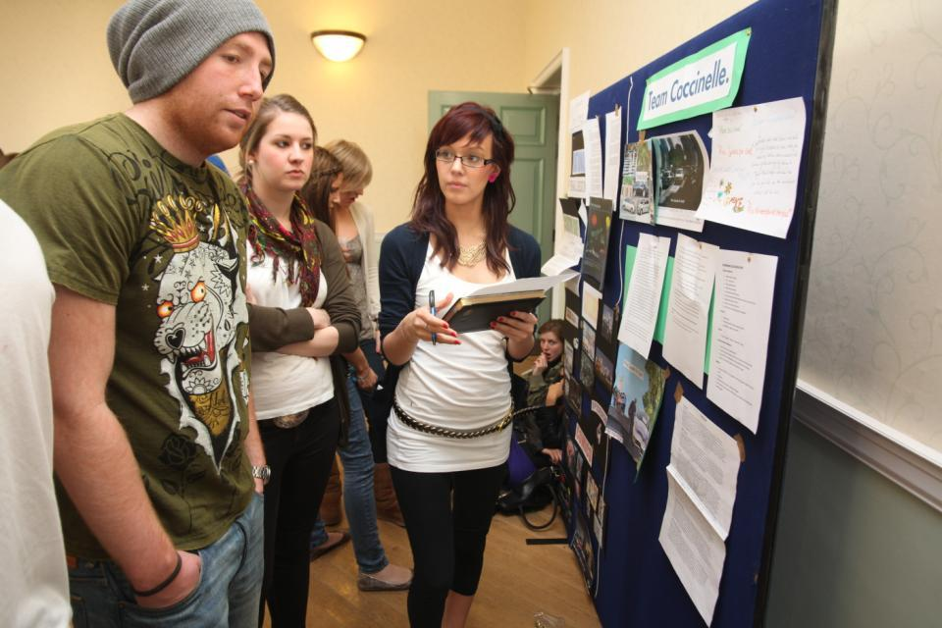
Do these students look engaged?

Slide 9
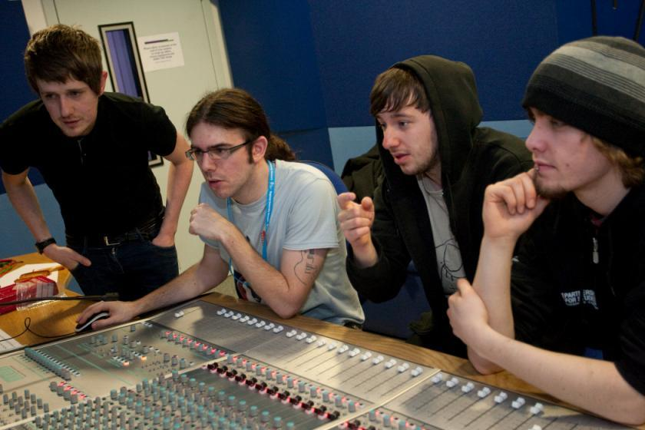
How about these?

Slide 10
Some characteristics of excellent teaching as described in the scholarly literature
Knows subject material thoroughly
Adopts a scholarly approach to the practice of teaching
Is reflective and regularly reviews own practice
Is well organised and plans curriculum effectively
Is passionate about teaching
Has a student-centred orientation to teaching
Regularly reviews innovations in learning and teaching and tries out ones relevant to own context
Ensures that assessment practices are fit for purpose and contribute to learning
Demonstrates empathy and emotional intelligence

Slide 11
How do we know if we are offering excellent student experiences?
Students are satisfied, learn well, achieve highly and have fulfilling learning experiences;
Students develop a range of competences they need including problem solving, working with others and self-management;
We as practioners are satisfied, motivated and find our workloads manageable;
Quality assurers and Professional and Subject bodies like what we do and have no complaints about systems and processes;
University managers are confident that the student experience offered is of high quality (and deal with few complaints).

Slide 12

Laurentius de Voltolina
2nd half of 14th Century
Italian Painter

Slide 13
Excellent curriculum delivery: delivering content…..
is less like delivering a parcel (the postman model) and more like delivering a baby (the midwife model).
University staff can advise, guide, intervene when things so wrong, but in the end only the student can bring learning into life!!
Content can be gleaned from many sources (e.g. MIT and our UK Open University are putting more and more content into open access areas).

Slide 14
The Maieutic model
Maieutics is a complex procedure of research introduced by Socrates, embracing the Socratic method in its widest sense. It is based on the idea that the truth is latent in the mind of every human being due to her/his innate reason but has to be “given birth” by answering questions (or problems) intelligently proposed. The word is derived from the Greek “μαιευτικός”, pertaining to midwifery.

Slide 15
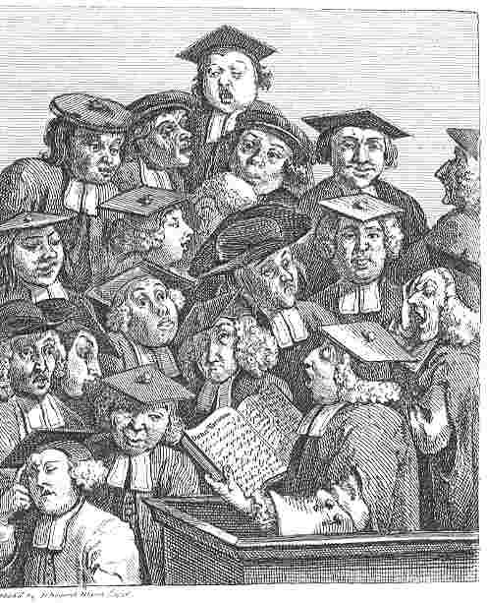
William Hogarth
1736
‘Scholars at a lecture’
How would the lecturer be rated in the NSS?

Slide 16


Slide 17
Things I wish I had known about effective teaching and support when I started doing it. It helps to:
Prepare diligently without being obsessive and be honest if you are asked questions you can’t immediately answer;
Spend as much time thinking about how you will structure learning activities as about the content of what is being taught;
Make convincing links between what you are doing with students today and what you have done previously, as well as signposting forward to future learning;
On the days when you aren’t feeling inspired or positive, it is helpful to cultivate a convincing air of enthusiasm and empathy (maybe get a magic jacket!).

Slide 18
Excellent assessment works well when:
Assessment is part of the learning process i.e. assessment for learning;
Students recognise the assessment tasks and processes to be fair, equivalent and authentic;
There is a high proportion of useful formative feedback and summative feedback is used sparingly but rigorously;
Students have dialogic opportunities to rehearse and explore new methods of assessment before they are implemented in summative contexts;
Those managing the assessment are able to do so without excessive strain.

Slide 19
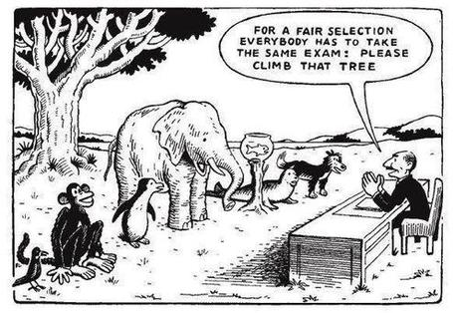

Slide 20
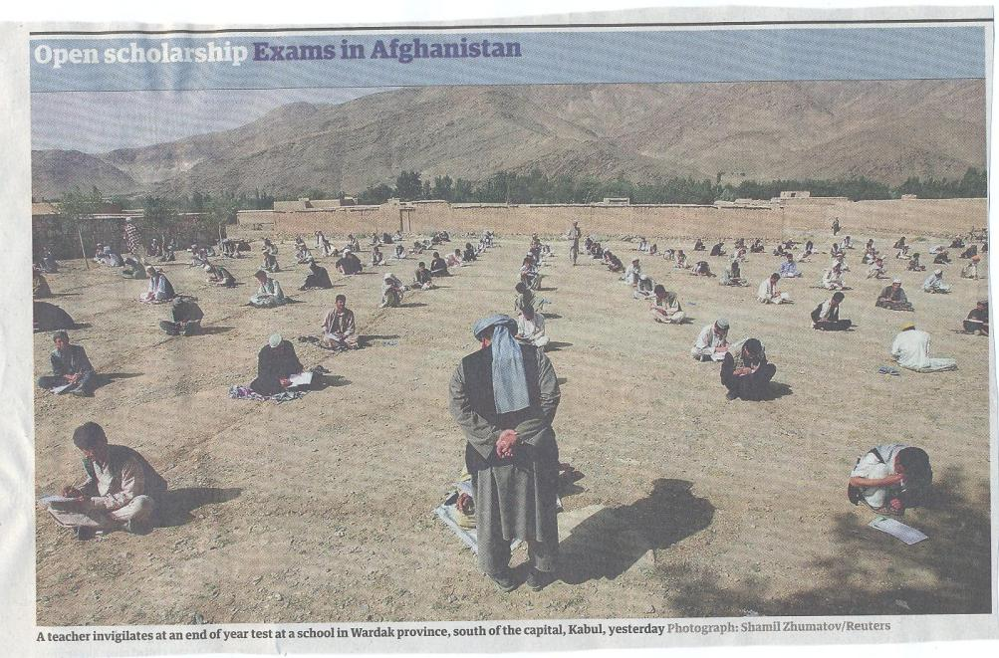

Slide 21
Excellent support for students involves helping them develop:
Confidence and self-efficacy (Dweck), so that success feels achievable;
A range of ‘literacies’ to include academic literacy, assessment literacy, digital literacy, information literacy, social and inter-personal literacy;
Coping strategies to enable them to identify when they need help and where to go to find it;
Resilience and grit: ‘bounce-back-ability’ so they can recover from setbacks.

Slide 22

The Leeds Met Book of Resilience
By Lucia Poole and Ruth Lefever, with Jacqueline Stevenson, Sean Dirrane and Amanda Wilson
Phil please could you see if you could insert the cover image from this document on this slide
http://www.leedsbeckett.ac.uk/publications/files/091124-36595_Book_of_Resilience_LoRes.pdf

Slide 23
How can we get students to fully engage? Some suggestions
Provide opportunities for students to get involved in authentic learning environments on campus or off;
Keep the curriculum current and life-relevant, without losing historical perspectives;
Give them real problems to solve and issues with which to engage;
Identify the skills they need to succeed and provide opportunities to rehearse and develop them;
Never compromise on the quality of the demands we make of them.

Slide 24
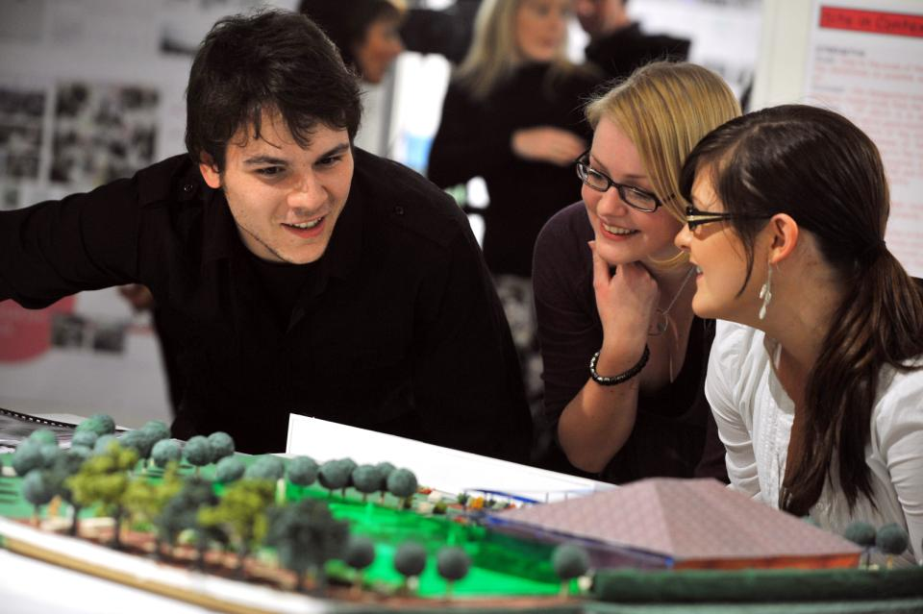
How can we make learning like this?

Slide 25
What kinds of management interventions can foster excellent student experiences?
Promotion and reward systems that recognise the importance of prioritising student support;
Identifying outstanding student supporters and using them as advocates and mentors to novices;
A culture of community, that encourages evidence-based dissemination of good practice;
Dialogues around what makes for excellent student experiences, and a commitment to continuously update our practice.

Slide 26
So what do you plan to do to be part of an excellent student support environment?
Whose work do you admire, and how can you emulate them?
Do you have people who can mentor you? And can you mentor others?
In what contexts can you seek opportunities for professional networking to help you remain in the vanguard of good practice?
Which are your best networks, and how can you make a positive contribution to them?
What forms of CPD work best for you? And how can you ensure your commitment to engaging with it?
To what extent do you continue to be a lifelong learner?

Slide 27
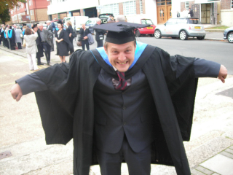
Rejoice
Notes:
Rejoice

Slide 28
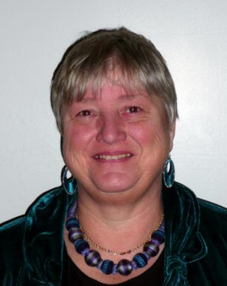
These and other slides are available on my website at http://sally-brown.net

Slide 29
Useful references and further reading (1)
Bain, K. (2004) “What the best College Teachers do” Cambridge Harvard University Press
Biggs, J. and Tang, C. (2007) Teaching for Quality Learning at University, Maidenhead: Open University Press.
Bloxham, S. and Boyd, P. (2007) Developing effective assessment in higher education: a practical guide, Maidenhead, Open University Press.
Boud, D. (1995) Enhancing learning through self-assessment, London: Routledge.
Brown, S. and Glasner, A. (eds.) (1999) Assessment Matters in Higher Education, Choosing and Using Diverse Approaches, Maidenhead: Open University Press.
Brown, S. and Race, P. (2012) Using effective assessment to promote learning in Hunt, L. and Chambers, D. (2012) University Teaching in Focus, Victoria, Australia, Acer Press. P74-91
Brown, S. (2015) Learning , Teaching and Assessment in Higher Education: Global perspectives, London, Palgrave

Slide 30
Useful references and further reading (2)
Carless, D., Joughin, G., Ngar-Fun Liu et al (2006) How Assessment supports learning: Learning orientated assessment in action Hong Kong: Hong Kong University Press.
Carroll, J. and Ryan, J. (2005) Teaching International students: improving learning for all. London: Routledge SEDA series.
Crosling, G., Thomas, L. and Heagney, M. (2008) Improving student retention in Higher Education, London and New York: Routledge
Dweck, C. S. (2000) Self Theories: Their Role in Motivation, Personality and Development, Lillington, NC: Taylor & Francis.
Falchikov, N. (2004) Improving Assessment through Student Involvement: Practical Solutions for Aiding Learning in Higher and Further Education, London: Routledge.
Gibbs, G. (1999) Using assessment strategically to change the way students learn, in Brown S. & Glasner, A. (eds.), Assessment Matters in Higher Education: Choosing and Using Diverse Approaches, Maidenhead: SRHE/Open University Press.
Higher Education Academy (2012) A marked improvement; transforming assessment in higher education, York: HEA.

Slide 31
Useful references and further reading (3)
McDowell, L. and Brown, S. (1998) Assessing students: cheating and plagiarism, Newcastle: Red Guide 10/11 University of Northumbria.
Meyer, J.H.F. and Land, R. (2003) ‘Threshold Concepts and Troublesome Knowledge 1 – Linkages to Ways of Thinking and Practising within the Disciplines’ in C. Rust (ed.) Improving Student Learning – Ten years on. Oxford: OCSLD.
Nicol, D. J. and Macfarlane-Dick, D. (2006) Formative assessment and self-regulated learning: A model and seven principles of good feedback practice, Studies in Higher Education Vol 31(2), 199-218.
PASS project Bradford http://www.pass.brad.ac.uk/ Accessed November 2013
Peelo, M. T., & Wareham, T. (Eds.). (2002). Failing students in higher education. Society for Research into Higher Education.
Pickford, R. and Brown, S. (2006) Assessing skills and practice, London: Routledge.
Rotheram, B. (2009) Sounds Good, JISC project http://www.jisc.ac.uk/whatwedo/programmes/usersandinnovation/soundsgood.aspx

Slide 32
Useful references and further reading (4)
Race, P. (2001) A Briefing on Self, Peer & Group Assessment, in LTSN Generic Centre Assessment Series No 9, LTSN York.
Race P. (2015) The lecturer’s toolkit (4th edition), London: Routledge.
Rust, C., Price, M. and O’Donovan, B. (2003) Improving students’ learning by developing their understanding of assessment criteria and processes, Assessment and Evaluation in Higher Education. 28 (2), 147-164.
Ryan, J. (2000) A Guide to Teaching International Students, Oxford Centre for Staff and Learning Development
Stefani, L. and Carroll, J. (2001) A Briefing on Plagiarism http://www.ltsn.ac.uk/application.asp?app=resources.asp&process=full_record&section=generic&id=10
Sadler, D. Royce (2010) Beyond feedback: developing student capability in complex appraisal,
Assessment & Evaluation in Higher Education, 35: 5, 535-550
Yorke, M. (1999) Leaving Early: Undergraduate Non-completion in Higher Education, London: Routledge.

