Slide 1
Assessment as a means of focusing student effort and enhancing student learning
University of Vic - Central University of Catalonia
15 June 2016
Sally Brown: NTF, PFHEA, SFSEDA
http://sally-brown.net
@ProfSallyBrown
Emerita Professor, Leeds Beckett University,
Visiting Professor, University of Plymouth, University of South Wales and Liverpool John Moores University.

Slide 2
Why is assessment such a big issue?
Good feedback and assessment practices are essential to student learning;
Student satisfaction surveys frequently highlight significant dissatisfaction around these issues;
In tough times, staff often find the pressure of achieving fast and formative feedback a heavy chore, especially when cohorts are large;
Research over 30+ years shows that shared and formative feedback has real impact on learning.

Slide 3
Why does assessment matter so much?
“Assessment methods and requirements probably have a greater influence on how and what students learn than any other single factor. This influence may well be of greater importance than the impact of teaching materials” (Boud 1988)
Notes:
Los métodos de evaluación influyen más en el aprendizaje del estudients que cualquier otro factor.

Slide 4

Laurentius de Voltolina
2nd half of 14th Century
Italian Painter

Slide 5
Determining and reviewing subject material: currency, relevance, level
Enhancing quality, seeking continuous improvement
Designing and refining learning outcomes
Evaluating programmes, strengths and areas for improvement
Curriculum
Design
Essentials
Considering delivery modes: face-to-face, online, PBL, blended…
Assuring quality, matching HEI, national and PSRB requirements
Thinking through student support
Designing fit for purpose assessment methods and approaches

Slide 6
Using assessment for learning (Sambell et al, 2012)
Assessment that is meaningful to students can provide them with a framework for activity;
“Students can escape bad teaching but they can’t escape bad assessment” (Boud, 1995);
Where assessment is fully part of the learning process and integrated within it, the act of being assessed can help students make sense of their learning;
Assessment should be formative, informative, developmental and remediable.

Slide 7
A4L the Northumbria model
Emphasises authentic & complex assessment tasks
Develops students’ abilities to evaluate own progress, direct own learning
Is rich in informal feedback (e.g. peer review of draft writing, collaborative project work)
Uses high stakes summative assessment rigorously but sparingly
Offers extensive ‘low stakes’ confidence building opportunities and practice
Is rich in formal feedback (e.g. tutor comment, self-review logs)

Slide 8
Formative and summative assessment
Formative assessment is primarily concerned with feedback aimed at prompting improvement, is often continuous and usually involves words.
Summative assessment is concerned with making evaluative judgments, is often end point and involves numbers.

Slide 9
Assessment literacy (Price et al, 2008): students do better if they can:
Make sense of key terms such as criteria, weightings, and level;
Encounter a variety of assessment methods (e.g. presentations, portfolios, posters, assessed web participation, practicals, vivas etc) and get practice in using them;
Be strategic in their behaviours, putting more work into aspects of an assignment with high weightings, interrogating criteria to find out what is really required and so on;
Gain clarity on how the assessment regulations work in their HEI, including issues concerning submission, resubmission, pass marks, condonement etc.

Slide 10
What really impacts on learning?
Concentrating on giving students detailed and developmental formative feedback is the single most useful thing we can do for our students, particularly those from disadvantaged backgrounds.
Summative assessment may have to be rethought to make it fit for purpose;
To do these things may require considerable imagination and re-engineering, not just of our assessment processes but also of curriculum design as a whole if we are to move from considering delivering content the most important thing we do.

Slide 11
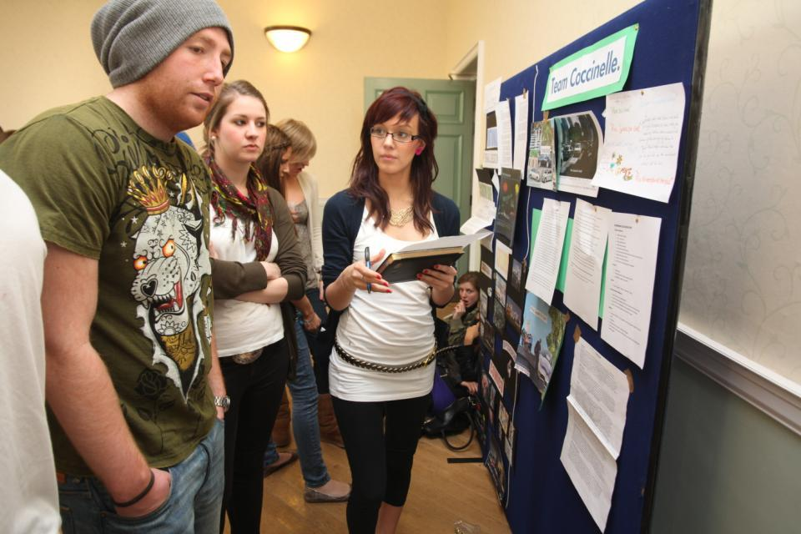
Do these students look engaged?

Slide 12
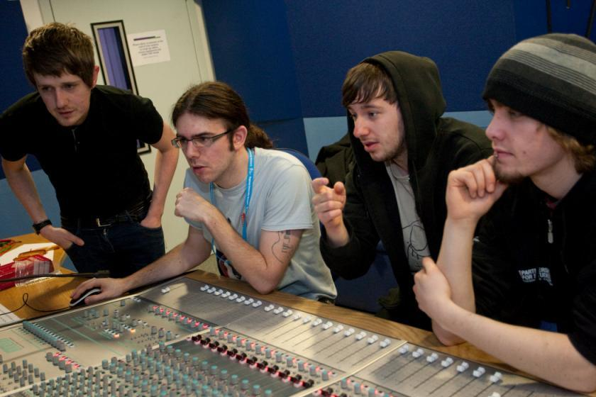
How about these?

Slide 13
Designing fit-for-purpose assessment methods & approaches: 10 questions
Are your assignments fully and constructively aligned with your learning outcomes?
Do they comply with your university requirements in terms of format, number, word limits etc?
Are summative assessments undertaken throughout the course, or is everything ‘sudden death’ end-point?
Is there excessive bunching of assignments in different modules that is highly stressful for students and unmanageable staff?
Are there plenty of opportunities for formative assessment, especially early on in the programme?

Slide 14
And the next five:
Are students over-assessed?
Do staff have time to mark the assessments in time for moderation etc?
When you have introduced innovative assignments, have they been introduced instead of existing ones or simply added to the assessment diet?
Are students encouraged to make good use of the feedback they receive?
Do the students perceive your assessment diet to be fair and providing meaningful recognition of their achievements?

Slide 15
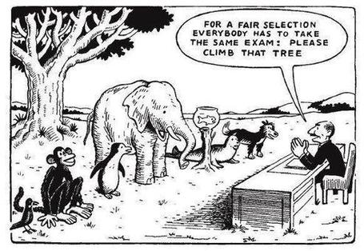

Slide 16
Sadler, the most cited author on formative assessment argues:
“Students need to be exposed to, and gain experience in making judgements about, a variety of works of different quality... They need planned rather than random exposure to exemplars, and experience in making judgements about quality. They need to create verbalised rationales and accounts of how various works could have been done better. Finally, they need to engage in evaluative conversations with teachers and other students.”

Slide 17
Peers taking part in assessment can impact highly on motivation and feedback
Motivation to participate in assessment activities is often enhanced when peers participate, since students often regard the opinion of their peers as more important than that of their tutors, parents or other people;
Peers, with training, are usually very competent at assessing each other's assessment products, for example presentations, posters, exhibitions and so on so long as they gauge evidence of achievement against clear criteria;
Where process is being assessed (rather than outcome), that is to say,evaluating the individual contributions of members of the group, it is essential to include intra-peer group assessment.

Slide 18
Good feedback: (after Brown, S. (2015), Assessment, learning and teaching in higher education: global perspectives, London: Palgrave-MacMillan)
Is dialogic, rather than mono-directional, giving students chances to respond to comments from their markers and seek clarification where necessary.
Helps clarify what good work looks like, so students are really clear about goals, criteria and expected standards, and provides opportunities to close the gap between current and desired performance.

Slide 19
Good feedback:
Actively facilitates students reviewing their own work and reflecting on it, so that they become good judges of the quality of their own work.
Doesn’t just correct errors and indicate problems, potentially leaving students discouraged and demotivated, but also highlights good work and encourages them to believe they can improve and succeed.

Slide 20
Good feedback:
Delivers high-quality information to students about their achievements to date and how they can improve their future work. Where there are errors, students should be able to see what needs to be done to remediate them, and where they are undershooting in terms of achievement, they should be able to perceive how to make their work even better.

Slide 21
Good feedback:
Offers ‘feed-forward’ aiming to ‘increase the value of feedback to the students by focusing comments not only on the past and present … but also on the future – what the student might aim to do, or do differently in the next assignment or assessment if they are to continue to do well or to do better’ (Hounsell, 2008, p.5).
Ensures that the mark isn’t the only thing that students take note of when work is returned, but that they are encouraged to read and use the advice given in feedback and apply it to future assignments.

Slide 22
Things students really hate about feedback
Poorly written comments that are nigh on impossible to decode, especially when impenetrable acronyms or abbreviations are used, or where handwriting is in an unfamiliar alphabet and is illegible.
Cursory and derogatory remarks that leave them feeling demoralised ‘Weak argument’, ‘Shoddy work’, ‘Hopeless’, ‘Under-developed’, and so on.
Value judgements on them as people rather than on the work in hand.

Slide 23
Five things students really hate about feedback
Vague comments which give few hints on how to improve or remediate errors: ‘OK as far as it goes’, ‘Needs greater depth of argument’, ‘Inappropriate methodology used’, ‘Not written at the right level’.
Feedback that arrives so late that there are no opportunities to put into practice any guidance suggested in time for the submission of the next assignment.

Slide 24
Making assessment work well
Intra-tutor and Inter-tutor reliability need to be assured;
Practices and processes need to be transparently fair to all students;
Cheats and plagiarisers need to be deterred/punished;
Assessment needs to be manageable for both staff and students;
Assignments should assess what has been taught/learned not what it is easy to assess;
Assessment should use formats that fit the purpose and the context.

Slide 25
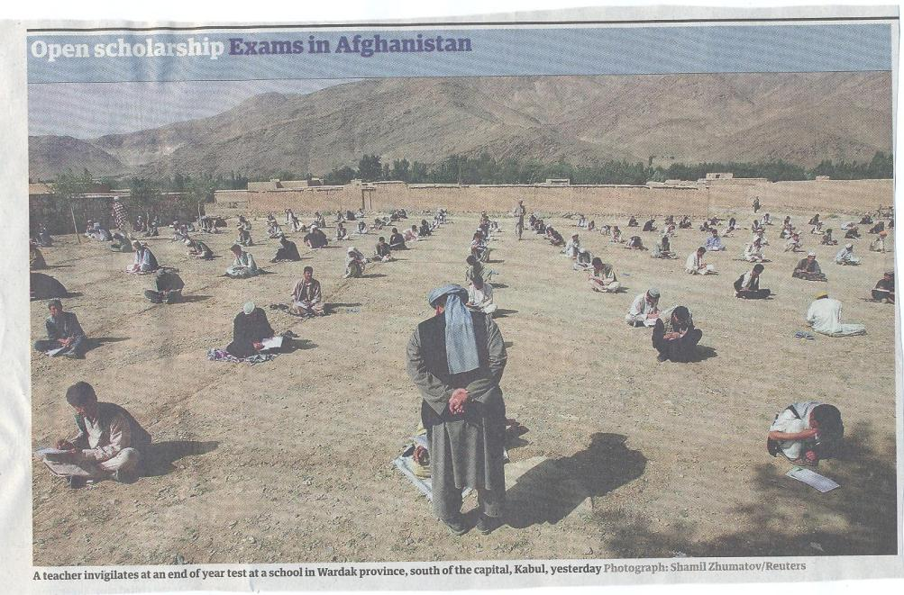

Slide 26
Can we provide opportunities for staged assessment?
Consider allowing resubmissions of work as part of a planned programme early on;
Students often feel they could do better once they have seen the formative feedback and would like the chance to have another go;
Particularly at the early stages of a programme, we can consider offering them the chance to use formative feedback productively;
Feedback often involves a change of orientation, not just the remediation of errors.

Slide 27
Using formative assessment to promote independence and learning
Investigate how learning can be advanced in small steps using a ‘scaffolding’ approach;
Provide lots of support in the early stages when students don’t understand the ‘rules of the game’ and may lack confidence;
This can then be progressively removed as students become more confident in their own abilities.

Slide 28
Encouraging students to use the feedback we provide for them
Delivery of feedback should not be left to chance, so its best to avoid asking students to pick up marked hard copy assignments from departmental offices;
Electronic submission of assignments has benefits and disadvantages but on balance the former outweigh the latter;
Perhaps require students to guestimate expected marks having read your feedback early in their programmes;
‘Assignment handler’ can deliver feedback electronically and only release marks once students have responded;
Audio files of audio feedback can be highly successful in enabling students to capture ‘live’ oral feedback, and can replace written feedback (e.g. JISC project ‘Sounds good’).

Slide 29
To better engage learners we can:
Make use of real examples and hot-off-the-press data to keep content current;
Give added-value to students who engage. Provide resources and text on-line that back up classroom activities (including audio/video recordings of your lectures) without ever letting it be perceived that this is a substitute for being there!
Provide challenges to students’ thinking without letting individuals feel publicly exposed or humiliated;
Relate their work to the forthcoming/ongoing assignment (without slavishly teaching to the exam);
Make spaces for dialogue, through clickers/ Twitter/ whatever, live and after the session.

Slide 30
How can we get students to fully engage? Some suggestions
Provide opportunities for students to get involved in authentic learning environments on campus or off;
Keep the curriculum current and life-relevant, without losing historical perspectives;
Give them real problems to solve and issues with which to engage;
Identify the skills they need to succeed and provide opportunities to rehearse and develop them;
Never compromise on the quality of the demands we make of them.

Slide 31
Conclusions
Assessment can be a powerful means of focusing student effort and enhancing achievement if it is well designed and constructively aligned (Biggs and Tang, 2007);
Students in the early stages of their learning journey are likely to need more support and positive feedback than later, when they are more robust and confident;
The first six weeks of the first semester are crucial in helping students understand how assessment works;
No single method of assessment or giving feedback is likely to be ubiquitously successful, so it’s worth using a variety of approaches;
Assessment needs to be manageable for staff and students if it is going to engage students in learning activities.

Slide 32

These and other slides will be available on my website at http://sally-brown.net

Slide 33
Useful references: 1
Assessment Reform Group (1999) Assessment for Learning : Beyond the black box, Cambridge UK, University of Cambridge School of Education.
Biggs, J. and Tang, C. (2007) Teaching for Quality Learning at University, Maidenhead: Open University Press.
Bloxham, S. and Boyd, P. (2007) Developing effective assessment in higher education: a practical guide, Maidenhead, Open University Press.
Brown, S. Rust, C. & Gibbs, G. (1994) Strategies for Diversifying Assessment, Oxford: Oxford Centre for Staff Development.
Boud, D. (1995) Enhancing learning through self-assessment, London: Routledge.
Brown, S. (2015) Learning, teaching and assessment in higher education: global perspectives, London: Palgrave-MacMillan.
Brown, S. and Glasner, A. (eds.) (1999) Assessment Matters in Higher Education, Choosing and Using Diverse Approaches, Maidenhead: Open University Press.
Brown, S. and Knight, P. (1994) Assessing Learners in Higher Education, London: Kogan Page.

Slide 34
Useful references 2
Brown, S. and Race, P. (2012) Using effective assessment to promote learning, in Hunt, L and Chalmers, D. University Teaching in Focus: a learning-centred approach, Victoria, Australia, Acer Press, and Abingdon: Routledge.
Carless, D., Joughin, G., Ngar-Fun Liu et al (2006) How Assessment supports learning: Learning orientated assessment in action Hong Kong: Hong Kong University Press.
Carroll, J. and Ryan, J. (2005) Teaching International students: improving learning for all. London: Routledge SEDA series.
Crosling, G., Thomas, L. and Heagney, M. (2008) Improving student retention in Higher Education, London and New York: Routledge
Crooks, T. (1988) Assessing student performance, HERDSA Green Guide No 8 HERDSA (reprinted 1994).
Falchikov, N. (2004) Improving Assessment through Student Involvement: Practical Solutions for Aiding Learning in Higher and Further Education, London: Routledge.

Slide 35
Useful references 3
Gibbs, G. (1999) Using assessment strategically to change the way students learn, in Brown S. & Glasner, A. (eds.), Assessment Matters in Higher Education: Choosing and Using Diverse Approaches, Maidenhead: SRHE/Open University Press.
Higher Education Academy (2012) A marked improvement; transforming assessment in higher education, York: HEA.
Hounsell, D., 2008. The trouble with feedback: New challenges, emerging strategies. Interchange, 2, pp.1-10.
Knight, P. and Yorke, M. (2003) Assessment, learning and employability Maidenhead, UK: SRHE/Open University Press.
Meyer, J.H.F. and Land, R. (2003) ‘Threshold Concepts and Troublesome Knowledge 1 – Linkages to Ways of Thinking and Practising within the Disciplines’ in C. Rust (ed.) Improving Student Learning – Ten years on. Oxford: OCSLD.
Mentkowski, M. and associates (2000) p.82 Learning that lasts: integrating learning development and performance in college and beyond, San Francisco: Jossey-Bass.
.

Slide 36
Useful references: 4
Nicol, D. J. and Macfarlane-Dick, D. (2006) Formative assessment and self-regulated learning: A model and seven principles of good feedback practice, Studies in Higher Education Vol 31(2), 199-218.
PASS project Bradford http://www.pass.brad.ac.uk/ Accessed June 2016
Peelo, M. T., & Wareham, T. (Eds.). (2002). Failing students in higher education. Society for Research into Higher Education.
Price, M., Rust, C., O'Donovan, B., Handley, K. and Bryant, R., 2012.Assessment literacy: The foundation for improving student learning. ASKe, Oxford Centre for Staff and Learning Development.
Pickford, R. and Brown, S. (2006) Assessing skills and practice, London: Routledge.
Race, P. (2001) A Briefing on Self, Peer & Group Assessment, in LTSN Generic Centre Assessment Series No 9, LTSN York.
Race P. (2015) The lecturer’s toolkit (4th edition), London: Routledge.

Slide 37
Useful references 5
Rotheram, B. (2009) Sounds Good, JISC project http://www.jisc.ac.uk/whatwedo/programmes/usersandinnovation/soundsgood.aspx
Rust, C., Price, M. and O’Donovan, B. (2003) Improving students’ learning by developing their understanding of assessment criteria and processes, Assessment and Evaluation in Higher Education. 28 (2), 147-164.
Ryan, J. (2000) A Guide to Teaching International Students, Oxford Centre for Staff and Learning Development
Stefani, L. and Carroll, J. (2001) A Briefing on Plagiarism http://www.ltsn.ac.uk/application.asp?app=resources.asp&process=full_record&section=generic&id=10
Sadler, D. Royce (2010) Beyond feedback: developing student capability in complex appraisal, Assessment & Evaluation in Higher Education, 35: 5, 535-550
Sambell, K., McDowell, L. and Montgomery, C. (2012) Assessment for Learning in Higher Education Abingdon, Routledge
Yorke, M. (1999) Leaving Early: Undergraduate Non-completion in Higher Education, London: Routledge.

