Slide 1
Meeting the challenges of programme level assessment
University of Reading
June 2016
Sally Brown
NTF, PFHEA, SFSEDA, PhD
Emerita Professor, Leeds Beckett University
Visiting Professor: University of Plymouth, University of South Wales & Liverpool John Moores University.

Slide 2
Rationale
In programmes where course teams know one another and their students, it is relatively straightforward to help students believe they are studying on coherent programmes with clear pathways through the curriculum.
However, the larger the institution and the cohort, the more likely it is that modules and other curriculum delivery components are designed and delivered in isolation, without clear thinking going into what the overall programme experience is like for the students undertaking them.

Slide 3
Outline
This workshop will focus on thinking through how we can meet the challenges of programme level assessment, particularly by:
Fostering programme-wide approaches to assessment (and encouraging our colleagues to work with us on this);
Considering how we can ensure that learning outcomes are addressed holistically at a programme level;
Avoiding the cantonisation of the curriculum, increasing the amount of formative feedback.

Slide 4
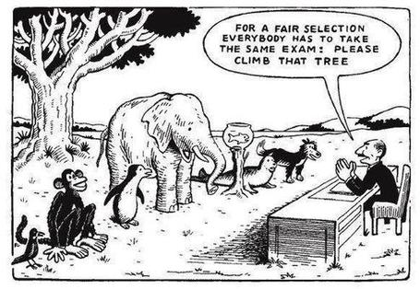

Slide 5
Determining and reviewing subject material: currency, relevance, level
Enhancing quality, seeking continuous improvement
Designing and refining learning outcomes
Evaluating programmes, strengths and areas for improvement
Curriculum
Design
Essentials
Considering delivery modes: face-to-face, online, PBL, blended…
Assuring quality, matching HEI, national and PRSB requirements
Thinking through student support
Designing fit for purpose assessment methods and approaches

Slide 6
It’s worth noting that:
Effective curriculum design which is constructively aligned is the key means by which we can offer excellent and supported student experiences;
Research indicates that students are more liable to stress and poor academic conduct (e.g. plagiarism and cheating) when subject to badly designed curricula;
The UK HEFCE-funded Programme Level Assessment project provides useful background information here, see PASS project Bradford http://www.pass.brad.ac.uk/ as does the HEA Marked Improvement project discussed earlier today.

Slide 7
What do we mean by Programme Focused Assessment?
“The first and most critical point is that the assessment is specifically designed to address major programme outcomes rather than very specific or isolated components of the course. It follows then that such assessment is integrative in nature, trying to bring together understanding and skills in ways which represent key programme aims. As a result, the assessment is likely to be more authentic and meaningful to students, staff and external stakeholders.”
Thanks to Chris Rust for slides adapted here. See PASS project at http://www.pass.brad.ac.uk/position-paper.pdf

Slide 8
Peter Hartley’s NTFS Bradford-led project on Programme Level Assessment
It set out to focus on redressing problems including:
not assessing learning outcomes holistically at a programme level;
the atomisation of assessment, often resulting in too much summative and not enough formative feedback and over-standardisation in regulations.
This results in students and staff failing to see the links between disparate elements of the programme, over-assessment and multiple assignments using repetitive formats.
Modules were often too short for complex learning and this tended to lead to surface learning and ‘tick-box mentality.

Slide 9
Programme Learning outcomes should reflect what students should achieve
Making it clear to students what is expected of them;
Making it clear to teachers what students are expected to learn in their own and other modules;
Helping teachers to select the most appropriate teaching strategy for the intended learning outcomes e.g. lecture, seminar, tutorial, group work, discussion, student presentation, laboratory work;
Helping teachers to select the most appropriate assessment style to assess the achievement of the learning outcomes, e.g. project, essay, performance assessment, multiple‐choice questions, exam;
Having a focus on programme learning outcomes – staff therefore need time to collaborate;
Are you confident that students being marked by different people or the same people at different times (inter & intra-tutor reliability) will achieve equivalent marks?

Slide 10
Programme Focused Assessment: potential benefits 1
Integrated learning and assessment at the meta-level, ensuring assessment of programme outcomes.
Students taking a deep approach to their learning.
Increased self and peer-assessment, developing assessment literacy.
Greater responsibility of the student for their learning and assessment, developing self-regulated learners.

Slide 11
Programme Focused Assessment: potential benefits 2
Reduced summative assessment workload for staff (especially connected with QA).
Possibly smaller number of ‘specialist’ assessors leading to greater reliability.
Possible greater opportunity to allow for ‘slow-learning’.
Possible link to, and enhancement of, PDP, leading to greater preparedness for CPD processes after graduation.

Slide 12
Putting this in to practice. We need to:
design an assessment strategy that involves a diverse range of methods of assessment (as all forms of assessment disadvantage some students);
consider when designing assessment tasks how any students might be disadvantaged;
maximise the opportunities for each student to achieve at the highest possible level;
ensure the assurance of appropriate standards for all students.

Slide 13
Mapping out the programme as a whole:
Are you ensuring that students are immersed in the subject they have come to study from the outset?
Is induction a valuable and productive introduction to the course and the assessment methods in use?
Do students have a positive and balanced assessment experience across the programme?
Are there points in the academic year when there doesn’t seem to be much going on (e.g. an extended Christmas break) when going home (and not coming back) seems like a good option?

Slide 14
Mapping progression
Is there a coherent model of progression across the student life-cycle from induction to ‘outduction’?
Do you manage transitions from year one to year two and year two to year three to ensure students remain committed and engaged?
Is there some continuity in the sources of student support throughout the course (e.g. personal tutors)?
Are students offered support and guidance in relation to personal development and employability?

Slide 15
What can we do in the first six weeks?
Enable students to feel part of a cohort rather than a number of a list;
Help students acclimatise to the new learning context in which they find themselves;
Familiarise them with the language and culture of the subject area they are studying (Northedge, 2003);
Foster the information literacy and other skills that students will need to succeed;
Guide them on where to go for help as necessary;
Offer them immersive experiences.

Slide 16
To what extent does your assessment approach across your programme:
Maximise fast, formative feedback opportunities without driving your markers into the ground?
Support student transition and retention by making assessment integral to learning?
Enable the development of digital literacy by providing tasks that use social and digital media?
Make the process of assessing and being assessed enjoyable for staff and students?
Assure the standards of assessment against national and PSRB benchmarks?

Slide 17
And…
Provide incremental assessment opportunities?
Use assessment activities that can engage students and be integral to learning?
Constructively align (Biggs 2003) assignments with planned learning outcomes and the curriculum taught?
Provide realistic tasks: students are likely to put more energy into assignments they see as authentic and worth bothering with?
Maximise the dialogic opportunities of student feedback?

Slide 18
Designing a programme-orientated curriculum: useful questions
What are the overall aims of your programme?
What will the students be expected to achieve in terms of academic, content disciplinary skills and attributes?
How will students learn?
How will you assess students?
How is the programme structured?
Do you have specific requirements for students at entry?
How do the course team listen to and act on student feedback?
What kinds of help can you offer students in terms of academic support and support for disabled students?
What links do you have with employers? Do you offer placements? How do you develop transferable skills?

Slide 19
To what extent, and how do you evidence good assessment practice at Reading?
Is there an emphasis on assessment for learning over systems focused on marks, grades and reliability?
Does the assessment design process ensure valid assessment of the intended learning outcomes?
Is there a trade-off between reliability and validity of assessment?
Are assessment decisions in relation to design, development and variety made within a programme context and focused on learning outcomes?
(From ‘A marked improvement’)

Slide 20
Twelve questions on assessment. You can:
Use these to help to design an authentic assessment approach at programme design stage;
Use them also as an aid to curriculum refreshment activity and prior to periodic review.

Slide 21
Assessment for learning: is assessment fully integrated within learning activities or is it an add-on that adds nothing to student engagement?
Preparation: are you developing students’ assessment literacy, so they understand fully what is required of them and can optimise their performances in a range of assessment contexts? Are staff inducted so they all share understandings of assessment practice.
Purpose: are you clear about why on each occasion you are assessing? Is it to give students guidance on how to improve or remediate work, or it is a scoring exercise to determine final grades? Is it focussing on theory or practise (or an integration of the two)?

Slide 22
Pacing and timing: are you offering feedback and assessment opportunities throughout the learning period or are assignments bunched together (particularly right at the end of the module)? Are you ensuring that students don’t have multiple assignments from different modules with the same submission date?
Volume of assessment: are you offering sufficient opportunities for students to learn through assessment without exhausting staff and putting excessive pressure on students in terms of workload?
Constructive alignment: is it clear how the assignments link to the learning outcomes, and do you offer good coverage of subject material and capabilities (or are you encouraging guessing of topics and risk taking activities)?

Slide 23
Variety: are you enabling students to demonstrate capability in diverse ways or are you reusing the same methods (essays, reports, unseen time-constrained exams) over and over again?
Inclusivity: Are students’ special needs in terms of assessment designed into assignments from the outset or do you have to make special arrangements for students with dyslexia, visual or aural impairments or other disabilities responsively rather than proactively?
Agency: is all your assessment undertaken by tutors or do you also use peers, students themselves, employers and clients?

Slide 24
Feedback: how fast can you provide it and what assurances can you give to students about its usefulness and ability to feed into future assignments?
Quality assurance: are you able to demonstrate that your assessment is fair, consistent and reliable? Will external scrutineers recognise the integrity of the assessment process?
Technology: are you using computer aided assessment where it is most useful (for drills and checking learning) enabling assessor time to be used most effectively where judgment is required?

Slide 25
How can we get students to fully engage? Some suggestions:
Provide opportunities for students to get involved in authentic learning environments on campus or off;
Keep assessment tasks current and life-relevant;
Give them real problems to solve and issues with which to engage;
Identify the skills they need to succeed and provide opportunities to rehearse and develop them;
Never compromise on the quality of the demands we make of them.

Slide 26
Encouraging students to take assessment more seriously
All assessment needs to be seen to be fair, consistent, reliable, valid and manageable;
Many assessment systems fail to clarify for students the purposes of different kinds of assessment activity;
Low-stakes early formative assessment helps students, especially those from disadvantaged backgrounds, understand the rules of the game.

Slide 27
Important aspects of complex, high-level learning outcomes can only be achieved when students are allowed time to ‘come to know’ the standards in use by the community
Slowly learnt academic literacies require rehearsal and practice throughout a programme (Knight and Yorke, 2004).
The achievement of high-level learning requires integrated and coherent progression based on programme outcomes.
Where there is a greater sense of the holistic programme students are likely to achieve higher standards than on more fragmented programmes (Havnes, 2007).
Students need to engage as interactive partners in a learning community, relinquishing the passive role of ‘the instructed’ within processes controlled by academic experts (Gibbs et al, 2004).

Slide 28
Prioritisation task
What are the key interventions you need to build into your development programmes?
How can you involve students further in a dialogue about assessment?
In your own programme assessment strategy or approach, can you identify:
Priorities for change?
Goals for the short, medium and long term?
What further information and resources do you require to improve your assessment? …….

Slide 29
Action planning for change
What changes are you planning?
Who needs to take responsibility?
What are your timelines and milestones?
What help do you need?
Are there further workshop topics you would welcome at a university level?
What does success in strategically improving assessment look like for you?
How will you know when you have been successful?

Slide 30
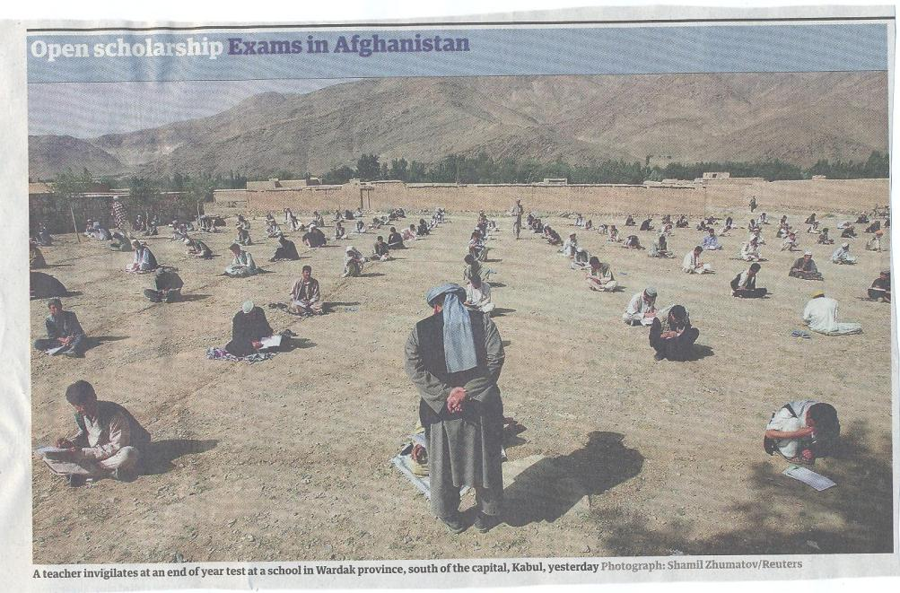

Slide 31
Conclusions
The benefits of programme level curriculum design and assessment are substantial for students, for academics and for the university;
There is considerable experience in achieving this, which demonstrates its viability;
However, it is an approach that requires substantial systematic and strategic design, and can only be achieved as a collaborative and university-wide effort.

Slide 32

These and other slides will be available on my website at http://sally-brown.net

Slide 33
Useful references: 1
Assessment Reform Group (1999) Assessment for Learning : Beyond the black box, Cambridge UK, University of Cambridge School of Education.
Biggs, J. and Tang, C. (2007) Teaching for Quality Learning at University, Maidenhead: Open University Press.
Bloxham, S. and Boyd, P. (2007) Developing effective assessment in higher education: a practical guide, Maidenhead, Open University Press.
Brown, S. Rust, C. & Gibbs, G. (1994) Strategies for Diversifying Assessment, Oxford: Oxford Centre for Staff Development.
Boud, D. (1995) Enhancing learning through self-assessment, London: Routledge.
Brown, S. and Glasner, A. (eds.) (1999) Assessment Matters in Higher Education, Choosing and Using Diverse Approaches, Maidenhead: Open University Press.
Brown, S. and Knight, P. (1994) Assessing Learners in Higher Education, London: Kogan Page.
Brown, S. and Race, P. (2012) Using effective assessment to promote learning in Hunt, L. and Chambers, D. (2012) University Teaching in Focus, Victoria, Australia, Acer Press. P74-91

Slide 34
Useful references 2
Carless, D., Joughin, G., Ngar-Fun Liu et al (2006) How Assessment supports learning: Learning orientated assessment in action, Hong Kong: Hong Kong University Press.
Carroll, J. and Ryan, J. (2005) Teaching International students: improving learning for all. London: Routledge SEDA series.
Dochy, F. J. R. C., Segers, M., & Sluijsmans, D. (1999). The use of self-, peer and co-assessment in higher education: A review. Studies in Higher education, 24(3), 331-350.
Falchikov, N. (2004) Improving Assessment through Student Involvement: Practical Solutions for Aiding Learning in Higher and Further Education, London: Routledge.
Gibbs, G. (1999) Using assessment strategically to change the way students learn, in Brown S. & Glasner, A. (eds.), Assessment Matters in Higher Education: Choosing and Using Diverse Approaches, Maidenhead: SRHE/Open University Press.
Higher Education Academy (2012) A marked improvement; transforming assessment in higher education, York: HEA.

Slide 35
Useful references 3
Knight, P. and Yorke, M. (2003) Assessment, learning and employability Maidenhead, UK: SRHE/Open University Press.
McDowell, L. and Brown, S. (1998) Assessing students: cheating and plagiarism, Newcastle: Red Guide 10/11 University of Northumbria.
Meyer, J.H.F. and Land, R. (2003) Threshold Concepts and Troublesome Knowledge 1 – Linkages to Ways of Thinking and Practising within the Disciplines, in C. Rust (ed.) Improving Student Learning – Ten years on. Oxford: OCSLD.
Morgan, M. (2013) (Ed.) ​Supporting Student Diversity in Higher Education: A practical guide, London: Routledge.
Nicol, D. J. and Macfarlane-Dick, D. (2006) Formative assessment and self-regulated learning: A model and seven principles of good feedback practice, Studies in Higher Education Vol 31(2), 199-218.
PASS project Bradford http://www.pass.brad.ac.uk/ Accessed August 2015.
Pickford, R. and Brown, S. (2006) Assessing skills and practice, London: Routledge.

Slide 36
Useful references 4
Race, P. (2001) A Briefing on Self, Peer & Group Assessment, in LTSN Generic Centre Assessment Series No 9, LTSN York.
Race P. (2015) The lecturer’s toolkit (4th edition), London: Routledge.
Rust, C., Price, M. and O’Donovan, B. (2003) Improving students’ learning by developing their understanding of assessment criteria and processes, Assessment and Evaluation in Higher Education. 28 (2), 147-164.
Ryan, J. (2000) A Guide to Teaching International Students, Oxford Centre for Staff and Learning Development
Sadler, D. Royce (2010) Beyond feedback: developing student capability in complex appraisal, Assessment & Evaluation in Higher Education, 35: 5, 535-550.
Wiggins, G. (1990) The Case for Authentic Assessment, ERIC Digest.
Yorke, M. (1999) Leaving Early: Undergraduate Non-completion in Higher Education, London: Routledge.

