Slide 1
Engaging staff, engaging students
University of Portsmouth
29 April 2016
Sally Brown @ProfSallyBrown
sally@sally-brown.net
NTF, PFHEA, SFSEDA
Emerita Professor, Leeds Beckett University
Visiting Professor University of Plymouth, University of South Wales & Liverpool John Moores University.

Slide 2
Rationale
Engaged students are more successful, tend not to drop-out and have more positive experiences of higher education than the disenchanted ones who are wholly strategic in their behaviours or who switch off altogether. They also tend to be more enjoyable and rewarding to teach.
In this keynote I aim explore how we help our students to act in beneficial ways that aid their engagement/ employability and at the same time regenerate our own enthusiasm for teaching our subjects.

Slide 3
Waffle on for a bit about THE current HE context

Slide 4
So what have you got to say about:
Students;
The employment context;
Staffing;
University finances;
Technologies to support learning and admin;
Learning paradigms;
Students as consumers;
The NSS and other performance indicators e.g. a TEF

Slide 5

From Jason Elsom
(@Jason Elsom)

Slide 6
The Enterprise agenda implies that Portsmouth graduates should be able to:
Develop critical & reflective subject understanding;
Think independently, analytically and creatively;
Work across disciplinary boundaries;
Synthesise new and existing knowledge;
Enjoy learning, be curious, go for challenges & opportunities;
Locate, access and critically engage with information;
Be informed citizens with a strong community orientation;
Work well in teams as leaders and followers;
Communicate effectively orally, in writing & across media;
Be entrepreneurial, enterprising, productive & innovative;
Be flexible & adaptable, working well in diverse contexts;
Actively engage in career decision making / forward thinking.

Slide 7
Whew!

Slide 8
Engagement: Why talk about it? Because:
Academics and learning support staff report increasing levels of disengagement by students of the ‘iGeneration’;
The nature of the transaction seems to be changing in the light of high fees;
Potentially the nature of student behaviour in higher education is changing radically in terms of academic and other literacies;
Institutions need to ensure that new students enter with, or have the opportunity to acquire, the skills needed for academic success;
HEIs must devise programmes in which the emphasis is on maximising students’ development.

Slide 9
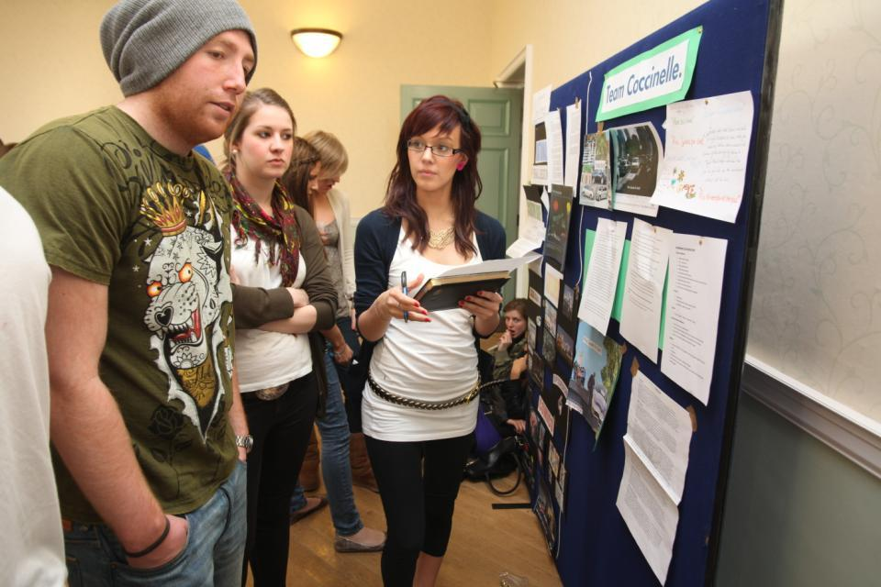
Do these students look engaged?

Slide 10
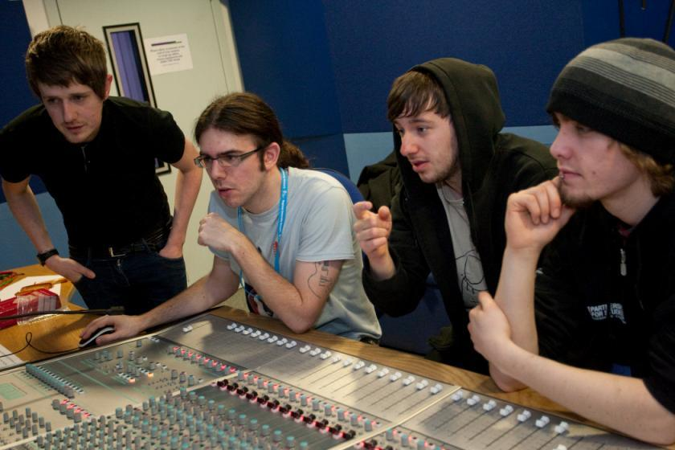
How about these?

Slide 11
What is an excellent teacher?
Talking to someone beside, above or below you, think about great teachers you know, and identify some of their characteristics.
Which of these characteristics do you think are most crucial to high NSS scores, and which to real student engagement?

Slide 12
Some characteristics of excellent teaching as described in the scholarly literature
Knows subject material thoroughly
Adopts a scholarly approach to the practice of teaching
Is reflective and regularly reviews own practice
Is well organised and plans curriculum effectively
Is passionate about teaching
Has a student-centred orientation to teaching
Regularly reviews innovations in learning and teaching and tries out ones relevant to own context
Ensures that assessment practices are fit for purpose and contribute to learning
Demonstrates empathy and emotional intelligence

Slide 13
How do we know if we are offering excellent teaching?
Students are satisfied, learn well, achieve highly and have fulfilling learning experiences;
Students develop a range of competences they need including problem solving, working with others and self-management;
We as teachers are satisfied, motivated and find our workloads manageable;
Quality assurers and Professional and Subject bodies like what we do and have no complaints about systems and processes;
University managers are confident that the student experience offered is of high quality (and deal with few complaints).

Slide 14

Laurentius de Voltolina
2nd half of 14th Century
Italian Painter

Slide 15
Delivering content…..
is less like delivering a parcel (the postman model) and more like delivering a baby (the midwife model).
University staff can advise, guide, intervene when things so wrong, but in the end only the student can bring learning into life!!
Content can be gleaned from many sources (e.g. MIT and our UK Open University are putting more and more content into open access areas).

Slide 16
The Maieutic model
Maieutics is a complex procedure of research introduced by Socrates, embracing the Socratic method in its widest sense. It is based on the idea that the truth is latent in the mind of every human being due to her/his innate reason but has to be “given birth” by answering questions (or problems) intelligently proposed. The word is derived from the Greek “μαιευτικός”, pertaining to midwifery.

Slide 17
Characteristics of an effective lecturer (the research suggests)
Strong orientation towards student learning;
Well prepared;
Comfort with subject material;
Ability to perceive that some students find the subjects we love hard, and even uninteresting;
Passion (and sometimes quirkiness);
Ability to vary activities within a lecture to maximise student engagement.

Slide 18

William Hogarth
1736
‘Scholars at a lecture’
How would the lecturer be rated in the NSS?

Slide 19
A tall order?
Effective lecturers combine the talents of a scholar, writer, producer, comedian, showman and teacher in ways that contribute to student learning. Nevertheless it is also true that few college professors combine these talents in optimal ways and that even the best lecturers are not always on top form
McKeachie et al p.53

Slide 20


Slide 21
Things I wish I had known about effective teaching when I started doing it. It helps to:
Prepare diligently without being obsessive and be honest if you are asked questions you can’t immediately answer;
Spend as much time thinking about how you will structure learning activities within a teaching session as about the content of what is being taught;
Make convincing links between what you are teaching students today and what you have done previously, as well as signposting forward to future learning;
Build in flexibility so you finish on time;
On the days when you aren’t feeling inspired it is helpful to cultivate a convincing air of enthusiasm for your subject and student learning.

Slide 22
To engage learners we can:
Make use of real examples and hot-off-the-press data to keep content current;
Give added-value to person who bothers to turn up. Provide resources and text on-line that back up classroom activities (including audio/video recordings of your lectures) without ever letting it be perceived that this is a substitute for being there!
Provide challenges to students’ thinking without letting individuals feel publicly exposed or humiliated;
Relate their work to the forthcoming/ongoing assignment (without slavishly teaching to the exam);
Make spaces for dialogue, through clickers/ twitter/ whatever, live and after the session.

Slide 23
How can we get students to fully engage? Some suggestions
Provide opportunities for students to get involved in authentic learning environments on campus or off;
Keep the curriculum current and life-relevant, without losing historical perspectives;
Give them real problems to solve and issues with which to engage;
Identify the skills they need to succeed and provide opportunities to rehearse and develop them;
Never compromise on the quality of the demands we make of them.

Slide 24
Robust quality: I argue that for engaged students we need
Rapid turnaround of assignments with detailed and useful feedback;
Proactive and positive initial training for teaching staff and ongoing CPD;
Regular developmental Peer Observation;
Teaching based on a supportive / reflective model;
Clear and widely publicised mutual expectations for students and staff;
Recognising and rewarding good teaching and learning support, and having obvious career pathways for those who dedicate their lives to enhancing the student experience;
Taking student feedback very seriously, and publicising widely action take as a result of feedback.

Slide 25
What kinds of management interventions can foster engaging teaching?
Promotion and reward systems that recognise the importance of teaching;
Identifying outstanding teachers and using them as advocates for commitment to teaching;
A culture of scholarship of teaching, that encourages evidence-based dissemination of good practice;
Dialogues around what makes for excellent teaching, particularly those associated with peer observation systems.

Slide 26
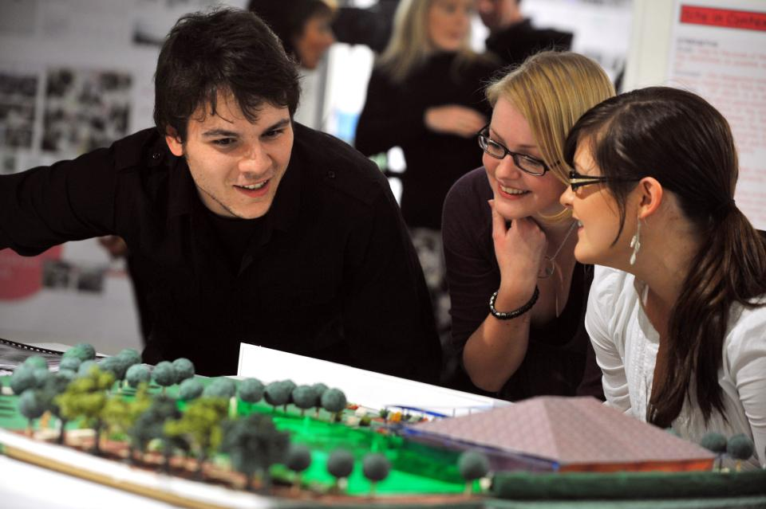
How can we make learning like this?

Slide 27
Bringing joy to the (live or virtual) classroom
Inspiring teachers tend to be systematic, consistent, well-prepared and compelling: they can usually work well at different levels and in diverse contexts;
It helps if we are able to teach with pleasure;
There are no standard recipes by which we can cook up engaging teaching, but there are some features we can combine in imaginative ways to create tasty and satisfying outcomes;
Engaging teaching comes in many different forms, and inspiring teachers develop their own styles and approaches that suit them (and their learners) well.

Slide 28

Joyful
Lucas Brown

Slide 29

These and other slides are available on my website at http://sally-brown.net

Slide 30
Useful references and further reading (1)
Bain, K. (2004) “What the best College Teachers do” Cambridge Harvard University Press
Biggs, J. and Tang, C. (2007) Teaching for Quality Learning at University, Maidenhead: Open University Press.
Bloxham, S. and Boyd, P. (2007) Developing effective assessment in higher education: a practical guide, Maidenhead, Open University Press.
Boud, D. (1995) Enhancing learning through self-assessment, London: Routledge.
Brown, S. and Glasner, A. (eds.) (1999) Assessment Matters in Higher Education, Choosing and Using Diverse Approaches, Maidenhead: Open University Press.
Brown, S. and Race, P. (2012) Using effective assessment to promote learning in Hunt, L. and Chambers, D. (2012) University Teaching in Focus, Victoria, Australia, Acer Press. P74-91
Brown, S. (2015) Learning , Teaching and Assessment in Higher Education: Global perspectives, London, Palgrave

Slide 31
Useful references and further reading (2)
Carless, D., Joughin, G., Ngar-Fun Liu et al (2006) How Assessment supports learning: Learning orientated assessment in action Hong Kong: Hong Kong University Press.
Carroll, J. and Ryan, J. (2005) Teaching International students: improving learning for all. London: Routledge SEDA series.
Crosling, G., Thomas, L. and Heagney, M. (2008) Improving student retention in Higher Education, London and New York: Routledge
Crooks, T. (1988) Assessing student performance, HERDSA Green Guide No 8 HERDSA (reprinted 1994).
Falchikov, N. (2004) Improving Assessment through Student Involvement: Practical Solutions for Aiding Learning in Higher and Further Education, London: Routledge.
Gibbs, G. (1999) Using assessment strategically to change the way students learn, in Brown S. & Glasner, A. (eds.), Assessment Matters in Higher Education: Choosing and Using Diverse Approaches, Maidenhead: SRHE/Open University Press.
Higher Education Academy (2012) A marked improvement; transforming assessment in higher education, York: HEA.

Slide 32
Useful references and further reading (3)
McDowell, L. and Brown, S. (1998) Assessing students: cheating and plagiarism, Newcastle: Red Guide 10/11 University of Northumbria.
Meyer, J.H.F. and Land, R. (2003) ‘Threshold Concepts and Troublesome Knowledge 1 – Linkages to Ways of Thinking and Practising within the Disciplines’ in C. Rust (ed.) Improving Student Learning – Ten years on. Oxford: OCSLD.
Nicol, D. J. and Macfarlane-Dick, D. (2006) Formative assessment and self-regulated learning: A model and seven principles of good feedback practice, Studies in Higher Education Vol 31(2), 199-218.
PASS project Bradford http://www.pass.brad.ac.uk/ Accessed November 2013
Peelo, M. T., & Wareham, T. (Eds.). (2002). Failing students in higher education. Society for Research into Higher Education.
Pickford, R. and Brown, S. (2006) Assessing skills and practice, London: Routledge.
Rotheram, B. (2009) Sounds Good, JISC project http://www.jisc.ac.uk/whatwedo/programmes/usersandinnovation/soundsgood.aspx

Slide 33
Useful references and further reading (4)
Race, P. (2001) A Briefing on Self, Peer & Group Assessment, in LTSN Generic Centre Assessment Series No 9, LTSN York.
Race P. (2015) The lecturer’s toolkit (4th edition), London: Routledge.
Rust, C., Price, M. and O’Donovan, B. (2003) Improving students’ learning by developing their understanding of assessment criteria and processes, Assessment and Evaluation in Higher Education. 28 (2), 147-164.
Ryan, J. (2000) A Guide to Teaching International Students, Oxford Centre for Staff and Learning Development
Stefani, L. and Carroll, J. (2001) A Briefing on Plagiarism http://www.ltsn.ac.uk/application.asp?app=resources.asp&process=full_record&section=generic&id=10
Sadler, D. Royce (2010) Beyond feedback: developing student capability in complex appraisal, Assessment & Evaluation in Higher Education, 35: 5, 535-550
Yorke, M. (1999) Leaving Early: Undergraduate Non-completion in Higher Education, London: Routledge.

