Slide 1
Engaging students, engaging staff: how can we energise higher education learning, teaching and assessment in the 21st century?
Learning, Teaching & Student Experience conference 26-27 April 2016
Aston University, Birmingham
Sally Brown
@ProfSallyBrown sally@sally-brown.net
NTF, PFHEA, SFSEDA
Emerita Professor, Leeds Beckett University
Visiting Professor University of Plymouth, University of South Wales & Liverpool John Moores University.

Slide 2
What are the biggest drains on energy?
(Waffle on about context a bit)

Slide 3
So what have you got to say about:
Students;
Staffing;
University finances;
Technologies and data analytics to support learning and admin;
Changing learning paradigms;
The necessity to develop students’ skills/literacies;
Students as consumers;
The NSS and other performance indicators e.g. a TEF?

Slide 4
What does energising the staff and student experience involve?
Being smart and fleet of foot in discerning trends from data and responding appropriately;
Foregrounding the student experience;
Building upon existing partnerships with students around quality assurance and enhancement;
Learning from experience about what works and doesn’t work, and using a scholarly approach to disseminating what we’ve discovered.

Slide 5
From Jason Elsom
(@Jason Elsom)

Slide 6
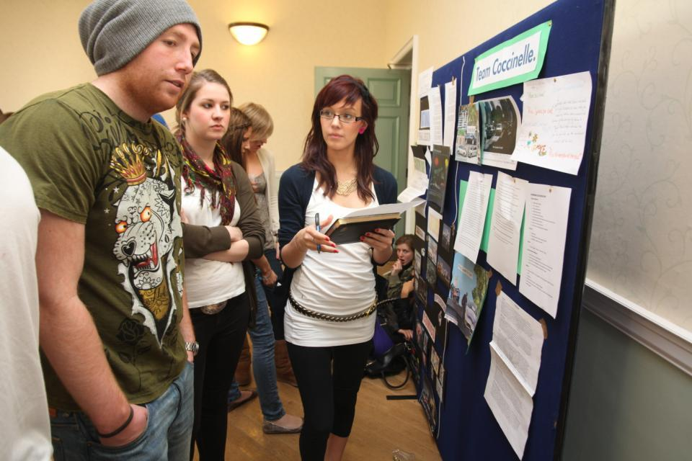
Do these students look engaged?

Slide 7
How about these?

Slide 8
Determining and reviewing subject material: currency, relevance, level
Enhancing quality, seeking continuous improvement
Designing and refining learning outcomes
Evaluating programmes, strengths and areas for improvement
Curriculum
Design
Essentials
Considering delivery modes: face-to-face, online, PBL, blended…
Assuring quality, matching HEI, national and PSRB requirements
Thinking through student support
Designing fit for purpose assessment methods and approaches

Slide 9
How do we know if we are offering engaging and energising teaching?
Students are satisfied, learn well, achieve highly and have fulfilling learning experiences;
Students develop a range of competences they need including problem solving, working with others and self-management;
We as teachers are satisfied, motivated and find their workloads manageable;
Quality assurors and Professional and Subject bodies like what we do and have no complaints about systems and processes;
University managers are confident that the student experience offered is of high quality (and deal with few complaints).

Slide 10
Laurentius de Voltolina
2nd half of 14th Century
Italian Painter

Slide 11
Delivering content…..
is less like delivering a parcel (the postman model) and more like delivering a baby (the midwife model).
University staff can advise, guide, intervene when things so wrong, but in the end only the student can bring learning into life!!
Content can be gleaned from many sources (e.g. MIT and our UK Open University are putting more and more content into open access areas).

Slide 12
The Maieutic model
Maieutics is a complex procedure of research introduced by Socrates, embracing the Socratic method in its widest sense. It is based on the idea that the truth is latent in the mind of every human being due to her/his innate reason but has to be “given birth” by answering questions (or problems) intelligently proposed. The word is derived from the Greek “μαιευτικός,” pertaining to midwifery.

Slide 13
Characteristics of an engaged and engaging university teacher (the research suggests)
Strong orientation towards student learning;
Well prepared;
Comfort with subject material;
Ability to perceive that some students find the subjects we love hard, and even uninteresting;
Passion (and sometimes quirkiness);
Ability to vary activities within a lecture to maximise student engagement.

Slide 14
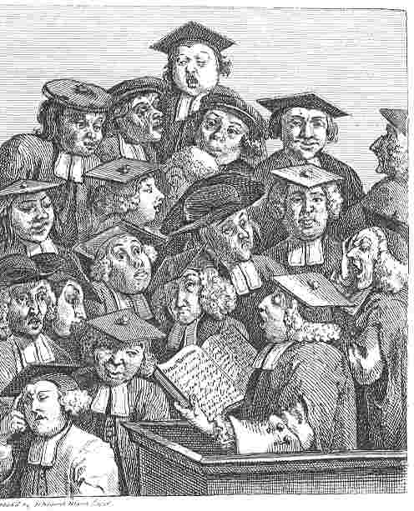
William Hogarth
1736
‘Scholars at a lecture’
How would the lecturer be rated in the NSS?

Slide 15
High quality teaching…
…“implies recognising that students must be engaged with the content of learning tasks in a way that is likely to enable them to reach understanding…Sharp engagement, imaginative inquiry and finding of a suitable level and style are all more likely to occur if teaching methods that necessitate student energy, problem solving and cooperative learning are employed”. (Ramsden, 2003, p.97)

Slide 16
To better engage learners we can:
Make use of real examples and hot-off-the-press data to keep content current;
Give added-value to person who bothers to turn up. Provide resources and text on-line that back up classroom activities (including audio/video recordings of your lectures) without ever letting it be perceived that this is a substitute for being there!
Provide challenges to students’ thinking without letting individuals feel publicly exposed or humiliated;
Relate their work to the forthcoming/ongoing assignment (without slavishly teaching to the exam);
Make spaces for dialogue, through clickers/ Twitter/ whatever, live and after the session.

Slide 17
How can we get students to fully engage? Some suggestions
Provide opportunities for students to get involved in authentic learning environments on campus or off;
Keep the curriculum current and life-relevant, without losing historical perspectives;
Give them real problems to solve and issues with which to engage;
Identify the skills they need to succeed and provide opportunities to rehearse and develop them;
Never compromise on the quality of the demands we make of them.

Slide 18
Engagement of international students: some important considerations
Is recruitment undertaken to ensure students have the potential to succeed?
Is induction framed appropriately to welcome international students?
Are steps taken proactively to ensure international students have a good chance of integrating with their study cohorts?
Is the curriculum international in scope and content? Are examples and case studies global?
Is the right kind of support offered (language, crisis support, befriending etc.)?

Slide 20
And how can we foster engagement among university staff? We can:
Lead by example, by ensuring regular refreshment of our pedagogic approaches as well as our content;
Seek recognition for our own teaching, learning and assessment expertise and leadership (for example, through HEA recognition at the right level);
Encourage colleagues to feel part of a community of (teaching) practice, maybe through communal learning, conversations, collegiality and cake;
Work to ensure our institutions practice what they preach and really value the role of those who put students first;
Remember to enjoy ourselves.

Slide 21
Joyful
Lucas Brown

Slide 22
These and other slides will be available on my website at http://sally-brown.net

Slide 23
Useful references and further reading (1)
Bain, K. (2004) What the best College Teachers do, Cambridge: Harvard University Press.
Biggs, J. and Tang, C. (2007) Teaching for Quality Learning at University, Maidenhead: Open University Press.
Bloxham, S. and Boyd, P. (2007) Developing effective assessment in higher education: a practical guide, Maidenhead, Open University Press.
Boud, D. (1995) Enhancing learning through self-assessment, London: Routledge.
Brown, S. and Glasner, A. (eds.) (1999) Assessment Matters in Higher Education, Choosing and Using Diverse Approaches, Maidenhead: Open University Press.
Brown, S. and Race, P. (2012) Using effective assessment to promote learning in Hunt, L. and Chambers, D. (2012) University Teaching in Focus, Victoria, Australia, Acer Press. P74-91.
Brown, S. (2015) Learning , Teaching and Assessment in Higher Education: Global perspectives, London, Palgrave.

Slide 24
Useful references and further reading (2)
Carless, D., Joughin, G., Ngar-Fun Liu et al (2006) How Assessment supports learning: Learning orientated assessment in action Hong Kong: Hong Kong University Press.
Carroll, J. and Ryan, J. (2005) Teaching International students: improving learning for all. London: Routledge SEDA series.
Crosling, G., Thomas, L. and Heagney, M. (2008) Improving student retention in Higher Education, London and New York: Routledge
Crooks, T. (1988) Assessing student performance, HERDSA Green Guide No 8 HERDSA (reprinted 1994).
Falchikov, N. (2004) Improving Assessment through Student Involvement: Practical Solutions for Aiding Learning in Higher and Further Education, London: Routledge.
Gibbs, G. (1999) Using assessment strategically to change the way students learn, in Brown S. & Glasner, A. (eds.), Assessment Matters in Higher Education: Choosing and Using Diverse Approaches, Maidenhead: SRHE/Open University Press.
Higher Education Academy (2012) A marked improvement; transforming assessment in higher education, York: HEA.

Slide 25
Useful references and further reading (3)
McDowell, L. and Brown, S. (1998) Assessing students: cheating and plagiarism, Newcastle: Red Guide 10/11 University of Northumbria.
Meyer, J.H.F. and Land, R. (2003) ‘Threshold Concepts and Troublesome Knowledge 1 – Linkages to Ways of Thinking and Practising within the Disciplines’ in C. Rust (ed.) Improving Student Learning – Ten years on. Oxford: OCSLD.
Nicol, D. J. and Macfarlane-Dick, D. (2006) Formative assessment and self-regulated learning: A model and seven principles of good feedback practice, Studies in Higher Education Vol 31(2), 199-218.
PASS project Bradford http://www.pass.brad.ac.uk/ Accessed November 2013.
Peelo, M. T., & Wareham, T. (Eds.). (2002). Failing students in higher education. Society for Research into Higher Education.
Pickford, R. and Brown, S. (2006) Assessing skills and practice, London: Routledge.
Rotheram, B. (2009) Sounds Good, JISC project http://www.jisc.ac.uk/whatwedo/programmes/usersandinnovation/soundsgood.aspx

Slide 26
Useful references and further reading (4)
Race, P. (2001) A Briefing on Self, Peer & Group Assessment, in LTSN Generic Centre Assessment Series No 9, LTSN York.
Race P. (2015) The lecturer’s toolkit (4th edition), London: Routledge.
Rust, C., Price, M. and O’Donovan, B. (2003) Improving students’ learning by developing their understanding of assessment criteria and processes, Assessment and Evaluation in Higher Education. 28 (2), 147-164.
Ryan, J. (2000) A Guide to Teaching International Students, Oxford Centre for Staff and Learning Development.
Stefani, L. and Carroll, J. (2001) A Briefing on Plagiarism http://www.ltsn.ac.uk/application.asp?app=resources.asp&process=full_record&section=generic&id=10
Sadler, D. Royce (2010) Beyond feedback: developing student capability in complex appraisal, Assessment & Evaluation in Higher Education, 35: 5, 535-550.
Yorke, M. (1999) Leaving Early: Undergraduate Non-completion in Higher Education, London: Routledge.

