Slide 1
International trends in higher education University College, Cork September 2015
Sally Brown
http://sally-brown.net
Twitter @ProfSallyBrown
Emerita Professor, Leeds Beckett University,
Visiting Professor, University of Plymouth and Liverpool John Moores University

Slide 2
The context
In a global higher education environment, student and academic mobility continues to increase, which many (including me) regard as a highly positive development, enriching learning opportunities for all. Higher Education is changing, and astute higher education practitioners recognise current trends and build appropriate responses into forward planning.
In this 90-minute interactive session, there will be opportunities to review current global trends and discuss their implications for universities in Ireland and beyond.

Slide 3
These trends include:
A desire for recognition of the professionalism of HE teaching, (e.g., The Organisation for Economic Cooperation and Development’s Assessment of Higher Education Learning);
The growth of private provision of HE and high fees;
Complexities around Masters level study and global competition for Masters students;
New regions driving global competition in research and teaching;
Internationalisation of the curriculum: what is being taught as well as the pedagogic approaches in use.

Slide 4
Ahelo: Assessment of Higher Education Learning Outcomes
The Organisation for Economic Cooperation and Development’s Assessment of Higher Education Learning Outcomes (Ahelo) project is seen as the university-level equivalent of the OECD’s highly influential global Programme for International Student Assessment tests for school pupils – and as having the potential to transform the established hierarchy in world higher education.
The OECD describes the Ahelo feasibility study as having looked at the scientific and practical feasibility of a test of what students know and can do at graduation. (Morgan, 2015)

Slide 5
Ahelo feasibility
A feasibility study was carried out, involving 17 countries and three American states - see http://www.oecd.org/edu/skills-beyond-school/countriesparticipatingintheahelofeasibilitystudy.htm Ireland was not in the pilot study
It included two disciplines – economics and civil engineering – plus a somewhat ill-defined category of ‘generic skills’. (Altbach, 2015)
The UK has decided not to participate in Ahelo but instead to have a Teaching Excellence Framework which is currently out for consultation and is highly controversial.

Slide 6
Many argue Ahelo could offer much
Andreas Schleicher, the OECD’s director for education and skills says that, globally, Ahelo “would just open up so many possibilities to have a more level playing field that is less influenced simply by past reputation and those kinds of things”.
He predicted that Ahelo could mean that “you will see institutions that may not be as expensive, that may be a bit in the shadow, but delivering superior learning outcomes”.
He added: “If you think of those elite universities, maybe much of their advantage is actually derived from social background: the intake they take, the selection. We have no idea currently.” ( Morgan, 2015).

Slide 7
The UK TEF framework: My eight potential dimensions
1. The HEI recognises and rewards excellent teaching e.g. by supporting HEA Fellowship accreditation, appointing Teacher Fellows, offering Professorships for L&T, and valuing academic leadership;
2. Students are involved in assuring and enhancing teaching at all stages from curriculum design through teaching to evaluation, there are robust systems for training, supporting, valuing and making good use of student representatives;

Slide 8
Three more dimensions
3. All New-to-HE staff are trained and supported through their early years of teaching (linked to probation) including GTAs, sessional and fractional staff , and career-wide CPD is provided for all who teach and take up is monitored;
4. Students are satisfied with their learning experiences as indicated by a basket of measures, one of which will be NSS outcomes;
5. Outcomes for students are excellent as indicated by retention and successful degree achievements and students are employed in graduate professions within three years of graduation;

Slide 9
6. Quality assurance measures result in QAA &
PSRB confidence;
7. Assessment is fit-for-purpose, appropriate to subject and level and is integrated with learning, with robust moderation in place to assure standards;
8. The HEI demonstrates a commitment to inclusivity and redressing all kinds of disadvantage, particularly in terms of Widening Participation and Fair Access.
These dimensions derived from discussions with UK NTFS colleagues and on line mail base discussions by members of SEDA, HEDG and the ANTF lists. See also #LTHEchat Extra on the Teaching Excellence Framework (with images, tweets) · LTHEchat · Storify

Slide 10
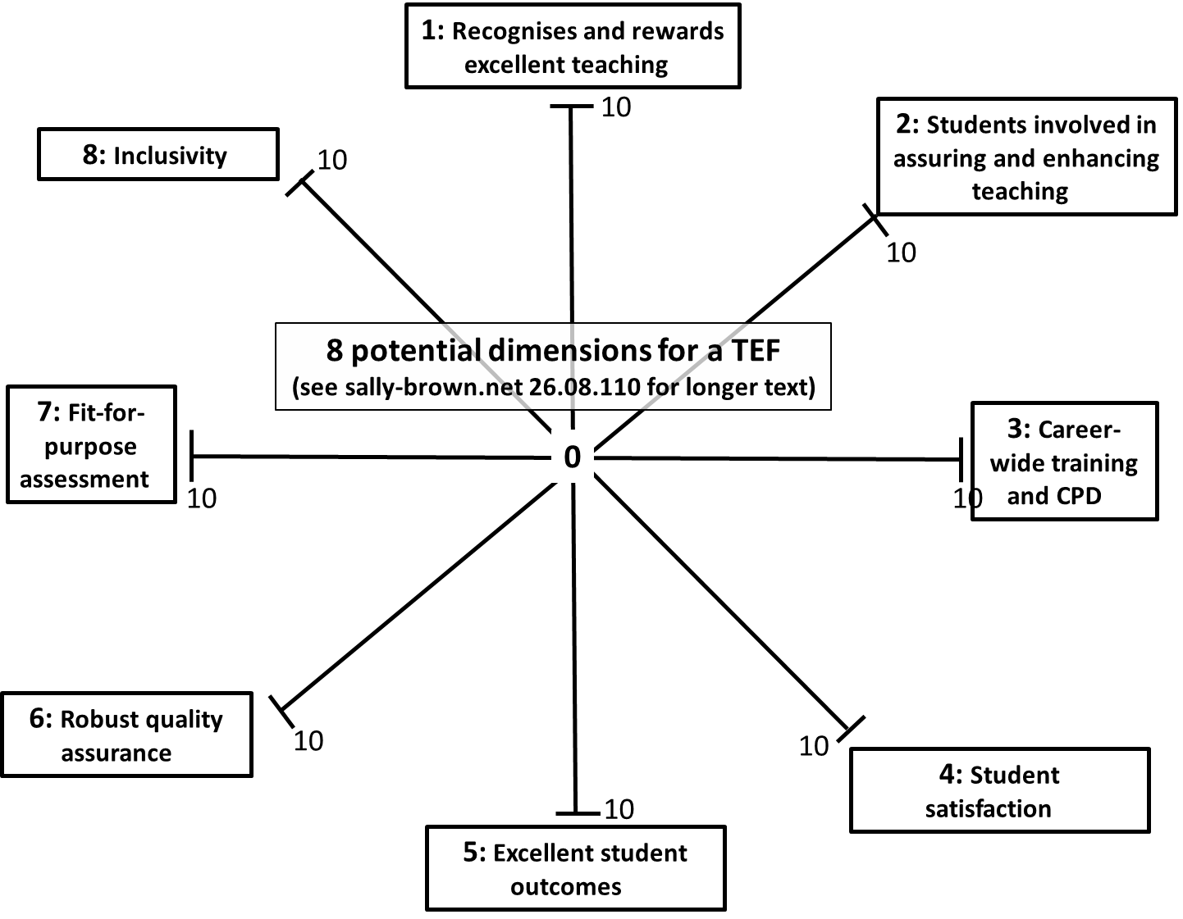
Rate your HEI or department on this spider diagram:
http://sally-brown.net/2015/08/casting-my-newly-beady-eye-on-tef/

Slide 11
The growth of private provision of HE and high fees
High fees and charges and the trend towards removal or reduction of grants for maintenance and support are tending to make students (and their parents) question the value of higher education;
When students pay more, this tends to change the nature of the transaction with the university;
Are they customers? How important is their satisfaction? What is the nature of the staff/student relationship?
If private providers can provide opportunities for degree level study for cut price rates (and often by distance/ online learning) can (and should) traditional HEIs compete?

Slide 12
Complexities around M-level study & global competition for Masters students
With high proportions of adults nowadays having undergraduate degrees, Masters awards are being seen as essential in many nations for good employment prospects;
Many nations (e.g. the Netherlands and Denmark) offer all their Masters programmes in the medium of English, so Anglophone universities are losing their competitive advantage globally;
Many universities are questioning the viability of some traditional models of Masters programmes (small cohorts, niche subjects) and looking to more economic provision (large groups, generic content with specialist options).

Slide 13
New regions driving global competition in research and teaching
There has been huge expansion in recent years in HE provision in many nations which traditionally sent their students to study abroad, particularly India and China;
Research rankings aren’t as dominated as they once were by Western nations (and the rankings themselves are becoming ever more dominant);
Individual universities might not be able to compete for long for research funding, hence collaborations such as the Golden Triangle in the UK of Oxford, Cambridge and London Universities.

Slide 14
How can we adopt international approaches to both what is being taught as well as the pedagogic approaches in use?
Internationalisation of the curriculum

Slide 15
The Global environment
There are surprisingly varied assumptions made about how learning, teaching and assessment are actually undertaken in universities in different nations.
Greater mutual understanding in these of areas can be enormously helpful in supporting student learning, ensuring academics have fulfilling careers and helping to make universities supportive learning communities.
Learning, Teaching and Assessment; Global Perspectives, (Brown, S. (2015) Palgrave Macmillan) focuses on what kinds of practices and approaches can best support students’ learning, engagement and achievement.

Slide 16
Internationalising curriculum content
Do you present students with global examples in subjects like Business Studies or are your case studies drawn from your own nation and one or two others?
Do you consider the implications of some of your historical references which might be unfamiliar to students from diverse national backgrounds?
Do you make it possible for students to draw on their own subject-related experiences in classroom discussions and activities, for example, different legal or practical contexts?

Slide 17
Diverse pedagogic approaches and contexts
Is your principal model of teaching one of transmission of knowledge or do you review learning as a partnership between teachers and students?
Do you value robust discussion in class, or is it more important to achieve consensus?
Is there a significant power distance between academics and students, or is the pedagogic context quite informal?

Slide 18
Diversity in classroom teaching approaches
Some HEIs in Pacific Rim nations providing substantially more one-to-one support than they might expect in the UK;
Some nations provide substantially less support than is common in other nations (for example, in some HEIs in Italy is not uncommon for the (very low) fees to cover only mass lectures, with seminars and personal tutoring available as extras).

Slide 19
Surprises in the international context
Students studying away from home often find approaches, methods, content and context very different from what they are used to;
Staff with diverse student cohorts are often surprised by student attributes and behaviours;
Institutions are not always well set up to support international students and recognise their achievements.

Slide 20
Further cultural issues:
Students from cultures where the genders are usually strictly segregated may find activities like group work and presentations challenging initially;
There can be issues around students who are not prepared to ask questions in class or seek support, for fear of ‘losing face’, or causing the teacher to ‘lose face’ ;
There is diversity in the extent to which robust discussion is valued, with students from some cultures preferring to focus on the importance of harmony and co-operation within the group rather the interests of the individual within it (Ryan op cit 2000).

Slide 21
Cultural mores can impact on expectations
“Eastern, Latin American and some Carribean cultures can, for example, deem it rude to make firm eye contact: while in the Uk it is often thought rude not too.” (Grace and Gravestock, 2009 p. 61)
This can be problematic where the assessment criteria for a presentation specifically mention eye contact, which may be difficult for some female students from the Indian sub-continent and others.

Slide 22
Variations in approaches based on cultural factors
These can centre on the extent to which historical texts and previously accumulated knowledge is respected and how much students are expected to have their own ideas, , how far authority figures, including teachers are respected (or not) and in particular, how far it is acceptable to be overtly critical of authoritative texts or figures and whether a ‘correct’ answer is sought and the extent to which alternative responses are acceptable.
(Ryan 2000)

Slide 23
What do students say on the authoritative role of the tutor?
“It was a shock for me to find that I wasn’t going to be marked by the tutor but by other students. How can they possibly be able to do that? The tutors should be doing this because they have the knowledge that we don’t have”.
“In our OSCEs [Objective Structured Clinical Examinations], we had to examine a patient whose comments on my proficiency formed part of the assessment. How can that be right? They know nothing of clinical matters.”

Slide 24
On ways of relating to others
“Home students are at such a great advantage over us. They seem to laugh and chat with the teachers in a very familiar way. We feel like outsiders and I think we are disadvantaged when it comes to the tests”.
“The tutor went through the criteria for the presentation with us, emphasising things like body language and eye contact but he didn’t understand that that would be a problem for me to look straight at all the male students”.

Slide 25
Comparable learning contexts? How far do you:
Socialise with students?
Encourage interruptions and questions in lectures?
Accept gifts from your students?
Encourage opposing views from students?
Provide detailed feedback and advice on draft assignments?
Routinely spend time with students after lectures?
Ask your students to call you by your first name?
Require them to participate in group assignments?
Allow them to negotiate marks?
Timetable exams on weekends?

Slide 26
What do students say on religious issues?
“We had two exams in one day, both lasting three hours. I had difficulty concentrating in the second one as I had been fasting since dawn. I didn’t really feel I did my best.”
“It was very uncomfortable for me taking an exam on a Saturday morning as it was our sabbath”.

Slide 27
Comparable technological environments? Do you expect your students to:
Have access to the internet at home?
Bring their own devices to class (BYOD) and use them in lessons?
Submit assignments and receive feedback electronically?
Access core subject content on-line before they come to classes?

Slide 28
And thinking about your teaching staff:
Are they qualified and enthusiastic advocates for using technology to support learning? Are they techno-tentatives? Refuseniks?
Do you use an assessment management system across the university for alignment of assignments to learning outcomes, submission and return of work, recording and presentation to exam boards of marks?
Do staff mainly interact with students electronically or in person?
Is communication to and between staff (plans, policies, developments, initiatives) mainly done face-to-face or virtually?

Slide 29
Teaching and technologies
The traditional lecture with little interaction is much more common in some nations than others;
Students can expect different modes of delivery and diversity in the level of provision of support materials including handouts, electronic texts and social learning environments, depending where they are studying.
Up-to-date IT equipment and even continuous electricity supplies to power computers are not ubiquitous.

Slide 30
Shared concepts of student support. Do you:
Adopt a close, caring and nurturing approach to students where the teacher's role is akin to that of a parent?
Regularly stay after lectures for 30-60 minutes to answer questions?
Regard students as independent, autonomous adults, capable of making their own decisions of how much and how hard to study?
Principally have contact with students in lecture theatre or is there much contact on an individual level?
Do parents have a central role in the educational transaction?

Slide 31
What do students say on expectations of a supportive relationship?
“He told us we could come to his office if there was something we didn’t understand, so I went, but after only half an hour, he said he had to go off to meeting, so I didn’t feel he had really helped me much”.

Slide 32
Some key questions on student support
Is recruitment undertaken to ensure students have the potential to succeed?
Is induction framed appropriately to welcome international students?
Are steps taken proactively to ensure international students have a good chance of integrating with their study cohorts?
Is the right kind of support offered (language, crisis support, befriending etc?)

Slide 33
Comparable assessment contexts?
There are likely to be differences in emphasis on unseen time-constrained exams, multiple choice questions and oral defences, vivas and presentations, which are much more common in Northern Europe and Scandinavia than in the UK;
Group assessment is strongly encouraged in some nations, where problem based learning is commonplace and is frowned on or banned in others (In Denmark for example it was illegal to assess students in groups until very recently).

Slide 34
Purposes of assessment
In some nations and contexts, assessment has a single purpose:, it exists primarily to judge the extent of the achievement of the learning outcomes summatively.
Where this is the case, the types of assessments in use tend to be restricted to traditional formats, particularly unseen time constrained exams.

Slide 35
Other purposes can include:
Determining readiness to progress to the next level of study;
Deciding with what grade or classification students will graduate;
Enabling a judgment to be made about whether a student is fit to practice in a clinical or other professional setting;
Determiningwhether professional requirements have been satisfied sufficiently to achieve professional accreditation;
Providing statistics for internal and external agencies.

Slide 36
What is being assessed?
In some nations accurately demonstrating the learning of by heart of tutor-delivered content is most highly prized, whereas elsewhere, use of that information in context is the prime expectation. As Beetham (2010) proposes:
‘When the focus is on accuracy of reproduction, learners will be given opportunities to practise the required concept or skill until they can reproduce it exactly as taught. When the focus is on internalisation, learners will be given opportunities to integrate a concept or skill with their existing beliefs and capabilities, to reflect on what it means to them, and to make sense of it in a variety of ways’ (Beetham, 2010, p.33).

Slide 37
What do students say on dealing with unfamiliar assessment formats?
“I couldn’t believe it when they told me there was no written exam. At first I thought it was wonderful but now I’m really worried because I don’t know what I am supposed to be doing.”
“I’ve never given an oral presentation before. Back home all our exams were written ones, so it was very nerve-wracking for me to have to stand up in front of everyone, with them all looking at me. It made it really hard for me to concentrate on what I was saying, even though I had done lots of preparation.”

Slide 38
More unfamiliar formats
“In my country, you only really get to do a viva for a post-graduate qualification so it was a shock to me to find that I was expected to do them for my course on my year abroad.”
“Back home exams only last a couple of hours, or three at the most. Here they are six hour marathons, sometimes more. It’s really exhausting.”

Slide 39
Complying with local requirements
Ryan and Carroll (2005) note common problems about students complying with word length regulations: for some African students, starting into the main body of the essay without a preamble is considered impolite, for example, meaning they frequently go considerably over length, while other students whose first language is not English comment on the problem of writing at length when their previous writing assignments have been 1,000 words long or so.

Slide 40
Diverse expectations concerning feedback
There are considerable differences in expectations internationally about the type, timing and purpose of feedback;
There is diversity in the explicitness of criteria and the amount of support students can expect if they are struggling with work.
In some nations, multiple assessment opportunities are provided, and students failing modules simply pick up credits else where (in Australia and New Zealand for example) and other nations, like the UK have much more hidebound regulations on progression issues.

Slide 41
Surprises about the assessment context
“I can’t imagine anyone back home bringing their families along to watch them presenting university course work, but here they all come along, aunties and cousins and grannies. I felt rather lonely doing mine all on my own”
“He gave me a B- for my essay. Back home I never got less than an A or maybe an A- so I went to see what the problem was, and he more or less brushed me off, saying it was fine. But it’s not fine! It’ll play hell with my Grade Point Average when I go back home”

Slide 42
On right answers
“They tell us to read around the topic and give us long book lists to help us prepare for writing essays, but how do you know where to start? I wanted to know which was the best book for me to concentrate on but no one would help me find it. In my country the books we need to study properly are indicated and everyone knows what they are.”
“In the lecture she gave us information about three different approaches to the subject, but she never told us which one was the right one. When I asked her about it, she said it was up to me to decide. How am I supposed to do that? She is the expert! So now I just don’t know what to write in my essay”

Slide 43
On language
“I’ve never been asked to write an essay as long as this before. Back home I was getting on really well with my written English, but what they asked for was usually only around 1,000 words long. This just takes so much time to get it right.”
“I went to my tutor and asked him to proof read my dissertation but he refused to help me. I am paying so much money as an overseas student here and I expected them to be more helpful to me.”

Slide 44
Contested terms which do not automatically translate include:
Assessment and evaluation: the terms tend to be reverses in the UK and the US, with the former meaning the grades and marks we give students and the latter meaning the comments students give on teaching staff in the UK and vice versa in the US. International practice elsewhere varies.

Slide 45
Faculty/staff/administration:
‘Faculty’ in the UK is an organisational term to describe groups of subjects or departments,, but in the US the term means academic teachers;
The term ‘instructor’ is used in the US for teaching staff, but in the UK these are technicians;
Professor in the UK is a status only reached after extensive application processes, is more widely used elsewhere;
University staff in the UK are all employees, but in the US it means professional and clerical administrators;
US ‘Administrators’ are termed Senior Managers in the UK.

Slide 46
Good global learning and teaching practice. We need to:
Provide clarity about mutual expectations in the classroom and in assessments;
If you are uncertain about what students feel about an issue, it’s often a good idea to ask them, sensitively and privately;
Be prepared for some students from some cultures to give you the answer they think you want (‘No, I’m fine’);
Be aware of international differences in practice and be open to diversity.

Slide 47
HEIs and nations must recognise we work in a global environment
We have to behave inter-culturally and cross-culturally to survive, and dominant cultures must be sensitive about not imposing their cultural, pedagogic and academic expectations on other parts of the world.
Student and staff mobility, the impact of transnational education, a readiness by some nations to teach undergraduates as well as postgraduates in a language other than their own to protect and enhance recruitment, and the ubiquity of international software and platform providers all mitigate against drawing up the barricades around our own national university systems.

Slide 48
Education in universities needs to be a joint endeavour in which learners and teachers work in partnership
This can never be an equal partnership, as the requirement for academics to make professional judgments on the achievements of students means there will always be a power imbalance between the two groups.
Nevertheless, the balance of power is shifting, and a recognition of the importance of co-working, communicating effectively, and recognising the drivers that prompt the actions of both is essential.
Students in many nations take important roles within quality assurance activities and contribute actively to curriculum design.

Slide 49
We need to balance tensions between cost effectiveness of teaching and assessment approaches with pedagogic effectiveness
Mass delivery of content e.g. by MOOCs is cheap but will not be cost effective, if the paradigm in use neglects the importance of student engagement.
Poor quality computer-based assessment is also cheap, but good CBA requires teamwork, by technically competent systems designers, advanced subject experts and knowledgeable educational developers who understand how question design works well.
We ignore at our peril five decades of research into what works well in university teaching if we go for quick fixes.

Slide 50
Education is transformative and can be either a locus for redressing disadvantage or conversely for reinforcing elitism
Higher education can confer life-advantages to those who succeed. These are not just pecuniary, but also tend to include improved self-efficacy and confidence, enhanced global perspectives, mature competences and professional status.
This places a heavy burden on academics since success or failure is likely to have high impact on lifelong achievements.
The choices we make and the actions we take have social, political and economic impact on both individuals and society.

Slide 51
Conclusions: where next in HE internationally?
Increasing competition for students globally (and that means Irish and UK student mobility as well);
Greater use of online learning across national boundaries;
International private competitors offering more provision in more countries e.g. Pearson Education;
Greater uncertainty about the viability of financial models for HE provision.

Slide 52
References and further reading
Altbach, P (2015) University World News
http://www.universityworldnews.com/article.php?story=20150515064746124 accessed August 2015
Beetham, H. (2010) Active learning in Technology-Rich Contexts, in Beetham, H. and Sharpe, R. Rethinking Pedagogy for a Digital age: designing for 21st Century learning, Abingdon: Routledge.
Brown, S. (2015) Learning, Teaching and Assessment in Higher Education: Global perspectives, UK: Basingstoke, Palgrave Macmillan.
Carroll, J. and Ryan, J. (2005) Teaching International students: improving learning for all, London: Routledge SEDA series.

Slide 53
Further references
Flint, N. R. and Johnson, B. (2011) Towards fairer university assessment: addressing the concerns of students, London: Routledge.
Grace, S. and Gravestock, P. (2009) Inclusion and Diversity: meeting the needs of all students. Key guides for effective teaching in Higher Education, Abingdon: Routledge.
Humfrey, C. (1999) Managing International students, Buckgingham, UK: Open University Press.
Jones, E. and Brown, S. (Eds) (2008) Internationalising Higher Education, London: Routledge.

Slide 54
More references
McNamara, D. and Harris, R. (1997) Overseas students in Higher Education: issues in teaching and learning, London: Routledge
Morgan, J. (7 May 2015)
https://www.timeshighereducation.co.uk/news/oecds-ahelo-project-could-transform-university-hierarchy/2020087.article
OECD (2014) Testing student and university performance globally: OECD’s AHELO http://www.oecd.org/edu/skills-beyond-school/testingstudentanduniversityperformancegloballyoecdsahelo.htm

Slide 55
And some more
Ryan, J. (2000) A Guide to Teaching International Students, Oxford: Oxford Centre for Staff and Learning Development.
Wisker, G. (2001) Good practice working with international students, Birmingham: SEDA paper 110, the Staff and educational Development Association.

Slide 56

These and other slides will be available on my website at http://sally-brown.net

