Slide 1
Enhancing the student experience to maximising student engagement, retention and success Cork Institute of Technology September 2015
Sally Brown NTF, PFHEA,SFSEDA
http://sally-brown.net @ProfSallyBrown
Emerita Professor, Leeds Beckett University,
Visiting Professor, University of Plymouth and Liverpool John Moores University.

Slide 2
Enhancing the student experience to maximise student engagement, retention and success
Retention is a matter of high importance to HE providers in Ireland and internationally, the costs of drop-out are high, both institutionally in terms of financial disadvantage, and also personally for the students who are likely to suffer the negative consequences in terms of both career and damaged self-esteem. Research tells us that students who have struggled to enter higher education in the first place are disproportionately represented among those who leave without completing their courses.
We have learned a lot in recent years about the kinds of factors that predispose students to dropping out of higher education and the kinds of behaviours that are indicators of the likelihood of students leaving early. While there will always be a proportion of students who drop-out for reasons beyond our control, there is much we can do to minimise attrition.

Slide 3
By the end of the workshop, participants will have had opportunities to:
consider what research tells us are the factors that impact on student retention;
review a range of enhancements to curriculum design, delivery and assessment that can improve student retention;
explore a range of interventions that we can undertake individually, as faculties and departments and as institutions as a whole to reduce the likelihood of student drop-out;
prioritise actions and interventions that they can implement in their own local contexts.

Slide 4
Enhancing the student experience and fostering student engagement
Universities will only thrive in the 21st century if they take seriously the need to engage students fully and ensure that their learning experience are transformative. This participative session is designed to enable staff to:
review imaginatively how the curriculum can be presented to students to maximise their learning;
consider a range of means by which students can be engaged through both traditional and technology- enhanced approaches;
prioritise strategies to improve student learning and foster employability.

Slide 5
Engaging students is crucial to their success (and ours)

Slide 6
How can we engage and motivate students?

Slide 7
Disengaged students
Don’t live up to their potential and fail to achieve their very best;
Make life more difficult for the staff who teach and support them;
Drop out of higher education, thereby damaging their own prospects and HEIs’ performance indicators;
HEIs suffer both financially and in terms of their status and reputation from high attrition rates.

Slide 8
Determining and reviewing subject material: currency, relevance, level
Enhancing quality, seeking continuous improvement
Designing and refining learning outcomes
Evaluating programmes, strengths and areas for improvement
Curriculum
Design
Essentials
Considering delivery modes: face-to-face, online, PBL, blended…
Assuring quality, matching HEI, national and PRSB requirements
Thinking through student support
Designing fit for purpose assessment methods and approaches

Slide 9
Laurentius de Voltolina
2nd half of 14th Century
Italian Painter

Slide 10
High quality teaching…
…“implies recognising that students must be engaged with the content of learning tasks in a way that is likely to enable them to reach understanding…Sharp engagement, imaginative inquiry and finding of a suitable level and style are all more likely to occur if teaching methods that necessitate student energy, problem solving and cooperative learning are employed”. (Ramsden, 2003, p.97)

Slide 11
Delivering content…..
is less like delivering a parcel (the postman model) and more like delivering a baby (the midwife model).
University staff can advise, guide, intervene when things so wrong, but in the end only the student can bring learning into life!!
Content can be gleaned from many sources (e.g. MIT and our UK Open University are putting more and more content into open access areas).

Slide 12
The Maieutic model
Maieutics is a complex procedure of research introduced by Socrates, embracing the Socratic method in its widest sense. It is based on the idea that the truth is latent in the mind of every human being due to her/his innate reason but has to be "given birth" by answering questions (or problems) intelligently proposed. The word is derived from the Greek "μαιευτικός," pertaining to midwifery.

Slide 13
To engage learners we can:
Make use of real examples and hot-off-the-press data to keep content current;
Give added-value to person who bothers to turn up. Provide resources and text on-line that back up classroom activities (including audio/video recordings of your lectures) without ever letting it be perceived that this is a substitute for being there!
Provide challenges to students’ thinking without letting individuals feel publicly exposed or humiliated
Relate their work to the forthcoming/ongoing assignment (without slavishly teaching to the exam)
Make spaces for dialogue, through clickers/ twitter/ whatever, live and after the session.

Slide 14
What kinds of behaviours offer warning signs of risk of drop-out
Failure to register with the library, to download required resources, to return books on time;
Not engaging with fellow students;
Not participating in group tasks;
Not submitting work on time (or at all);
Poor marks on early assignments;
Not picking up or responding to assessed work;
Non attendance, or very poor or intermittent attendance.

Slide 15
Yorke reported that for full-time and sandwich students, factors influencing drop out were
Poor quality of experience
Inability to cope with course demands
Unhappy with social environment
Wrong choice of course
Financial need
Dissatisfaction with some part of university provision.
(Yorke, 1999)

Slide 16
Additionally, withdrawal of failure is more probable when:
Students have chosen ‘the wrong programme’;
Students lack commitment and/or interest;
Students’ expectations are not met;
The quality of teaching is poor;
The academic culture is unsupportive (even hostile) to learning;
Students experience financial difficulty; and
Demands for other commitments supervene.
Peelo and Wareham p 34-5

Slide 17
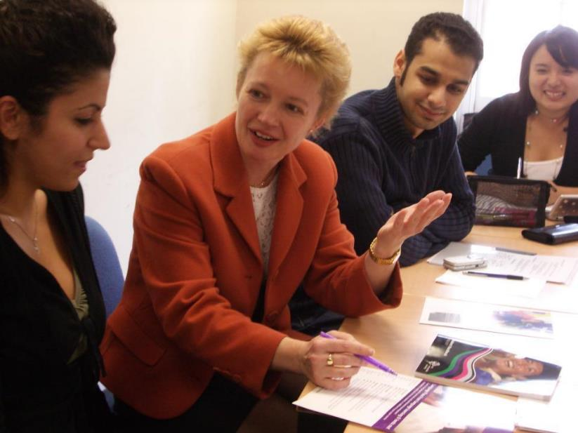
Students yearn for (and expect) personalised learning and assessment experiences

Slide 18
Poor attendance correlates with drop out and low engagement:
Research at Southampton institute (Lim), Glasgow Caledonian University (Begg) and University of Kent (Van der Velden) shows associations between weak attendance patterns and attrition;
Whatever the cause, not being there exacerbates other problems with study;
Endeavours to monitor and follow-up poor attendance has high pay off in terms of improving retention.

Slide 19
Further factors identified by Peelo and Wareham including assessment issues
The pressures of rising student numbers and reduced state funding have led to a decline in opportunities for staff-student interchange and feedback;
Higher education is becoming more impersonal;
Modularisation has led to semester-end (rather than year-end) assessment, which has led to a reduction in the amount of formative assessment being given to students - and formative assessment is crucial for engagement.

Slide 20
Mature students drop out too
The older female students were less likely than their younger peers were less likely to cite matters related to wrong choice of field of study. 'Mature' entrants tend to have taken time over a decision that is often buttressed by their experience of life outside the educational system. Basically, they know what they want to do. On the evidence of this study, however, these students more frequently run into difficulty with finance and family.
Peelo and Wareham p33

Slide 21
How can we get students to fully engage? Some suggestions
Provide opportunities for students to get involved in authentic learning environments on campus or off;
Keep the curriculum current and life-relevant, without losing historical perspectives;
Give them real problems to solve and issues with which to engage;
Identify the skills they need to succeed and provide opportunities to rehearse and develop them;
Never compromise on the quality of the demands we make of them.

Slide 22
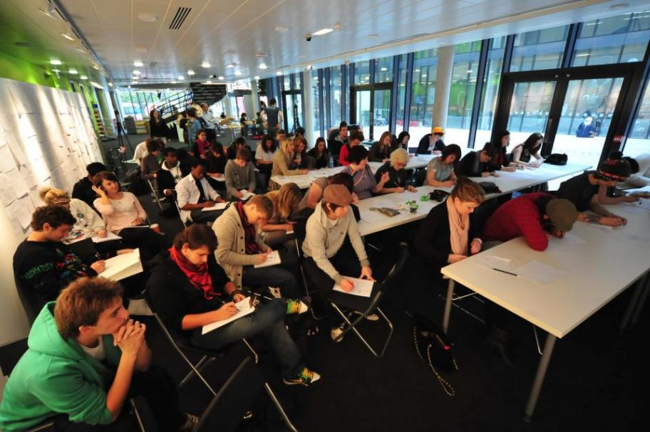
Polysemic activities: how can we engage and excite students’ attention in classes?

Slide 23
Engagement of international students: some important considerations
Is recruitment undertaken to ensure students have the potential to succeed?
Is induction framed appropriately to welcome international students?
Are steps taken proactively to ensure international students have a good chance of integrating with their study cohorts?
Is the curriculum international is scope and content? Are examples and case studies global?
Is the right kind of support offered (language, crisis support, befriending etc.)?

Slide 24
Group working can be problematic

Slide 25
I-society: it’s all about me!

Slide 26
What can universities do?
“Whereas a higher education institution can not do much about students’ background circumstances, it is probable that there is more academic failure in UK higher education than there should be. There seems to be scope in institutions for improving the ways in which they support students’ learning – and hence for reducing the incidence of academic failure. In the end, this comes down to an orientation towards the enhancement of the quality of the student experience.”
(Yorke 2002 op cit p39).

Slide 27
Drop out and assessment
“Roughly two-thirds of premature departures take place in, or at the end of, the first year of full-time study in the UK. Anecdotal evidence from a number of institutions indicates that early poor performance can be a powerful disincentive to continuation, with students feeling that perhaps they were not cut out for higher education after all – although the main problems are acculturation and acclimatisation to studying. “ (Yorke p37)
Implications: assessment in the first semester is critical: it should be formative, informative, developmental and remediable.

Slide 28
Student-centred assessment can improve retention..…

Slide 29
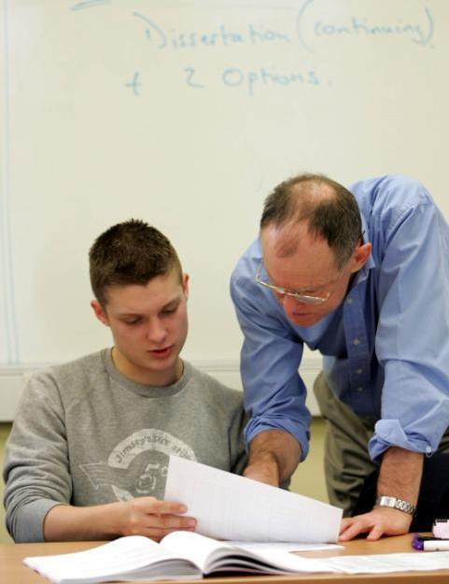
And they really want personalised feedback

Slide 30
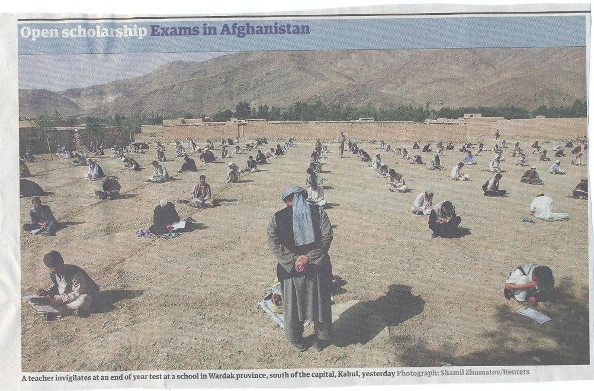

Slide 31
Technologies can support giving feedback

Slide 32
Bob Rotheram’s ‘Sounds good’ project

Slide 33
The uses of computer-assisted formative assessment
While CAA is used in some contexts summatively, many would argue that it is most powerfully used to support formative feedback, especially where automatically generated by email.
Students seem to really like having the chance to find out how they are doing, and attempt tests several times in an environment where no one else is watching how they do.
Another benefit is that CAA systems allow you to monitor what is going on across a cohort, enabling you to concentrate your energies either on students who are repeatedly doing badly or those who are not engaging at all in the activity.

Slide 34
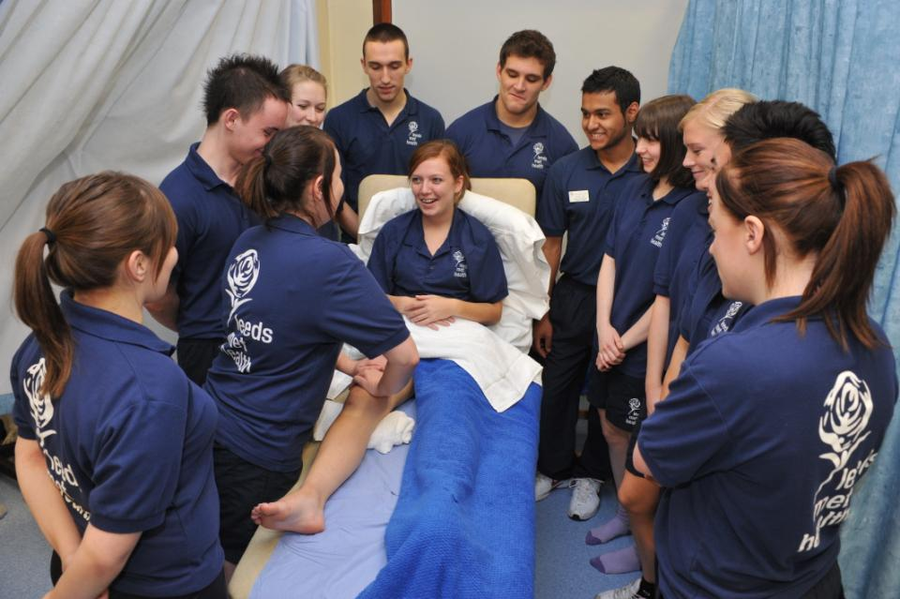
Authentic assessment helps learning

Slide 35
Assessment successes breed confidence

Slide 36
Assessment, confidence and retention
Crudely, student achievement is linked to students own beliefs about their abilities, whether these are fixed or malleable;
Students who subscribe to an entity (fixed) theory of intelligence need ‘a diet of easy successes’ (Dweck, 2000:15) to confirm their ability and are fearful of learning goals as this involves an element of risk and personal failure. Assessment for these students is an all-encompassing activity that defines them as people. If they fail at the task, they are failures.

Slide 37
Students who believe that intelligence is malleable may be more robust
Students who believe that intelligence is incremental have little or no fear of failure. A typical response from such a student is ‘The harder it gets, the harder I need to try’. These students do not see failure as an indictment of themselves and [can] separate their self-image from their academic achievement. When faced with a challenge, these students are more likely to continue in the face of adversity because they have nothing to prove. (after Clegg in Peelo and Wareham 2002)

Slide 38
Students really need to understand what is acceptable academic conduct

Slide 39
Information literacy is crucial

Slide 40
Helping students understand the rules of the game
The hardship was not understanding. When they give you an assignment and say it was on this handout. But my difficulty is not understanding what to do at first… I think that there’s a lack of my reading ability, which I can’t blame anyone for. I can only blame myself because I don’t like reading. And if you don’t read, you’re not going to learn certain things. So I suppose that’s to do with me…..it’s reading as well as putting what you read into your essay. You can read it and understand it. I can read and understand it, but then you have to incorporate it into your own words. But in the words they want you to say it in, not just: She said this, and this is the way it should be. The words, the proper language. (Bowl op cit 2003 p90).

Slide 41
Problems associated with reading
If 25% of your marks is from reading, you’ve got to try and show that, even if you haven’t read. I’m not going to sit there and read a chapter, and I’m certainly not going to read a book. But I’ll read little paragraphs that I think are relevant to what I’m writing, and it’s got me through, and my marks have been fine. But I can’t read. If I read too much, it goes over my head. If I’m writing something, I know what I want to say and I need something to back me up… then I will find something in a book that goes with that. I’m not going to try to take in the whole book just for one little bit. I have my book next to me and then I can pick out the bits. (Jenny, full-time community and youth work student). (Marion Bowl Non-traditional entrants to Higher Education 2003 p89).

Slide 42
Help students understand what is required with reading
Help them also to understand that there are different kinds of approaches needed for reading depending on whether they are reading for pleasure, for information, for understanding or reading around a topic;
Help them to become active readers with a pen and Post-its in hand, rather than passive readers, fitting the task in alongside television and other noisy distractions;
Give them clear guidance in the early stages about how much they need to read and what kinds of materials they need to focus on.

Slide 43
Students may need guidance on what to do with feedback

Slide 44
Making the most of feedback
Plan to maximise the impact of formative feedback. Make extra time helping students to understand the importance of feedback and the value of spending some of their time after receiving work back to learn from the experience.
Provide opportunities for students to respond to our feedback, for example, by giving students follow-up task or give them ‘feed-forward’ comments to improve their next piece of work.
Think about the means by which we deliver feedback, since this can be vital in determining how much notice students take of what you say.

Slide 45
Use formative assessment to help students with writing
Devote energy to helping students understand what is required of them in terms of writing;
Work with them to understand the various academic discourses that are employed within the subject/institution;
Help them to understand when writing needs to be personal and based on individual experience, such as in a reflective log, and when it needs to be formal and using academic conventions like passive voice and third person, as in written reports and essays.

Slide 46
What can we do as individuals to engage students through assessment?
Set small early assessed tasks (formative or summative) and turn them round fast in the crucial first semester;
Monitor student attendance and take action when students disappear and particularly when work is not handed in;
Make time available for student support, but know when to refer matters on when the problems are beyond our capabilities;
Do what we can to personalise the learning experience.

Slide 47
Engaging students through assessment
Pays high dividends in terms of student satisfaction;
Can be highly resource intensive if a strategic approach is not adopted;
Often requires a significant process of rethinking the processes and practices of assessment;
Usually implies increasing the amount of formative assessment and sometimes slimming down the volume of summative assessment;
Can change students’ lives.

Slide 48
Robust quality: I argue that for engaged students we need
Rapid turnaround of assignments with detailed and useful feedback;
Proactive and positive initial training for teaching staff and ongoing CPD plus regular developmental Peer Observation and teaching based on a supportive / reflective model;
Recognising and rewarding good teaching and learning support, and having obvious career pathways for those who dedicate their lives to enhancing the student experience;
Taking student feedback very seriously, and publicising widely action take as a result of feedback;
Teachers’ commitment to student learning..

Slide 49
From Jason Elsom
(@Jason Elsom)

Slide 50
Mapping progression
Is there a coherent model of progression across the student life-cycle from induction to ‘outduction’?
Do you manage transitions from year one to year two and year two to year three to ensure students remain committed and engaged?
Is there some continuity in the sources of student support throughout the course (e.g. personal tutors)?
Are students offered support and guidance in relation to personal development and employability?

Slide 51
Enhancements to curriculum design and delivery: we can:
Explore how we can best use the first half of the first semester to induct students into good study patterns and practices to enhance learning and improve retention (Yorke 2009);
Reconsider the kinds so activities students engage with the maximum ‘learning by doing’;
Rethink the way in which we use lecture periods to include activity as well as delivery;
Consider how we can best make use of technologies to support learning and engagment.

Slide 52
Supportiveness: we must
Adopt a holistic approach to the development of skills, particularly information literacy, so that this is fully integrated into the learning programme;
Enable students to become self-aware and reflexive learners who become robust in the face of problems;
Help students build resilience through ‘a diet of early successes’ and positive reinforcement.

Slide 53
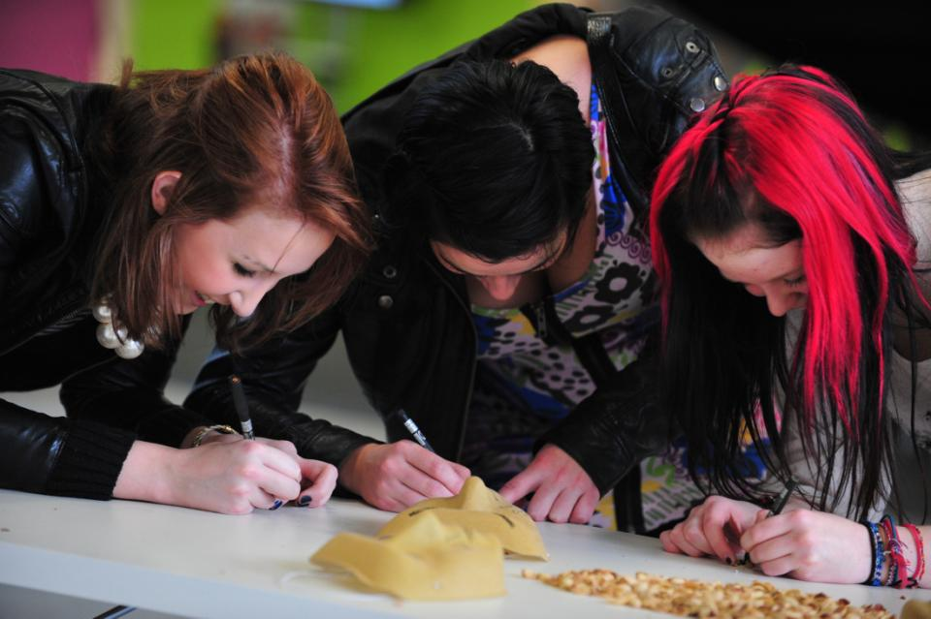
In the end, it’s all about engagement

Slide 54
These and other slides will be available on my website at http://sally-brown.net

Slide 55
Useful references
Bowl, M. (2003) Non-traditional entrants to higher education ‘they talk about people like me’, Stoke on Trent, UK: Trentham Books.
Boud, D. (1995) Enhancing learning through self-assessment London, Routledge.
Higher Education Statistics Agency http://www.hesa.ac.uk/pi/default.htm
Hilton, A. (2003) Saving our Students (SoS) embedding successful projects across institutions, UK: Project Report York: Higher Education Academy.

Slide 56
Further references
Peelo, M. and Wareham, T. (eds.) (2002) Failing Students in higher education Maidenhead, UK: SRHE/Open University Press.
Sadler, D. R. (1989) Formative assessment and the design of instructional systems, Instructional Science 18, 119-144.
Yorke, M (1999) Leaving Early: Undergraduate Non-Completion in Higher Education, London: Taylor and Francis.
Yorke, M. and Longden, B. (2004) Retention and Student Success in Higher Education, UK: Maidenhead, Open University Press.

